Slide 1

Our Values
Talent Updates – Jun.2020
Your great subtitle in this line
My Success Plan
Waters iLEARN
E-Mailing
Location

Slide 2
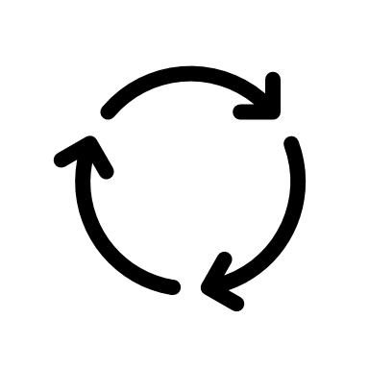





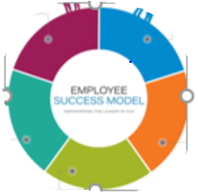
Growth and Development: My Success Plan
“An on-going process of identifying and implementing action plans that help employees grow and develop within the context of evolving business needs”
It is about gaining different experiences to build professional depth and breadth ….rather than being limited to upwards movement/promotion
It is about skills, competencies and behaviors –both for your current and potentially future role
It is about continuous improvement and growth mindset
Owned by Employees.
Supported &
facilitated by Managers.
Prioritized by
Waters
It can and should be a priority for all employees and managers

Slide 3
Steps in the Growth & Development Process
Growth & Development is an ongoing process and can be made more effective by documenting and implementing the steps in the journey.
Growth and Development
1. Increase Self Awareness
2. Draft My Success Plan
3. Have Development Conversation
4. Agree & Execute Your Plan
5. Track Progress
Available in the
People Leader Hub

Slide 4

Step1:Self-Awareness
“We see people and things not as they are, but as we are.”- Anthony De Mello
Self-Awareness is the first and most critical step in planning for one’s growth and development. It starts by taking the time to think about:
  Where I am in my growth and development journey and where I want to be?
  What are my strengths and opportunities?
How can I be more self-aware?
  Self- reflection: Take the time to self-reflect using questions on the next slide.
  Feedback: Ask for feedback from your manager, peers, direct reports, internal/external customers and other trusted advisors.
Career Drivers depend on Life Values, Job Satisfiers and Life Situation.

Slide 5
Self-Awareness…contd.
REFLECTION: Ask yourself the below questions:
What am I passionate about?
What do I love to do?
What activities give me the most meaning and satisfaction?
What strengths can I leverage?
What am I excited to learn?
What do I value most?
What kinds of environments do I prefer to work in?
What is changing around me, and how does that impact me?
FEEDBACK : Gain perspective from your manager, peers, direct reports, internal customers and other trusted advisors about
Strengths
Communication Style
Interpersonal Skills
Contributions in Key Projects
Development Opportunities

Slide 6
Self-Awareness…contd.
TOOLS of Self- assessments, Feedback and Profiling
  ESM Inventory
  Insights Discovery Profile
  Performance Feedback
  Informal Feedback
  Life Values: Exercise
  Job Satisfiers: Exercise

Slide 7
Step 2: Draft ‘My Success Plan’
My Success Plan (MSP) will be an essential part of your employee journey at Waters. This will enable you to capture and document your current and future development needs. An important aspect of MSP is to record and validate these needs through ongoing discussion with your manager and also your colleagues.
GUIDELINES:
Identify not more than 1 or 2 development goals. Make them SMART. Take into consideration strengths and development opportunities identified during performance discussion with your manager
Include goals tied to ESM Behaviors, skills, capabilities required to meet business needs
Explore range of Learning Strategies through the 70-20-10 Learning Model
Design activities based on the need arising from lack of skill or lack of experience
Consider including potential barriers and support required
Identify specific metrics and measures to track successful completion of goals
Assign target completion dates to each activity.
Example of Activities designed for Progressive Development

Slide 8

Step 3: Development Conversation with Your Manager
A Development Conversation is most impactful when the employee and the manager have deep, meaningful dialogue coupled with action plans around measurable goals on current and future opportunities.
Employees
Manager
Focus on key areas that are most important to you instead of reviewing a list
Be honest and avoid being tactical
Ask open-end questions and request for more information
Pause and listen after you have asked a question
Its ok to not have all the answers. Ask for help and look beyond your immediate team to make connections
Actively listen, let your direct report do most of talking
Be supportive and express genuine interest in their development
Be honest if you do not have answers to all the questions
Pause after you have asked a question, this will allow your direct report an opportunity to process information
Do not jump too quickly to a solution; adopt Inside-Out Coaching method

Slide 9
Development Conversation: Employee Perspective
Prior to the Conversation
During the Conversation
After the Conversation
Draft My Success Plan using the blank template
Incorporate feedback from manager, peers, clients, mentors and direct reports
Consider inputs from performance reviews and other assessments
Think SMART Goals
Understand your level of skills from current and future perspectives
Own your development. Take the lead in the conversation- do most of the talking
Be open minded, ask questions and listen actively
Be honest about types of work you enjoy. Describe your preferred work environment with examples
Ask for support, references and introductions beyond your team to build network
Create realistic and achievable metrics to track progress
Assign timelines to the identified metrics
Create milestones to track progress
Employ 70-20-10 Learning Model
Update and share the final plan with your manager
Sample Questions to Ask your Manager during a Development Conversation

Slide 10
Development Conversation: Manager Perspective
Prior to the Conversation
Review employee’s past performance evaluation
During the Conversation
Listen actively
Analyze current skills, knowledge and behaviors
Consider the learning opportunities that can be made available on the job
Deliberate on the MSP shared; employee’s goals, achievements, strengths and opportunities of development
Ask open ended questions
Gain clarity on the employee’s personal vision of career success and the roles they want to pursue.
Encourage employees to share their long term career goals and associated development needs
Post the Conversation
Review the updated plan
Plan the next check-in to provide support and commitment to meet the set milestones
Share information on the employee’s growth journey with leadership
Sample Questions to Ask your Employee during a Development Conversation

Slide 11
Step 4: Agree and Execute your plan
Share your finalized My Success Plan with your manager
Confirm and agree on any changes and updates to be made to the development plan
Agree on the next steps and follow-up actions including the regular check-ins.
Upload to iPerformance
  (include instructions / link/ image)
Ensure discipline and rigor in actioning your development activities
Make your growth and development a priority
My Success Plan is a living and breathing document. Make sure to review and update as necessary throughout the year.

Slide 12
Step 5: Track Progress
Regularly review progress, and update plan as necessary
  Include feedback from manager and other stakeholders
Through regular check-in’s, discuss progress with your manager
Remember to keep Growth and Development a continuous journey.
          “Be not afraid of growing slowly,
          be afraid only of standing still.”
          – Chinese Proverb

Slide 13
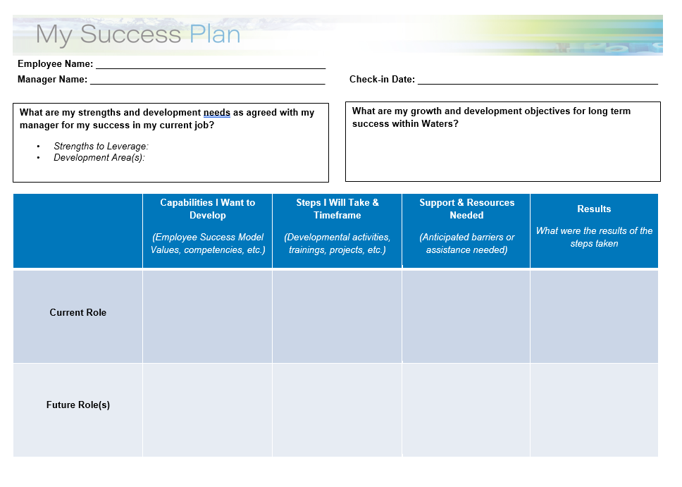

My Success Plan Form: Blank Template

Slide 14




Water’s iLEARN

Slide 15
