Slide 1
January – February 2021
2021 Cascade Templates

Slide 2
Initiatives | Workstream | Indomitable Workstream Objective Demonstrate our indomitable spirit by delivering high impact innovation and 3-4% incremental growth over the next 12 months.
Seize Market Share Win back market share in LC and MS, drive growth in contract labs and regain position in China | LC | Increase analytical LC instrument market share by 1.7 points by the end of 2021 as measured by our own growth rate and the SDi market growth rate.
 | MS | Win back share in MS by accelerating sales for Mass Detection, TQ FlexUp program, BioAccord and High Res mass spec in Research in 2021 by adding incremental 4.9% in growth.
 | Contract Organizations | Generate $11MM incremental revenue from the Contract Organizations initiative alone (no overlap) in 2021 by (i). expansion - growing existing share globally at pharma contract development and manufacturing organizations (ii). take share - increasing our sales focus at Waters-underserved food contract testing organizations in regions with current opportunity.
 | China | Win back 0.7% market share in MS by accelerating sales for pharma (1.5 M), food (1.5 M) and clinical (2 M) in 2021(Q1 1.0 M, Q2 1.2 M, Q3 1.3 M and Q4 1.5 M).
Grow the Aftermarket Increase sales of service plans, software maintenance renewals and chemistry | Chemistry | Ensure 20% of instrument orders also include FlexChemistry. Grow Chemistry topline by an incremental 2.5%. Identify and contact new competitive customers, ramping from 20-100 per quarter. Drive PREMIER columns as the standard of analysis: each chemistry rep contacts 10 new PREMIER contacts per week.
 | Informatics | Increase informatics renewal rates by 8% and 3rd party connection instrument connection revenues by 25% Revenue contribution from Tetrascience collaboration of >$3M
 | Service | Grow Service Revenue to $XXXM and Service Margin to $YYYM in 2021 with a focus on Service Plan Coverage. Ensure at least 25% of instrument orders are also sold with a service plan and when a warranty expires at least 36% convert to a service plan. Maintain strong plan to plan renewal rates of at least 81%.
Strengthen Commercial Capabilities Make it easier to buy from us online and through digital procurement systems, and implement better pricing governance | E-commerce | Increase online sales through waters.com by 23% in 2021 by increasing visibility for Waters, and ensuring that when customers search, Waters shows up at the top of the results page.
 | Pricing | Align our process and governance for setting list price and determining discounts to create maximum value for Waters.
Reinvest Through Productivity Gains Be more efficient in how we spend money with vendors and collect payment from customers so we can reinvest | Direct Spend | Establish a center of excellence aimed at reducing the cost of raw materials and making it easier for local teams to purchase the highest quality materials at the lowest cost from our suppliers.
 | Net Working Capital | Increase company cash flow by enhancing our ability to turn inventory and collect payment faster - matching industry benchmarks.
Inspire Top Performance Empower our teams to succeed with focus and accountability | Performance Management | Improve accountability for high performance in 2021 by setting SMART objectives, having quarterly conversations, rewarding high performance and addressing poor performance.
Notes:
Establish a center of excellence aimed at reducing the cost of raw materials and making it easier for local teams purchase the highest quality materials at the lowest cost from our suppliers.
Ensure X% of instrument orders are also sold with a service plan and when a warranty expires Y% convert to a service plan" X = 16%(current) to 35% (end of 2022) and Y = 35%(current) to 37% (end of 2022)

Slide 3
How We Win in 2021
  Waters has a great brand, strong technology and deep customer relationships
  However, we have lost market share across the portfolio and in key customer segments due to weak commercial execution and a portfolio disadvantage
In 2021, we will focus on these priorities to reclaim our indomitable spirit:
Enterprise Priorities
Advance our company beyond the pandemic
Outperform the market with profitable growth | Champion a culture of responsibility, focus and urgency | Develop and implement a long-term strategy
Notes:
The life science tools market remains attractive where leaders have created a lot of value
Waters has a good brand and strong technical reputation resulting in solid profitability
However, we have lost market share across the portfolio and in key customer segments due to weak commercial execution and a portfolio disadvantage
Great brand, technology and customer relationships
We’ve lost momentum over the last few years

Slide 4

How Global Operations Will Help Waters Win in 2021
Advance our company beyond the pandemic
Outperform the market with profitable growth | Champion a culture of responsibility, focus and accountability | Develop and implement a long-term strategy
SMART Objectives | Success Measures | Relevant Initiatives
[COVID] Continue to advance COVID protective measures to enable increased employee engagement, interaction and productivity. Support commercial efforts to help fight the Pandemic. | Site Readiness = Green On-Time Moonshot Delivery Incr’d Occupancy per Plan | Employee Health & Wellbeing Public Health – Project Moonshot Business Continuity & Growth
[GROWTH] Enable growth by ensuring >95% product availability, on time NPI and by driving product quality improvement. Drive improved profitability through year over year productivity improvement. | Product Avail > 95% Meet AOP Targets Install Success > 90% | Product Availability Improvement Productivity Improvement: Labor, Material, Freight, Inventory, Indirect Spend Product Quality Improvement
[CULTURE] Establish cultural norms, performance mechanisms and operating processes for driving a culture of responsibility, focus and accountably. | Distributed Ratings & Comp 3 GO LF Sessions Held 2021 Deliverables Complete | Organizational Effectiveness GO Leadership Forum Sustainability 2025
[STRATEGY] Develop and implement a long term Global Operations strategy for driving scalability, productivity and execution excellence. | 5 Year Plan Complete Transformation Initiated Risk Plan Complete | Operational Scalability Center Led Operating Model Business Continuity Risk Reduce

Slide 5
How Singapore Operations Will Help Waters Win in 2021
Advance our company beyond the pandemic
Outperform the market with profitable growth | Champion a culture of responsibility, focus and accountability | Develop and implement a long-term strategy
SMART Objectives | Success Measures | Relevant Initiatives
[COVID] Continue to advance COVID protective measures to enable increased employee engagement, interaction and productivity. Support commercial efforts to help fight the Pandemic. | Return to work per plan On-Time Moonshot Delivery | Adhere to BCTF & local govt guidelines Deliver per moonshot plan - CPSO and SIT
[GROWTH] Enable growth by ensuring >95% product availability, on time NPI and by driving product quality improvement. Drive improved profitability through year over year productivity improvement. | Product Avail > 95% Meet transfer timeline & within cost Meet AOP Targets Install Success > 90% Plan attainment > 75% Productivity improvement per plan | PA for SIN made Instruments / spares Product Transfers (RADIAN - Q2-2021, Arc Premier – Q2-2021 Arc FTN - Q3-2021 Arc HPLC FTN - Q4-2021) AOP attainment include capital spending ISO certification Supplier audit localization / qualification / agreement Mfg competency audit Reduce warehouse OSD Warranty returns for instruments India realignment into APAC Cost reduction projects

Slide 6
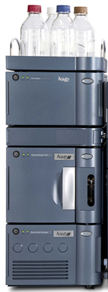
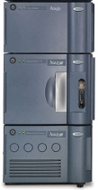
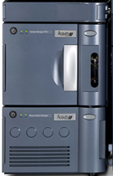
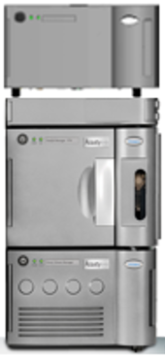
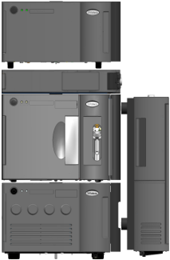
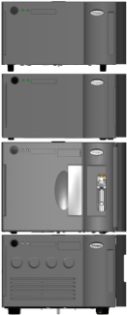
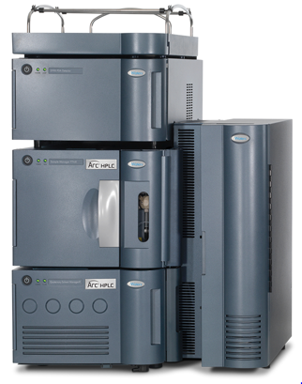
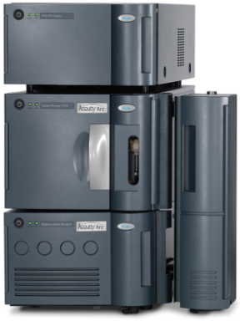
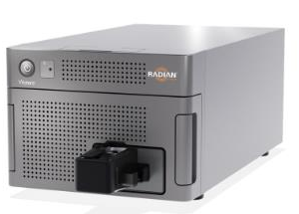
Product transfers - to build in Singapore
2020 (completed) | Jan-21 | Feb-21 | Mar-21 | Apr-21 | May-21 | Jun-21
Radian ASAP (remote training)
Arc FTN (remote training)
Arc PREMIER (NPI, local training)
– 4x Column Managers & 3x Detectors
BioAccord
LC Stack (SIT)
LC SIT Short Stacks
Arc HPLC QSM
ACQUITY PREMIER

Slide 7
How Singapore Operations Will Help Waters Win in 2021
Advance our company beyond the pandemic
Outperform the market with profitable growth | Champion a culture of responsibility, focus and accountability | Develop and implement a long-term strategy
SMART Objectives | Success Measures | Relevant Initiatives
[CULTURE] Establish cultural norms, performance mechanisms and operating processes for driving a culture of responsibility, focus and accountably. | Complete lean training and projects Business process simplification Diversity & inclusion Performance management Sustainability 2025 | Participate and complete at least one lean / productivity improvement by end of 2021 Warehouse / Freight projects (Master wt, RFQ) Voice of customers Production plan / warranty returns dashboard Packaging & labelling optimization Quarterly inclusiveness / team building events Smart goals by 8 Mar, quarterly performance conversations on employees' progress
[STRATEGY] Develop and implement a long term Global Operations strategy for driving scalability, productivity and execution excellence. | Mfg. Footprint Enabling capabilities Sourcing globalization / Category management | Completion of Industrial 4.0 projects Implementation of DSOP and DPE (eEvent log) Equipment, Tester & Tooling Upgrades & renewal ADC expansion project QMS digitization and Ops IT roadmap APAC Repair & Refurbishment Global Sourcing Transformation

Slide 8
How Operations Will Help Waters Win in 2021
Advance our company beyond the pandemic
Outperform the market with profitable growth | Champion a culture of responsibility, focus and accountability | Develop and implement a long-term strategy
SMART Objectives | Success Measures | Relevant Initiatives
Above Market Profitable Growth Develop & Execute Plan to achieve 75% Plan Attainment for each site/product line Achieve Product Availability Targets for each Product Line On time transfer of product against project timeline AOP attainment | Drive Product Availability 98.5% Drive monthly CM OTD 98.5% Business Process Simplification (Manufacturing Scorecard) Per Product transfer timeline RADIAN - Q2-2021 Arc Premier - Q1-2021 Arc FTN - Q3-2021 Arc HPLC FTN - Q4-2021 Meet or Exceed site AOP by 5% | DC PA performance for SG20 products Quarter Consensus, plan loading To identify and track manufacturing performances for each contract manufacturers Product Transfers Monthly forecast review
2. Return from COVID - Project Moonshot | Deliver LCMS & Consumable Kit Options to agreed timelines as per the Moonshot business plan[ | CPSO & SIT short stack
3. Develop and Execute Future State Strategy Capacity & Capability in place to meet support growth targets and NPI Roadmap Timelines Industry 4.0 - Data, Analytics, Systems Warranty & APAC Refurbishment | Mfg. Footprint Enabling capabilties Tester & Tooling Upgrades Implementation of DSOP and DPE (eEvent log) Warranty returns instruments for LC –by Q3 APAC Repair & Refurbishment by Q2 | SIT line relocation APAC Repair & Refurbishment renewal workplans Instruments Returns APAC R&R
4. High Performing, Responsible, Entrepreneurial Culture - Improve accountability for high performance in 2021 by setting SMART objectives, having quarterly conversations, rewarding high performance and addressing poor performance. | 90+ % have SMART objectives by Feb. 28 100% have quarterly conversations about progress 80+ % agree they are receiving regular feedback | Performance Management

