Slide 1
Check-In Conversations
Waters Performance Management
Global Talent Development
April 2021
Notes:
Welcome back to the next training in our Performance Management Series, which focuses on Check-In Conversations.
Introduce facilitator & producer.
Training logistics:
This call is being recorded.
We will share the slide deck at the end of the session.
Please participate actively to get the most from this session. You can share your comments by typing it in the chat function or raise your hand to talk directly to us.

Slide 2


Performance Management Focus 2021
Performance Management Focus 2021
3 Accelerators
Inspire top performance through a performance management system where managers are accountable for:
1
2
3
SMARTER Objectives
Set SMART objectives aligned with Waters’ priorities
Check-In Conversations
Evaluate and review progress to provide timely feedback
Differentiated Performance
Promote continued performance through rewards and resources
Notes:
(Animated Slide)
These are the three pillars we are focusing on to strengthen our Performance Management Practices.
When Belinda Hyde, our new SVP Human Resources, talks about the purpose of Performance Management, this is what she says: The purpose of Performance Management is to helping Waters Employees perform at their absolute best.
People can perform well when they exactly know what they need to do. When
- They have clear objectives that are challenging and exciting to them.
They get regular feedback on their performance.
And there is some sort of linkage to the rewards they get.
So to help us all perform at our best Waters Performance Management System focuses on these three pillars: (Read the slide).
We all have an opportunity to take accountability and focus on executing our performance management practices with urgency to accelerate our company’s performance. That will result in the organization doing well and we achieve our enterprise priorities of
Advance our company beyond the pandemic
Outperform the market with profitable growth
Champion a culture of accountability, urgency and focus
Develop and implement a long term strategy
The focus of today’s session are check-in conversations that give you an opportunity to provide your manager with regular updates on the progress you are making towards your SMART objectives, and for you to actively ask for feedback regarding your performance.

Slide 3
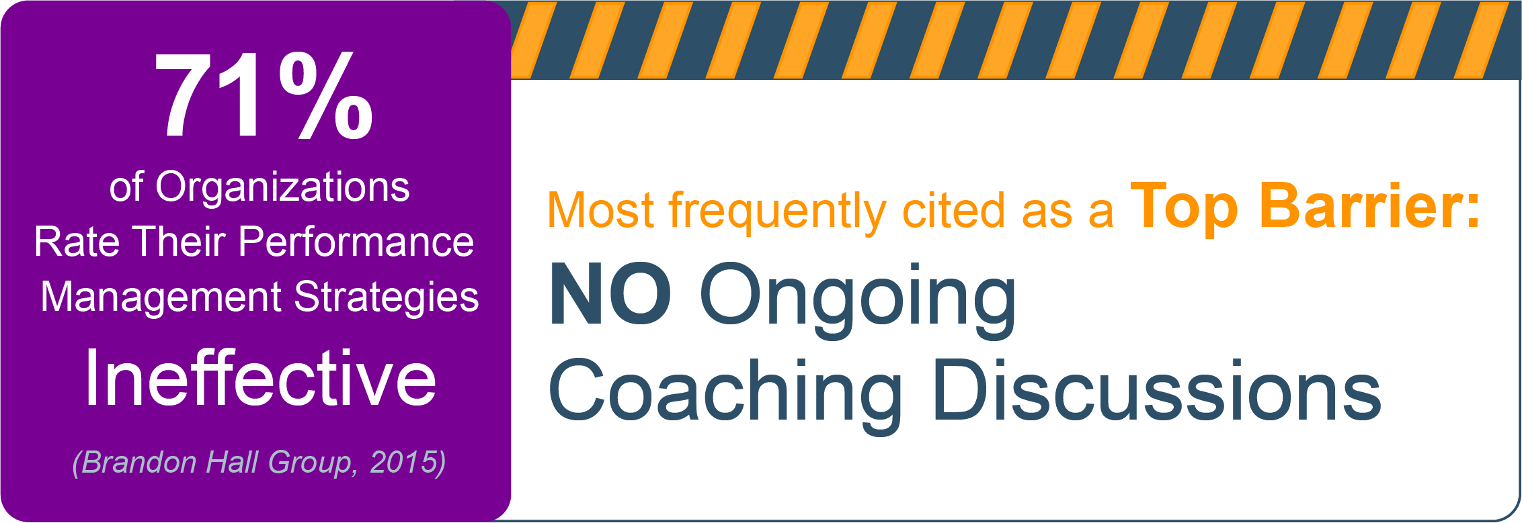

The Outside And Inside View
Ongoing Check-In Conversations
Source: L. Loew, Performance Management 2015: Coaching for Development Needed,
Brandon Hall Group, 2015.
Waters
Pulse Survey 2020
I get continuous feedback on how
I am performing throughout the year.
54%
Notes:
(Animated Slide)
Speaker Notes for BOTH MANAGER & EMPLOYEE SESSION
So how are we here at Waters comparing when it comes to our Performance Management Practices?
Here is data from Brandon Hall Group, which found that an astonishing 71% of organizations find their Performance Management Practices ineffective.
The top barrier that was identified is “No ongoing Coaching Conversations.”
(click to bring up the Waters information)
When we asked the organization during the Q4 Pulse Survey in 2020 regarding our feedback practices, the results clearly indicate that we have lots of room for improvement and an immediate need for action when it comes to regular feedback and coaching.

Slide 4
Agenda
Benefits of ongoing Check-In conversations
Ongoing Check-Ins
  Prepare for the conversation
  Framework to conduct the conversation
  Framework to provide effective feedback
iPerformance support
Call to action
Notes:
During today’s session we will cover the following topics:
Quickly read the slide

Slide 5
Participant Poll
Type in the chat function:
Why are you going to have regular check-in conversations?
Notes:
(ANIMATED SLIDE)
So what is the WIFM “What’s in it for me?” of having regular check-ins with your manager. Please type your answer in the chat function.
Facilitator: Do a short de-brief of the answers and close by saying:
To support you with check-in conversations we will introduce a few easy tools, that can help you to actively participate in check-in conversations and get in the habit of asking for feedback frequently.

Slide 6
What are Check-Ins and why are they important?
A good check-in…
Inspires top performance by confirming employees are clear on what’s expected of them & receive ongoing feedback on progress against objectives
Champions a culture of urgency, focus and accountability
Delivers feedback to employees closer to the event & aligned to their objectives
Enables comments to be written & stored in one location for easy reference
Makes annual review less onerous
This is important because …
It improves productivity and engagement of employees in an organization
Employees are expecting honest and constructive feedback and coaching
It is the foundation for good individual development plans
It works as a dashboard, providing early warning signals of potential problems and creates opportunities for managers to address them
It helps managers make differentiation decisions while referencing progress already documented throughout the year
Notes:
Note to facilitator: We will not show this slide during the training, but keep it in the materials as reference.

Slide 7
Agenda
Benefits of ongoing Check-In conversations
Ongoing Check-Ins
  Prepare for the conversation
  Framework to conduct the conversation
  Framework to provide effective feedback
iPerformance support
Call to action
Notes:
Transition slide, no need for facilitation.

Slide 8
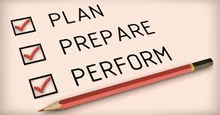
Before the Check-In Conversation
To prepare: reflect on these questions
Review last quarter’s performance
  Which objectives did I complete?
  What am I especially proud of achieving?
  Did I achieve the initiatives for the objectives I am working on?
  If not, do I know what the root cause is?
    What information do I need to share with my manager about the root cause?
  What solutions will I present to my manager to get back on track?
Think ahead to next quarter
  Are the initiatives for my objectives still the right work to do to achieve the result?
  Are the measures for each objective still the right ones?
  What risks and impediments do I foresee? What action will I take to mitigate?
Notes:
Speaker Notes EMPLOYEE SESSION
A very important step to be able to actively participate in your check-in conversations is to be prepared.
You want to share with your manger
what you did to work towards your objectives.
highlight what you are proud of achieving.
and have an honest conversation where you are getting stuck or encounter obstacles that may negatively impact the outcome.
You suggestions on how to solve problems and overcome obstacles.
During the check-in conversation you will look back on the previous quarter, and look forward to the next quarter to plan the next steps.
Using these questions to prepare for your check-in allows you to get focused and know what you need to share with your manager.
It also allows you to clearly articulate your suggestions on how to solve or mitigate problems to showcase your focus, accountability and urgency.

Slide 9


During the Check-In Conversation
Be prepared to answer these questions &
PARTICIPATE ACTIVELY
  How is it going?
    What are you proud of achieving?
  Where are you getting stuck?
    How can I help?
  What can you do differently?
    What are you learning?
Notes:
(Animated Slide)
Speaker Notes for EMPLOYEE SESSSION
The key purpose of the check-in conversations is to share information on the progress you are making towards your objectives.
When you are prepared to answer these three questions you get the opportunity to share with your manager what they need to know to make sure they are informed and they can provide you the support you need to perform at your best.
Answering these questions might feel a bit awkward the first few times. But I can say from personal experience that they are a good way to showcase your achievements and have a conversation with your manager about what you need to be successful, if you are willing to engage in an open conversation.

Slide 10
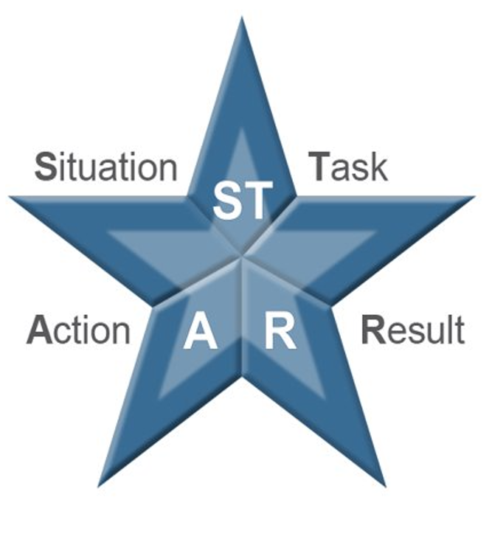
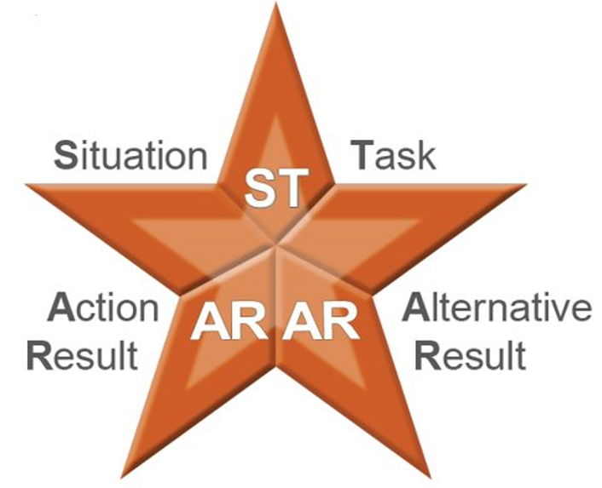
During the Check-In Conversations
Proactively ask for feedback
Ask for feedback on a specific situation or task: What feedback do you have for me regarding ……?
Describe the Situation or Task
Describe the Action that was taken
Describe the Result and impact of that action
If the Result was not ideal
Explore an Alternative Action which could have led to
A more desirable Alternative Result and impact
Notes:
(Animated Slide)
Speaker Notes EMPLOYEE SESSION
In the 2020 Pulse Survey Waters employees have expressed our preference for more meaningful feedback.
Feedback is most effective if it is provided frequently and close to the actual event.
We also know that by simply saying the word “Feedback” many of us get nervous because we expect something negative.
For feedback to be meaningful and, over time, become less threatening, we need to believe that it is offered with our best interest in mind.
The STAR Model is an easy to remember framework, that allows anyone to provide meaningful feedback that helps the recipient to understand context and what impact their actions had.
Let’s look at two examples:

Slide 11
STAR / STAA/AR Example
Maria, in the meeting with the project team, you did very well to engage the quieter attendees.
By asking them directly to share their thoughts, and patiently awaiting their response without interrupting,
you received input form all attendees and made them feel valued and heard.
Situation/Task
Action
Result
Carl, I have noticed something unusual that is not typical for your performance. The reports you are responsible for have been delivered late for the past two weeks and had several errors.
Because of this the information for the Project Score Card was not complete.
Now you engage in a conversation to get more information and discuss solutions:
Can you help me to understand what is going on? What can you do differently?
I can inform you earlier about issues and possible delays and ask for your support.
That way you can plan better. And we can work together so I learn from you and can be more independent going forward.
Situation/Task & Action
Undesirable Result
Alternative Action
Alternative Result
Notes:
(Animated Slide)
Please read the scenario and tell me which part is the Situation/Task, which part is the Action, which part is the Result.
Why is this better than simply saying:
Maria, you did a great job in the meeting. Keep doing what you are doing
There are situations where the outcome of the actions is not ideal. Employees deserve to being made aware to give them a chance to learn and improve. The expanded STAR/AR invites us to explore Alternative Actions to get to a more desirable alternative result.
Here is an example for a STAR/AR
Same process, tell me which parts of the examples align with the STAR model.
STAR/AR feedback is very important to help your direct reports to learn and develop, to do this effectively you MUST come from a place where you genuinely want to help, and not appoint blame or express your frustration. You also need to know as much information as possible about the situation. Lastly start off STAR/AR feedback by providing context.

Slide 12



The Flow of a Check-In Conversation
Plan
Clarify
Agree
Open
Close
Open the conversation and connect with your manager.
The purpose of the conversation is clarified.
“This is what I would like to discuss today.”
“How’s it going?”
“Where are you getting stuck?”
Be open to receiving STAR feedback and observations.
SHARE and PARTICIPATE ACTIVELY
“What can you do differently?”
“How can I help?”
Be open to receive guidance as needed.
SHARE and
PARTICIPATE
ACTIVELY
Prioritize next steps.
Update Objectives as necessary
Be open to receive guidance as needed.
Summarize and confirm what was agreed during the conversation.
Schedule the next check in meeting.
Notes:
PRODUCER post the job aid in the chat so participants know the 3 questions.
Now let’s look at how the “3 Questions” and STAR/AR feedback can be applied in in the flow of a check-in conversation:
Your manager will open the conversation. Connecting or breaking the ice with a bit of small talk is important.
As this is a dialogue where you are a partner, you are invited to share if there is anything you would like to discuss during the meeting.
In the “Clarify” stage these questions will be asked to invite you to share the status of the objectives and if there are any obstacles. Your manager is going to share their feedback and observations using the STAR/AR model.
The next step is to look forward to the next quarter, what needs to be done, how can issues be addressed.
Be ready to share your suggestions how to address issues and solve problems.
Your manager will provide guidance throughout the process.
Next you and your manager “Agree” the next steps and, if necessary, make changes to the objective(s)
To close the conversation, you will summarize what was discussed and agree the date for the next check-in.
Of course you all know that conversations are rarely as linear as this model suggests, which is ok. Being aware of these steps should help to stay focused and not get stuck, so that at the end of the meeting both of you know that there is a clear path forward to ensure accountability, focus and urgency on the key priorities to help Waters grow and win.
We have created a job aid for you which the producer just posted in the chat.

Slide 13
When to Schedule Quarterly Check-in Conversations?
Q1 January-March
When the conversations occur within each quarter is up to your Manager & you.
Q2 April-June
Q3 July-September
Q4 October-December
Notes:
It is up to your manager and you, how often and when you meet during the quarter.
Even though it is your manager’s responsibility to ensure that the check-in conversations happen, nothing stops you from being proactive, in fact it is highly recommended. As we begin this journey of exercising a new muscle of continuous feedback, reach out and request check-ins to build your habit.
For the Q1 2021 check-in, we realize that we just completed the objectives setting process a few weeks ago. We all have been working during Q1 and there is always opportunity to ask for and provide feedback.
By the time we get to Q2 it will be an excellent opportunity to check-in- on the progress you have made during the first half of the year.
Waters Senior Management will receive reporting to see if recurring conversations are happening across the organization. To ensure reports can be generated your Managers are responsible for changing the check-in status to “Yes” next to the appropriate quarter in the Objectives section of the iPerformance system.

Slide 14
Agenda
Benefits of ongoing Check-In conversations
Ongoing Check-Ins
  Prepare for the conversation
  Framework to conduct the conversation
  Framework to provide effective feedback
iPerformance support
Call to action

Slide 15
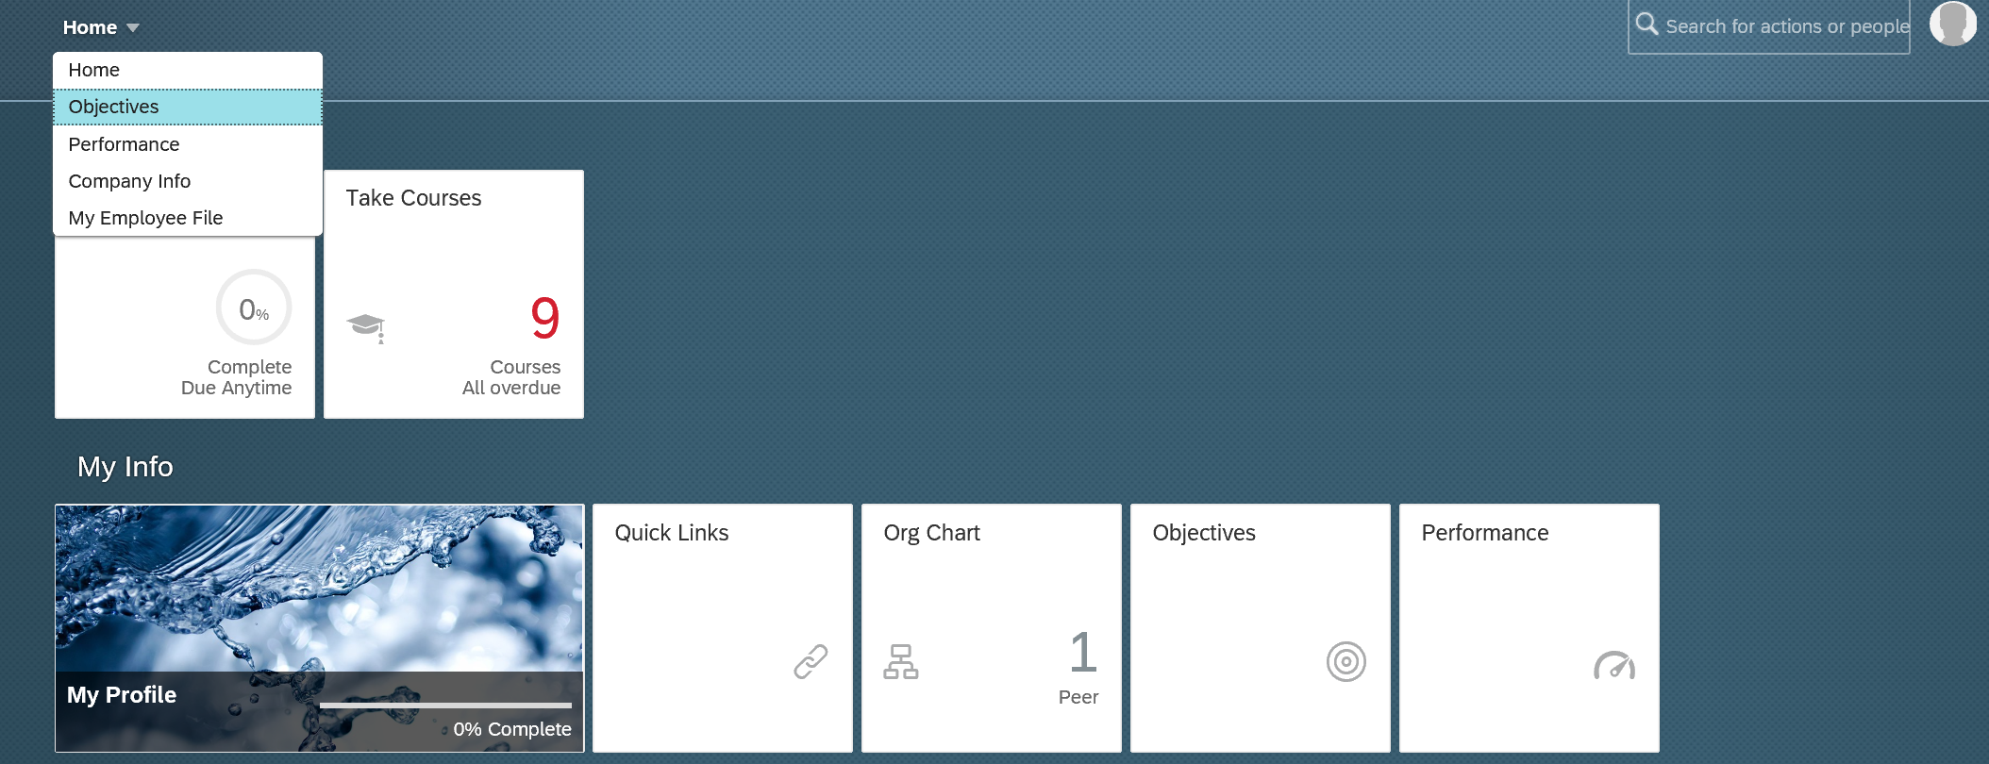
Using iPerformance for Quarterly Check-ins
Notes:
2 ways to get to your objectives:
From Home dropdown / Objectives
From Objectives Tile

Slide 16
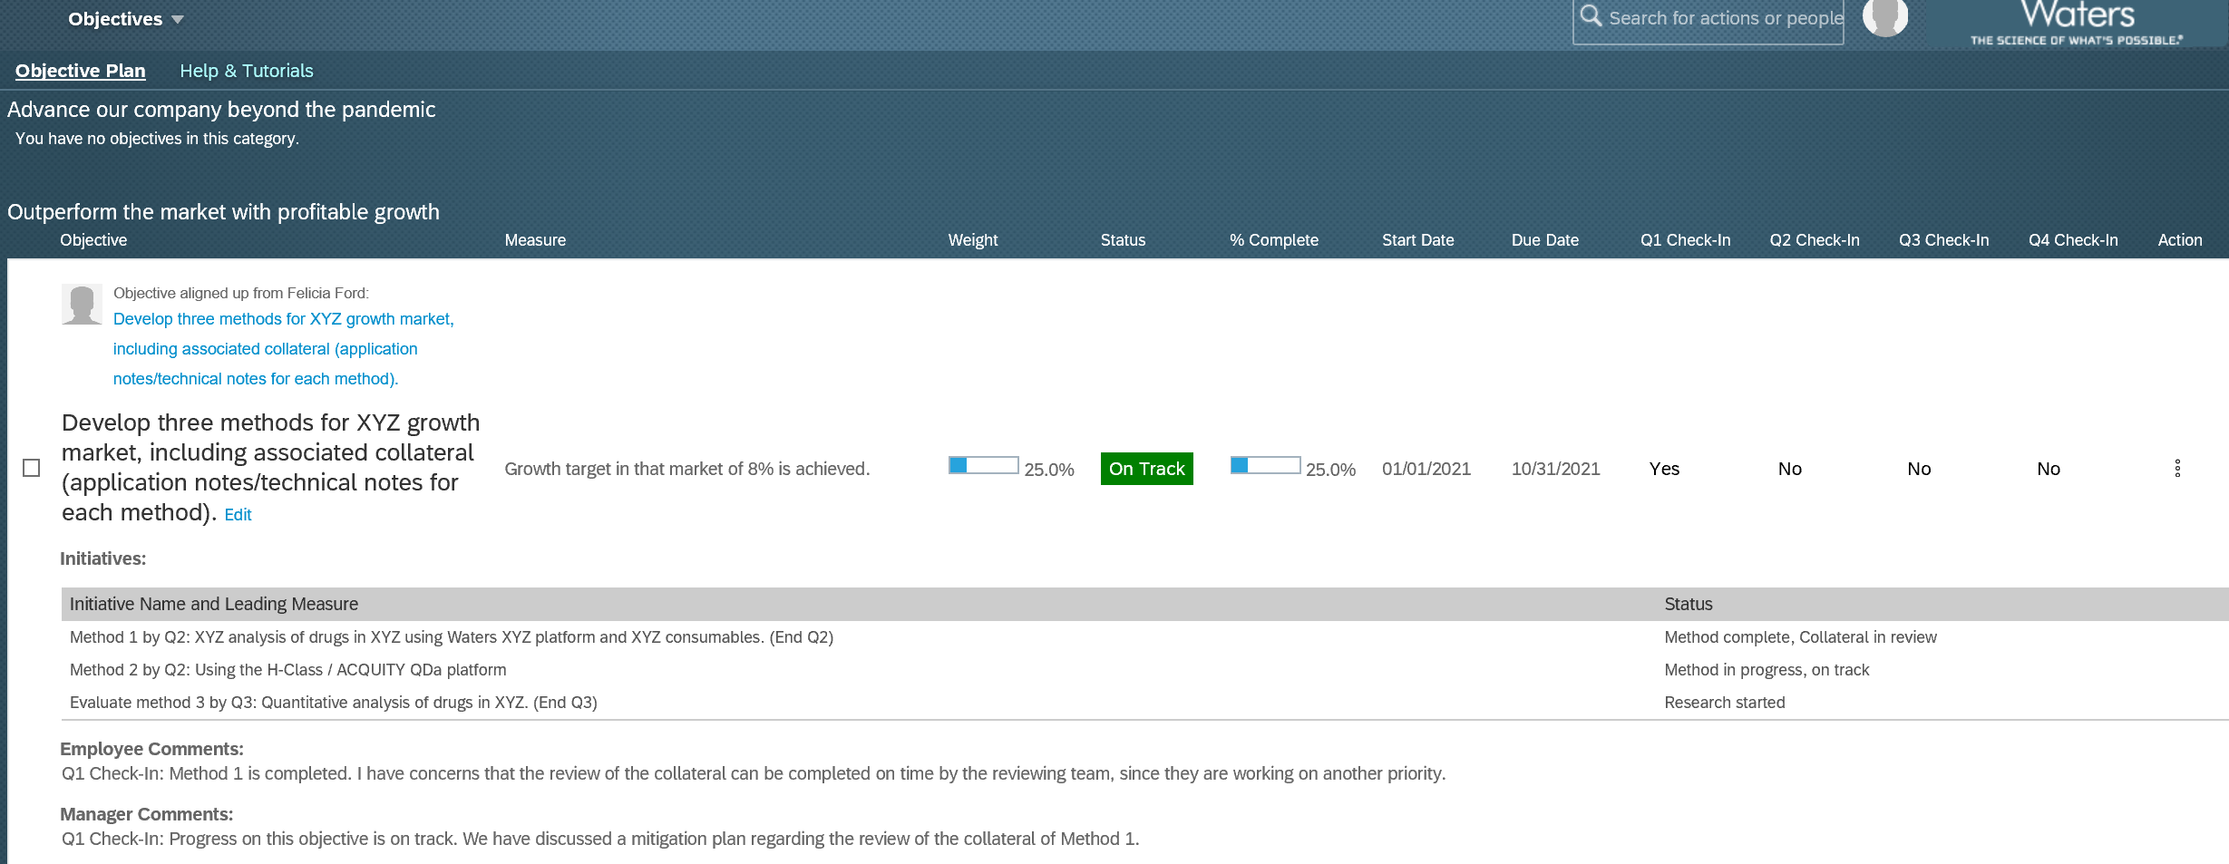
Using iPerformance for Quarterly Check-ins
Notes:
Once you are on the objective screen you see all your objectives with plenty of information
Which enterprise priority the objective is aligned with
If the objective is cascaded by your manager and much more.
To update the status of your objective click on “Edit”

Slide 17
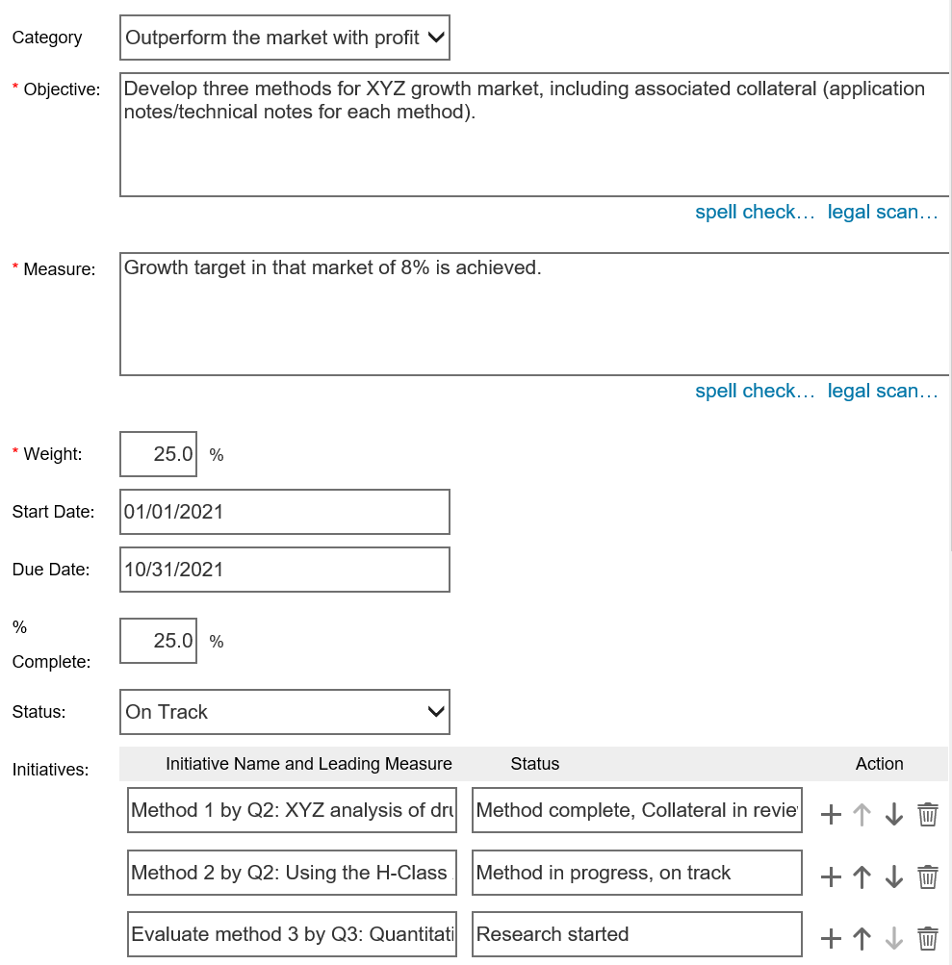
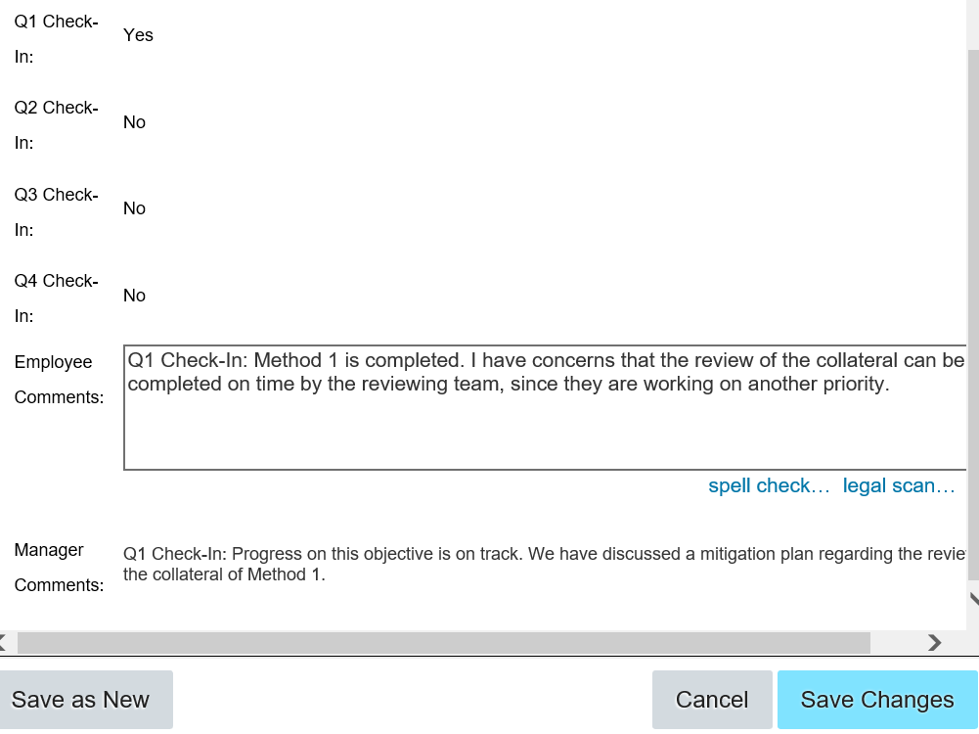

iPerformance Support for Quarterly Check-In Conversations
Notes:
(Animated Slide)
Clicking on “Edit” will open up the detailed view of each objective.
It is VERY IMPORTANT that you keep scrolling down on this window to display the quarterly check-in drop down and comment fields.
You want to add comments about your progress each quarter, since this will make the year end review so much easier. Both you and your manager can see the comments that are added to the system.
As you can see in this example the employee and manager refer to the quarter in their written comments.
This is a practice we recommend, since it makes it easier to recall which comments happened at which point in the year.
By using the comment section frequently throughout the year you will have a record of your achievements already documented.
It is your managers responsibility to update the quarterly check-in box and change it from “No” to “Yes”.
The systems allows you to update your progress regarding objectives on an ongoing basis when ever you want:
update the % Complete
or the Status of the over all objective.
The Initiatives section allows for status comments on each initiative as well.
If these fields are updated it will show in the objective overview .

Slide 18
Agenda
Benefits of ongoing Check-In conversations
Ongoing Check-Ins
  Prepare for the conversation
  Framework to conduct the conversation
  Framework to provide effective feedback
iPerformance support
Call to action

Slide 19
Call to Action
Get in the habit of asking for ongoing Check-In Conversations with your manager
Proactively ask for feedback
Provide STAR/AR feedback to others, close to the actual event
Frequently update your progress towards objectives and add comments in iPerformance
When the Check-In Conversations occur
within each quarter is up to your manager & you!
Notes:
(Animated Slide)
Read the bullets on the slide

Slide 20
Resources

Slide 21
Resources
  Check-In Conversation & STAR Feedback Guide
  STAR Feedback Planner
  iPerformance System
  iPerformance Getting Started Guide
  My Success Plan
  **TA Colleagues: Please visit the TA Portal to access these materials**
  iLearn
  Performance Management Channel
  Supporting an employee’s ongoing performance
  Goal Attainment: Getting to performance
Notes:
There is a wealth of resources available to you on UC as well as iLearn.

Slide 22

What Questions Do you Have?

Slide 23
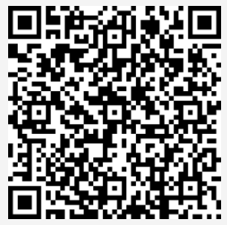
We would like to hear from you: your feedback please
Point your camera on this code
1
2
Survey Link
https://forms.office.com/Pages/ResponsePage.aspx?id=EnEsbZWvnk6s1tKpkOQIUQ4PYqxKy4BNhBtkKBNPN2tUREpNQlcwSzNQQjM1NlNFRzMzSkMzRVhORy4u
Notes:
NOTE TO PRODUCER: Post the link to the survey in the chat of the meeting for people who don’t have a QR code ready available.
NOTE TO FACILITATOR: Make sure you have time for people to complete the survey BEFORE you close the meeting, otherwise we won’t get the feedback.

