Slide 1
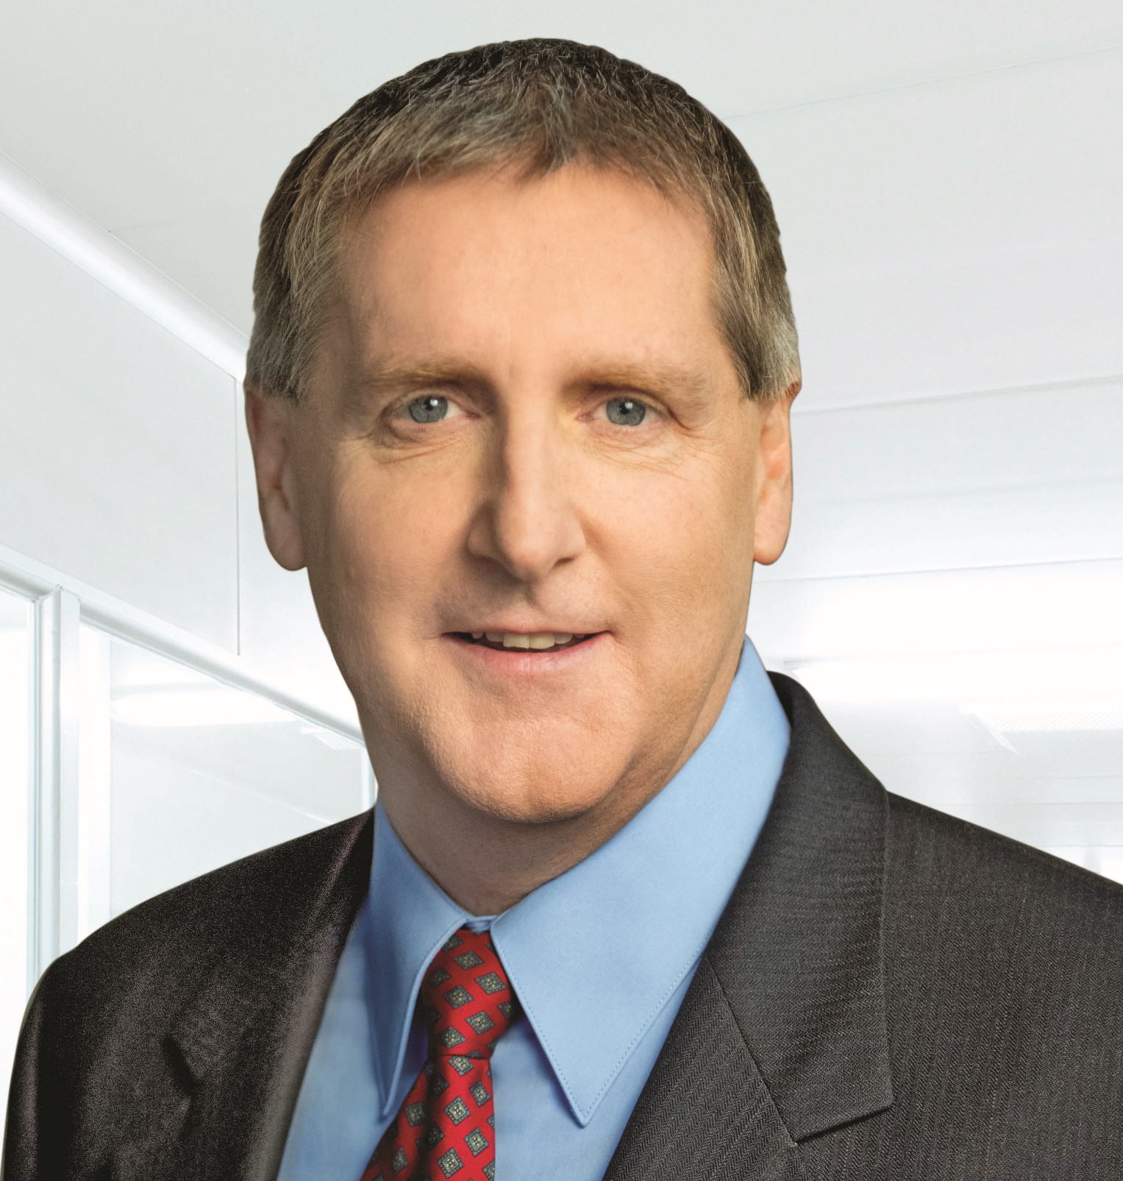
Dan Welch
Global Operations 2021 Employee Kick Off
SVP, Global Operations

Slide 2
How We Win in 2021
  Waters has a great brand, strong technology and deep customer relationships
  However, we have lost market share across the portfolio and in key customer segments due to weak commercial execution and a portfolio disadvantage
In 2021 we will focus on these priorities to reclaim our indomitable spirit
Enterprise Priorities
Advance our company beyond the pandemic
Outperform the market with profitable growth | Champion a culture of responsibility, focus and urgency | Develop and implement a long-term strategy
Notes:
The life science tools market remains attractive where leaders have created a lot of value
Waters has a good brand and strong technical reputation resulting in solid profitability
However, we have lost market share across the portfolio and in key customer segments due to weak commercial execution and a portfolio disadvantage
Great brand, technology and customer relationships
We’ve lost momentum over the last few years

Slide 3





Our Guiding Principles
Global Operations
Our Mission
To deliver world-class quality products on-time and at industry leading costs.
 | We shall operate as one global team with a sense of urgency, ownership and accountability by providing clear goals and objectives to all layers of the organization.
 | We shall establish collaborative partnerships with all organizations to deliver enterprise results.
 | We shall drive innovation that delivers continuous improvement and increased capabilities.
 | We shall foster an organization where inclusion, empowerment and risk taking are equally valued and evident.
 | We shall develop a strong talent pipeline with agility to align with emerging skill requirements.

Slide 4

How Global Operations Will Help Waters Win in 2021
Advance our company beyond the pandemic
Outperform the market with profitable growth | Champion a culture of responsibility, focus and accountability | Develop and implement a long-term strategy
SMART Objectives | Success Measures | Relevant Initiatives
[COVID] Continue to advance COVID protective measures to enable increased employee engagement, interaction and productivity. Support commercial efforts to help fight the Pandemic. | Site Readiness = Green On-Time Moonshot Delivery Increased Occupancy per Plan | Employee Health & Wellbeing Public Health – Project Moonshot Business Continuity & Growth
[GROWTH] Enable growth by ensuring >95% product availability, on time NPI and by driving product quality improvement. Drive improved profitability through year over year productivity improvement. | Product Avail > 95% Meet AOP Targets Install Success > 90% | Product Availability Improvement Productivity Improvement: Labor, Material, Freight, Inventory, Indirect Spend Product Quality Improvement
[CULTURE] Establish cultural norms, performance mechanisms and operating processes for driving a culture of responsibility, focus and accountably. | Distributed Ratings & Comp 3 GO LF Sessions Held 2021 Deliverables Complete | Organizational Effectiveness GO Leadership Forum Sustainability 2025
[STRATEGY] Develop and implement a long-term Global Operations strategy for driving scalability, productivity and execution excellence. | 5 Year Plan Complete Transformation Initiated Risk Plan Complete | Operational Scalability Center Led Operating Model Business Continuity Risk Reduce

Slide 5
How [ORGANIZATION] Will Help Waters Win in 2021
Advance our company beyond the pandemic
Outperform the market with profitable growth | Champion a culture of responsibility, focus and accountability | Develop and implement a long-term strategy
SMART Objectives | Success Measures | Relevant Initiatives
1. [GROWTH OBJECTIVE STATEMENT] | [METRIC] [METRIC] | [INITIATIVE] [INITIATIVE]
2. [COVID OBJECTIVE STATEMENT] | [METRIC] [METRIC] | [INITIATIVE] [INITIATIVE]
3. [STRATEGY OBJECTIVE STATEMENT] | [METRIC] [METRIC] | [INITIATIVE] [INITIATIVE]
4. [OBJECTIVE STATEMENT] | [METRIC] [METRIC] | [INITIATIVE] [INITIATIVE]
5. [CULTURE] Improve accountability for high performance in 2021 by setting SMART objectives, having quarterly conversations, rewarding high performance and addressing poor performance. | 90+ % have SMART objectives by Feb. 28 100% have quarterly conversations about progress 80+ % agree they are receiving regular feedback | Performance Management

Slide 6
How I Will Help Waters Win in 2021
Advance our company beyond the pandemic
Outperform the market with profitable growth | Champion a culture of responsibility, focus and accountability | Develop and implement a long-term strategy
SMART Objectives | Success Measures | Relevant Initiatives
[OBJECTIVE STATEMENT] [INITIATIVE] [INITIATIVE] | [METRIC] [METRIC] | [OBJECTIVE]
[OBJECTIVE STATEMENT] [INITIATIVE] [INITIATIVE] | [METRIC] [METRIC] | [OBJECTIVE]
[OBJECTIVE STATEMENT] [INITIATIVE] [INITIATIVE] | [METRIC] [METRIC] | [OBJECTIVE]
[OBJECTIVE STATEMENT] [INITIATIVE] [INITIATIVE] | [METRIC] [METRIC] | [OBJECTIVE]
[OBJECTIVE STATEMENT] [INITIATIVE] [INITIATIVE] | [METRIC] [METRIC] | [OBJECTIVE]

