Slide 1
Assessing Talent
TAG Training 2018

Slide 2
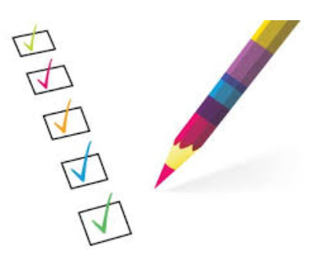
Agenda
Talent Management / Talent Reviews
TAG Survey Results and TAG Modifications
Goals of TAG Model
The Model
Definitions of TAG Groups
Case Study Examples
Potential vs. Promotability
Defining Potential
Linking TAG to iPerformance
Global Individual Development Plan (IDP)

Slide 3
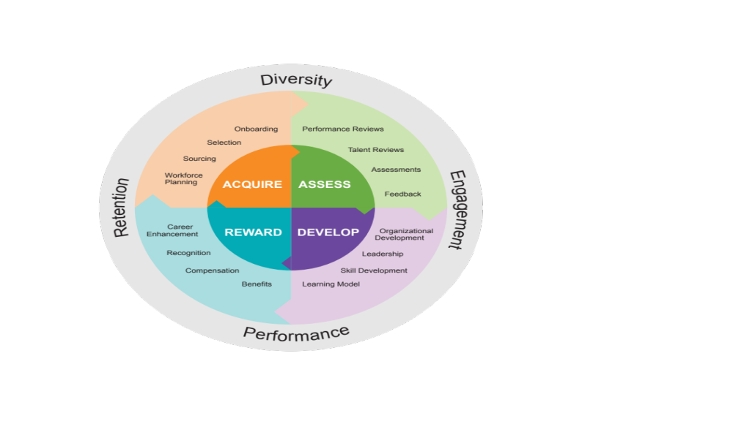
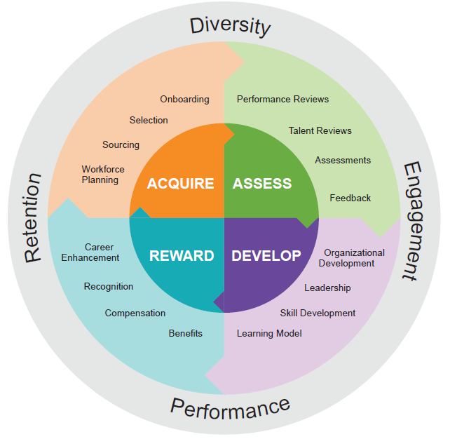
Waters Talent Management Integrated Framework
Our goal is to harness the full talents of our people, and accelerate our capabilities that support our strategic objectives.
Notes:
It is important to start with a glancing at Waters Talent Management Framework. This was shown at one of Chris O’Connell’s Townhall meetings.
It speaks to the four important components of TM – which is Acquire, Assess, Develop and Reward.
Within the “Assess”, is the Talent Reviews; During the yearly Talent Review, we assess our talent on a global basis. It is critical we have an assessment tool that identifies our talent correctly. Each organization understanding their talent is important. In addition, once the assessment is completed, we can then develop our people appropriately.

Slide 4

Talent Reviews
Prepare our Organization for the Future
Align organizational structures and talent with Waters strategy.
Identify, develop and retain our successor, potential, technical, general management and diverse talent.
Build and execute a plan for closing all talent gaps.
Secure a sufficient supply of diverse talent for our future

Slide 5

Waters Talent Assessment Groups (TAG)
Talent Assessment Tool
Notes:
The new assessment model is Tag – which stands for Waters Talent Assessment Groups. Instead of boxes, we have groups, or categories.
Here is the model.
“TAG You’re It” is just to put some fun into the model. It means, everyone contributing to Waters can be “Tagged”, and everyone Tagged is important. All groups are important, not just the high potentials.

Slide 6
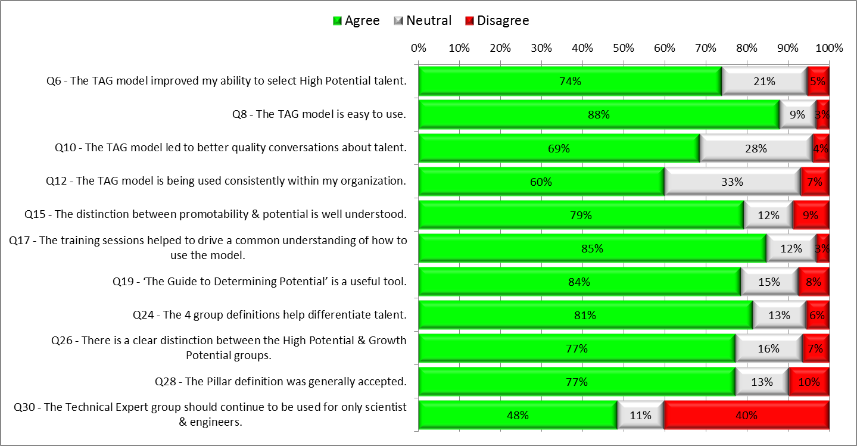
TAG Survey Results 2017 (126 Mgrs/26 HRBP’s = 152 total respondents)
Notes:
The last question was about having only scientists/engineers used for “The Tech Expert Group”. Even though 40% disagree – for business reasons, Waters needs to capture this specific scientist/engineering group solely. Any organization can list their “Functional” experts if needed outside of the Tag model, and address those individuals through existing programs and practices.

Slide 7
TAG Modifications 2018 - Final
Technical Expert
  Removed language regarding “mentor”, “coach”
  For business reasons, Waters needs to capture this specific scientist/engineering group solely. However, an org can list their “Functional” experts if needed outside of the Tag model, and address those individuals through existing programs and practices.
High/Growth Potential
  Changed language – move 1 or 2 levels “prior to” 8 years and “prior to” 5 years
  Extended the two-level promotion “exception” within HP to include level 54
  Will continue to use job levels as criteria for assessing speed of growth
Pillar
  Added statement under “notes” – If an employee does not fit the definition, address through Performance Mgt process
  Removed language stating all new hires need to be placed in Pillar group
Tag slide deck changes
  Added examples for each TAG group to improve consistency
  Added 1 slide on Survey Results
  TAG Modifications

Slide 8
TAG Goals
Differentiate our talent for future business growth
Develop leadership talent pipeline and succession candidates
Identify, develop and retain our technical talent
Enable alignment with Talent Reviews
Notes:
The goals of the TAG Model are (from left to right); (read slide).

Slide 9
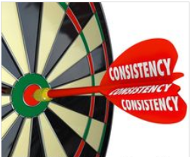
Consistency is Everything!
The TAG Model will only be as successful as our ability
to apply it consistently across the globe.
Drive alignment around
the model
Common understanding
of how to use the model
Notes:
It is most important that everyone utilizes it consistently. The expectation is for every Manager that uses the model fully understand the definitions of each group.

Slide 10
Tech Expert
High Potential
Pillar
Growth Potential
Waters Talent Assessment Groups (TAG)
Notes:
Here is the assessment model - TAG
There is no Tiers! It is important to state that all four groups are very important to Waters! However, this tool is to identify High Potential, Technical Experts, and Growth Potential. We need to know who is in these three areas, and how to develop them.
The fourth group is Pillar. They are the backbone of the company, and 70% (approximate) of our employees are in Pillar. The individuals in Pillar can be developed, and be promoted. We will discuss more on this in a minute.
Growth Potential will hold two types of people; 1) those that will move to High Potential, and 2) those that will move to Tech Expert. People will not be staying in Growth Potential for their whole career. It is a holding area for up to 8 years. It may be that some Growth Potentials may move to Pillar at some time (hence, the two sided arrow).
Let’s take a deeper dive into each group. How to identify, and how to develop.
Note – employees with an overall “B” performance rating will not be tagged.

Slide 11
Pillar (70%)
A Pillar is someone that is a valuable contributor, and important to the success of the Company
Definition:
A valuable contributor and important to the success of the Company
May be promotable within area of specialty, or move laterally within technical stream/function
Strong contributor and viewed as experienced with subject matter knowledge and expertise
Demonstrates capability and expresses interest in continued growth and development in own area of specialty
Notes:
Employees at all levels within the Company, including managers, can be considered Pillars
Any employee that does not fit the Pillar definition, should be addressed through the Performance Management process.
Competencies, Traits, Behaviors:
Action-oriented, intelligent, positive, honest, hardworking, passionate
How to Develop:
Discuss aspiration for functional promotions. Use stretch goals, coach and monitor to reach full contribution. Development Goal within iPerformance is advisable.
Notes:
Approximately 70% of our global employees will be located in the Pillar group. Any level can be a Pillar. VP’s, Directors, Managers, and Individual Contributors.
(Read through the slide)
Many of these individuals will be promoted within their functional expertise. For example, a Financial Analysis II to a Sr. Or a Senior Mechanical Engineer to a Principle.
Pillar captures a large and important group within the organization and encourages continued growth & development.
Some will want to move to Growth Potential (tech or manager), but some will want to remain a Pillar…and that is ok!

Slide 12
High Potential (1-5%)
A High Potential is someone with the ability, aspiration, and commitment
to rise to and succeed in more senior, leadership position.
Definition:
Possesses the ability, aspiration and commitment to assume higher level leadership responsibilities
Generally seen as having long term potential to move 2+ management levels (minimum 53 level) prior to 8 years
Could move laterally within the Company and/or assume more responsibility in current role and continue to be successful
Is highly regarded by peers and direct reports
Should be able to relocate (domestically and/or globally)
Notes:
Employees at all levels can be considered as High Potential assuming they can move 2+ management levels, reaching the 53 level or above, prior to 8 years.
Exceptions are levels 54 and up: 1 level of movement within 8 years can be identified as High Potential.
Competencies, Traits, Behaviors:
Strategic perspective, Leadership, champion change, business acumen, focus on results, risk taking
How to Develop:
Identify next likely positions and incorporate essential developmental steps. Development may include essential experiences, mentoring, lateral role change, added responsibilities, and training. Coach, reward, and encourage. Individual Development Plan (IDP) is required.
Notes:
Here is the definition of High Potential. When looking at a an organization, should be anywhere between 1-5% of High Potentials. This model can be used at all layers within the organization.
(Read the slide)

Slide 13
Technical Expert (1-5%)
An Expert has extensive technical knowledge that has resulted in impactful scientific contributions to Waters business.
Definition:
Maintains extensive technical knowledge and impactful scientific contributions on Waters business
Possesses skills of great value in the marketplace and aligned with our business strategy
Recognized internally and externally as a technology guru in their field of expertise
Respected technical role model and ’go-to’ individual
Notes:
Employees within the technical areas can be considered. Technical areas include:
  Scientists and Engineers
Experts are usually at the levels of 25 and up.
Has little or no interest in high level leadership roles, but may be responsible for a small team and/or be promotable within area of specialty
Competencies, Traits, Behaviors:
Exceptional technical skills, technical lead, innovator, influencial , collaborator
How to Develop:
Utilize as a role model and technical expert. Engage and connect to Tech Knowledge Transfer programs (teaching & technical coaching) . Actively retain and reward. Continue to develop as a technical expert. Individual Development Plan (IDP) is required.
Notes:
Here is the definition of Technical Expert. We are a technical company and as such need to retain & transfer knowledge from our Technical Experts. This group does not refer to functional experts. While valued, they should be considered for the other talent groups.
Some functions may have zero percent in the Technical Expert Group.
(Read the slide)
Also:
There is an important business need for the scientific/engineering experts to be identified in order to retain these individuals & transfer their important scientific knowledge.
Although Tech Expert is a destination, individuals in this group will still be developed through promotions, project work and leading larger teams.

Slide 14
Growth Potential (20%)
A Growth Potential has the ability, aspiration and commitment for significant career advancement but at a less accelerated pace than an High Potential or Technical Expert.
Definition:
Potential for significant career advancement but at a less accelerated pace than an High Potential or Technical Expert
Generally seen as having potential to move 1 management level or become a Technical Expert prior to 5 years
Requires either broader functional or technical experience before being considered an High Potential or Technical Expert
Demonstrates ability to take on new and unfamiliar responsibilities and succeed
Notes:
Employees at all levels can be considered as Growth Potential, assuming they can move 1 management level, reaching the 51 level or above, prior to 5 years.
Or they can become a Technical Expert prior to 5 years. Experts are usually at the levels of 25 and up.
Competencies, Traits, Behaviors:
Depending on future track, these traits should reflect those of the High Potential or Tech Experts if they are to grow into those groups
How to Develop:
Identify future track; Leader or Technical Expert. Use stretch goals to determine potential and continue to assess. Deepen understanding of current role, and/or broaden role to expand breadth. Consider mentoring, lateral movements, stretch assignments, cross-functional projects and training. Coach, reward and encourage. Individual Development Plan (IDP) is required.
Notes:
Growth Potentials are individuals that are on their way to be a High Potential or Tech Expert. While an employee can be a Growth Potential for several years, this is not a group to stay indefinitely.
(Read slide)
Within 8 years to be promoted. Some will be promoted earlier. If there is no opportunity currently for a Grow Potential, they remain in this group.
Please consider management level examples as guidelines. You will have to use discretion when determining the advance pace of high potential and growth potential employees.

Slide 15
Waters Talent Assessment Groups (TAG)
High Potential
“Future Leaders”
(≈ 1-5%)
Possesses the ability, aspiration and commitment to assume higher level leadership responsibilities
Generally seen as having long term potential to move 2+ management levels (minimum 53 level) prior to 8 years
Traits: Strategic perspective, Leadership, champion change, business acumen, focus on results, risk taking, develops others
Development: Identify next likely position and incorporate essential development steps.
Technical Expert
“Guru”
(≈ 1-5%)
An expert with skills of great value in the marketplace and aligned with our business strategy
Has little to no interest in high level leadership roles, but may be promotable within area of specialty
Traits: Exceptional technical skills, technical lead, continued academic, innovator, influencial , collaborator
Development: Utilize as role model and technical expert. Continue to develop in technical expertise.
Pillar
“Essential to company operations”
(≈ 70%)
A valuable contributor and important to the success of the Company
May be promotable within area of specialty, or move laterally within technical stream/function
Traits: Action-oriented, intelligent, positive, honest, hardworking, passionate
Development: Use stretch goals, coach and monitor to reach full contribution.
Growth Potential
“Talent Pipeline”
(≈ 20%)
Potential for significant career advancement but at a less accelerated pace than a High Potential
Potential to move 1 management level (min 51 level) prior to 5 years
They can become a technical expert prior to 5 years
Traits: Depending on future track, traits should reflect those of the HIPOs or Experts if they are to grow into those groups
Development: Identify future track – Leader or Technical Expert. Use stretch goals and continue to develop & assess.
Notes:
Here is a snapshot of the four groups. It is not the full definitions as we just reviewed, but gives a high level definition, and displays all four groups at once.
Do not force the percentages, as they are approximate numbers. It’s best to assess your team without referring to the numbers. Once done, check to see where you are. If you are way off in one group, you may want to re-assess.
Anyone with an overall “B” in performance will not be “tagged”. They will be managed through the Performance Management process. This percent is less than 1% within all of Waters.

Slide 16
Case Study Example
Individual at level 25
Leads a small team of engineers
Is very highly regarded, and the go-to person for their knowledge
Considered the “guru” in their field
Delivers impactful scientific contributions at Waters
Technical Expert

Slide 17
Case Study Example
Level 51 Manager
Very successful in current role
Effective leadership skills including managing priorities, organizational results, and developing team
Is demonstrating the ability to take on additional responsibilities
Promotion to level 52 is strongly considered
Potential for promotion beyond level 52 is unknown
Growth Potential

Slide 18
Case Study Example
Manager promoted to Level 53 within the last 8 months
Previous promotion was 10 years ago
Very good performer
Desires to reach Level 54
Does not demonstrate capabilities to perform Sr. Director (level 54) or VP level responsibilities.
Pillar

Slide 19
Case Study Example
Level 52 Manager
Has achieved great success in this role and past roles
Exhibits excellent leadership skills including having a strategic mindset and champions change.
Spends time understanding the full business picture
Desires additional responsibility
High learning agility to take on executive level responsibility someday
High Potential

Slide 20

Defining Potential vs. Promotability
Notes:
There is a difference between potential and promoability. Let’s review the differences.

Slide 21

Potential vs. Promotability
This model is built on the distinction of potential and promotions
Employees in any group are able to be promoted within their area of specialty
  Examples; Financial Analyst II to Senior, Senior Engineer to Principal, Application Chemist I to II
Potential is defined by the ability to either grow in a high level leadership role, or high level Technical Expert role.
Notes:
(Read slide)

Slide 22
Defining Leadership Potential
High Potential & Growth Potential Employee:
Contain all three to succeed in a leadership position at varying levels
Aspiration
Ability
Commitment
Ability
Innate Characteristics:
Learning Agility
Emotional Intelligence
Interpersonal & Leadership
Drives for excellence
Commitment
4 Elements:
Committed to Waters
Shared Values
Seeks Feedback
Acts on Feedback
Aspiration
Employee desires:
Broadening experiences
Stretch roles
Advancement/Leadership
More Influence
Notes:
In order for an employee to be high potential, they must posses all three; Ability, Aspiration, and Commitment. The ability is performance. The aspiration is the individuals desire to move up the ladder, and the commitment is an individuals commitment to Waters.
While the growth potential group includes leadership & technical tracks, this slide does not pertain to employees in the ‘technical’ growth potential group, only leadership track employees.

Slide 23
A Guide to Determining Potential
Ability
Does this employee consistently demonstrate strong performance?
Does this employee inspire confidence through his/her decision making?
Is this employee sought out by others as advisor, to help with complex issues?
Is this employee able to prioritize and focus on the bigger picture?
Does this employee accurately assess talent potential and develop team members?
Does this employee gain new skills and abilities more quickly than peers?
Does this employee apply current knowledge and skills in new situations effectively?
Is this employee a source of innovative ideas and/or solutions?
Does this employee manage unexpected changes effectively?
Is this employee a proactive advocate and catalyst for change?
Does this employee comfortably handle risk and uncertainty?
Does this employee take charge to make thing happen, even if beyond job responsibilities?
Does this employee display the managerial courage to address and resolve difficult tasks?
Does this employee have a track record of successfully leading through persuasion and influence?
Ability
Commitment
Aspiration
23
Notes:
A “guide” has been created to help you determine high potentials and growth potentials. We have a numbering system that can be applied. It is just a guide, and not mandatory.

Slide 24
A Guide to Determining Potential
Commitment
Does this employee believe the best way to advance his/her career is to stay at Waters?
Does this employee represent Waters core values, and is considered a role model for others?
Does this employee show enthusiasm and pride for Waters goals and achievements?
Does this employee create a sense of loyalty and community within their team?
Does this employee show a positive attitude towards Waters business strategies?
Is this employee actively seeking feedback on his/her performance?
Is this employee willing to relocate to advance his/her career?
Ability
Commitment
Aspiration
24

Slide 25
A Guide to Determining Potential
Aspiration
Is this employee effectively working and collaborating across functional and org boundaries?
Is it important to this employee to assume broadening experiences and stretch roles?
Does this employee seek opportunities out of his/her comfort zone?
Does this employee want to rise to a more senior management position at Waters?
Does this employee want greater amounts of responsibility over the course of his/her career?
Is it important to this employee to have more influence over important issues facing Waters?
Ability
Commitment
Aspiration
25
Notes:
Please use these questions as a guide to determine potential. You will still need to use discretion when determining high potential vs. growth potential.

Slide 26
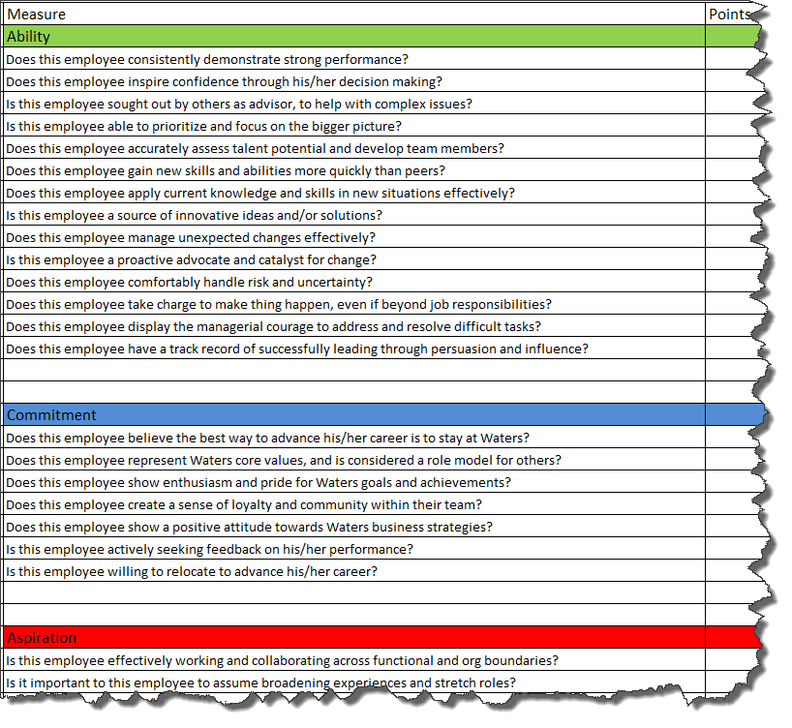
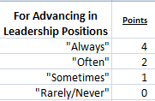

Guide to Determine Potential (worksheet)

Slide 27
Linking TAG to iPerformance and IDP’s in 2017
For High Potentials and Growth Potentials in Layers 3 and 4:
(Chris O’Connell = Layer 1)
Add 1 general “Development” objective in iPerformance
    Objective weighting = 0%
Create detailed IDP and attach in SF “My Employee File”
    This will ensure coordination of all development for these individuals
    A Global IDP form will be provided
    IDP’s currently do not have a centralized system
    Long term plan is Success Factors Talent Module
For the Managers of the above group, create a general “Development Ownership” objective
    Objective weighting = 0%
Notes:
Objectives not mandatory, but IDP’s are.

Slide 28
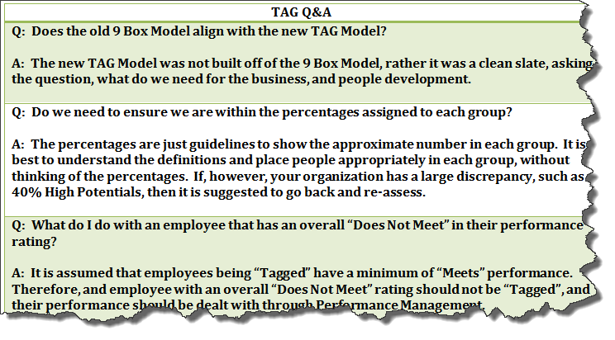
Notes:
We have a Q&A that can be sent out to anyone that has taken this TAG training.

Slide 29

Waters New Global IDP

Slide 30
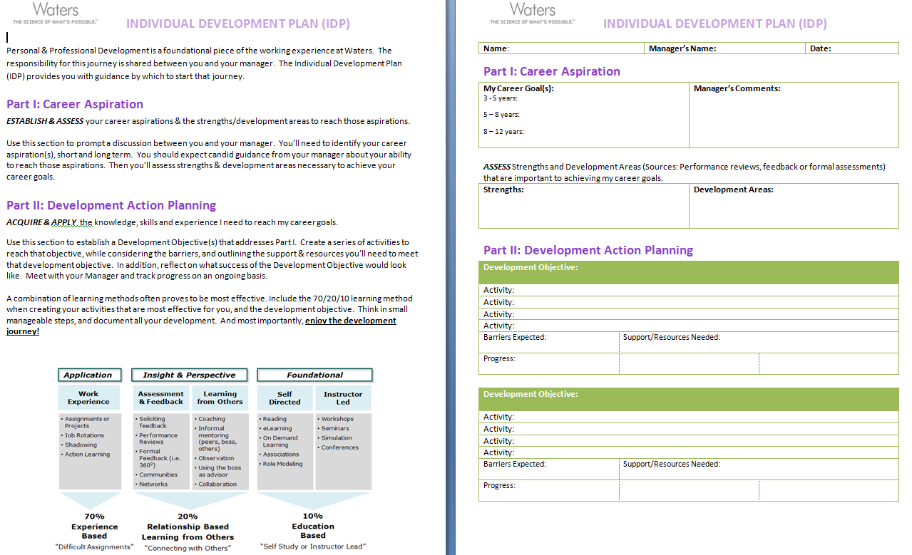
GLOBAL IDP

Slide 31
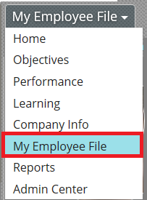
Tools and Supporting Framework
Waters Global Learning & Development Community
Global IDP Form & iPerformance
Notes:
Although not mandatory (will not be « policed » by HR), many find that having a place to store and access their IDP makes it easier to update and monitor. iPerformance allows for this (by uploading document in « my employee files »). To discuss and agree with your line manager.

Slide 32
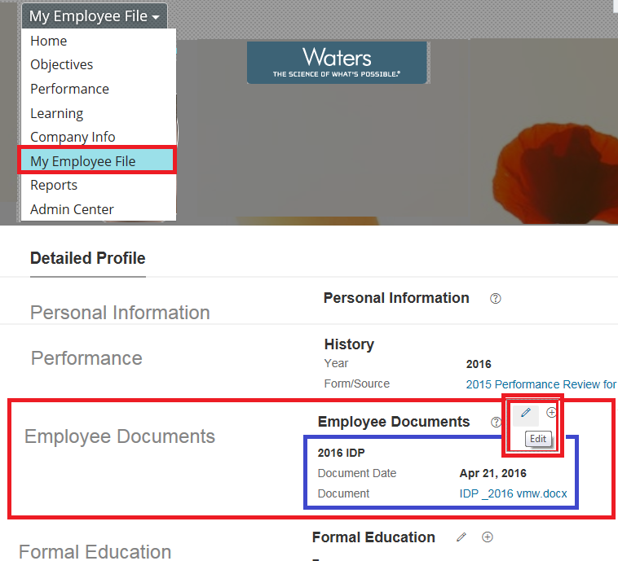
Upload your IDP to iPerformance
Use the Edit button to add updated IDP to the iPerformance platform
Any Word or pdf document can be uploaded
You & your manager can access and make reference at any time

Slide 33
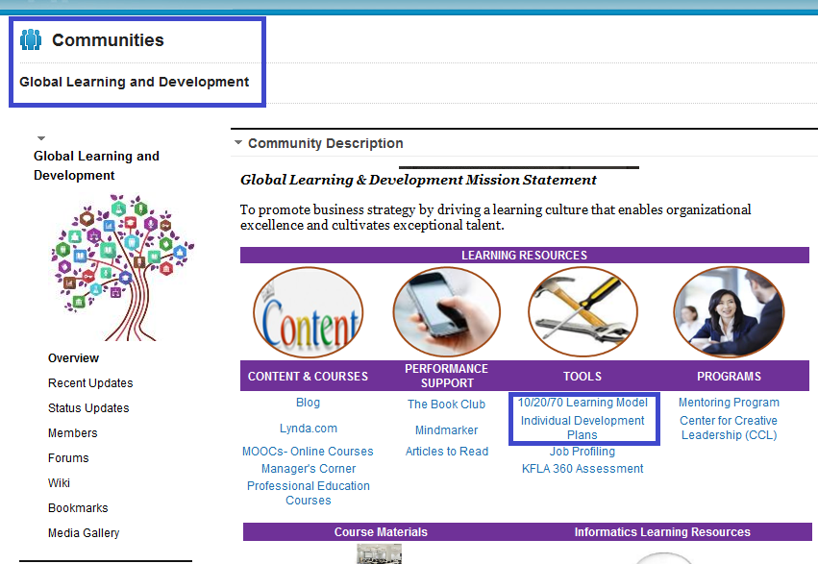
Global Learning & Development
Notes:
This is the front page of the GLD Community (looks similar to the internal L&D Community. Employees will have access to the Global IDP here, as well as info on the 70/20/10 Learning Model. Please push employees to this Community for info.

Slide 34


