Slide 1
Move by itself
Reproduce
Grow
Respond to changes
Air, food and water for survival
Die
Characteristics of living things (MRGRAD)
Living Things
Plants
Microorganisms
Fungi
Animals
Cannot move from place to place | Can move from place to place | Cannot move from place to place | Can move from place to place
Can make its own food | Cannot make its own food | Cannot make its own food | Cannot make its own food
Can be seen with our naked eyes | Can be seen only under microscope | Can be seen with our naked eyes | Can be seen with our naked eyes
Reproduce by seeds or spores | Binary fission or budding | Reproduce by spores | Give birth or lay eggs
Medicinal uses, ornamental purposes, gives us food and oxygen, home to animals | Can be used to make cheese and yoghurt. Can cause us to be sick | Some are poisonous and/or inedible. Some are edible | Some are edible. Use as material such as wool jacket and leather bags
Flowering plants, non-flowering plants like ferns and moss | Yeast, bacteria | Yeast, mushroom, toadstool, puffball, bracket fungus | mammal, reptile, fish, insect, bird, amphibian
© Illuminate Learning Centre Pte Ltd

Slide 2
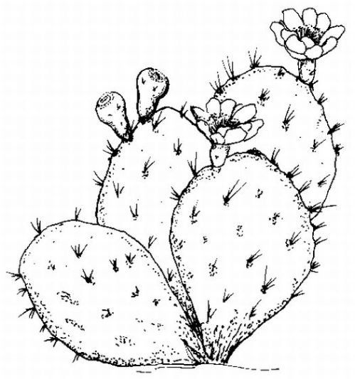
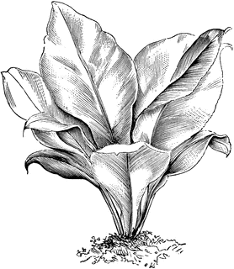
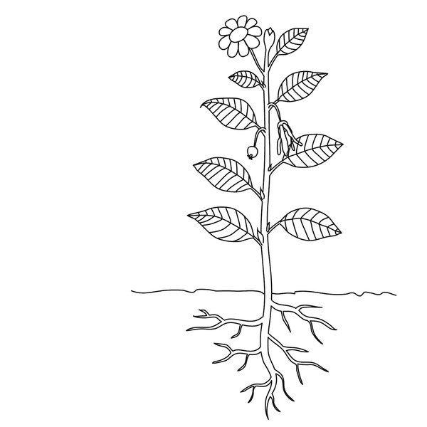
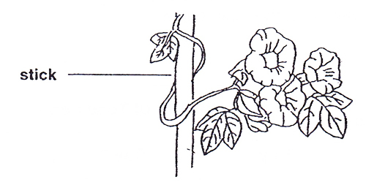
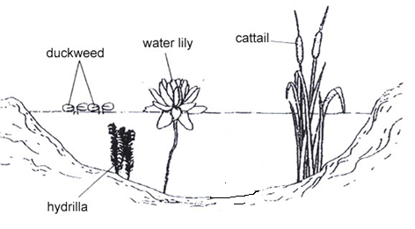
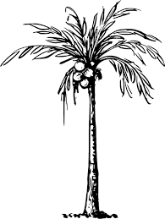
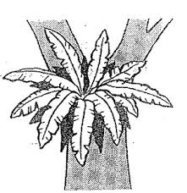
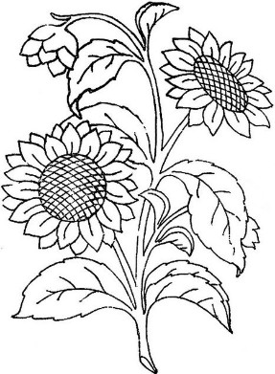
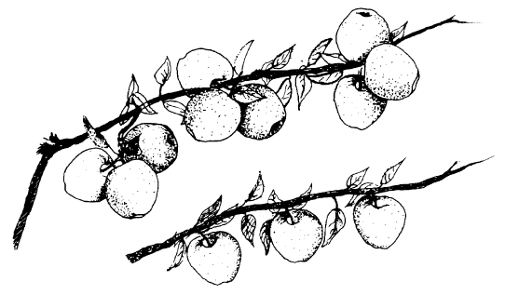
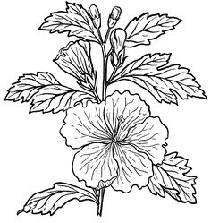
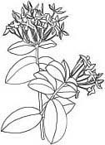
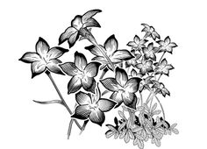
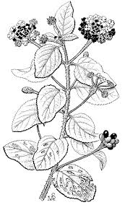
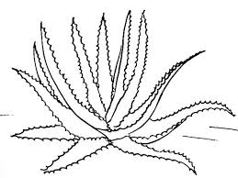
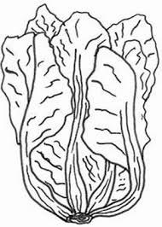
Amelia saw a plant in her garden. It has no flowers so she said that it was a non-flowering plant. Her mother told her it was actually a flowering plant. Why is that so?
Flowering plant vs Non-flowering plant
Its flowers have not bloomed yet or the plant has not matured yet.
Plants with strong stem vs Plant with weak stem
Plants
Water plant vs Land plant
Flowering plants bear fruits
Plants that reproduce by spores vs Plants that reproduce by seeds
Plants with single flower and Plants with cluster flowers
Latana Desert rose
Aloe vera Cabbage
Poisonous plants
Edible plants, ornamental plants, medicinal plants
© Illuminate Learning Centre Pte Ltd

Slide 3
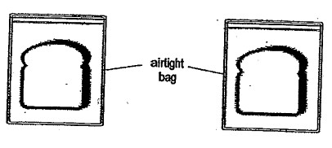
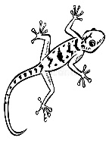
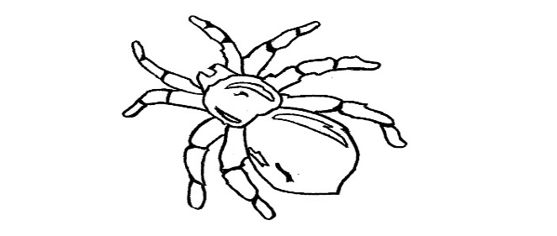
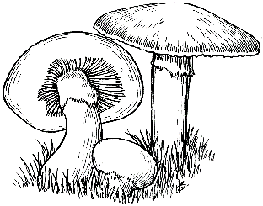
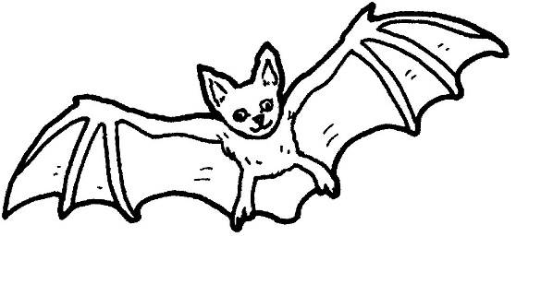
Anabelle had two pieces of bread. She toasted one of them and added water to
the other. She kept both of them in air-tight bags. After a few days, she found
mould growing on Bread A but not in Bread B. Why is that so? Explain your answer.
What is the difference between amount of water and presence of water?
*Mould needs water, warmth, food and air to grow.
Bread A Bread B
Mould needs water to grow. Bread A has water for mould to grow but not Bread B.
Mushroom
A tick is not an insect. Insect has six legs but a tick has eight legs.
A mushroom is not a plant as it cannot make its own food but a plant can.
A bat is not a bird. A bird has feathers but a bat has hair.
© Illuminate Learning Centre Pte Ltd

