Slide 1

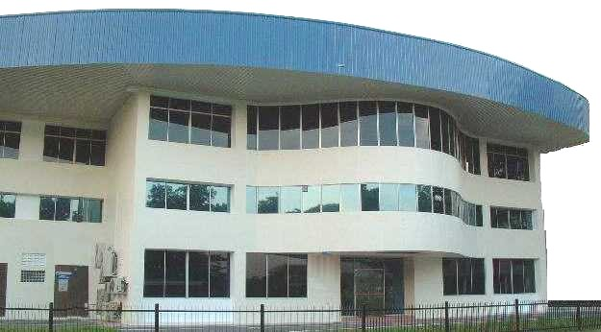

Waters / CEI
Present on the month of Apr 2018
For the Month of Mar 2018

Slide 2
Agenda
Review of last MTR minutes & action items
First Pass Yield
  Overall Results & individual instrument results
  Instrument > targets (does not meet Waters targets or having downtrend)
    Categories failure mode into material, tooling, fixtures, testers, workmanship, others
    Improvement actions & effectiveness
Manufacturing readiness
  Training review and competencies updates
  Tooling & Fixtures updates
  Testers updates
  Documentation (ASP, TSP updates)
Quality (trending, analysis of issues (repeated case), updates / actions taken)
  Suppliers
    LAR
    SCAR
    Audit schedules, audit results, findings and closure
  In Process
    NCR
    CAPA
    Quality alerts
  Customers & field complaints
  QMS updates
Others
  ECO, TMD
  AOB

Slide 3
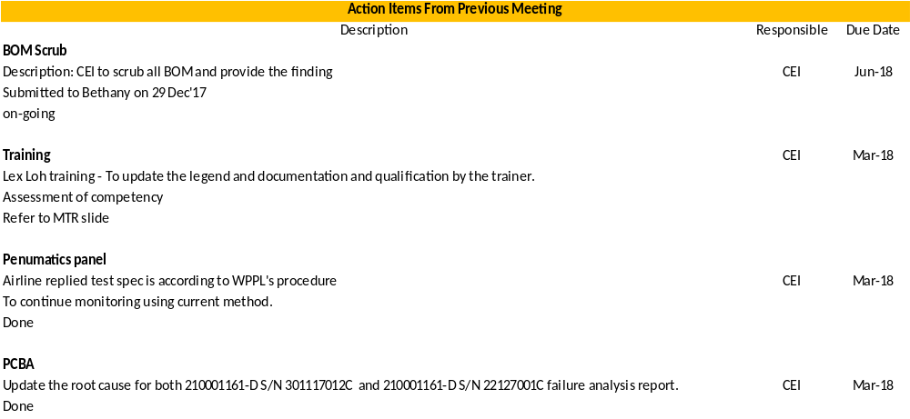
Review Of Last MTR Minutes
Outstanding issues reported in last MTR

Slide 4

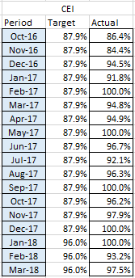
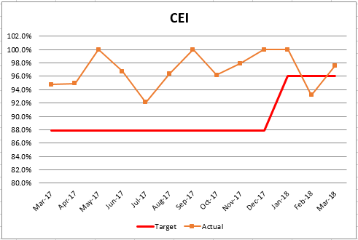

Slide 5

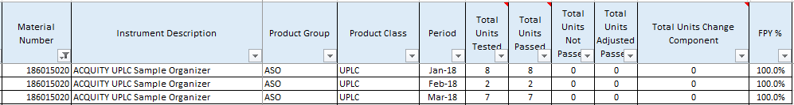
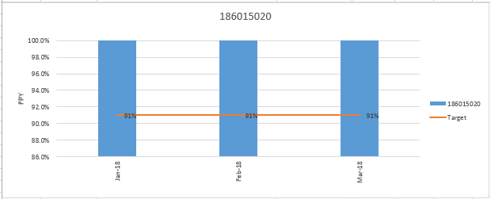

Slide 6

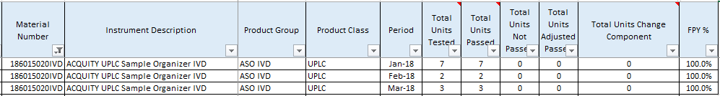
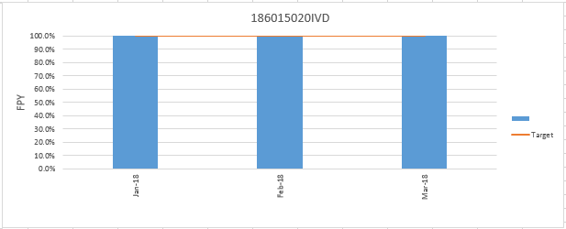

Slide 7

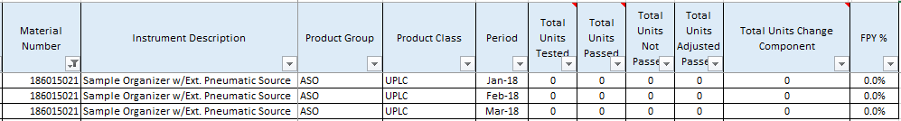
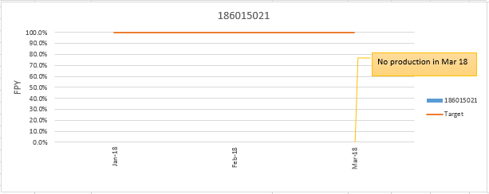

Slide 8

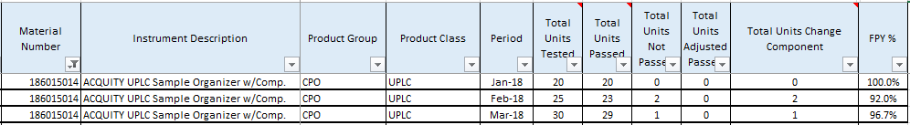
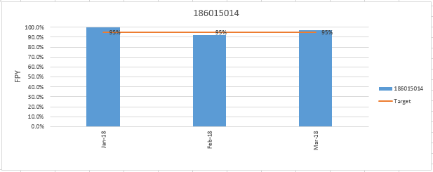

Slide 9
  Discussion on instruments models
  - Instrument > targets (does not meet Waters targets or having downtrend)
Pneumatic Panel 279001402 ISSUES:
Symptoms: Failed Pressure Decay Test during the final Testing.
ACTIONS:
Push in all fitting to confirm no leakage as a result still failed.
Done offline testing as result shown failed as the pressure was above 1.0 PSI.
Return to Airline on 7 Dec 2017.
RESULTS:
Airline returned on 16/1/18. Found Bad V124 Valve in the bottom Position and has repaired and passed the test.
Installed and passed the pressure decay test on the unit.
Airline replied they tested based on Waters specification.

Slide 10
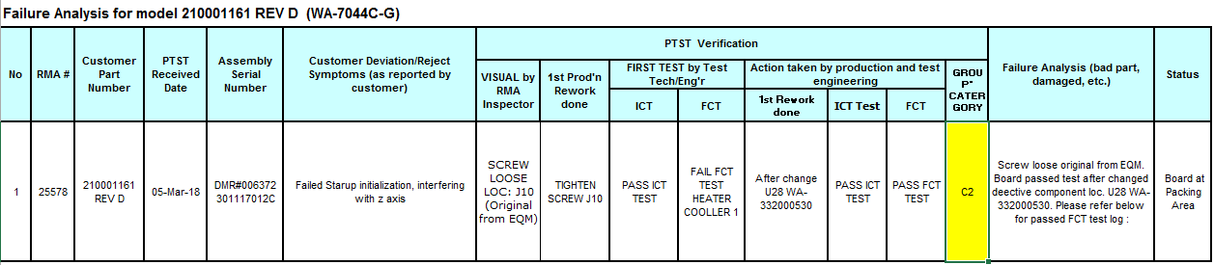
PCBA ISSUES:
Personality board 210001161-D S/N 301117012C
Symptoms: After completed the downloading of firmware, the system will start with the initialization, during the initialization it run half way and it prone “Failed startup Initialization”. Message show has interfering with Z axis. This error cause unable to go to next step ‘configure overrun sensor fiber optic amplifier’.
RESULTS:
During verification found FCT failed heater cooler 1, change the defective component Location at U28.
After replaced defective component passed ICT and FCT.
ACTIONS:
Replaced one new PCBA and passed the test.
DMR raise and send back on 28 FEB 2018 to PTST for rework.
Return and install on unit and passed the initialization and functional test.

Slide 11
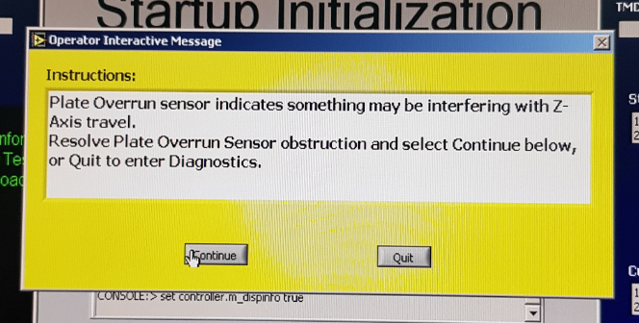
PCBA ISSUES:
Personality Board 210001161-D S/N 22127001C
Symptoms: After completed the downloading of firmware. The system will start with initialization, during the initialization has resolved the plate overrun sensor obstruction. However, tried to click ‘Continue Button’ and it unable to continue the test. Then it remain as it is.
Replaced new PCBA and Passed the test.

Slide 12
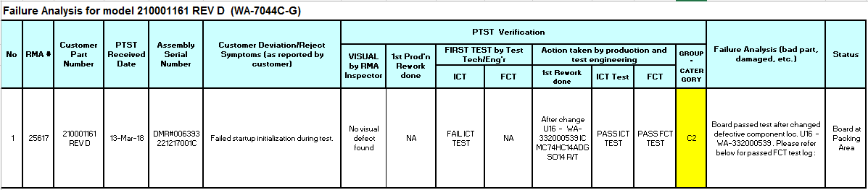
RESULTS:
During verification found ICT failed, Change the defective component Location at U16.
After replaced defective component passed ICT and FCT.
ACTIONS:
DMR raised and send back on 08 MAR 2018 to PTST for rework .
Board Return and install on unit and passed the initialization and functional test.

Slide 13
PCBA ISSUES:
Personality Board 210000450-A S/N 010218026C
Symptoms: Failed startup initialization showing Plate latch and X shuttle sensor error. At diagonastic page show plate latch away and home sensor 'ON'. XTS home and away sensor 'ON'.
RESULTS:
Replaced Barrier Board passed the test.
DMR raise and send back on 4 Apr 2018 to PTST for rework.
Waiting for Batam to ship back and provide failure analysis report.

Slide 14
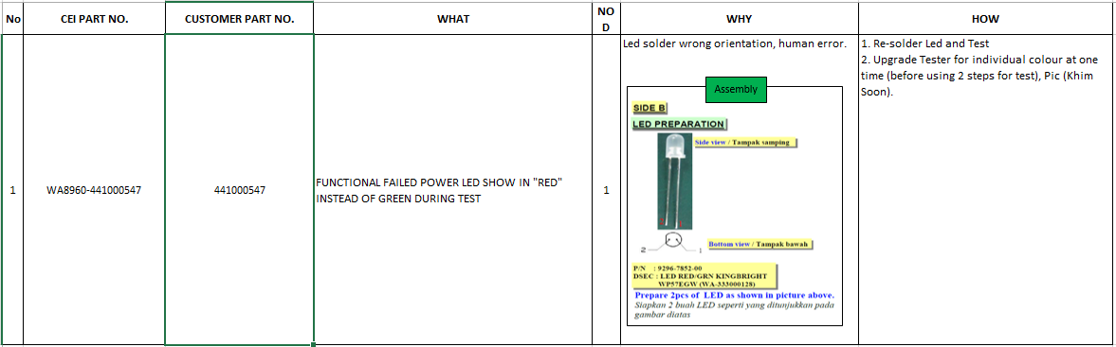
Cable ISSUES:
441000547 ASSY, CABLE, ELEV. POWER-STATUS LED'S
Symptoms: During functional test, check Power LED and it show 'red' instead of Green light. Normal it should light up Green. Replaced new cable and it show functioning normal.
RESULTS:
ACTIONS:
DMR raise send back on 21 MAR 2018 to PTST for rework.
Return on 29 Mar 2018.
Install and it pass the functioning.

Slide 15
  Categories failure mode into material, tooling, fixtures, testers, workmanship, others
  - Improvement actions & effectiveness
  NA

Slide 16
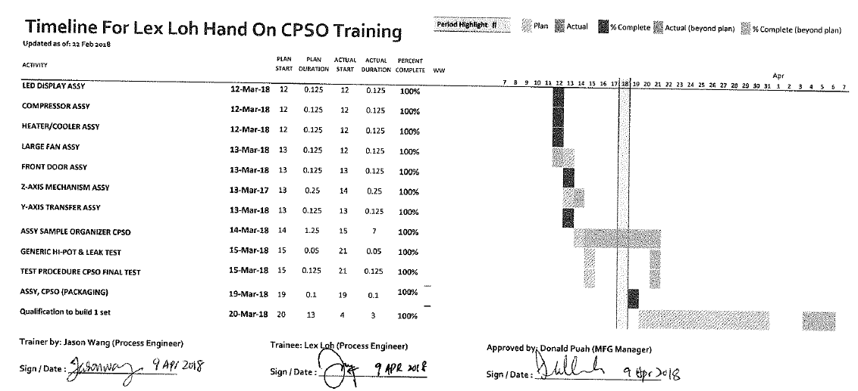

Manufacturing readiness
- Training review and competencies updates
Training start from 12 Mar – 31 Mar 2018 for LEX LOH

Slide 17
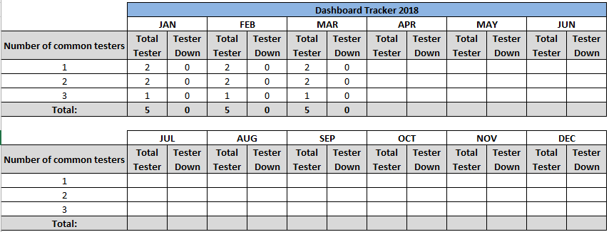
Manufacturing readiness
- Tooling & Fixtures updates

Slide 18
Manufacturing readiness
- Testers updates
NA
- Documentation (ASP, TSP updates)
NA

Slide 19

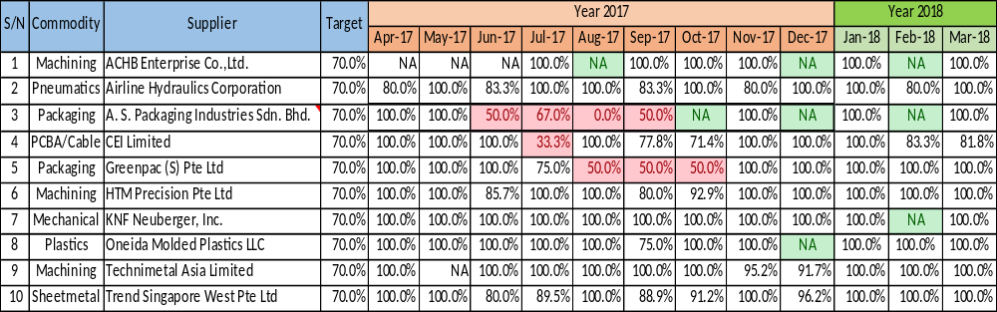

Slide 20

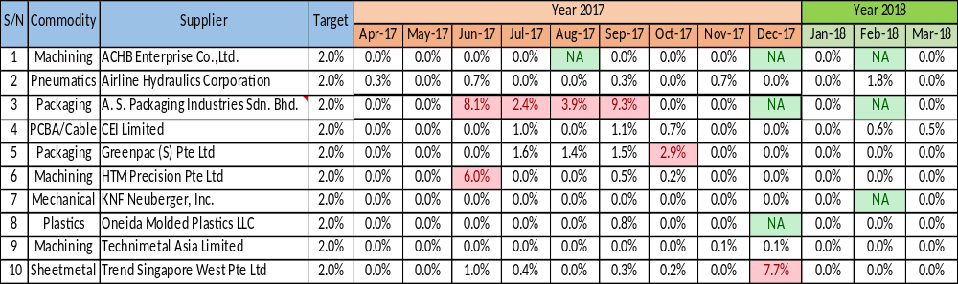

Slide 21

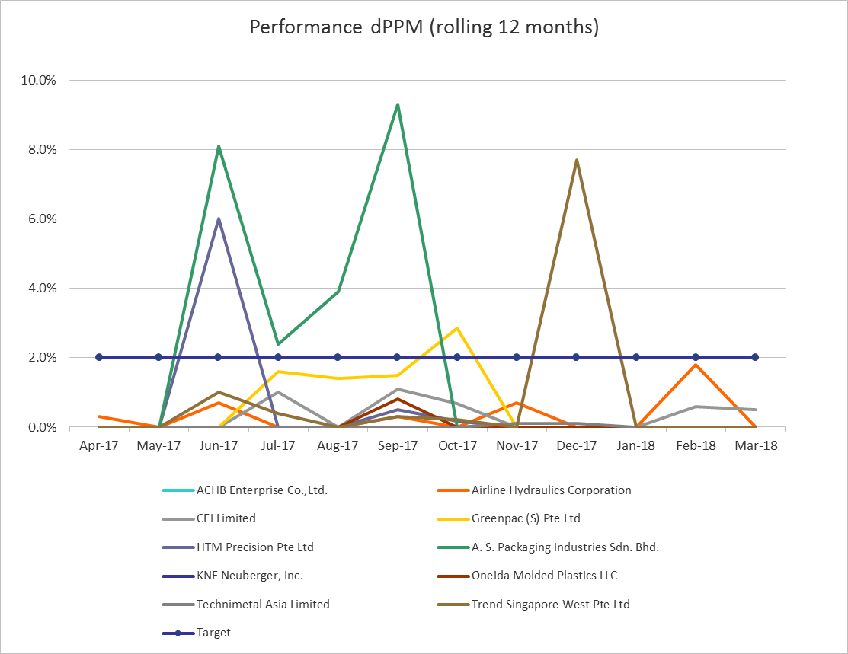

Slide 22
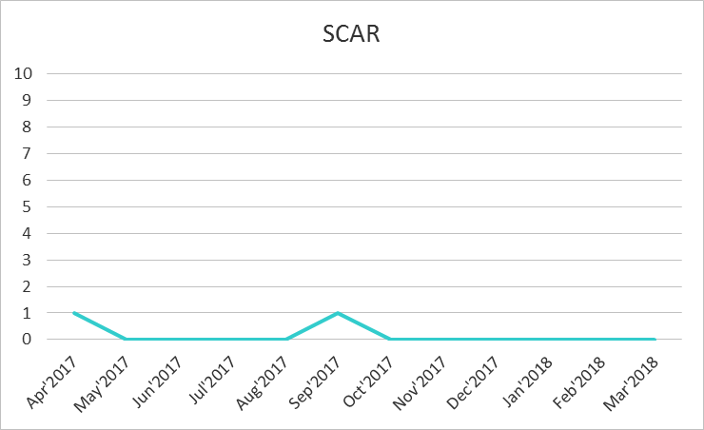
Quality - Suppliers
Key Suppliers (Top 10) Monthly Overall Quality Performance – SCARS (running 12 months)

Slide 23
Quality Issues (Supplier) – SCAR Update / Action Taken on Supplier
S/N | Supplier | Failure Mode/ Issue | Action Plan | Owner | Target Date | Status
NA | NA | NA | NA | NA | NA | NA

Slide 24
Quality - Suppliers
Audit Schedules
Supplier Audit 2018
Jan |  | Feb |  | Mar |  | Apr |  | May |  | Jun
Plan | Actual | Plan | Actual | Plan | Actual | Plan | Actual | Plan | Actual | Plan | Actual
 |  |  |  |  |  | Greenpac | 5-Apr |  |  | Foamtec
Jul |  | Aug |  | Sep |  | Oct |  | Nov |  | Dec
Plan | Actual | Plan | Actual | Plan | Actual | Plan | Actual | Plan | Actual | Plan | Actual
 |  |  |  | HTM |  |  |  |  |  | Trend

Slide 25
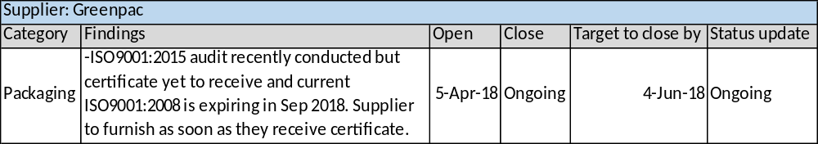
Quality - Suppliers
Audit Results, Findings and Closures

Slide 26
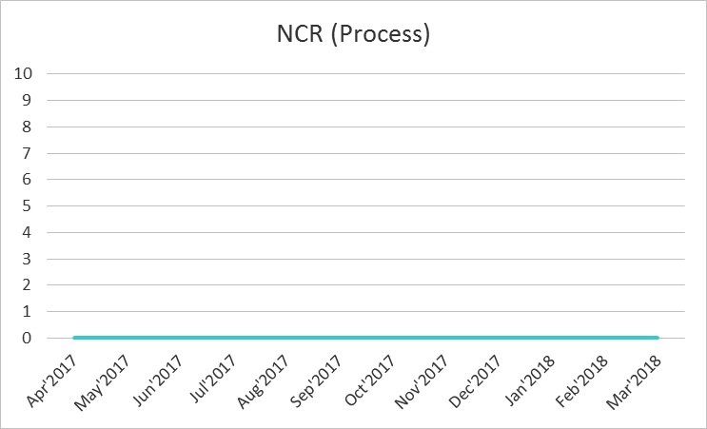
Quality Issues (Process) – NCR (running 12 months)

Slide 27
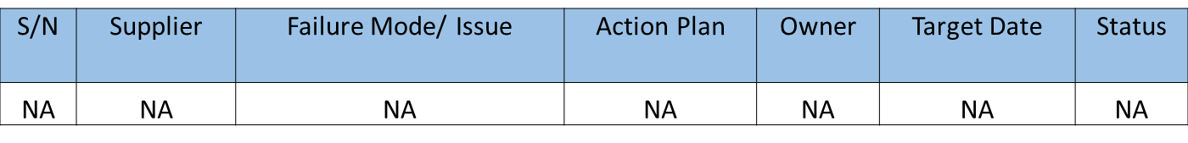
Quality Issues (Process) – Repeated NCR / NCR Update

Slide 28
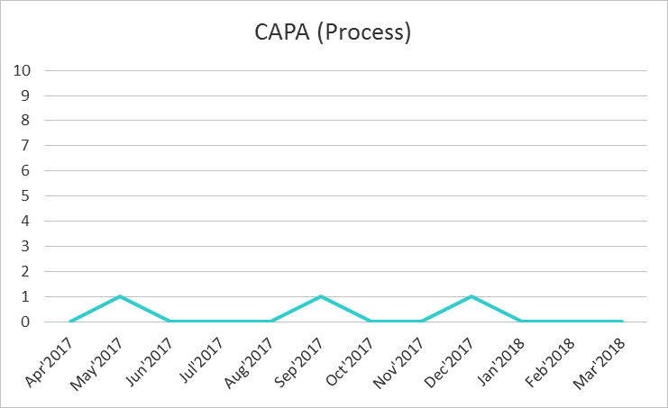
Quality Issues (Process) – CAPA Trending (running 12 months)

Slide 29
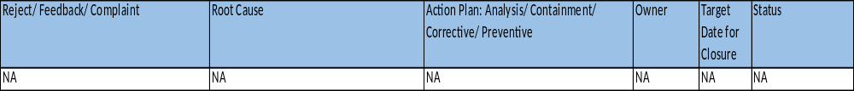
Quality Issues (Process) – Repeated CAPA / CAPA Update

Slide 30
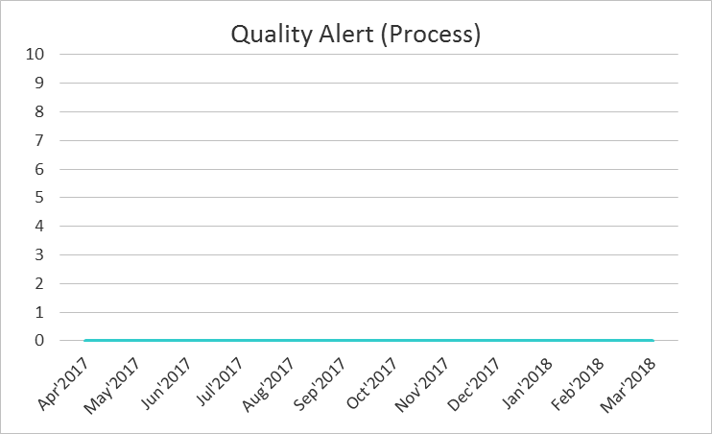
Quality Issues (Process) – Quality Alert Trending (running 12 months)

Slide 31
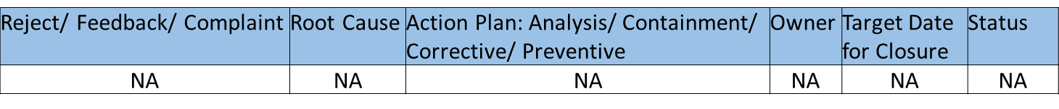
Quality Issues (Process) – Repeated Quality Alert and Quality Alert Update

Slide 32
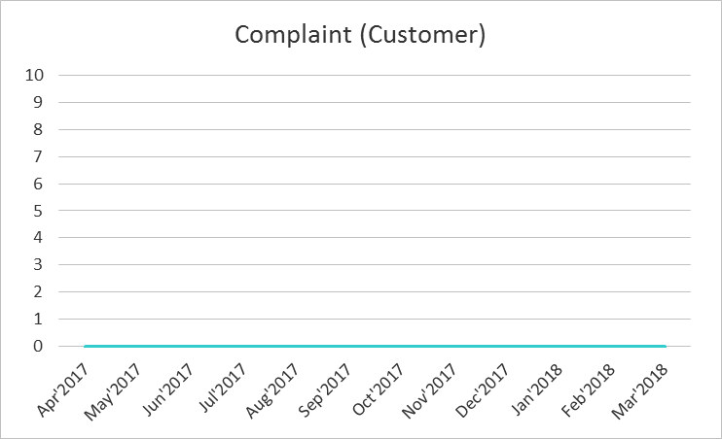
Quality Issues (Customer) – Complaint Trending (running 12 months)

Slide 33
Quality Issues (Customer) – Repeated Complaint and Complaint Update

Slide 34
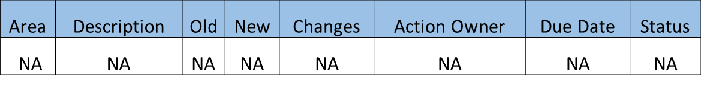
Quality Issues (QMS) – Update On Changes Affecting QMS

Slide 35

Any Other Business
Temporary Manufacturing Deviation (TMD)

Slide 36

Any Other Business
Temporary Change Notice (TCN)

Slide 37
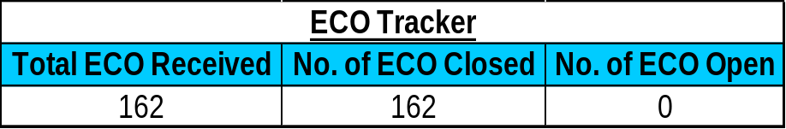
Any Other Business
Engineering Change Order (ECO)
Note:
ECR# 9218380 received, Impact sheet submitted on 13 Apr 2018.

Slide 38
Thank You
38

