Slide 1
MTR Field Data Nov 2018
PIM Team
Jan 2019

Slide 2
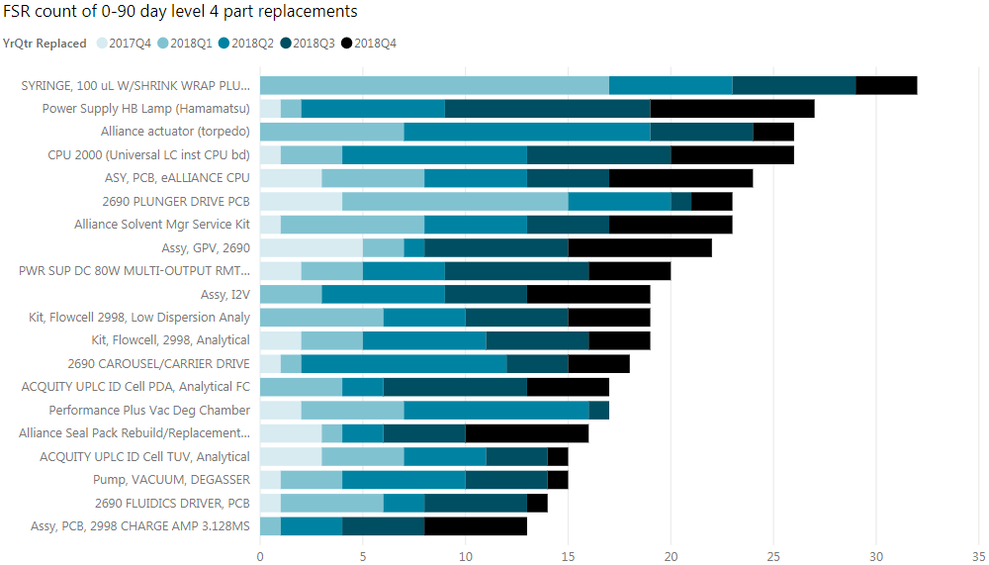
Flextronics – Parts usage 0-90 days, Mfd Jul 2017 – Dec 2018
Milford Part
Waters Investigation
CMO Investigation
Requested
Level 4 part replacements
Notes:
Alliance GPV –Mfg failures due to known GPV solenoid issue. Risk build of 120 units to begin week of 12 November 18, instead of using units as spares. Low (1 – 4%) fallout expected
Carousel Carrier – 26/32 failures in Jan-Jul 2017, Recent SU failures seen (Jan-Apr 18). B. Wildman to follow up with Flex to understand if Milford Eng resources are required
QSM GPV – High (~10%) failure seen late Aug early Sept. Build with process-improved GPV’s beginning
Syringe – 2018 usage all at 1 site…
Plunger Driver PCB reduction in failures since CA in Nov 2017

Slide 3
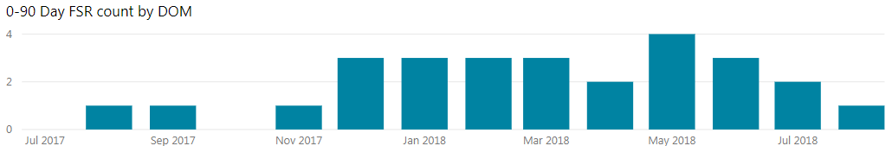
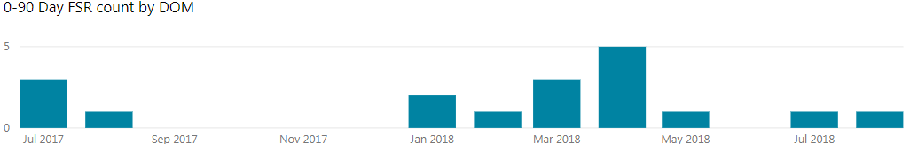
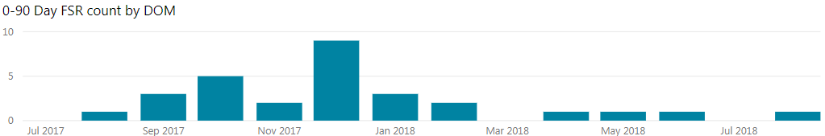
Flextronics - Actions
Product Improvement Management team now involved in Monthly Technical Reviews
HB Lamp PSU (Hamamatsu) – 700002785 / 279001105
  PSU used across multiple lines, no field trend noted at this time, PIM follow up at next MTR
Carousel Carrier – WAT270928 / WAT271290
  Need to understand cause of recent failures, parts requested for return and analysis
  PIM to follow up with Flex at next MTR
Alliance Actuators – 700001031 / 289000527
  Failure analysis in process in Milford, plunger homing faults & motor loss sync errors reported
Failure charts shown by DOM
CMO Investigation
Requested

Slide 4
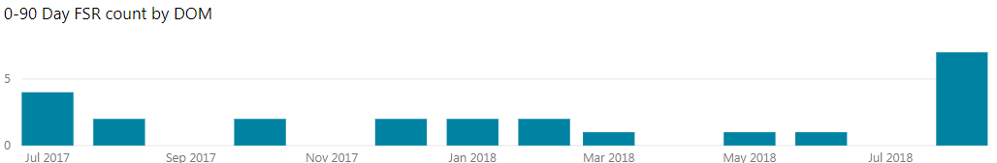
Flextronics - Actions
eAlliance CPU
  Request Flex look into CPU usage during manufacture
  Examine Flex Senai for any trends

