Slide 1
Waters Overall Continuous Improvement Plan
27 Mar 2019

Slide 2

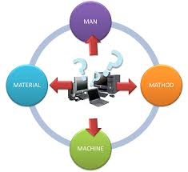

Continuous Improvement 2019 Plan
QUALITY
4M
ENHANCEMENT
Consigned Tester Repair/Upgrade
Consigned Tooling Repair/Upgrade
ASP/TSP
Tools Drawing Check
Yield Improvement Workshop
Field data -> Factory quality improvement
eDHR
Capacity Enhancement
Pick to Scan
eEvent log
Flexflow- Tester integration
Cloud service

Slide 3

eDHR
In Progress
Complete
Sl No. | Activity | May’18 | Jun’18 | Jul’18 | Aug’18 | Sep’18 | Oct’18 | Nov’18 | Dec’18 | Jan’19 | Feb’19 | Mar’19 | Apr’ 19 | May’ 19
1 | eDHR (Alliance) Project Kick Off Meeting with internal team.
2 | Identify requirements. Map details of manual DHR - Alliance
3 | Approval from IT for system readiness to implement eDHR
4 | IT to develop customized eDHR function into version 2.9
Assembly records DHR to eDHR (Phase 1)
5 | Creation of the eDHR matrix - Alliance |  |  | Plan | On-hold
6 | Identify requirements. Map details of manual DHR – BSM / QSM
7 | Share the details for further inputs – With WPPL
8 | Creation of the eDHR matrix - BSM / QSM |  |  |  | QSM
9 | Testing of eDHR matrix in test server |  |  |  |  | QSM
10 | Share the details for further inputs after test – With WPPL
11 | V & V – Protocol creation (User interface level validation)
12 | V & V – Protocol creation (Corp System level validation) *newly added |  |  |  |  |  |  |  |  |  |  | Plan
14 | V & V – Compilation of User inference & Corp System protocol |  |  |  |  |  |  |  |  |  |  | Plan
15 | V & V of the system – Protocol reports review with WPPL |  |  |  |  |  |  |  |  |  |  | Plan
16 | Finalize the eDHR matrix and validation reports with WPPL. |  |  |  |  |  |  | Plan | Plan |  |  | Plan
17 | Communication and training |  |  |  |  |  |  |  | Plan |  |  | Plan | Plan
18 | Go Live eDHR for QSM (in addition to manual DHR) |  |  |  |  |  |  |  | Plan |  |  | Plan | Plan
19 | Removal of manual DHR |  |  |  |  |  |  |  | Plan |  |  |  |  | Plan
Test reports from SigmaSure to eDHR shall be planned after QSM eDHR implementation (Phase 2)

Slide 4
Consigned Tooling Health Assessment & Repair/Upgrade
In Progress
Complete
Overall Status of Consigned Jigs/Fixtures/Tooling Health Review
Identification
301
Assessment & Review of Health of Consigned Tooling
131
Actions on the observation
TBD
Consigned Equipment Health Review Status :
Sl No. | Action | Dec’18 | Jan’19 | Feb’19 | Mar’19 | Apr’19 | May’19 | Jun’19 | Jul’19 | Aug’19
1 | Identify the list of consigned Jigs/Fixtures/Tooling (Excel master list or Asset manual) | Plan
2 | Finalize the scope of assessment method (Visual check/Dimensional check) | Plan
3 | Analyze downtime data | Plan
4 | Establish checklist to review the health of the Jigs/Fixtures/Tooling | Plan
5 | Assess the health of Jigs/Fixtures/Tooling based on Checklist |  | Alliance (131) | Alliance (131) | Alliance (131) | Pumps/Generic(51) | Detectors (59) | BSM/QSM (60)
6 | Consolidate and review the assessment with Waters team. |  |  |  |  | Alliance (131) | Pumps/Generic | Detectors | BSM/QSM
7 | Follow up and work with Waters on the actions on the observation. |  |  |  |  | Alliance (131) | Pumps/Generic Detectors | Detectors BSM/QSM | BSM/QSM

Slide 5
Consigned Test Equipment Repair/Upgrade
In Progress
Complete
Overall Status of Consigned Equipment Health Review ( Test Equipment)
Spare Parts list creation
10
Source spare parts
1
PM update
TBD
Consigned Equipment Health Review Status :
Sl No. | Action | Jan19 | Feb 19 | Mar 19 | Apr 19 | May 19 | Jun 19 |  |  | Remarks
1 | 2690 Pump Head Tester |  |  |  | Spare part list | Source parts | Source parts | PM update |  | COMPLRESS DRY AIR FILTER-F504-01AH - Raise OESR for obsolete Pump Head Tester PCBA (056451) Rev.0
2 | HPMV Tester |  |  |  | Spare part list | Source parts | Source parts | PM update |  | COMPLRESS DRY AIR FILTER-F504-01AH - To raise OESR for Zilog Microcontroller / Keypad
3 | Carousel Carrier Drive Alignment Station |  |  |  | Spare part list | Source parts | Source parts | PM update |  | NA
4 | Fluidics Tray Tester |  |  |  | Spare part list | Source parts | Source parts | PM update |  | COMPLRESS DRY AIR FILTER-F504-01AH - To raise OESR for Zilog Microcontroller / Keypad
5 | Injector Seal Pack Tester |  |  |  | Spare part list | Source parts | Source parts | PM update |  | COMPLRESS DRY AIR FILTER-F504-01AH - To raise OESR for Zilog Microcontroller / Keypad
6 | Injector Seal Pack Tester |  |  |  | Spare part list | Source parts | Source parts |  | PM update | COMPLRESS DRY AIR FILTER-F504-01AH - To raise OESR for Zilog Microcontroller / Keypad
7 | 515 Final Tester |  | Spare part list | Spare part list |  | Source parts | Source parts |  | PM update | COMPLRESS DRY AIR FILTER-F504-01AH - To raise OESR for Zilog Microcontroller / Pump Control Module
8 | 1500 Series Final Test Station |  | Spare part list | Spare part list |  | Source parts | Source parts |  | PM update | COMPLRESS DRY AIR FILTER-F504-01AH To raise OESR for Zilog Microcontroller / Pump Control Module
9 | Flow Cell Tester | Spare part list |  |  |  | Source parts | Source parts |  | PM update | Parker 1. CPI Fittings 5/16 Parker Valve PN 71216SN1BL00N0111Q3 3. GENERANT BUTLER HPRV-250S High Pressure Release Valve
10 | 2998 rough alignment CPU |  |  |  | Spare part list | Source parts | Source parts |  | PM update | TBD

Slide 6
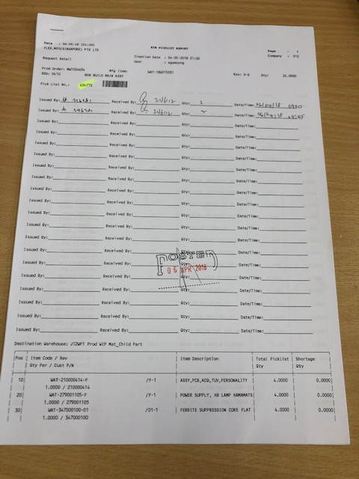
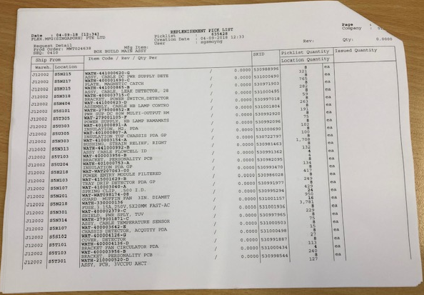

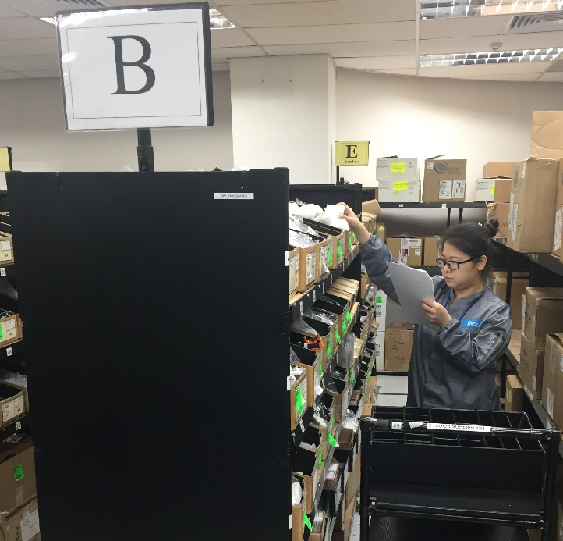
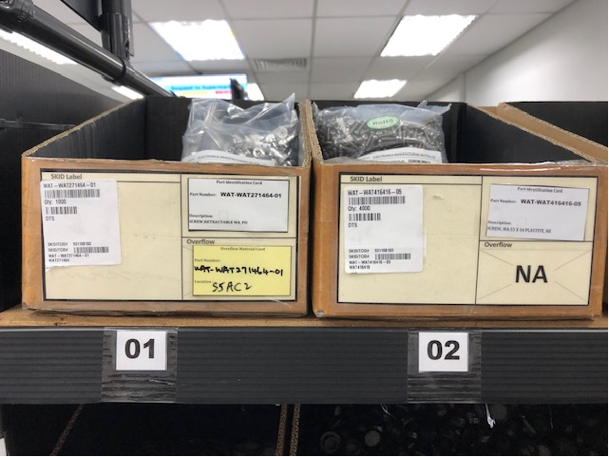
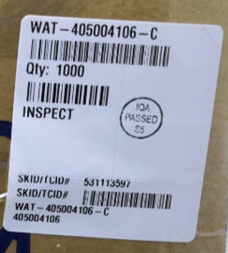

Enhancement of Material Kitting Process
Current Process
Pick to scan
Picklist with barcode
Scan Picklist
Part number and location appear on the scanner
Go to the rack location for
the first part indicated on
the scanner.
Go to rack location. Pick Material based on Picklist.
- Scan SKID Identifier, part no# and pick the part.
- Repeat this step for subsequent part that appears
on the scanner

Slide 7
e-Event Log
Current
Handwritten, manual data input
Inconsistent data of event capturing
e-Event Log
Drop Down Selection from template
Consistent data of event capturing
Manual data collection from handwritten copy
Ease of event monitoring & data analyzing
Plan
Discuss and align plan with CM - Done
Preparation
Get ready procedure and infrastructure – in progress
Implementation
Pending- Target Q2
Monitoring
Pending – Target Q2-Q3

Slide 8
Continuous Improvement Plan 2019
In Progress
Complete
Continuous Improvement Plan – Focus Areas |  |  | Jan-Mar |  | Apr-Jun |  | Jul-Sep |  | Oct-Dec
Quality | 1. Yield Improvement Workshop |  | Alliance |  | Detectors |  | Detectors
 | 2. Field data -> Factory quality improvement |  | Kick Off |  | Alliance |  | Monitor & Control
Enhancement | 1. eDHR |  | V&V, BSM |  | BSM |  | QSM/Alliance |  | Detectors
 | 2. Capacity Enhancement(Tester Utilization 80%) |  | Capacity Plan |  | Implementation |  | Implementation |  | -
 | 3. Pick to Scan (Supermart) |  | Feasibility |  | Execution |  | Monitor & Control |  | -
 | 4. eEvent log |  | Kick Off |  | SM |  | - |  | -
 | 5. Flexflow- Tester integration |  | - |  | - |  | Scoping |  | Execution
 | 6. Cloud service for Back up (Server & Testers) |  | - |  | Scoping |  | Execution |  | -
4M | 1. Consigned Test Equipment Repair/Upgrade |  | Pumps |  | Alliance |  | Detectors |  | -
 | 2. Consigned Tooling Health Assessment, Repair/Upgrade |  | Alliance |  | Pumps/Generic |  | SM/Detectors |  | -
 | 3. Tool drawing verification |  | 155 / 205
 | 4. ASP/TSP assessment, compliance check |  | ECO / OESR |  | ECO / OESR |  | - |  | -

Slide 9
THANK YOU

Slide 10
Backup Slides

Slide 11

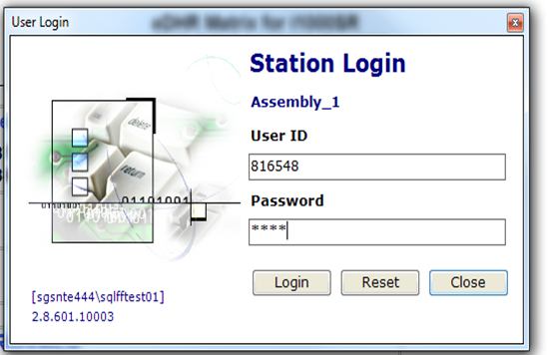
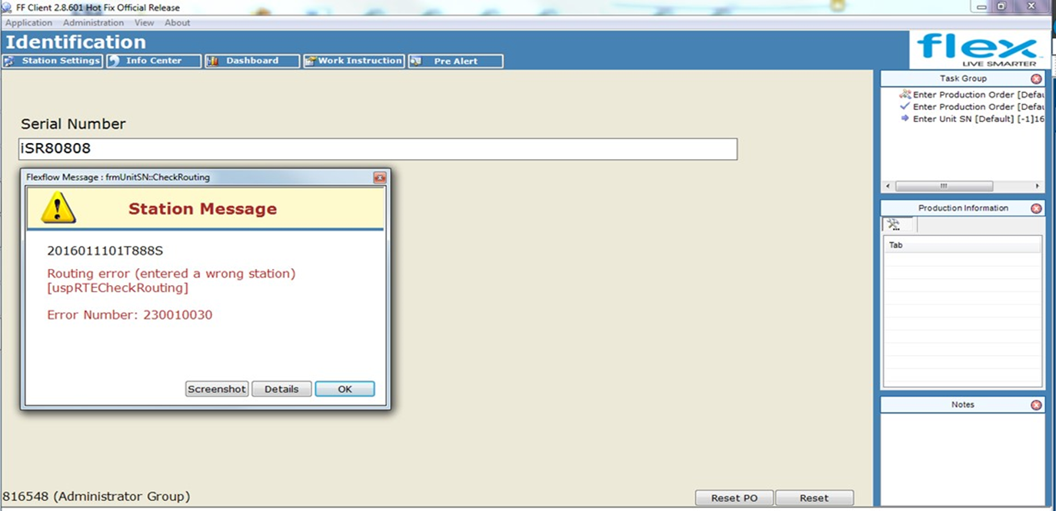
eDHR
Sub Assy A
ET Station
FLEX
DHR
Main Line Assy
FT Station
FVMI
FQA
Pack
Sub Assy B
Sub Assy C
Barcode scanning
Data is less prone to GDP errors
Latest Revision of Work Instruction
Automated checking for expiry date of Time Sensitive Material
Lot number & expiration date will be recorded.
User control – Only certified user can access
Improve GDP
Ensure operator is referring to the correct Work Instruction (WI) (including Revision)
Time Sensitive Material Poka Yoke
Technician Identity
Date of Manufacturing
Critical Part information
Quality Checks and Quality Alert
Test data (Dependent on customer access)
Label Used
Control the curing start & end time
Automated checking against due date of Calibrated equipment
Calibration due date & Equipment ID will be recorded
Essential Info Captured
No Duplicate
Serial Number
Curing Time
Poka Yoke
Calibrated Tools Poka Yoke

Slide 12
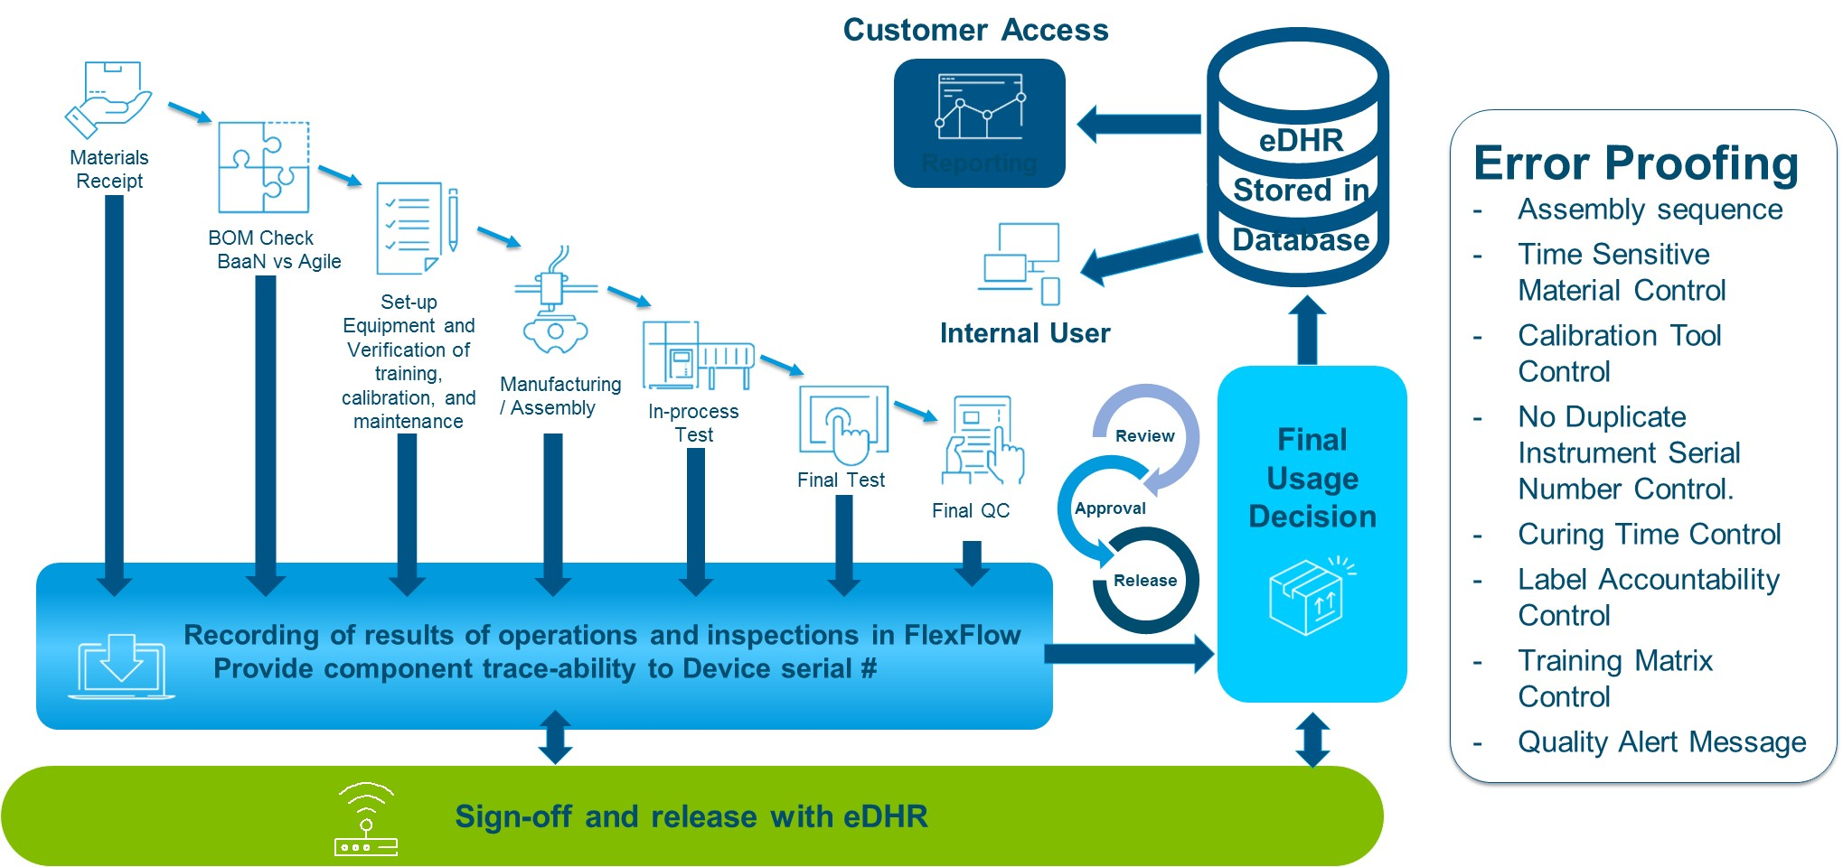
eDHR

Slide 13
eDHR
In Progress
Complete
Sl No. | Activity | May’18 | Jun’18 | Jul’18 | Aug’18 | Sep’18 | Oct’18 | Nov’18 | Dec’18 | Jan’19 | Feb’19 | Mar’19 | Apr’ 19 | May’ 19
Test reports from SigmaSure to eDHR shall be planned after QSM eDHR implementation
1 | Creation of proposal to pull test reports from SigmaSure to eDHR
2 | Review of networking and web storage of eDHR
3 | Review & Approval of feasibility by Waters
4 | System enhancement to allow SigmaSure access by eDHR
5 | Verification of test reports in eDHR
6 | Communication and training
7 | Go Live (in addition with test reports)

Slide 14
Consigned Test Equipment Repair/Upgrade
Objective:
For all 10 testers identified as part of Health review , to identify and list down and get critical spare parts to replace as part of regular PM or repair in the event of test equipment down and recover.
Pre-Requests:
Obsoleted Hardware Ex: PCBA , Flow valve etc.
Obsoleted Software Ex: Windows Operating System
Schematic/Block diagram/BOM
Operational manual / PM documents
Supplier/ Vendor list for Spare parts

Slide 15
Consigned Tooling Health Assessment & Repair/Upgrade
Objective:
  Perform Health review on Consigned Jigs/Fixtures/Tooling to understand the current condition (Good/Bad ) and take appropriate action (Replace/Rework) to minimize production line down related with Consigned Jigs/Fixtures/Tooling
Method:
Flex shall perform health review on Consigned Jigs/Fixtures/Tooling based on :
  Risk assessment thru RPN = Criticality* Risk * Down time Occurrence
  Ageing (Deprecation ……)
  Visual condition (Go or No Go )
  Dimensional check per drawings(top level or component level)
  Form, Fit & Functional check (Mechanical/Electrical/ ESD related etc.)

Slide 16

Consigned Tooling Health Assessment & Repair/Upgrade
Pre-Requests:
Confirmed list of Tooling list.
Drawings for all the Jigs/Fixtures/Tooling
Preventive Maintenance Check list for the Jigs/Fixtures/Tooling
Supplier/ Vendor list for Jigs/Fixtures/Tooling
Spare parts List

Slide 17
Consigned Jigs/Fixtures/Tooling Health Review
Criteria
Criticality ( C ) : | 3 = Unique Jigs/Fixtures/Tooling 2 = Multiple Jigs/Fixtures/Tooling but will affect output when down 1 = Standard Jigs/Fixtures/Tooling
Risk ( R ) : | 3 = High Risk, production volume high, will be affected once Jigs/Fixtures/Tooling down 2 = Medium Risk, Jigs/Fixtures/Tooling down will not affect output for max 2 weeks 1 = Low Risk, Jigs/Fixtures/Tooling down will not affect output when down for more than 2 weeks.
Down time Occurrence (O): | 3 = More often than once a Quarter 2 = One in Quarter 1= Unlikely. Almost never.
Risk Priority Number ( RPN ) = C * R * O (maximum possible is 27) If the RPN is more than 14 (common standard score is half of maximum possible), the priority to work on equipment is deemed high and need action plan to reduce Criticality/Downtime/Risk.

