Slide 1



Brainstorming for 0.3ml flow rate high failure

Slide 2
Prepared By:
Loo Kok Leong
Khalip
Tan Hong Cheng
Chua Chong Keong
Martin
Chan Myae Soe

Slide 3
Problem Statement
Production is seeing a spike of 0.3ml/min flow rate accuracy failures (lower spec limit – 0.297ml/min) on QSM (186017000) in Apr
Possible Root Causes
Measurement data collection and Investigation (Methanol density)
Measurement data collection and Investigation (Calibration data of balances in Testers)
Measurement data collection and Investigation (Temperature and Humidity)
Measurement data collection and Investigation (Testers variations data analysis )

Slide 4
Measurement data collection and Investigation (Methanol density)

Slide 5
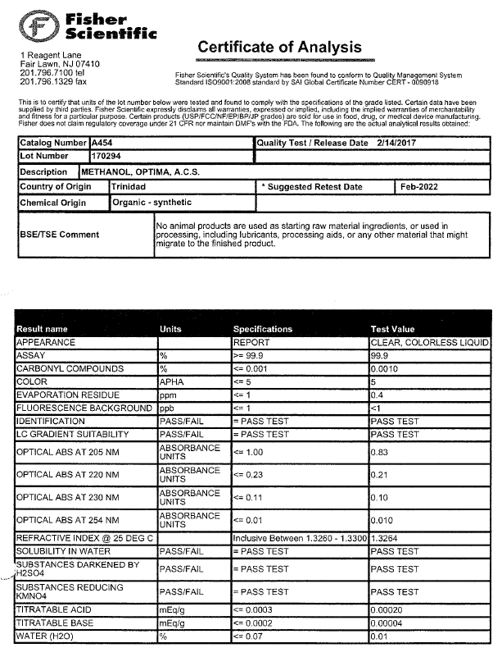
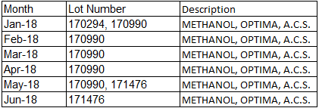
COA of the Methanol

Slide 6
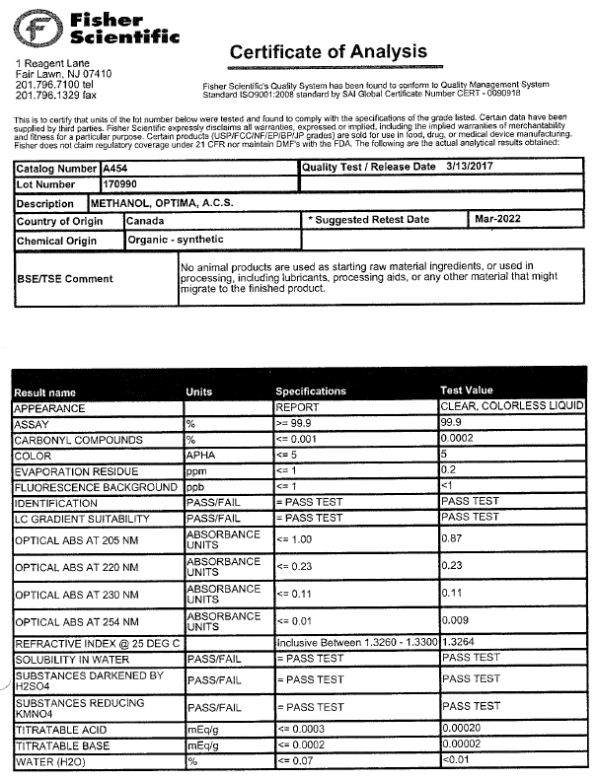
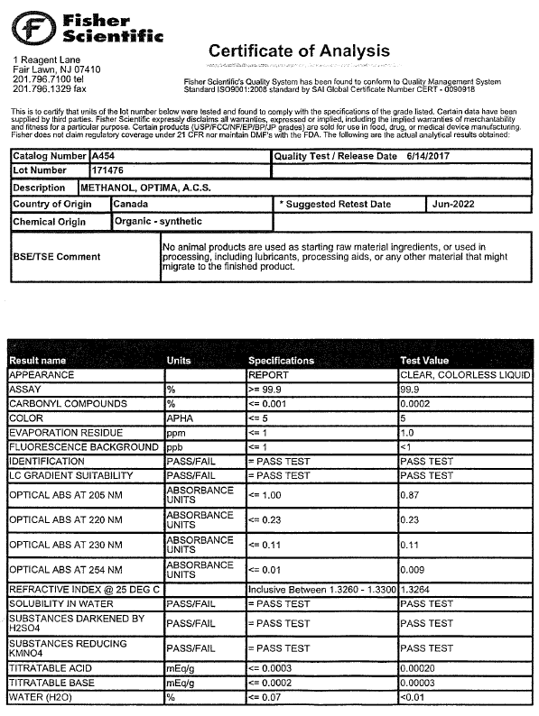
COA of the Methanol (Continued)

Slide 7
COA of the Methanol (Conclusion)
From mid of Jan to mid of May, same batch of Methanol was used across all testers
The high failure is happened on April and May
So, Methanol is not the cause of 0.3ml/min flow rate failure

Slide 8
Measurement data collection and Investigation (Calibration data of balances in Testers)

Slide 9
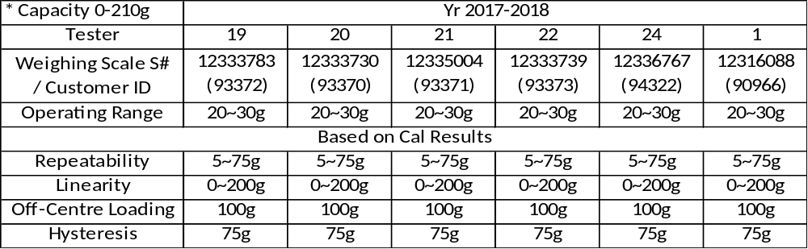
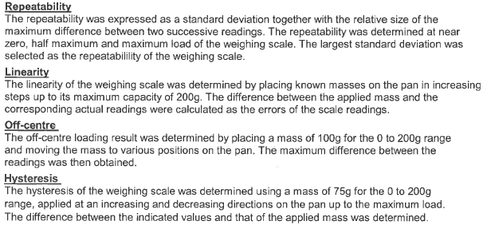
Calibration

Slide 10
Calibration: Conclusion
No abnormalities found in weighting scale calibration report
Weighting scale is not the root cause for this failure

Slide 11

Measurement data collection and Investigation (Temperature and Humidity)

Slide 12
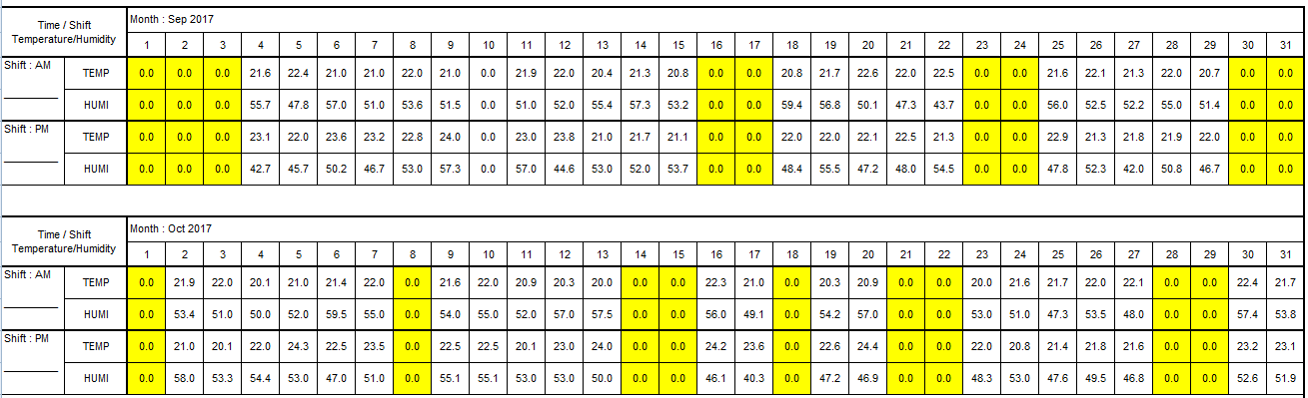
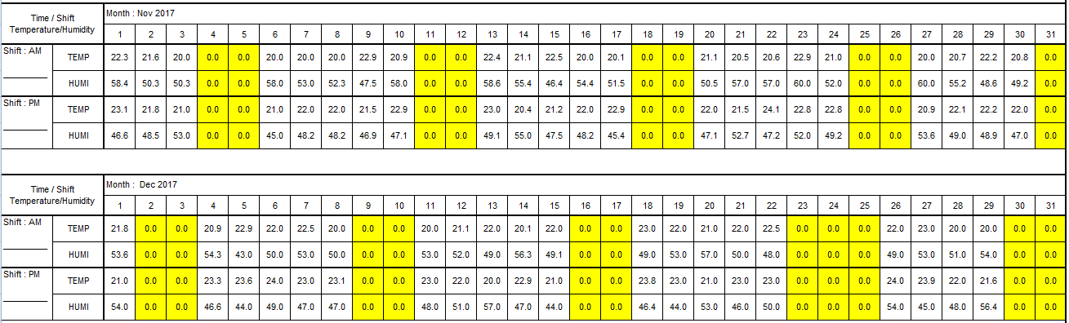
Temp & Humidity : Sept, Oct, Nov, Dec 2017

Slide 13
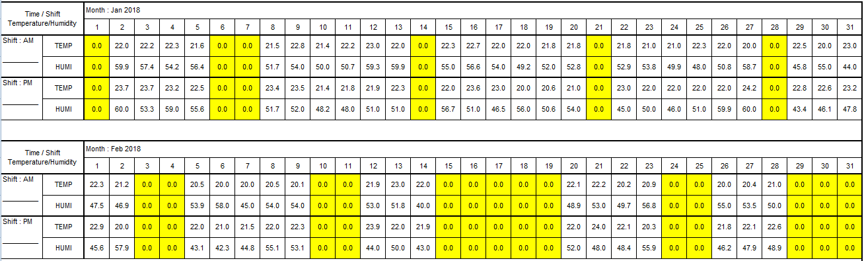
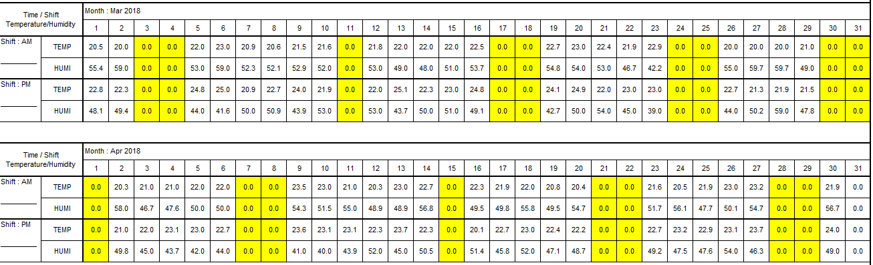
Temp & Humidity : Jan, Feb, Mar, Apr 2018

Slide 14
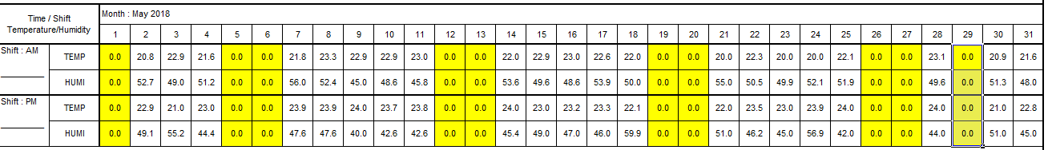
Temp & Humidity : May 2018

Slide 15
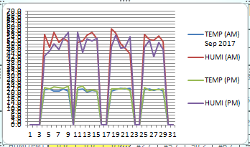
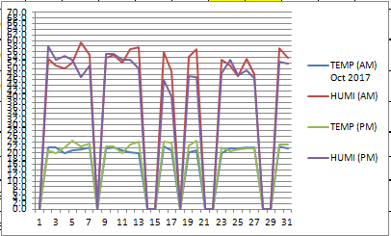
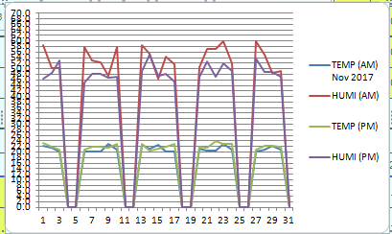
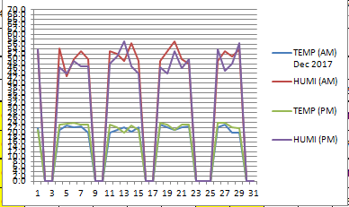
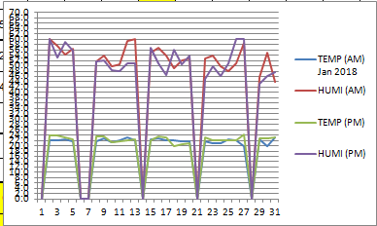
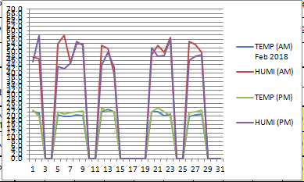
Temp & Humidity : In Graph

Slide 16
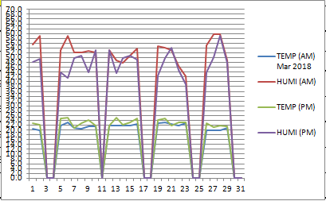
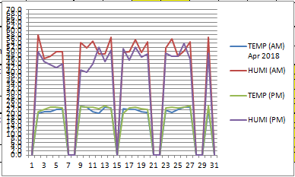
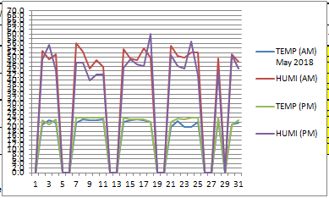
Temp & Humidity : In Graph

Slide 17
Temp & Humidity : Conclusion
Both temperature and humidity are within the control limit according to the data
So, Environment is not related to the 0.3ml/min flow rate failure

Slide 18
Measurement data collection and Investigation (Testers variations data analysis )
Exception: 28 Nov 2017 to 31 May 2018 for Tester 1

Slide 19
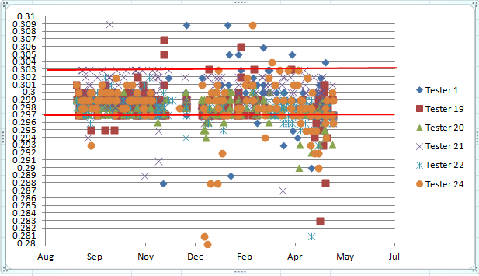
Run Chart – 0.3ml/min flow rate data by all testers

Slide 20
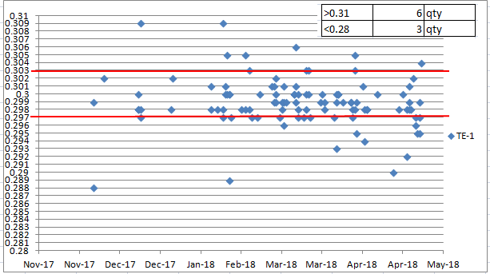
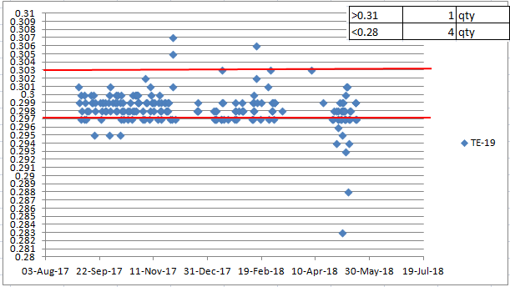
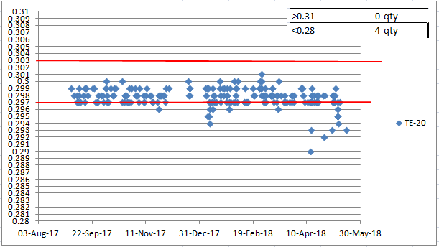
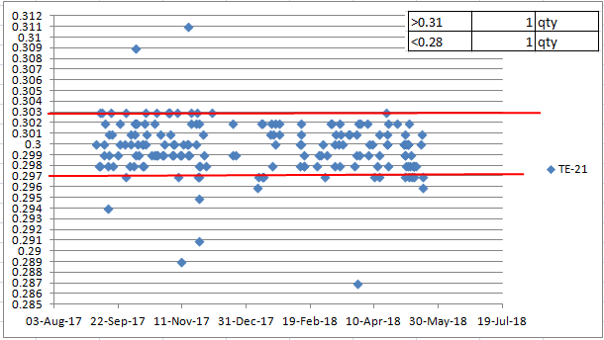
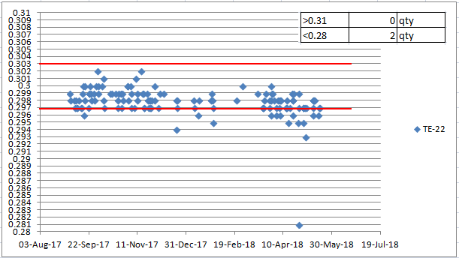
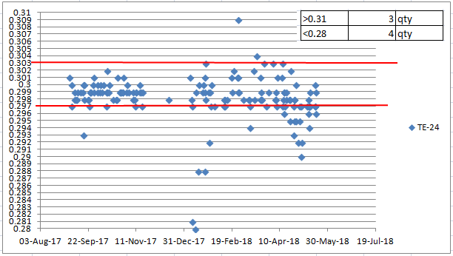
Run Chart – 0.3ml/min flowrate data in each tester

Slide 21
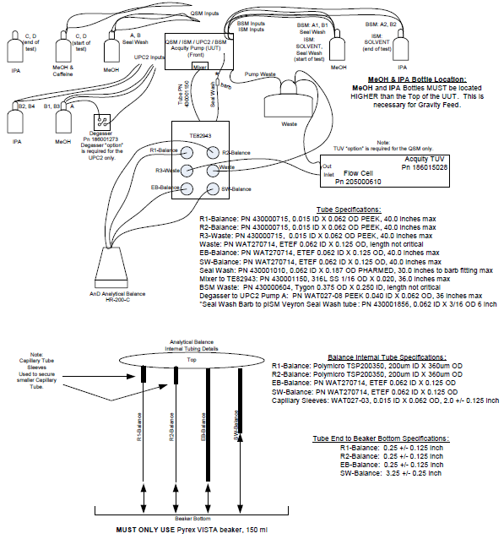
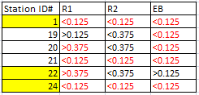
Gap Measurement in between bottom of beaker to end of tube
In TSP, specification for tube is defined. Those specifications are critical to maintain the flow
R1:
In spec: tester #19
Shorter: tester #20 and #22
Longer: tester #1, #21,#24
21

Slide 22
Tester Variation: Conclusion
Failure rate increase across all the testers starting from April.
As per tube measurement data, tester #19 is in spec but it is one of the high failure tester
Tube spec should be maintained as per recommended in TSP to maintain the correct measurement flow
However, Sudden increment of 0.3ml/min flow rate failure is less chance of root cause

Slide 23
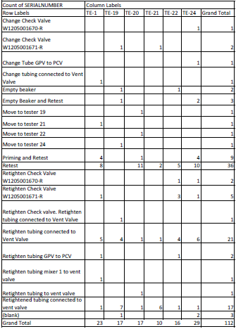
Troubleshooting done for 0.3ml flow rate failure

Slide 24
Troubleshooting: Conclusion
As per data collected, the most troubleshooting step is “retest” followed by “retightened tube connected to vent valve”
So, it shows that instability of measurement

Slide 25

Software / Firmware Change History
Conclusion
Firmware was upgraded on 6th Dec onward
We may need to study the repeatability and reproducibility to understand the consistency of firmware/software

Slide 26
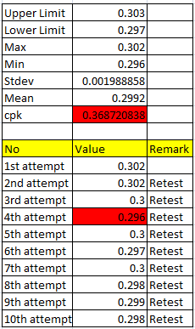
Study: In Progress
Unit S/N: E18VQS048G (known passed unit at 24 with value 0.303)
Tester: #1
Step1: Under diagnosis mode
  run seal wash and flow rate
  Prime D, C, B, A
  Run 0.3ml flow rate
  Collect data
Step2: Under diagnosis mode: run 0.3ml flow rate and collect data
Step 3 onward: repeated step 2
Based on the data collection, variation is pretty high in each run
Cpk for 0.3ml/min flow rate is too low based on the 10 times test on the same unit at same tester

Slide 27
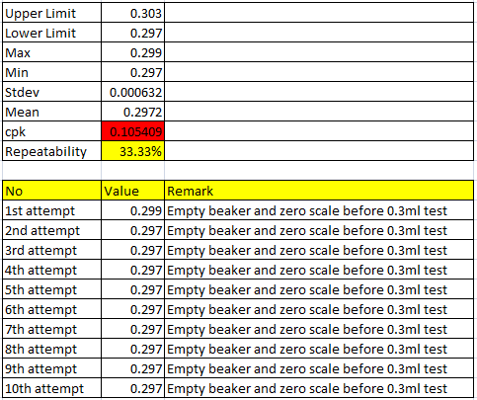
Study: In Progress
Unit S/N: E18VQS060G (known passed unit at tester#24 with value 0.298ml/min)
Tester: #1
Step1: Under diagnosis mode
  run seal wash and flow rate
  Prime D, C, B, A
  Empty Beaker and Zero scale
  Run 0.3ml flow rate
  Collect data
Step2: Under diagnosis mode: repeat c, d, e in step 1
Step 3 onward: repeated step 2
Based on the data collection, test value is very stable after second attempt.

Slide 28
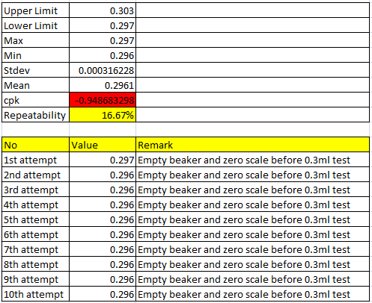
Study: In Progress
Unit S/N: E18VQS060G (known passed unit at tester#24 with value 0.298ml/min)
Tester: #24
Step1: Under diagnosis mode
  run seal wash and flow rate
  Prime D, C, B, A
  Empty Beaker and Zero scale
  Run 0.3ml flow rate
  Collect data
Step2: Under diagnosis mode: repeat c, d, e in step 1
Step 3 onward: repeated step 2
Based on the data collection, test value is very stable after second attempt.

Slide 29
The End

