Slide 1


WPPL-GES Weekly Meeting

Slide 2
Agenda:
1. Scope of weekly review and failure alert level.
2. First Pass Yield (Hard Failures Review & FPY Trending) based on per family:
  FTN
  iBSM/QSM
  Column Mgr and Htr
  Alliance
  Detector
3. Others
  AOB

Slide 3
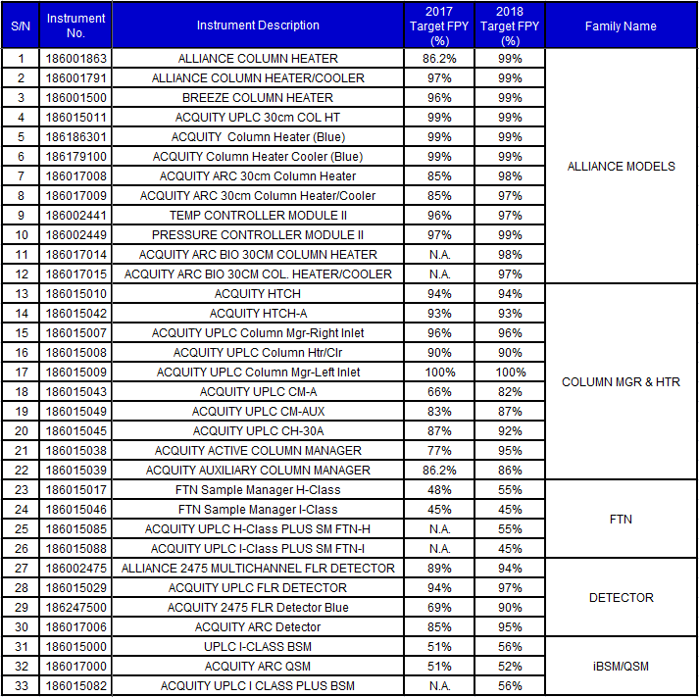
Instruments based on Family Name:

Slide 4
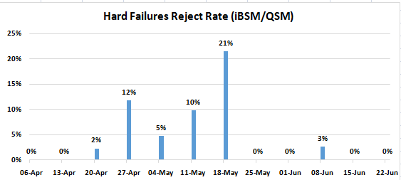

iBSM/QSM

Slide 5
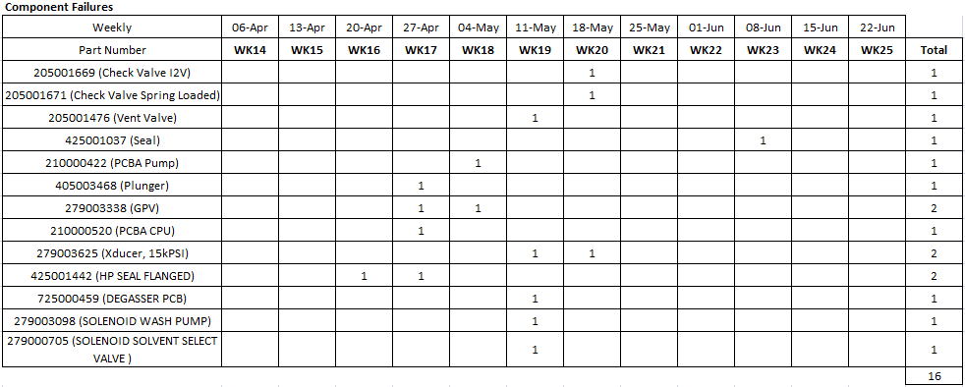
iBSM/QSM
Remarks:
No parts were on the failure alert level for WK25.

Slide 6
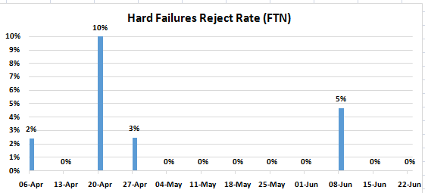

FTN

Slide 7
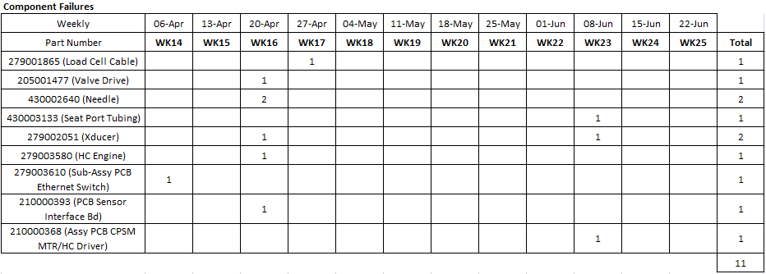
FTN
Remarks:
No parts were on the failure alert level for WK25.

Slide 8
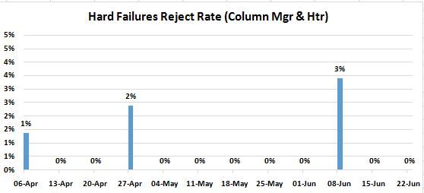

Column Mgr & Htr

Slide 9
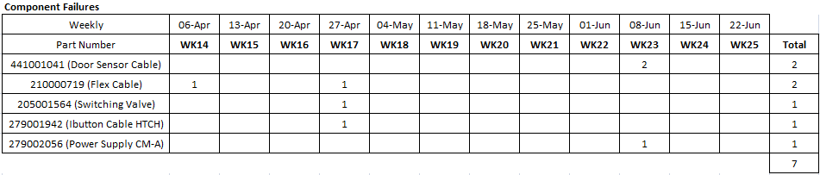
Column Mgr & Htr
Remarks:
No parts were on the failure alert level for WK25.

Slide 10
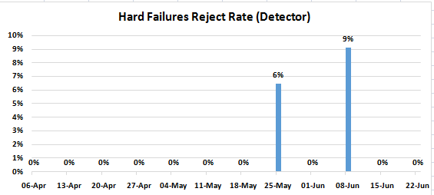

Detector

Slide 11
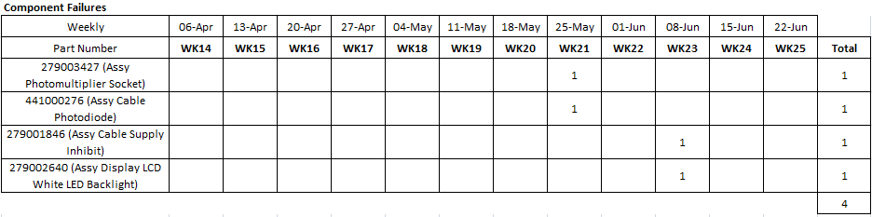
Detector
Remarks:
No parts were on the failure alert level for WK25.

Slide 12
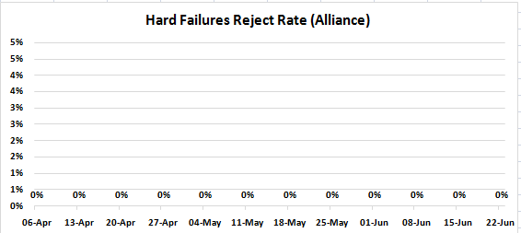

Alliance

Slide 13
Alliance
Remarks:
No parts were on the failure alert level for WK25.

