Slide 1


WPPL-GES Weekly Meeting

Slide 2
Agenda:
1. Scope of weekly review and failure alert level.
2. First Pass Yield (Hard Failures Review & FPY Trending) based on per family:
  FTN
  iBSM/QSM
  Column Mgr and Htr
  Alliance
  Detector
3. Others
  AOB

Slide 3
Review Of Last QME Joint Meeting Minutes
Action Items from Previous Meeting
Description | Responsible | Due Date | Status
iBSM Material Issue: Defect: Gasket easily torn after adjustment Part Number/Description: 425000430/GASKET DEGASSER CHAMBER Supplier/Vendor: FOAMTEC (S) PTE LTD Qty Affected: 124 pcs Instruments Affected: 186015000 (ACQUITY UPLC I-CLASS BSM) PO No. 3510011082 Update Summary: ECR No. 9227048 for foamtec already received, ongoing request for sample from Supplier to conduct FA. 115 pcs quarantined, awaiting for disposition and approval for the Rev C. Foamtec already collected the affected part, propose to Close this case | SQE-SuZhen/ Sunny QA-Dette | Q4 2018 | For closure
Material Issue: Defect: MAGNETIC TARGET used wrong M3 Set Screw/MAGNETIC TARGET Supplier/Vendor: TIMKEN COMPANY Quantity Received: 700 pcs Supplier PO No.: 4590432425 (500pcs) & 4590423192 (200pcs) Affected Models: FTN Update Summary: Venture submitted the issued NCR SG181201 for approval Venture provide the first draft of the CAR#18-026 for review to WPPL. SCAR received from Timken, for review. | SQE-Sunny QA-Dette Eng-KL | Q1 2019 | Open

Slide 4
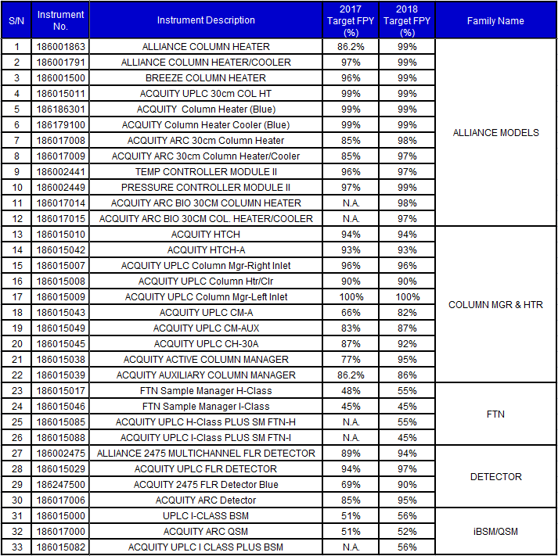
Instruments based on Family Name:

Slide 5
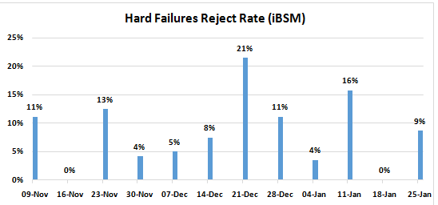

iBSM

Slide 6
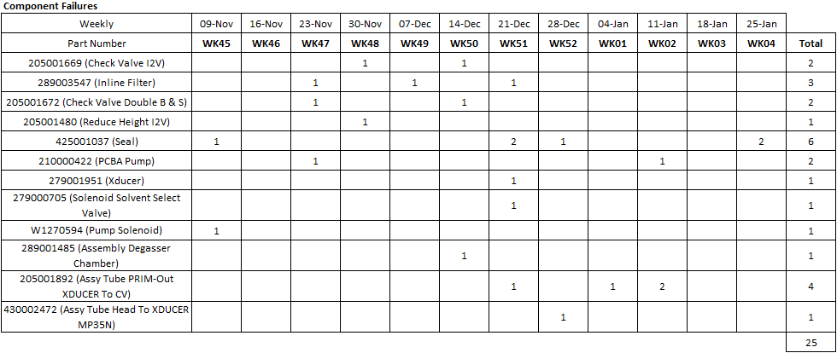
BSM
Remarks:
186015082: Test Pump A Dynamic Leak - Primary Leak Rate (Part Number - 425001037 X2) for WK04.

Slide 7
Summary of Hard Failures Verification
No | Model | Part Number | 1st UUT Serial Number | Failure | Action | 2nd UUT Serial Number | Failure | Action
1 | 186015082 | 425001037 (Seal) | A19BSP007G | Test Pump A Dynamic Leak - Primary Leak Rate | Test Pump A Dynamic Leak - Primary leak rate is above the limit. Check tubing connection - Okay Retightened check valve - Fail Replaced I2V check valve - Fail Replaced seal - Pass | A19BSP035G | Test Pump A Dynamic Leak - Primary Leak Rate | Same failure could be duplicated. - Failure followed to Seal. Verified and rejected.
2 | 186015082 | 425001037 (Seal) | A19BSP026G | Test Pump A Dynamic Leak - Primary Leak Rate | Test Pump A Dynamic Leak - Primary Leak Rate Fail Check tubing connection - OK Changed check valve - Fail Changed seal - Pass | A19BSP055G | Test Pump A Dynamic Leak - Primary Leak Rate | Same failure could be duplicated. - Failure followed to Seal. Verified and rejected.

Slide 8
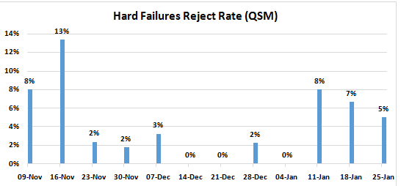

QSM

Slide 9
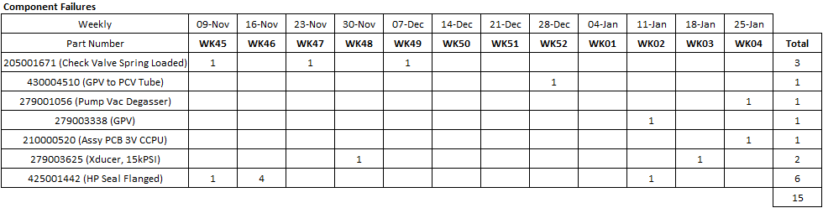
QSM
Remarks:
186017000: Test Loader Downloaded Fail (Part Number - 210000520) for WK04.
186017000: Test Degasser Pressure Fail (Part Number - 279001056) for WK04.

Slide 10
Summary of Hard Failures Verification
No | Model | Part Number | 1st UUT Serial Number | Failure | Action | 2nd UUT Serial Number | Failure | Action
1 | 186017000 | 210000520 (Assy PCB 3V CCPU) | A19VQS780G | Test Loader Downloaded Fail | Test Loader Downloaded Failed (Serial Port error) Manual download firmware - Fail Replaced CPU - Pass | A19VQS805G | Test Loader Downloaded Fail | Same failure could be duplicated. - Failure followed to CPU PCB. Verified and rejected.
2 | 186017000 | 279001056 (Pump Vac Degasser) | A19VQS810G | Test Degasser Pressure Fail | Test Degasser Pressure Fail Verification: Observed that degasser is noisy During priming, degasser motor is turning very fast and not smooth. Changed degasser - Pass Observed that degasser's shaft is misaligned | NA | NA | NA

Slide 11
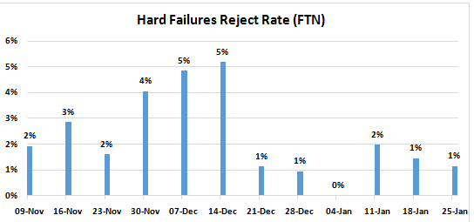

FTN

Slide 12
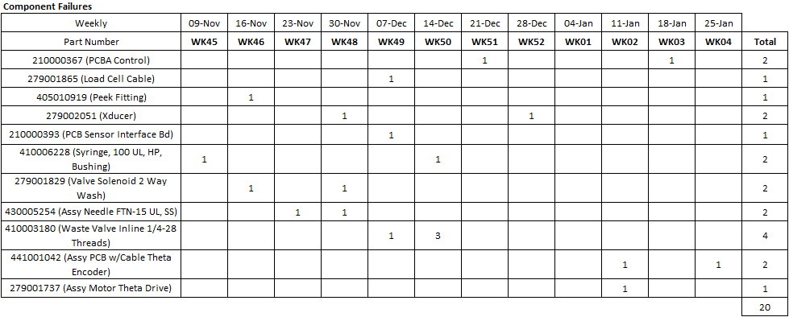
FTN
Remarks:
RTZ sub-assembly : Test Belt Tension Fail (Part Number - 441001042) for WK04.

Slide 13
Summary of Hard Failures Verification
No | Model | Part Number | 1st UUT Serial Number | Failure | Action | 2nd UUT Serial Number | Failure | Action
1 | RTZ Sub-assembly | 441001042 (Assy PCB w/Cable Theta Encoder) | NA | Test Belt Tension Fail | Failed at test theta belt function with degree per iteration is more than 60 while spec called for LSL:1 and USL:1.75. | NA | Test Belt Tension Fail | Same failure could be duplicated. - Failure followed to Assy PCB w/Cable Theta Encoder with 50 degree per iteration. Both failures resolved after changing theta encoder cable. Verified and rejected.

Slide 14
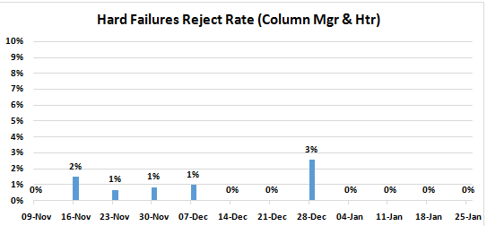

Column Mgr & Htr

Slide 15
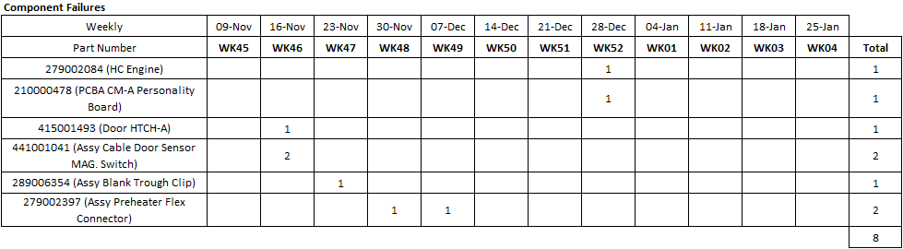
Column Mgr & Htr
Remarks:
No parts were on the failure alert level for WK04.

Slide 16
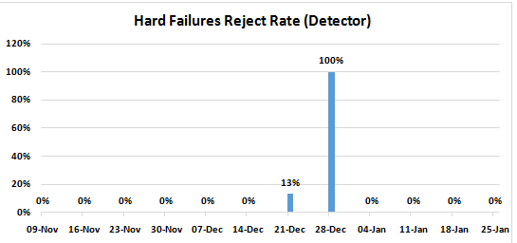

Detector

Slide 17
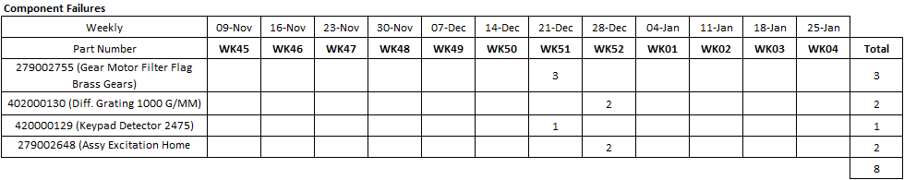
Detector
Remarks:
No parts were on the failure alert level for WK04.

Slide 18
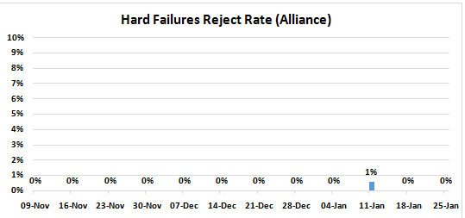

Alliance

Slide 19
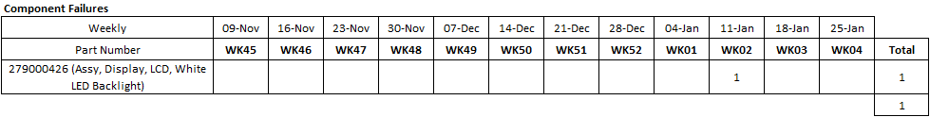
Alliance
Remarks:
No parts were on the failure alert level for WK04.

