Slide 1


WPPL-GES Weekly Meeting

Slide 2
Agenda:
1. Scope of weekly review and failure alert level.
2. First Pass Yield (Hard Failures Review & FPY Trending) based on per family:
  FTN
  iBSM/QSM
  Column Mgr and Htr
  Alliance
  Detector
3. Others
  AOB

Slide 3
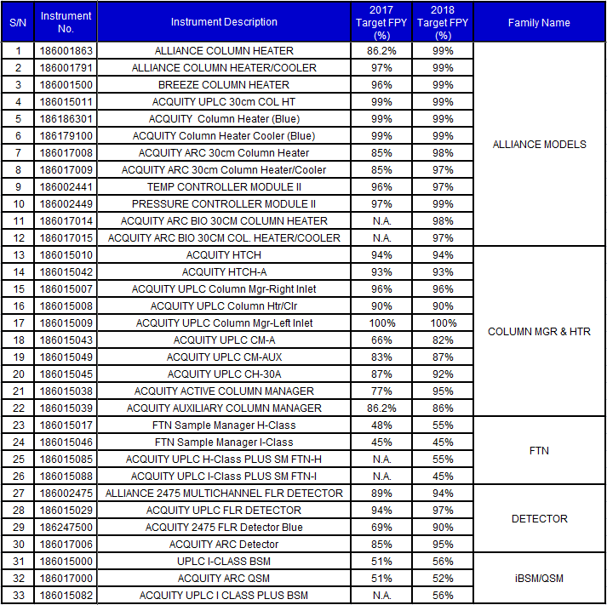
Instruments based on Family Name:

Slide 4
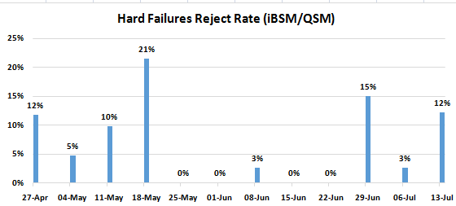

iBSM/QSM

Slide 5
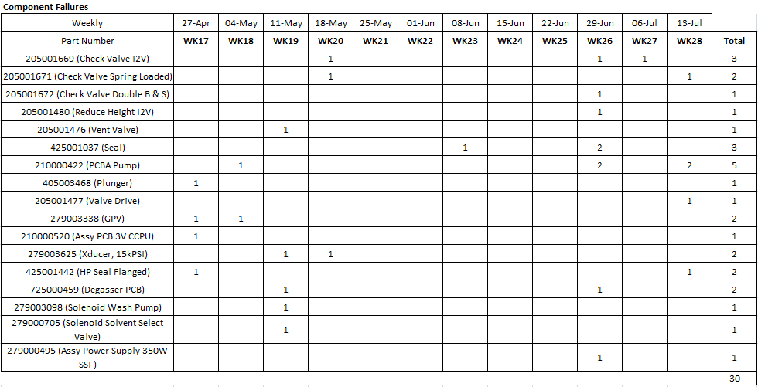
iBSM/QSM
Remarks:
186017000 (Fail Functional) Test Dynamic Leak - Primary Leak Rate PN 205001671 for WK28.
186017000 (Fail Functional) Test Dynamic Leak - Primary Leak Rate PN 425001442 for WK28.
186017000 (Fail Functional) Test Alarm at Bootup Fail PN 205001477 for WK28.
186015082 (Fail Functional) Test Stop Flow Input Open Test PN 210000422 for WK28.
186015000 (Fail Functional) Test Alarm at Bootup PN 210000422 for WK28.

Slide 6
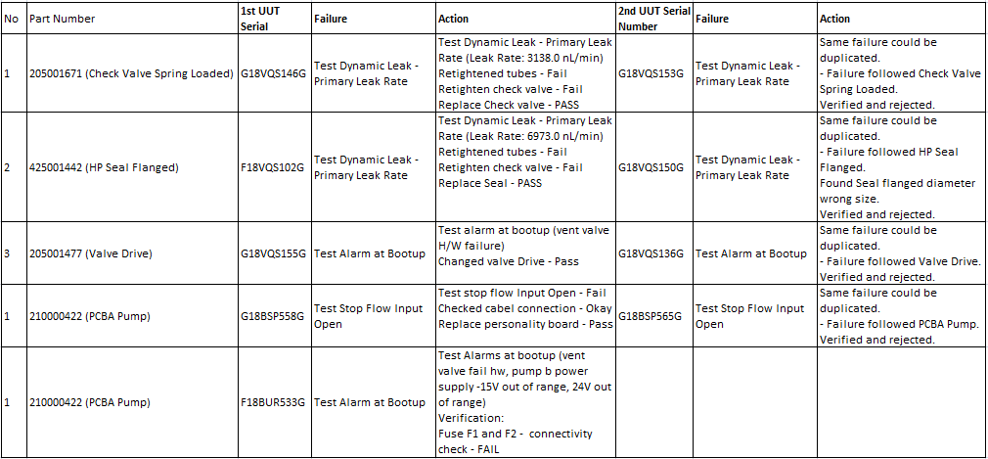
Summary of Hard Failures Verification

Slide 7
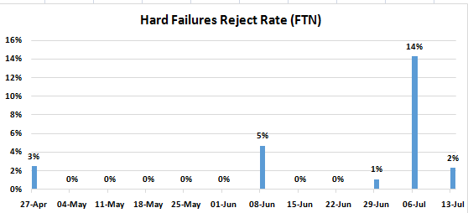

FTN

Slide 8
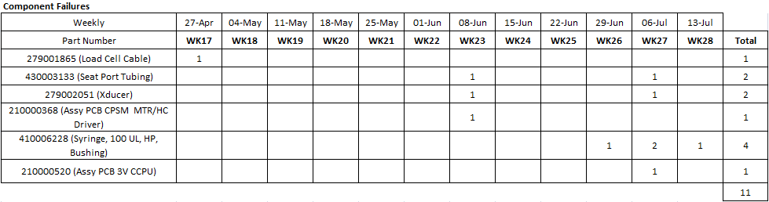
FTN
Remarks:
Metering syringe sub-assembly (Fail Functional) Failed Decay Test PN 410006228 for WK28.

Slide 9
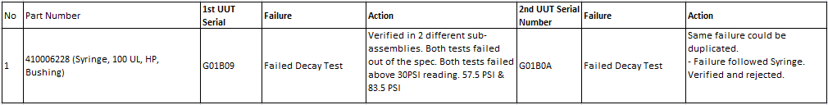
Summary of Hard Failures Verification

Slide 10
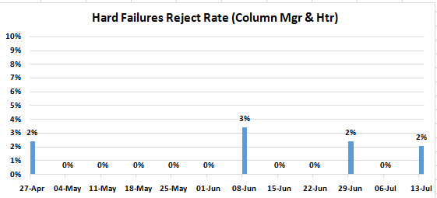

Column Mgr & Htr

Slide 11
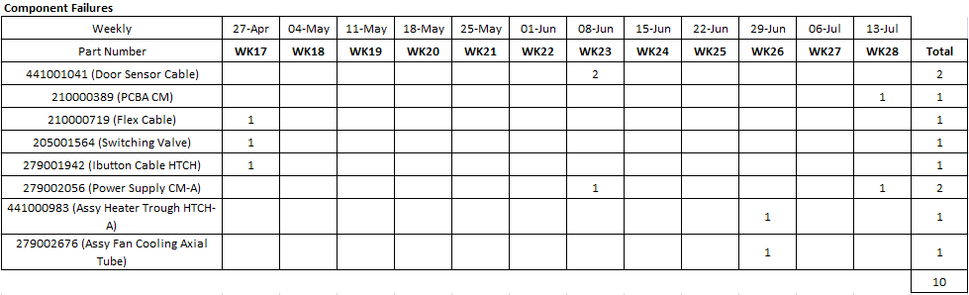
Column Mgr & Htr
Remarks:
186015043 (Fail Functional) UUT Cannot be Power On PN 279002056 for WK28.
186015008 (Fail Functional) Leak Detector Fail PN 210000389 for WK28.

Slide 12
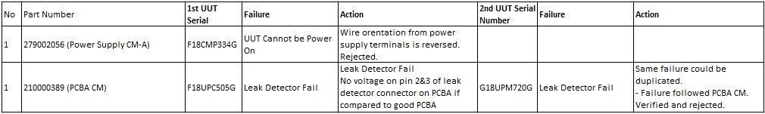
Summary of Hard Failures Verification

Slide 13
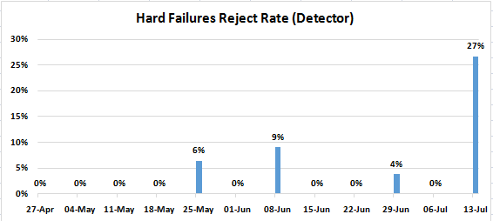

Detector

Slide 14
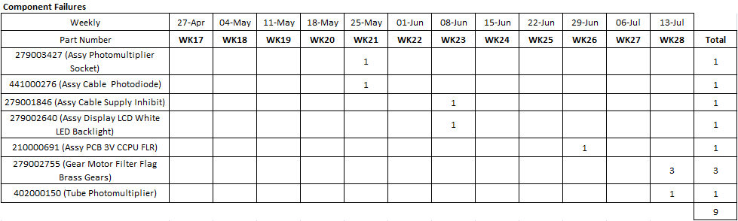
Detector
Remarks:
279003225 (Fail Functional) Filter Initialization Failure PN 279002755 X2 for WK28.
279003225 (Fail Functional) Fail Function PN 279002755 for WK28.
279001335 (Fail Functional) Fail Function PN 402000150 for WK28.

Slide 15
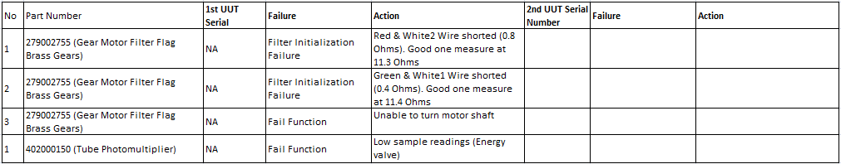
Summary of Hard Failures Verification

Slide 16
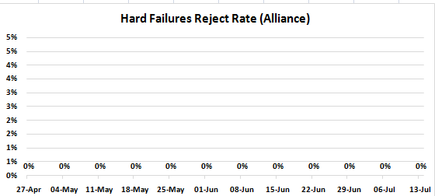

Alliance

Slide 17
Alliance
Remarks:
No parts were on the failure alert level for WK28.

