Slide 1


WPPL-GES Weekly Meeting

Slide 2
Agenda:
1. Scope of weekly review and failure alert level.
2. First Pass Yield (Hard Failures Review & FPY Trending) based on per family:
  FTN
  iBSM/QSM
  Column Mgr and Htr
  Alliance
  Detector
3. Others
  AOB

Slide 3
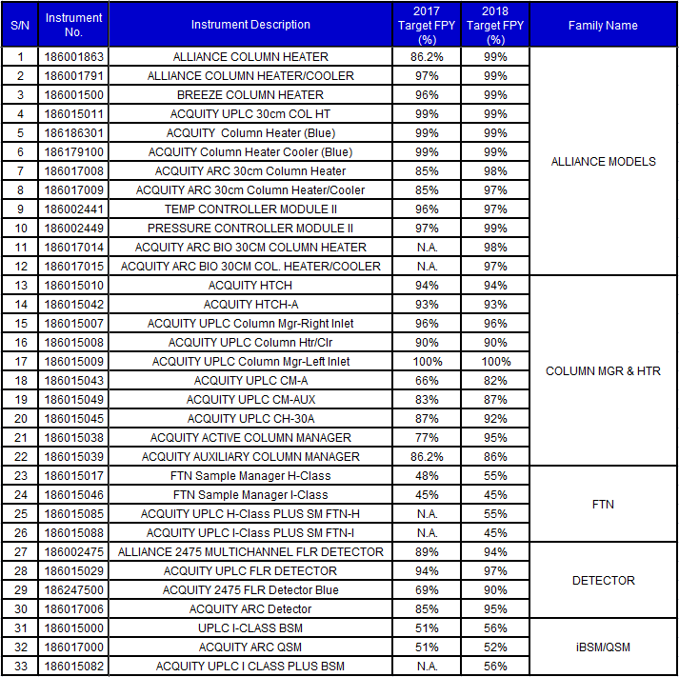
Instruments based on Family Name:

Slide 4
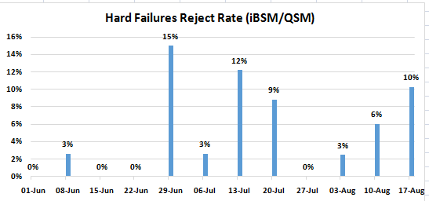

iBSM/QSM

Slide 5
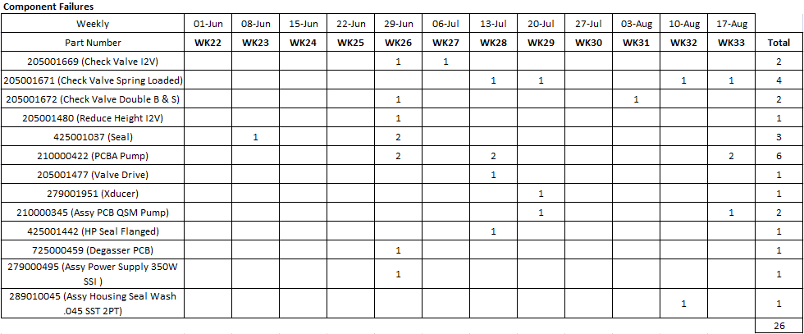
iBSM/QSM
Remarks:
186017000 (Fail Functional) Test Input D Prime with MeOH Fail PN 205001671 for WK33.
186017000 (Fail Functional) Test Alarms at Bootup PN 210000345 for WK33.
186015000 (Fail Functional) Test Alarms at Bootup PN 210000422 for WK33.
186015082 (Fail Functional) Test Alarms at Bootup PN 210000422 for WK33.

Slide 6
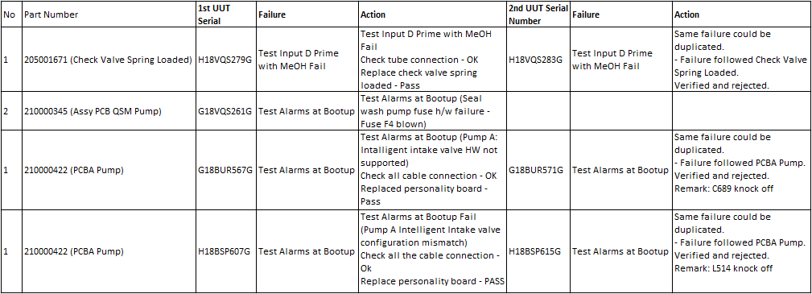
Summary of Hard Failures Verification

Slide 7
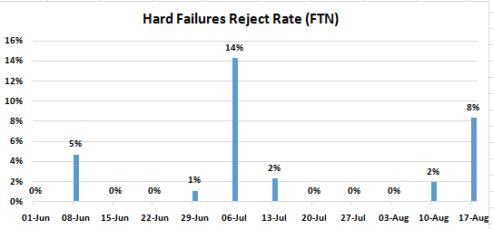

FTN

Slide 8
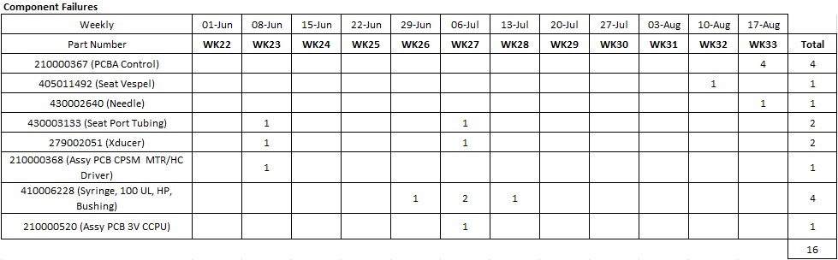
FTN
Remarks:
186015017 (Fail Functional) Dynamic Leak Test PN 430002640 for WK33.
186015017 (Fail Functional) Restart Initialization Error PN 210000367 for WK33.
186015017 (Fail Functional) R Axis Calibration Fail PN 210000367 for WK33.
186015046 (Fail Functional) Restart Initialization Error PN 210000367 X2 for WK33.

Slide 9
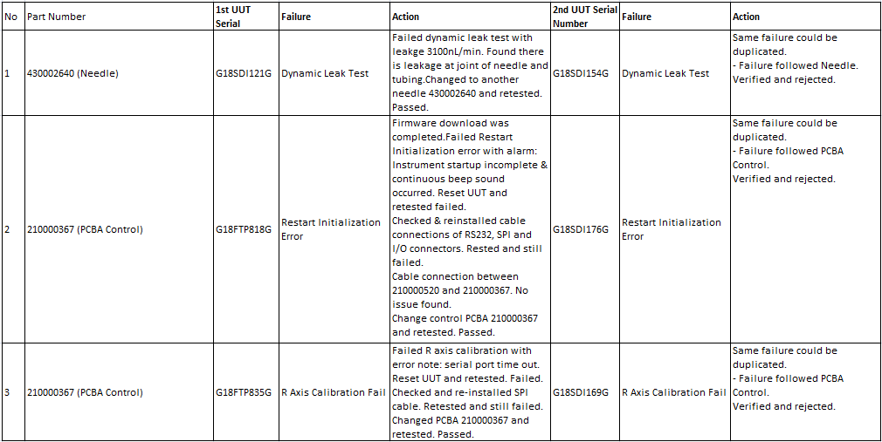
Summary of Hard Failures Verification

Slide 10
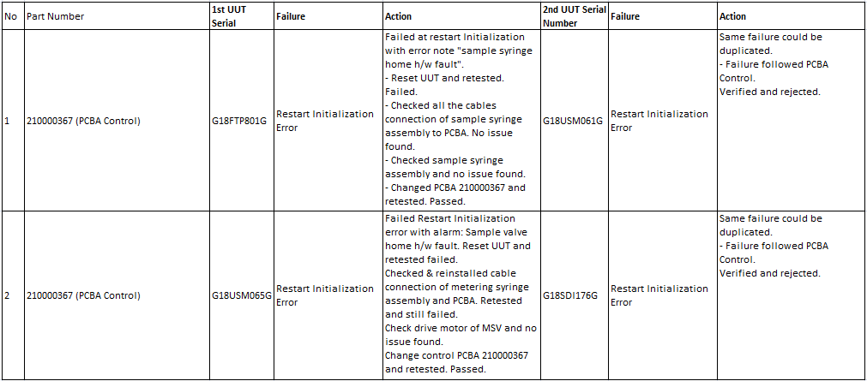
Summary of Hard Failures Verification

Slide 11
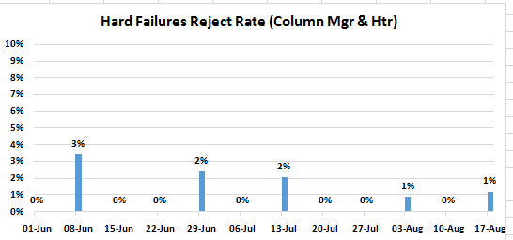

Column Mgr & Htr

Slide 12
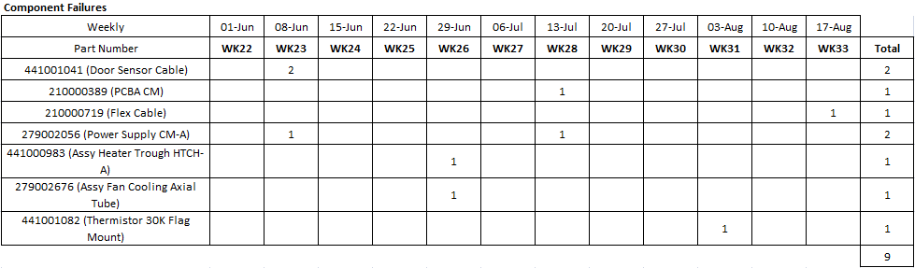
Column Mgr & Htr
Remarks:
186015042 (Fail Functional) Pre Heater Interface Test [Right] Fail PN 210000719 for WK33.

Slide 13
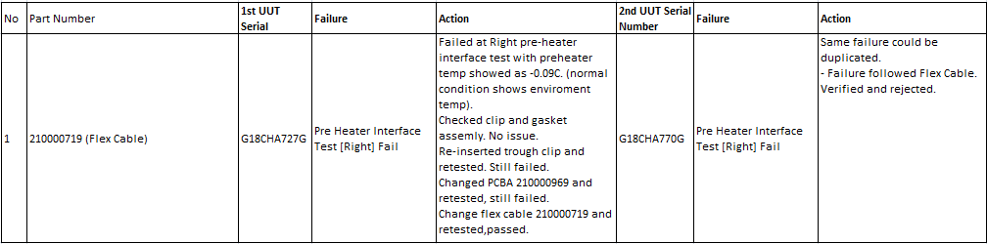
Summary of Hard Failures Verification

Slide 14
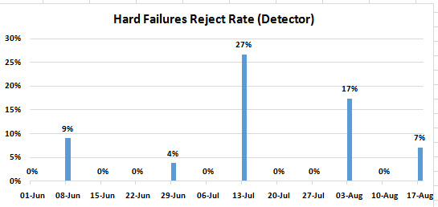

Detector

Slide 15
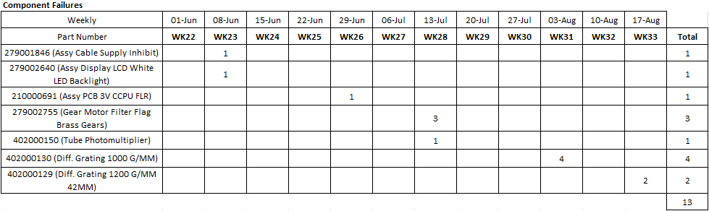
Detector
Remarks:
279001335 (Fail Functional) Fail Function PN 402000129 X2 for WK33.

Slide 16
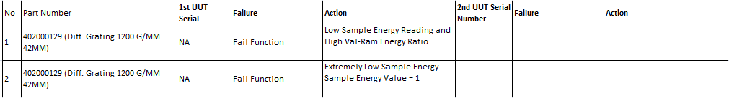
Summary of Hard Failures Verification

Slide 17
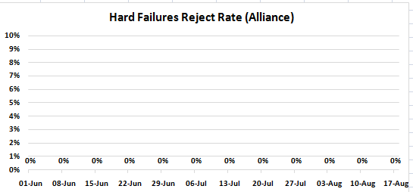

Alliance

Slide 18
Alliance
Remarks:
No parts were on the failure alert level for WK33.

