Slide 1


FTN Testers – BSM Seal Change Activity

Slide 2
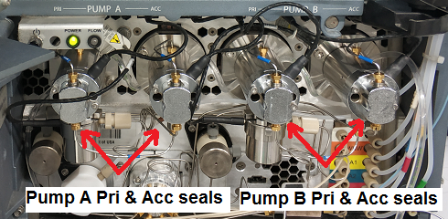
Background Information
BSM Pump seal leakage causes Dynamic Leak Test and Chemistry Test failures in FTN models, H Class and I Class functional tests.
Dynamic Leak test failure is one of the top failures in both FTN models, H Class and I Class and followed by Chemistry tests.
Purpose
To improve FPY and to reduce testers downtime.
BSM Seal Change Plan & Execution
Plan to change both pump A and pump B BSM seals after 6 months later of annual PM for all testers based on change history in 2017 and 2018.
Numbers of BSM seal change incidents and related failures were monitored after annual PM and before next change.
The plan was started in Nov 2018.

Slide 3
BSM Seal Change Incidents Review
TE10, TE11, TE12 and TE13 (before and after “6 months interval change activity” implemented on Nov-18 )
Time Interval | Number of BSM seal change (included PM) | Number of failures related to BSM seal | Total FTN units tested | % of failures related to BSM seal
Oct-17 to Oct-18 | 11 | 116 | 1760 | 6.60%
Nov-18 to May-19 | 5 | 30 | 1079 | 2.78%
TE14, TE15, TE16 and TE17 (before and after “6 months interval change activity” implemented on Jan-19 )
Time Interval | Number of BSM seal change (included PM) | Number of failures related to BSM seal | Total FTN units tested | % of failures related to BSM seal
Jan-18 to Dec-18 | 9 | 114 | 1477 | 7.71%
Jan-19 to Jun-19 | 5 | 17 | 706 | 2.40%
Based on above data comparison, it could be concluded that “regular BSM seal activity” helps to reduce Dynamic Leak Test failure (due to BSM seal) about 4%~5%.

