Slide 1


WPPL-GES Weekly Meeting

Slide 2
Agenda:
1. Scope of weekly review and failure alert level.
2. First Pass Yield (Hard Failures Review & FPY Trending) based on per family:
  FTN
  iBSM/QSM
  Column Mgr and Htr
  Alliance
  Detector
  QDA & Beacon
3. Others
  AOB
  Review of Summary Reports (if any)

Slide 3
Review Of Last QME Joint Meeting Minutes
Action Items from Previous Meeting
Description | Responsible | Due Date | Status
Spare Return: Beacon HTL PN 2890111842 (RMA No. RMA#WAT035/19) 2 x 289011842 S/N 3/023 & 3/024 ; Ref QR#2206075 & QR#2207800 failed Duty Cycle Part received on 16Aug2019 under NCR-SG190801. Updated Summary: Both Heater Coils returned Wk40 to supplier Thermocoax for FA, retested Insulation Test and No Fault Found and received on 26Nov2019. Performed insulation test on the 2 Heater Coils PN 279003868 (Serial No. U6BH/06 & U6BH/09) installed with the RTD both measured 10GΩ under 500VCC and shared last 28Nov19. Approval received on 07Jan2020 to rework the 2 RMA HTL and replace the 2 Heater Coils while the baking test will be done at WPPL since the test rig will be moved. For the 2 Heater Coils that was tested as NDF by Thermocoax, Venture to provide quotation to issue PO. NCR-SG190801 for Disposition Approval shared last 13Jan2020, pending approval. | ENG-Alan Test-MiMi QA-Martin WPPL-Sidd | 10Feb’20 | Open
Shipped 40U built of material (PN 410002253 - HINGE) from Baiteng, on 07Oct2019 under PO No. 4502413360 and reflected under SCAR-SG191101: Updated Summary: NCR-SG191001 received 18Oct2019 and awaiting for instruments to return under RMA# WAT046/19. NCR-SG191001 sent on 12Nov2019 for final approval prior shipment. Investigation Report W1INV-19-22 package shared last 07Nov2019. Signed SCAR-SG191101 sent on 06Jan2020 for RCA approval, pending for signed copy. All Corrective Actions completed and to share final copy prior approval. | QA-Martin/Dette Program-KL ENG-YT | 30Jan’20 | Open

Slide 4
Review Of Last QME Joint Meeting Minutes
Action Items from Previous Meeting
Description | Responsible | Due Date | Status
NCR-SG191105_5225 Needle Carriage (Return to Venture on 02 Dec 2019) 38pcs: Updated Summary: Initial assessment provided last 06Dec2019 and to provide the NCR for disposition approval 11Dec2019. Also, quotation already provided 03Dec2019. NCR final approval received on 23Dec19 and shipped on 27Dec2019. Flex Cables supplied by PICA checked for conformal coating in 2pcs 5225 and fresh part 210000524, results provided last 09Jan2020. The other 2pcs is still awaiting for further instructions and to issue a new NCR. Received NCR#SG200102 on 15 Jan 2020. | QA-Martin/Sheena ENG-HC Test-Lwin | 27Feb’20 | Open
FTN Conversion: Affected FTN Instruments using the below RMA#. 186015046 X 12 (RMA#WAT053/19) 186015017 X 26 (RMA#WAT054/19) Updated Summary: Total 38units to be shipped back 27Nov2019 and assessed for any damages/issues. List of FTN ECO since year 2016-present provided last 29Nov2019. TMPCN shared last 14Nov19 and TMD received on 09Dec2019 to start the conversion. 38units were shipped on 23Dec2019. Additional 1U 186015017 (built year 2016) received on 14Jan2020 and will commence conversion on WWK3, estimate to ship on WWK4. | QA-Martin ENG-HC Test-Lwin | 31Jan’20 | Open
Loan 2475 Serial# C19475751G from ADC for Tester Validation: NCR-SG200101 received 03Jan2020 under RMA#WAT001/20 and receive the unit on 07Jan2020. Updated Summary: TMD010681 v01 to cover the test validation and new test report template while NCR disposition approved on 14Jan2020, ongoing testing. | QA-Martin ENG-HC Test-MiMi | 02Apr’20 | Open

Slide 5
Review Of Last QME Joint Meeting Minutes
Action Items from Previous Meeting
Description | Responsible | Due Date | Status
KBD QDa RCA returns: Updated Summary: The affected Venture built QDa ongoing return for RCA in Wilmslow. Doc 45603 is to be updated and the Pumping Block is to be modified to make this an easier process. Pending review in Wilmslow. | QA-Martin ENG-Alan Test-MiMi | Q1’20 | Open
Assy, Cap and Cup, Part No. W1289006036-R. Dimension Out issue (MRPC): Updated Summary: 10pcs of (selected) defective parts to MRPC from the 293 pcs currently in MRB. 293 pcs in MRB agreed by MRPC to provide CN for this lot. 83 pcs sorted with 59 pcs release as GOOD (24pcs Reject). The measured out of spec from the recent 425pcs will also claim back to MRPC once completed. Internal Quality team will support to sort/measure the remaining 342 pcs (425pcs recent lot), to use micrometre to measure. 50pcs was requested by Waters Milford to measure using CMM. This activity already done, and currently tabulating and to be shared to WPPL. Result: ALL within SPEC 30pcs to 50pcs of PN 405010169 (mating part) to send to MRPC waiting for the green light from Waters Milford before proceed. Action in place in MRPC: Temporary Action: Process controls are used to bring the parts into tolerance starting with the last shipment in December. Permanent Action: The tool is going through a proper adjustment and requalification, the 1000pcs (ETA Feb’20) will be from the New Tool Qualification approval will be done by Waters Milford | QA-Dette/Suzhen ENG-HC Prog-KL | Q1’20 | Open

Slide 6
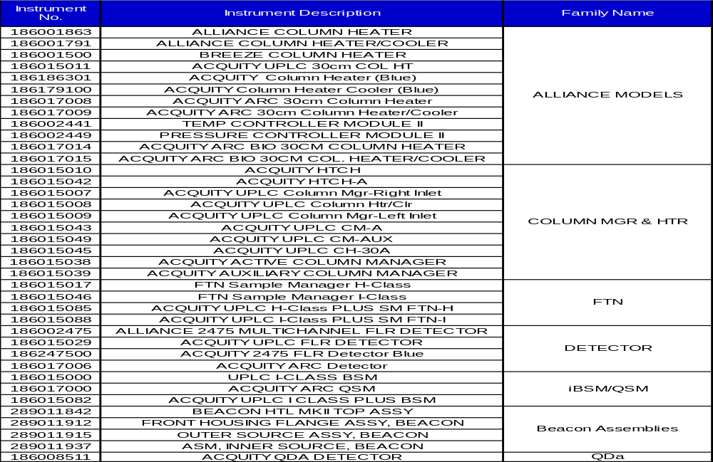
Instruments based on Family Name:

Slide 7
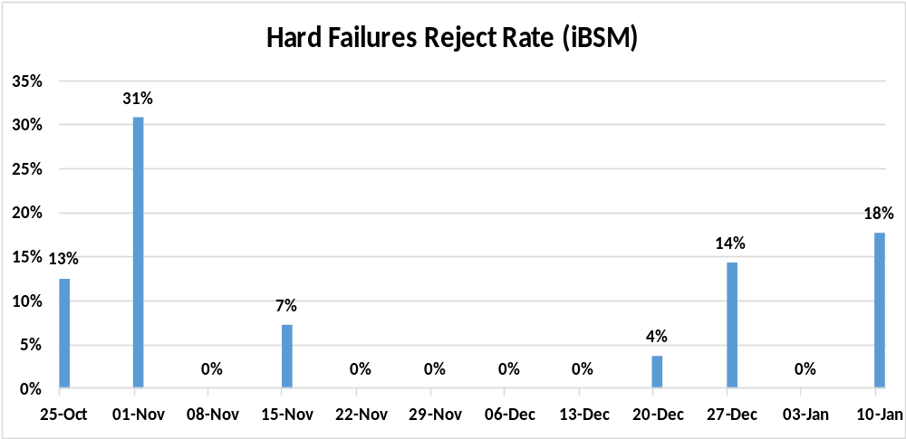
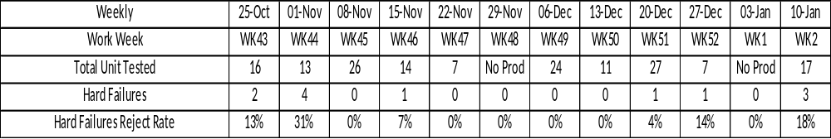
iBSM

Slide 8
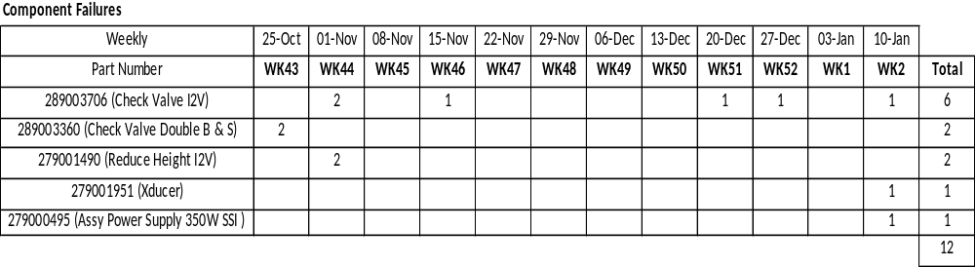
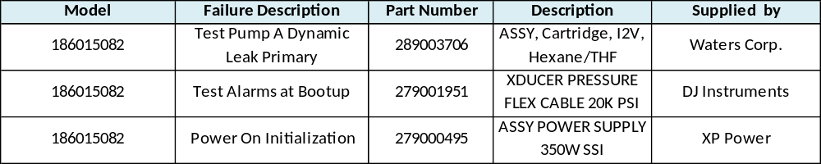
BSM

Slide 9
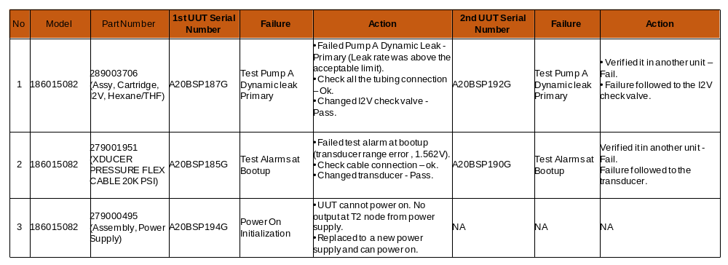
Summary of Hard Failures verification

Slide 10
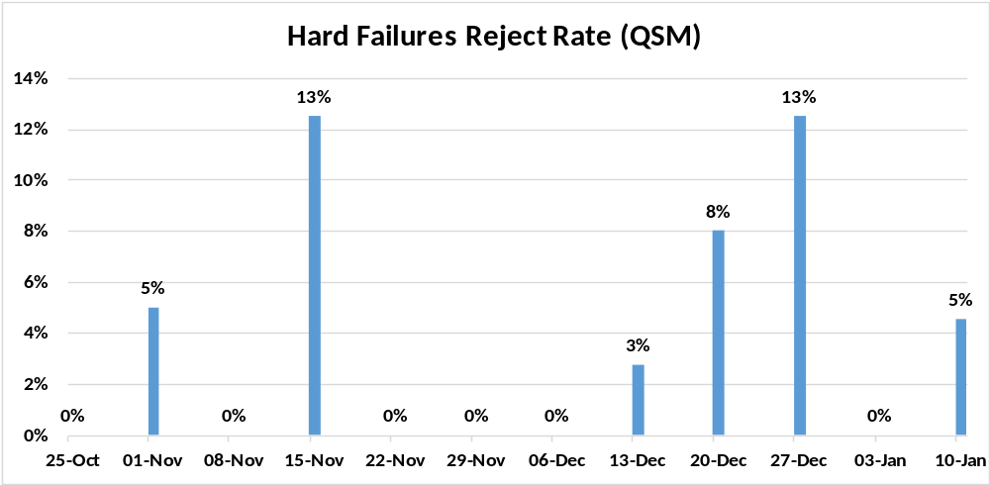
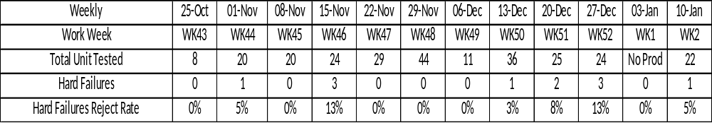
QSM

Slide 11
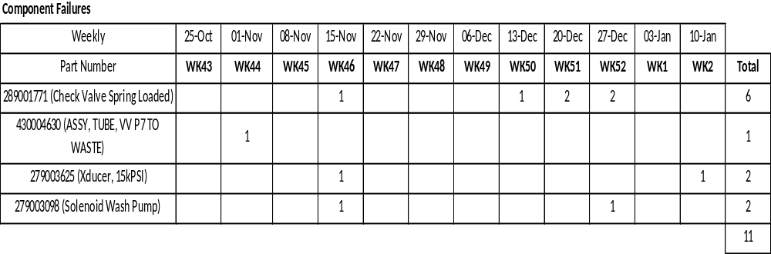
QSM

Slide 12
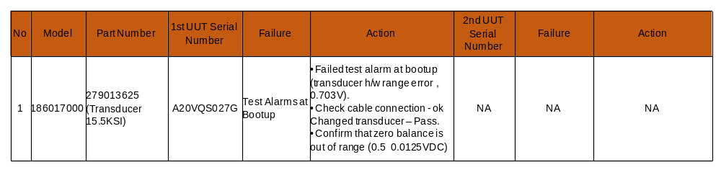
Summary of Hard Failures verification

Slide 13
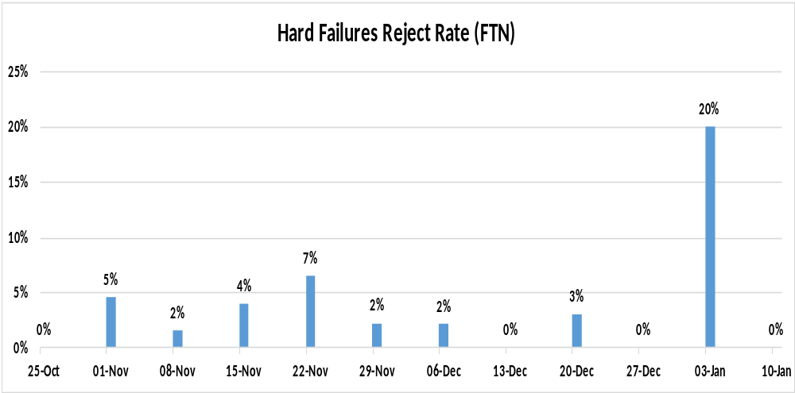
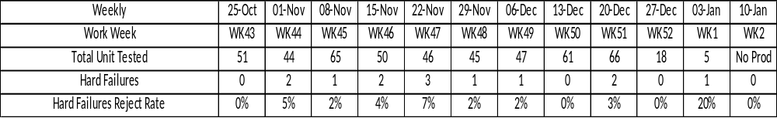
FTN

Slide 14
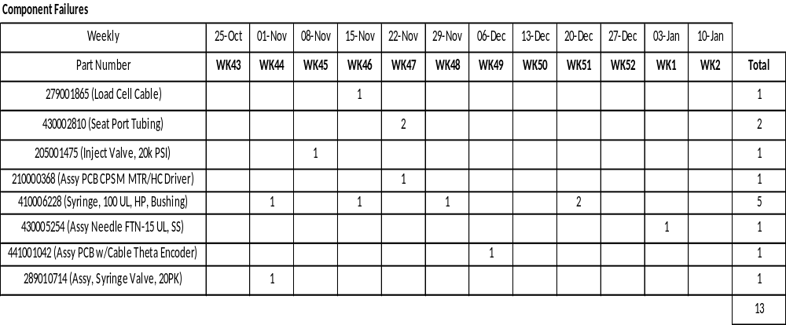
FTN
Remarks:
No production for WK02.

Slide 15
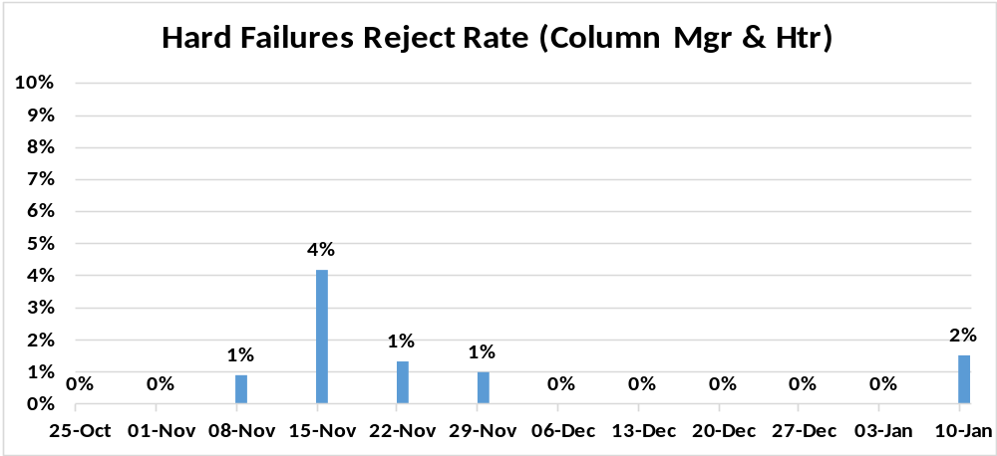
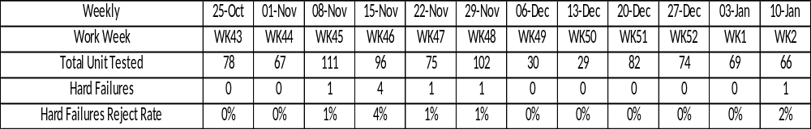
Column Mgr & Htr

Slide 16
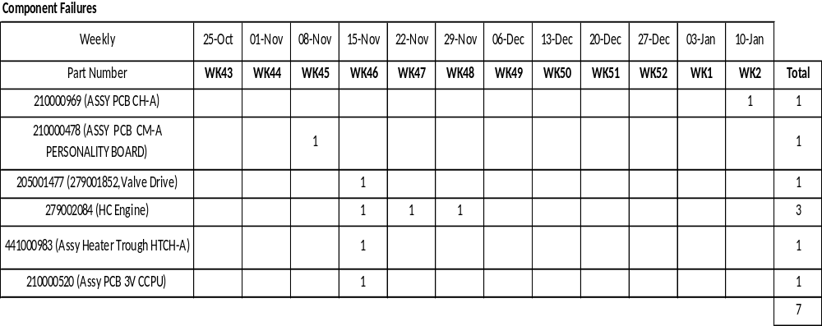
Column Mgr & Htr

Slide 17
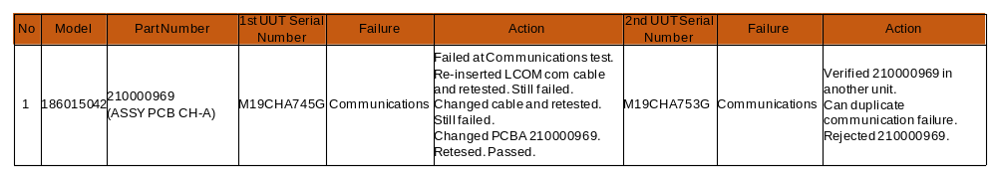
Summary of Hard Failures verification

Slide 18
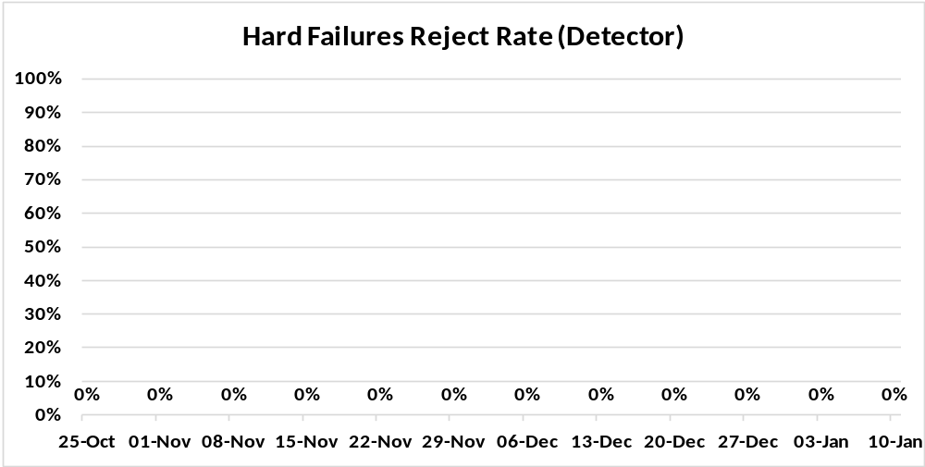
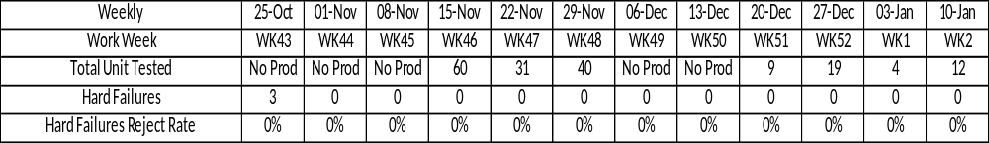
Detector

Slide 19
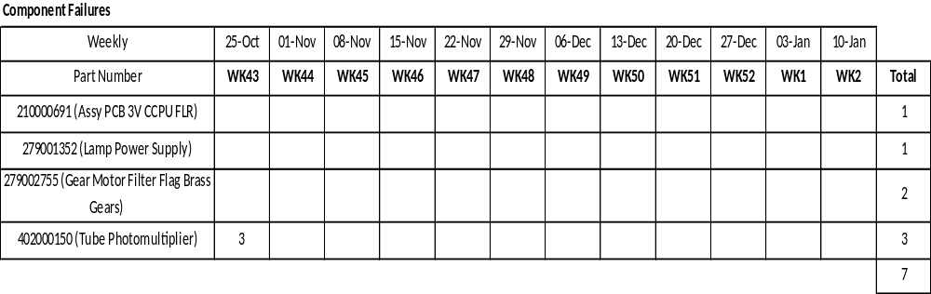
Detector
Remarks:
No part was on the failure alert level for WK02.

Slide 20
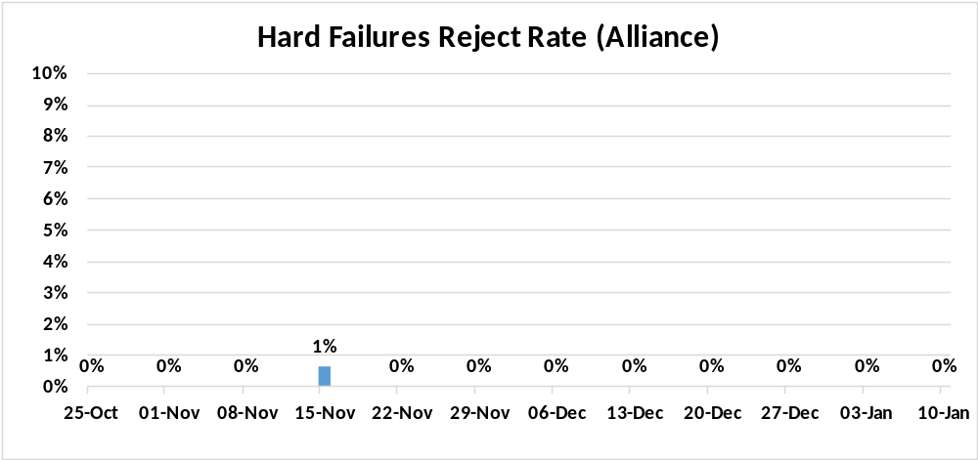
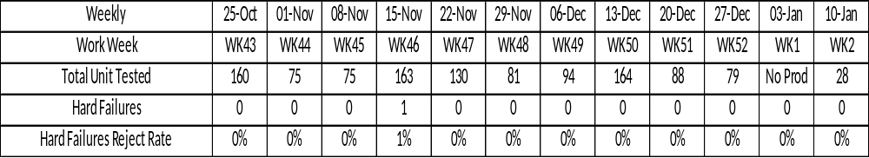
Alliance

Slide 21
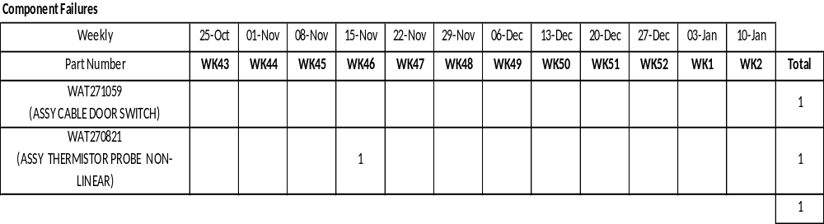
Alliance
Remarks:
No part was on the failure alert level for WK02.

Slide 22
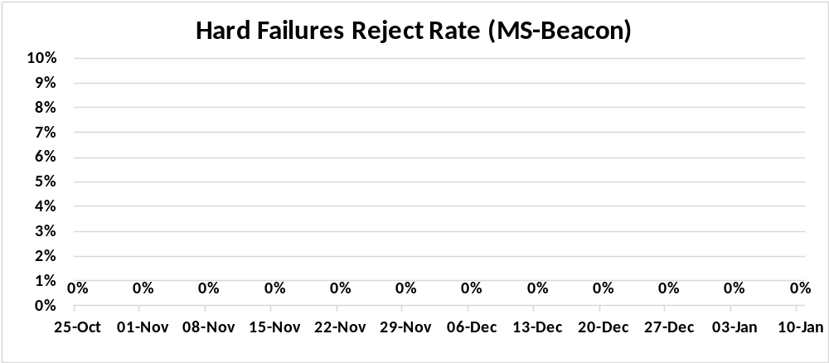
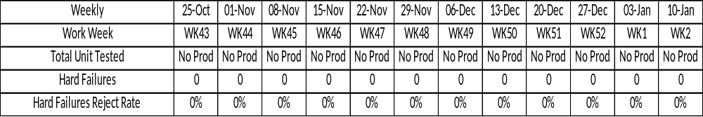
MS-Beacon

Slide 23
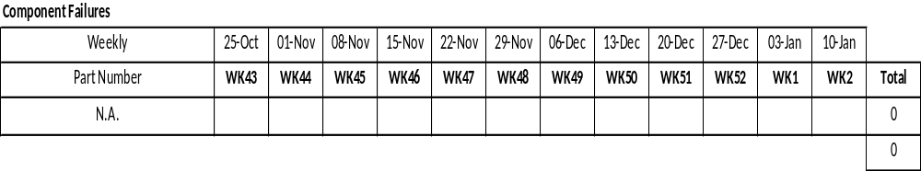
MS-Beacon
Remarks:
No production for WK02.

Slide 24
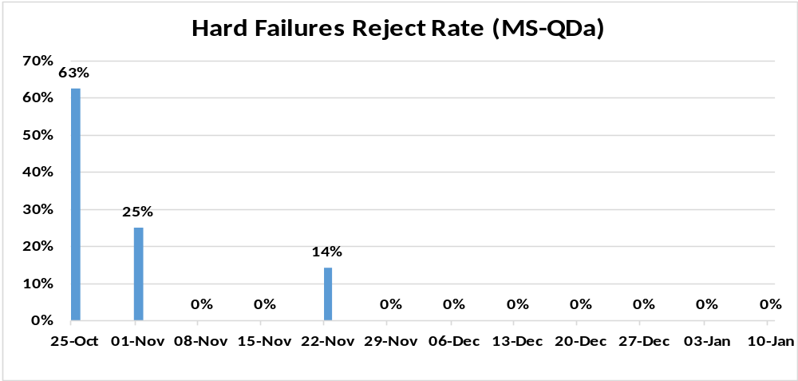
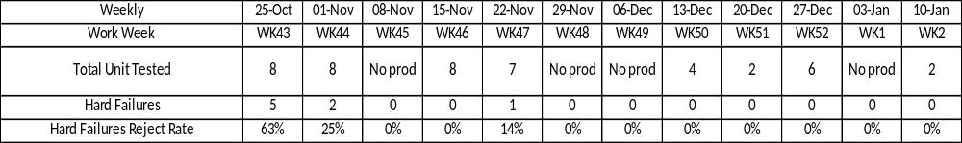
MS-QDa

Slide 25
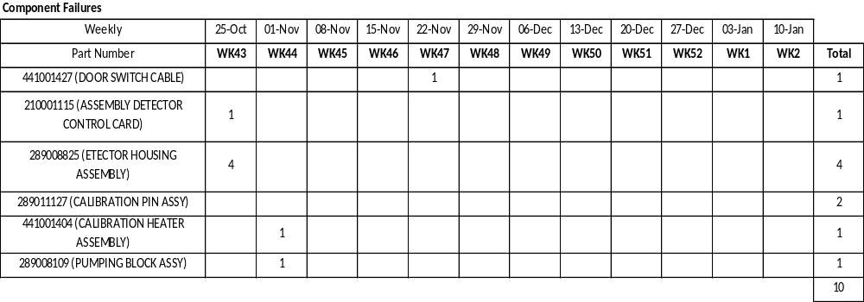
MS-QDa
Remarks:
No production for WK02.

Slide 26
End of Joint Meeting Updates for Work Week 02
Thank You.

