Slide 1


BSM Pump Seal Change Data for FTN Testers- 2017

Slide 2
BSM pump seal change records for FTN testers- 2017
Part numbers required to be changed for Pump seal leakage are
1) WAT076152 (CRC O-ring 2.016)
2) W1425000930-R (Seal Wash .0787 ID)
3) W1425001037-R (Seal Wash Press Dual Supply)

Slide 3
BSM pump seal change vs Qty tested for individual tester -2017
 | Jan | Feb | Mar | Apr | May | Jun | Jul | Aug | Sep | Oct | Nov | Dec
TE10 | 15 | 40 | 65 | 90 | 126 | 144 | 175 | 200 | 229 | 257 | 282 | 339
 |  |  | 65 |  |  |  | 110
TE11 | 29 | 44 | 67 | 96 | 130 | 160 | 190 | 217 | 246 | 269 | 293 | 352
 |  | 44 | 23 |  |  | 93 | 30
TE12 | 24 | 50 | 78 | 109 | 142 | 171 | 207 | 243 | 271 | 279 | 279 | 298
 |  |  | 78
TE13 | 28 | 54 | 80 | 108 | 141 | 172 | 206 | 234 | 252 | 267 | 295 | 351
 |  | 54 |  |  | 141 |  |  | 180
TE14 | 8 | 25 | 50 | 86 | 119 | 148 | 180 | 212 | 241 | 272 | 296 | 328
 |  |  |  | 86 |  |  | 94 |  |  | 92
 |  |  |  |  |  |  |  |  |  | 272
TE15 | 14 | 36 | 57 | 71 | 95 | 117 | 138 | 164 | 188 | 218 | 238 | 268
 |  |  |  |  |  | 117 | 21
TE16 | 10 | 34 | 62 | 101 | 137 | 167 | 201 | 236 | 259 | 292 | 320 | 361
 |  | 34 | 62 |  |  |  |  | 174 | 23
TE17 | 25 | 48 | 52 | 72 | 97 | 120 | 141 | 159 | 178 | 207 | 228 | 269
 |  |  | 52 |  | 45 |  |  | 62 |  |  | 228
 | Pump A seal change regardless of primary or accumular
 | Pump B seal change regardless of primary or accumular
 | Annual Seal Change
 | Tested Qty different between previous change and current change

Slide 4
BSM pump seal change records for FTN testers- 2017
Month -2017 | TE10 | TE11 | TE12 | TE13 | TE14 | TE15 | TE16 | TE17
Jan |  |  |  |  | ü | ü | ü | ü
Feb |  | ü |  | ü |  |  | ü
 |  | ü
Mar | ü | ü | ü |  |  |  | ü | ü
 | ü | ü | ü |  |  |  |  | ü
Apr |  |  |  |  | ü
May |  |  |  | ü |  |  |  | ü
Jun |  | ü |  |  |  | ü
Jul | ü | ü |  |  | ü | ü
Aug |  |  |  | ü |  |  | ü | ü
Sep |  |  |  |  |  |  | ü
Oct | ü | ü | ü | ü | ü
 |  |  |  |  | ü
Nov |  |  |  |  |  |  |  | ü
Dec
Total frequency of change | 3 | 5 | 2 | 4 | 4 | 3 | 5 | 5
 | Jan | Feb | Mar | Apr | May | Jun | Jul | Aug | Sep | Oct | Nov | Dec
Pump A -Accumulator | TE14,TE15 | TE13 |  |  |  |  |  | TE13 |  | TE10,11,12,13,14 | TE17 | TE16,TE17
Pump A -Primary | TE14,TE15 | TE16 |  |  |  |  |  |  |  | TE10,11,12,13 |  | TE16,TE17
Pump B -Accumulator | TE14,TE15 | TE11 | TE10,11,12,16,17 |  |  |  | TE10,11,14,15 | TE16,17 |  | TE10,11,12,13,14 |  | TE16,TE17
Pump B -Primary | TE14,TE15 | TE11 | TE10,11,12,17 | TE14 | TE13,17 | TE11,15 |  |  | TE16 | TE10,11,12,13 |  | TE16,TE17
- Performed PM for TE16 & 17 in end of Dec 2016 (but record as Jan 2017 for presentation purpose). TE14 & TE15 are performed PM in Jan-2017.
- Performed PM for TE10,11,12 & 13 in Oct-2017. - Annual PM presents as

Slide 5
Tested units contribution among FTN testers- 2017
Month -2017 | TE10 | TE11 | TE12 | TE13 | TE14 | TE15 | TE16 | TE17
Jan | 15 | 29 | 24 | 28 | 8 | 14 | 10 | 25
Feb | 25 | 15 | 26 | 26 | 17 | 22 | 24 | 23
Mar | 25 | 23 | 28 | 26 | 25 | 21 | 28 | 4
Apr | 25 | 29 | 31 | 28 | 36 | 14 | 39 | 20
May | 36 | 34 | 33 | 33 | 33 | 24 | 36 | 25
Jun | 18 | 30 | 29 | 31 | 29 | 22 | 30 | 23
Jul | 31 | 30 | 36 | 34 | 32 | 21 | 34 | 21
Aug | 25 | 27 | 36 | 28 | 32 | 26 | 35 | 18
Sep | 29 | 29 | 28 | 18 | 29 | 24 | 23 | 19
Oct | 28 | 23 | 8 | 15 | 31 | 30 | 33 | 29
Nov | 25 | 24 | 0 | 28 | 24 | 20 | 28 | 21
Dec | 57 | 59 | 19 | 56 | 32 | 30 | 41 | 41
Total Unit tested | 339 | 352 | 298 | 351 | 328 | 268 | 361 | 269

Slide 6
BSM Pump Seal record for FTN testers- 2018

Slide 7
BSM pump seal change records for FTN testers- 2018
Month -2018 | TE10 | TE11 | TE12 | TE13 | TE14 | TE15 | TE16 | TE17
Jan |  |  |  |  | ü | ü | ü | ü
Feb
Mar | ü
Apr |  |  |  |  |  |  | ü
May
Jun
Jul |  |  |  | ü |  |  | ü
 |  |  |  | ü |  |  | ü
Aug |  | ✓
Sep |  |  |  |  |  |  |  | ü
Oct | ü | ü | ü | ü |  | ü
Nov
Dec |  |  |  |  |  |  | ü
Total frequency of change | 2 | 2 | 1 | 2 | 1 | 2 | 4 | 2
Presents annual PM.
 | Jan | Feb | Mar | Apr | May | Jun | Jul | Aug | Sep | Oct
Pump A -Accumulator |  |  |  | TE16 |  |  |  |  |  | TE10,11,12, 13
Pump A -Primary |  |  |  |  |  |  |  |  |  | TE10,11,12, 13
Pump B -Accumulator |  |  |  |  |  |  | TE16 |  |  | TE10,11,12, 13
Pump B -Primary |  |  | TE10 |  |  |  | TE16 | TE11 | TE17 | TE10,11,12, 13,15

Slide 8
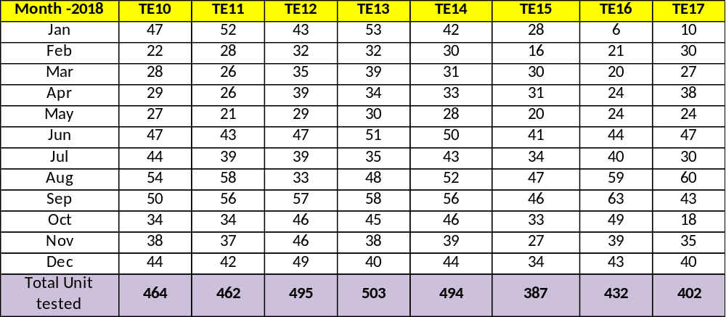
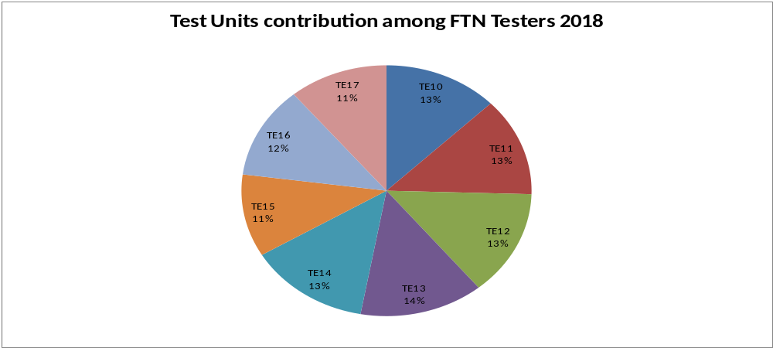
Tested units contribution among FTN testers- 2018

Slide 9
BSM seal change incidents & related failures
TE10, TE11, TE12 and TE13 (6 months interval)
Time Interval | Number of BSM seal change (included PM) | Number of failures related to BSM seal | Total FTN units tested | % of failures related to BSM seal
Oct-17 to Mar-18 | 5 | 51 | 775 | 6.6%
Apr-18 to Oct-18 | 6 | 65 | 985 | 6.6%
TE14, TE15, TE16 and TE17 ( 6 months & monthly)
Time Interval | Number of BSM seal change (included PM) | Number of failures related to BSM seal | Total FTN units tested | % of failures related to BSM seal
Oct-17 to Mar-18 | 6 | 81 | 643 | 12.6%
Apr-18 to Oct-18 | 5 | 90 | 1102 | 8.1%
Nov 18 | 0 | 3 | 140 | 2.1%
Dec 18 | 4 | 17 | 155 | 10.9%

Slide 10
BSM seal change incidents & related failures – monthly
TE10, TE11, TE12 and TE13
Time Interval | Number of BSM seal change (After PM, ad-hoc) | Number of failures related to BSM seal | Total FTN unit tested | % of failures related to BSM seal
Oct 18 | 0 | 7 | 157 | 4.5%
Nov 18 | 0 | 6 | 159 | 3.7%
Dec 18 | 0 | 4 | 169 | 2.3%
Jan 19 | 1* | 4 | 122 | 3.3%
Feb 19 | 0 | 1 | 128 | 0.7%
Mar 19 | 0 | 3 | 78 | 3.8 %
Apr 19 | 0 | 2 | 119 | 1.6%
May 19 | 0 | 3 | 147 | 2.0%
Jun 19
July 19
Aug 19
Sep 19
Oct 19
* Incident on TE10, actual leakage root cause was BSM vent valve (which is not part of PM). BSM seals were changed due to troubleshooting process.

Slide 11
BSM seal change incidents & related failures – monthly
TE14, TE15, TE16 and TE17
Time Interval | Number of BSM seal change (After PM, ad-hoc) | Number of failures related to BSM seal | Total FTN unit tested | % of failures related to BSM seal
Jan 19 | 0 | 4 | 101 | 3.9%
Feb 19 | 0 | 2 | 142 | 1.4%
Mar 19 | 0 | 2 | 80 | 2.5%
Apr 19 | 0 | 3 | 125 | 2.4%
May19 | 1 (TE17) | 2 | 144 | 1.38%
Jun19
July 19
Aug 19
Sep 19
Oct 19
Nov 19
Dec 19
* Incident on TE17, required to change pump A Acc & pump B Acc at the end of May 19.

Slide 12
BSM seal change plan – TE 10 to TE 17
Tester ID | Plan Date | Remark
TE13 | 25-Apr-19 | Change completed
TE12 | 25-Apr-19 | Change completed
TE11 | 26-Apr-19 | Change completed
TE10 | 26-Apr-19 | Change completed
Tester ID | Plan Date | Remark
TE17 | June-19 | Change completed
TE16 | June-19 | Changing in progress
TE15 | June-19 | Change completed
TE14 | June-19 | Change completed

Slide 13
BSM Seal Change Incidents Comparison
TE10, TE11, TE12 and TE13 (before and after “6 months interval change evaluation” implemented on Nov-18 )
Time Interval | Number of BSM seal change (included PM) | Number of failures related to BSM seal | Total FTN units tested | % of failures related to BSM seal
Oct-17 to Oct-18 | 11 | 116 | 1760 | 6.60%
Nov-18 to May-19 | 5 | 30 | 1079 | 2.78%
TE14, TE15, TE16 and TE17 (before and after “6 months interval change evaluation” implemented on Nov-18 )
Time Interval | Number of BSM seal change (included PM) | Number of failures related to BSM seal | Total FTN units tested | % of failures related to BSM seal
Jan-18 to Dec-18 | 9 | 114 | 1477 | 7.71%
Jan-19 to May-19 | 5 | 13 | 592 | 2.20%
Based on above data comparison, it could be concluded that “regular BSM seal activity” helps to reduce Dynamic Leak Test failure (due to BSM seal) about 4%~5%.

Slide 14
Improvement & Regular Tester care on FTN testers in 2018
Reduced numbers of system over pressure
In end of Sep 2017, Waters released new software version 1.41. One of the known changes was that the priming flow path of Dynamic Leak test was changed to “bypass & waste” routes of Column Manager accordingly instead of routing through column 2 & 4 of Column Manager.
In 2018, we are seeing reduced numbers of system over pressure due to column 4 blockage. Therefore, it is one of the factors that helps to reduce BSM seal wear & tear.
No. of Column 4 changes including PM
Tester ID | 2017 | 2018 | Remark
TE10 | 8 | 0 | -
TE11 | 6 | 0 | Column Evaluation in 2017
TE12 | 6 | 0 | Column Evaluation in 2017
TE13 | 3 | 2 | -
TE14 | 2 | 2 | -
TE15 | 4 | 1 | -
TE16 | 2 | 1 | -
TE17 | 6 | 1 | Column Evaluation in 2017
Regular System Priming
Weekly system, work order based BSM priming with solvent lines A1 & B1 for 3 mins plus seal wash priming.
Daily system priming through Column 4, Column 2, Bypass and Waste.
It could be conclude that above items are also helping to reduce BSM seal ware and tear of FTN testers.

Slide 15
Seal change frequency setting plan – 2019 proposal

Slide 16
Review BSM seal change plan - 2019
Numbers of seal change from PM 2017 to PM 2018, included PM change
Tester ID | Pump A, Primary | Pump A, Accumulator | Pump B, Primary | Pump B, Accumulator
TE10 | 2 | 2 | 3 | 2
TE11 | 2 | 2 | 3 | 2
TE12 | 2 | 2 | 2 | 2
TE13 | 2 | 3 | 3 | 2
TE 10
Total 3x seal changed from 2107 PM to 2018 PM
- 1x all changed in PM 2017
- 1x pump B primary in Mar 2018
- 1x all changed in PM 2018
Required to change after 6 months of 2017 PM
TE 11
Total 3x seal changed from 2107 PM to 2018 PM
- 1x all changed in PM 2017
- 1x pump B primary in Aug 2018
- 1x all changed in PM 2018
Required to change after 10 months of 2017 PM
TE 12
Total 2x seal changed from 2107 PM to 2018 PM
- 1x all changed in PM 2017
- 1x all changed in PM 2018
Required to change at next PM, 2018
TE 13
Total 3x seal changed from 2107 PM to 2018 PM
- 1x all changed in PM 2017
- 1x pump B & pump A accumulator primary
in July 2018
- 1x all changed in PM 2018
Required to change after 9 months of 2017 PM

Slide 17
BSM Pump Seal Change Data for FTN Testers- 2017

Slide 18
Failure vs. Tester pump seal change analysis for individual Tester- 2017
Failure types generally considered for FTN tester’s pump seal change analysis are ..
Dynamic Leak Test
Preblank Injections Test
Carryover Test
Chemistry Precision Area
Chemistry Precision Height
Chemistry X-Intercept
Chemistry Linearity
Note: Failures due to
Loose/Leak fittings
Communication failure
Column Error
Empower error are not included in the consideration.

Slide 19
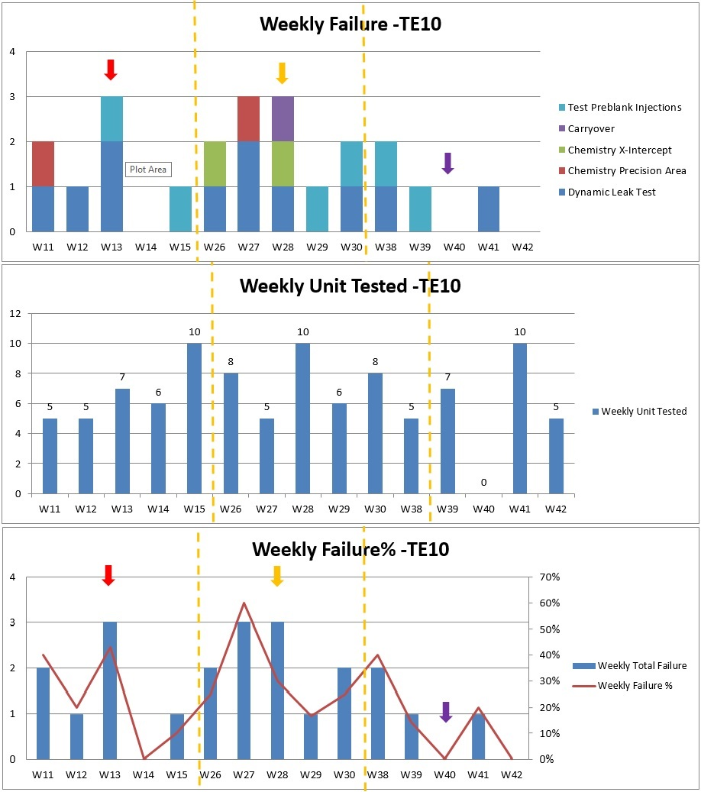
TE10
30-Mar-17 (Wk 13), Changed
Pump B –Accumulator & Primary seals.
10-July-17 (Wk 28), Changed
Pump B –Accumulator seal.
04-Oct-17 (Wk 40), Performed PM.
Observed that the failures reduced comparison between the weeks after changing the seals and the weeks before change & the week that changed.
Failures before & after 2 week intervals of seal change are reviewed.

Slide 20
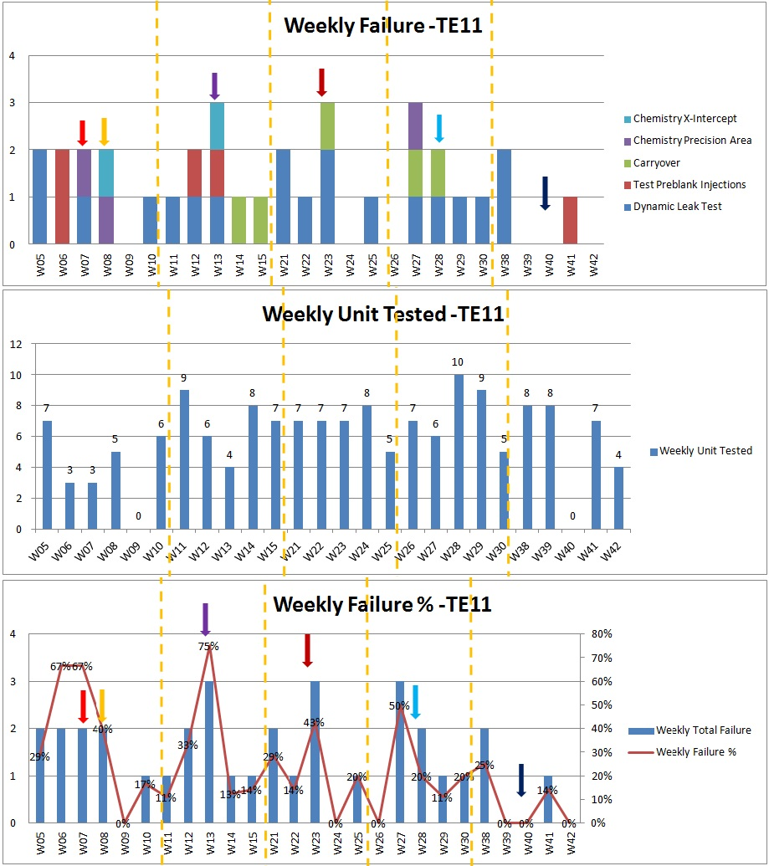
TE11
17-Feb-17 (Wk 07) - Changed
Pump B –Accumulator seal.
20-Feb-17 (Wk 08) - Changed
Pump B –Primary seal.
30-Mar-17 (Wk 13) - Changed
Pump B –Accumulator & Primary seals.
07-June-17 (Wk 23) - Changed
Pump B –Primary seal.
10-July-17 (Wk 28) - Changed
Pump B –Accumulator seal.
03-Oct-17 (Wk 28) – Performed PM.
- Observed that the failures reduced comparison between the weeks after changing the seals and the weeks before change & the week that changed.
Failures before & after 2 week intervals of seal change are reviewed.

Slide 21
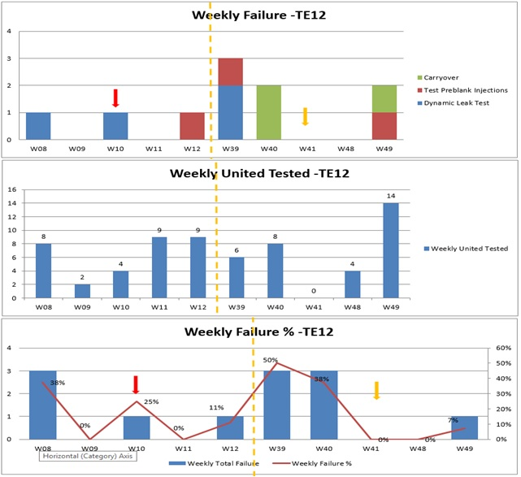
TE12
9-Mar-17 (Wk 10) - Changed
Pump B –Accumulator & Primary seals.
10-Oct-17 (Wk 41) – Performed PM.
Observed that the failures reduced comparison between the weeks after changing the seals and the weeks before change & the week that changed.
TE 12 completed PM & resumed testing on WK48 due to Detector unit.
Failures before & after 2 week intervals of seal change are reviewed.

Slide 22
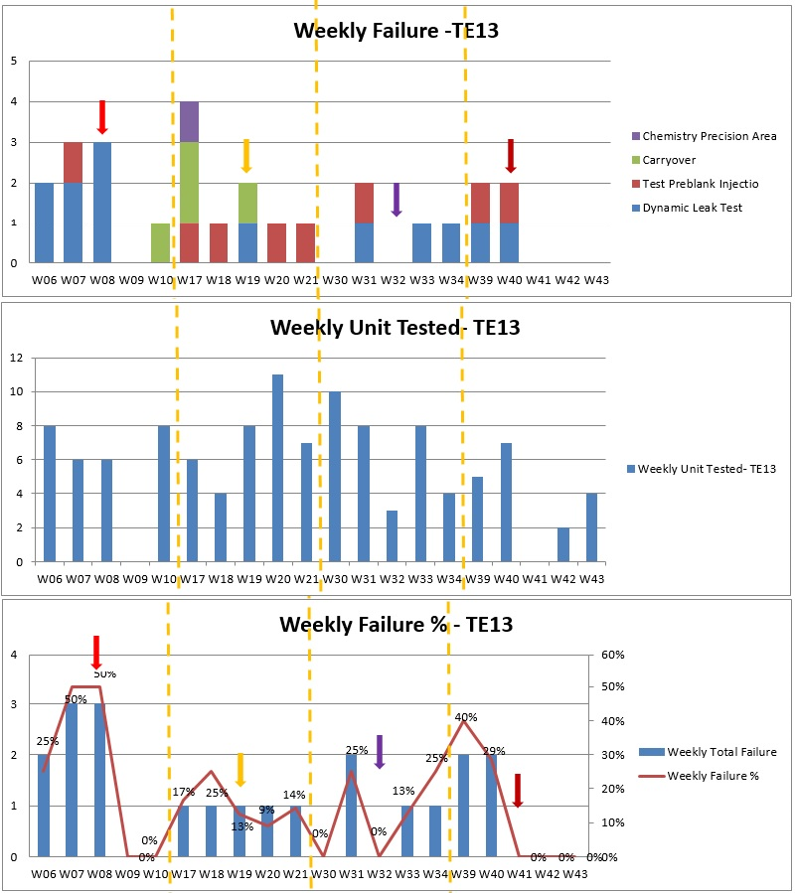
TE13
22-Feb-17 (Wk 8) - Changed
Pump A –Accumulator seal.
08-May-17 (Wk 19) – Changed
Pump B –Primary seal.
10-Aug-17 (Wk 32) – Changed
Pump A –Accumulator seal.
12-Oct-17 (Wk 41) – Performed PM.
- Observed that the failures reduced comparison between the weeks after changing the seals and the weeks before change & the week that changed.
Failures before & after 2 week intervals of seal change are reviewed.

Slide 23
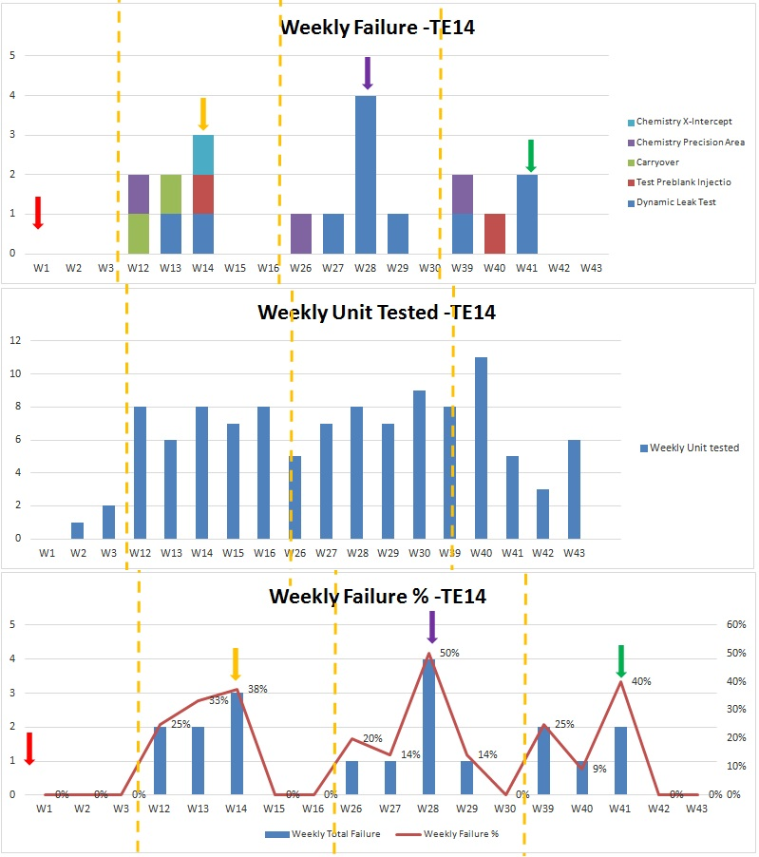
TE14
04-Jan-17 (Wk 1) - Performed PM.
03-Apr-17 (Wk 14) – Changed
Pump B –Primary seal.
10-July-17 (Wk 28) – Changed
Pump B - Accumulator seal.
12-Oct-17 (Wk 41) – Changed Pump A - Accumulator seal.
- Observed that the failures reduced comparison between the weeks after changing the seals and the weeks before change & the week that changed.
Failures before & after 2 week intervals of seal change are reviewed.

Slide 24
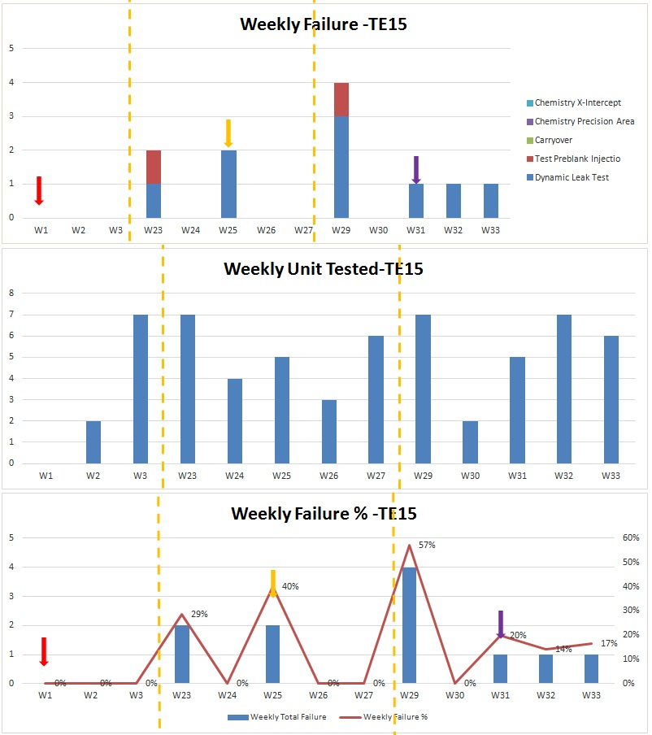
TE15
04-Jan-17 (Wk 1) - Performed PM.
19-Jun-17 (Wk 25) – Changed
Pump B –Primary seal.
31-July-17 (Wk 31) – Changed
Pump B - Accumulator seal.
- Observed that the failures reduced comparison between the weeks after changing the seals and the weeks before change & the week that changed.
Failures before & after 2 week intervals of seal change are reviewed.

Slide 25
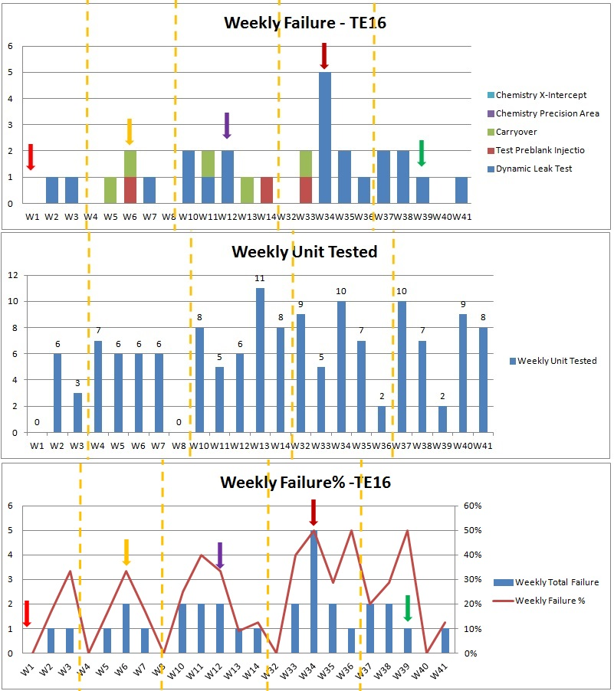
TE16
29-Dec-17 - Performed PM.
07-Feb-17 (Wk 6) – Changed
Pump A –Primary seal.
24-Mar-17 (Wk 12) – Changed
Pump B - Accumulator seal.
21-Aug-17 (Wk 34) – Changed
Pump B - Accumulator seal.
28-Sep-17 (Wk 39) – Changed
Pump B - Accumulator seal
- Observed that the failures reduced comparison between the weeks after changing the seals and the weeks before change & the week that changed.
Failures before & after 2 week intervals of seal change are reviewed.

Slide 26
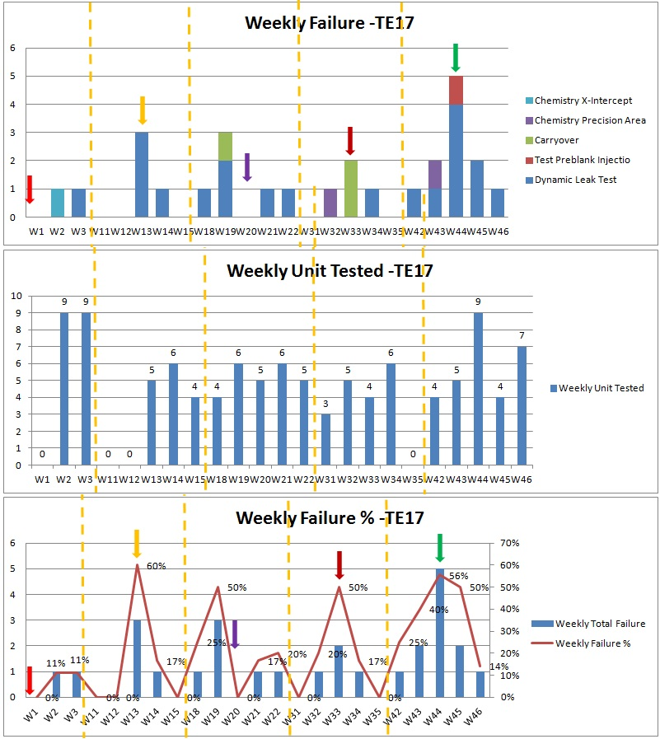
TE17
30-Dec-17 - Performed PM.
07-Feb-17 (Wk 6) – Changed
Pump A –Primary seal.
24-Mar-17 (Wk 12) – Changed
Pump B - Accumulator seal.
21-Aug-17 (Wk 34) – Changed
Pump B - Accumulator seal.
28-Sep-17 (Wk 39) – Changed
Pump B - Accumulator seal
- Observed that the failures reduced comparison between the weeks after changing the seals and the weeks before change & the week that changed.
Failures before & after 2 week intervals of seal change are reviewed.

