Slide 1
PIM Investigation Review Meeting
Bill Wildman
27 June 2018

Slide 2
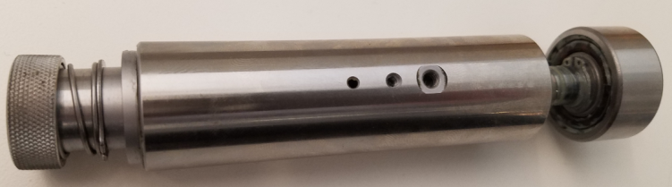
Meeting Agenda
Review current Major Investigations
  QSPI degasser boards
  Actuator
    Broken springs
    Rusty bearings
  SS Solvent filters & rust spots
Review Action Items
Review current and new issues - updates and latest

Slide 3
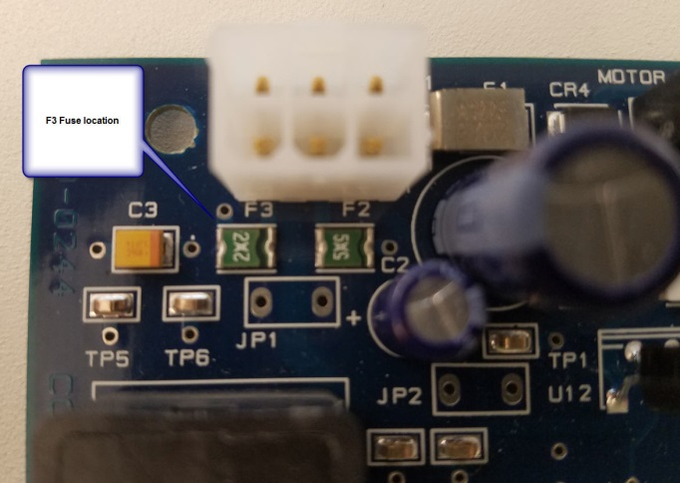
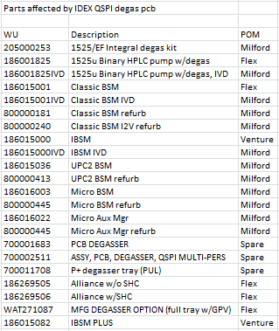
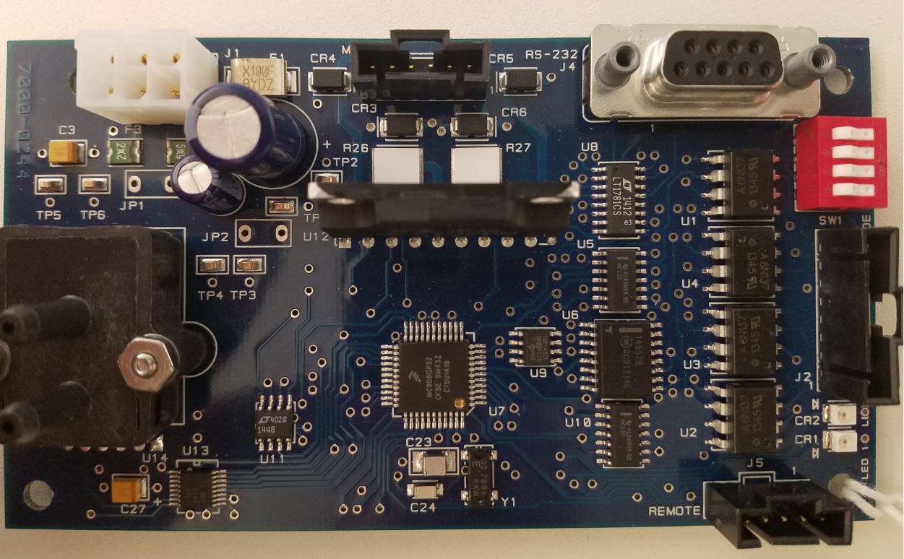
QSPI Degas PCB Issue
Potentially affected products

Slide 4
QSPI Degas PCB Issue
Became aware of issue 22 May 2018 (10 work days ago)
  Multi-functional team formed.
  One Lot code (#5017) affected
    1,207 pcb’s
Potentially affects 22 products
  Classic, I-Class, UPC2, M-Class, Alliance and 1525u.
  3 separate IVD products
Reported symptom – Failure of the degasser pump to start
  Intermittent failure
  Total of 23 instances in Flex mfg (none at Venture or Milford)
Failure symptom: Degasser motor fails to turn.
Actions: Monitor SU and early warranty failures (none to date for this symptom)
  Create Service Alert.

Slide 5
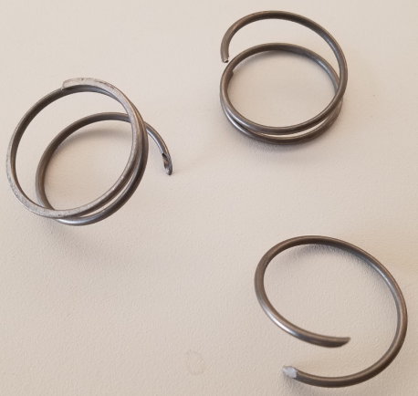
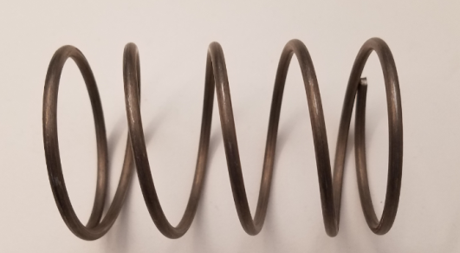
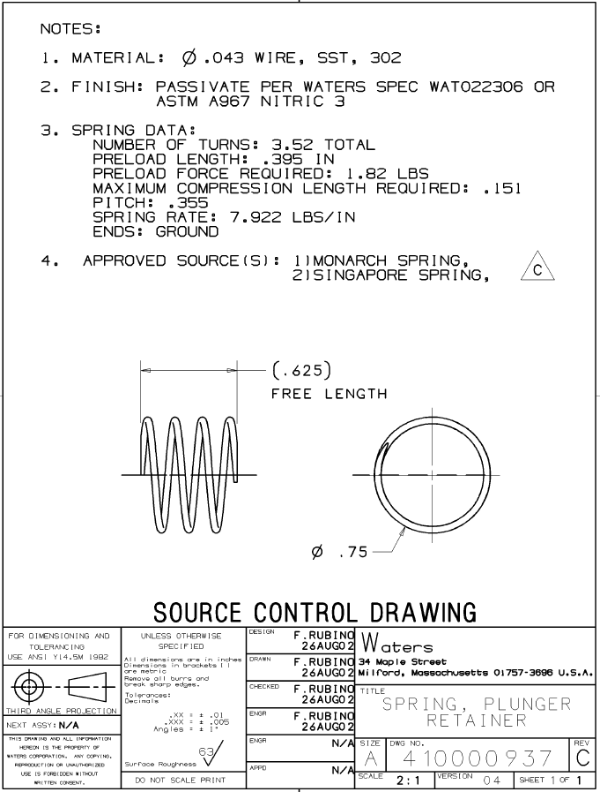
Actuators – All product lines
Review current Major Investigations
  Actuator
    Broken springs
    Rusty bearings
First report was ~5 years ago.
Multiple reports began in late 2017.
Not widespread issue (only 2-3 returns) but unacceptable
No apparent time-period-related failures
Being examined by Sustaining Engineering along with rusty bearings to attempt to find root cause
A total of 5 actuators have been examined with no apparent consistent failure mode
Status unchanged from April
  “Monitor” for further occurrences
  One more instance received in June

Slide 6
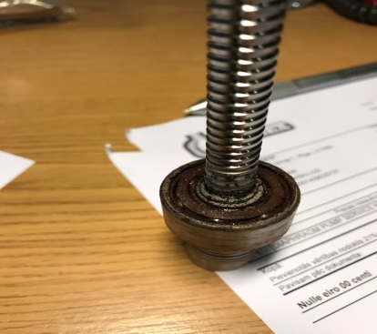
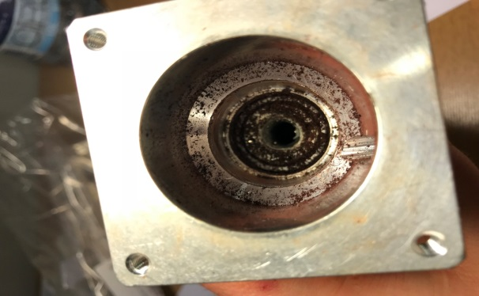
Actuators – All product lines
Review current Major Investigations
  Actuator
    Broken springs
    Rusty bearings
Finland example
Originally requested investigation of “torpedoes” due to within-warranty failures of Alliance (June 2017)
NEW failure mode seen 9 Jan 2018, rusty bearings, within warranty.
Not widespread issue (14 occurrences) but unacceptable
Seems to be isolated to instruments M16 – B17 (Dec 2016 – Feb 2017)
Failed bearings currently being investigated by vendor (Milford Eng. Oversight)
June Update
No additional failures outside of Dec 2016 – Feb 2017 range
Failure analysis by vendor
  Inconclusive
  Returning 2 more examples to vendor for FA
  Status unchanged from April
    “Monitor” for further occurrences
      2 more failures (again within failure range)

Slide 7
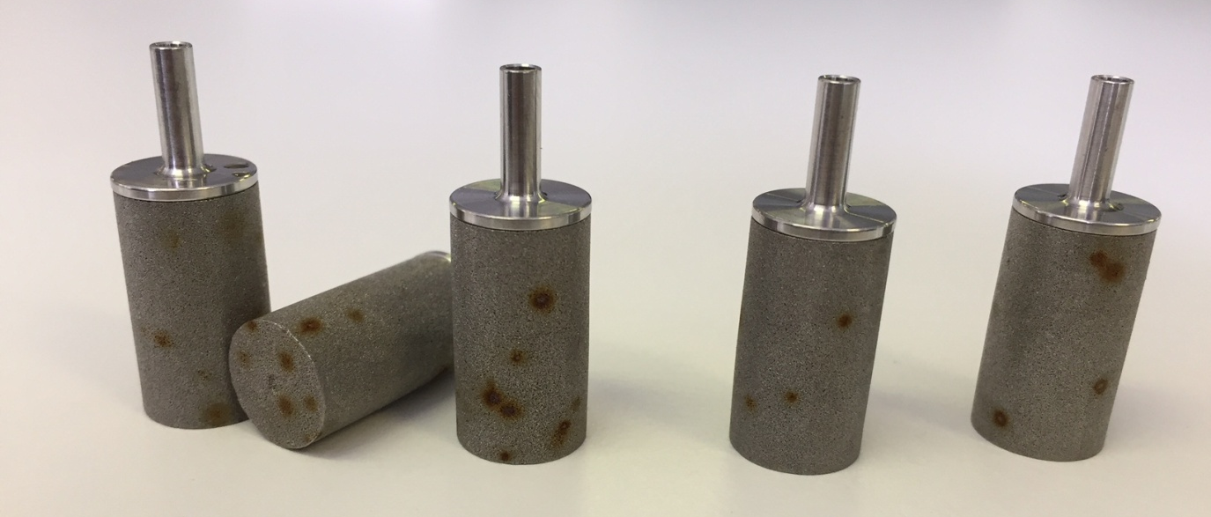
Solvent filters and rust spots
Review current Major Investigations
  Actuator
    Broken springs
    Rusty bearings
  SS Solvent filters & rust spots
    Very sporadic reports over the last many years.
    Reports turned more frequent, late 2017 early 2018.

Slide 8
Solvent filters and rust spots
Review current Major Investigations
  SS Solvent filters & rust spots
    “Filter Staining Team” formed 19 March 2018.
    Rusting due to free iron contained within the 316L SS
      2 filter vendors – both get raw material from same supplier
        Raw material supplied by one vendor showed free iron in the base material – ASTM copper sulfate test
    We directly contacted the base material vendor
      Unwilling to examine and/or change their process
        Prevents reaching root cause
    Finding and verifying a new supplier that can maintain higher quality standards we require for our customers.

Slide 9
ACTION Items-Updates
New Action items per 1 June meeting
  Look at possibility of making sure no faulty QSPI pcbs got into PLUS products.
    The pullback of units and rework would be extensive.
      Given the apparent failure rate of ~2% (23/1,207) and the fact no field SU or early warranty failures have been seen to date, the customer risk is low
        Action: Continue field monitoring.
  For solvent filter spots
    Change course from trying to work with uncooperative vendor to seeking alternative source of raw SS powder.

Slide 10
Minor Issues - Field and Manufacturing - YTD 2018 (1 of 4)
    Inconsistencies in brackets used in CM-30 CH and CHC
      Product improvement request from GSS
        In queue
    Alliance CPU – VRTX error
      Pending analysis when reworked in Repair Center
        In process
    New Path 1 & 2 mixers – 5 um instead of 0.5 um frit
      Spares presently available
        ASSY, MIXER, 4.6MM X 100MM, 200um PATH 1 289012516
        ASSY, MIXER, 4.6MM X 30MM, 200um PATH 2 289012501
      New PM kit for QSM-R with new mixers – 201000317 (in stock and shipping
        Old PM kit production stopped
      Newly manufactured instruments began production week 1 of June 2018
      Retrofit plan resume discussion mid-July, due to FDA inspection
        In process

Slide 11
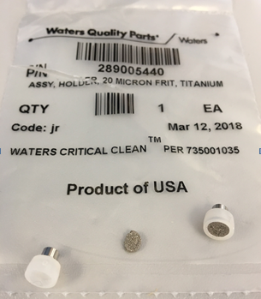
Minor Issues - Field and Manufacturing - YTD 2018 (2 of 4)
    Defective Ti frit
      Product audit in process
      No defective material found.
        Appears to be an isolated case.
      Closed

Slide 12
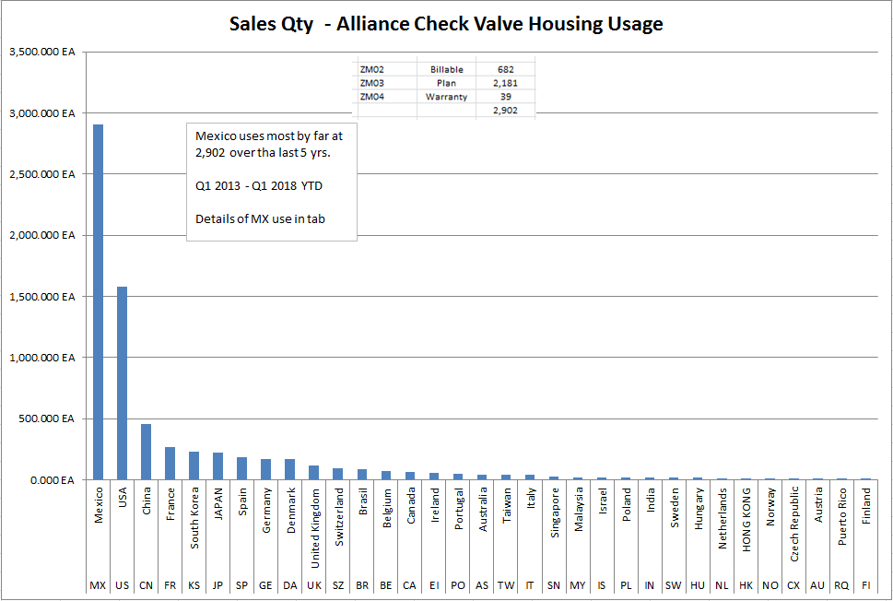
Minor Issues - Field and Manufacturing - YTD 2018 (3 of 4)
    Alliance CV housing (700002332) usage in Mexico questioned
      GSS follow up requested

Slide 13

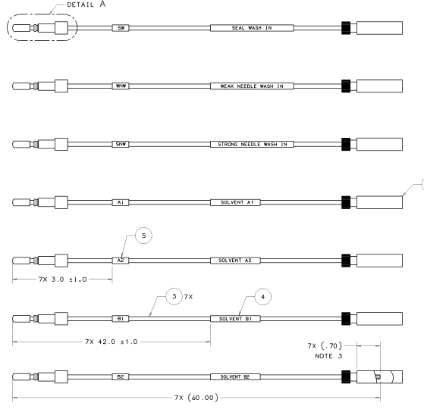
Minor Issues - Field and Manufacturing - since 4Q17 (4 of 4)
  10um He sparger inlet filter (410002552)
    Customer found LAS contamination.
    Found in 2nd set of filters also.
    Returned filters to be examined by Quality Assurance Lab
      Filters from CC process also to be examined to confirm or refute LAS are coming from the process
      In process
430002198 – PEEK Solvent inlet tube ass’y

Slide 14
June 2018 - New Issues Reported - Field and Manufacturing
GlycoWorks RFMS Deglyco Module 96-sample (186008840)
  See next slide Stop Ships - 07 June 2018
  The lot# on the COA is correct, but the lot# on the product label is incorrect.
Insulin HMWP column 7.8 x 300 (WAT201549), P-Pak I 125 Insulin Assay Bulk (WAT248063)
  See next slide Stop Ships – 06 June 2018
  Column is not performing as intended. There is inadequate resolution between the dimer and monomer. It only affects material from lot #0046.

Slide 15
Current Stop Ship and Retrofit Statuses
Stop Ships-LC
GlycoWorks RFMS Deglyco Module 96-sample (186008840) – 07 June 2018 –
  Stop Ship ID: BWIN-AZGSKZ
Insulin HMWP column 7.8 x 300 (WAT201549), P-Pak I 125 Insulin Assay Bulk (WAT248063) – 06 June 2018
  Stop Ship ID: BWIN-AZGNKX
Current LC Retrofits:
Alliance GPV Retrofit: Approved
AOB?
Next meeting for Alliance and Pumps
  25 July 2018

Slide 16
Questions?

