Slide 1
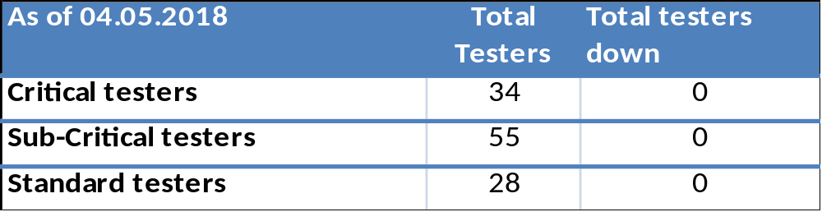
Fixture Dashboard
TE82760-4 – 2475 detector Final tester PM 03May2018 - Completed
TE82760-5 – 2475 detector Final tester PM 10May2018
Notes:
Venture – Reference energy failure at optics bench
Flex – wavelength verification issue, PDA issue
Check if affecting ASO

Slide 2
CM | Tester | Total Tester | IQ Status
 |  |  | Completed | In Progress | Pending
GES | FTN | 8 | 8 | 0 | 0
 | I-BMS | 6 | 6 | 0 | 0
Flex | H-BSM | 8 | 8 | 0 | 0

Slide 3
Bifrost –Tester IQ Status
CM | Week of (estimate) |  | 09.Apr.18 | 16.Apr.18 | 23.Apr.18 | 30.Apr.18 | 07.May.18
Venture | FTN | TE83064-10 | Completed
 |  | TE83064-11 | Completed
 |  | TE83064-12 |  | Completed
 |  | TE83064-13 |  | Completed
 |  | TE83064-14 |  |  | Completed
 |  | TE83064-15 |  |  | Completed
 |  | TE83064-16 |  |  |  | Completed
 |  | TE83064-17 |  |  |  | Completed
 | I BSM | TE82943-1 |  | Completed
 |  | TE82943-19 |  | Completed
 |  | TE82943-20 |  |  | Completed
 |  | TE82943-21 |  |  | Completed
 |  | TE82943-22 |  |  |  | Completed
 |  | TE82943-24 |  |  |  | Completed
Flex | H QSM | TE82943-11 |  | Completed
 |  | TE82943-12 |  | Completed
 |  | TE82943-13 |  |  | Completed
 |  | TE82943-14 |  |  | Completed
 |  | TE82943-15 |  |  |  | Completed
 |  | TE82943-16 |  |  |  | Completed
 |  | TE82943-17 |  |  |  |  | Completed
 |  | TE82943-18 |  |  |  |  | Completed

Slide 4
Alliance FPY

