Slide 1
Operations
Production Updates

Slide 2

Manufacturing: Overview
Status (WW04’21) | Flex | Venture | CEI
OESR
Tooling/Tester
Engineering Activities Evaluation Validation
Stop production
Potential impact / Under investigation
No production impact
Notes:
Validation at Flex on-hold; Will resume when Memo is out for “e- fill form”

Slide 3
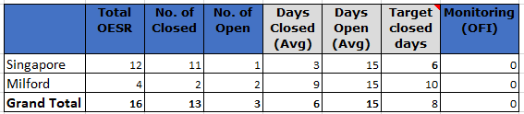
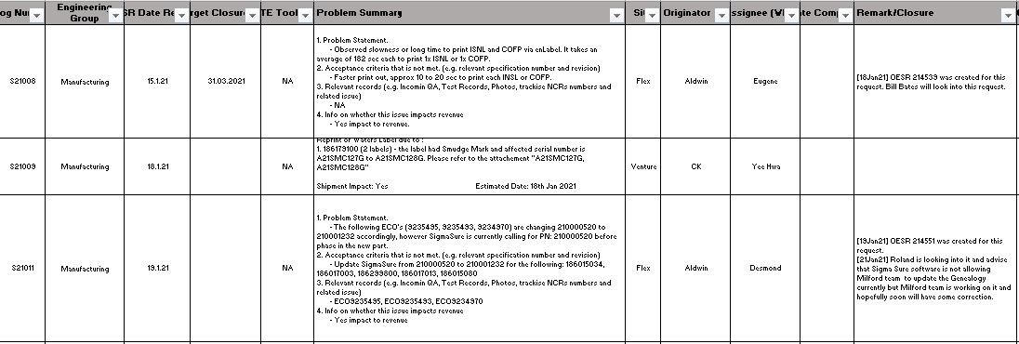
Manufacturing: OESR Update
Notes:
Points to share
No# of OESRs (Received, Open, Close)
Actions for closure

Slide 4
Manufacturing: Tester Dashboard
Where Used | Criticality | Total Testers | Total Testers Down | Impact to Production | Status of Repair | Downtime | Target Closure
Instrument Level | Critical Testers | 48 | 0 | No | NA
 | Sub-Critical Testers | 56 | 0 | No | NA
 | Standard Testers | 48 | 0 | No | NA
PCBA | Test System | 15 | 0 | No | NA
 | FCT Fixtures | 72 | 0 | No | NA
 | ICT Fixtures | 71 | 0 | No | NA

Slide 5
Manufacturing: Tooling PM Status
Preventive Maintenance Plan for Consigned Tools
Monthly PM is applicable to all torque wrenches and tools with critical dimensions (CD).
Quarterly PM is applicable to the rest of the consigned tools.
CMO | Total Physical Tools | Tools Category | Q1 2021
 |  |  | Jan | Feb | Mar
Venture | 220 | Tools with CD | 59 | 59 | 59
 |  | Other Tools | 63 | 53 | 45
Flex | 257 | Tools with CD | 47 | 47 | 47
 |  | Other Tools | 91 | 113 | 5
CEI | 114 | Tools with CD | 8 | 8 | 8
 |  | Other Tools | 35 | 35 | 36
Tooling PM Status (WW04’21) | Venture | Flex | CEI
 | CD: 59 / 59 Others: 63 / 63 | CD: 47 / 47 Others: 91 / 91 | CD: 8 / 8 Others: 35 / 35
Notes:
Balance 3 tooling from Flex, were sent to external calibration.
CPU PCB 210000520
Personality PCB 210000404

Slide 6
Manufacturing: Evaluation at Flex
Tracking TMDs with evaluation purpose
No | Deviation# | Description | Affected Assembly and Quantity | SBR Status & Feedback
1 | TMD010715 | 210000414 ASSY, PCB, ACQTUV PERS ROHS is revised to Rev H. 210001232 ASSY, PCB, 3V CCPU to replace 210000520 ASSY, PCB, 3VCCPU AHCT | 186015031 (8 assemblies) | ICT and FCT verification have passed. Closed. First instrument Serial Number D20TUV545A.
Complete buy-off Pending buy-off Building in-progress Failure analysis

Slide 7
Manufacturing: Evaluation at Venture
Tracking TMDs with evaluation purpose
No | Deviation# | Description | Affected Assembly and Quantity | Status & Feedback
1 | TMD010799 | To allow the use of new pressure transducer 279011951 in BSM | 186015085 (50 assemblies) | On-hold. Potential part issue, pending clarification
2 | TMD010808 | To allow the use of new pressure transducer 279012051 in FTN | 186015088 (100 assemblies) | To be load to production for Final Test

Slide 8

Manufacturing: Evaluation at CEI
Tracking TMDs with evaluation purpose
No | Deviation# | Description | Affected Assembly and Quantity | Status & Feedback
1 | TMD010726 | Optical sensor 349000136 is obsoleted. To evaluate 279002338 ASSY, CABLE, AMPLIFIER, FIBER OPTIC along with the 410003852-ABRACKET, MOUNTING, FIBEROPTIC AMPLIFIER into 186015020 ACQUITY UPLC Sample Organizer | 186015020 (15 assemblies) | 186015020 x 14 units + 1 unit
Complete buy-off Pending buy-off Building in-progress Failure analysis

Slide 9
Manufacturing: Tester Validation
SDS Tester At Flex : Completed 8 Testers IQ Validation
 |  | WW14 | WW17 | WW20 | WW21 | Remarks
 |  | 30.Mar | 20.Apr | 11.May | 18.May
Flex | TE-11 | IQ |  |  |  | Completed
 | TE-12 | IQ |  |  |  | Completed
 | TE-13 |  |  | IQ |  | Completed
 | TE-14 |  | IQ |  |  | Completed
 | TE-15 |  | IQ |  |  | Completed
 | TE-16 |  |  | IQ |  | Completed
 | TE-17 |  |  |  | IQ | Completed
 | TE-18 |  |  |  | IQ | Completed

