Slide 1
Fallout Rate: 0.3ml/min flowrate
2*
3*
1*
1* - Trim R1 & R2 tubes at tester 1 on 1st June 18 as per TSP (19/65 -29% failed at TE#1 until 31st Oct 18)
2* - Implemented monthly test tube change started from 26 Jul 18
3* - Trim R1 & R2 tubes at tester 24 on 5th Sep 18 as per TSP and monitor result
(2/21 (9.5%) failed at TE#24 until 31 Oct 18)

Slide 2
Fallout Rate: Failure Mode Vs Test Station (Jun-Oct 18)

Slide 3
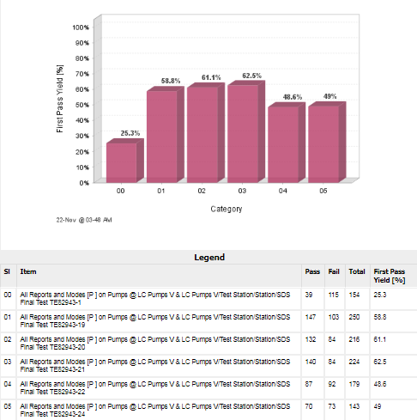
FPY based on tester station in SigmaSure

Slide 4
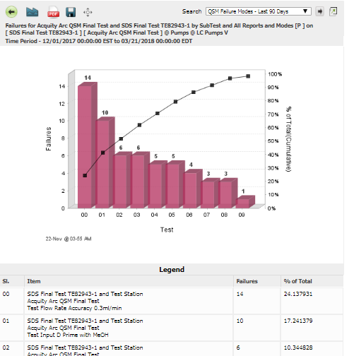
Failure rate by failure modes

Slide 5
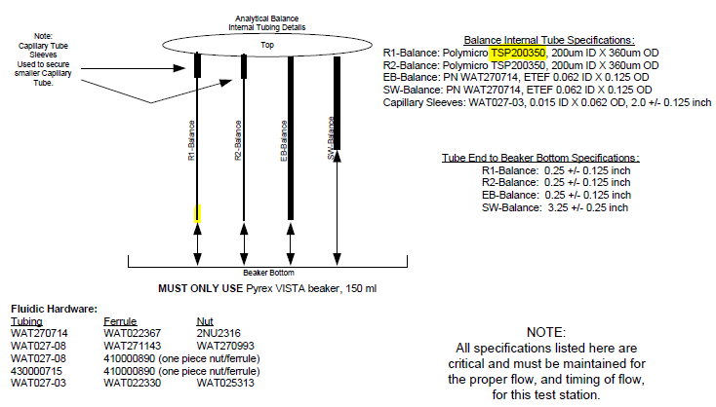
Can we replace these tunings to improve the FPY of 0.3ml/min flow test?
Do you have parts for us to do this experiment for flow rate yield improvement?

