Slide 1
China Indomitable
-IDC and Pharma Academy
Greater China PMO
Mar 2021

Slide 2
Overview _ Indomitable Project (IDC and Pharma Academy)

Slide 3
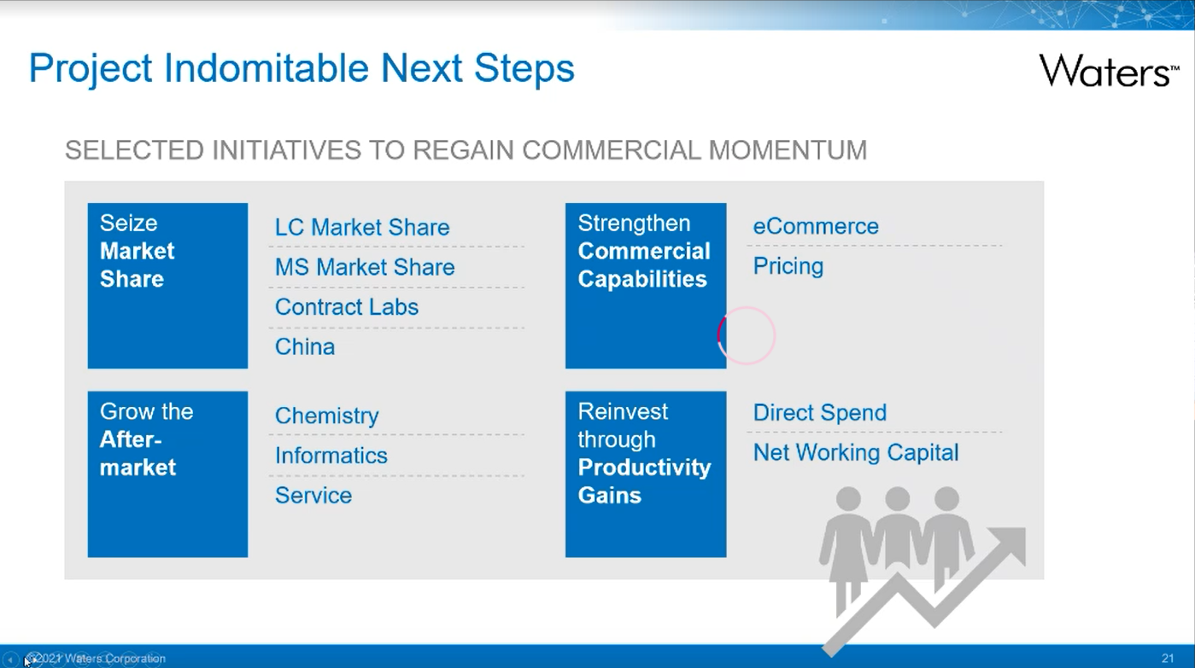

Slide 4
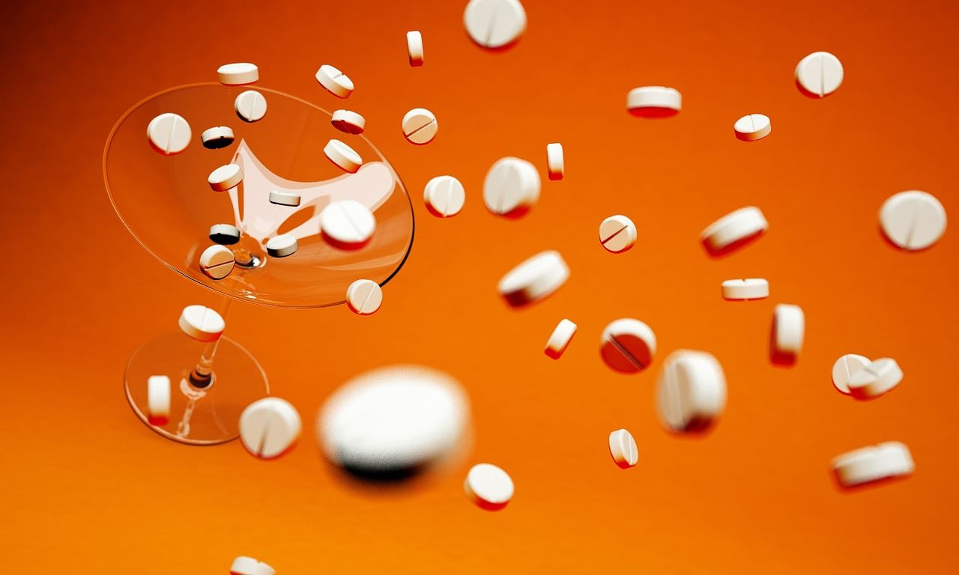
China Indomitable Project _ Management Team
Leader
Rebecca Liu
PMO to be hired
Sales Force
East + Central | South | North | HK&TW
XiangWei Li | Liang Yu* | ze han wang * | Dicky Ma*
XuBin Xu | Lu Zeng Hung | wei xu | Henry Chen*
Cao Lei | Lin Hai | weiwei dong | Teresa Shih
Qi Zhen Wei | Xiao Yong | miao chen | Amanda Wang
Zhu Liang | Zhou Chi | yuan yuan | Vicky Wan
Chun Ming Song* | Bu AnBo | chao ma | Ray Lee
Chen Xiao Jie | Chen Yi Jun | lei wang
HongYi Zhao | Zhou Huan Huan | meng zhao
Wu Jie | Bingham Liang* | cheng gang ye
Penetrate IDC and pharma academy
Leader: Laura Song
Team: Meihui Shi, Chen Li, Zhenzhong Shen, Jinjin Lu, Chunming Song, Zehan Wang, Yu Liang, Bingham Liang, Dicky Ma
*regional leader

Slide 5



Market Situation and Strategy
2017-2021F Revenue Projection
Market Trend
* Ratio of pharma/BMR business
Government strengthen system on regulatory science, with over 100 NMPA key labs in IDC and universities approved from 2019. More standard methods to be developed from these labs.
The 14th five-year plan fortifies drug innovation, public health, research, biotech., TCM and national (key) labs, targeting strategic regions.
More synergies among Government-Application-Industry-University Education-Academy Research (政用产学研)
*20%
*15%
*14%
Gaps
2019 LC market share
18%
14%
LC Selling Price Range ($) | China Market Size (Unit) | Waters Sales (Unit) | Waters share %
<$30k | 2388 | 44 | 2%
$30k - $45k | 3123 | 431 | 14%
$45k - $65k | 2130 | 714 | 34%
> $65k | 908 | 370 | 41%
Indomitable Strategy
35%
30%
Align sales support and sales enablement with sales team, redesigning value propositions from pharma/BMR application & workflow.
Special LC package promotion and seeding for sales program (Premier, Radian and RDa).
Strengthen KOL network and impact through collaborations.
Non-pharma sales team not familiar with pharma/BMR applications and workflows.
Non-industry customers did not see more benefit (comparing with competitors).
KOL network (lack of MS experts).
Notes:
CI + R Business 占总体Pharma/BMR 的比例
2017,2018 占比 18%
2019 占比 20%
2020 14%
2021 17%
2021年 OPEN机会 CI+R total 79M$, PC01 15M$, PC06 63M$
CI 9.6 M$
R 70M$
LC 15M
MS 63M$
历史转化率(win/win+lost+close)
2019年转化率 25%， 2020年转化率 20%
LC 2019 (35%) to 2020 (31%)
MS 2019 (18%) to 2020 (14%)
不包括 close
LC 2019 （50%） to 2020 (49%)
MS 2019 (27%) to 2020 (21%)
Cycle time:
2019年平均331天，2020年平均404天
最大cycle time，2019年 2278天，2020年 3159天
Oppo conversion rate decrease in 2020, LC 35% to 31%, MS 18% to 14%. Big LC pipeline gap.

Slide 6
2021 Financial Target (breakdown to region, quarter)
KPI Criteria:
Trade class/sub-Trade class: R & CI
Vertical Market L2:
  Pharmaceutical &
  Biopharmaceutical &
  Biomedical Research
K$ | IDC | University |  | Total
2021 Sales Target | 10,924 | 27,704 |  | 38,628
Regional allocation
East | 1,376 | 7,458 |  | 8,834
North | 3,998 | 9,230 |  | 13,228
Central | 1,853 | 4,060 |  | 5,913
South | 3,696 | 5,761 |  | 9,457
Hong Kong | - | 706 |  | 706
TaiWan | - | 489 |  | 489
Quarterly Target $K | Q1 | Q2 | Q3 | Q4
Total | 5,750 | 7,607 | 10,278 | 14,994
Target: $38.6M
Next Actions:
1. Regional target breakdown – regional owner

Slide 7
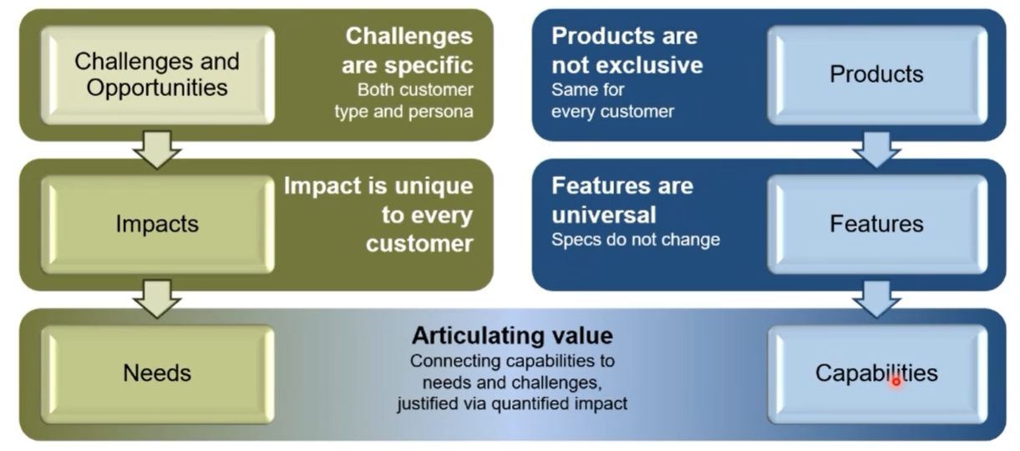
Target Customers and Value Proposition
目标客户
中检院 / 药检所 / 医疗器械检验所（CI）
大学与科研院所（R）
监管科学（89家药监局重点实验室 及 省级/地市级药检所）
中医药大学，中医中药研究院
大学药学院，中药学院，生物制药学院
药物化学，天然产物化学
方向
Customer Value Proposition
Leading with Science: To leverage Premier and Waters’ workflow based total solutions in method, impurity, biopharma, TMR, E&L, and Omics to promote MS.
Enable with data and compliance: To leverage Waters strong pharma compliance solution and data management to take LC share.
Cost effectiveness for routine LC analysis with Alliance/ column set / Empower QS / 3 year warranty special promotion package.

Slide 8
Execution
药检所、医疗器械检验所（CI）
大学和科研院所
完成所管理区域企业的监管、检验任务、标准升级项目；
NMPA药品检验检测机构能力建设指导原则（2019-8） https://www.nmpa.gov.cn/xxgk/fgwj/gzwj/gzwjyp/20190830170601912.html
NMPA医疗器械检验检测机构能力建设指导原则（2019-8） https://www.nmpa.gov.cn/xxgk/fgwj/gzwj/gzwjylqx/20190830170201343.html
2020药典新增的检测项目和相应的检测能力（中药农残、GTI）
《化妆品注册备案资料管理规定》（2021-3）
疫苗、诊断试剂相关
NMPA重点实验室（第一批，第二批）
应用研究、基础研究、教学、企业横向合作与服务（CRO）、分析测试中心/服务平台
国家（重点）实验室、NMPA重点实验室（第二批）
中医药大学，中医中药研究院
大学药学院，中药学院，生物制药学院
药物化学，天然产物化学
Customer Initiative
Leading with Science: To leverage Waters new products and workflow based total solutions in methods, medicinal chemistry, protein & biopharma, TMR & natural product research and multi-Omics for routine and advanced research.
Cost effectiveness for routine LC analysis with Alliance/ column set / Empower QS / 3 year warranty special promotion package
Customer Opportunities
可靠的合规数据助力有效监管
新型分析技术、方法以及广泛的技术合作帮助加强在药品质量研究和监管科学上的影响力
Package solution for routine analysis (常规检验) on TCM pesticide, 配方颗粒，GTI
Application and workflow-based strategy for NMPA key labs (中药、仿制药、安全性、制剂、辅料、杂质研究，E&L等）
Segment customers based on four applications (medicinal chemistry, protein & biopharma, TCM & natural products, regulatory science)
Penetrate non-Waters LC base via Alliance promotion package (young P.I.s, routine LC and education)
Strategy
10.9 M$
27.7 M$
Target Goal
2021 YTD Pipeline
1.8 M$
11.2 M

Slide 9
2021 Key Focus
Medicinal chemistry
Protein & biopharma
TMR & natural product research
Regulatory Science
Demand generation
(CEM & MKT)
Target accounts visit
(Sales, SD)
Improve pipeline win-rate
(Sales, SD)
New Technology & Applications
  VOC from KOLs (柯昌强, 魏黎明, 果德安, 王喜军, 李惠琳, 胡泽平, 叶丹, etc.)
  Radian, Premier, BioAccord, RDa, IMS
Education series (Method, QDa, RDa)
Big Case Review - COIN in Compass
Sales Get Familiar with Customers’ Workflow & Application
  Medicinal chemistry / Protein & biopharma / TMR & natural product research / Regulatory Science
New MS Seeding for Sales (3 Month) Campaign (Radian, RDa)
IDCs – routine analysis on TCM pesticide, 配方颗粒 and GTI
NMPA key labs - Application and workflow promotion with on-site seminars and collaborations
University & Academia - Penetrate non-Waters LC base using Alliance promotion (young P.I.s, routine LC and education)
KOL & Collaboration
(MKT, SD, Sales, Service & Application)
NIFDC, CPU, COI, Suzhou IDC, Synthetic biology (South?)
Regional reference sites
Strategic big project ?
Notes:
销售做什么？ Opportunity 填写到系统中。销售培训， 每个月讨论

Slide 10
Execution _ Sales Enablement (Win-Rate, Reconnection)
Compass Tracking
Monthly meeting review
KOLs
(3+2)
1st round: target Accounts
(# 34 + 82)
Whole Market Customers
(# 药检所，中医药、药学 & 生命科学学科)
Actions | Owner | Timeline
Visit and maintain relationship | sales | Full year
On-site seminar & collaboration discussion | SD | Plan before May 1;
VOC and marketing promotion | MKT | Jun 30
Actions | Owner | Timeline
Visit, define COIN of opportunities and work out winning tactics (34 accounts) Visit, define customers’ applications and needs (82 accounts) | sales | Jun 30
On-site seminar, nurture activities (82 accounts) IDC seminars tour marketing tracker submitted | SD | Full year Before May 1
Sales training | MKT | Jun 1
Actions | Owner | Timeline
Demand generation with virtual activities | MKT | Full year
Invite speakers from KOLs, promote webinar invitations IDC seminar tour | Sales/SD | Full year
Notes:
Compass中CRM 更新opportunity。 有培训、targeted list follow. Dashboard (opportunity， win-rate, task, instrument sold

Slide 11
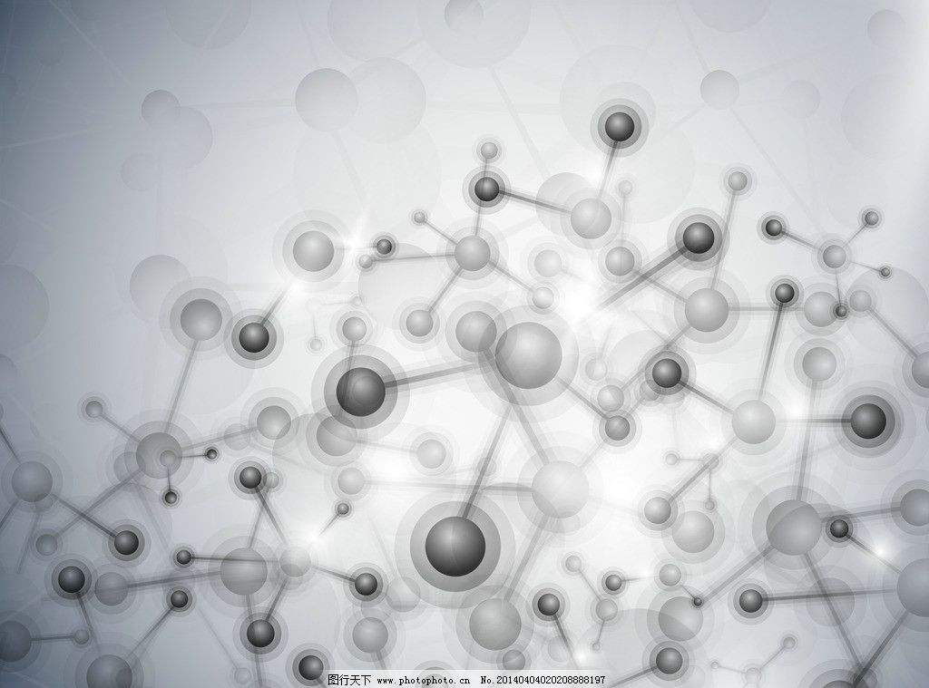
Pharma Indomitable Project
Demand Generation Plan
Q2
Q3
Q4
Regulatory Science: 16
Regulatory Science: 8
Regulatory Science: 7
In-person Activity
(Sponsored Conf./Seminar/Workshop)
Pharma Academy: 9
Pharma Academy: 6
Pharma Academy: 3
TCM: 2
TCM: 1
TCM: 1
LC: 1
MS:3
LC: 2
MS:9
Regulatory Science: 4
Regulatory Science: 2
Pharma Academy: 6
Virtual Activity
Pharma Academy:7
Pharma Academy: 11
MS:2
TCM: 3
LC:2
LC: 1
MS:3
Regulatory Science: WeChat & News released with in-person and virtual activities
Digital/PR
Pharma Academy: WeChat & News released with in-person and virtual activities
TCM: WeChat & News released with in-person and virtual activities
LC: WeChat & News released with in-person and virtual activities
MS: WeChat & News released with in-person and virtual activities

Slide 12
Responsibility _ Indomitable Project (IDC and Pharma Academy)

Slide 13
Indomitable _ Responsibility
Item | MKT Activity | Sales Activity | KPI | How to Track
Demand generation | Market campaigns to create MQL | Transfer MQL to opportunities | Improve conversion rate | Monthly compass dashboard review
Scale Coverage | Deliver the 1st round target account list (89 NMPA key labs) and assign tasks to sales in Compass (Apr. 15th ) Deliver 2nd round target account list (university) (July 15) IDC visit guidance for target accounts | Need to complete the tasks and try to create sales opportunity | Achieve targeted pipeline number
Current pipeline win-rate | Sales tools (MKT) Precision Internal sales training (MKT & SC & SD & Product) KOL or reference site enforce | Big project biweekly review with RGM Sales manager deliver sales play training | Revenue: 38.6M$ (breakdown to person)

Slide 14




China Indomitable – Penetrate IDCs & Pharma Academy
Workstream | Name | Go Live | 1/22/21 | Overall Status [G/Y/R] | G/Y/R | Stage [L Gate] | xxx | Accountable Leader | Name
Workstream
Review with Regions
Momentum / Full Potential
2021 Investment
Accountable Leader
China Indomitable
Laura Song
3/1/21
$37.1 / $38.6M
Demo: 3, HC: 1, Capital: $ 40K
Description and Value Prop
Execution
Outcomes
Description
Drive $19M incremental revenue ($1.5M indomitable) in IDC and academy via focused sales coverage and strengthening KOLs network on regulatory science, TCM research, pharmacy schools and new mass spectrometry methods, with NMPA key labs as prioritized targets.
Will contribute to net $46M full potential
Customer Value Proposition
Leading with Science: To leverage Premier and Waters’ workflow based total solutions in impurity, biopharma, TMR, E&L, and Omics to promote MS.
Enable with data and compliance: To leverage Waters strong pharma compliance solution and data management to take LC share.
Cost effectiveness for routine LC analysis with Alliance/ column set/ QDa/ Empower QS special promotion package.
Critical milestones
Revenue $M | Q1 | Q2 | Q3 | Q4 | Sub-Total
Momentum | 5.8 | 7.3 | 9.7 | 14.4 | 37.1
Extra | - | 0.3 | 0.6 | 0.6 | 1.5
Total | 5.8 | 7.6 | 10.3 | 13.0 | 38.6
Associated investments
(HC/Demo/support etc.)
Select KPIs
Opportunities Created (net new – leading): 105 M
Pipeline (4X revenue, 180 days ahead - leading): 154 M
MQL, new accounts and new contacts?
Prioritize target accounts and conduct pipeline review (Feb, NR)
Finalize collaboration plan, demand generation plan (Mar, NR)
Promotion package get approval (Mar. NR)
Execute demand generation plan, develop sales tools and conduct sales enablement (Apr, RR)
Enhance reference site influence – e.g., COI, CPU & NIFDC (May, RR)
Seeding campaign and scale coverage to all NMPA key labs (on-site seminars & virtual webinars) (Q2, RR)
Monthly check on KPIs (NR)
Add 1 MKT manager for IDC (Apr)
10K for IDC conference sponsorship (Apr)
30K for MKT activity
Seeding for sales: 1 BioAccord, 1 RDa, 1 Radian(Q2)​
Leadership Needed
Decisions needed
MKT manager hire go/no go
Special promotion for academy (Alliance/ column set/ QDa/ Empower QS + 3y warranty + consumables).
Critical Dependencies
Non-pharma sales enablement collateral / deployment.
Improve after-sales support for better customer experiences, to secure repeated business and reference sites.
Roadblocks/Risks
Customer acceptance of Waters new products -Radian/Premier
Notes:
Convert demo instrument to dollar value.
Measuring of influence of reference site.
Resource required (RR)
No resources required (NR)
Resource gate (RG)
Background information of Milestone 2 &3 :
IDCs and University customers are managed by non-pharma sales team. Sales are not familiar with pharma and Omics workflow and applications. Enabling sales to understand customers’ workflow and pains will help on value proposition and secure selling price.
At the same time, branding and virtual promotions of Waters solution, VOC on regulatory science, TCM research, pharmacy schools and life science omics are very important.
The role and responsibilities of the IDC marketing specialist is to develop sales tool, execute regular sales training and prepare materials for demand generation.
Background information for milestone 4:
IDC and academy are the source of standard methods, application of new technologies and nurture of future users for analytical instrument vendors. Take a tree as an example, IDC and university is the root while industry is the branch and leaf. We plan to leverage this program to strengthen Waters KOL network on regulatory science, TCM research, pharmacy schools and life science omics.

