Slide 1
Event Log Interface
Team Lead - Michelle Farley, Quality
Core Team
Terri Cronin, Production; Matt Franklin, ME; Tyler Modelski TE

Slide 2



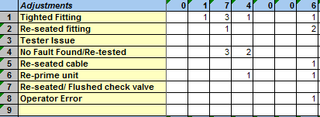
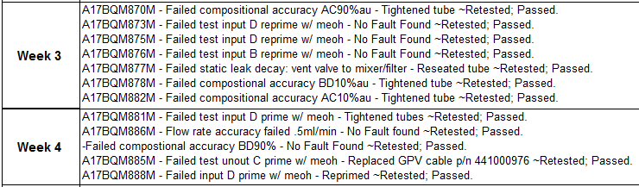

Production Quality Data Basic Overview – Current State
Z:\FPY 2017
Event Logs & Test Info
Update
Xfer
Info
Prod Techs
Prod Supervisors
Key Prod Associates
FPY Data Sheets (x23)
(#s, Problem Categories,
& Detailed Data)
Prod Supervisors
MOE Management
QEs & MOE Engineers
Inconsistent data
Challenging time-based or cross product-base analysis
Insight generation is cumbersome
Prod Supervisors
MOE Management
Engineers
Update
Update
Analyze
MOE .xlsx
(α)
Deep Dives
Metrics Dashboards (\\finserv2\share\InstOps)
O:\2016 Org Management\Top Level Metrics
MOE .xlsx
(β)
MOE .pptx
Project Selection
Employees
Milford Ops Mgt Staff
MOE Staff

Slide 3

Proposed Future State
Event Logs & Test Info
Update
Database
Xfer
Info
New User Interface
Prod Techs
Prod Supervisors
Key Prod Associates
1 system
Automated Through Dashboards
MOE Management
Prod Supervisors
Engineers
Metrics Dashboards
Deep Dives
Top Level Metrics
Project Selection
Employees
MOE Staff
Milford Ops Mgt Staff

Slide 4
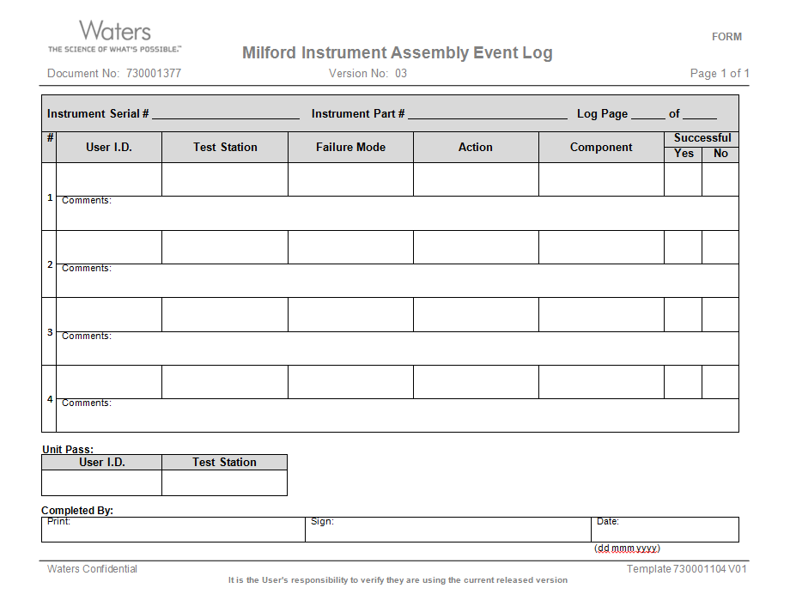
Work Flow
Paper
LabView
Sigma Sure
Sigma Sure
/ Other
  Event Logs
  User Interface – “Event Log Interface” (ELI)
  Database
  Dashboard
Paper
Excel
  Manufacturing Aid (Guidance)
  Configuration Files

Slide 5

User Interface

