Slide 1




WATERS QBR – 11th Sept 2019

Slide 2
  AGENDA (1400 - 1600)
  INTRODUCTIONS
  BUSINESS UPDATES (Presenter : Elson Ang)
  MATERIAL UPDATES (Presenter : Lee Lean Lye)
  NPI & ENGINEERING UPDATES (Presenter : Loo Kok Leong)
  QUALITY UPDATES (Presenter : Bernadette Balan)
  MFG LINE TOUR
  GENERAL DISCUSSIONS

Slide 3

BUSINESS
OVERVIEW

Slide 4
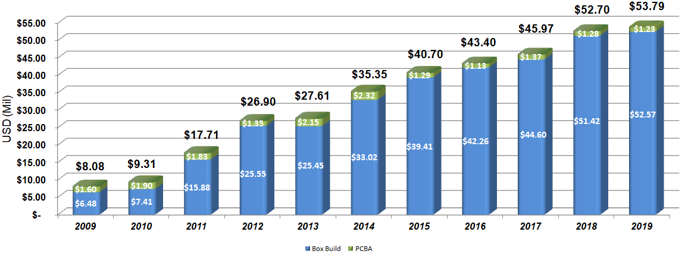
REVENUE YOY COMPARISON
FCST as at 1st Sep’19

Slide 5
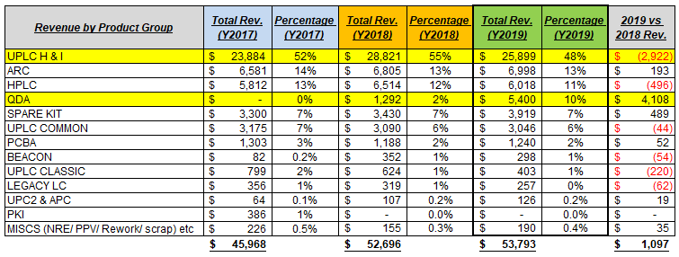
REVENUE BY PRODUCT GROUP (in $’000)
  UPLC H&I , still an huge drop in sales at US$2.99M, although there are some demand increase receive in 2H’19
  Main sales increase on QDA (an new product which starts build in Q3’18), total of 425 units for Y2019

Slide 6
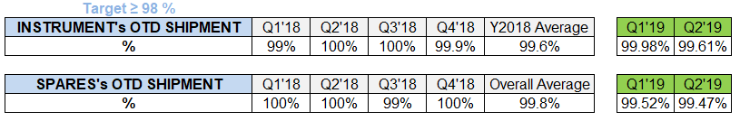
OTD (ON-TIME DELIVERY) 2018 , 1H’19
Instruments & Spare kits, quarterly OTD > 99%

Slide 7
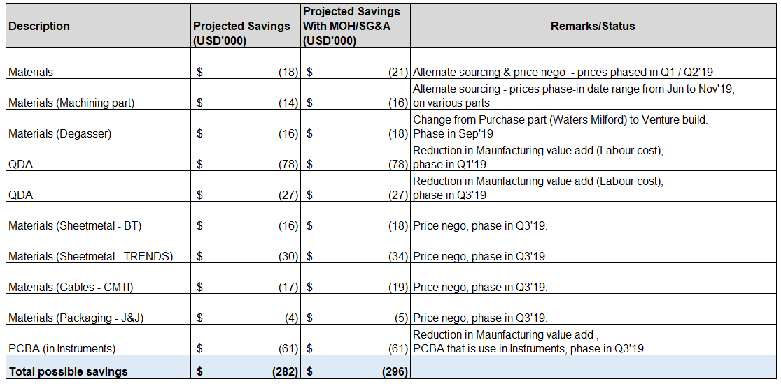
COST REDUCTION – Updates
CR target for Y2019 at US$300K

Slide 8
KEY SUPPLIERS
& MATERIALS
OUTLOOK

Slide 9
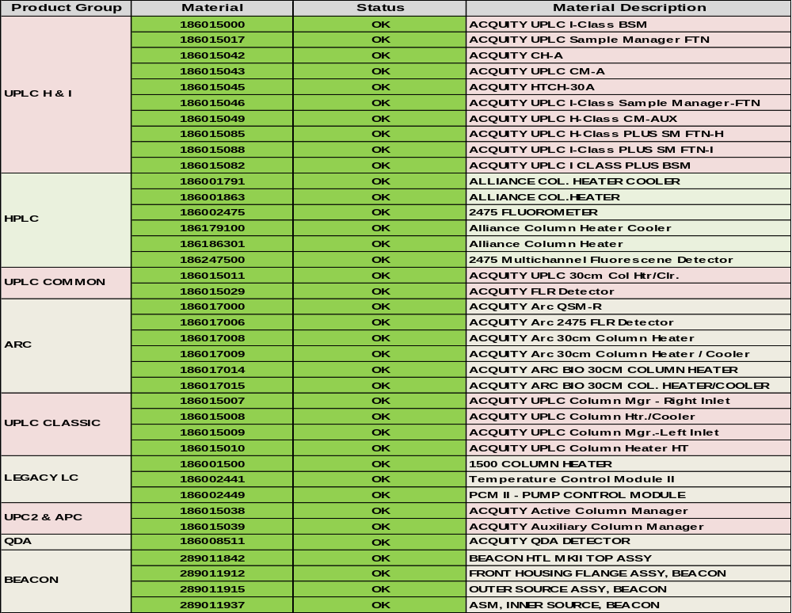
Summary of Clear to Build for Q3’2019.
All of the instrument are cleared for Q3’2019. Except for FTN spare ( 5225) due to upside.

Slide 10
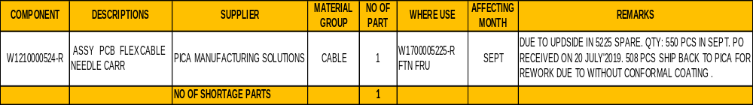
Gating Material for Q3’2019
Challenging supplier which we need to further expediting are as per above
due to upside in spare 5225.

Slide 11
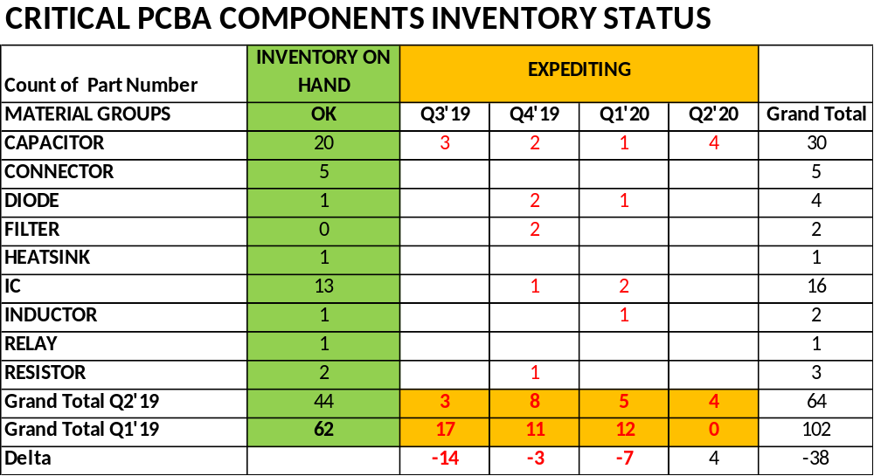
Assurance of Supply
68% of the parts are on hand and cover till Q2 ’2020 demand.
Allocation parts are in reducing trend.

Slide 12
NPI & ENGINEERING UPDATES

Slide 13
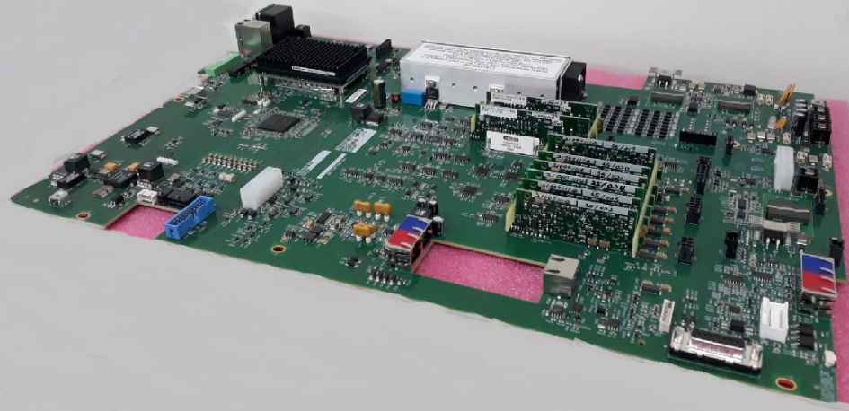
NPI PRODUCT
Mantis Mass Detector
Integration of ASAP (Atmospheric Solids Analysis Probe) with ACQUITY QDa Detector;
Design validation target completion by mid Q3 2020;
Schedule for Commercialization activities support FCS by end Q3 2020;
Alpha | Beta | Pre-Production
Q3 2019 | Q1 2020 | H2 2020 | 2021 | 2022 | 2023 | 2024
x6 | x12 | x40 | x180 | x224 | x246 | x246
Venture supports Alpha build of Detector Control
Card. Boards shipped to Wilmslow & WPPL
from 26/Jul/19;
Boards passed testing and built into Alpha
instrument in Wilmslow;
PCBA DFM proposals submitted to enhance
Beta design;
10-Layer PCB
PCBA Size 490x330mm
Part Count Approx x1,900

Slide 14
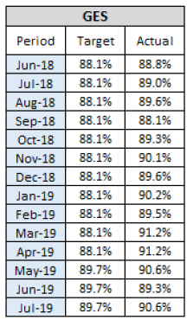
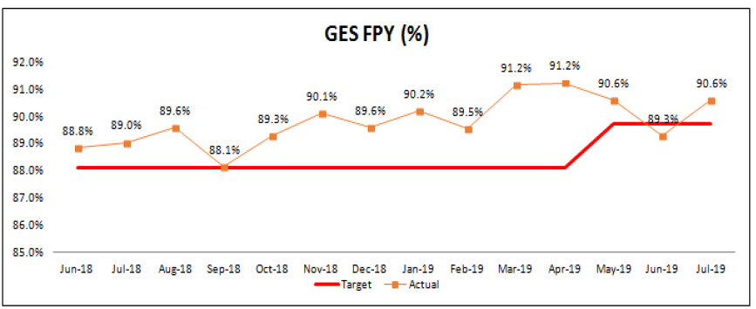

LC – First Pass Yield
LC FPY (%)
1
3
2
Mar’19 – 91.2%, exceeded 3% from Target.
  FTN -- Sample Syringe Decay (3.5%) with revised of Test Specification
1
2
Jun’19 – 89.3%, dropped 0.4% below Target.
  QSM– High priming failure at input lines due to air bubbles
  Improvements – Solution 4L → 1L, manual priming (syringe) or increase retries in Test
July’19 – 90.6%, exceeded 0.9% from Target.
  QSM– Manual priming with syringe, data collection
3

Slide 15

LC – 2019 Test Yield Improvements Plan
Q1
Q2
Q3
Q4
Actual VS Projected
FTN Sample Manager
  Sample Syringe Decay
  Dynamic Leak
6%
FTN
90%
100%
50%
70%
100%
Solvent Mgr (BSM & QSM)
  Priming A – D Input Lines
  Test Flow rate accuracy
BSM
QSM
1.3%
30%
70%
100%
50%
100%
FLR Detector
  Ramen Wavelength
3%
FLR
30%
50%
100%

Slide 16
QDa – Average Rework Timing with Improvement Plan
Actual VS Projected
Average Rework Timing
0.07hr
Q1
Q2
Q3
Q4
QDa (1.73 hrs to 0.75 hrs)
Rework skillset
Internal Calibrant
Pumping Block
Average Rework Timing Reduction
50%
75%
On Going
30%
60%
100%
70%
90%
100%

Slide 17
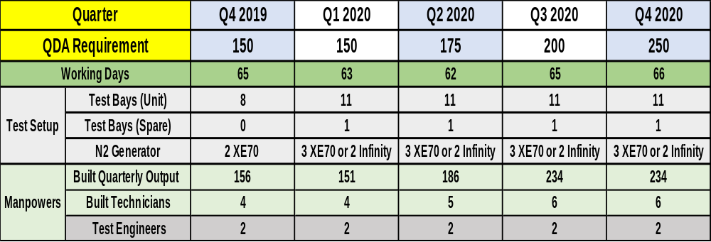
QDa – Built Plan and Support in Year 2020
Test Bays :
8 had completed and approved.
Remaining 4 test bays(3 x Unit, 1 x Spare) to be validated in Q4’19, to be approved in Q1’20.
N2 Generator :
To be determined whether to use PEAK standalone XE70 or Infinity.
Paul Merson to advise the results with Nitrogen Air Purifier.

Slide 18
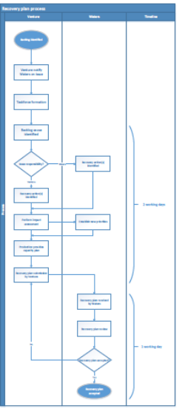
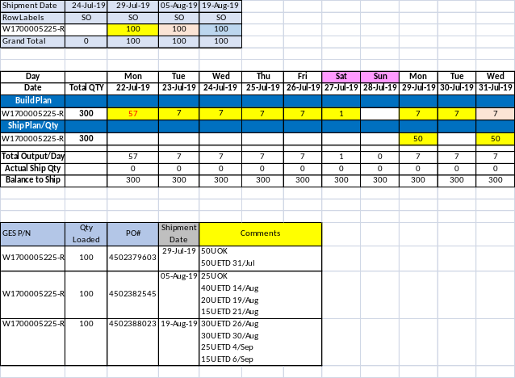
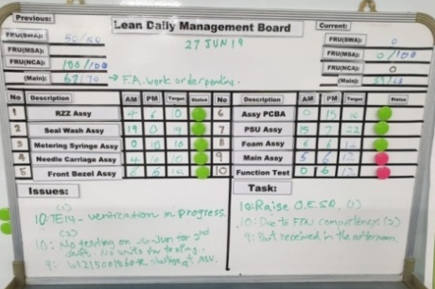
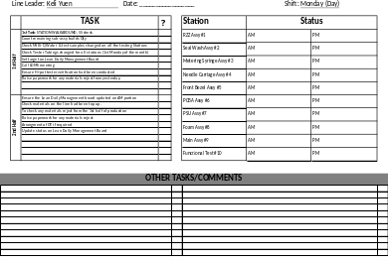
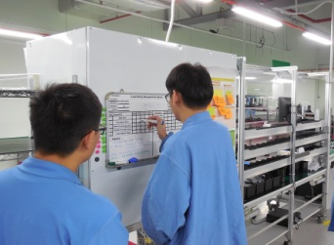
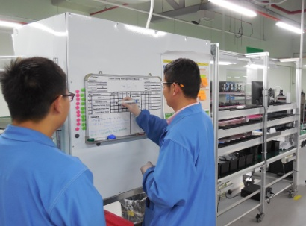
Continuous Improvement – Lean Activities
Team 3 Lean Project – Rework and Recovery | Team 4 Lean project -- Process
Purpose : Established process flow between WPPL & Venture for recovery plan (Jun ~ Sep’19). Actions : Define Role and responsibilities for each process (Date : Jun’19, Closed). Recovery plan template (Date : Jul 19, Closed). Release SOP (Date : Sep 19, Open). | Purpose : Conduct Daily Lean Management System at FTN Actions : Leader or Technical Operator to update completed output timely (Date : Jul 19, Closed). Split sub-assemblies from main assy in BOM (Date : Aug 19, Closed). Implemented LSW for FTN leader to track production activities (Date : Sep 19. Closed).

Slide 19
QUALITY
UPDATES

Slide 20
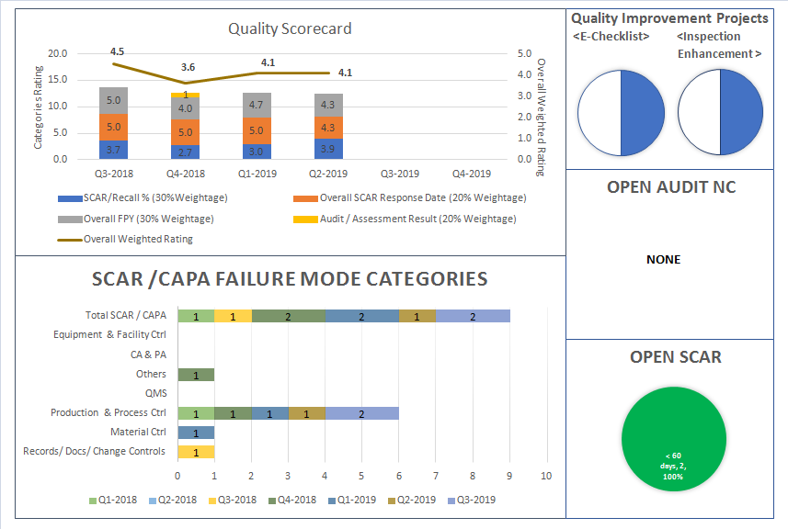
Quality Dashboard
20

Slide 21
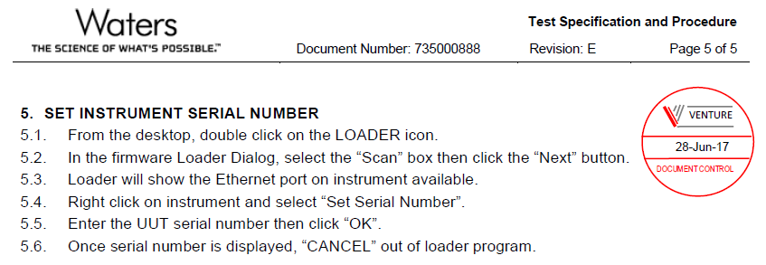
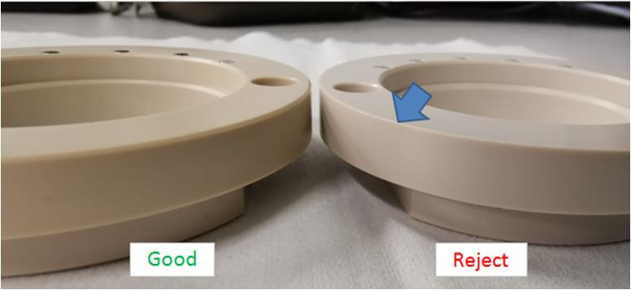
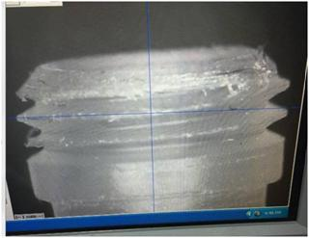
Lowlights
SCAR to Venture | SCAR to Supplier | SCAR to Supplier
Process Control CAR19-007 Review all the existing TSP in Production floor and complete the assessment of the production operators to assess if following the steps as required in the TSP, before the scheduled competency assessment by customer. Revised the Assessment Form No. HRM-033 to align the requirement on recertification using ASP/TSP. Status: Closed (23-July-19) | Tooling Wear & Tear Supplier: YKM Reject Rate: 75% Implement first piece full dimensional check (Not in place previously) Raised QA alert to brief all relevant operators involve in the inspection of the part and add-in the OQA inspection to check on the chamfer. 3 lots monitoring completed Status: Closed (30-Aug-19) | Tooling Wear & Tear Supplier: Globaltron Reject Rate: 75% Enhance the preventive maintenance of the cutter to every 2000pcs and sufficient oil to reduce the friction during machining. Implemented the use of standard ring gauge instead mating part during part buy-off verification. 3 lots monitoring completed Status: Closed (30-Aug-19)
21

Slide 22
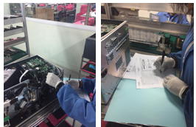


Highlights: Continuous Improvement
E-DHR | Material Inspection Enhancement
Purpose: Digitalize DHR (Device History Records) Progress update: Solution will be developed in-house with support from HQ IT Various service providers and proposals have been evaluated. Once establish, the checklists will be completed via tablet, the DHR will be generated electronically. There will be quality gain, productivity savings, and most importantly traceability and data analysis (including dashboard) will be significantly enhanced. Target Completion: Q4’19~Q1’20 | Scope: Enhance Inspection effectiveness (IPQC and IQC) Progress Update: Inspection checklists for 60 parts from high-runner model FTN have been reviewed, and some are updated to enhance effectiveness. Next target identified model is CM-A with highest number of feedback related to material from 2018 data. Target Completion: Q4’19~Q1’20
22

Slide 23
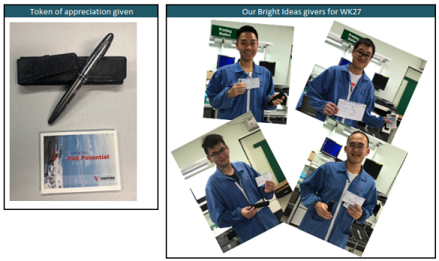

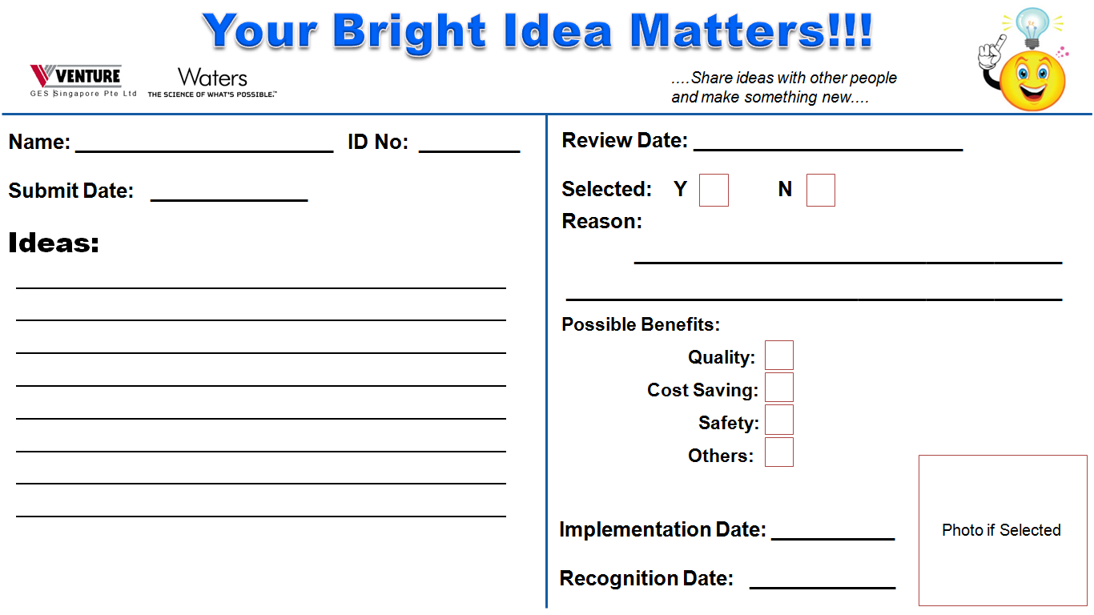
Highlights: Continuous Improvement
Bright Ideas
Purpose: Create a culture where production staff voices are valued Progress update: Program launched, along with poster showing the value of the work of production staff. Each of the 9 submission are reviewed through with the staff individually, and complimented. Souvenir given for each submission, and publicized. 1 of the idea is actually being implemented. Productivity gains being tabulated, and will be publicized to further this culture. Changes are being considered based on production staff voice, for example, some prefer to submit in group, or in native tongue.

Slide 24
GENERAL
DISCUSSIONS
24

Slide 25
THANK YOU

Slide 26
APPENDIX

Slide 27
Instruments by Product Group
Product Group | Material | Material Description
UPLC H & I | 186015000 | ACQUITY UPLC I-Class BSM
 | 186015017 | ACQUITY UPLC Sample Manager FTN
 | 186015042 | ACQUITY CH-A
 | 186015043 | ACQUITY UPLC CM-A
 | 186015045 | ACQUITY HTCH-30A
 | 186015046 | ACQUITY UPLC I-Class Sample Manager-FTN
 | 186015049 | ACQUITY UPLC H-Class CM-AUX
 | 186015085 | ACQUITY UPLC H-Class PLUS SM FTN-H
 | 186015088 | ACQUITY UPLC I-Class PLUS SM FTN-I
 | 186015082 | ACQUITY UPLC I CLASS PLUS BSM
HPLC | 186001791 | ALLIANCE COL. HEATER COOLER
 | 186001863 | ALLIANCE COL.HEATER
 | 186002475 | 2475 FLUOROMETER
 | 186179100 | Alliance Column Heater Cooler
 | 186186301 | Alliance Column Heater
 | 186247500 | 2475 Multichannel Fluorescene Detector
UPLC COMMON | 186015011 | ACQUITY UPLC 30cm Col Htr/Clr.
 | 186015029 | ACQUITY FLR Detector
ARC | 186017000 | ACQUITY Arc QSM-R
 | 186017006 | ACQUITY Arc 2475 FLR Detector
 | 186017008 | ACQUITY Arc 30cm Column Heater
 | 186017009 | ACQUITY Arc 30cm Column Heater / Cooler
 | 186017014 | ACQUITY ARC BIO 30CM COLUMN HEATER
 | 186017015 | ACQUITY ARC BIO 30CM COL. HEATER/COOLER
UPLC CLASSIC | 186015007 | ACQUITY UPLC Column Mgr - Right Inlet
 | 186015008 | ACQUITY UPLC Column Htr./Cooler
 | 186015009 | ACQUITY UPLC Column Mgr.-Left Inlet
 | 186015010 | ACQUITY UPLC Column Heater HT
LEGACY LC | 186001500 | 1500 COLUMN HEATER
 | 186002441 | Temperature Control Module II
 | 186002449 | PCM II - PUMP CONTROL MODULE
UPC2 & APC | 186015038 | ACQUITY Active Column Manager
 | 186015039 | ACQUITY Auxiliary Column Manager
QDA | 186008511 | ACQUITY QDA DETECTOR

