Slide 1

The Fundamentals of Systems Engineering
5-day Course

Slide 2
Welcome to the Course
from
Stuart Burge and John Weaver

Slide 3

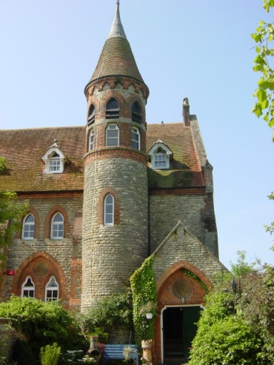
My Castle

Slide 4
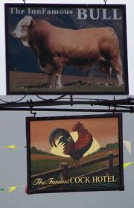

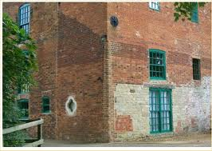
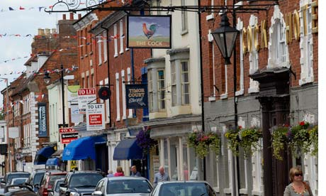
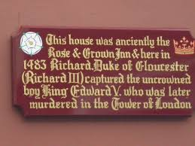
It’s all Cock and Bull
The roots of Stony Stratford's leather industry go back to 1600 when the famous Penn family (some of whom later emigrated to found the state of Pennsylvania in the United States of America). They diverted the river - the Great Ouse - to establish a water mill in one corner of their land."

Slide 5
Language Calibration

Slide 6
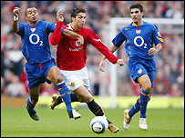
Football

Slide 7
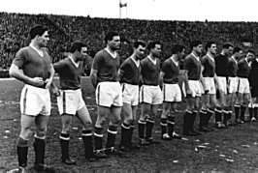
Football Team (This is the whole team)

Slide 8

This not a Football

Slide 9
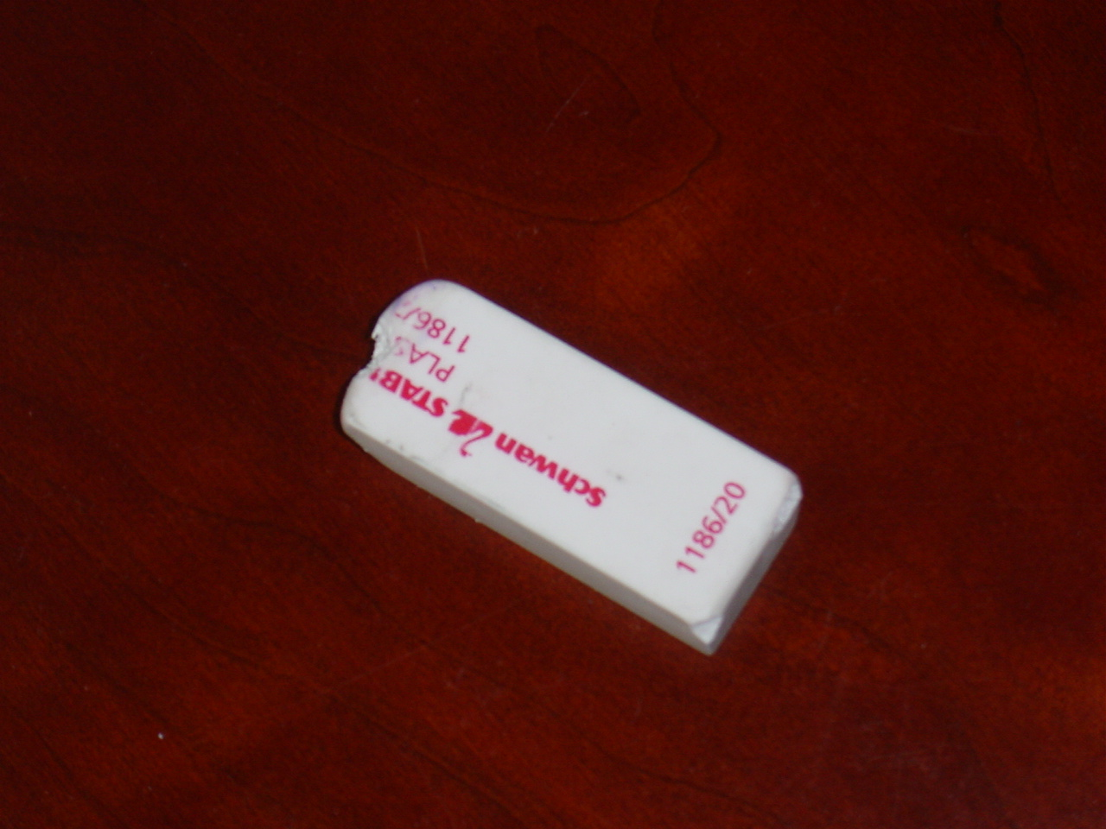
This is a rubber

Slide 10
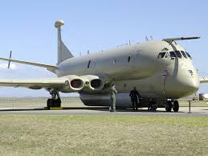
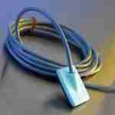

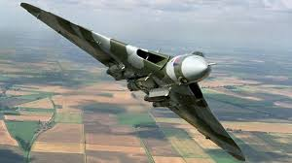

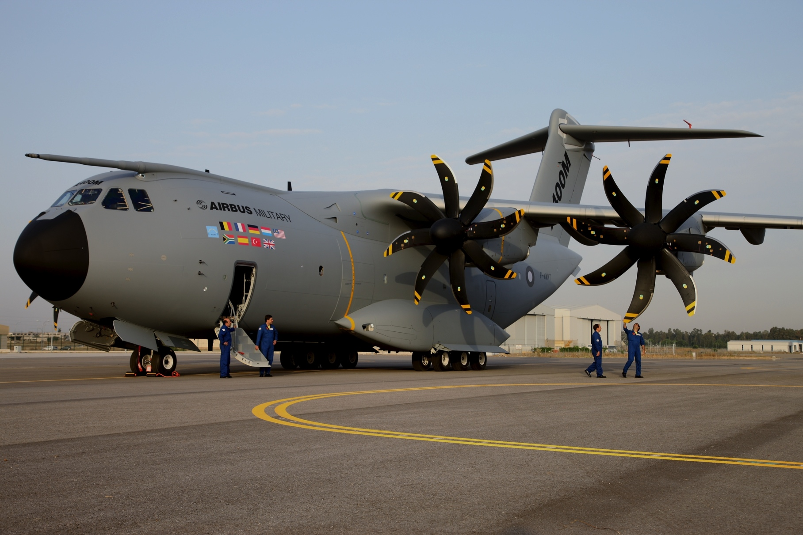
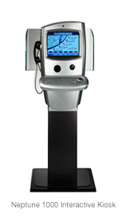
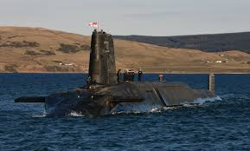

Slide 11
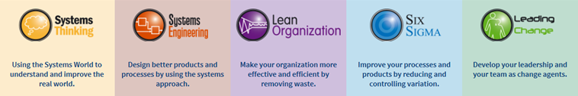

















NOW
Engineering Training and Consultancy
What
We
DO

Slide 12
Purpose of the Course
To help Waters deliver excellence
by:
introducing the concepts and benefits of applying Systems Thinking to the creation of a new, or modification to an existing, system - aka Systems Engineering
emphasising the importance of integrating people, process and tools in the design of systems
showing how systems engineering is applicable to both product and service (process) based systems
demonstrating the use of Systems Engineering tools to provide participants with a common toolset
enabling participants to identify stakeholders, elicit their requirements and translate these into specific, precise and measurable technical requirements
enabling participants to generate and down-select alternative design concepts
demonstrating the systems approach to robust optimisation (how SE feeds Robust Design)
developing some competencies required for successful team projects
considering the impact on future business of adopting a systems approach to engineering

Slide 13
  enjoying yourself !!

Slide 14
Course Survival
Course Administration
  Start Time 0830
  Finish Time 1700
  Emergency Exits and Fire Drill
  Messages and Mobiles
  Breaks and Meals
Ground Rules
  If you have any questions, please ask
  When we take breaks, please, be prompt in returning so we can stay on schedule
  There will be a number of team activities, please take an active role
  Remember - have fun and enjoy yourself!

Slide 15
Chinese Proverb
不聞不若聞之，聞之不若見之，見之不若知之，知之不若行之；學至於行之而止矣(不闻不若闻之，闻之不若见之，见之不若知之，知之不若行之；学至于行之而止矣

Slide 16
Course Survival
Course Administration
  Start Time 0830
  Finish Time 1700
  Emergency Exits and Fire Drill
  Messages and Mobiles
  Breaks and Meals
Ground Rules
  If you have any questions, please ask
  When we take breaks, please, be prompt in returning so we can stay on schedule
  There will be a number of team activities, please take an active role
  Remember - have fun and enjoy yourself!

Slide 17
Agenda
Monday Tuesday Wednesday Thursday Friday
0830
1000
1100
1200
1230
1500
1700
Introductions, Aims and Agenda
Gathering Requirements
Deducing Unspoken Basic Requirements using Functional or Viewpoint Analysis
Verifying and Validating Requirements using Quality Function Deployment
System Concept selection and evaluation using a Pugh Matrix
This is Systems Engineering
Verifying the System Design Concept using QFD 2
Understanding the concept of operation using Functional Modelling
Specifying Requirements
A Systems Approach to Optimisation and Robustness
Analysing Requirements
Lunch
Lunch
Lunch
Lunch
Lunch
A Systems Approach to Requirements
Requirements Engineering
Assess the System Meta Solution using Needs Means Analysis
Understanding the concept of operation using Functional Modelling
A Systems Approach to Systems Design
A Systems Approach to Verification and Validation
System Architecting: Finding the best Architecture
Analysing Expressed Requirements using Systemic Textual Analysis
Determine Systems Requirements
Summary, Review and close
Exploring undesirable behaviour using Sensitivity and Failure Analysis
Generating System Concepts

Slide 18
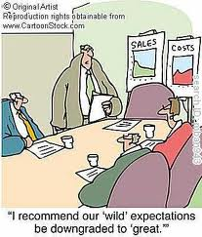
Quick Expectations
In Small Teams discuss and write down on a flip chart what you are expecting to achieve from attending this course
Nominate one person to:
  introduce the individuals in the team - Name and Job Role
  describe the team’s expectations to the group
Time
  10 minutes discussion
  10 minutes group feedback

