Slide 1


A Systems Approach to
Determine
System
Requirements
This Session
Defines a Systems Approach to Determining Systems Requirements
Introduces the Holistic Requirements Model – a systems approach to understanding requirements
Demonstrates the importance of system functionality as an invariant and logically defensible method of handling complexity

Slide 2
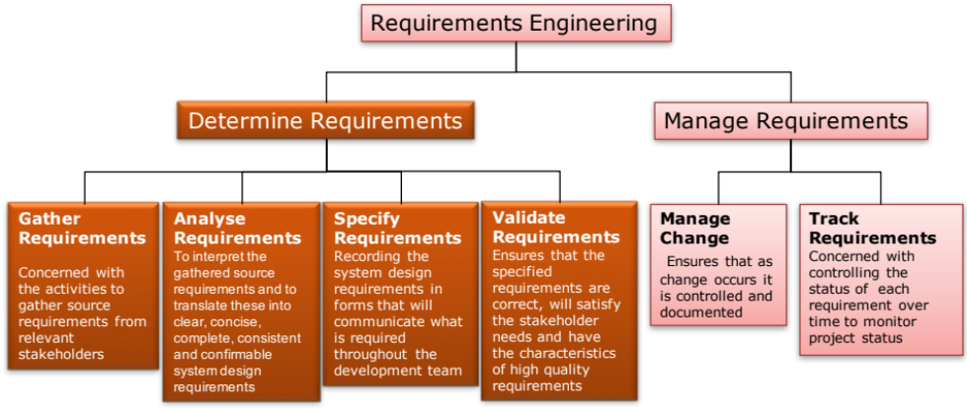
Where are we? And what are we trying to do?
Purpose :
  To elicit, capture, identify and interpret customer, and other stakeholder, requirements accurately, and to translate these into clear, concise, complete, consistent and confirmable technical system design requirements
Outcomes :
  A set of source requirements that define the customer and stakeholder needs and expectations (especially those aspects that are Critical or Key Requirements )
  A complete and consistent set of measurable system design requirements that have been validated and verified as satisfying the customer and stakeholder requirements

Slide 3
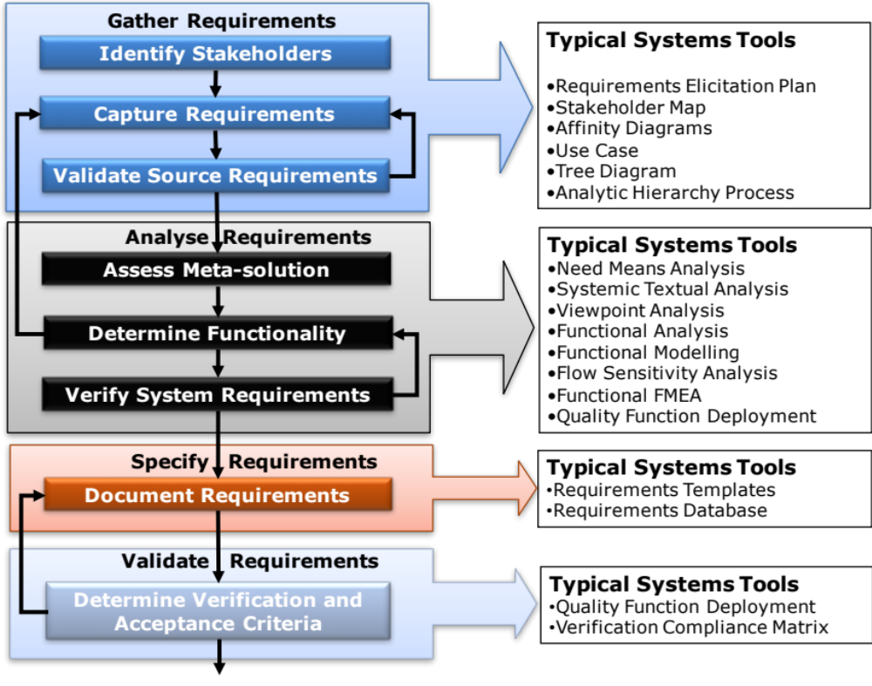
Determine Requirements: Tasks and Tools
Notes:
9
9

Slide 4
Understanding Requirements
Requirements originate from various sources
Source requirements are:
  Incomplete
  Inconsistent
  Incorrect
  Ambiguous
  Rambling
  Unconfirmable

Slide 5
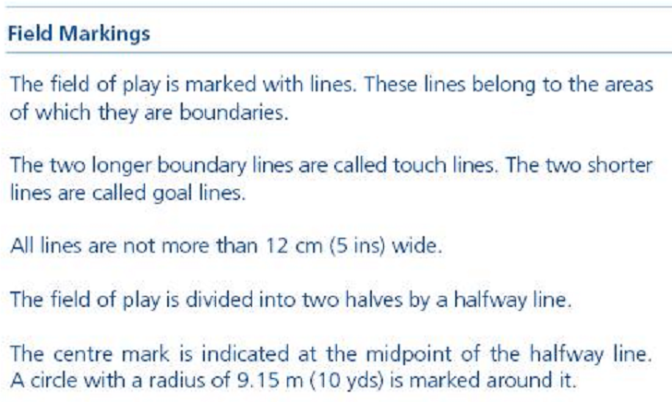
Incomplete
*

Slide 6
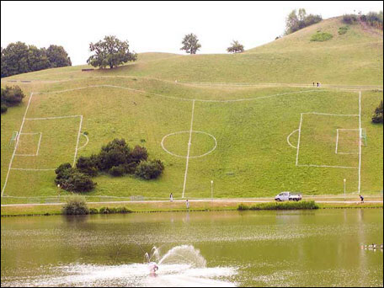
*

Slide 7

Inconsistent

Slide 8

Incorrect

Slide 9
Ambiguity of Understanding
“Aoccdrnig to a rscheearch at Cmabrigde Uinervtisy, it deosn't mttaer in waht oredr the ltteers in a wrod are, the olny iprmoatnt tihng is taht the frist and lsat ltteer be at the rghit pclae. The rset can be a toatl mses and you can sitll raed it wouthit porbelm. Tihs is bcuseae the huamn mnid deos not raed ervey lteter by istlef, but the wrod as a wlohe.”

Slide 10
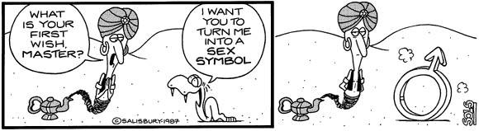
Ambiguity of Context

Slide 11
Un-confirmable
The System should be easy to use

Slide 12
Getting to Grips with Requirements
Achieving
  Completeness: requires several viewpoints to be taken
  Consistency, Conciseness and Clarity: requires the identification and removal of ambiguity this in turn requires communication to share information and arrive at a common understanding - to avoid having different perceptions
  Correctness and Confirmation: requires the verification and validation of requirements
This demands discipline and organization
A consistent approach to engineering the requirements – a process (high level shown earlier)
A consistent way of organizing and interpreting requirements – a requirement model or architecture

Slide 13
Organizing Requirements
There are many ways of organizing requirements, but only one systems view. This systems view of requirements provides a complete and consistent framework for organizing and understanding the deficiencies of a set of requirements.
It is called the Holistic Requirements Model and says that a complete and consistent set of system requirements will comprise:
  Operational Requirements
  Functional Requirements
  Non-functional Requirements
          Non-functional Performance Requirements
          Non-functional System Requirements
          Non-functional Implementation Requirements
Notes:
11

Slide 14
Operational Requirements
An Operational Requirement defines the major purpose of a system (i.e. what it fundamentally does - its capability) together with the key overarching constraints (that define the context)
All Systems have purpose and context – the Operational Requirement captures these
System
Operational Requirement
Dishwasher
To clean domestic eating and cooking utensils and crockery efficiently and without damage
Civil Aircraft
To transfer passengers and their baggage from one point to another efficiently and safely
Toaster
Overhaul
Aircraft
To achieve high aircraft availability in a cost
-effective and safe fashion
p.s. customers often don’t tell us their Operational Requirement
All systems have a purpose and a context. The job of the Operational Requirement is to define these in simple terms - to define the “mission” of the system

Slide 15

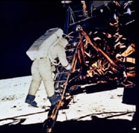
1961: Kennedy and the Ultimate Operational Requirement
President John F Kennedy in a speech to a joint session of Congress broadcast on TV and radio around the United States
“I believe that this nation should commit itself to achieving the goal,
  before this decade is out, of landing a man on the Moon and returning him safely to Earth”
One
Small
Step
Do you know the Operational Requirement of the system you are currently working on?
Is it written down in 20 or fewer words that is the common understanding of the whole team?
Writing an Operational Requirement is not easy. It can take several hours to arrive at an agreed set of 20 or fewer words!

Slide 16
Functional Requirements
Functional Requirements specify the functions of the system - what the system has to DO in order to satisfy its Operational Requirement
For example some of the functions of a civil aircraft are:
  Navigate aircraft
  Manoeuvre aircraft
  Store passengers
  Control passenger storage environment
  Communicate with other aircraft and ATC
  Etc.
Note that a Functional Requirement contains a function expressed as a phrase comprising a verb (action) followed by a noun (object)
  A functional requirement should define something the system has to DO
  A phrase can have a verb but not be a function! For example “easy to use” has a verb but this is not a function – we don’t say the system “does easy to use” it has “to be easy to use” – a property or attribute
  Best practice is to define functions as verb noun combinations that describe an action on an object
  Beware of pseudo-functions, verb noun combinations that do not define an action on an object. For example ”provide style” is a pseudo-function because style is a property and not a thing – it is an abstract noun rather than a common noun. Functions that end with an abstract noun are pseudo-functions
We try to write Functional Requirements in way that does not specify, imply or assume a solution (like seat passengers). However, every system has to integrate with legacy systems and therefore this is not always possible
Notes:
13

Slide 17
Non-functional Requirements
Non-functional Requirements are constraints on the system
Non-functional requirements do NOT specify what the system has to do (but they might imply it!)
Non-functional requirements specify:
  How well it does something
  How it does something
They fall into three categories:
  Non-functional Performance
  Non-functional System
  Non-functional Implementation
Notes:
14

Slide 18
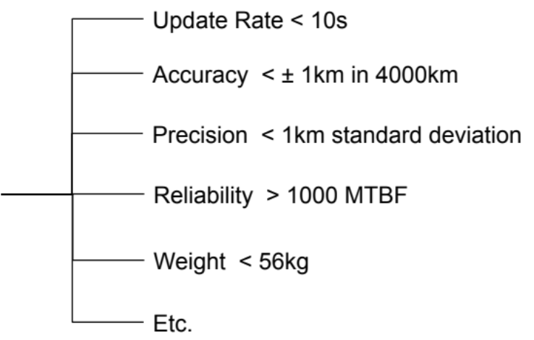
Non-functional Performance Requirements
Non-functional Performance Requirements are linked to functions and define how well a particular function has to perform – they are the constraints on a particular function. They comprise an attribute or property with an associated target value
Non-functional
Performance Requirement
System
Function
Aircraft
Navigate
aircraft
There is no verb! Hence these are not functional requirements (they do, however, IMPLY a Functional Requirement)

Slide 19
Non-functional System Requirements
Non-functional System Requirements define constraints that affect the whole system (at least more than one function) and include:
  Physical Attributes
    System Size
    System Weight
    etc.
  The ilities
    System Reliability
    System Maintainability
    System Interoperability
    etc.
  System Performance
    System Cost
    System Speed
    System Manoeuvrability
    etc.
Performance Requirements come in two forms: those that affect the system
and those that affect
a specific function
WE DELIBERATELY SEPARATE THEM
Note: the Non-functional System Requirements will get “flowed down” in to lower level requirements
Notes:
16

Slide 20
Non-functional Implementation Requirements
Non-functional Implementation Requirements define how a system is to be built in terms of a specific technology. They are solution-based requirements from the customer or legislation
Non-functional
Implementation Requirement
System
Function
Aircraft
Communicate ..
Phillips A/C 1267 VHF Radio
Dishwasher
Remove Waste
Electric Pump
Toaster
Receive Power
UK Domestic 13A Plug to BS1363
Overhaul
Aircraft
Maintain Component History
Microsoft Access database on a PC
Non-functional Implementation Requirements come in two types: Justifiable: where the requirement is reasonable - typically because it relates to a design decision made at the higher system level
Lazy: where the stakeholder has resorted to a solution-based requirement because they do not know how to express it otherwise
We need to identify the Non-functional Implementation Requirements and determine whether they are lazy or justifiable

Slide 21
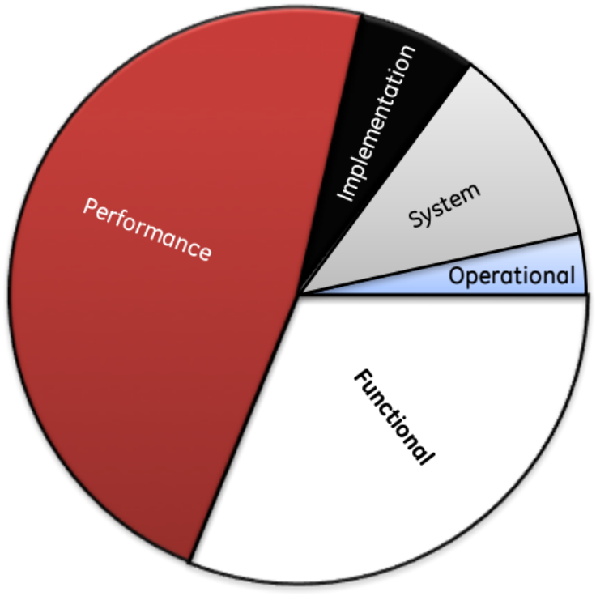
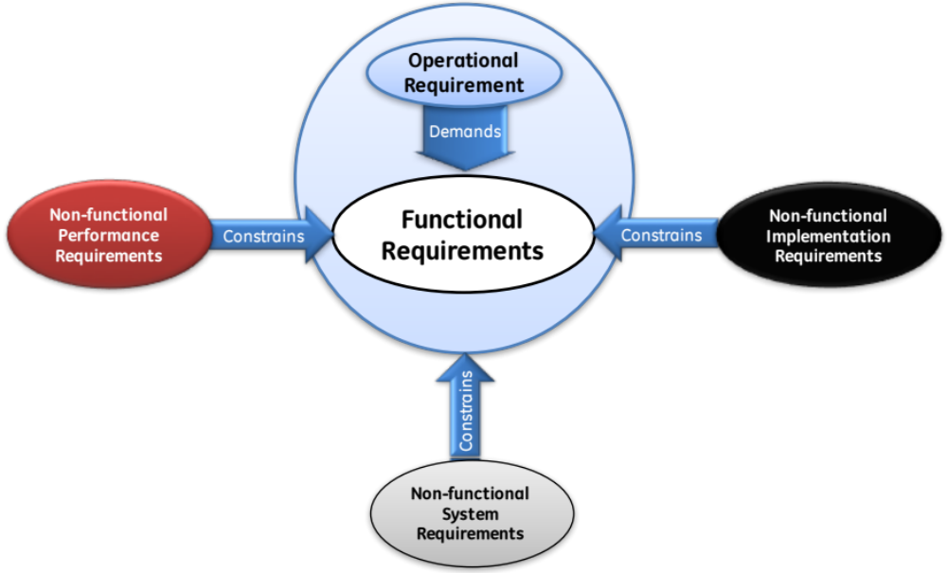
Summary: The Holistic Cutting of the Cake!
Holistic Requirements Model
The requirement categories of the Holistic Requirements Model are not arbitrary – together they form a complete and consistent set of requirements that has a structure which we can exploit to identify missing requirements and provide a powerful universal framework for system design

Slide 22
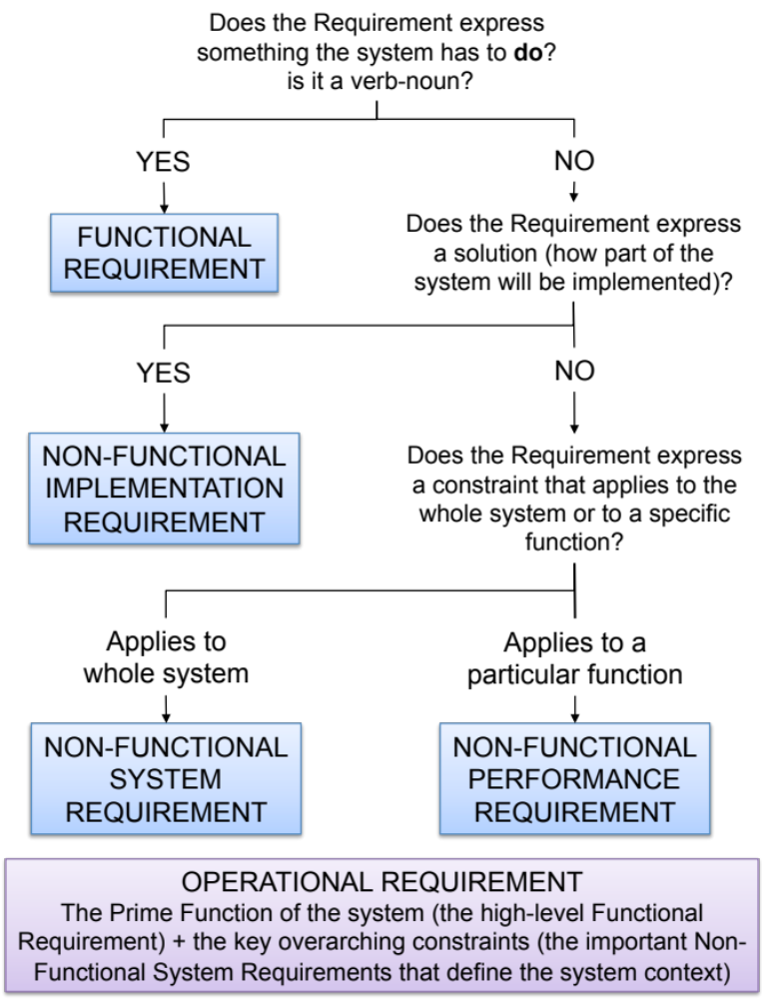
Using the Holistic Requirements Model
The flowchart opposite can help in consistently and correctly categorizing a set of source requirements
Its use does require practise BUT it can provide a fast method to identify the deficiencies in a set of source requirements
Even experienced users will “get it wrong” on the first pass – but know subsequent iteration will address any miscategorization

Slide 23

Exercise – Requirements Categories
In teams go through your toaster requirements and indicate which are:
  Operational requirements OP
  Functional requirements F
  Non-functional requirements
    System NFS
    Performance NFP
    Implementation NFI
Time 20 minutes

Slide 24
Nature of Customer Requirements
Humans tend not to specify functionality!
It is assumed or implied through constraints
What is often missing from a set of requirements is the functionality
It’s not surprising, actually! Customers are often not interested in how something is done but how well it’s done
We must, however, determine has to be done - the functionality - because it is this that the system has do to deliver the customer’s expressed requirements

Slide 25


What is the generic functionality necessary to
  “to toast bread product”
Time 10 minutes
Toasting System
To toast bread product
Notes:
.

Slide 26


Generic System Functionality
Generic System Function | Implementation
Load bread | Stick bread slice on end of toasting fork
Generate heat | Open coal fire
Apply heat | Use toasting fork to bring bread close to open fire
Monitor toasting | Look at the bread from time to time
Control toasting | Move bread to get even toasting
Remove heat | Use toasting fork to bring toast away from coal fire
Unload toast | Take toast off the toasting fork
Generic System Function | Implementation
Load bread | Put bread into slots
Generate heat | Electric elements
Apply heat | Lower bread next to elements using lever mechanism
Monitor toasting | Look at the bread from time to time
Control toasting | Timer
Remove heat | Lift bread from elements using lever mechanism
Unload toast | Take toast from slots

Slide 27
Generic Toaster Functionality
Toast Bread Product
System
Purpose
Load Bread
Generate Heat
Apply Heat
Monitor Toasting
Control Toasting
Remove Heat
Unload Toast
Sub-
Purpose
Did your requirements for the toaster specify any of these?
How do your requirements relate to the system functions?
Every engineered system has an underlying set of functionality that enables it to achieve its purpose. Similar systems will have similar functionality; indeed, systems that have the same purpose will have a set of functionality that is identical. This functionality is the Generic System Functionality (GSF) and is time invariant (provided the purpose does not change the GSF does not change)
Whilst the GSF is a consequence of the system purpose and is fixed, it can be implemented in many ways which change as technologies evolve and emerge. The generic system functionality is not the complete set of system functionality – a system can have functionality that is not generic:

Slide 28
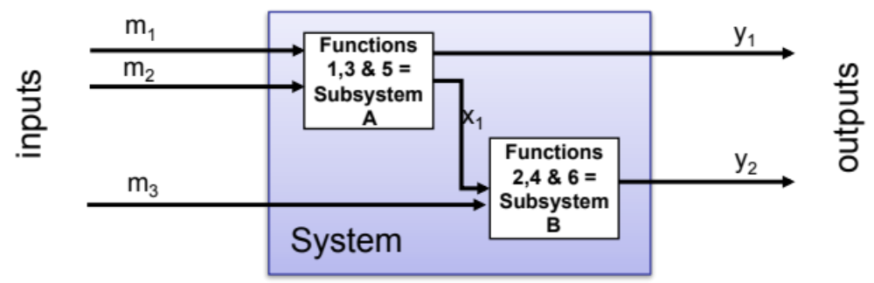
Using Functionality to Manage Complexity
In Systems Engineering
Systems Engineering handles complexity by dividing the problem up into simpler yet integrated and interdependent sub-elements. It helps to be able to identify the sub-elements at an early stage, but how this is done is critical - the best way is to determine an invariant system architecture
Purpose ≡ Function
For a given problem (Operational Requirement) there will be a fixed set of generic functions that will not change over time. These generic functions provide a rational and invariant basis for the division of that problem

Slide 29
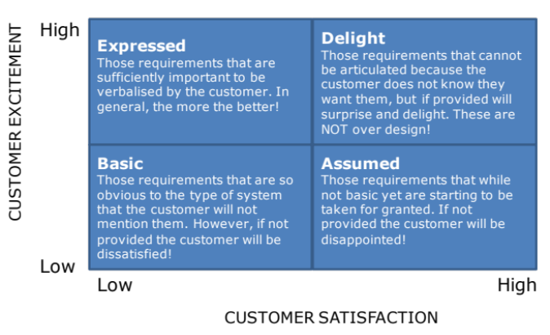


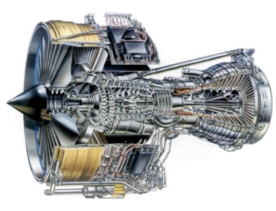

The Expressed Requirements are never complete, consistent, correct or clear
I WANT
are just the
The problem is getting from here to here
We have to find the unspoken requirements – but how?
WOW!
The complexity of the problem and the likely complexity of the solution means it is difficult to consider the whole.
The approach has to be one of divide and rule. But what is the best way to divide?

Slide 30



The Systems Approach to System Design
The bridge between requirements and the solution is the functionality (purpose)
FUNCTIONALITY
Requirements
-Land
Solution-Land
Functionality helps us uncover the unspoken requirements
Functionality is invariant and provides a consistent basis for dividing and ruling

Slide 31
Functionality Delivers what the Customer Wants
Generic System Functions
Load Bread
Generate Heat
Apply
Heat
Monitor
Toasting
Control
Toasting
Remove Heat
Unload Toast
Even Toasting
Quick
Affordable
Easy to Use
Attractive
Reliable
etc
What the customer wants
◎
○
△
Key = strong medium weak

Slide 32
Functionality Delivers what the Customer Wants
Generic System Functions
Load Bread
Generate Heat
Apply
Heat
Monitor
Toasting
Control
Toasting
Remove Heat
Unload Toast
Even Toasting
○
◎
◎
◎
◎
△
Quick
○
○
△
△
○
△
△
Affordable
○
△
△
△
○
△
○
Easy to Use
◎
○
◎
△
◎
Attractive
△
△
△
△
Reliable
○
◎
○
△
○
etc
What the customer wants
◎
○
△
Key = strong medium weak

Slide 33
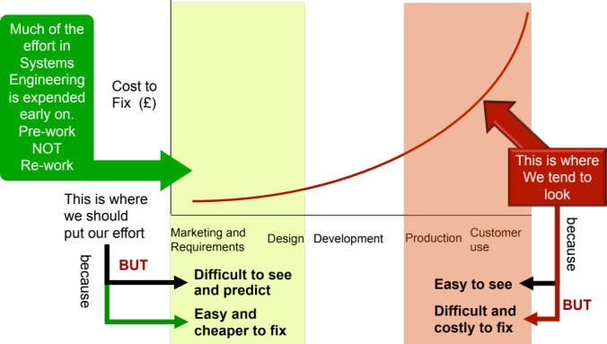
The Consequences
The Traditional approach appears “faster” we have an answer quickly BUT!
Elicit and gather stakeholder requirements
Determine system concept
Build prototype and test
Redesign
Build prototype and test
Realise/Produce
The Systems Engineering approach is initially slower! But faster in the end
Elicit and gather stakeholder requirements
Determine System Functionality
Determine system concept
Build prototype and test
Realise/Produce
1st
Attempt
And it gets quicker every time!
Elicit and gather stakeholder requirements
Determine System Functionality
Determine system concept
Build prototype and test
Realise/Produce
2nd
Attempt
Remember
Thinking Functionally is the Pre-work that will reduce the Rework

Slide 34
Generic Functionality Helps Us Innovate:
Automate Manual Functions
The next generation of toasters will aim to automate monitoring!
Generic System Function | Implementation
Load bread | Stick bread slice on end of toasting fork
Generate heat | Open coal fire
Apply heat | Use toasting fork to bring bread close to open fire
Monitor toasting | Look at the bread from time to time
Control toasting | Move bread to get even toasting
Remove heat | Use toasting fork to bring toast away from coal fire
Unload toast | Take toast off the toasting fork
Generic System Function | Implementation
Load bread | Put bread into slots
Generate heat | Electric elements
Apply heat | Lower bread next to elements using lever mechanism
Monitor toasting | Look at the bread from time to time
Control toasting | Timer
Remove heat | Lift bread from elements using lever mechanism
Unload toast | Take toast from slots
M
M
M
A
M
A/M
M
M
M
A/M
M
A/M
M
M

Slide 35


Generic Functionality Helps Us Innovate:
Expand the System Boundary
Include external boundary functionality
Generic System Function | Implementation
Load bread | Put bread into slots
Generate heat | Electric elements
Apply heat | Lower bread next to elements using lever mechanism
Monitor toasting | Look at the bread from time to time
Control toasting | Timer
Remove heat | Lift bread from elements using lever mechanism
Unload toast | Take toast from slots
Include external boundary functionality

Slide 36
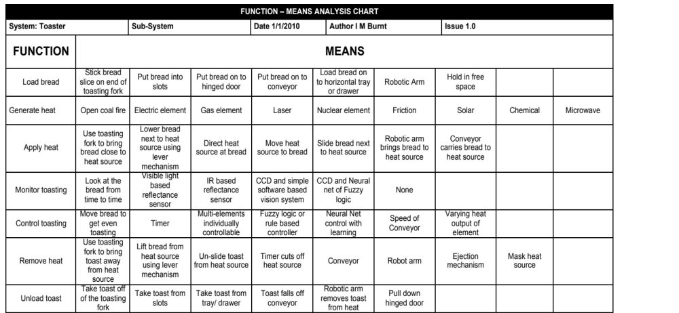
Generic Functionality helps us innovate:
Explore functional solutions

Slide 37
Discussion – Generate Heat - Solutions
What are all the solutions to the GENERATE HEAT function
Toasting System

Slide 38

Generic Functionality helps us Create Holistic Solutions

Slide 39
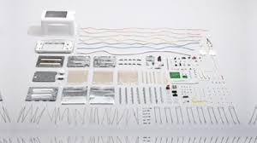
There is more to a system than its Generic Functionality
The generic system functionality is not the complete set of system functionality – a system can have functionality that is not generic:

Slide 40
There is more to a system than its Generic Functionality
The generic system functionality is not the complete set of system functionality – a system can have functionality that is not generic:
  Solution Dependent Functionality: A particular generic function solution may require further solution specific functionality. For example Generate Heat can be solved by Electric Element but this solution demands that you “Earth Case” to protect the user
  Legislation Dependent Functionality: legislation requires us to incorporate additional functionality. For example electric toasters have to isolate electricity
  Architectural Functionality: At the system level the collected functional solutions require further functionality typically to support, align, contain and protect. These functions manifest as structures, casings, frameworks, chassis etc.
  Emergent Functionality: Functionality aimed at managing emergent behaviour/properties. Usually relates to informing the user of failure situations

Slide 41
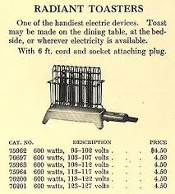
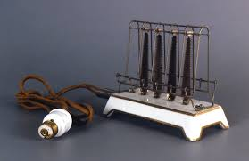
The First Toaster
The first complaints?

Slide 42
Finally: Functions can be Modelled Mathematically
In certain cases it is possible to model the system mathematically
  Outputs(Y) = function(Inputs(U), State(X))
If we can model the system before it is built we can predict its behaviour – there are NO SURPRISES!
What limits us is our mathematical ability to handle uncertainty
Inputs (U)
System (X)
Outputs (Y)

Slide 43


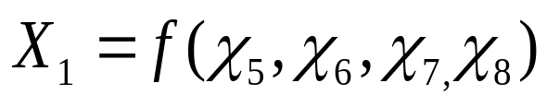
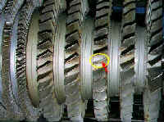
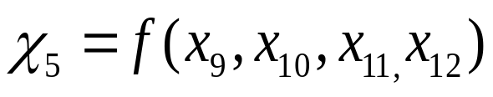
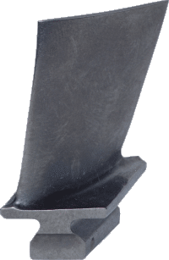

Traceability and Emergence
Assess potential emergent behaviour through the transmission of variation
The System Functionality provides a way of flowing down requirements

Slide 44
The Systems Approach to System Design
The bridge between requirements and the solution is the functionality (purpose)
FUNCTIONALITY
Requirements
-Land
Solution-Land
Functionality helps us uncover the unspoken requirements
Functionality is invariant and provides a consistent basis for dividing and ruling
Functionality helps us determine the system architecture
Functionality helps us identify and select the technological solutions

Slide 45
Holistic Requirements Model
The categories of requirements provide a complete and consistent framework that is driven by the Operational Requirements and has the Functional Requirements (what is to be done) at its heart
The Holistic Requirements Model allows us to “divide and rule” through using the functionality as the basis for work division

Slide 46
Using The Holistic Requirements Model
Operational
Requirements
Demands
Functional Requirements
Requires
Non-functional
Infers
Non-functional
Performance
Requirements
Implementation
Requirements
Requires
Infers
Requires
Infers
Non-functional
System
Requirements
We can use the Holistic Requirements Model to deduce and infer
the requirements that have not been expressed by the customer

Slide 47
Holistic Requirements Model:
Not the Silver Bullet
The Holistic Requirements Model provides a sound framework for understanding requirements and indicating where they are deficient but to achieve this requires
Clear
Concise
Complete
Consistent
Correct
Confirmable
Ambiguous
Rambling
Incomplete
Inconsistent
Incorrect
Un-measurable
PEOPLE
Determine
System
Requirements
System
Design
Requirements
Stakeholder/
Source
Requirements
TOOLS

Slide 48
Making it Work: People and Tools
Achieving completeness requires several viewpoints to be taken (demanding a multidisciplinary team approach)
Achieving consistency, conciseness and clarity (removing ambiguity) requires tools that allow the team to communicate, to share information and have a common understanding to avoid having different perceptions but simple enough for the whole team to use
Correctness means we need tools that can verify and validate requirements
There are many similar tools that can accomplish the same goal. We must NOT, however, introduce overly complex tools thinking that they will do a better job. The fundamental maxim of good Systems Engineering is KISS (Keep It Simple - Stupid)

Slide 49


















Process and Tools
Gather Requirements
Analyse and Validate Requirements
Specify
Requirements
The Business Requirements provide the rationale and overall business constraints for a system development project
Determine the Emergent Functionality
Stakeholder Map
Flow Sensitivity Analysis
The System Requirements defines the measurable design requirements for the system
Determine system stakeholders and select key ones for requirements elicitation
Identifies causal paths for potential system sensitivities
Functional Failure Mode and Effect Analysis
Quality Function Deployment 1
Captures the potential functional failure modes, effects and causes to identify remedies ab initio
Cross checks requirements for consistency and completeness
Verification Compliance Matrix
Affinity Diagram
Use Case
Determine Validation and Verification methods for each requirement and specify V& V Requirements
Elicit and capture key stakeholder requirements
Captures how a user expects to interact with a system
Determine the necessary generic System Functionality
Tree Diagram/Analytic Hierarchy Process
Systemic Textual Analysis
Viewpoint/Functional Analysis
Function Flow Diagram
Organize and prioritise key stakeholder requirements
Analyses expressed requirements into their atomic form to identify and clarify missing and ambiguous requirements
Generates and organizes system generic functionality necessary to achieve the Operational Requirement
Captures and shows how the component functionality of a system must cooperate to deliver the Operational Requirement
Requirements Database
The User Requirements defines the expressed requirements of a particular stakeholder or stakeholders
Need Mean Analysis
Identifies and explores system solutions at different levels to determine System Meta-Solution

Slide 50
Summary
The nature of Stakeholder Expressed Requirements has been discussed. They are often incomplete, inconsistent, rambling, incorrect, ambiguous and un-confirmable
The Holistic Requirements Model is shown to help “untangle” the requirements mess!
  Operational
  Functional
  Non-functional
    Performance
    System
    Implementation
System complexity demands a team approach which in turn demands a structured process and a common tool set
Understanding requirements requires us to take several perspectives and to review and check our understanding
Notes:
32

