Slide 1


Analyse Requirements
Modelling Requirements using
Functional
Modelling
Secondary Information Goes Here
This Session:
To describe and practise Functional Modelling as a tool that can be used to help in Analysing Requirements by building an operational model of the system of interest

Slide 2


















Process and Tools
Gather Requirements
Analyse and Validate Requirements
Specify
Requirements
The Business Requirements provide the rationale and overall business constraints for a system development project
Determine the Emergent Functionality
Stakeholder Map
Flow Sensitivity Analysis
The System Requirements defines the measurable design requirements for the system
Determine system stakeholders and select key ones for requirements elicitation
Identifies causal paths for potential system sensitivities
Functional Failure Mode and Effect Analysis
Quality Function Deployment 1
Captures the potential functional failure modes, effects and causes to identify remedies ab initio
Cross checks requirements for consistency and completeness
Verification Compliance Matrix
Affinity Diagram
Use Case
Determine Validation and Verification methods for each requirement and specify V& V Requirements
Elicit and capture key stakeholder requirements
Captures how a user expects to interact with a system
Determine the necessary generic System Functionality
Tree Diagram/Analytic Hierarchy Process
Systemic Textual Analysis
Viewpoint/Functional Analysis
Function Flow Diagram
Organize and prioritise key stakeholder requirements
Analyses expressed requirements into their atomic form to identify and clarify missing and ambiguous requirements
Generates and organizes system generic functionality necessary to achieve the Operational Requirement
Captures and shows how the component functionality of a system must cooperate to deliver the Operational Requirement
Requirements Database
The User Requirements defines the expressed requirements of a particular stakeholder or stakeholders
Need Mean Analysis
Identifies and explores system solutions at different levels to determine System Meta-Solution

Slide 3
Where are we?: Analyse Requirements
Assess System Meta-Solution
Applying Systems Thinking to the task of analysing requirements tells us that we will need to take various perspectives to help uncover the unspoken requirements
Determine “working” Operational Requirement
Determine System Functionality
Determine Emergent Functionality
Determine Non-Functional Performance Requirements
The iteration may not be simple
Verify and Validate Requirements

Slide 4
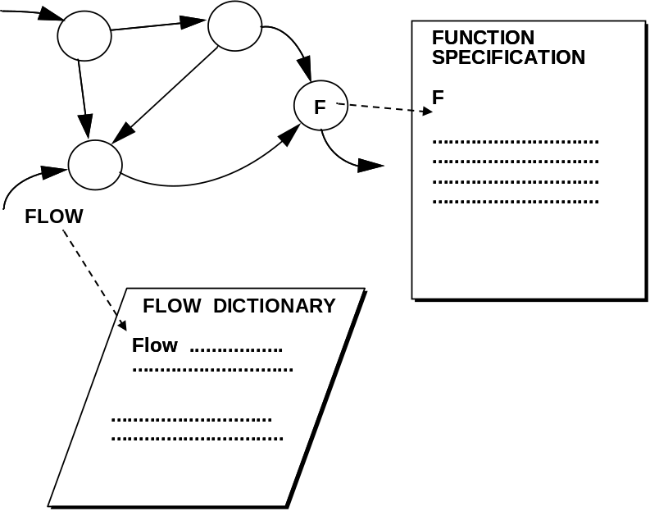
Functional Modelling
What is it?
  Functional Modelling is a simple, but incredibly powerful tool to create a readable and maintainable model of an existing or planned system that highlights the functionality and the interconnectivity between the system functions
Why use it?
  Functional Modelling uses the logic of the system ”problem” to determine the functionality that is necessary to deliver the Operational Requirements of a system
Where to use it?
  Whenever attempting to determine and analyse a set of requirements.
  Particularly useful when there is a need to ensure that the required system functionality is complete and consistent
How does it work?
  Functional Modelling uses three sub-tools to build a model of the system. These are:
    FUNCTION FLOW DIAGRAM
    FLOW DICTIONARY
    FUNCTION SPECIFICATION

Slide 5
FUNCTION FLOW DIAGRAM (FFD)
(Similar to Data Flow Diagrams)
Is a network representation of the system in terms of its component functions and the interdependencies or “flows” between the functions
One of the beauties
of the Function Flow Diagram is its limited diagramming convention. This enables the team to concentrate on understanding the system rather than the modelling notation
TERMINATOR
FLOW
FLOW
FUNCTION

Slide 6
Function Flow Diagram Conventions
The FUNCTION NAME - best defined as a simple verb noun phrase
FUNCTION: transforms input flows into output flows
TERMINATOR: a Function or source or destination of flows external to the system
FLOW: an input or output quantity (information, control, material or energy)
FUNCTION
NAME
TERMINATOR NAME - either a verb noun phrase (FUNCTION) or a noun phrase (thing)
TERMINATOR
NAME
FLOW_NAME
The FLOW NAME - a noun (thing)
Note: Software Engineers may have come across a similar modelling method called Data Flow Diagrams. These have similar diagramming conventions and use a fourth symbol to represent data stores. In general system modelling this fourth symbol is less useful and has been omitted. The aim with FFDs is simplicity.

Slide 7
Flow Dictionary and Function Specification
Flow Dictionary (FD)
  Complements the Function Flow Diagrams by documenting each of the flows on any of the diagrams
  It is a complete set of formal definitions which are accomplished by declaring the component elements of each input or output flow and the relationships that apply among them
Function Specification (FS)
  Specifies the component functions by defining the transformation that converts inputs to outputs
  Function specifications are written in a structured language

Slide 8
The Model
The three sub-tools allow the construction of a model which is consistent, complete and unambiguous
The key element of the model is the Function Flow Diagram
This model provides the first estimate of
Y = f(x, u)
FUNCTION
SPECIFICATION
F
F
..............................
..............................
..............................
..............................
FLOW
FLOW DICTIONARY
Flow .................
.............................
.............................
...............................

Slide 9
Modelling Process
Step 1
Collect and generate information about the system of interest
Step 2a
Draw Function Flow Diagrams
Step 2b
Compile Flow Dictionary
Draft System Model
Step 2c
Generate Function Specifications
Step 3
Walkthrough the draft model with customer/ reviewer and seek approval
A key step in any modelling activity is validation. With Functional Modelling this is achieved by walkthroughs
Okay?
Approved System Model

Slide 10
Role of the Function Flow Diagrams
The FFD describes the system from the viewpoint of the component functions and the flows (the connections or dependencies) between functions
The FFD highlights the potential or logical interfaces between functions That is logic and common sense says there should be a flow. Note that some of these logical interfaces will become real interfaces
Flows do not indicate movement - they just indicate that a particular function requires a flow as an input, or produces a flow as an output
The FFD deliberately de-emphasises control and decision making to highlight the logical interfaces. Decisions are hidden within functions and defined in the Functional Specifications
The FFD is an abstract view of the system and therefore flows can represent
  Physical quantities
  Energy flows
  Information (data) flows
  Control signals

Slide 11
Structured and Top Down
The System “bubble” should be labelled with the system name. It is good practice to write the Operational Requirement to maintain the “functional” view .
It is also common practice to label it as Function 0
For anything larger than a very small system, a single FFD will be cluttered with detail and not easily comprehended
To overcome this a 'Top-Down' treatment is used to produce a levelled set of FFDs
The starting point is to represent the system of interest as a single function; showing the boundary of the system and its interactions and interfaces with the environment - the “super-system”
This top level FFD is called the CONTEXT DIAGRAM - it shows the system in its operational context
The interfaces between the system and its terminators should be captured as flows which should be given a meaningful name
Super-
system
Element/
Function
INTERFACE
NAME
SYSTEM NAME
Operational
Requirement
INTERFACE NAME
INTERFACE NAME
0
INTERFACE
NAME
Super-
system
Element/
Function
INTERFACE
NAME
Super-
system
Element/
Function
Elements which the system interacts with are captured as terminators. They should be named as a thing or as a function (verb noun)

Slide 12

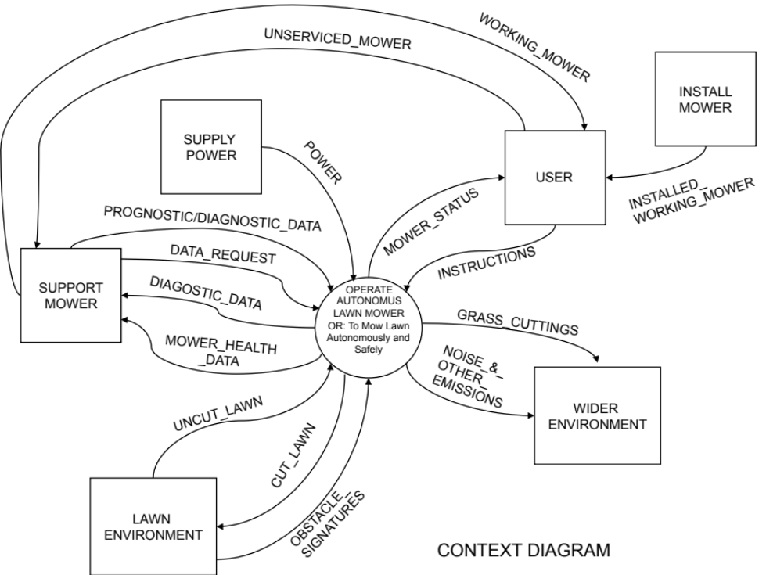
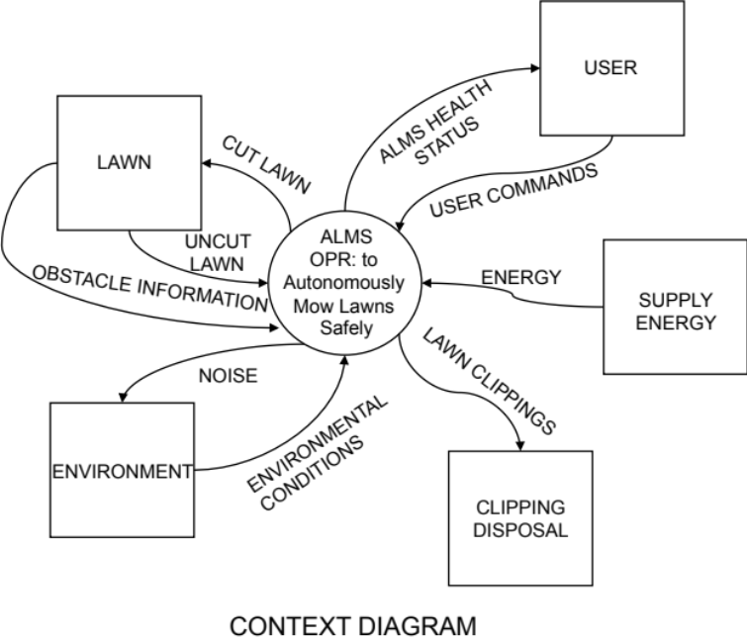
Context is Important
Both Diagrams are “right” but show a different perspective of the system.
It is often convenient to start by considering the operational perspective first.

Slide 13
Modes of Operation
Many Systems have several modes of operation, for example: Deployment, Start up, Operation, Shut down, etc.
When attempting to model such systems, a single “all-encompassing” model is often not possible
In such cases it is best to identify the modes of operation and construct a model for each mode
Power-Off Mode
Initialisation
Mode
It is often easier to consider each mode separately and construct several models
Diagnostic Service
Mode
Operational
Mode

Slide 14
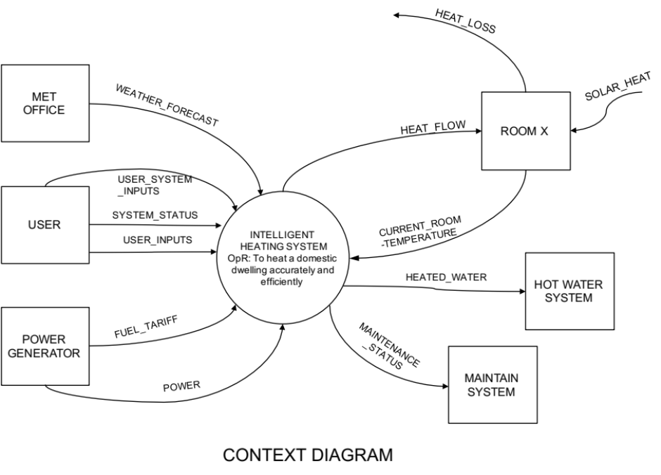
Exercise – Context Diagram
In teams
Construct a CONTEXT DIAGRAM for the case study example
Assume the system is fulfilling its prime purpose
Flip chart the outcomes and be prepared to share with the rest of the group
Time: 20 Minutes

Slide 15
Defensible Logic to Create the Lower Level FFDs
Rules:
  The CONTEXT DIAGRAM is decomposed on the next level of FFD into a number of functions that can realistically be represented on a single diagram. This is called DIAGRAM 0
  A rule of thumb is that there should be no more than 7 functions on any one FFD
  The functions of DIAGRAM 0 are taken in turn and decomposed further to form lower-level FFDs
  This activity of successive decomposition is continued down to the 'primitive' level where the functions cannot usefully be further decomposed.
From the system purpose, the approach is to logically deduce the necessary system functionality i.e. what the system will have to do to meet its purpose.
We use the input flows from the CONTEXT DIAGRAM to determine the functionality logically necessary to generate the output flows.
Central to this logic is that every function MUST have at least one input flow and one output flow

Slide 16
Lower Level FFDs
The CONTEXT DIAGRAM is decomposed on the next level of FFD into a number of functions that can realistically be represented on a single diagram. This is called DIAGRAM 0
A rule of thumb is that there should be no more than 7 functions on any one FFD
The functions of DIAGRAM 0 are taken in turn and decomposed further to form lower-level FFDs
This activity of successive decomposition is continued down to the 'primitive' level where the functions cannot usefully be further decomposed:
  decomposition should continue down to, and stop at the level where it is necessary to make design decisions
  The purpose of functional decomposition is to logically deduce the necessary system functionality – we use the tool to help us logically deduce functionality i.e. what the system will have to do. At this point we are actually engineering requirements. This is not design: we are not specifying how something is to be done but deciding what is to be done. Please note that “bad” requirements engineering cannot be compensated for by “good” design!

Slide 17
Functions to Sub-functions
EXTERNAL
ELEMENT
Z
EXTERNAL
ELEMENT
X
A
A
SYSTEM
NAME
Operational
Requirement
FUNCTION
4
D
FUNCTION
1
B
EXTERNAL
ELEMENT
Y
C
FUNCTION
2
D
CONTEXT DIAGRAM
B
FUNCTION
3
The central function in the Context Diagram is described in more detail in a lower level diagram
DIAGRAM 0
C

Slide 18
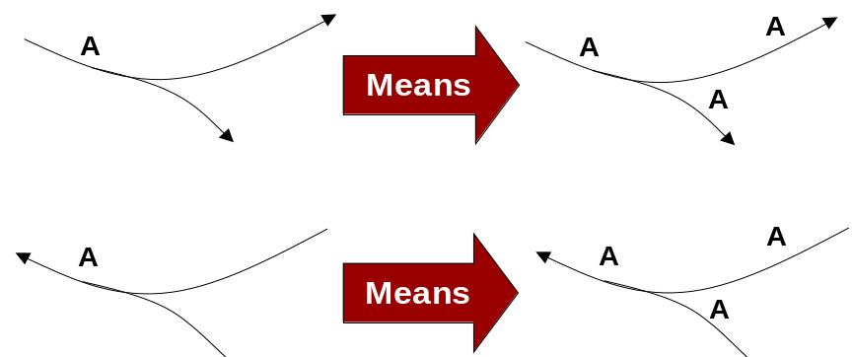
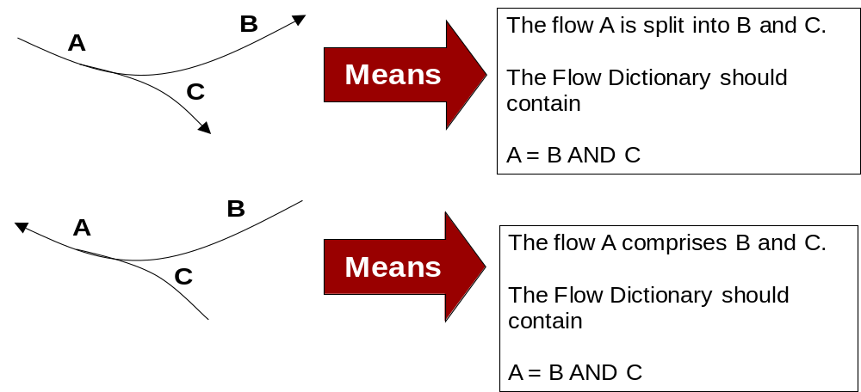
Flow Conventions

Slide 19
Use Logic
FLOW_X
A Function CANNOT produce an output without receiving an input
FUNCTION
A
FUNCTION
B
A Function CANNOT have an input without producing an output
FLOW_Z

Slide 20
Balancing Flows
A1
A
1.1
1
C
B
1.2
A2
B
Parent Diagram
Child Diagram
Inputs and outputs should balance between parent and child diagrams. Just as we have functional decomposition to show increasing detail, diagrams can also have flow decomposition with the relationship defined in the Flow Dictionary
A = A1 AND A2

Slide 21
USER
DOMESTIC
SERVICES
USER_INSTRUCTIONS
POWER
DIRTY_ITEMS
MAINS_WATER
USER_INFO
CLEANED_ITEMS
CLEANING_AGENTS
INTELLIGENT
WASHING
SYSTEM
To automatically
& intelligently clean
items without damage
WASTE_WATER
NOISE
DIAGNOSTIC_REQUEST
HEAT
LOCAL ENVIRON-MENT
VIBRATION
DIAGNOSTIC_INFO
DIAGNOSTIC
USER
Draft CONTEXT DIAGRAM

Slide 22
DIRTY_ITEMS
LOADED_DIRTY
_ITEMS
Draft DIAGRAM 0
DETERMINE
LOAD
MAKE UP
2
POWER
LOAD DIRTY ITEMS
1
MANAGE
POWER
9
USER_INSTRUCTIONS
DIAGNOSTIC_REQUEST
DIAGNOSIS_DATA_REQUEST
MANAGED
_POWER
(TO EVERY
FUNCTION)
LOAD_MAKE_UP
SENSED_LOADED_DIRTY_ITEMS
BEST_CYCLE
Note: All Functions may produce heat, vibration and noise, but assume that the WASH ITEMS function dominates
RECEIVE
INSTRUCTIONS
3
RECEIVED_
INSTRCUTIONS
DETERMINE
BEST CYCLE
5
HEAT
VIBRATION
CLEANING
_AGENTS
DIAGNOSIS_
_DATA
REQUEST
WASH
ITEMS
6
WASTE_WATER
CLEANING_MIX
_DEMAND
LOAD_MAKE_
UP_STATUS
NOISE
MANAGE
CLEANING
FLUIDS
4
DISPENSED_
CLEANING_MIX
WASHED
_ITEMS
In this example more that 7 functions have been used! The tool is iterative and in the early stages this often happens. Later versions should be more compliant with the “rules”.
WASH_STATUS
CLEANING
_AGENT
_STATUS
MAINS_WATER
UNLOAD
CLEANED
ITEMS
7
TRANSMIT
USER
INFO
8
USER_INFO
DIAGNOSTIC_INFO
CLEANED_ITEMS

Slide 23
SENSED_
LOADED_
DIRTY_ITEMS
Note there is no explicit time order. It is implicit and deliberate to emphasize functions and interconnections
FILL/MIX
LOAD
6.1
HEAT
LOAD
6.2
HEATED_
MIXED_LOAD
MIXED_LOAD
DISPENSED_
CLEANING
_MIX
HEAT_
STATUS
CLEAN
LOAD
6.3
MIX_STATUS
HEAT_DEMAND
CLEAN_DEMAND
USED_CLEANING
_WATER
MIX_DEMAND
CLEAN_STATUS
CLEANED
_LOAD
DRAIN WASTE
WATER
6.7
BEST_CYCLE
CONTROL
WASH
CYCLE
6.4
DRAIN_DEMAND
DRAIN_STATUS
WASTE_
WATER
RINSE_DEMAND
RINSE
LOAD
6.6
USED_RINSE
_WATER
RINSE_STATUS
EXTRACT
_DEMAND
DAMP_
CLEANED_ITEMS
EXTRACT
_STATUS
Draft DIAGRAM 6
EXTRACT
EXCESS
WATER
6.5
EXTRACTED_WATER
RINSED_LOAD
DAMP_
CLEANED_ITEMS

Slide 24
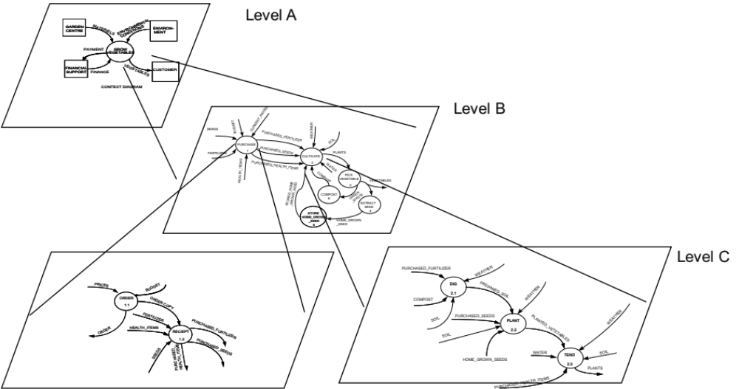
The Final Result: A Set of Levelled FFDs

Slide 25
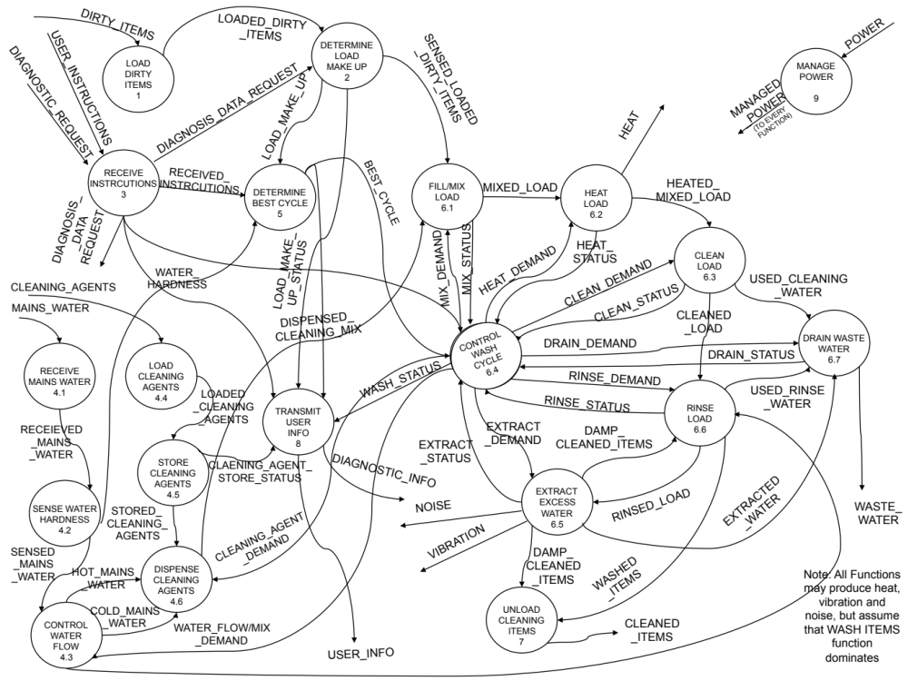
At the Primitive Level
If we were to combine all the Function Flow Diagrams together at the lowest level of detail (the primitive level) we would have a single picture of the system requirements in terms of the system functionality and the interdependencies

Slide 26
Example: Service Type System Context Diagram
GARDEN
ENVIRONMENTAL
PHYSICAL
ENVIRONMENT
CENTRE
MATERIEL
_CONDITIONS
GROW
VEGETABLES
SYSTEM
0
REPAYMENTS
FINANCIAL
SUPPORT
FINANCE
VEGETABLES
CUSTOMER
CONTEXT DIAGRAM

Slide 27
Example Diagram 0
CURRENT_PRICES
SEEDS
INVOICE
WEATHER
PURCHASED_FERTILIZER
PURCHASE
SUPPLIES
SOIL
FERTILIZER
1
PURCHASED_SEEDS
PLANTS
CULTIVATE
CROP
ORDER
2
PURCHASED_HEALTH_ITEMS
WATER
HEALTH_ITEMS
COMPOST
PICK
VEGETABLES
VEGETABLES
3
STORED_HOME
_GROWN_SEED
COMPOST
WASTE
6
GREEN
_WASTE
EXTRACT
SEED
STORE
HOME GROWN
SEED
5
4
DIAGRAM 0
HOME_GROWN
_SEED

Slide 28
Example Diagram 2
PURCHASED_FERTILIZER
WEATHER
PREPARE
GROWING
MEDIUM
WEATHER
PREPARED_SOIL
2.1
COMPOST
WEATHER
SOIL_QUALITY
PURCHASED_SEEDS
PLANT
VEGETABLES
SOIL_QUALITY
2.2
PLANTED_VEGETABLES
SOIL_QUALITY
WATER
TEND
VEGETABLES
HOME_GROWN_SEEDS
2.3
PLANTS
DIAGRAM 2
PURCHASED_HEALTH_ITEMS

Slide 29
Constructing Function Flow Diagrams
Constructing a set of Function Flow Diagrams is iterative
  Start with the Context Diagram but expect it not to be complete until some of the lower diagrams have been drafted
  Be prepared to modify diagrams
  Work forwards and backwards
    Forwards: start with a system input (look for the one that initiates the operational requirement) and ask what happens to it as a “sequence” of functions that leads to an output
    Backwards: start with a system output (look for the one that relates to the operational requirement) and determine what functions would deliver this output, then ask what inputs are necessary, then what functions generate those inputs etc.
  Diagrams should “tell a story”
  Consider the operational view of the prime system first
The Viewpoint Structure Chart is often a good starting point for constructing DIAGRAM 0 – BUT BEWARE:
  You need to be clear on the system you are modelling and the context (e.g. Operational model vs. lifecycle model)
  All the functions identified on a Viewpoint Structure Chart should appear on the Function Flow Diagrams BUT the groupings/levels selected may be different (at some point the structure chart should be updated to reflect the Function Flow Diagrams)

Slide 30
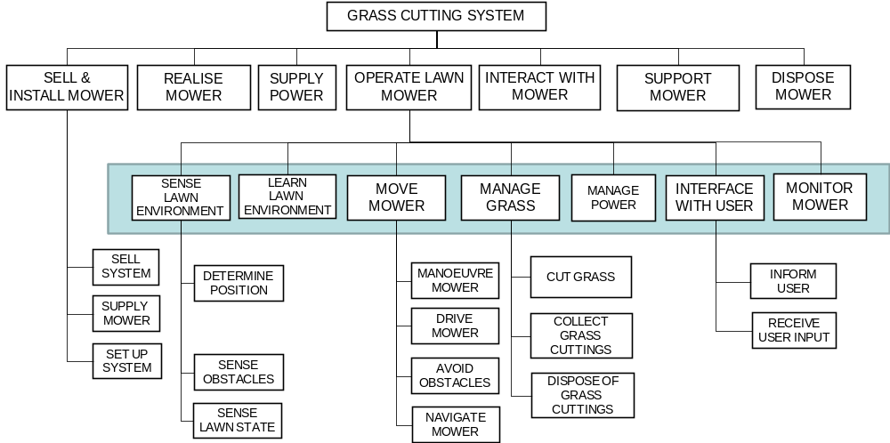
Starting DIAGRAM 0
Use the Viewpoint Structure Chart to help draw DIAGRAM 0. Identify the System of Interest
SENSE LAWN ENVIRONMENT
INTERFACE WITH USER
MANAGE POWER
These functions should be reconciled with the inputs and outputs of the CONTEXT DIAGRAM before determining the flows between functions
MONITOR MOWER
MOVE MOWER
MANAGE GRASS
LEARN LAWN ENVIRONMENT

Slide 31
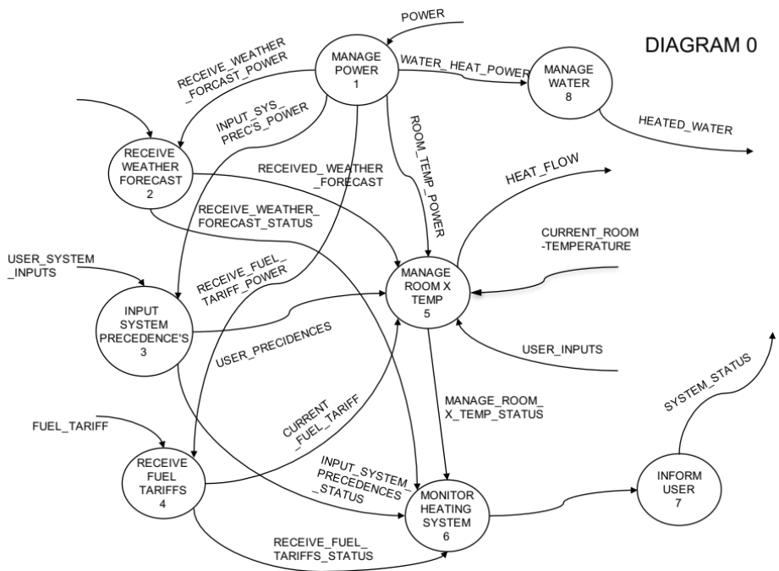
Exercise: Diagram 0 and Beyond
In teams
Using the earlier CONTEXT DIAGRAM construct lower level Function Flow Diagrams – require at least Diagram 0 and one lower level FFD (don’t bother with the Flow Dictionary or Function Specifications)
Flip chart the outcomes and be prepared to share with the rest of the group
Time: 45 Minutes

Slide 32
HEAT_LOSS
WEATHER SERVICE
SOLAR_HEAT
WEATHER_FORECAST
ROOM X
HEAT_FLOW
USER_SYSTEM
_INPUTS
USER
INTELLIGENT
HEATING SYSTEM
OpR: To provide hot water & controllable space heating in a multi-room dwelling with optimum energy usage
SYSTEM_STATUS
CURRENT_ROOM
-TEMPERATURE
USER_INPUTS
HOT WATER DISTRIBUTION SYSTEM
HEATED_WATER
POWER
GENERATOR
FUEL_TARIFF
MAINTENANCE_STATUS
MAINTAIN
SYSTEM
POWER
CONTEXT DIAGRAM

Slide 33
POWER
MANAGE
POWER
1
DIAGRAM 0
RECEIVE_WEATHER
_FORCAST_POWER
WATER_ HEAT_POWER
MANAGE
WATER
8
WEATHER_FORECAST
INPUT_SYS_
PREC’S_POWER
HEATED_WATER
RECEIVE
WEATHER
FORECAST
2
RECEIVED_ WEATHER
_FORECAST
ROOM_TEMP_POWER
HEAT_FLOW
RECEIVE_WEATHER_
FORECAST_STATUS
CURRENT_ROOM
-TEMPERATURE
USER_SYSTEM
_INPUTS
MANAGE
ROOM X
TEMP
5
RECEIVE_FUEL_
TARIFF_POWER
INPUT
SYSTEM
PRECEDENCE'S
3
USER_PRECIDENCES
USER_INPUTS
SYSTEM_STATUS
CURRENT
_FUEL_TARIFF
MANAGE_ROOM_
X_TEMP_STATUS
FUEL_TARIFF
RECEIVE
FUEL
TARIFFS
4
INFORM
USER
7
INPUT_SYSTEM_
PRECEDENCES
_STATUS
MONITOR
HEATING
SYSTEM
6
RECEIVE_FUEL_
TARIFFS_STATUS
FUNCTION 5 FUNCTIONALITY IS REPEATED FOR EACH HEATING AREA/ROOM

Slide 34
DIAGRAM 5
FUNCTION_STATUS
USER_PROPS_INPUT
CURRENT_ROOM
-TEMPERATURE
INPUT ROOM
PROPS
5.1
SENSE
ROOM TEMP
5.2
NOTE: THIS FLOW FROM EVERY FUNCTION
SENSED_ROOM
-TEMPERATURE
ROOM_PROPS
PREDICT
ROOM
TEMP
PROFILE
5.3
RECEIVED_ WEATHER
_FORECAST
PREDICTED_
ROOM_TEMP
_PROFILE
USER_INPUT
SET
DESIRED
ROOM TEMP
5.4
SET_TEMP
DETERMINE
ROOM HEAT
PROFILE
5.5
USER_PRECIDENCES
HEAT
PROFILE
ROOM_BEHAVIOUR
DELIVER
ROOM HEAT
PROFILE
5.6
CURRENT
_FUEL_TARIFF
ROOM_TEMP_POWER
LEARN ROOM
BEHAVIOUR
5.7
HEAT_FLOW

Slide 35
Role of the Flow Dictionary
The Flow Dictionary (FD) specifies precisely what is meant by each and every flow on the FFDs
Just as the FFDs show the decomposition of the functions, the Flow Dictionary performs a similar task for the Flows
Remember that the Flows are often abstracted and show “information” such a voltages, fluid flows, material flows etc. and the dictionary is important in making sure this is clear.
Remember also that every Flow represents a logical interface (that could be a real interface in the real world) hence the Flow Dictionary is specifying the system interfaces

Slide 36
Flow Dictionary Conventions
The Flow Dictionary makes use of 5 operators that allow for the definition of any possible entry:
  IS EQUIVALENT TO or =
  AND or +
  EITHER-OR or [Item1, item2]
  REPETITIONS OF { item }
  OPTIONAL (item)
Example
  TELEPHONE_DIRECTORY = {[BUSINESS_NAME, PERSONAL_SURNAME + (INITIALS)]+ADDRESS+
  TELEPHONE_NUMBER}
The Flow Dictionary specifies the logical interfaces of the system – it is an early Interface Requirements Document (IRD)
Examples
CLEANING_AGENTS = DETERGENT + (STAIN_REMOVER) + (FABRIC_CONDITIONER) + (BLEACH) + (DYESTUFF)
At the root definition a common approach is to change case
DETERGENT = all currently available powders, tablets and liquids in IS 9756
POWER = 28V dc supply to EN 719745
The underscore is used to indicate that this is a single item and not two or more items
It is in the Flow Dictionary that we can capture the Non-functional Requirements

Slide 37
Role of the Function Specification
The Function Specification provides more information about a particular function.
It should describe in more detail what the function does and if possible describes the rules governing the transformation of input flows to output flows
Usually written in a structured specification language based on high level procedural software languages
FUNCTION 8.1 MONITOR IWM – this function will collect appropriate health data from potentially all other functions in order to perform a self-test and report on the current status of the system.
IF POWER on
  DO THE FOLLOWING
  Collect Health Data
Execute SELF_TEST
IF SELF_TEST Failed
Generate USER_MESSAGE
Deliver USER_MESSAGE
If critical initiate system shut-down
ELSE IF SELF_TEST ok
Generate USER_MESSAGE
Deliver USER_MESSAGE
Initiate WASH_CYCLE
END
UNTIL POWER OFF

Slide 38
Creating a Functional Dictionary
The initial Functional definition should comprise:
FUNCTION 8.1 MONITOR IWM – this function will collect appropriate health data from potentially all other functions in order to perform a self-test and report on the current status of the system.
IF POWER on
  DO THE FOLLOWING
  Collect Health Data
Execute SELF_TEST
IF SELF_TEST Failed
Generate USER_MESSAGE
Deliver USER_MESSAGE
If critical initiate system shut- down
ELSE IF SELF_TEST ok
Generate USER_MESSAGE
Deliver USER_MESSAGE
Initiate WASH_CYCLE
END
UNTIL POWER OFF
Input A
VERB NOUN
Output X
Input B
Output Y
+
Input C
Output W
Input D
Or a
CONTEXT DIAGRAM for each Function
Function Performance Requirements

Slide 39
Functions to Requirements
Functions specify what a system has to do to meet a system’s Operation Requirement. In turn we need to specify how well the individual functions have to perform. The Holistic Requirement Model calls these the Non-functional Performance Requirements
Non-functional Performance Requirements comprise: a set of metrics, measures or properties and associated numerical value as a target, lower or upper limit, that defines how well a particular function has to perform
For any given function there WILL be many NFP requirements that are specific to that function
Radiant heat output > 0.5kW/m² radiant heat per side
Heat area per side = 140x140mm
Time to 350ºC < 10 seconds
Generate Heat
Cost (DTUPC) < £0.47
First Year Failure Rate < 0.005
etc.

Slide 40
Deducing Non-functional Performance Requirements
If we are designing a system with a known meta-solution we should have most the of the NFP requirements. It will be a matter of collecting and collating them against the Functions
If not, a common approach here is to consider two solutions, say A and B, to each function and ask what could be measured to decided between them? The key here is to identify measurable characteristics
We should also consider the flow-down of the Non-functional System requirements

Slide 41
Old World meets New World
Function Flow Diagrams, Flow Dictionary and Function Specification can provide a link between Systems Engineering and modern Object Oriented approaches and Agile programming
  The Context Diagram and Lower Level Diagrams are a nothing more than a sophisticated USE Case Diagram
  The Function Specification (Function Dictionary) are both internal and external USE Cases
  The Flow Dictionary provides a draft Data Structure
Care must be exercised as to when the decision to move into software is appropriate

Slide 42
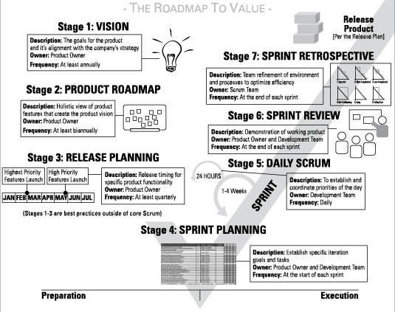
V Diagram of Agile (a Version)

Slide 43
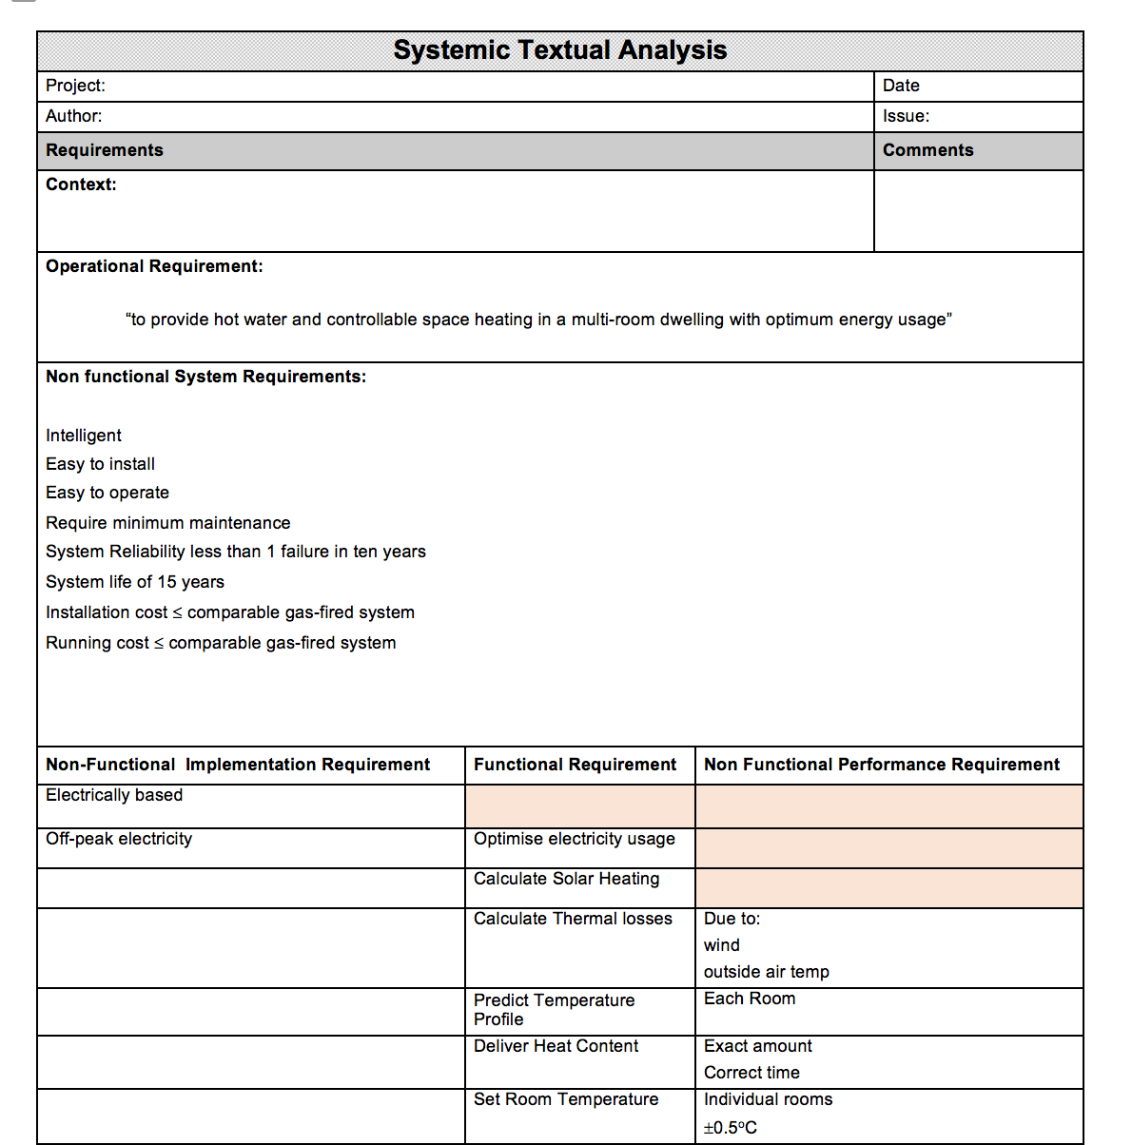
Tying up loose ends
Functional Modelling is very good at helping to identify 10% - 20% of system functionality not discovered by Viewpoint Analysis
Functional Modelling is very good at defining the logical interfaces of the system and checking the basic operational concept
If a Viewpoint Analysis and/or Systemic Textual Analysis have been undertaken they should be updated with the new derived requirements from the Functional Modelling
If a Systemic Textual Analysis has not been undertaken – start one now.

Slide 44
Uses for Functional Modelling
Functional Modelling builds a model of the system requirements and can therefore be used to:
  Analyse and model the requirements of an entirely new system
    Can help to define the “Concept of Operation” – how the proposed system is expected to work. In fact the the high-level FFD present a simple way of capturing the Concept of Operations (CONOPS) that is readable and maintainable.
  Analyse and model an existing system
  Analyse changes in customer requirements and their impact on a new/old system
    Customer requirement changes are typically either the addition of new functionality or changes to the non-functional performance or system requirements
    A functional model can be used to gain a qualitative assessment of the impact of the changes which can, if needed, be shown to the customer

Slide 45
Summary Functional Modelling
Pros
  Simple to use (only three modelling symbols)
  Universal – can model any type of system
  Builds a defensible model of how functions logically have to co-operate to deliver the system purpose
  Identifies logical system interfaces
  Whole team involvement giving more shared knowledge and a common understanding
  Oversights and errors detected early
  Visual standard communication
  Systematic method
  Documentation as outcome
  Customer involvement
Cons
  Very useful for operational type functionality in the first iteration
  Restricted symbology can be confusing
  Difficult to accurately model real time systems1 – does not show control flows
¹There are many other Functional/Behavioural modelling tools. Many are able to handle real-time systems, command and control issues, etc.
The modelling tool presented here, however, is SIMPLE which allows the WHOLE TEAM to be involved leading to greater team understanding of the system problem and consequently a better system design

Slide 46
Other Modelling Tools
There are many other functional/behavioural modelling tools:
  IDEF0 (Integrated Definition for Functional Modelling)
  SADT (Structured Analysis and Design Technique)
  Data Flow Diagrams
  Control Flow Diagrams
  State Transition Diagrams
  Entity Relationship Diagrams
  CORE (Controlled Operational Requirements Expression)
  UML (Unified Modelling Language)
  SysML (System Modelling Language)
  and hundreds more
It is horses for courses – they all have value but some are not simple

Slide 47
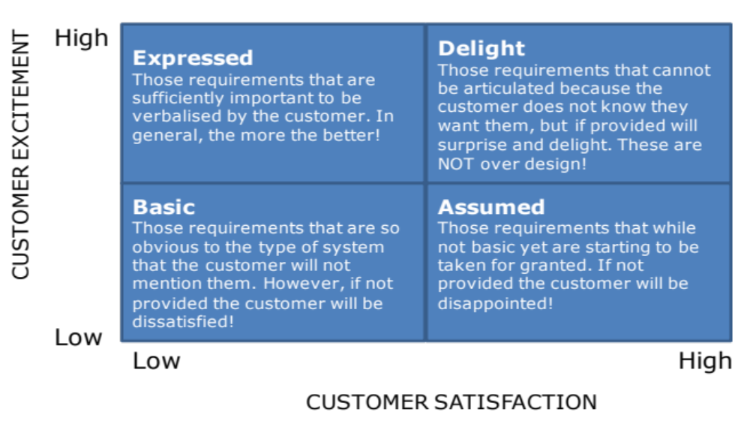
Summary
Functional Modelling helps the team construct a model of the necessary system functionality and how it logically “co-operates” to deliver the Operational Requirements. This allows for the identification of further system functionality and moreover the logical system interfaces providing an early understanding of Y = f(x,u)
Systemic Textual
Analysis
Viewpoint/
Functional Analysis
Functional
Modelling

