Slide 1


Analyse Requirements
Sensitivity and Failure Analysis
Assessing Requirements for Emergent Sensitivities
This Session:
Introduces the concept of system sensitivity where small variations in system parameters can have a large impact on system performance
Introduces the concept of robust design
To describe and practise Sensitivity and Failure Analysis as tools that can be used to assess system sensitivity and thereby design out issues ab initio

Slide 2


















Process and Tools
Gather Requirements
Analyse and Validate Requirements
Specify
Requirements
The Business Requirements provide the rationale and overall business constraints for a system development project
Determine the Emergent Functionality
Stakeholder Map
Flow Sensitivity Analysis
The System Requirements defines the measurable design requirements for the system
Determine system stakeholders and select key ones for requirements elicitation
Identifies causal paths for potential system sensitivities
Functional Failure Mode and Effect Analysis
Quality Function Deployment 1
Captures the potential functional failure modes, effects and causes to identify remedies ab initio
Cross checks requirements for consistency and completeness
Verification Compliance Matrix
Affinity Diagram
Use Case
Determine Validation and Verification methods for each requirement and specify V& V Requirements
Elicit and capture key stakeholder requirements
Captures how a user expects to interact with a system
Determine the necessary generic System Functionality
Tree Diagram/Analytic Hierarchy Process
Systemic Textual Analysis
Viewpoint/Functional Analysis
Function Flow Diagram
Organize and prioritise key stakeholder requirements
Analyses expressed requirements into their atomic form to identify and clarify missing and ambiguous requirements
Generates and organizes system generic functionality necessary to achieve the Operational Requirement
Captures and shows how the component functionality of a system must cooperate to deliver the Operational Requirement
Requirements Database
The User Requirements defines the expressed requirements of a particular stakeholder or stakeholders
Need Mean Analysis
Identifies and explores system solutions at different levels to determine System Meta-Solution

Slide 3
Where are we?: Analyse Requirements
Assess System Meta-Solution
Applying Systems Thinking to the task of analysing requirements tells us that we will need to take various perspectives to help uncover the unspoken requirements
Determine “working” Operational Requirement
Determine System Functionality
Determine Emergent Functionality
Determine Non-Functional Performance Requirements
The iteration may not be simple
Verify and Validate Requirements

Slide 4


Slide 5
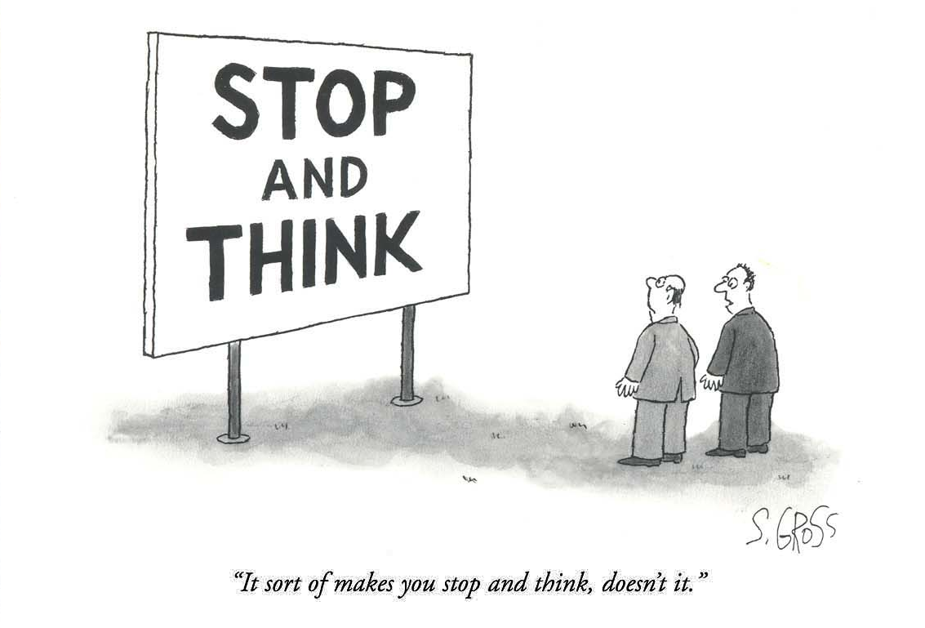
Introduction
The increase in complexity of systems has resulted in many displaying undesirable emergent behaviour. Hindsight often shows these to be “obvious” and therefore avoidable – “if only we had time to think!”
One aspect of undesirable emergence is system sensitivity and failure which can be assessed before a design exist to provide:
  design suggestions to prevent or detect the potential issue(s)
  an early understanding of possible trade-offs
  an identification of critical functions
  the identification of “sensitive flows”
  the identification of potential system failure modes, their effects and causes
Such analyses will provide an early assessment of risk and promotes ideas and guidance for generating and selecting conceptual solutions
Notes:
4
4

Slide 6
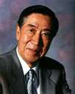
Philosophy
An understanding of undesirable emergent behaviour due to system sensitivity can be provided through the work of Dr Genichi Taguchi
Taguchi realised that apparently minor variations in a system parameter can have a significant effect on overall system performance
He also realised that aspects of the traditional approach to sensitivity through the use of tolerances and specification limits can be very misleading
Taguchi proposed the idea of robust design
Notes:
5
5

Slide 7
Traditional Variation Cost Model
In here
☹
Lower Spec
Limit
Target
Upper Spec
Limit
In here
☹
In here
☺

Slide 8
Traditional Variation Cost Model
The traditional loss model implies that an item just inside the specification limit imparts no loss and therefore is the same as the item exactly on target
£x or $x
Loss 0
Loss 0
Quality
Loss £x or $x
In here
☹
£0
Lower Spec
Limit
Target
Upper Spec
Limit
In here
☹
In here
☺

Slide 9

Which one would you take home
This Computer passed its final test just inside
the specification limits
This Computer passed its final test exactly on target
$899
$899

Slide 10
Traditional Variation Cost Model
The traditional loss model implies that an item just inside the specification limit imparts no loss and therefore is the same as the item exactly on target
£x or $x
Loss 0
Loss 0
Quality
Loss £x or $x
In here
☹
£0
Lower Spec
Limit
Target
Upper Spec
Limit
In here
☹
In here
☺

Slide 11
Traditional Variation Cost Model
Common sense suggests there is a difference between the item just inside the specification limit and the item exactly on target. The traditional model is wrong!
£x or $x
Loss 0
Loss 0
Quality
Loss £x or $x
Is there a
Difference?
In here
☹
£0
Lower Spec
Limit
Target
Upper Spec
Limit
In here
☹
In here
☺

Slide 12
Variation
Taguchi realised that the traditional model is only “correct” up to the point the product left the factory, but it does not take into account what happens afterwards. He argued that all products will deteriorate with use and therefore items close to specification limits will either:
  fail early because the deterioration takes them quickly out of specification
  have a very long life
In other words, Taguchi realised he needed to understand the through-life costs and reasoned that a loss is always incurred when a system’s quality characteristic y deviates from its target value m, regardless of how small the deviation is.
Taguchi used the Taylor series to mathematically prove to the first order:
Taguchi applied his concepts to products, we now realise that it applies to any system
Loss = k(y - m)² = ∆²
Notes:
6
6

Slide 13
Taguchi Variation Cost Model
Taguchi’s loss function states that any system that does not meet its target specification will either impart a loss to the company or a loss to the customer (he generalised this to talk about a loss to society)
Quality
Loss £/$
LSL
USL
Loss £/$
Loss £/$?
Variation of X
Loss = k(y-m)²
y
Deviation
from target
Target
m

Slide 14
Effect of Variation
Every component in a system will have its own characteristic loss function, but the ‘degree of loss’ is dependent upon the constant k.
Large k: loss is
sensitive to
variation
Small k: loss is
insensitive to
variation
Loss
Target
Note: Manufacturing Variation is only one of three sources of variation that lead to performance degradation. The other two are environmental and use. System Designers often take account of these as a matter of course – it’s the Manufacturing variation they often choose to ignore!
Notes:
8
8

Slide 15
The Robust Design Approach
Systems Design
Fundamental design and
engineering concepts
established
Parameter Design
Determination of target values and
sensitivity to variation – i.e. loss functions
determined. Elements that are sensitive should be redesigned
Tolerance Design
Tolerances established based on
sensitivity analysis. Robust components
do not need a tight tolerance -
sensitive ones do

Slide 16
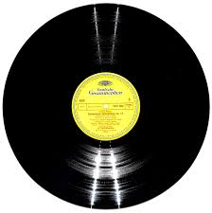

✖
✔

Slide 17
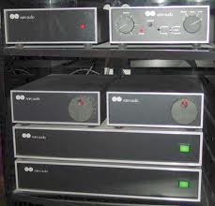
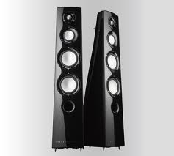
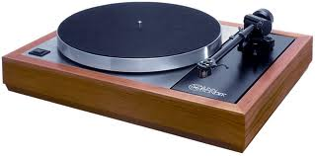


Slide 18
Taguchi and Requirements Interpretation
Taguchi’s approach is applied only once the basic concept design has been agreed which could result in an expensive redesign (but not as expensive as a redesign after production has started)
It is possible is to apply his philosophy during requirements determination since:
  all parameters in a system are subject to target values
  functionality will be affected through the variation of input quantities about their respective target values
  functionality will be affected by the variation of the function’s operation
In other words it is possible to use previous experience and common sense to identify potential issues before design commences and hence design out problems ab initio
Notes:
10
10

Slide 19
Functional Sensitivity Analysis
X₁
Taguchi’s approach requires us to know the transfer function between the inputs and outputs of a particular function. This transfer function can typically only be determined after it has been designed
X₂
Function
Y
Y = f(X₁, X₂, X₃)
X₃
What is f? - the relationship between the Y and the Xs – if we know
what f is and the variation in the Xs we could determine the
impact on the output
Y = -17.4 + 3.2X₁ - 0.4X₂² - lnX₃ + etc.
Variation in the output
is transmitted
Likely variation in X₃

Slide 20
Functional Requirement Sensitivity Analysis
X₁
X₂
Y
Function
X₃
When engineering requirements we do not know what “f” is (we know its name but not the mathematics) – but we can use the knowledge of the team to assess how sensitive a function’s outputs are to the likely input variation and how that function might fail

Slide 21
Approach 1
Will the expected variation in the inputs cause excessive variation in the output of the CULTIVATE CROP function assuming that the inputs are used correctly?
CURRENT_PRICES
SEEDS
INVOICE
WEATHER
PURCHASED_FERTILIZER
PURCHASE
SUPPLIES
SOIL
FERTILIZER
1
PURCHASED_SEEDS
PLANTS
CULTIVATE
CROP
ORDER
2
PURCHASED_HEALTH_ITEMS
WATER
HEALTH_ITEMS
COMPOST
PICK
VEGETABLES
VEGETABLES
3
Approach 2
What happens if an input is not used correctly? – How can the function fail, what will be the effects experienced by the user and what are the causes?
STORED_HOME
_GROWN_SEED
COMPOST
WASTE
6
GREEN
_WASTE
EXTRACT
SEED
STORE
HOME_GROWN
_SEED
5
4
HOME_GROWN
_SEED
Notes:
11
11

Slide 22
Sensitivity Analysis the Approach
The basic approach is one of applied common sense! It is about questioning to seek information in a structured manner
The questions that need to be asked at this stage include:
  how sensitive is the function to the expected variation in an input?
    what are the likely variations in the inputs?
    how will variations in the inputs affect the variation of the outputs?
  how could the functions fail and what are the potential failure modes and effects?
The answers to these questions generate information about the system and this knowledge is then helpful in:
  concept generation and selection
  assessing risk
  determining trade-off studies
Notes:
12
12

Slide 23
Approach
Takes an external view of the functions:
Input/Output sensitivity
(Black Box view)
Takes an internal view of the functions: Internal failure modes
(White Box view)
Flow
Sensitivity
Robustness Assessment
Function
Sensitivity
Notes:
14
14

Slide 24
Flow Sensitivity Analysis
What Is it?
  Flow Sensitivity Analysis is a simple tabular method for assessing the relative effect of flow variation on the performance of a system
Why do it?
  To determine where there may be potential undesirable emergence and therefore design it out ab initio
How to do it:
  The approach is to form an input/output matrix for the lowest level FFDs:
    identify and list, from the functional model, the input flows and their receiving functions
    Identify and list, from the functional model, the output flows
  Consider each input/output combination in the matrix and assess the effect of variation in the input flow on that function and output flow as judged on a simple three level scale:
    insensitive the input variation will not cause significant variation in the output
    med. sensitive
    very sensitive the input variation causes significant variation in the output
Notes:
15
15

Slide 25
Example
ABC
IJK
X
PQR
DEF
Y
This cell is empty since there is no direct link between ABC and PQR
LMN
List inputs
& receiving Functions
Output
Input
Receiving
Function
IJK
LMN
PQR
ABC
X
DEF
X
Record here the sensitivity of the input – output pair
IJK
Y
Notes:
18
18

Slide 26
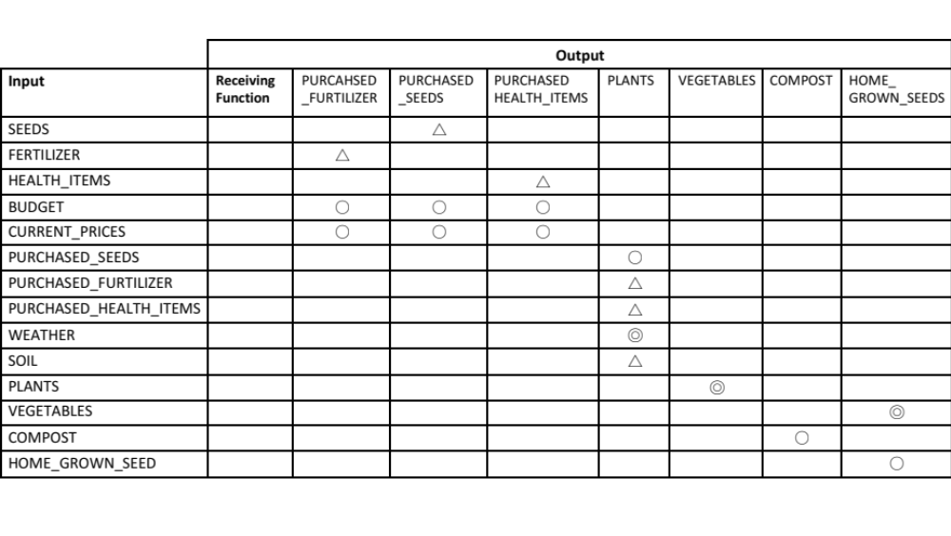
Sensitivity Input-Output

Slide 27
Causal Effect
CURRENT_PRICES
SEEDS
INVOICE
WEATHER
PURCHASED_FERTILIZER
PURCHASE
SUPPLIES
SOIL
FERTILIZER
1
PURCHASED_SEEDS
PLANTS
CULTIVATE
CROP
ORDER
2
PURCHASED_HEALTH_ITEMS
WATER
HEALTH_ITEMS
COMPOST
PICK
VEGETABLES
VEGETABLES
3
STORED_HOME
_GROWN_SEED
COMPOST
WASTE
6
GREEN
_WASTE
EXTRACT
SEED
STORE
HOME GROWN
SEED
5
4
HOME_GROWN
_SEED
Notes:
19
19

Slide 28
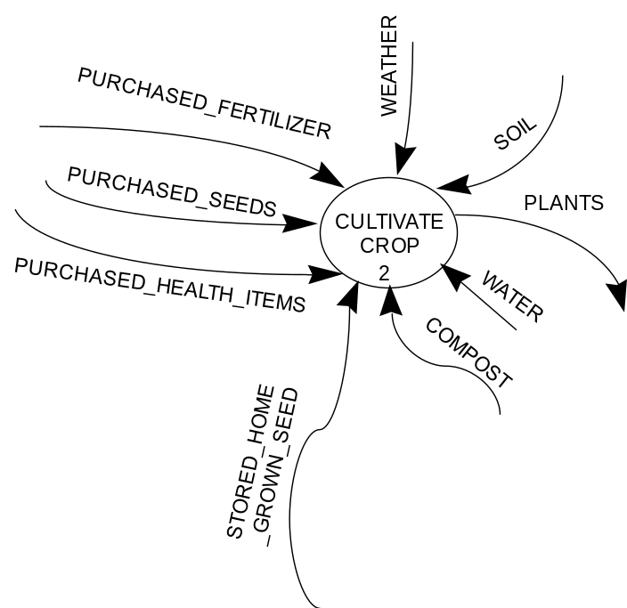
Function Sensitivity
Assuming that the inputs are correct how can the function fail?
Flow sensitivity examines the effect of variation in flows on functionality. However, while this does indicate whole system effects we also need to consider the internal failure of the functions.
Although the precise nature of the functional failure is unlikely to be known until its implementation is decided, it is still possible to make an assessment by considering functional failure modes, effects and causes
Rather than ‘invent’ a new tool Failure Mode and Effects Analysis (FMEA) is ideal for conducting the necessary functional failure assessment
Notes:
20
20

Slide 29
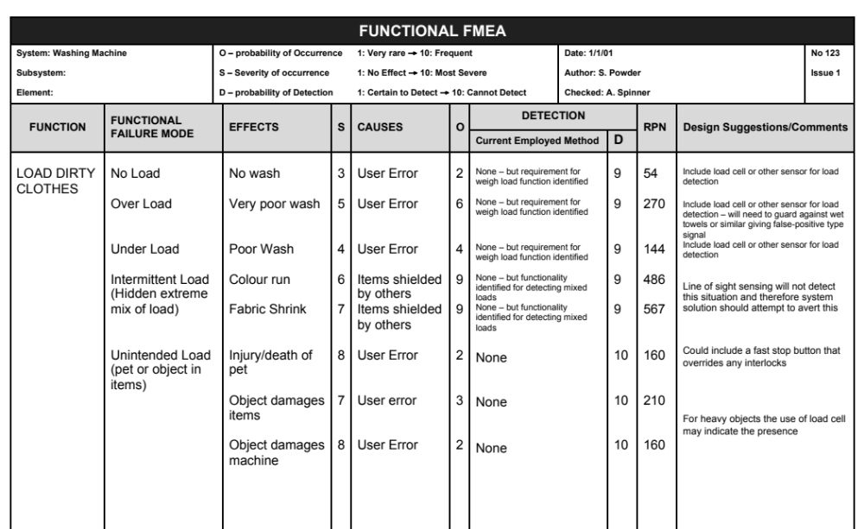
Functional Failure Modes and Effects Analysis
What is it?
  A systematic approach to identifying, documenting, and prioritising potential functional failure modes, effects and causes
Why do it?
  Helps identify additional functionality or features ab initio that will make the system more robust in the hands of the customer
How to do it?
  Functional FMEA works best when drawing upon the expertise and knowledge of a multi-disciplinary team
  The team should consider the system functions and how they might fail, identifying potential:
    Failure mode
    Effects of failure
    Causes of failure
  Ratings are assigned to the probability of occurrence, severity of an occurrence and probability of detection, and these are then used to determine an overall risk value
The FMEA example above shows the failure modes for the LOAD DIRTY ITEMS function of a Washing Machine

Slide 30
Functional FMEA - How to do it
STEP 1: Identify and list
the system functions
STEP 2: For each function identify potential functional failure modes
STEP 3: For each failure mode identify effects experienced by the user and rate the Severity
STEP 4: For each failure mode identify causes and the probability of Occurrence
STEP 5: For each failure mode identify current prevention detection methods employed and assess effectiveness
STEP 6: Determine overall risk
STEP 7: Consider high risk situations to determine emergent functionality or design ideas to prevent failure

Slide 31
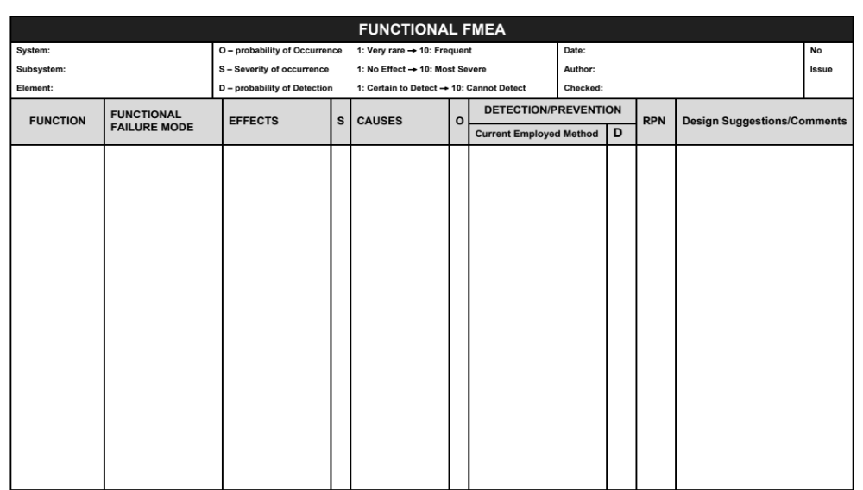
The Functional FMEA Template

Slide 32
Failings of FMEA
Define what you understand by Failure?
FMEAs often fail to deliver because people apply their own understanding of what is meant by failure. It is an everyday word that is often associated with schooling and education, poor services as well as equipment breakdowns.
In the serious world of engineering we have to be precise – people’s lives depend on it!

Slide 33
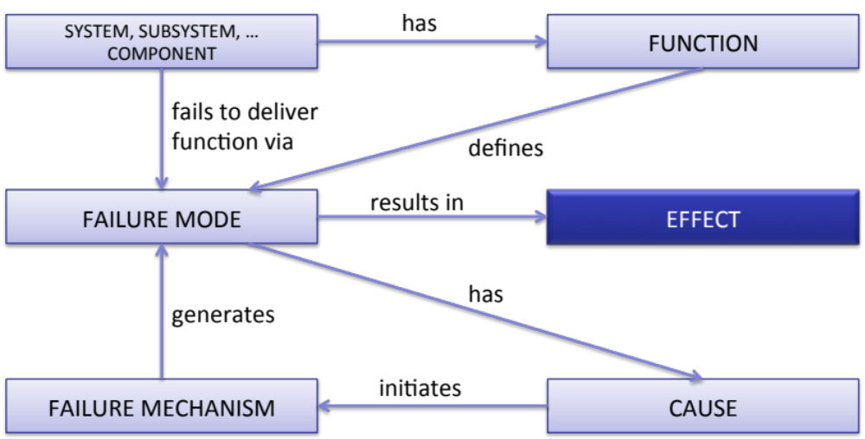
A Systems View of Failure
FAILURE: The termination of the ability of an item to perform a required function. (BS4778-3.1:1991)
FUNCTION: what the item does, its purpose
FAILURE MODE: the manner in which the item fails to meet its intended function. (SAE J1739 JAN2009)
EFFECT: The consequence(s) a failure mode has on the operation, function, or status of the highest indenture level. This is expressed as what the CUSTOMER/USER might experience as a result of the failure mode. [MIL Std 1629A]
CAUSE: the underlying event that leads to a failure mode, it initiates the failure mechanism.
FAILURE MECHANISM: The physical, chemical or other process that results in failure. (BS4778-3.1:1991)
Most FMEA templates do not include a column to capture Failure Mechanism and in consequence when users identify a failure mechanism they capture it as the Failure Mode or Cause.
This leads to an inconsistent use of the tool, confusion and frustration – p.s. even the standards get it wrong!

Slide 34
Failure Demonstration
PART/COMPONENT
has
FUNCTION
fails to deliver
function via
defines
FAILURE MODE
results in
EFFECT
has
generates
FAILURE MECHANISM
initiates
CAUSE

Slide 35
Failure Demonstration
PAPER CLIP
has
FUNCTION
fails to deliver
function via
defines
FAILURE MODE
results in
EFFECT
has
generates
FAILURE MECHANISM
initiates
CAUSE

Slide 36
Failure Demonstration
PAPER CLIP
has
HOLDS 2 OR MORE PIECES OF PAPER TOGETHER
fails to deliver
function via
defines
FAILURE MODE
results in
EFFECT
has
generates
FAILURE MECHANISM
initiates
CAUSE

Slide 37
Failure Demonstration
PAPER CLIP
has
HOLDS 2 OR MORE PIECES OF PAPER TOGETHER
fails to deliver
function via
defines
NO HOLD - Broken
results in
EFFECT
has
generates
FAILURE MECHANISM
initiates
CAUSE

Slide 38
Failure Demonstration
PAPER CLIP
has
HOLDS 2 OR MORE PIECES OF PAPER TOGETHER
fails to deliver
function via
defines
NO HOLD - Broken
results in
PAPER NOT HELD TOGETHER
has
generates
FAILURE MECHANISM
initiates
CAUSE

Slide 39
Failure Demonstration
PAPER CLIP
has
HOLDS 2 OR MORE PIECES OF PAPER TOGETHER
fails to deliver
function via
defines
NO HOLD - Broken
results in
PAPER NOT HELD TOGETHER
has
generates
FAILURE MECHANISM
initiates
CYCLICAL LOADING

Slide 40
Failure Demonstration
PAPER CLIP
has
HOLDS 2 OR MORE PIECES OF PAPER TOGETHER
fails to deliver
function via
defines
NO HOLD - Broken
results in
PAPER NOT HELD TOGETHER
has
generates
FATIGUE
initiates
CYCLICAL LOADING

Slide 41
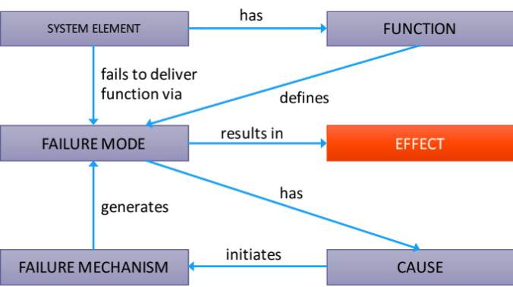
The Functional FMEA Form
But teams identify the mechanism (it’s important) but don’t know where to put it!
So ANYWHERE!
There is NO column for the MECANISM

Slide 42
The Functional FMEA Form
Use this column to record the system functions
Use this column to record
Risk Priority Number RPN
Use this columns to rate
the Severity of occurrence
Use this column to record the currently employed detection method
Use this column to record the functional failure
mode
Use this column to record the potential and actual causes of the failure
Use this columns to rate
the probability of Detection
Use this column to record the symptoms of the failure experienced by the customer
It is the comments
column that is the important output since it flags design ideas/issues
Use this columns to rate
the probability of Occurrence

Slide 43
Functions
The first column of a FFMEA contains the system functions
These must be described as a verb-noun phrase – i.e. they define something the system has to do – an action on an object
In the ideal world every function of a system should be subject to a FFMEA – but in the real world this is unlikely because of time or resource constrains
  In such instances it is important to identify the critical system functions by one means or another

Slide 44
Functional Failure Mode
A Functional FMEA examines the functions and the failure modes must be expressed in this context
  In fact all Failure Modes must be defined relative to a function since it is central to the definition of failure
  Failure modes are used in preference to failures, since a given failure may have several failure modes.
Failure modes should be written in the context of the verb description, as “anti-functions”
There are only 5 types of failure modes – the “usual suspects”:
  Over, Under, No, Intermittent, Unintended
  Example:
    Wash Clothes
      Over wash
      Under wash (wash cycle completed and wash cycle not complete)
      No wash
      Intermittent wash (sometimes washes sometimes doesn’t)
      Unintended wash (oops it’s the cat!)
    Note: for a specific function not every type of failure mode will apply and there may be several interpretations of one type
The key to Functional Failure Modes is to put the function’s verb after the usual suspects and then interpret for the particular situation

Slide 45
Effects
The EFFECT of a potential failure mode is what the USER of the system might actually experience as a result of that failure mode
User dissatisfaction is not an effect – all the effects will result in dissatisfaction – the purpose of the effects column is to record why the user is dissatisfied
It is important to recognise here that for any potential functional failure mode there can be several possible effects experienced by the user of the system. Each of these should be recorded. For example the “wash items” function has the potential functional failure mode of “over-wash” this could have several effects including:
      shrinkage
      colour run
      colour fade
      physical fibre damage
Note that different failure modes could have the same effect
Other stakeholders may also experience effects as a consequence of the failure mode – these are not recorded on the FFMEA – if necessary a FFMEA can be performed for another stakeholder

Slide 46
Severity S
Severity relates to the effect experienced by the user/customer (i.e. to the description given in the “effects” column). It is a measure of how dissatisfied they would be if they experienced the effect
Severity is assessed on a simple 1 to 10 scale
Severity needs to be “calibrated” against the context and user
1
10
Not severe
The user may not know the failure has occurred
Extremely severe
Usually reserved for death or injury of user

Slide 47
Causes
Causes should be limited to design concerns i.e. we assume that the system is manufactured/installed correctly
Analysis must stay within the defined scope (applicable system and interfaces to adjacent systems)
There is usually more than one cause of failure for each failure mode
Causes must be identified for a failure mode, not an individual effect. Causes may be repeated if a failure modes has several effects
Causes can be either potential or actual. FFMEA is about stopping people making the same mistake as well as potentially new mistakes
  It is therefore important to have the right people in the room
  FFMEA can be used to capture “corporate knowledge”
As part of the cause description we should also capture the Failure Mechanism

Slide 48

Failure Mechanism
Most FMEA forms, including the one presented here, don’t have a column for the failure mechanism
This is indeed unfortunate because in completing FMEAs is a common error to confuse failure modes, causes and failure mechanisms!
PIVOT
Two FUNCTIONS
1 Aligns Shear Surfaces
2 Control Motion of Shear Surfaces
FAILURE MODES
(For Control Motion of Shear Surfaces)
No Control
Over Control
Under Control
Unintended Control
Intermittent Control
CAUSES
Poor material selection
Poor tolerances
Uneven load distribution
FAILURE
MECHANISM
Wear
EFFECT
Poor “cut”
edges
We should (we MUST) identify the complete
Cause -> Mechanism -> Failure mode -> Effect chain

Slide 49
Handling Failure Mechanisms
Failure Mechanism is the physical, chemical or other process that results in failure. (BS4778-3.1:1991)
Most FMEA Templates do not have a column for the mechanism – but as part of our analysis we identify it!
We capture the MECHANISM as part of the cause description
Typical Failure Mechanisms
  Products
    Corrosion
    Fretting
    Creep
    Fatigue
  Processes
    Operator Fatigue
    Complacency
    Fear
    Misinformation

Slide 50
Occurrence O
  Occurrence relates to the likelihood that a particular cause will occur leading to the failure mode and ultimately the effect
  Occurrence is assessed on a simple 1 to 10 scale
Very rare 1
10 Frequent
OCCURRENCE RATINGS
Rating | Description | Criteria | Probability of Failure
1 | Remote Occurrence | Failure highly unlikely to occur. History of similar design satisfactory with no failures | 1 in 1,500,000
2 | Very Slight Occurrence | Failure very unlikely to occur. History of very few failures | 0.0000067
3 | Slight Occurrence | Very few and infrequent failures | 0.000067
4 | Low Occurrence | Few and infrequent failures may be expected | 0.0005
5 | Medium Occurrence | Some failures likely, but not in major proportions | 0.0025
6 | Regular Occurrence | Regular failures may be expected | 0.0125
7 | Moderately High Occurrence | Frequent failures may be expected | 0.05
8 | High Occurrence | Failure of major proportions may be expected | 0.125
9 | Very High Occurrence | Frequent failures. History of similar design issues | 0.33
10 | Extremely High Occurrence | Constant failure | 0.5

Slide 51
Detection/Prevention
Currently Employed Method
On a Functional FMEA “Detection/Prevention” relates to what we did last time.
  There is an implicit assumption that we have designed a similar system before and may, therefore, have experienced the failure mode.
  In which case, it is possible some detection or prevention method has been incorporated in the previous design.
The purpose of the Detection/Prevention column is to identify and record this and assess how effective it was
If there was none – write none. This often happens if it is an unprecedented function or system

Slide 52
Prevention/Detection D
The “D” column is an assessment of “how good” the currently employed Prevention/Detection method is at preventing or providing a warning of the impending failure
The 1 to 10 Detection scale is based upon whether or not the user will experience the effects of the failure mode
1
10
Certain to prevent or detect failure before user experiences the failure effects
Cannot prevent or detect failure - user certain to experience failure effects
A classic example of a 1 is a car fuel gauge. This device can give ample warning of the fact the car will stop if the fuel is not replenished

Slide 53
Detection Ratings
DETECTION RATINGS
Rating | Description | Criteria
1 | Remote probability of failure reaching the user | A known detection method exists for similar systems with a strong history of excellent performance and is included in the system requirements
2 | Very Slight probability the failure mode will reach the user | A known detection method exists for similar systems and is included in the system requirements
3 | Slight probability the failure mode will reach the user | A known and robust detection method exists for other systems and is included in the system requirements
4 | Low probability the failure mode will reach the user | A known detection method exists for other systems and is included in the system requirements
5 | Medium probability the failure mode will reach the user | A known and robust detection method exists for other systems but is not included in the system requirements
6 | Moderately probability the failure mode will reach the user | A known method exists for other systems but is not included in the system requirements
7 | Moderately High probability the failure mode will reach the user | An experimental detection method exists for other systems and is included in the system requirements
8 | High probability the failure mode will reach the user | An experimental detection method exists for other systems but is not included in the system requirements
9 | Very High probability the failure mode will reach the user | No known detection method but one is included in the system requirements
10 | It is certain that the failure mode will reach the user | No known detection method and no requirement to do so specified

Slide 54
Risk Priority Number RPN
The values assigned to S, O and D are now multiplied together to give a Risk Priority Number:
    SxOxD = RPN
The purpose of the RPN is to direct action where it is required
Care must be exercised, since the S, O and D ratings are not absolute but relative! Different teams constructing the same FMEA will typically generate the same failure modes, effects and causes - but will assign different values to SOD - BUT the prioritisation is likely be the same

Slide 55
Design Suggestions/ Comments
The final column of a Functional FMEA is that allocated for fixes!
Although the system has yet to be designed per se, knowledge of potential failures can lead to design ideas which if built in ab initio will be minimum cost
It is important to remember why we are conducting the FFMEA – to identify new functionality/ideas for either eliminating the potential failure mode or detecting it. Accordingly there are levels of intervention:
  Design the failure mode out completely
  Provide a detection method that warns the user of impending failure – e.g. a fuel gauge on a motor car warns when the car is about to fail (run out of fuel)
  Inform the user the failure has occurred

Slide 56
Example
It is the comments column that is the important output since it is used to capture design ideas that can be built into the systems ab initio

Slide 57
Exercise – FFMEA
In teams
  Conduct a functional FMEA for a particular function
    List all the Failure Modes
    Select one Failure Mode and list all the Effects
    Select one Effect and list all the Causes
    Select one Cause and list the Current Detection Methods (guess)
    Assign S, O, and Ds as you proceed
    Determine some suitable design ideas
  Flip chart the outcomes and be prepared to share with the rest of the group
  Time: 30 Minutes

Slide 58
A New Functionality
So far, the various tools have been used to identify system functionality associated with the operation of the system – i.e. what's needed to make it work - the Operational Functionality
Completing a FFMEA will lead to many design ideas. These should be reviewed to:
  Identify common themes
  Determine additional system functionality
This new functionality is called Emergent Functionality and can often delight the customer, but remember - they don’t necessarily want to pay for it
Operational Functionality: the functionality necessary for a system to deliver its operational requirement
Emergent Functionality: the functionality of a system that addresses emergent behaviour

Slide 59
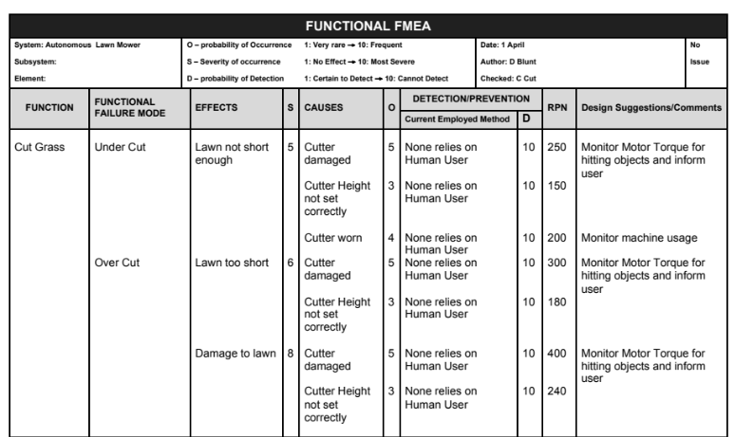
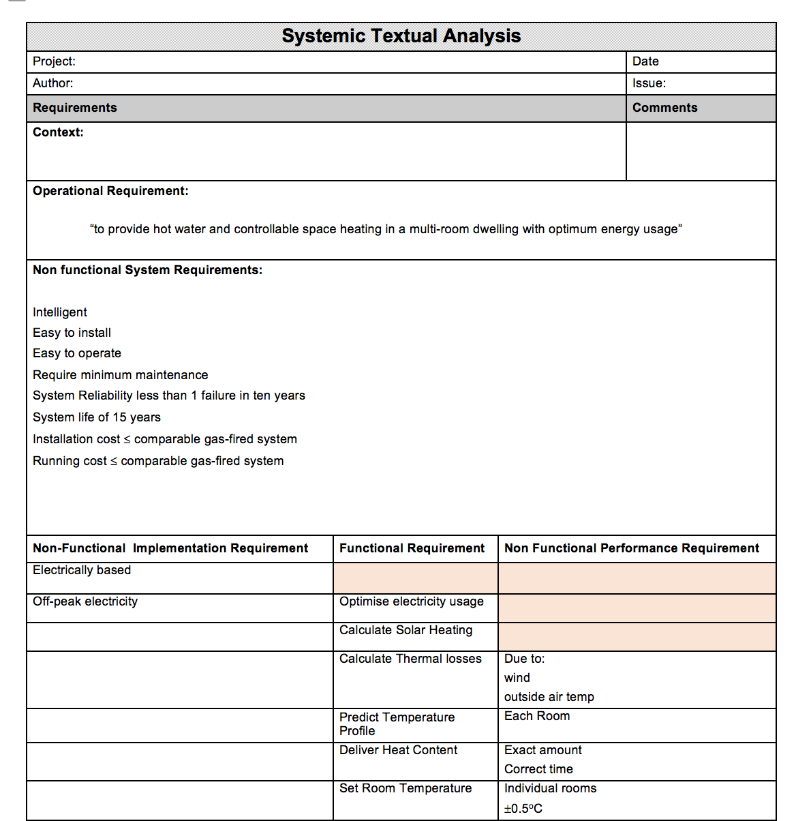
Tying up loose ends
Flow Sensitivity Analysis and Functional FMEA are very good at helping to identify 10% - 20% of system functionality not discovered by Viewpoint Analysis
Functional FMEA is very good at defining emergent functionality.
If a Functional Model, Viewpoint Analysis and/or Systemic Textual Analysis have been undertaken they should be updated with the new derived requirements from the Functional FMEA
If a Systemic Textual Analysis has not been undertaken – start one now.

Slide 60
Functional FMEA
Pros
  Simple to use
  Leads to shared and common understanding
  Identifies potential problems early so that they can be designed out
  Identifies potential HAZARDS before design commences and therefore provides information to influence concept generation and selection
  Since for a given Capability, the underlying functionality will not change over time, the FFMEAs will have aspects that will also not change:
    Functions
    Function Failure Modes
    Effects
  We can therefore reuse which will reduce the analysis effort in the longer term
Cons
  Often left until it’s too late – once the design has been done
  Can become tedious so people don’t think
  Since no design has been undertaken, causes may not be root causes. Hence there is a need to undertake Design FMEA
  Difficultly in identifying causes
Notes:
24
24

Slide 61
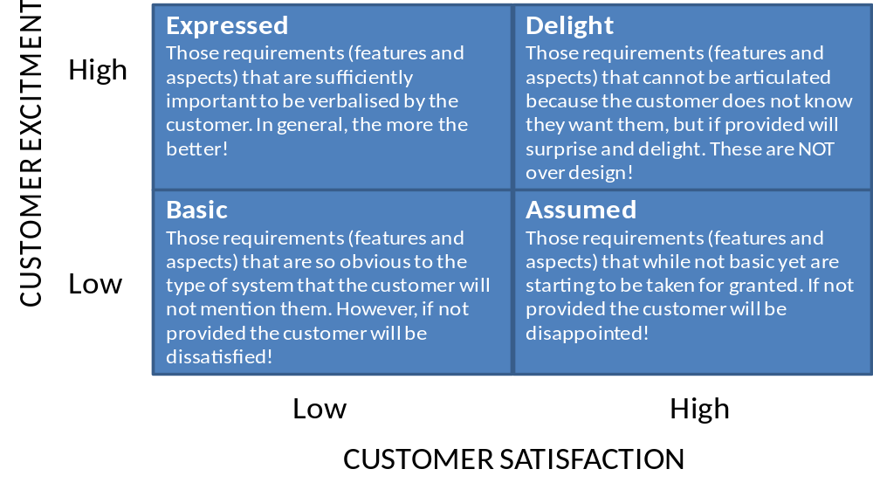
Summary
Functional FMEA and Flow Sensitivity are simple tools that uses the knowledge and experience of the team to identify potentially sensitive functions and flows that could result in undesirable emergent behaviour – they identify the critical functions and inputs
Systemic Textual
Analysis
Failure
Analysis
Viewpoint/
Functional Analysis
Functional
Modelling

