Slide 1


Specifying and Managing Requirements
This Session:
Provides guidance on how to specify good requirements and structure requirements documents
Introduces the elements of Requirements Management

Slide 2














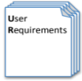



Process and Tools
Gather Requirements
Analyse and Validate Requirements
Specify
Requirements
The Business Requirements provide the rationale and overall business constraints for a system development project
Determine the Emergent Functionality
Stakeholder Map
Flow Sensitivity Analysis
The System Requirements defines the measurable design requirements for the system
Determine system stakeholders and select key ones for requirements elicitation
Identifies causal paths for potential system sensitivities
Functional Failure Mode and Effect Analysis
Quality Function Deployment 1
Captures the potential functional failure modes, effects and causes to identify remedies ab initio
Cross checks requirements for consistency and completeness
Verification Compliance Matrix
Affinity Diagram
Use Case
Determine Validation and Verification methods for each requirement and specify V& V Requirements
Elicit and capture key stakeholder requirements
Captures how a user expects to interact with a system
Determine the necessary generic System Functionality
Tree Diagram/Analytic Hierarchy Process
Systemic Textual Analysis
Viewpoint/Functional Analysis
Function Flow Diagram
Organize and prioritise key stakeholder requirements
Analyses expressed requirements into their atomic form to identify and clarify missing and ambiguous requirements
Generates and organizes system generic functionality necessary to achieve the Operational Requirement
Captures and shows how the component functionality of a system must cooperate to deliver the Operational Requirement
Requirements Database
The User Requirements defines the expressed requirements of a particular stakeholder or stakeholders
Need Mean Analysis
Identifies and explores system solutions at different levels to determine System Meta-Solution

Slide 3
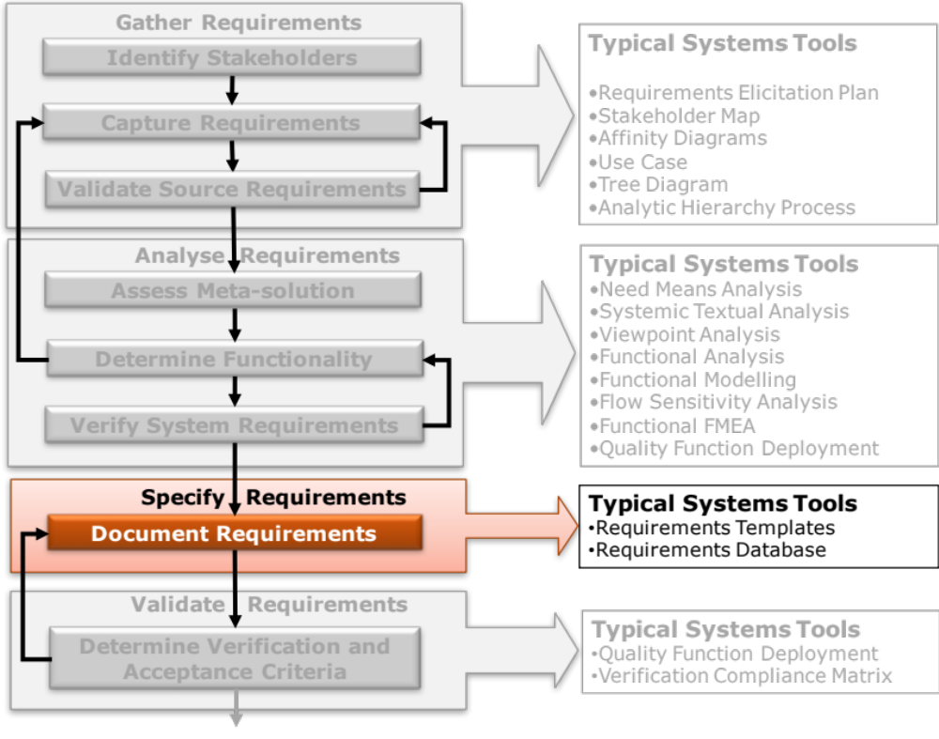
Determine Requirements: Tasks and Tools
Notes:
9
9

Slide 4
Requirements
Requirements cause problems for two key reasons:
  In general, people find it difficult to specify requirements – usually because they have received no guidance
  Equally, people find it difficult to analyse and understand requirements – usually because they have received no guidance
Notes:
Considering our reliance on written requirements most people in an organization are not taught how to
Write Requirements
OR
Analyse Requirements

Slide 5
Specifying Requirements
Specifying Requirements is a crucial activity in Requirements Engineering
It is more than just generating a list of written requirements - it is about:
    Documenting requirements
      Writing requirements
      Diagramming requirements
    Structuring Requirements
      Within a Requirement Set (Document)
      Across and between Requirement Sets (Documents)
A well documented set of requirements may still be difficult to understand because they are poorly organized.
Requirements are a “system” where individual requirements are components in that system. As we know from Systems Thinking the organization of the components (architecture) is often more critical to system performance than the individual components
In the olden days we had requirements documents. The advent of requirements software now means we have the requirements in a single database – but those requirements can be divided in to a number of interrelated sets

Slide 6
“A bad system will beat a good person every time.”
W. Edwards Deming
Structuring Requirements

Slide 7
Introduction
How we organize our requirements has a significant impact on their readability and therefore their understandability
Most requirements documents are poorly organized, overly long, boring and difficult to read
This has happened because
  They are organized around the system’s physical architecture which itself has evolved in a piecemeal (disjointed, haphazard) fashion as technology has advanced. The requirements document is therefore piecemeal in organization
  An over-reliance on text based requirements
  Failure to recognise that a human designed system does NOT exist in isolation but always with associated systems that impose requirements on the designed Prime System and vice versa

Slide 8
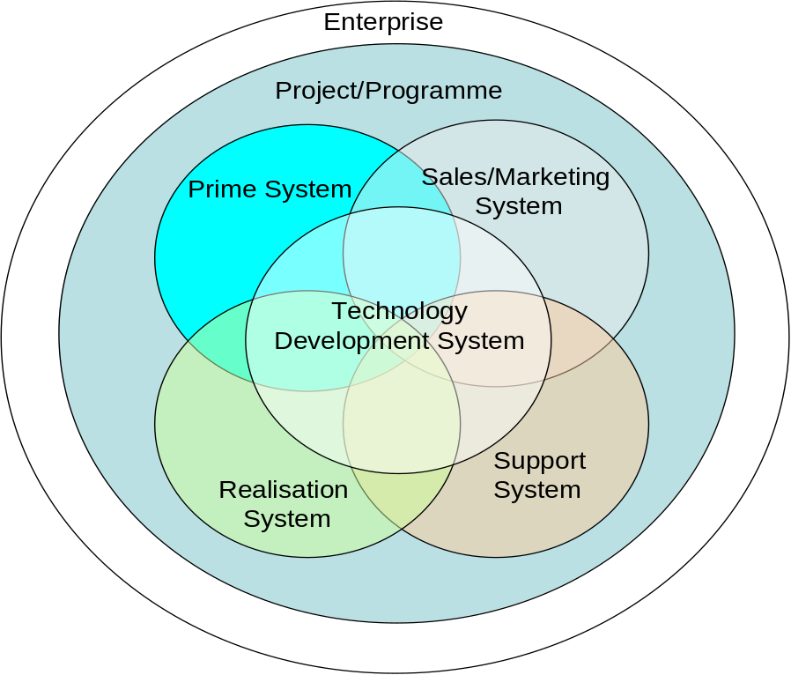
The PRIME System’s Friends
Every PRIME system is associated with several other systems. When we ask “stakeholders” what are their requirements for the PRIME system they will also tell us requirements for the other systems!
The project or programme is also a system
The enterprise itself is also a system
The System responsible for developing new technologies for ALL the other systems
The System responsible for marketing and selling the prime system
The Systems (design, development, supply chain) that realise the Prime System
The System responsible for the support the prime system in operation and ultimately for disposal
Conclusion: We cannot stop customers and stakeholders giving requirements for the associated systems. This is not a bad thing (in fact it is good that they do this) but it does mean we have to sort the raw requirements and align them to their respective systems

Slide 9
The Enterprise View
Each of the associated systems will have requirements
We try to re-use many of these systems, but there will be changes with every new prime system
Part of planning the Systems Engineering on a project/programme is to decide what Requirements Sets will be needed
Enterprise or Business Requirements
Prime System Requirements
Project Requirements
Technology Development Requirements
Sales/Marketing Requirements
Development Requirements
Supply Chain Requirements
Confirmation Requirements
Support Requirements
Confirmation Requirements

Slide 10
Requirements for the Systems
Given a particular project or programme, each of the associated systems, including the prime, will have its own requirements
Those requirements can be broadly divided into four main sets (documents)
  Business
  Stakeholder/User
  System
  Confirmation

Slide 11
The Basic Requirements Sets
For each system the basic requirements can be put into 4 sets (documents):
Business
Requirements
Set
Business Requirements specify why a project is being undertaken and what is expected from a business viewpoint. The business requirements may also contain marketing, outsourcing and project requirements, although on large projects or programmes these may be separate
Stakeholder
Requirements
Set
Stakeholder (User) Requirements specify what the user/customer will be able to do with the system together with their KEY performance needs and constraints. Such requirements may come directly from users or we may need to gather them
System
Requirements
Set
System Requirements also specify “what” information but in terms of the systems functional requirements and the system constraints. Systems requirements define in clear, concise, confirmable terms the system design problem that if solved will deliver the stakeholder requirements
Confirmation
Requirements]
Set
Confirmation Requirements specify how the other requirements sets are to be proven to have been met. They define the method or methods to be used (test, demonstration, review, analysis, or analogy) and the evidence that is sought

Slide 12
More on the Basic Requirements Sets
For each system the basic requirements can be put into 4 sets: (documents)
Business
Requirements
Set
Why - needed by the business and the project. Who - should be expressed by the business leaders based on information and evidence from marketing, sales, engineering, manufacturing and support.
Stakeholder
Requirements
Set
Why - needed by the project and the design team. Who - expressed by the key stakeholders. Either passively or actively gathered. Typically the responsibility of marketing to create - but supplemented by work from engineering and marketing to gather from lifecycle stakeholders
System
Requirements
Set
Why - needed by the system designers. Who - Expressed by engineering (systems engineering) following the analysis of the BRS and SRS. Should detail how the system will deliver the SRS and BRS though it's functions and functional performance requirements
Confirmation
Requirements]
Set
Why - needed by the system integrators, project, business and "customer" Who - expressed by various people because each of the above sets need confirmation evidence; BRS: how in an evidenced-based way will we demonstrate to the business that the "project" has met its business requirements. It should be written at the same time as the BRS - by the same people! SRS: typically written by the SE community

Slide 13
Requirements Sub-sets
The four basic sets of requirements can be captured in multiple levels. For example:
Business Requirements
Part of the Systems Engineering planning activity is to design the document architecture necessary for a particular project. For “standard” projects a standard architecture should be used
Business
Requirements
Set
Programme/
Project Requirements
Marketing Requirements

Slide 14
Replication and Duplication
At the lower-level, the higher-level system becomes the key Stakeholder for the lower-level
Business Requirements
Document
Stakeholder
Requirements
Document
Design System
(Current Level)
Build System
(Current level)
System
Requirements
Document
Confirmation
Requirements
Document
Subsystem
Requirements
Business Requirements
Document
This does not mean there will be separate requirements documents at each level but requirements relating to the business, user, system and confirmation. Indeed, at the lower levels we have subsystem requirements documents etc. that will contain the requirements
Stakeholder
Requirements
Document
Engineer
Subsystems
(Lower Levels)
System
Requirements
Document
Confirmation
Requirements
Document

Slide 15
Internal Requirement Document Organization
Organization must also happen inside requirements documents
Even relatively small projects can have hundreds of requirements. While each requirement should be individually understandable, so should the complete set. In other words the document also needs to show how the requirements fit together – and this is the role of the document structure
Humans can understand any degree of complexity if it is presented in small ‘chunks’ together with a ‘map’ of how the chunks are structured together
  The goal is to show the reader one simple structure (map) that can allow for any amount of detail which is presented at lower levels
  The higher levels leave out the fine detail and concentrate on the essential information at that level. The information that is hidden at higher levels can then be revealed in the lower levels
  Experience shows that you will probably need at least three levels of detail

Slide 16
Typical Contents of a Requirements Document
  Summary/Abstract – a brief description of the purpose and contents of the requirements document
  Document Information – Project, Document Title, Author, Revision history, Review and Approval information
  Table of contents
  Introduction
    Purpose
    History
    Scope
    Assumptions
    Approach (how the requirements in the document were obtained)
    Compliance Levels
    Abbreviations
  Requirements
  Appendices

Slide 17
The Requirements Section
It is the organization of the requirements section that is most critical
It is important to always remember
Requirements are linked and therefore we need to find ways in which the links can are clear
Therefore always consider:
    Diagrams
    Tables
someone will have to understand what has been written

Slide 18
What is a Stakeholder Requirement?
Stakeholder Requirements are what the key Stakeholders want of the system
They are typically:
  Non-functional System Requirements – constraints at the system level
  Non-functional Implementation Requirements – solution based requirements (also constraints)

Slide 19
Example Stakeholder Requirements Structure
Non-Verifiable Requirements must identified early and resolved
No. | Key User Requirement | Source | Priority | Subordinate Requirements | Verification
1.1 | The PCS shall improve how P&S develops its engineers | T1C7 T3C4 T3C10 | E | The PCS shall generate development plans for: Individuals BU The PCS shall support individual PDRs The PCS shall provide employees with clear job and role descriptions The PCS shall promote “experiences” as development interventions | Demonstration Not verifiable Not verifiable Not verifiable
1.2 | The PCS shall provide strategic capability analysis | T1C11 T2C3 T3C11 | E | The PCS shall highlight and identify critical strategic resources and competencies The PCS shall allow “talent searches” across the enterprise The PCS shall provide statistical data on skill distribution across BU | Demonstration Demonstration Demonstration

Slide 20
What are System Requirements
The Holistic Requirements Model helps us define what System Requirements are:
Non-functional Performance Requirement
Non-functional Performance Requirement
Function A
+
Non-functional Performance Requirement
etc.
Non-functional Performance Requirement
Non-functional Performance Requirement
Function B
+
Non-functional Performance Requirement
etc.
+ any interface requirements decided by the higher-level system

Slide 21
Deducing Non-functional Performance Requirements
If we are designing a system with a known meta-solution we should have most the of the NFP requirements. Their parameters/metrics at least – we may not yet have the numerical target values - TBD
It will be a matter of collecting and collating them against the Functions
If not, we will have to derive them:
  a common approach here is to consider two solutions, say A and B, to each function and ask what could be measured to decided between them? The key here is to identify measurable characteristics
We should also consider the flow-down of the Non-functional System requirements e.g. reliability, cost, weight, size etc.

Slide 22
Structuring the System Requirements
The high-level structure of a requirements document is critical. Generally there are two approaches
Physically Based
Use (functionally) Based
Requirements organized around the physical architecture (structure) of the previous design
Advantages:
  Easy to relate to the physical “product”
  Based on an existing known (and therefore working) architecture
  The enterprise is also often organized in this way and so work allocation is easy to apportion.
Disadvantages:
  Focuses on “things” rather than capability
  Not natural to users/customers
  Leads to sub-optimisation
  Difficult to read in toto
Requirements organized around the natural patterns of use (scenarios)
Advantages:
  Focuses on delivering capability to the user
  Easy for users/customers to understand
  Ensures whole system (holistic) view
  Presents requirements as a story
Disadvantages:
  Doesn’t relate easily to the physical “product”
  Doesn’t match the enterprise architecture
Best Practice

Slide 23
Organizing Requirements in Practice
Prepare Aircraft for Flight
  1.1 Fuel Aircraft
  1.2 Clean Aircraft Interior
  1.3 Load Baggage
  1.4 Load Meals and Supplies
  1.5 Load Passengers
  1.6 Perform Pre-flight Checks
  1.7 Push-off from stand
Fly Aircraft from A to B
  2.1 Communicate with Air Traffic Control
  2.2 Taxi to Runway
  2.3 Takeoff Aircraft
    2.3.1 Accelerate Down Runway
    2.3.2 Abort Takeoff
    2.3.3 Rotate Aircraft
  2.4 Fly Aircraft
    2.4.1 Climb Aircraft
    2.4.2 Navigate Aircraft
Requirements Heading form a natural sequence of activities
Related activities are grouped logically into scenarios or modes of operation
The hierarchical nature of organization lends itself to simple diagrams like a Function Tree Diagram or tabular layout
Significant exceptions are listed where they would logically occur

Slide 24
System Requirements Tabular Layout
No. | Functional Requirement | Non Functional Performance Requirement | Source | Verification
1.0 | The system shall determine the current location to: | 1. Accuracy ± 300mm | Derived from SRD requirement 1.6 | Test
 |  | 2. Repeatability ± 30mm | Derived from SRD requirement 1.6 | Test
 |  | 3. Weight < 1.7kg | Derived from SRD requirement 2.6 | Test
 |  | 4. Size Envelope < 300x50x60 (WxHxD)mm | BS1759 | Test
 |  | 5. Reliability > 1000hrs MTBF | Derived from SRD requirement 29.0 | Analysis and Test
2.0 | The system shall …. | 1. XXXX

Slide 25
Writing Requirements
I have made this [letter] longer, because I have not had the time to make it shorter.
Blaise Pascal, "Lettres provinciales", letter 16, 1657
French mathematician, physicist (1623 - 1662)
Written Requirements are still the prime way in which one stakeholder conveys their needs and expectations
  Yet we struggle to achieve this even though we are using our natural language - English
  To write a good requirement does require us to understand the English language – but some simple guidelines can help

Slide 26
What are “Good” Requirements?
A good requirement should be:
  Clear: unambiguous and using the active voice
  Concise: simple structure with few words
  Consistent: with itself and other requirements
  Complete: it expresses complete meaning
  Correct: asks for something that is possible (do-able and legal)
  Confirmable: can be proven to have been met

Slide 27
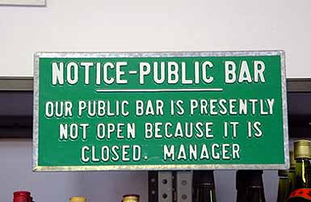
Clear

Slide 28
Concise
You don’t need a lot of words to convey clear understanding
    The Lord’s Prayer 56
    The 10 Commandments 197
    The U.S. Declaration of Independence 300
    The EC Directive on the export of duck eggs 29,611

Slide 29
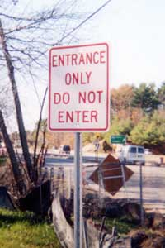
Consistent

Slide 30
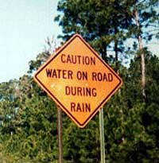
Complete

Slide 31
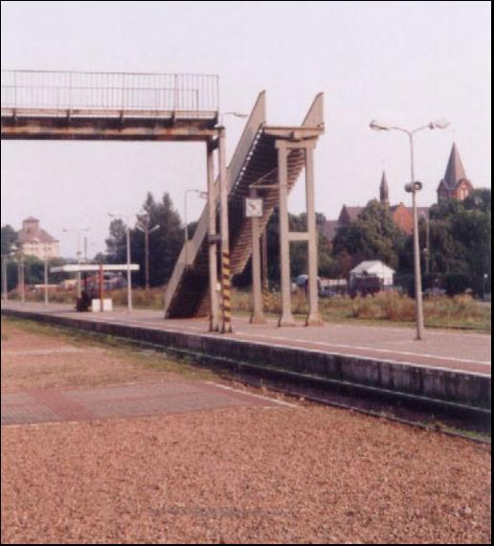
Correct

Slide 32

Confirmable

Slide 33
Guidelines for Writing Good Requirements
The 11 DOs
  Do write requirements one at a time as a simple sentence
  Do avoid compound or complex sentences
  Do use simple direct sentences – don’t ramble
  Do use the active voice
  Do use simple English words
  Do avoid “let-out” clauses or wishful thinking
  Do refrain from designing the system
  Do identify the stakeholder (remember we treat the system of interest as a stakeholder) who wants each requirement
  Do focus on stating the result to be provided to the stakeholder
  Do ensure the requirement is confirmable
  Do define the level of compliance sought

Slide 34
The Art of Writing Requirements
  Clear, Concise, Consistent, Complete, Correct & Confirmable
Writing “good” requirements is not easy
3 Possible styles
Classic
Alternative
Tabular
It is always important, when writing requirements, to remind yourself:
  This requirement is a contractual obligation
  Somebody has to understand this requirement

Slide 35
Anatomy of the Classic Style Requirement
Born out of the Defence industry, the classic style for writing requirements uses the following format
Describes the conditions that need to occur for the requirement to become active. They are:
    Ubiquitous
    Event Driven
    State Driven
    Optional
Defines the level of compliance:
  SHALL
  MUST
  WILL
  SHOULD
  MAY
Specifies any required performance level or other conditions for the response
[preconditions][the stakeholder][compliance level][response][qualifier]
The person or thing that wants the system response
Describes what the system must actually do that is “visible” to the stakeholder

Slide 36
Preconditions
There are four basic types of preconditions to a requirement
  Contonuous
    Requirement is always active
    No preconditions or trigger
  Event-driven (keyword When)
    Required response to a triggering event
  State-driven (keyword While)
    Required response in a specified state
  Option (keyword Where)
    Applicable only if the “feature” is included
Note: it is possible to use combinations of When, While and Where for complex conditional clauses – but beware complex conditional cases are sources of misunderstanding – consider alternative approaches e.g. Flow Charts, State Transition Diagrams etc.

Slide 37
Ubiquitous and Event Driven
Continuous
Used to define behaviour that must be active at all times (“continuous”)
Examples
  The control system shall prevent engine over-speed
  The user shall be able to check their account balance
Event Driven
Initiated only when a triggering event is detected at the system boundary
Examples
  When power is applied to the system, the system shall initiate the Built In Test Equipment
  When the account balance is greater or equal to the withdrawal request, the user shall be able to withdraw cash

Slide 38
State-driven and Optional
State-driven
Requirement is active while the system is in a defined state
Examples
  While the autonomous lawn mower is in mow mode the manage power function shall monitor energy levels
  While a person is a registered guest, they shall be able to charge food and drink purchases to their room bill
Optional
Applicable only to systems that include a particular “feature”
Examples
  Where electronic components are used in the control system, they shall comply with IR2301
  Where the guest is a gold card holder, the guest shall be provided with internet access free of charge

Slide 39
The Auxiliary Verb and the Level of Compliance Sought
The System [what goes here] Toast Bread Products
Must
  Indicates a mandatory requirement that originates in the laws of the land
Shall
  Indicates a mandatory requirement
Should
  Indicates a desirable requirement
May
  Indicates either an optional requirement, or a statement relating to how mandated requirements can be achieved
Will
  Indicates either a statement of intent, or a statement relating to something outside the scope of the system being developed, but that is relevant to the system
Note:
These are not the only possible auxiliary verbs, others include: could, ought, might, would, can.
The auxiliary verb specifies the level of compliance of a requirement.
It is recognised good practice that a “good set” of requirements contains only “shall”. However, when receiving requirements expect anything and expect it to be incorrectly used.
Notes:
Stakeholder requirements may contain the above words. “Should” and “may” indicate non mandatory optional requirements that need sorting out and agreeing with the customer ASAP.
Assume that all “should”s are “shall”s unless you explicitly say otherwise.
Assume that all “may”s are not “shall”s unless you explicitly say otherwise.
Ideally, following requirements analysis only “shall”s should remain (and “must” and “will” where appropriate). However, this might not be possible until after the design activities have taken place and requirements have been allocated to sub products.
It is worth checking with the customer as to whether they have adopted or assumed a scheme similar (or more importantly, different) to this in their requirements.

Slide 40
Guidance: Writing and Analysing
Writing Requirements
  Never assume that other people will use the same definitions as you! When writing requirements always define what you mean by these terms
  In the ideal world, use only SHALL
Analysing Requirements
  Expressed requirements are likely to contain Must, Shall, Should, Will and May
  “Should” and “May” indicate non- mandatory optional requirements that need sorting out and agreeing with the customer - quickly
  Assume that all “should”s are “shall”s
  Assume that all “may”s are not “shall”s
  Ideally, following requirements analysis only “shall”s remain (some writers like to use “must” for legal requirements). However, this might not be possible until after the design activities have taken place and requirements have been allocated to subsystems

Slide 41
Unwanted Behaviour Requirements
There are situations where “unwanted behaviour” occurs and we should wish the system to respond in a certain way
“Unwanted behaviour” includes
  Failures
  Deviations from desired behaviour
  Any unexpected behaviour of interacting systems
Unwanted Behaviour Requirements therefore define the required response of the system to unwanted external events. They are a variation of the Event-driven requirement:
This format forces the separation of:
  Circumstances in which the requirement can be invoked (preconditions)
  The expected system behaviour (response)
Examples
If the Automated Teller System is out of cash, then the Automated Teller System shall inform the user it is out of cash
If [preconditions] the system [auxiliary verb] [response][qualifier]

Slide 42
Common Pitfalls in Writing Requirements
As has been said before, writing good requirements is not easy and mistakes will be made that include:
  Ambiguity
  Multiple requirements
  Complex logic
  Let-out clauses
  Rambling
  Designing the system
  Mixing different kinds of requirements
  Speculation
  Un-definable, un-confirmable requirements
  Possibilities
  Wishful thinking
  Negative Requirements
See Appendix A
For more detail

Slide 43
The Alternative Style of Requirement
Classic Style
The system shall deliver a thrust of at least 70,000lbs at sea level, 120kts and International Standard Atmosphere + 15ºC
Alternative Style
A thrust of at least 70,000lbs shall be delivered at sea level, 120kts and International Standard Atmosphere + 15ºC
The differences between the two styles may seem only stylistic, but readability of requirements is critical and so is emphasis. The “alternative “ style places the emphasis clearly on what is required – a thrust of at least 70,000lbs, whereas in the classic style the emphasis is on the “system”. Most customers (stakeholders) actually couldn’t care less about the system but they do care about the response!

Slide 44
So What?
The alternative style of writing requirements results in requirements that:
  Are more concise
  Are easier to read
  Place the emphasis on the response
However, the alternative style is in passive voice which is often considered poor practice
All the requirements written in the classic style can be rephrased in the alternative style
Mixing the two styles is not recommended because of the emphasis they confer
Therefore as a general rule, use the active voice. But there are occasions when writing requirements where the use the passive voice can be useful.
If we really don’t care how something is done, as long as it is done, then the passive voice can be useful because it promotes innovation – for example
  The gas turbine shall deliver a thrust of at least 70,000lbs at sea level, 120kts and International Standard Atmosphere + 15ºC
  The system shall deliver a thrust of at least 70,000lbs at sea level, 120kts and International Standard Atmosphere + 15ºC
  A thrust of at least 70,000lbs shall be delivered at sea level, 120kts and International Standard Atmosphere + 15ºC

Slide 45
Tabular Style
Tables often provide a powerful way of writing requirements because they convey the information in easily digestible chunks
Tables are also a format that is amenable to computerisation and therefore computer-based requirements management. This means that additional columns can be added to provide further information about a particular requirement (or group of requirements) such as the requirement attributes like number, status, author, owner etc.
Critical though to using a tabular style is the:
  Table headings
  Table layout
  Numbering system
Functional Requirement | Non Functional Performance Requirement | Comments
The system shall determine the current location to: | Accuracy ± 1ft
 | Repeatability ± 2 inches
 | Weight < 1.7lbs
 | Dimensions 7x6x3 inches (w,d,h)
 | etc

Slide 46
A Process for Writing Requirements
Writing “good” requirements is not easy – but can be made easier by following a simple process
Collect source information
Draft Requirement
Review and agree Requirement
Specify Requirement
Attributes

Slide 47
Requirement Attributes
A system can have many hundreds if not thousands of requirements. These will originate from many stakeholders and may have differing priorities. Requirements should have a reason for their existence and a defined and agreed method of confirmation.
These aspects are typically captured as the attributes of a particular requirement
Typically Requirement Attributes include:
  Number: all requirements must be uniquely numbered for reference and traceability
  Source/Author: person, document or other origin of a particular requirement. The source provides useful information on whom to ask regarding questions
  Priority: a statement of the relative importance of a particular requirement
  Owner: who within the organization owns (is responsible for making sure the requirement is met) a particular requirement
  Rationale: why the requirement is needed
  Comments: reviewer’s or writer’s comments about a particular requirement
  Status: the standing of a particular requirement: draft, agreed, modified, confirmed or retired
  Change History: documents the changes to a particular requirement
  Risk: confidence level of meeting the requirement (may include date information)
  Due by: date that the requirement must be provided
  Method of Verification: type of confirmation method(s) to be used in verifying that the requirement has been met

Slide 48
A Final Quality Check
A useful check on the quality of an individual requirement is to ask “how would this be confirmed?”
It is only when we consider actually proving a requirement has been met do its deficiencies appear
Remember requirements are a commercial obligation – if we cannot confirm that they have been met we have not fulfilled our commercial obligation

Slide 49

Exercise : Writing Requirements
In pairs consider the case study exercise:
  Individually write one System Design Requirement for the Case Study system
  In pairs share and critique each others requirements
  Retain these requirements for later use.
  Time 15 minutes
Notes:
This exercise is described in the exercise trainer notes.

Slide 50
“a picture paints a thousand words” unknown¹
Diagramming Requirements
1: It is believed that the modern use of the phrase stems from an article by Fred R. Barnard in the advertising trade journal Printers' Ink, promoting the use of images in advertisements that appeared on the sides of streetcars.[1] The December 8, 1921 issue carries an ad entitled, "One Look is Worth A Thousand Words.

Slide 51
Diagramming
Humans communicate information using three basic methods
Method | Characteristics
Natural Languages | Natural/intuitive but ambiguous. Linear understanding. Can show small scale structure but does not convey large to medium scale structure
Mathematical Languages | Difficult to use but unambiguous. Linear understanding. Difficult to show structural relationships
Pictures/Diagrams | Natural and easy to use. With appropriate diagramming conventions/notation can be unambiguous. Concurrent understanding. Can show large and medium scale structure. Tedious to show structural detail

Slide 52
Standardised Diagramming Tools
There are numerous diagrams/pictures that can be used instead of, and to supplement, written requirements.
These diagramming approaches are only useful if they convey the information the sender intended. This is achieved through the use of Standard Notations.
Tool Category | Tools (not exhaustive)
Define/Describe System Context | Context Diagram, Use Case Diagram, Input-Output Diagram
Define/Describe System Interfaces | Context Diagram, Function Flow Diagrams, N² Diagram, Use Case Diagram
Define/Describe System Purpose/Functionality/Behaviour | Viewpoint Analysis, Function Flow Diagrams, Activity Diagrams, Sequence Diagrams
Define/Describe Data/Information Relationships | Entity Relationship Diagrams, Class Diagrams, Flow Dictionary
Define/Describe System States | State Transition Diagram, State Chart Diagrams
Define/Describe Complex Logic | Flowchart, Structured Specification Languages, Decision Tables/Trees
Tools in BOLD are included in this course

Slide 53
When to Use Diagrams/Pictures
Whenever you can
But Remember
This requirement is a contractual obligation
Somebody has to understand this requirement

Slide 54
“…that it is very important to have a system. If you have a system which tells you where you are, then you will never be lost.”
Alexander McCall Smith “Morality for Beautiful Girls”
Managing Requirements

Slide 55
The Life of a Requirement
Requirements have a life! and it is important to understand something about that life since it can provide vital information about the state of the system development
The life states are:
  Born (drafted or created)
  Matured (adolescent)
  Approved
  Changed or modified (mid-life crisis)
  Achieved or Confirmed
  Retired
A system can also have many thousands of requirements!
It’s important to manage this

Slide 56
And Finally
Remember the purpose of writing requirements
  These requirements are a contractual obligation
  Somebody has to understand these requirements
Be creative in writing requirement documents
  Use diagrams
  Use tables
  Make sure the structure is simple at the highest level
Review requirements documents following system commissioning and acceptance
  Was the system easy to commission?
  Was the system readily accepted?

Slide 57

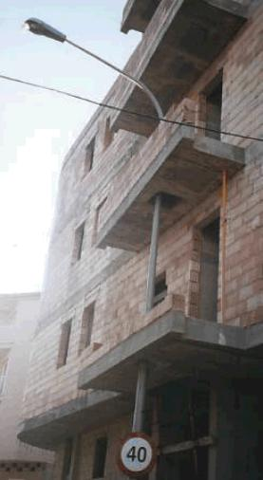
Remember Requirements are a Contractual Obligation

Slide 58
Appendix A

Slide 59
Avoid ambiguity
For many reasons ambiguity is perhaps the commonest of all pitfalls. Avoiding ambiguity is difficult since it requires us to write clearly and explicitly. This can, however, lead to the text becoming tedious and boring.
Words to avoid “or” “/” “and/or”
Dangerous expressions: any TLAs
Example
It is visible or audible? Or will both be needed?
What “same”
“also” !!
  The same subsystem shall also be able to generate a visible or audible caution/warning for the attention of the co-pilot or navigator or MCO
It is a caution or warning?
“attention” how is this verified
MCO a TLA
Which one or all?
In this example the writer has attempted to allow some design freedom (requirement should be solution free!) but has ended up introducing ambiguity

Slide 60
Avoid Multiple Requirements
Avoid using conjunctions (and, or, also, but, for, yet) when writing requirements – unless part of a clear precondition or qualifier
Example
  The power low indication shall be displayed when the voltage drops below 3.6 volts, and the current workspace or input data shall be saved

Slide 61
Avoid Complex Logic
Complex logic in requirements offers plenty of opportunities for ambiguity and misunderstanding
Consider the familiar on-line banking situation:
Users shall be able to transfer monies between accounts for which they have access. The user shall be able to specify a withdrawing account, a destination account and a transfer amount. If the transfer amount requested is greater than the currently available balance in a particular account the user shall be able to reduce the transfer amount or cancel the transfer.
This situation describes a relatively simple situation, but is already heading towards the realm of a very poorly written requirement
For complex logic situations other approaches have to be used:
  Structured Specification Languages (see Functional Modelling)
  Diagramming – even flowcharts!

Slide 62
Avoid Let-out Clauses
Requirements that contain let-out clauses can at first glance look definite and clear. Such requirements, unless spotted early, generate problems during confirmation (validation or verification as appropriate)
Words to avoid include: except, unless, although
Words to use with caution: if, when, where
Example
  The fire alarm shall always be sounded when smoke is detected, unless the alarm is being tested or the engineer has suppressed the alarm

Slide 63
Avoid Rambling
You don’t need a lot of words to convey clear understanding
    The Lord’s Prayer 56
    The 10 Commandments 197
    The U.S. Declaration of Independence 300
    The EC Directive on the export of duck eggs 29,611

Slide 64
Avoid Designing the System
“Good” requirements are solution free – within the scope of the meta-solution. This is often overlooked when writing subsystem requirements because in order to specify the subsystem the higher level system has to be designed.
Danger signs include: materials, component names, brand names, software packages or objects.
Example:
  The TV receiver shall receive the digital signal from the antenna using a shielded copper core with a nylon covering and a waterproof hardened rubber outer covering

Slide 65
Avoid Mixing Different Kinds of Requirements
A common error in narrow markets when the distinction between Customer/User Requirements and Systems Design Requirements is blurred.
Danger signs are user perspective requirements (the user shall be able to) mixed in with system, design or installation aspects
Example
  The user shall be able to view the currently selected channel number which shall be displayed in 24pt Arial font in the top right hand corner of the LCD display

Slide 66
Avoid Speculation
Remember requirements define our contractual obligation – there is no room for wish lists or general expressions about things that someone probably wants
Words to avoid: usually, generally, often, normally, typically
Danger signs: vagueness about which stakeholders
Example:
  Users normally like an early indication of low power level

Slide 67
Avoid Vague Un-definable Terms
Adjectives and adverbs should be avoided because they are too vague. The consequence is that they are impossible to confirm without some form of translation into an equivalent quantitative requirement. (This is often true of customer/user requirements – but we should be able to avoid this)
Words to avoid: maximise, minimise, very, highly, flexible, approximately
Phrases to avoid: user friendly, easy to use
Examples:
  The system shall be easy to use
  The system shall be very reliable
  The system status indication shall be displayed as soon as possible after the system self-test is completed

Slide 68
Avoid Possibilities
Requirements that express possibilities should be avoided and are often ignored by the system developer
Words to avoid: may, might, should, ought, could, perhaps, probably and possibly
Examples
  The aircraft structure should be able to withstand 110% overload
  The autonomous lawn mower shall avoid permanent and moving obstacles, a learning facility may be useful

Slide 69
Avoid Wishful Thinking
Requirements must be realistic, yet it is possible, and easy, to write un-realistic requirements
Danger phrases: 100% reliable, safe, future-proof, never fail, please all users, error free
Examples:
  The system shall be 100% safe in normal operation
  The navigation subsystem shall handle all unexpected errors without crashing
  The system shall be state of the art

Slide 70
Avoid Negative Requirements
It is good practice to find out what stakeholders “don’t want”, but the response is often a negative requirement. For example
    The system shall not burn the toast
In such cases the intent of the requirement can be retained through a neutral requirement and associated performance. For example:
    The system shall control the toasting of the bread product to the level set by the user.

Slide 71
Are My Requirements “Good”?
Writing “good” requirements is a skill that can be honed with practise
Following the guidelines presented here can help
A useful “test” of “goodness” is to consider how a particular requirement is to be confirmed – how would I prove that the requirement has been met?
  this aspect is covered formally in a later section, but is a useful discipline to maintain at all times.

Slide 72
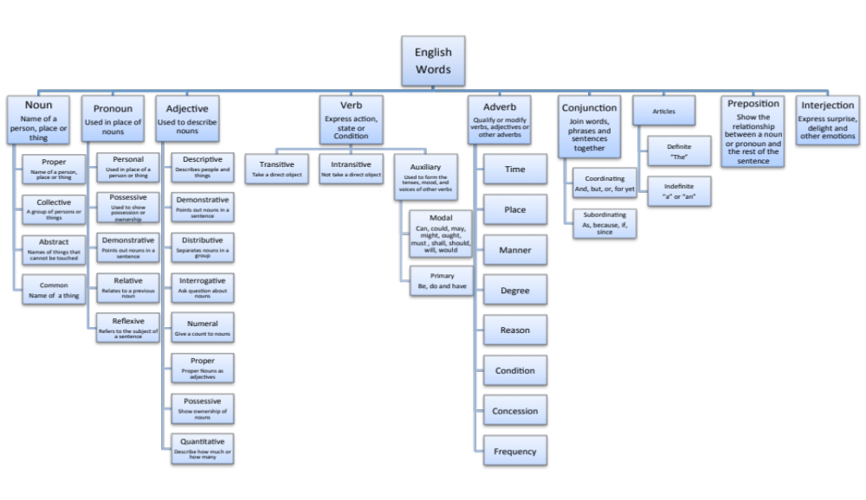
Basic English: Word Types
There are 9 types of word in the English language
Banned
Banned
Banned
Banned
Banned
Banned
Banned
Recognising the various word types is a useful skill in both analysing and writing requirements. The use of many of them is bad practice

