Slide 1

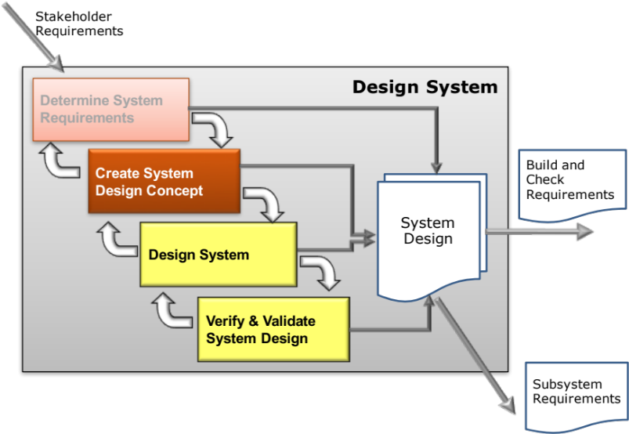
A Systems Approach to Systems Design
This Session
Explains a Systems Approach to System Design
Emphasises the importance of using functionality to:
  Manage complexity
  Provide an invariant traceability record
  Help assure a holistic solution

Slide 2
Where are we?
Purpose :
  To determine the overall system design concept that best matches the requirements
Outcomes :
  A conceptual system design solution in terms of
    the technologies that will deliver the technical system design requirements (and thereby the customer/stakeholder requirements)
    a system architecture that allows the concept design to be realised
  Engineering Design and Analysis to determine baseline design
  Initial flow-down of requirements to subsystem level
  “Design is a funny word. Some people think design means how it looks. But of course, if you dig deeper, it’s really about how it works”
Steve Jobs

Slide 3
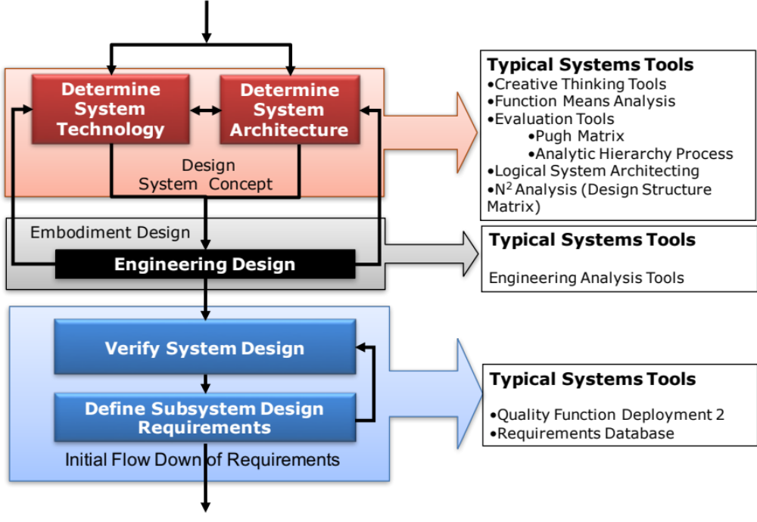
Key Tasks and Systems Tools
Notes:
9
9

Slide 4


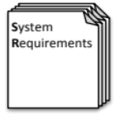
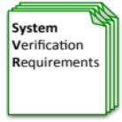
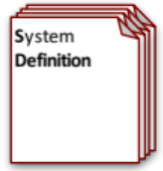
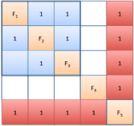



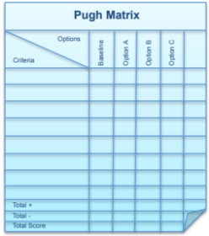
Process and Tools
Requirements Database
Create System Definition and Sub-System Requirements and associated Sub-System Verification Requirements
Quality Function Deployment 2
N² Analysis
Verify System Concept Solution meets the System Requirements and allocation of Sub-System Requirements
Determines the natural structure of a system that can be exploited
Preliminary Design and Feasibility
Use Engineering Modelling, Simulation and Analysis to undertake preliminary design and feasibility
Logical System Architecting
Determines candidate system architectures with minimal interfaces
Function Means Analysis
Identifies and captures all possible functional solutions to a system design problem and thereby determine suitable candidate system concepts
Compares candidate system concepts against a set of criteria
Pugh Matrix

Slide 5
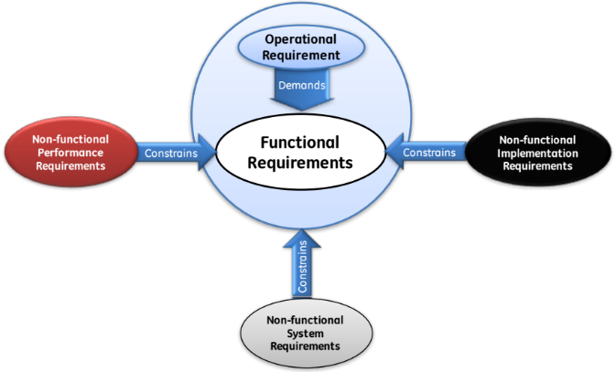
In order to Design a System we Must Have
From the Holistic Requirements Model
The Operational Requirement,
Key Non-functional System Requirements
and
Key Non-functional Implementation Requirements
USER
Requirements
The Operational Requirement,
FUNCTIONAL Requirements
and
Non-functional Performance Requirements
SYSTEM
Requirements
Failure to have the System Requirements results in the traditional approaches:
  Photocopying
  Flower Arranging
  Pet Pony
  Evolution

Slide 6
A bad beginning makes a bad ending Euripides, Aegeus Greek tragic dramatist ( 480 BC - 406 BC)
The use of the various tools in the Determine System Requirements sub-process has provided an understanding of the customer/stakeholder requirements in terms of:
  The overall purpose of the system - the Operational Requirement(s)
  The basic (generic, legislative, emergent) functionality needed to achieve the overall purpose - the Functional Requirements
  The constraints placed upon the system and its functions – the Non-functional Requirements
  The sensitivity of the functions to variation and failure
With this information it is now possible to undertake the first steps in developing a concept design solution

Slide 7
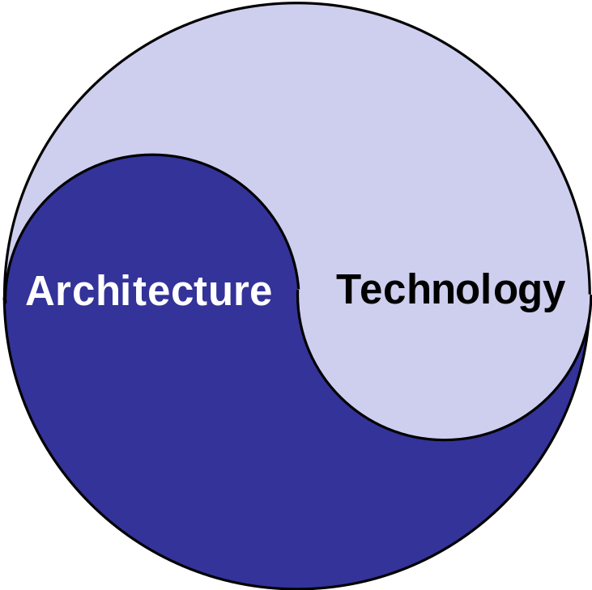
The Yin Yang of System Design
System Design comprises two interrelated sets of decisions:
  What TECHNOLOGY is to be used
  What is the ARCHITECTURE of the system
Both have to be decided in order to specify the complete system design
Which comes first?
  Decisions made in terms of the technology can restrict and constrain the choice of architecture
  Decisions made in terms of architecture can restrict and constrain the choice of technology
Good System Design keeps options open as long as possible

Slide 8
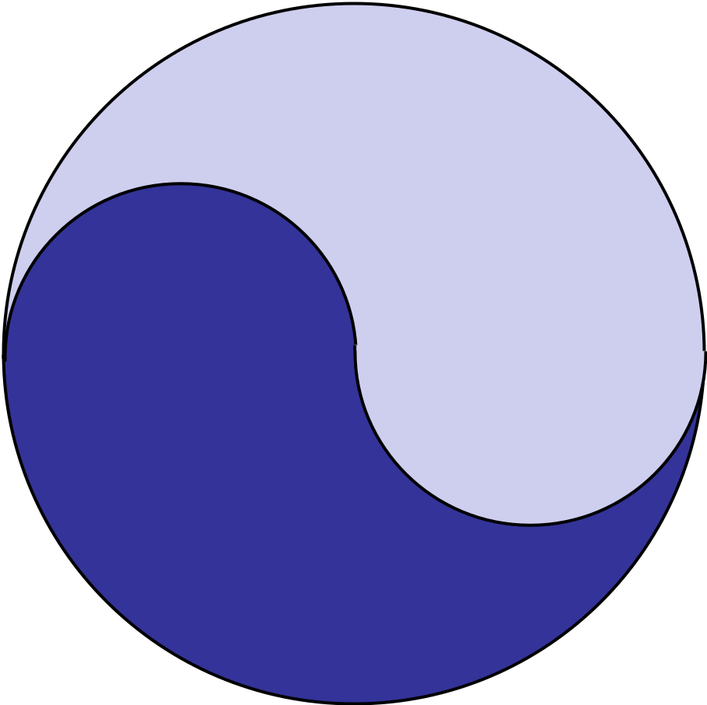
Process and Tools
Requirements Database
Create System Definition and Sub-System Requirements and associated Sub-System Verification Requirements
Quality Function Deployment 2
N² Analysis
Verify System Concept Solution meets the System Requirements and allocation of Sub-System Requirements
Determines the natural structure of a system that can be exploited
Preliminary Design and Feasibility
Use Engineering Modelling, Simulation and Analysis to undertake preliminary design and feasibility
Logical System Architecting
Determines candidate system architectures with minimal interfaces
Function Means Analysis
Identifies and captures all possible functional solutions to a system design problem and thereby determine suitable candidate system concepts
Compares candidate system concepts against a set of criteria
Pugh Matrix

Slide 9
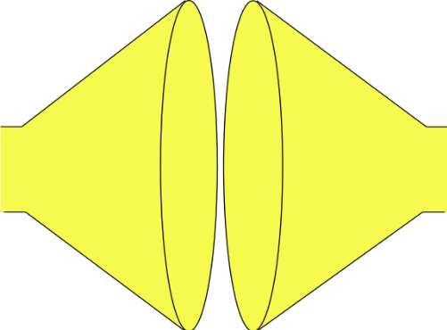
How is this Done
Remember the Systems Approach to Creating a System
We are Here
Search and evaluate the solutions to determine and select the “best” solution
(Convergent Thinking)
Do
Do
Do
MAKE THE SYSTEM TO THE DESIGN
GENERATE SOLUTION OPTIONS AND SELECT
SYSTEM PROBLEM
UNDERSTAND
PROBLEM
solution
solution
“best”
solution
Built System
Understand the problem in terms of Purpose and Context
solution
Stakeholder needs and expectations
solution
Check (& Act)
Identify and document all possible solutions to the problem (Divergent Thinking)
Confirm the understanding of the problem reflects the stakeholder’s needs and expectations
Check (& Act)
Confirm that the selected solution solves the stakeholders’ problem
Check (& Act)
Confirm that the built System solves the stakeholders’ problem

Slide 10
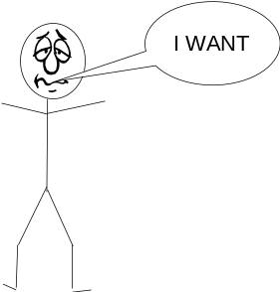


The Systems Approach to System Design
The bridge between requirements and the solution is the functionality (purpose)
FUNCTIONALITY
Requirements
-Land
Solution-Land
Functionality helps us uncover the unspoken requirements
Functionality is invariant and provides a consistent basis for dividing and ruling
Functionality helps us determine the system architecture
Functionality helps us identify and select the technological solutions

