Slide 1

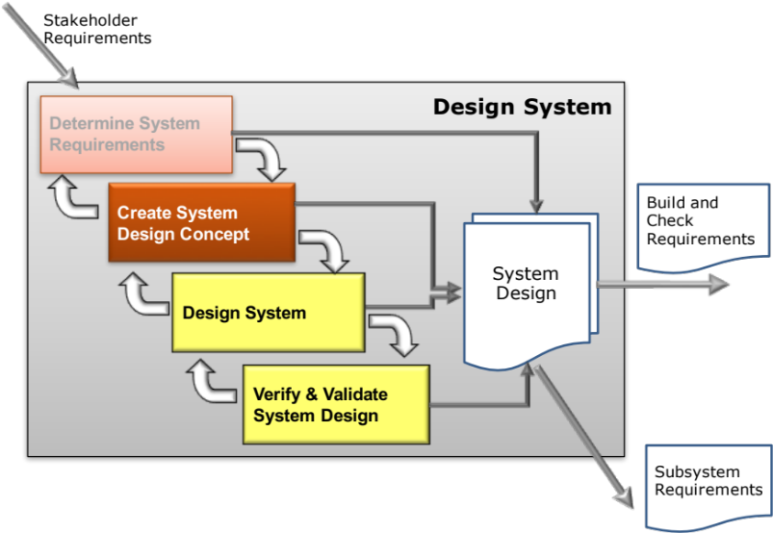
Create System Design Concept
System Architecting
Secondary Information Goes Here
This Session:
Explains the importance of architecture on system performance
Explains the concepts and principles of System Architecting
Describes Logical System Architecting and N² Analysis as simple practical tools for generating candidate system architectures
Emphasizes the importance of interfaces in architectural design and approaches to their design and management

Slide 2


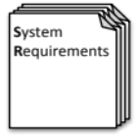

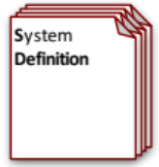
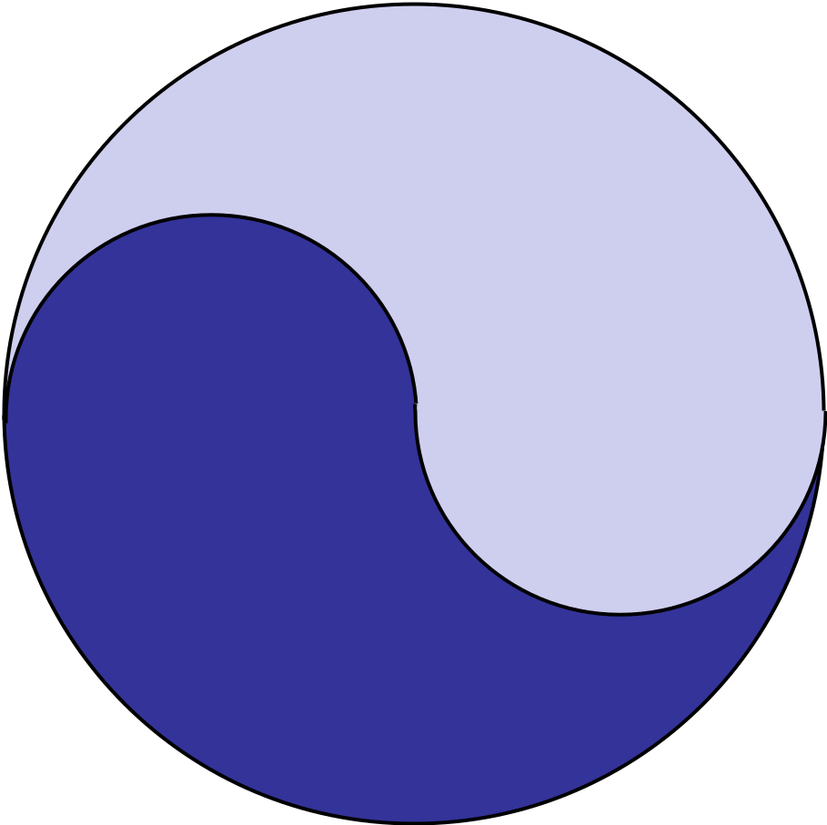
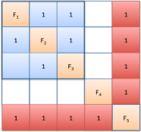



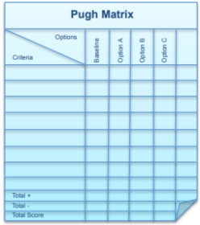
Process and Tools
Requirements Database
Create System Definition and Sub-System Requirements and associated Sub-System Verification Requirements
Quality Function Deployment 2
N² Analysis
Verify System Concept Solution meets the System Requirements and allocation of Sub-System Requirements
Determines the natural structure of a system that can be exploited
Preliminary Design and Feasibility
Use Engineering Modelling, Simulation and Analysis to undertake preliminary design and feasibility
Logical System Architecting
Determines candidate system architectures with minimal interfaces
Function Means Analysis
Identifies and captures all possible functional solutions to a system design problem and thereby determine suitable candidate system concepts
Compares candidate system concepts against a set of criteria
Pugh Matrix

Slide 3
Definitions
Architecture
  mass noun
    the art or practice of designing and constructing buildings.
      The style in which a building is designed and constructed, especially with regard to a specific period, place or culture
    the complex or carefully designed structure of something
(New Oxford English Dictionary 2007)
System Architecture – the organization and structure of a system
System Architect – a person who designs system architectures
System Architecting – the synthesis of a system architecture

Slide 4
Architecture?
No Architecture
Architecture

Slide 5
System Architecture
System Architecture is about:
  Organization
    Groups of system components into SUBSYSTEMS
  Interconnection (what are the INTERFACES)
    Command, control and information
      communication between subsystems
      communication between system components
    Energy flows
    Force flows
    Heat flows
    Material flows
The way in which a system behaves and performs is often fundamentally affected by the architecture
Synthesising an architecture is therefore important
Architecture is key to systems integration
Note that some may be emergent but we still have to consider them in our design

Slide 6
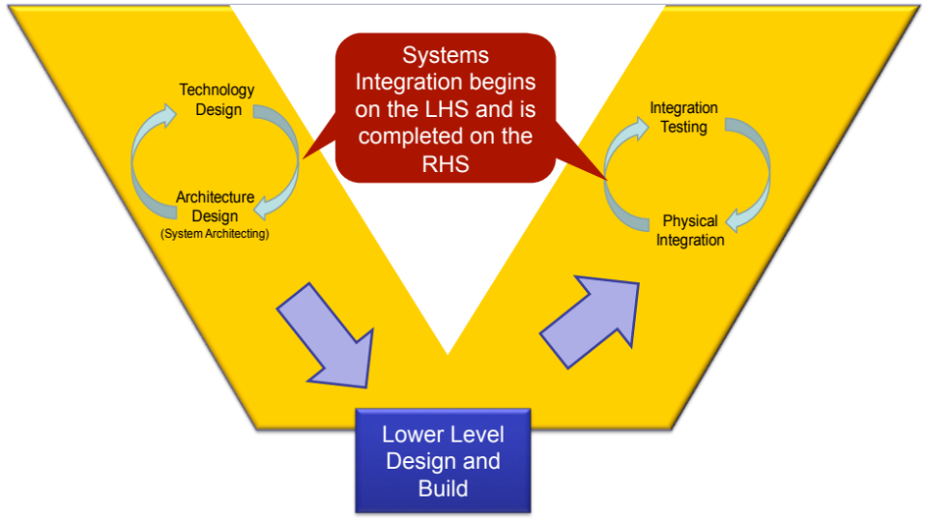
What is Systems Integration
Systems Integration has two elements:
  Physical System Integration is the bringing together of the component subsystems into one system and ensuring that the subsystems function together as a system that is able to deliver the desired operational requirements
  Design Integration is:
    Deciding on the “best” means to system functionality
    Deciding on the “best” organization of subsystems
    Deciding on the “best” interfaces
What is done in the design activity fundamentally affects what happens in the physical integration

Slide 7
Implications of Architecture Selection
Physical Integration – the architecture will define the ground rules for physical system integration and therefore test
System performance is constrained by the architecture, and equally a specified performance level may force an architecture
Development – speed and ease of development is a function of the architecture (fundamentally can elements be developed in parallel )
Realisation (Manufacturing/Test/Implementation) – the choice of architecture is a strong influence on the ease of realisation (manufacturability, testability etc.)
The inherent reliability of a system is dictated by the architecture and equally the architecture can drive reliability
Maintainability, longevity, upgradeability etc. are all a function of architecture
Architecture is Important

Slide 8
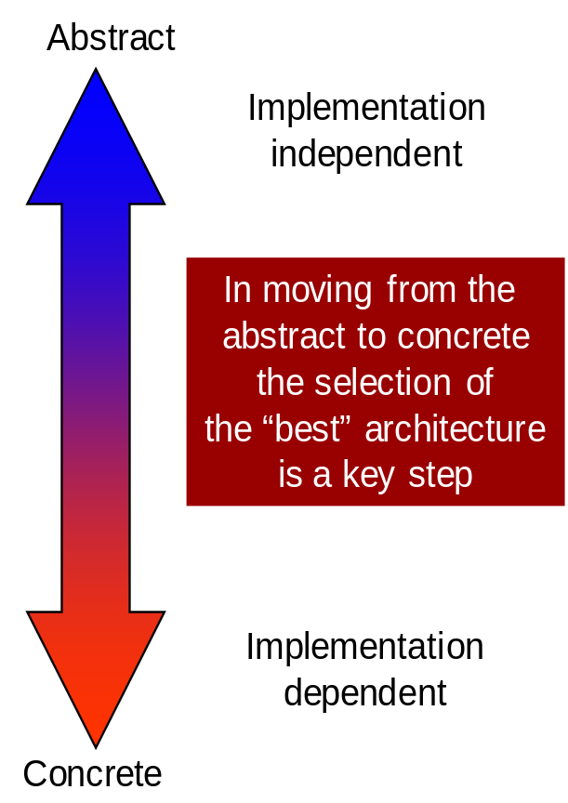
Types of System Architecture
Requirements Architecture
  The structure and interdependencies between the system requirements
Logical (Functional) Architecture
  The structure and interdependencies between the system functionality
Physical Architecture
  The physical resources of the system and how they are connected
Technical (Control) Architecture
  The rules that define how the physical resources deliver the functionality necessary for the system to achieve its purpose
We often consider architecture to mean the “physical” aspect we can touch – but there are other “abstract” architectures used during design
The use of FUNCTIONALITY allows us to almost seamlessly move from one architecture type to the other

Slide 9
Systems Architecture Principles
In helping to determine the “best” architecture there is an overriding design maxim
        minimise the number of interfaces
To minimise the number of interfaces there are a number of systems principles that are useful
  Cohesion
  Binding and Coupling
Remember that most systems issues occur at the interfaces

Slide 10


Cohesion
Wherever possible functionality should be combined in the design solution
  Aim to get system components to do more than one thing
  In simple terms a lower part count increases reliability and reduces cost (in general)
Functions that are physically connected or correlated (QFD 1) should be investigated for potential synergies
A classic example of this is the Mini where the gearbox was made integral with the sump of the engine. Such ideas, however, frequently incur some element of risk. In the case of the Mini, there was the need to find a suitable oil that would serve both engine and gearbox
The definition of cohesion here comes from classic mechanical engineering good practice (for example the texts of M J French “Engineering Design”). The term has a different meaning in software. In software engineering it refers to the “single mindedness” of a module, i.e. each module should do one thing, one thing only, and do it well, without needing any other modules to help it do it.

Slide 11
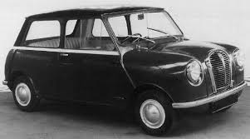
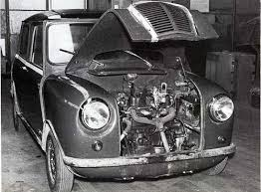
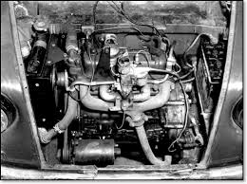
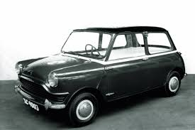

Slide 12
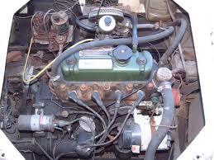

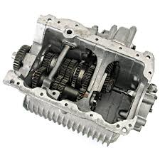
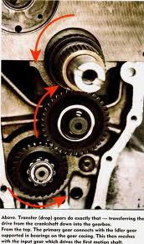
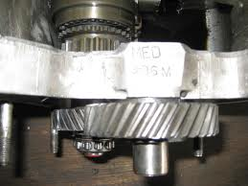

Slide 13
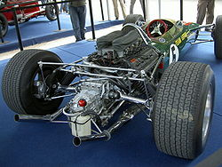


Slide 14
Binding
Functions bind together when they share common interfaces. Groups of functions that are tightly bound should be considered candidates for physical grouping or potential aggregation as subsystems
Functions tightly bound
A potential subsystem?
Functions loosely bound
High binding must be balanced with low “Coupling”

Slide 15
Coupling
Coupling is the degree of connectivity between subsystems
Two subsystems with
LOW coupling. A ”good” architecture
Two subsystems with
HIGH coupling. A ”poor” architecture
We should always attempt to reduce the degree of coupling – i.e. minimise the number of interfaces

Slide 16
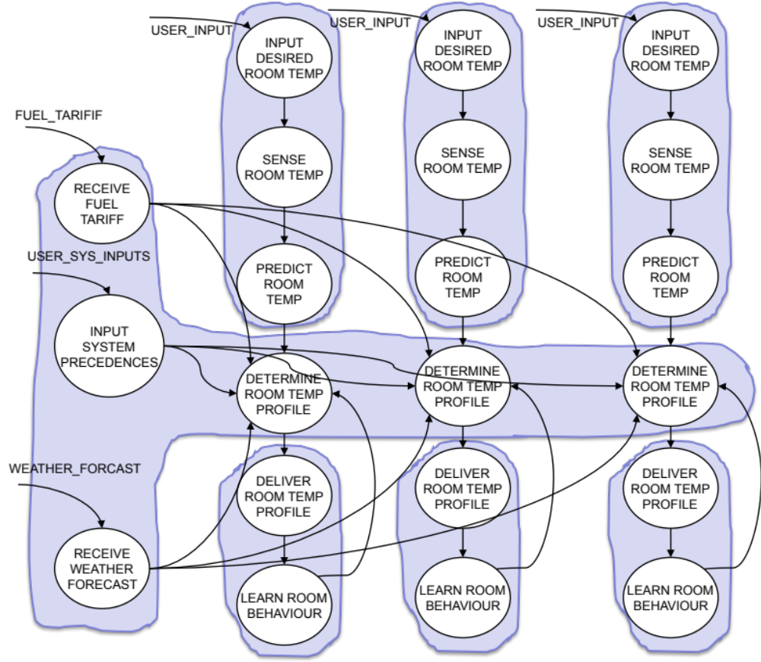
Logical System Architecting
What is it?
  Looking for the natural clusters of functionality that have:
    High binding
    Low coupling
Why do it?
  Although there is no formal proof (yet), natural architectures appear to be more robust since they minimise the number of interfaces
When to do it?
  Can be done as soon as a functional (Logical) model is available
How to do it?
  Grouping and un-grouping functions to find clusters that have the lowest coupling and highest binding by computing the average logical interfaces per candidate subsystem

Slide 17
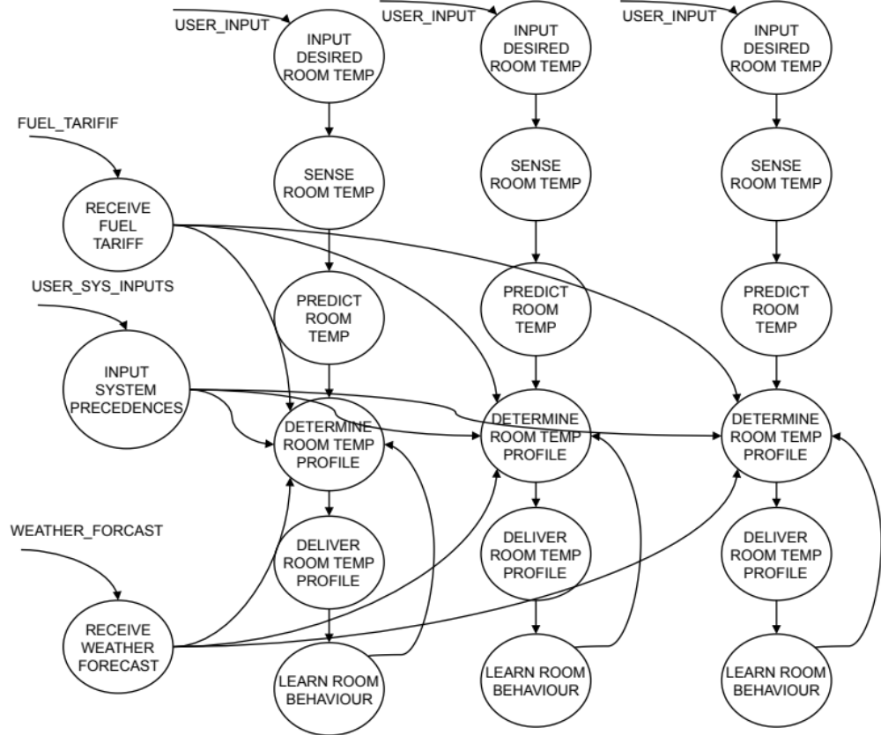
Example Intelligent Heating System
Function Flow Diagram for an Intelligent Heating System
Room 1 Room 2 Room 3

Slide 18
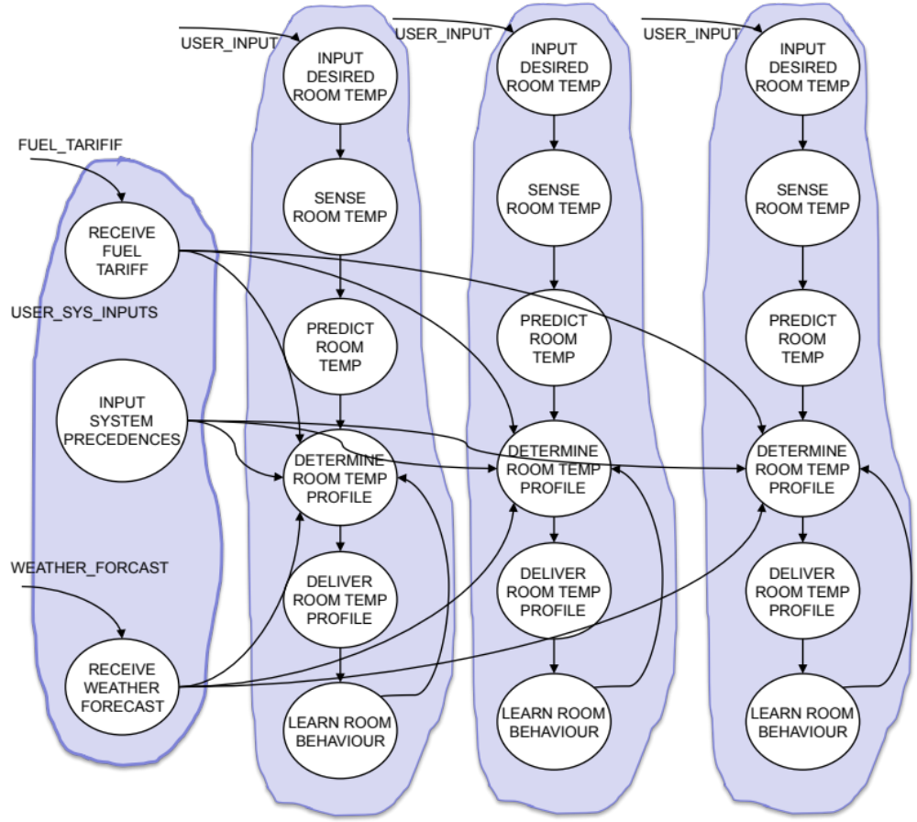
Zone Based Architecture
Zone Based Architecture
24/4 = 6 interfaces per potential subsystem
Room 1 Room 2 Room 3

Slide 19
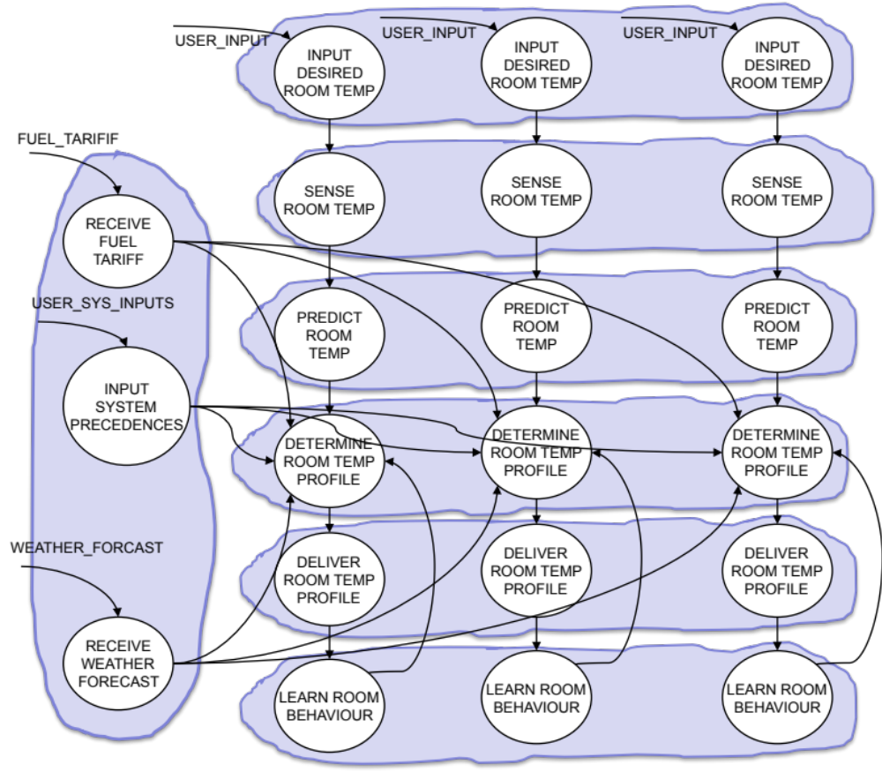
Common Purpose Architecture
Common Purpose Architecture
60/7 = 8.57 interfaces per potential subsystem
Room 1 Room 2 Room 3

Slide 20
Minimum Coupling Design
Minimum coupling architecture
24/7 = 3.43 interfaces per potential subsystem
We still have to reconcile this architecture with the chosen technology
Room 1 Room 2 Room 3

Slide 21
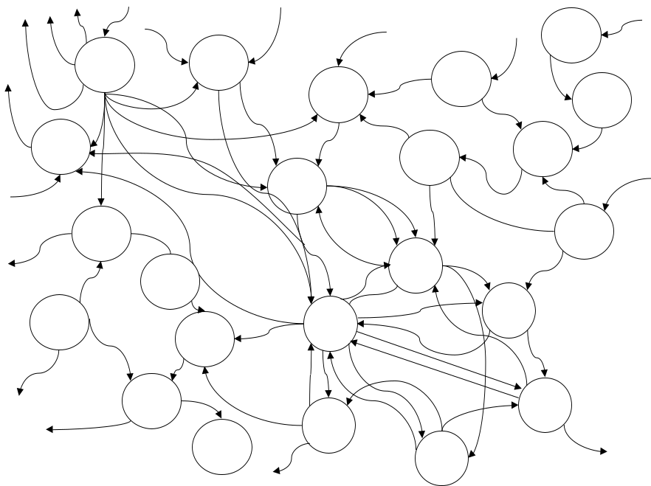
Grouping in Practice
This example illustrates the principle of architecting, but for other systems?
A very useful tool is N² Analysis (Also called Design Structure Matrix DSM)
What would be the best logical architecture for this system?

Slide 22
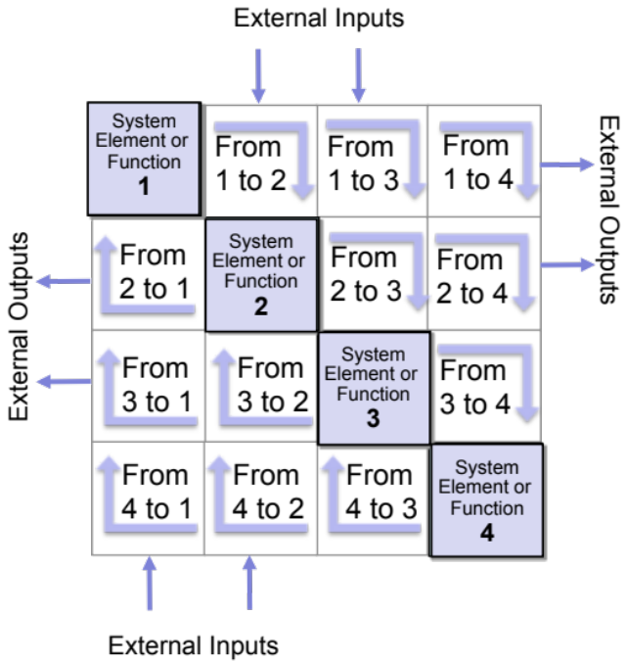
N² Analysis
What is it
  A tool to identify the interconnectivity of a system
  It is particularly useful in system design to assess the degree of binding and coupling in a system
Why use it?
  N² Analysis can be used to help find the natural architecture for a system
  N² Analysis can help identify where redundancy might be necessary
  N² Analysis can be used to document and manage interfaces
When to use it?
  The approach could be used even before technological concept generation to help identify natural clusters of functionality
How to use it
  An N² chart comprises a matrix in which the functions or system elements are recorded on the leading diagonal. The remaining cells of the matrix are used to signify the presence of interfaces between functions

Slide 23
Generic N² Diagram Rules
External Inputs to
Functions 2 and 3
System
Element or
Function
1
From
1 to 2
From
1 to 3
From
1 to 4
System Elements or Functions:
are on the diagonal
have inputs and outputs
outputs are contained in rows; inputs are contained in columns
External Outputs from
Functions 1 and 2
From
2 to 1
System
Element or
Function
2
From
2 to 3
From
2 to 4
External Outputs from
Functions 2 and 3
From
3 to 1
From
3 to 2
System
Element or
Function
3
From
3 to 4
From
4 to 1
From
4 to 2
From
4 to 3
System
Element or
Function
4
External Inputs to
Functions 1 and 2
Notes:
5 - 23
Notes:
This illustrates the format and labeling conventions for the N² diagram.
Although this lesson uses the N² diagram to show physical interfaces, the N² diagram is useful at functional or physical level.
The N² diagram identifies entity interfaces.
The N² diagram is used by systems engineers to identify, define, and record interfaces. Project managers can use the N² diagram to manage (assign responsibility and track accomplishment of) the interfaces.

Slide 24
Influence of Critical Element
Critical Element
F₁ | 1 |  | 1
 | F₂ | 1 | 1
 |  | F₃ | 1
1 | 1 | 1 | F₄ | 1 | 1 | 1
 |  |  | 1 | F₅ | 1
 |  |  | 1 |  | F₆ | 1
 |  |  | 1 |  |  | F₇ | 1
 |  |  |  |  |  |  | F₈ | 1 | 1 | 1
 |  |  |  |  |  |  | 1 | F₉ | 1
 |  |  |  |  |  |  | 1 | 1 | F₁₀ | 1
 |  |  |  |  |  |  | 1 | 1 | 1 | F₁₁
Simple linear cascade flow between elements
Tightly bound group of elements
Feedback Loop
Nodal Point – a natural “break” between element groups
Complex interconnections

Slide 25
The N2 Analysis Process
Step 1:
Construct Unstructured Matrix
The approach is basically linear, but, there is iteration
Step 2:
Analyse Unstructured Matrix to investigate underlying structures
Step 3:
Draw Conclusions about System Structure

Slide 26
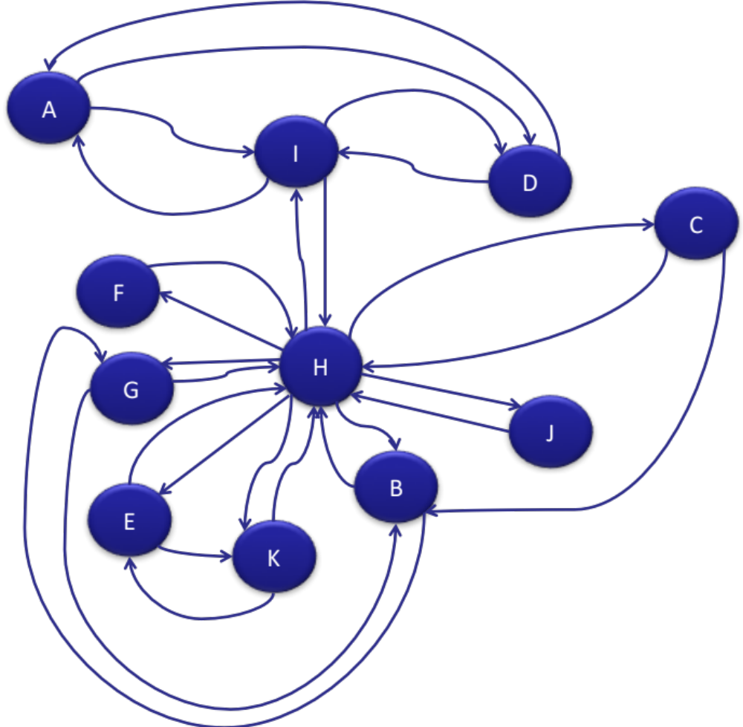
Step 1: Construct the Unstructured Matrix
Step 1, or the input to step 1 is critical to performing a N2 Analysis. You could argue that there is a “Step 0” which is to generate a model of the system of interest that show the components and the interconnections between those components. In terms of the Systems Engineering tools presented in this course the Function Flow Diagram is the obvious choice although there are other Systems Thinking tools that can be used
Here we have a Function Flow Diagram that comprises 11 functions

Slide 27
Step 1: Example
A outputs to D
A |  |  | 1 |  |  |  |  | 1
 | B |  |  |  |  | 1 | 1
 | 1 | C |  |  |  |  | 1
1 |  |  | D |  |  |  |  | 1
 |  |  |  | E |  |  | 1 |  |  | 1
 |  |  |  |  | F |  | 1
 | 1 |  |  |  |  | G | 1
 | 1 | 1 |  | 1 | 1 | 1 | H | 1 | 1 | 1
1 |  |  | 1 |  |  |  | 1 | I
 |  |  |  |  |  |  | 1 |  | J
 |  |  |  | 1 |  |  | 1 |  |  | K
From the FFD we can construct the unstructured N² matrix. In this case a “1” is used to signify a flow between two functions

Slide 28
Step 2
To find the natural structure that exists in most systems we re-order the rows of the N² Matrix. To show you the outcome of such a re-ordering exercise, the matrix opposite shows the “hidden” structure that comprises a number of natural clusters of functions (if you are designing a system these could be potential subsystems) and a critical element centred on Function H.
Moving from the un-clustered matrix to the clustered one can be accomplished by two means. Software packages do exist to perform the task, or it can be achieved by hand. At first glance the “by hand” method may appear somewhat daunting, but with a few simple “tricks” it can be made tractable.
A | 1 | 1
1 | D | 1
1 | 1 | I |  |  |  | 1
 |  |  | C | 1 |  | 1
 |  |  |  | B | 1 | 1
 |  |  |  | 1 | G | 1
 |  | 1 | 1 | 1 | 1 | H | 1 | 1 | 1 | 1
 |  |  |  |  |  | 1 | E | 1
 |  |  |  |  |  | 1 | 1 | K
 |  |  |  |  |  | 1 |  |  | J
 |  |  |  |  |  | 1 |  |  |  | F

Slide 29
The Starting Point
A |  |  | 1 |  |  |  |  | 1
 | B |  |  |  |  | 1 | 1
 | 1 | C |  |  |  |  | 1
1 |  |  | D |  |  |  |  | 1
 |  |  |  | E |  |  | 1 |  |  | 1
 |  |  |  |  | F |  | 1
 | 1 |  |  |  |  | G | 1
 | 1 | 1 |  | 1 | 1 | 1 | H | 1 | 1 | 1
1 |  |  | 1 |  |  |  | 1 | I
 |  |  |  |  |  |  | 1 |  | J
 |  |  |  | 1 |  |  | 1 |  |  | K
The starting point is the unclustered N² Matrix. This is often arbitrary as a consequence of the model used.
Should included at least two levels of detail i.e. Diagram 0 and the associated child Diagrams

Slide 30
Finding Critical Elements
A |  |  | 1 |  |  |  |  | 1 |  |  | 2
 | B |  |  |  |  | 1 | 1 |  |  |  | 2
 | 1 | C |  |  |  |  | 1 |  |  |  | 2
1 |  |  | D |  |  |  |  | 1 |  |  | 2
 |  |  |  | E |  |  | 1 |  |  | 1 | 2
 |  |  |  |  | F |  | 1 |  |  |  | 1
 | 1 |  |  |  |  | G | 1 |  |  |  | 2
 | 1 | 1 |  | 1 | 1 | 1 | H | 1 | 1 | 1 | 8
1 |  |  | 1 |  |  |  | 1 | I |  |  | 3
 |  |  |  |  |  |  | 1 |  | J |  | 1
 |  |  |  | 1 |  |  | 1 |  |  | K | 2
2 | 3 | 1 | 2 | 2 | 1 | 2 | 8 | 3 | 1 | 2
Use row and column sums to look for critical elements

Slide 31
Finding Clusters
A |  |  | 1O |  |  |  |  | 1O
 | B | O |  |  |  | 1O | 1O
 |  | C |  |  |  |  | 1O
 |  |  | D |  |  |  |  | 1O
 |  |  |  | E |  |  | 1O |  |  | 1O
 |  |  |  |  | F |  | 1O
 |  |  |  |  |  | G | 1O
 |  |  |  |  |  |  | H | 1O | 1O | 1O
 |  |  |  |  |  |  |  | I
 |  |  |  |  |  |  |  |  | J
 |  |  |  |  |  |  |  |  |  | K
To find the clusters - form the Upper-triangular matrix by placing the lower-triangular entries in their upper reciprocal cells. If the symbol is changed (here from 1 to 0) it becomes easy to see potential clusters.

Slide 32
A |  |  | 1O |  |  |  |  | 1O
 | B | O |  |  |  | 10 | 1O
 |  | C |  |  |  |  | 1O
 |  |  | D |  |  |  |  | 1O
 |  |  |  | E |  |  | 1O |  |  | 1O
 |  |  |  |  | F |  | 10
 |  |  |  |  |  | G | 1O
 |  |  |  |  |  |  | H | 1O | 10 | 10
 |  |  |  |  |  |  |  | I
 |  |  |  |  |  |  |  |  | J
 |  |  |  |  |  |  |  |  |  | K
Functions A, D and I are tightly bound.
Move row containing D to just below row containing A.
Move row containing I to just under row containing D.

Slide 33
A |  |  | 1O |  |  |  |  | 1O
 | B | O |  |  |  | 10 | 1O
 |  | C |  |  |  |  | 1O
 |  |  | D |  |  |  |  | 1O
 |  |  |  | E |  |  | 1O |  |  | 1O
 |  |  |  |  | F |  | 10
 |  |  |  |  |  | G | 1O
 |  |  |  |  |  |  | H | 1O | 10 | 10
 |  |  |  |  |  |  |  | I
 |  |  |  |  |  |  |  |  | J
 |  |  |  |  |  |  |  |  |  | K
A similar situation for B, G and H

Slide 34
A |  |  | 1O |  |  |  |  | 1O
 | B | O |  |  |  | 10 | 1O
 |  | C |  |  |  |  | 1O
 |  |  | D |  |  |  |  | 1O
 |  |  |  | E |  |  | 1O |  |  | 1O
 |  |  |  |  | F |  | 10
 |  |  |  |  |  | G | 1O
 |  |  |  |  |  |  | H | 1O | 10 | 10
 |  |  |  |  |  |  |  | I
 |  |  |  |  |  |  |  |  | J
 |  |  |  |  |  |  |  |  |  | K
A similar situation for E, H and K

Slide 35
Step 3: Draw Conclusions
Step 3 is perhaps the most difficult one because it requires us to make decisions.
The Structured N2 Matrix opposite certainly demonstrates that there is structure inside the system problem described by the Function Flow Diagram
If this was a system design problem, the N2 Matrix can be used to explore potential system architectures.
A | 1 | 1
1 | D | 1
1 | 1 | I |  |  |  | 1
 |  |  | C | 1 |  | 1
 |  |  |  | B | 1 | 1
 |  |  |  | 1 | G | 1
 |  | 1 | 1 | 1 | 1 | H | 1 | 1 | 1 | 1
 |  |  |  |  |  | 1 | E | 1
 |  |  |  |  |  | 1 | 1 | K
 |  |  |  |  |  | 1 |  |  | J
 |  |  |  |  |  | 1 |  |  |  | F

Slide 36
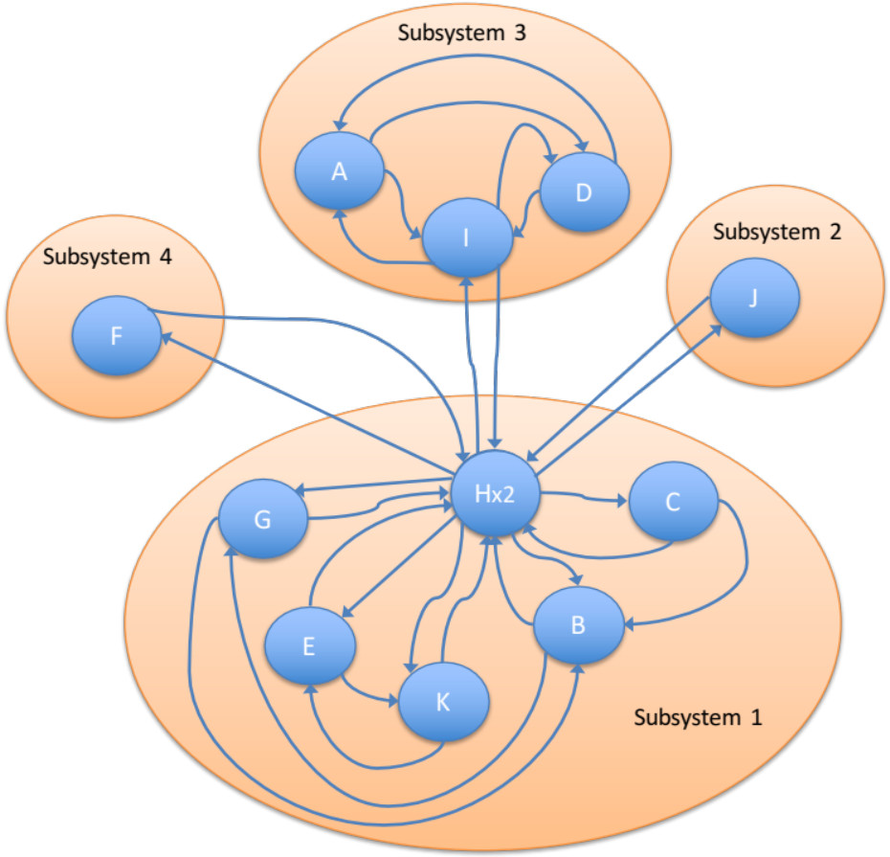
A Potential System Architecture
For example the “grouped” Function Flow Diagram shows such a potential architecture, where the various functions have been allocated to subsystems.
Most system problems (whether designed, adapted or evolved) happen at the interfaces. It therefore follows that if the system has fewer interfaces there should be fewer issues.
This of course has to be taken with a large pinch of common sense! Reducing the number of interfaces and the expense of interface complexity may not be a good thing.

Slide 37
Handling Critical Functions
Function H is critical, and its failure, or degraded performance, will potentially affect the performance of the whole system.
Context is all important here, in this example we don’t really know what the system problem is, however, system elements like H point towards where redundancy may be required.
In hardware-based systems this may mean duplicating the critical components.
In Human Activity Systems, the critical element is often an individual. It is important to note from a systems viewpoint, its not the actual individual that is important, but the function they perform that is critical. Again, duplication may be the answer, or at least having a “deputy” or assistant.

Slide 38
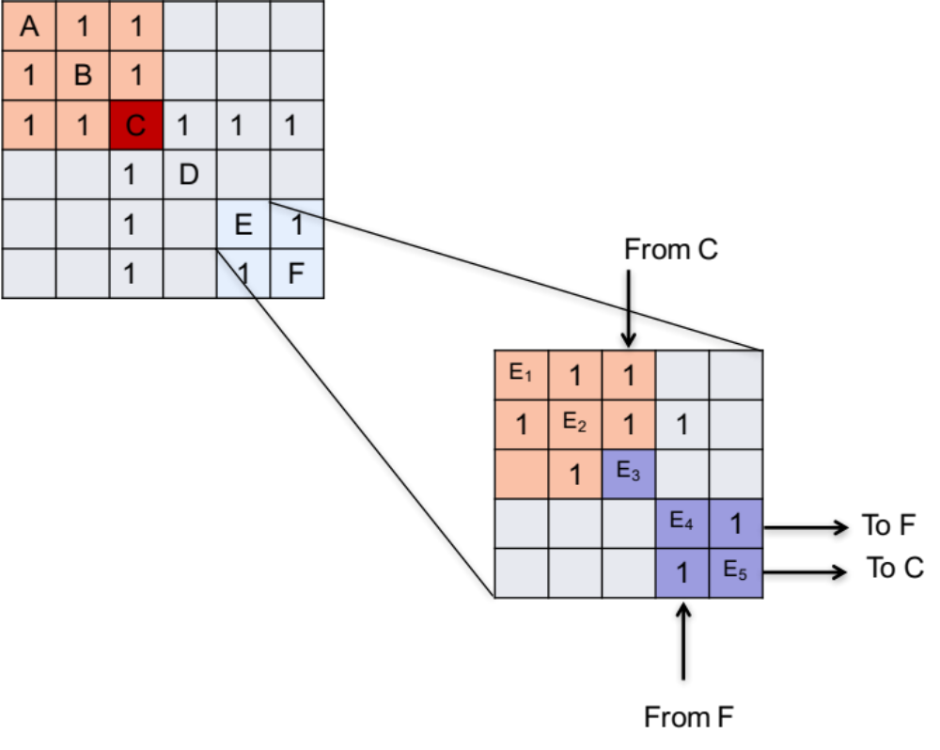
Applying Top-Down N2
Managing complexity is always an issue with N² Analysis. If based on Function Flow Diagrams then the advice is Diagram 0 and the Child Diagrams: - 7x7 =49x49 Matrix!
Structure that we see at a high level may have further structure at a lower level

Slide 39
Example
Channel Tunnel Security Subsystem: Unclustered chart that shows the potential interfaces with the strength determined on a 0-9 scale
Damage Control | A |  |  |  |  |  |  |  |  | 6 |  |  |  |  | 6
Interpol |  | B |  |  | 3 |  |  |  | 9 |  | 3 | 3
Active Sensors |  |  | C |  |  |  |  | 8 | 8 |  |  |  |  | 8 | 9
Environmental Sensors |  |  |  | D |  |  |  | 8 |  |  |  |  |  |  | 9
Customs |  | 3 |  |  | E | 3 |  |  | 7 |  | 1 | 3
Baggage Inspection |  |  |  |  | 6 | F
Safety Control |  |  |  |  |  |  | G |  |  |  |  |  |  |  | 2
Rail Operations |  |  |  |  |  |  | 9 | H |  |  |  |  |  |  | 9
Intelligence |  |  |  |  |  |  |  |  | I |  |  |  |  | 9 | 8
Logistics | 2 |  |  |  |  |  |  |  |  | J |  |  |  | 2 | 6
Immigration |  | 6 |  |  | 1 |  |  |  | 7 |  | K | 6
Local Police |  | 6 |  |  | 2 |  |  |  | 9 |  | 2 | L |  | 1 | 4
Emergency Services |  |  |  |  |  |  |  |  |  |  |  |  | M |  | 4
Security |  |  | 1 |  |  |  |  |  | 7 | 7 |  | 3 |  | N | 8
Operations | 9 |  | 1 | 2 |  |  | 9 | 7 | 5 |  |  | 4 | 4 | 9 | O

Slide 40
Example
Natural Subsystem – exploit collocation
Baggage Inspection | F | 6
Customs | 3 | E | 1 | 3 | 3 | 7
Immigration |  | 1 | K | 6 | 6 | 7
Interpol |  | 3 | 3 | B | 3 | 9
Local Police |  | 2 | 2 | 6 | L | 9 |  |  | 1 | 4
Intelligence |  |  |  |  |  | I |  |  | 9 | 8
Emergency Services |  |  |  |  |  |  | M |  |  | 4
Active Sensors |  |  |  |  |  | 8 |  | C | 8 | 9 | 8
Security |  |  |  |  | 3 | 7 |  | 1 | N | 8 |  |  |  |  | 7
Operations |  |  |  |  | 4 | 5 | 4 | 1 | 9 | O | 7 | 9 | 2 | 9
Rail Operations |  |  |  |  |  |  |  |  |  | 9 | H | 9
Safety Control |  |  |  |  |  |  |  |  |  | 2 |  | G
Environmental Sensors |  |  |  |  |  |  |  |  |  | 9 | 8 |  | D
Damage Control |  |  |  |  |  |  |  |  |  | 6 |  |  |  | A | 6
Logistics |  |  |  |  |  |  |  |  | 2 | 6 |  |  |  | 2 | J
Critical Node centred on operations – note the two “systems” are coupled through the local police
Partial Critical Node and natural subsystem

Slide 41
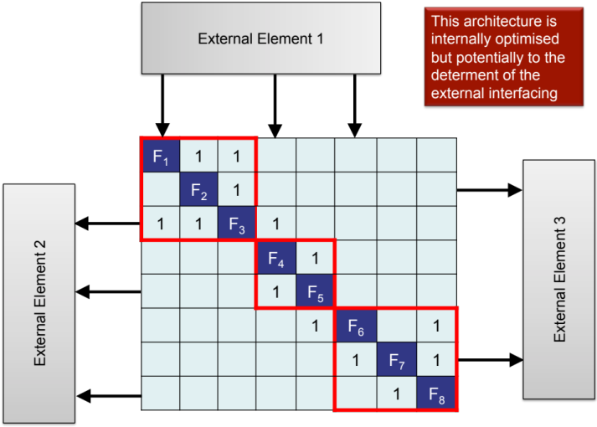
Exercise – N² Analysis
In teams
Use your Function Flow Diagram to construct an N² matrix for the Case Study
Investigate the matrix for any natural subsystems or critical nodes
Identify potential candidate logical architectures
Time: 15 minutes

Slide 42
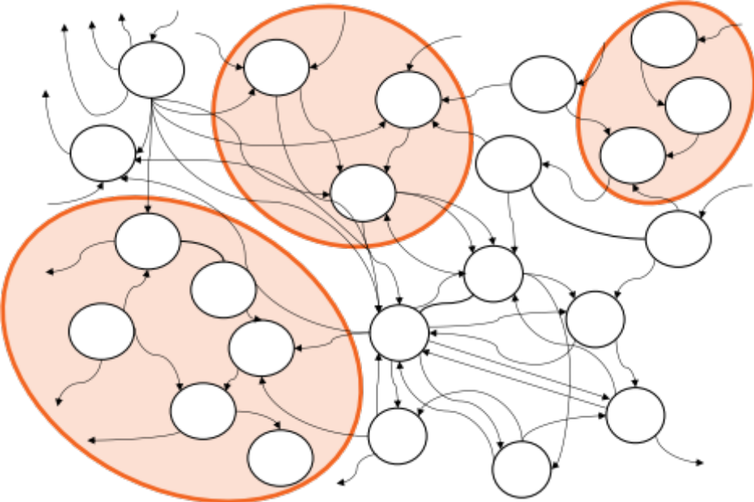
Using N2 Analysis
N2 Analysis can help determine the best logical architecture and, while this may not be physically realisable, it is often worthwhile modelling the best logical architecture for future reference and analysis
Note that there may be more than one logical architecture – model all the possible candidates at least at highest level
Next Steps
Reconcile the logical architectures with the implementation choices
  Technological choices for functionality
  Use of standard interfaces
  Design and Define system interfaces

Slide 43
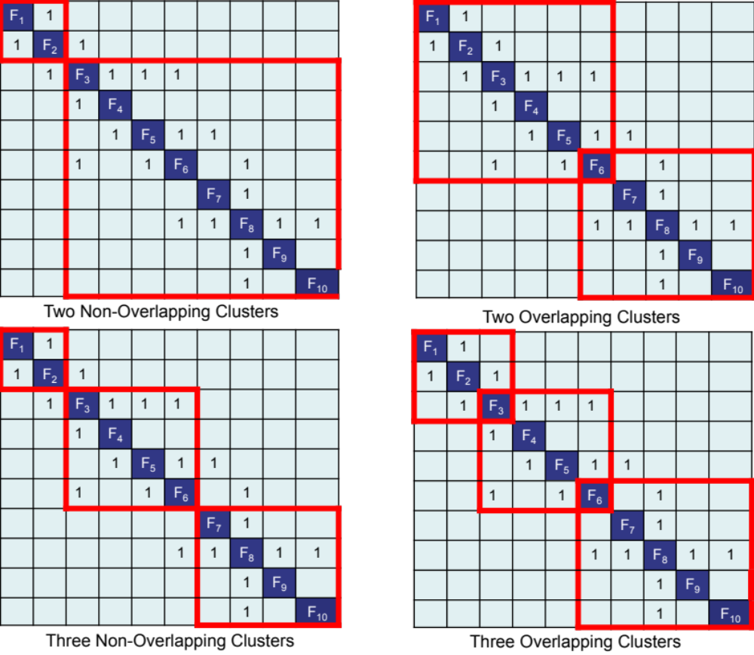
Architecture Choices
There is always choice and decisions about the system architecture should be delayed until the technological choices have been identified

Slide 44
External Versus Internal Interfaces
System external interfaces are defined by the higher-level system design and are often fixed and described as requirements on the system design – BUT:
  Internal interfaces are different since they are created as part of system architecting. This is a powerful opportunity for the development team to optimise either the
    Local system design: in this case the system architecture is selected to optimise the performance of the system potentially to the detriment of the bigger system to which it belongs
    The higher level system design: in this case the performance of the local system is sacrificed to yield improved performance at the bigger system level

Slide 45

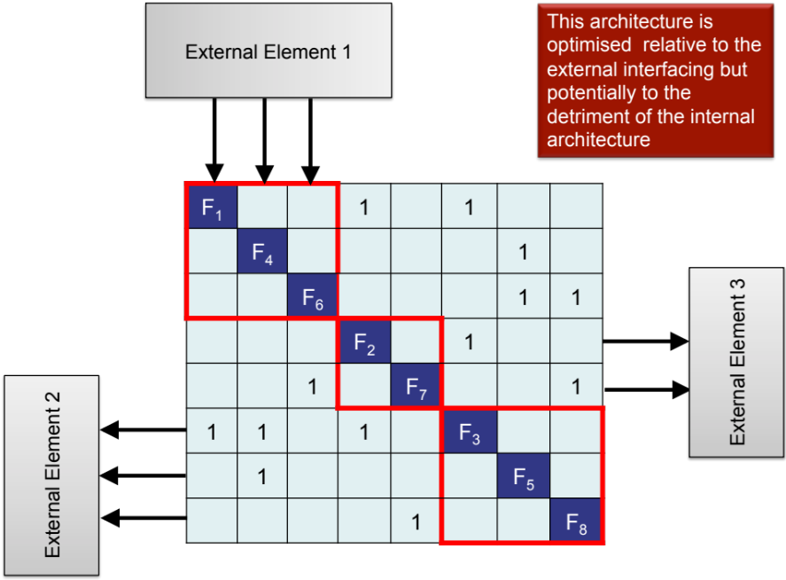
External Versus Internal Interfaces
Lower-level architectures are constrained by the higher-level architecture. Even though there may well be a better way, because at the higher-level, the lower-level architecture is sub-optimal.

Slide 46
Architecture and System Meta-solution
There is a connection here between the levels of Systems Architecture and the concept of the system Meta-solution.
A system Meta-solution was defined as an organization's current preferred solution to a systems problem (Operational Requirements)
We can now be more precise and talk about the Meta-solution in terms of the current preferred architecture to a systems problem
In a complex system there will be levels; system, subsystem, sub-subsystem, etc. The architectures cascade, and is the reason why changing an architecture at one level often has an impact at the higher level
Self-organizing systems (Human Activity Systems) will “try¹” different architectures over time eventually settling on the one that works! (i.e. make the bigger system optimal)
¹ “try” is used to imply an ad-hoc approach. What we should really do is experiment scientifically to find the optimum

Slide 47
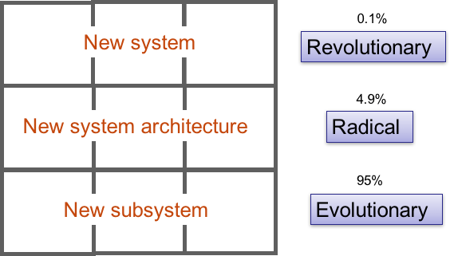
Architecture and System Meta-solution
Accepting a particular Meta-solution (architecture) means that changes should take place within the constraints of the higher system architecture, otherwise sub-optimisation can occur.
Radical innovation often requires the higher-level architecture to change to accommodate the lower-level change
“Any intelligent fool can make things bigger and more complex. It take a touch of genius – and a lot of courage-to move in the opposite direction”
E F Schumacher

Slide 48
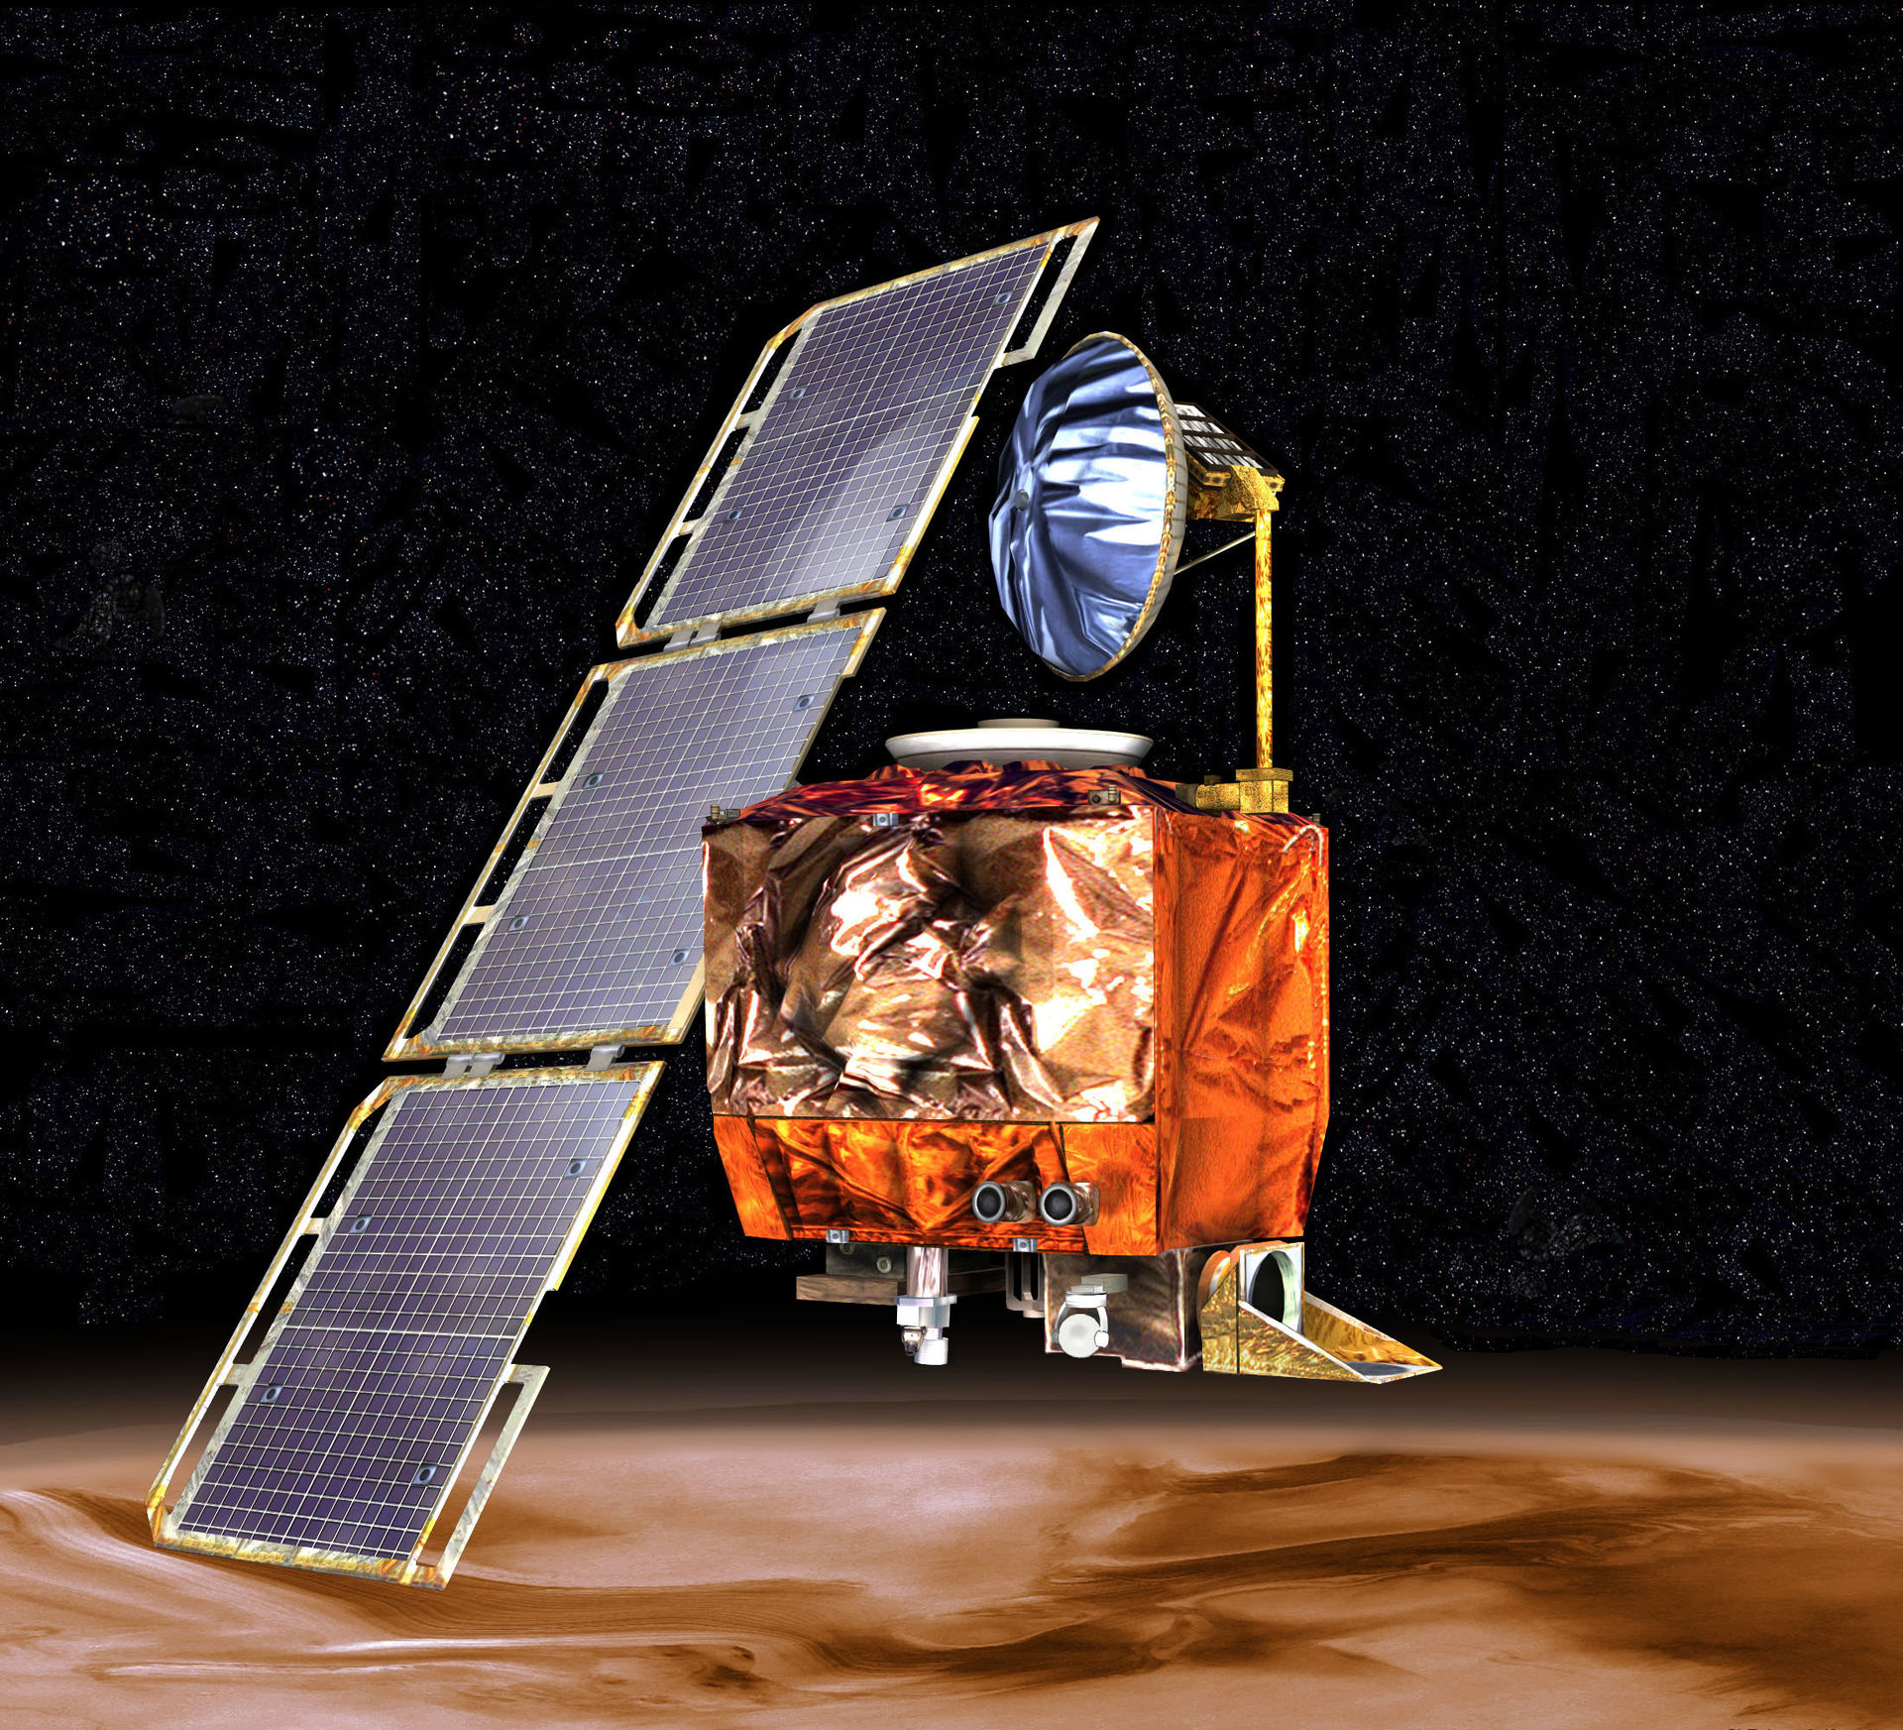
Interfaces
Definition
Noun
A point where two systems, subjects, organizations, etc. meet and interact
A device or program enabling a user to communicate with a computer
Verb
Interact with (another system, person etc.)
Connect with (another computer or piece of equipment) by an interface
In Systems Engineering an interface is like any other system element, they have purpose (function) and context (constraints) but are often overlooked . In consequence most system problems occur at the system interfaces
The Mars Climate Orbiter on September 23, 1999, was lost as the spacecraft went into orbital insertion, due to ground-based computer software which produced output in pound-seconds (lbf s) instead of newton-seconds (N s) specified in the contract between NASA and Lockheed. The spacecraft encountered Mars on a trajectory that brought it too close to the planet, causing it to pass through the upper atmosphere and disintegrate.

Slide 49
Need for Managing Internal Interfaces
System architecting and system concept design creates a set of subsystems AND the interfaces between them
‘Ownership’ of each subsystem is usually obvious as it is assigned to an individual or group as it is defined
However, the subsystem interfaces need special attention since each subsystem owner may assume:
  the other party is responsible for the interface, or
  each party makes its own assumptions about the interface requirements.
In both cases, the project runs the risk of future interface incompatibility, since the subsystems mature their concepts (and their interfaces) independently
The solution is to explicitly identify the owner of every interface

Slide 50
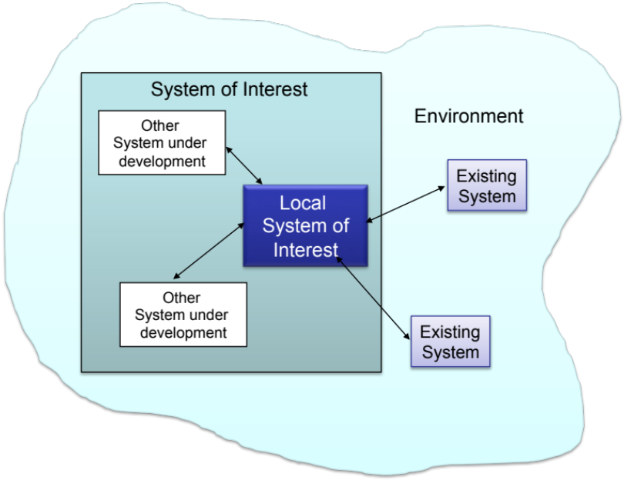
Key Interface Documents
Interface Definition Document (IDD) - defines interfaces to an existing system. It states what interfaces exist that are design constraints. Can be anything, such as mass, type of connector, EMI…
  Owned by manager of the system with which you want to interface
  Probably not going to change
Interface Requirement Document (IRD) - defines interfaces for two developing systems or subsystems. Includes both physical and functional interfaces
  Jointly managed (NEEDS ONE OWNER) and signed by the managers of the two systems in development.
Interface Control Document (ICD)
  defines the design solution
  for the physical interface
Notes:
.

Slide 51


Interface Design
A square peg in a round hole
Interfaces should be designed such that
  Subsystems are as independent as possible. As a result these subsystems will be easier to develop and test independently and when they are integrated there will be fewer problems with compatibility.
  Group like functions within a subsystem. This reduces the exchange of common data and focuses development expertise.
  Use standard interfaces, e.g., mechanical, electrical and data wherever possible

Slide 52
Managing Interfaces Using a N2 Matrix
Sub-system
A
M
Key
T
M
T
M - Mechanical
Sub-system B
T - Thermal
E - Electrical
Sub-system
C
M
- Interface
Sub-system D
E
E
E
Sub-system E
M E
M E
N² Matrices can also be used to record interfaces. Once an interface has been designed it can be captured on a N² Matrix. They provide a convenient summary of the interfaces. They can therefore be used to manage the interfaces during the life of a system
Sub-system F
T
Sub-system G
M
E
E
Sub-system H

Slide 53
Summary: System Architecture, N2 and Interfaces
The choice of architecture has a fundamental impact on system performance
Architecture is NOT just the layout (how the resources are organised) it is also about control (how the resources are used)
System architectures are designed and the golden rule is to minimise interfaces
System interfaces are defined, distributed and managed like other system elements.
Internal interfaces, since they are created as the system is decomposed and synthesised, can be optimised by the development team.
In developing interfaces group like functions to minimise the number and complexity of the interfaces, keep them simple and always consider the use of standard interfaces.
N2 Matrices are a powerful interface identification and management tool. They are used to:
  Capture the existence and nature of an interface
  Highlight input and output assumptions and requirements
  Demonstrate where there are feedback loops between subsystems
  Identify candidate functional allocations to subsystems – system architecting

