Slide 1

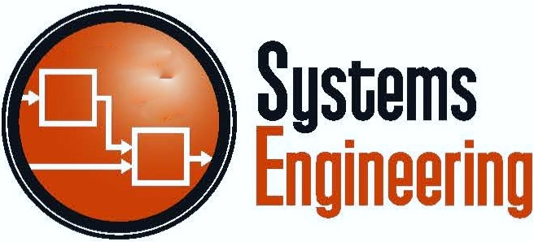

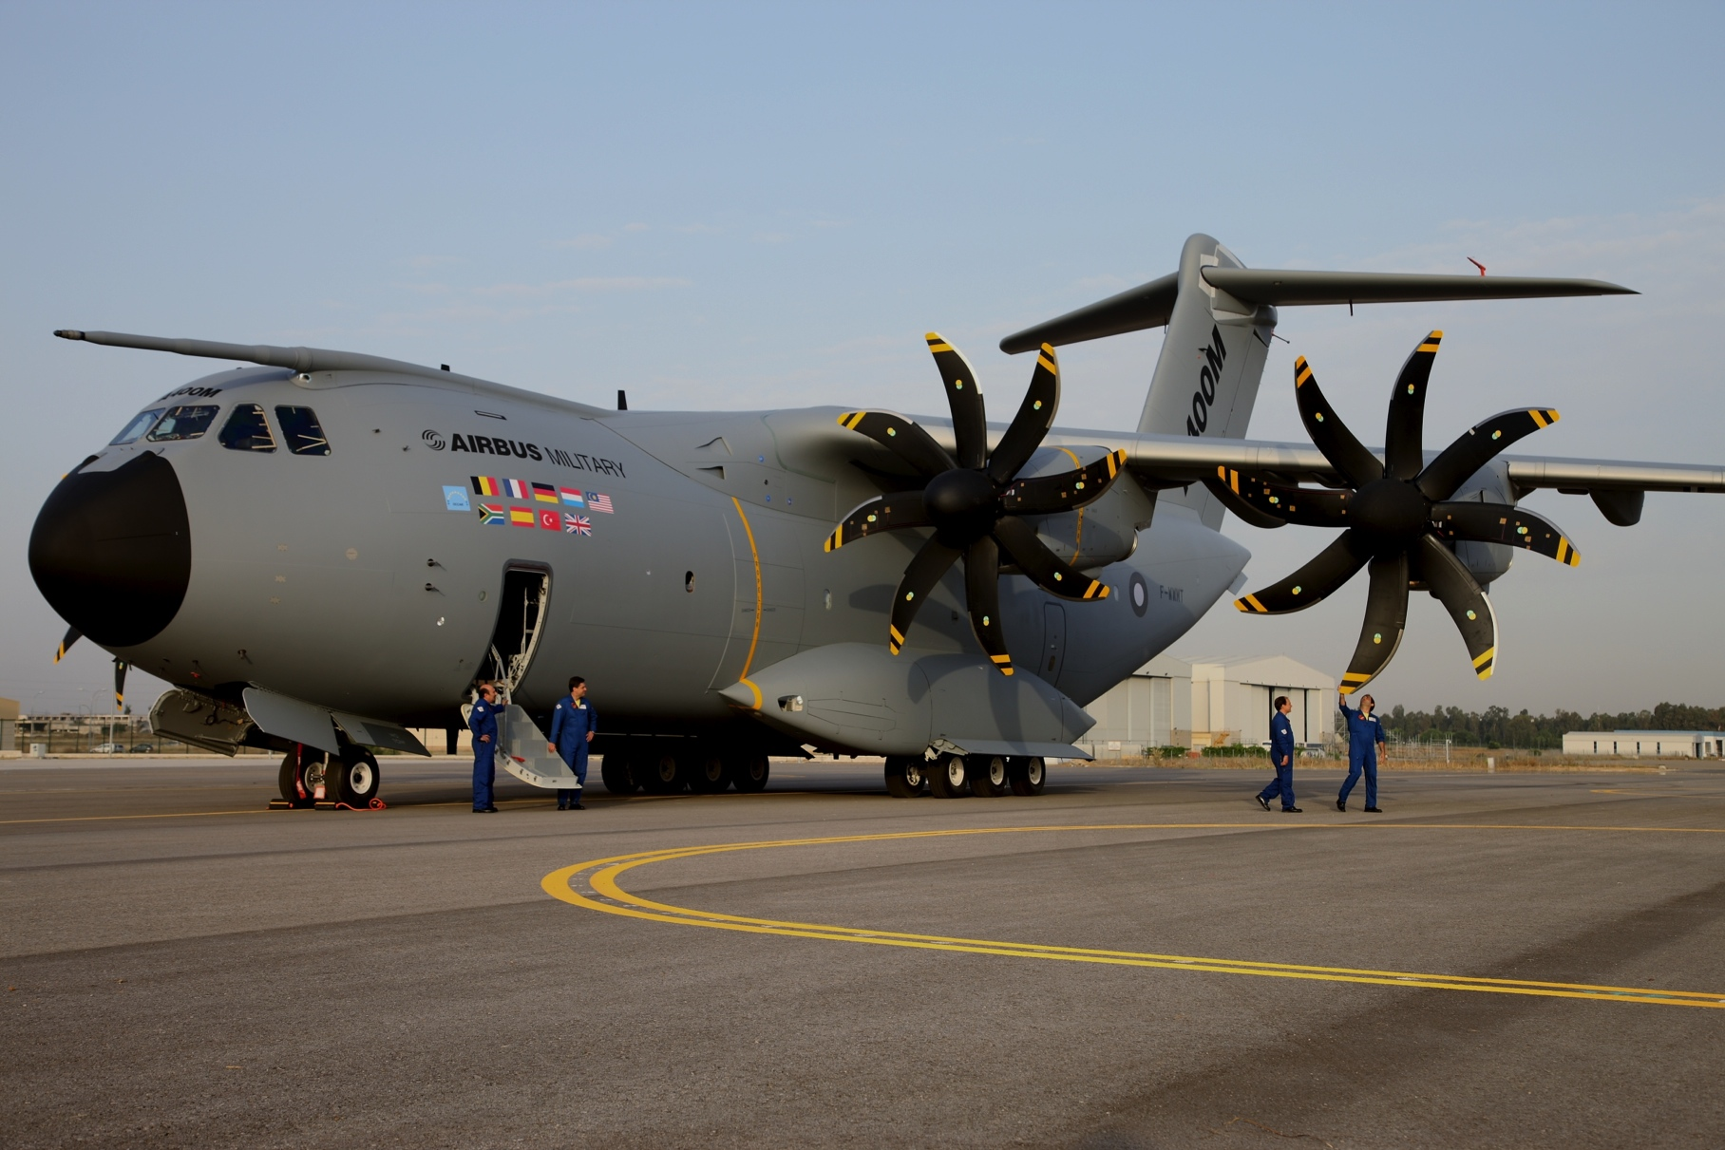



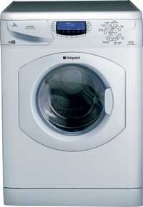
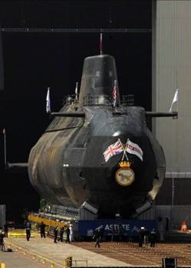
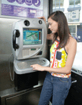
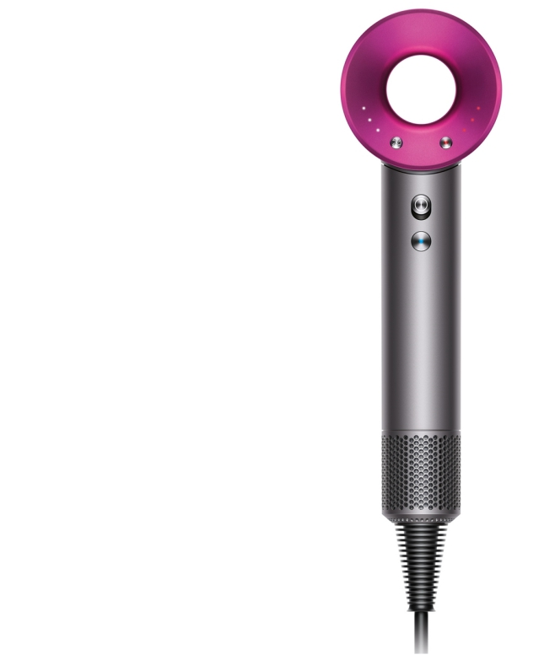

Workshop on Turbine System Functionality and System Mapping
Copyright Notice: This work is unpublished but copyright exists and is held by Stuart Burge. This work must not be copied, distributed or otherwise used without permission

Slide 2
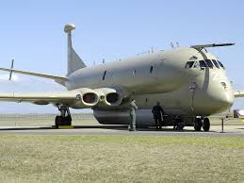
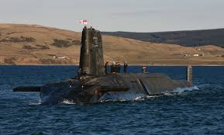


Slide 3
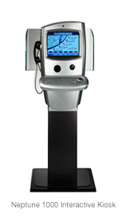

Slide 4
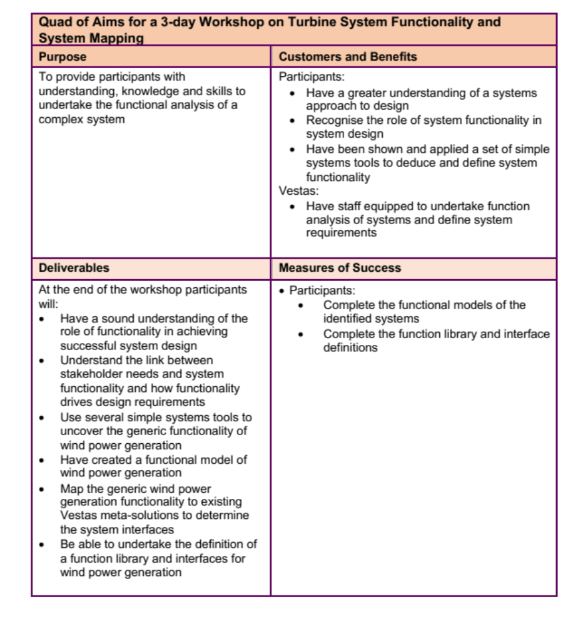
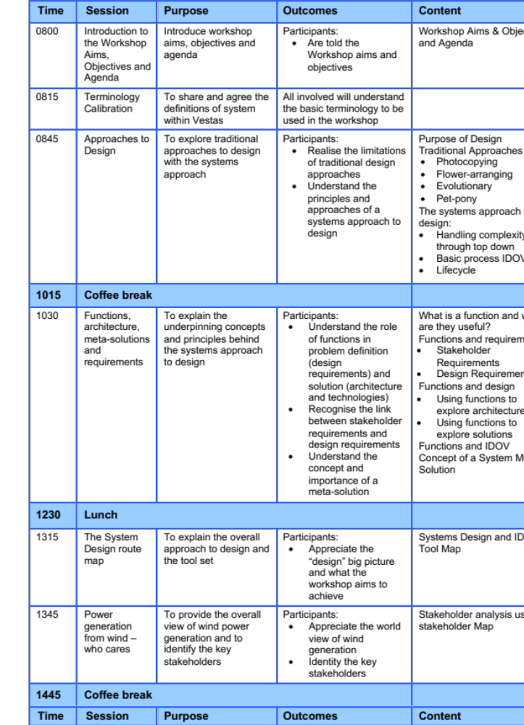

Slide 5
About BHW
Copyright Notice: This work is unpublished but copyright exists and is held by Stuart Burge. This work must not be copied, distributed or otherwise used without permission

Slide 6
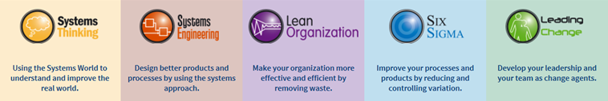
What we do
BHW sells Know-How

Slide 7









BHW - What we Do with Who
Six Sigma
Training &
projects
‘Train-the Trainer’
Lean
Six Sigma
Performance
Improvement
through BSG system
Systems Engineering
Tools Training
Systems Engineering
Training
Project Support
Expert Development
Basic
problem-solving
plant-wide
Coaching (Lean) Champions
- facilitation and training skills
‘Focus on Improvement’
all staff engaged
branch head team building,
facilitator training,
C.I. - BSG
Systems Engineering
SE Workshops
Systems
Thinking
Lean
Kaizen Blitz
8D problem solving
Six Sigma

Slide 8









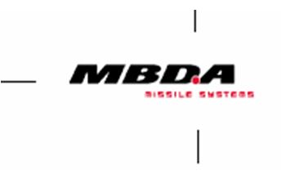















Our Systems Customers
Industry
Universities
People Development
BHW deliver training, provide project support, and coach and develop SE experts
Business Development
BHW advise and support the implementation / deployment of Systems Engineering
BHW deliver modules on
MEng, MSc, and EngD
Programmes

Slide 9

Quick Introductions
Who are you?
What’s your role?
What are your expectations of this workshop?

Slide 10
Our View of Systems Engineering
Dr Stuart Burge
Copyright Notice: This work is unpublished but copyright exists and is held by Stuart Burge. This work must not be copied, distributed or otherwise used without permission

Slide 11



Collect some Customer Requirements
Before we start I would like to collect some customer/user requirements to help in understanding Systems Engineering
You need to purchase a new toaster this coming weekend. What would be your requirements for this toaster?
Notes:
This exercise is described in the exercise trainer notes.

Slide 12



In Simple Terms a Systems Approach in Engineering is about:
I WANT
Customer/User Requirements
turning into
It’s about design
WOW!
The Solution

Slide 13
Traditional Design
When given a problem it is human nature to immediately think of solutions. We want an outline answer we can work on. This concept design solution often based on prior experience where previous solutions are adapted to fit the current problem or assumptions are made unconsciously about a solution.
problem
solution

Slide 14
Approaches – The Choices
Photocopying

Slide 15

Photocopying
Take an existing design (that works!) and enlarge or reduce to fit the requirements
Benefits
  Have a solution quickly
  Previous one worked so risk are considered low
Issues
  Scales laws are often to high powers (X³ or X⁴) – we assume linearity but it isn’t and undesirable behaviour occurs
  Requirements not fully understood and the “photocopied” design doesn't work – redesign and greater costs

Slide 16
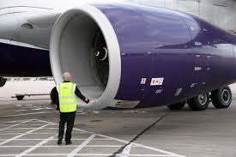

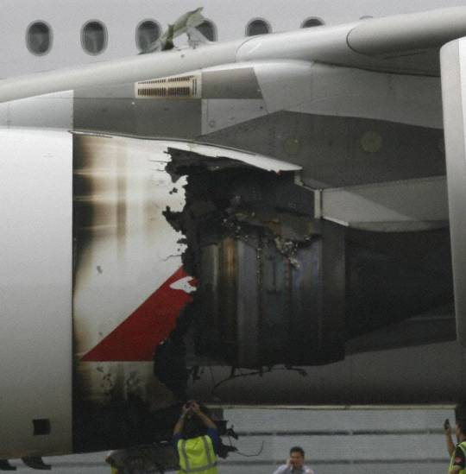

Trent 700
Fan Dia 97.4’’
Thrust 70,000lb
Trent 900
Fan Dia 116’’
Thrust 85,000lb
x1.19

Slide 17
Approaches – The Choices
Photocopying
Flower
Arranging

Slide 18

Flower Arranging
Take some nice looking components and arrange that to build a bigger thing
Benefits
  Uses know and trusted components
  Good fun
Issues
  Unexpected behaviour
  Relies on luck (can be mitigated by analysis i.e. design analyse redesign analyse, re-redesign analyse) – therefore costly

Slide 19
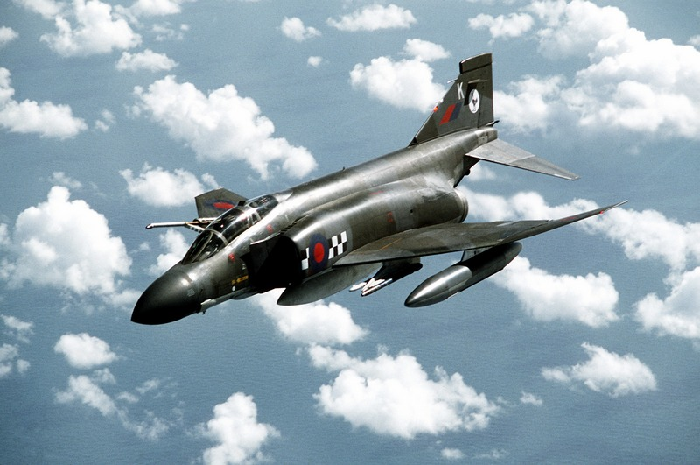
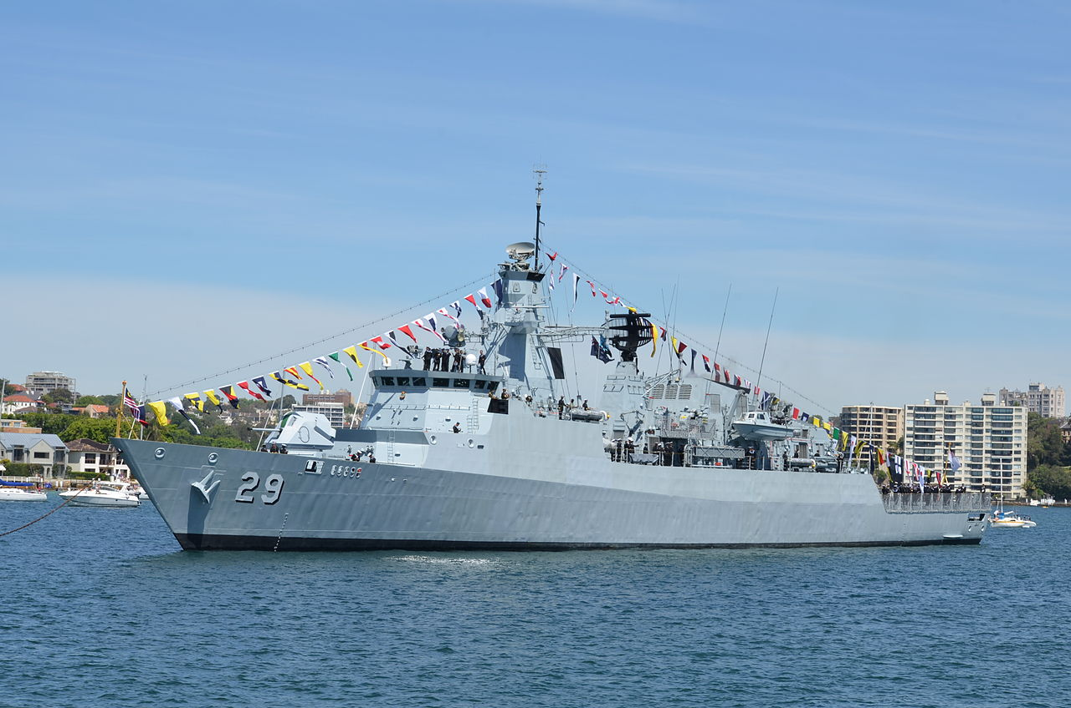

Slide 20
Approaches – The Choices
Photocopying
Flower
Arranging
Evolutionary

Slide 21

Evolution
Successive modifications to an existing design quite often involving replacing one or more sub-systems
Benefits
  Perceived as tried and tested – trustworthy
  Continuous improvement
Issues
  Improvements are incremental – limited opportunity for step change
  Shortfalls in performance due to unexpected interactions

Slide 22
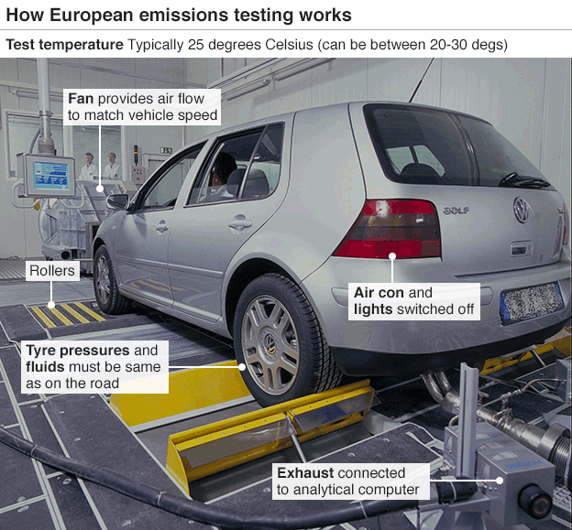
A Special Mention
The Volkswagen Group comprises 12 principal vehicle manufacturers and their corresponding marques:
AUDI AG
Lamborghini S.p.A.
Bentley Motors Ltd
Bugatti Automobiles S.A.S.
Porsche AG,
Ducati Motor Holding S.p.A.
MAN SE,.
Scania AB
SEAT, S.A.
Škoda automobilová a.s.
Volkswagen Commercial Vehicles
Volkswagen Passenger Cars

Slide 23
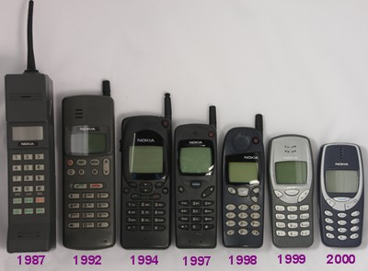
Evolutionary
2007
Sales
Size
In September 2013, Microsoft announced that it would acquire Nokia's mobile phone business

Slide 24
Approaches – The Choices
Photocopying
Pet Pony
Flower
Arranging
Evolutionary

Slide 25
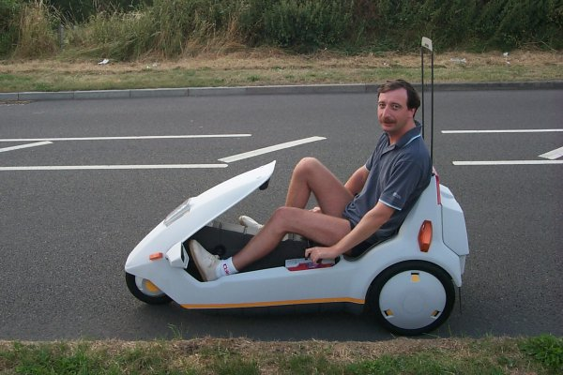
Pet Pony
A idea, usually a piece of technology, that an individual wants to use come what may
Benefits
  Might be the next “wheel”
Issues
  More logical, risk adverse approaches overridden
  Extensive late re-design or having to live with a sub-standard system
Sir Clive Sinclair was so convinced that the C5 was the future of personal transport he spent £12M of his own money (1985) – equivalent to £100m today

Slide 26


There’s many more
Notes:
Apple Newton – this first ipad! Ridiculed in the press for its expense and lack of flexibility compared to a note pad and pencil
Digital Audio Tape: never really took off like compact cassettes – even though technically it was rather good.

Slide 27
Analysis to the Rescue
When given a problem it is human nature to immediately think of solutions. We want an outline answer we can work on. This concept design solution often based on prior experience where previous solutions are adapted to fit the current problem or assumptions are made unconsciously about a solution. It is also human nature to stop once we have found the first adequate solution and begin:
problem
solution
Engineering Analysis

Slide 28
Analysis and Engineering Design
Analysis is the core of traditional engineering design where we use engineering science to understand
Having jumped to a solution
Take apart the design
Understand the parts
Combine the understand of the parts to understand the whole

Slide 29
Traditional Design
Approach: Solutioneering
When given a problem it is human nature to immediately think of solutions. These are often based on prior experience where previous solutions are adapted to fit the current problem or assumptions are made unconsciously about a solution. It is also human nature to stop once we have found the first adequate solution
problem
solution
We Believe
  Fast
  The only way
  Worked in the past
  Get there in the end
We Experience
  Redesign
  Late
  Cost overruns
  Testing
  Firefighting
  Heroes

Slide 30
Conclusion
We no longer have the time or the money to rely on traditional “solutioneering” approaches (1 in 10 chance of getting it right1)
We need:
  to identify and fix issues early
  a through-life view – design for the life cycle
  a concurrent (Product, Manufacturing, Operation, Support, Disposal) view
  a performance, quality and cost view
We need a Systems Approach to Systems Design
¹Elm J.P and Goldenson D.R “The Business Case for Systems Engineering Study: Results of the Systems Engineering Effectiveness Survey” November 2012 SPECIAL REPORT, CMU/SEI-2012-SR-009, Carnegie Mellon University

Slide 31
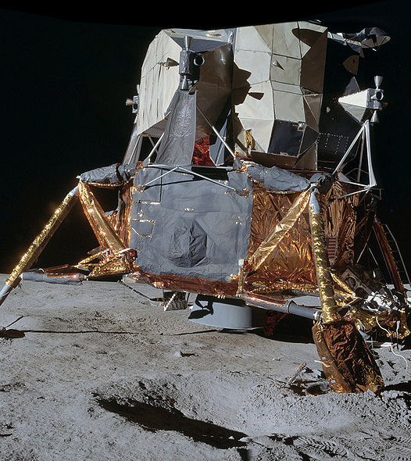
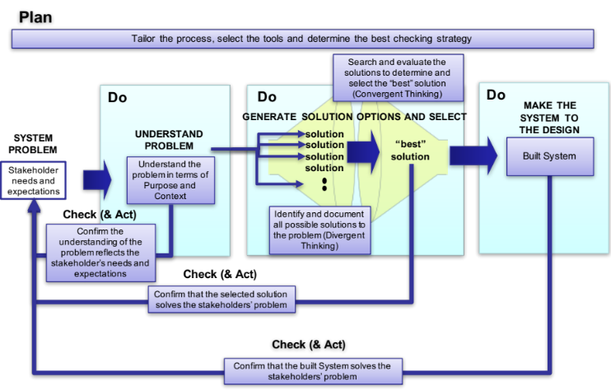
A Systems Approach to Systems Design
Rigorous process based on Systems Thinking
Benefits
  97% success rate (Carnegie Mellon University, 2012)
Issues
  Perceived to be slow – but actually faster because of low rate of avoidable re-design

Slide 32
The Systems Approach to Systems Design is based on
Systems Thinking:
  Purpose
    Every system has a purpose that defines fundamentally what it has to do
  Context
    Every system has context that defines the environment and constraints that impact upon that system
    System Context often restricts the solution options that satisfy the purpose
  Structure
    The behaviour of a system is dictated by its structure
Meta-Processes:
  Divergent and Convergent Thinking
  Plan Do Check Act Cycle

Slide 33
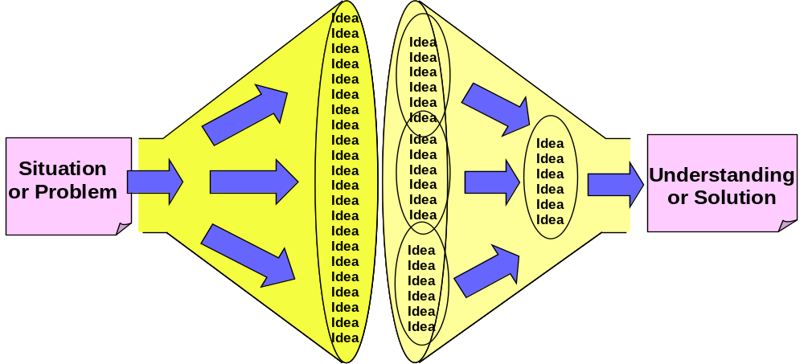
Divergent-Convergent Thinking a Systems Meta Process
When attempting to understand a situation or solve a problem the task is to find amongst all the possibilities the critical aspects. This task logically comprises two activities:
    generating information
    organizing information
We often try to do this in one step by “jumping” to the “answer” – the problem is we stop thinking once we find a first adequate “answer”
It is better to divide the task up into its component activities
Divergent Thinking
Convergent Thinking
Concerned with generating ideas or information about a situation or problem
Concerned with organizing and making sense of ideas or information

Slide 34
Plan Do Check Act a Meta Systems Process
Often attributed to the American quality guru Edwards Deming, he said he got the idea from Walter Shewhart the inventor of Statistical Process Control. But even Shewhart’s work can be traced to the English man Francis Bacon who first expounded the scientific method of Hypothesis, Experiment and Evaluation.
Do
Carry out the activity
Check
Check the activity
D
C
PDCA is logical common sense that is often not followed. PDCA is the basis of Project Management, Life Cycle Management.
Plan
What has to be done
P
A
Act
Act on the check
Notes:
References:
Deming, W. Edwards (1986). Out of the Crisis. MIT Press. ISBN 0-911379-01-0.
Shewhart, Walter A[ndrew]. (1931). Economic control of quality of manufactured product. New York: D. Van Nostrand Company, ISBN 0-87389-076-0

Slide 35
We put our effort in the Wrong place
Source GE DFSS course
Cost to
Fix (£)
Errors found late on
are caused very early on
Much of the effort in Systems Engineering is expended early on.
Pre-work NOT
Re-work
This is where
we tend to look
This is where
we should
put our effort
Requirements
Engineering
Design
Development
Production
Customer
use
because
BUT
because
Difficult to see
and predict
Easy to see
Difficult and
costly to fix
BUT
Easy and
cheaper to fix

Slide 36
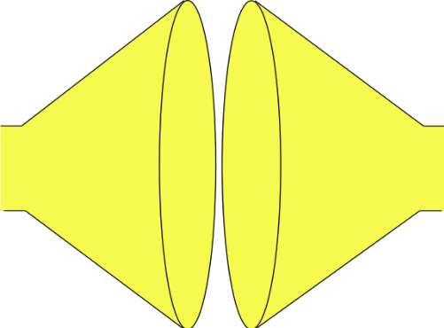
Systems Engineering uses a Systems Approach to System Design
Plan
Tailor the process, select the tools and determine the best checking strategy
Search and evaluate the solutions to determine and select the “best” solution
(Convergent Thinking)
Do
Do
Do
MAKE THE SYSTEM TO THE DESIGN
GENERATE SOLUTION OPTIONS AND SELECT
SYSTEM PROBLEM
UNDERSTAND
PROBLEM
solution
solution
“best”
solution
Built System
Understand the problem in terms of Purpose and Context
solution
Stakeholder needs and expectations
solution
Check (& Act)
Identify and document all possible solutions to the problem (Divergent Thinking)
Confirm the understanding of the problem reflects the stakeholder’s needs and expectations
Check (& Act)
Confirm that the selected solution solves the stakeholders’ problem
Check (& Act)
Confirm that the built System solves the stakeholders’ problem

Slide 37
Systems Engineering uses a Systems Approach to System Design
SYSTEM PROBLEM
Stakeholder needs and expectations

Slide 38
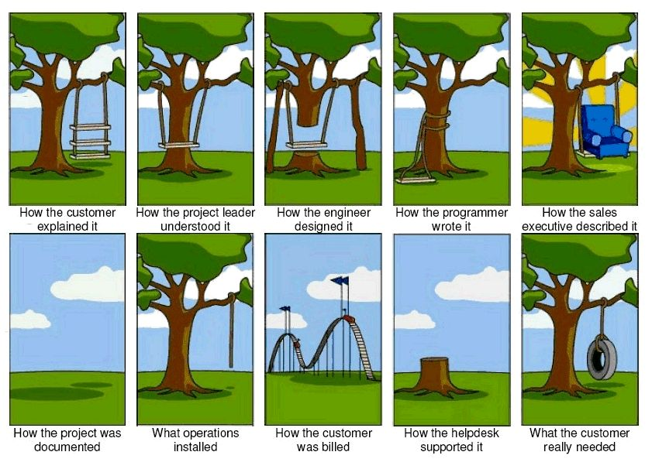
Requirements: A Common Problem
Notes:
Having explained what we intend to do on the previous slide this introduces a diversion. In order to explain how to determine and manage requirements it is useful to spend some time talking about customers and in general how they express their needs and requirements.

Slide 39
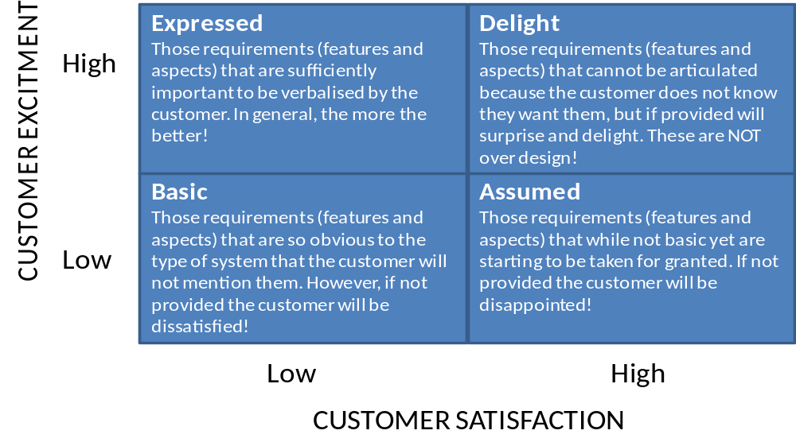
Simplified Kano Model
Conclusion:
Customers/Stakeholders only tell us their expressed requirements typically only 20% - 30% of the full set of requirements (spoken vs. unspoken requirements) – WE HAVE TO determine the missing ones – the Unspoken Requirements
Notes:
This slide continues the argument. The previous slide indicates that errors committed during the early activities are expensive and difficult to find - but why. This slide starts to answer this question
The diagram above shows that customer satisfaction and customer excitement form two dimensions - they are not the same thing. The four quadrants then lead to a number of situations:
Basic: those requirements that form the basic set of expectations of a customer. These may not be expressed by the customer, but are well know. Examples include windscreen wipers on a motor vehicle
Expressed: those requirements verbalised by the customer
Assumed: Requirements or expectations not expressed by the customer. Similar to basic requirements and indeed over time will become basic requirements. Examples include electric windows, power steering, and ABS on a motor vehicle
Delight: features beyond the current expectations of customers
The point here is that for customer delight we have to capture and provide the stated Expressed requirements and the unstated Basic and Assumed requirements. Customers will never tell exactly every thing they expect

Slide 40
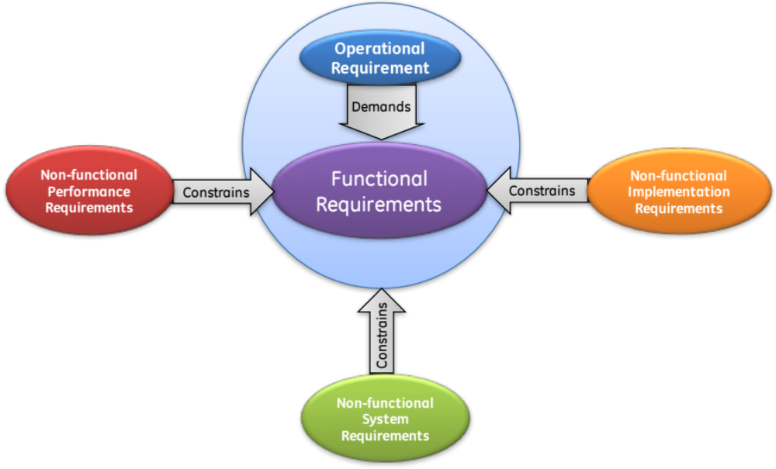
Holistic Requirements Model
Based on a Systems View of requirements, the Holistic Requirements Model states that a complete and consistent set of system requirements will comprise:
  Operational Requirements
  Functional Requirements
  Non-functional Requirements
    Non-functional Performance
    Non-functional System
    Non-function Implementation
Notes:
11
The next few slides are vital for the remainder of the course and indeed the whole philosophy.
There are many ways of classifying requirements but the 3 groups given above represent a consistent and complete framework that can be extremely valuable in system development.
They are defined in the next few slides.

Slide 41
Operational Requirements
An Operational Requirement defines the major purpose of a system (i.e. what it fundamentally does - its capability) together with the key overarching constraints (that define the context)
System
Operational Requirement
All Systems have purpose and context – the Operational Requirement captures these
Dishwasher
To clean domestic eating and cooking utensils
efficiently and without damage
Civil Aircraft
To transport passengers and their baggage from one point to another efficiently and safely
Toaster
Overhaul
Aircraft
To achieve high aircraft availability in a cost
effective and safe fashion
All systems have a purpose and context. The job of the Operational Requirement is to define these in simple terms. To define the “mission” of the system
p.s. customers often don’t tell us their Operational Requirements
Notes:
Every system has an operational requirement(s) which is a statement in a sentence or two which defines the major purpose of the system – what it fundamentally does – what its capability is. They also contain the key overarching constraints that fundamental to that system. A system will have many constraints but a few ( typically one or two) are very important.
The examples given above are to illustrate typical operational requirements:
The fundamental job of a dish washer is “to clean eating and cooking utensils”. This can be done many ways including ways that will damage the items (eg using conc. Nitric acid as a cleaning fluid will certainly clean the items but they will be damaged). Hence “without damage” is the overarching constraint.
The fundamental job of a civil aircraft is “to transfer passengers and their baggage from one point to another”. Here safety is the overarching constraint.
Some system’s operational requirement may have more than one overarching constraint.
It is often useful to ask the class if they have a clear written operational requirement for their current project – that is know and understood by all team members. Typically they don’t, although some say “no but its obvious!” It’s never obvious and having a clear succinct operational requirement is fundamental to good system design and development. A good illustrative example here is JFK’s statement – “by the end of the decade we will put a man on the Moon and bring him back safely” Very clear purpose “put a man on the Moon” with two overarching constraints: “by the end of decade” and “bring him back safely”. Would it have happened if JFK had have said “put something somewhere soon”!!!
A good teaching point here is ask the class for the operational requirement for the toaster. The class will quickly determine to “toast bread” as its fundamental purpose, but often add without burning as an overarching constraint. The point here is that some people like burnt toast! What is needed is an edible output from the toaster. Also the toaster should not get so hot so as to burn the user – hence a good encompassing overarching constraint is safely. It is worthwhile writing on the Flip Chart
Operational Requirement for a Toaster
“to toast bread products safely”
Another issue that can occur at this point depends upon the level of the system. Every system fulfils a need and when we examine the need we can often identify meta-solutions. For example – do people need a dish washer? No they need clean items and there are many alternative ways of providing clean items. However, as a dishwasher manufacturer I make money from dishwashers – but I should pay attention to alternative meta-solutions.

Slide 42
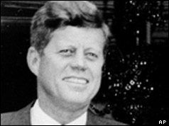
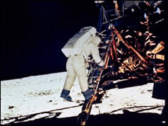
1961: Kennedy and the Ultimate Operational Requirement
President John F Kennedy in a speech to a joint session of Congress broadcast on TV and radio around the United States
“I believe that this nation should commit itself to achieving the goal,
  before this decade is out, of landing a man on the Moon and returning him safely to Earth”
One
Small
Step
Do you know the Operational Requirement of the system you are currently working on?
Is it written down in 20 or fewer words that is the common understanding of the whole team?
Writing Operational Requirements is not easy. It can take several hours to arrive at an agreed set of 20 or less words!

Slide 43
Functional Requirements
Functional Requirements specify the functions of the system - what the system has to DO in order to satisfy its Operational Requirement
For example some of the functions of a civil aircraft are:
  Navigate aircraft
  Manoeuvre aircraft
  Store passengers
  Control passenger storage environment
  Communicate with other aircraft and ATC
  etc
Note that Functional Requirements contain a function expressed by a verb or better still a verb phrase comprising a verb (action) followed by a noun (object)
  A functional requirement should define something the system has to DO
  A phrase can have a verb but not be a function! For example “easy to use” has a verb but this is not a function – we don’t say the system “does easy to use” it has “to be easy to use” – a property or attribute
  Best practice is to define functions as verb noun combinations that describe an action on an object
  Beware of pseudo functions verb noun combinations that do not define an action on an object. For example .”provide style” is a pseudo function because style is a property and not a thing – it is an abstract noun rather than a common noun. Functions that end with an abstract noun are pseudo functions
We try to write Functional Requirements in way that does not imply a solution (like seat passengers). However, every system has to integrate with legacy systems and therefore this not always possible
Notes:
13
Functional Requirements define what the system has to DO in order to satisfy the operational requirement(s). The key to understanding functionality is the word “DO”. What is it that the system has to do? Functional Requirements therefore have to contain a verb.

Slide 44
Non-functional Requirements
Non-functional Requirements are constraints on the system
Non-functional requirements do NOT specify what the system has to do (but they might imply it!)
Non functional requirements specify:
  how well it does something
  how it does something
They fall into three categories:
  Non-functional Performance (constraints on the individual functions)
  Non-functional System (system-level constrains)
  Non-functional Implementation (solution-based requirements)
Notes:
14
The operational and functional requirements specify what the system has to do. The non-functional requirements modify or constraint the operational or functional requirements. These can be further sub-classified as:
Non-Functional Performance
Non-Functional System
Non-Functional Implementation
Which are defined in the next slides.

Slide 45
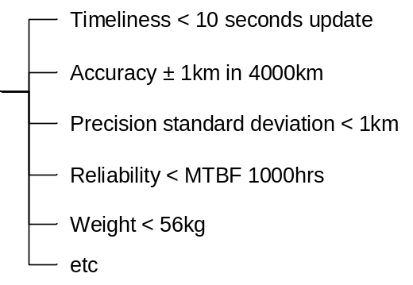
Non-functional (Functional) Performance Requirements
Non-functional Performance Requirements are linked to corresponding Functional Requirements and define how well a particular function has to perform – they are the constraints on a particular function. Typically they comprise a measure (attribute, parameter, property etc.) and a numerical target value
System
Function
Non-functional (functional)
Performance Requirement
Aircraft
Navigate
aircraft
>
There is no verb! Hence these are not function requirements (they do, however, IMPLY a function)
Notes:
Non-Functional Performance Requirements specify how well a particular function has to perform. For every function there will be a set of associated performance requirements.
The examples above illustrate this point – but it is worth noting that for any function there will be a set of non-functional performance requirements

Slide 46
Non-Functional System Requirements
Non-Functional System Requirements define constraints that affect more than one Function, potentially the whole system
They can include:
  Physical Attributes
    System Style
    System Size
    System Weight
    etc
  The ilities
    System Reliability
    System Maintainability
    System Interoperability
    System Deployability
    etc
  System Performance
    System Cost
    System Speed
    System Manoeuvrability
    etc
Performance requirements come in two forms: those that affect the whole system and those that affect only a specific function
WE DELIBERATELY SEPARATE THEM
Note: the Non-Functional System Requirements will get “flowed down” in to lower level requirements
Notes:
16
Some of the “performance” requirements do not associate with just one function but impact on several (or all) functions. They affect or constrain the whole system. These requirements are called Non-Functional System Requirements. This class of requirements not only include performance but other types of requirements such as size, weight etc and the “illities”.
The “illities” are an important group because it is these that often form the key user requirements.
Non-Functional System Requirement also includes contractual/commercial requirements. These are important to capture and share because they can have just a greater bearing on the system solution as the more performance oriented ones.

Slide 47
Non-Functional Implementation Requirements
Non-Functional Implementation Requirements define how a system is to be built in terms of a specific technology. They are solution-based requirements from the customer or legislation
System
Function
Non-functional
Implementation Requirement
Aircraft
Communicate ..
Phillips A/C 1267 VHF Radio
Dishwasher
Remove Waste
Electric Pump
Toaster
Receive Power
UK Domestic 13A Plug to BS1363
Overhaul
Aircraft
Maintain Component History
Mircosoft Access database on a PC
Non-Functional Implementation Requirements come in two types:
Justifiable: where the requirement is reasonable typically because relates to a design decision made at the higher system level
Lazy: where the stakeholder has resorted to a solution based requirement because they do not know how to express it otherwise
We need to identify the Non-functional Implementation Requirements and determine whether they are lazy or justifiable. Lazy NFIs should be probed for the actual requirements
Notes:
Non-Functional Implementation Requirements are those where the customer has specified the solution. They can also include legislative requirements.
Both examples in the slide illustrate the situation where the customer has provided the solution as a requirement. As such Non-Functional Implementation Requirements often represent the ultimate restrictive constraint.

Slide 48
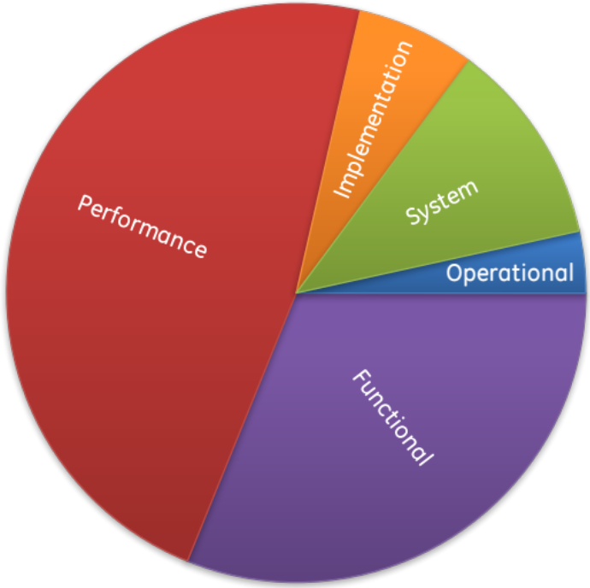
Summary: The Holistic Cutting of the Cake!
Holistic Requirements Model
The requirement categories of the Holistic Requirements Model are not arbitrary – they have a very strong structure which we can exploit to identify missing requirements and provide a powerful invariant framework for system design and development

Slide 49
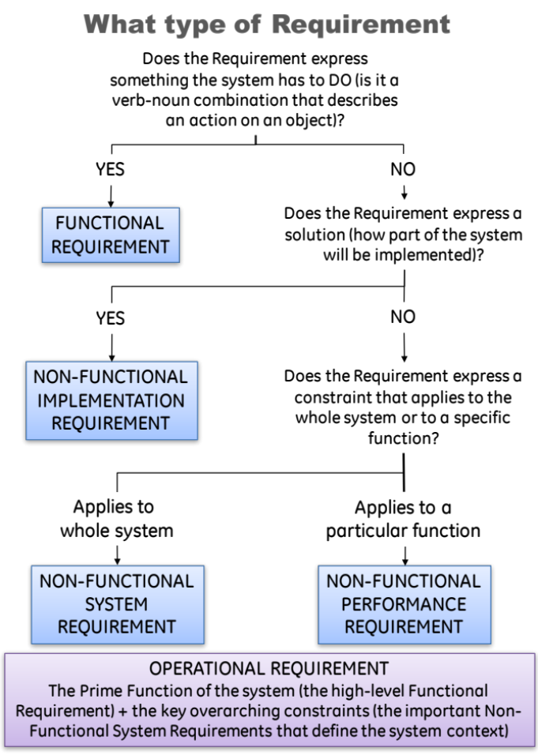
Using the Holistic Requirements Model
The flowchart opposite can help in consistently and correctly categorizing a set of source requirements
Its use does require practice BUT it can provide a fast method to identify the deficiencies in a set of source requirements
Even experienced users will “get it wrong” on the first pass – but they know subsequent iteration will address any miss-categorization

Slide 50
Practice – Requirements Categories
In teams go through your Toaster User Requirements and indicate which are:
  Operational requirements OP
  Functional requirements F
  Non-functional requirements
    System NFS
    Performance NFP
    Implementation NFI
Time 15 minutes
Notes:
This exercise is described in the trainer notes, but its purpose is to show the class that customers often write requirements as constraints.

Slide 51
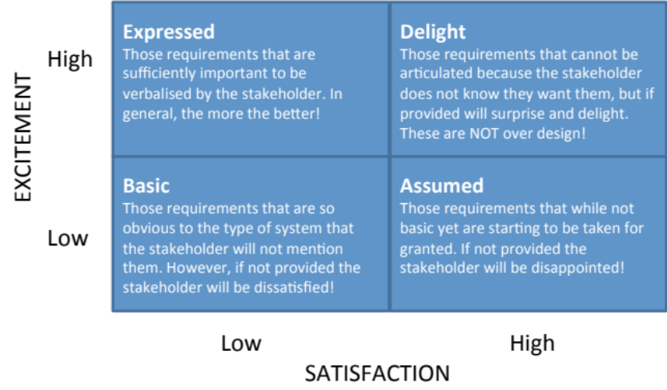
Nature of Customer Requirements
We tend not to specify functionality!
We assume or imply functionality through constraints
What is often missing from a set of requirements is the functionality
The expressed requirements are typically constraints – Non-functional System and Non-functional Implementation Requirements
  “Design is a funny word. Some people think design means how it looks. But of course, if you dig deeper, it’s really about how it works”
Steve Jobs
There are other requirements that are left unspoken. We now know these are the FUNCTIONAL requirements and their associated performance Requirements
Notes:
This slide emphasizing the fact that we tend not specify to functionality (even a group of engineers don’t). We write requirements as a set of constraints. This not at all surprising when we consider the user/customer – if you where flying at 50M at 1,000kph you tend not be concerned about how a HUD works but will the symbology be bright enough when I fly into the sun?
Customers rarely tell us what functionality is required. They may imply it through constraints (non-functional requirements). However, as a system developer we MUST determine that functionality that is necessary to deliver the operational requirement(s).

Slide 52
Discussion – Toaster Functionality
What is the generic functionality necessary to satisfy the operational requirement?
  “to toast bread products”
Notes:
This discussion is described in the trainer notes – it is a most important discusion.

Slide 53


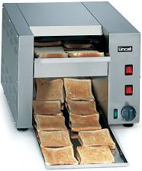
Generic System Functionality
Generic System Function | Implementation
Load bread | Stick bread slice on end of toasting fork
Generate heat | Open coal fire
Apply heat | Use toasting fork to bring bread close to open fire
Monitor toasting | Look at the bread from time to time
Control toasting | Move bread to get even toasting
Remove heat | Use toasting fork to bring toast away from coal fire
Unload Toast | Take toast off the toasting fork
Generic System Function | Implementation
Load bread | Put bread into slots
Generate heat | Electric elements
Apply heat | Lower bread next to elements using lever mechanism
Monitor toasting | Look at the bread from time to time
Control toasting | Timer
Remove heat | Lift bread from elements using lever mechanism
Unload Toast | Take toast from slots
Generic System Function | Implementation
Load bread | Put bread on conveyor
Generate heat | Electric elements
Apply heat | Conveyor takes bread past the electric elements
Monitor toasting | Look at the output
Control toasting | Speed of conveyor and heat setting of elements
Remove heat | Toast falls onto catch tray
Unload Toast | Take toast from catch tray

Slide 54
Generic Toaster Functionality
Toast Bread Products
System
Purpose
Load Bread
Generate Heat
Apply
Heat
Monitor
Toasting
Control
Toasting
Remove Heat
Unload Toast
Sub-purpose (Function)
Did your requirements for the toaster specify any of these?
Every engineered system has an underlying set of functionality that enables it to achieve its purpose.
Similar systems will have similar functionality; indeed, systems that have the same purpose will have a set of functionality that is identical. This functionality is the Generic System Functionality (GSF) and is time invariant (provided the purpose does not change the GSF does not change).
Whilst the GSF is a consequence of the system purpose and is fixed, it can be implemented in many ways which change as technologies evolve and emerge. The generic system functionality is not the complete set of system functionality – a system can have functionality that is not generic

Slide 55
What is a System Function
A System Function defines something the System has to do – it’s a job, a task, an activity. They can be viewed as turning inputs into outputs:
Functions are defined as a
  And potentially, mathematically
  Y = f(u, x)
Choose for VERBS that don’t imply a solution
  Deliver Toast (good)
  Eject Toast (bad because it suggests a “pop-up” mechanism)
Do explore different verbs – we always have choice.
Use imperative verbs – command verbs wherever possible
The NOUN defines the object the verb acts on. It should be a concrete noun
  something that be touched, seen, tasted, smelt or heard.
Beware of abstract nouns
  these are things you cannot touch, see, hear, smell or taste (but can sometime measure) like reliability, safety, style, etc.
Function
Inputs
Outputs
VERB NOUN

Slide 56
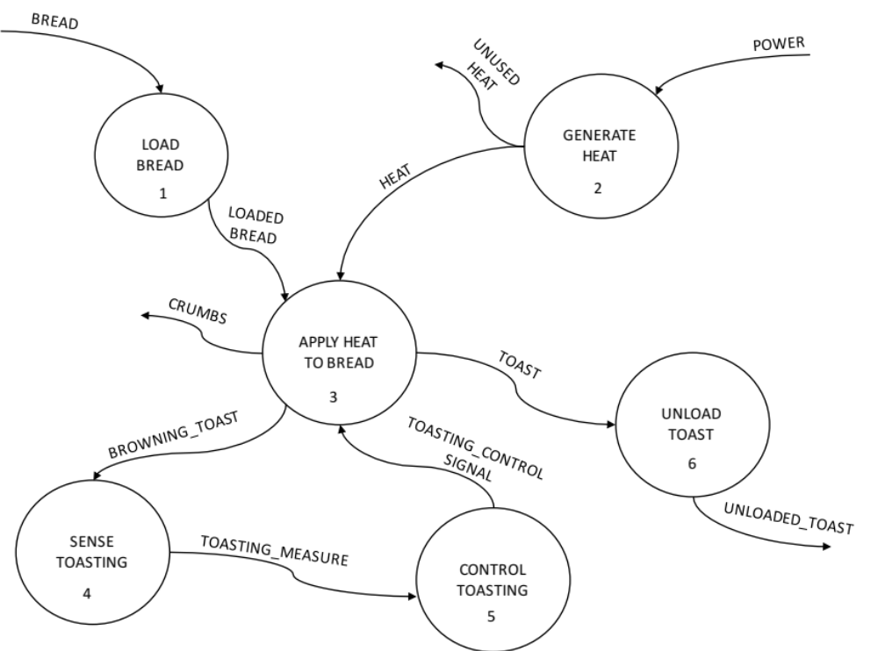
System Functions Logically Interact
To meet the overall system purpose the functions have to logically interact, with the outputs of functions feeding the inputs of others.
If I understand these interconnections I understand my system

Slide 57
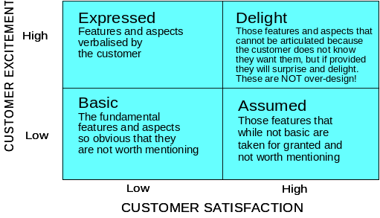
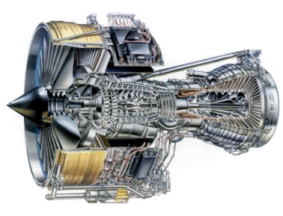

The customer requirements are never complete, consistent, correct or clear
I WANT
are just the
The problem is getting from here to here
We have to find the unspoken requirements – but how?
WOW!
The complexity of the problem and the likely complexity of the solution means it is too difficult to “jump to the solution”
The approach has to be one of divide and rule. But what is the best way to divide?

Slide 58
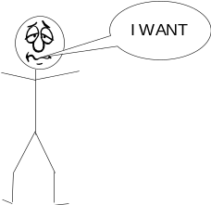


The Systems Approach to System Design
The bridge between requirements and the solution is the functionality (purpose)
FUNCTIONALITY
Requirements
-Land
Solution-Land
Functionality helps us uncover the unspoken requirements
Functionality is invariant and provides a consistent basis for dividing and ruling
Functionality can help find Unwanted Behaviour

Slide 59
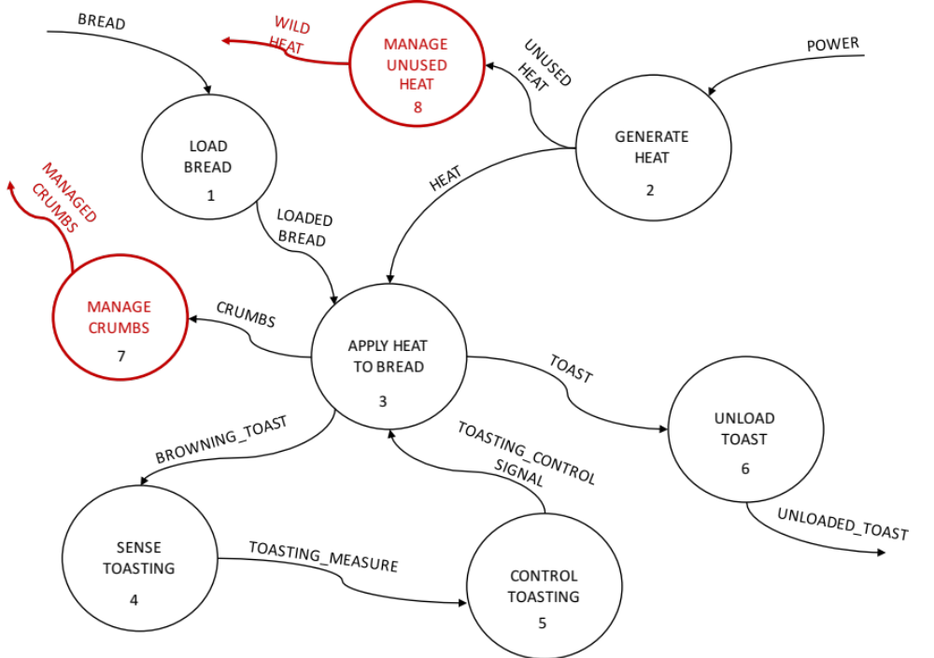
Unwanted Behaviour
We can examine System Functions for unwanted outputs and for Functional Failures to identify undesirable behaviour so it can be designed out ab initio

Slide 60
PLAN – DO – CHECK - ACT
Do
SYSTEM PROBLEM
UNDERSTAND
PROBLEM
Stakeholder needs and expectations
Understand the problem in terms of Purpose and Context
Check (& Act)
Confirm the understanding of the problem reflects the stakeholder’s needs and expectations

Slide 61
Functionality Delivers what the Customer Wants
Generic System Functions
Load Bread
Generate Heat
Apply
Heat
Monitor
Toasting
Control
Toasting
Remove Heat
Unload Toast
Even Toasting
Quick
Affordable
Easy to Use
Attractive
Reliable
etc
What the customer wants
◎
○
△
Key = strong medium weak

Slide 62
Functionality Delivers what the Customer Wants
Generic System Functions
Load Bread
Generate Heat
Apply
Heat
Monitor
Toasting
Control
Toasting
Remove Heat
Unload Toast
Even Toasting
○
◎
◎
◎
◎
△
Quick
○
○
△
△
○
△
△
Affordable
○
△
△
△
○
△
○
Easy to Use
◎
○
◎
△
◎
Attractive
△
△
△
△
Reliable
○
◎
○
△
○
etc
What the customer wants
◎
○
△
Key = strong medium weak

Slide 63
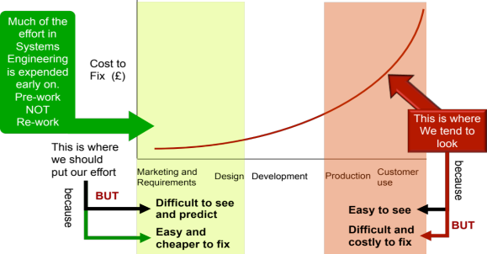
The Consequences
The Traditional approach appears “better” we have an answer quickly BUT!
Elicit and gather stakeholder requirements
Determine system concept
Build prototype and test
Redesign
Build prototype and test
Realise/Produce
The Systems Engineering approach is initially slower! But faster in the end
Elicit and gather stakeholder requirements
Determine System Functionality
Determine system concept
Build prototype and test
Realise/Produce
1st Attempt
And it gets quicker every time!
Elicit and gather stakeholder requirements
Determine System Functionality
Determine system concept
Build prototype and test
Realise/Produce
2nd Attempt
Remember
Thinking Functionally is the Pre-work that will reduce the Rework

Slide 64
The Cost of Not Fully Understanding Where You are Going!
200
150
100
50
0
Percentage of Cost Overrun
0 5 10 15 20
Percentage of Development Cost spent on Requirements
Adapted from: Hooks, Managing Requirements, 1994 - Figure 1
and Young, Effective Requirements Practices, Addison-Wesley, 2001 - Figure 4-1

Slide 65
Systems Engineering uses a Systems Approach to System Design
Search and evaluate the solutions to determine and select the “best” solution
(Convergent Thinking)
Do
Do
GENERATE SOLUTION OPTIONS AND SELECT
SYSTEM PROBLEM
UNDERSTAND
PROBLEM
solution
“best”
solution
solution
Understand the problem in terms of Purpose and Context
solution
Stakeholder needs and expectations
solution
Check (& Act)
Identify and document all possible solutions to the problem (Divergent Thinking)
Confirm the understanding of the problem reflects the stakeholder’s needs and expectations

Slide 66
Discussion – Generate Heat - Solutions
What are all the solutions to the GENERATE HEAT function
Notes:
This discussion is described in the trainer notes – it is a most important discusion.

Slide 67
Functions in Design
Highest-Level
Function
Pleasure User
Theater Play/show
Higher-Level
Function
Entertain User
Cinema/Film
Level of abstraction
Sport
Mobile Phone
Function (purpose)
Converts a signal into light and sound
Lap/desk Top
Tablet
Projector
Object
TV
TV

Slide 68
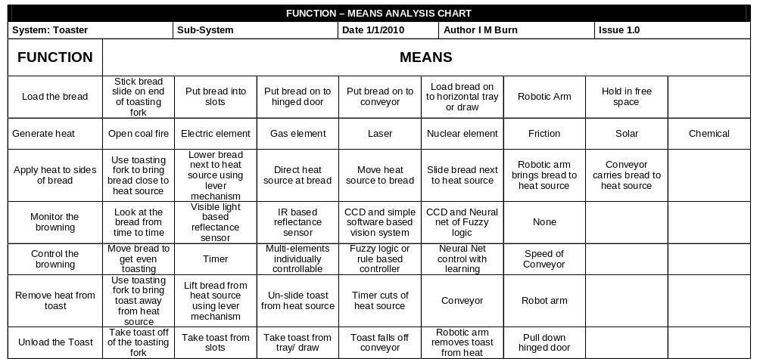
Generic Functionality helps us innovate and be holistic (i.e. don’t miss anything)

Slide 69
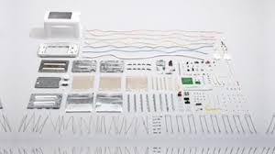
There is more to a system than its Generic Functionality
The generic system functionality is not the complete set of system functionality – a system can have functionality that is not generic:

Slide 70
There is more to a system than its Generic Functionality
The generic system functionality is not the complete set of system functionality – a system can have functionality that is not generic:
  Solution Dependent Functionality: A particular generic function solution may require further solution specific functionality. For example Generate Heat can be solved by Electric Element but this solution demands that you “Earth Case” to protect the user
  Legislation Dependent Functionality: legislation requires us to incorporate additional functionality. For example electric toasters have to isolate electricity
  Architectural Functionality: At the system level the collected functional solutions require further functionality typically to support, align, contain and protect. These functions manifest as structures, casings, frameworks, chassis etc.
  Emergent Functionality: Functionality aimed at managing Unwanted Behaviour. Usually relates to informing the user of failure situations

Slide 71
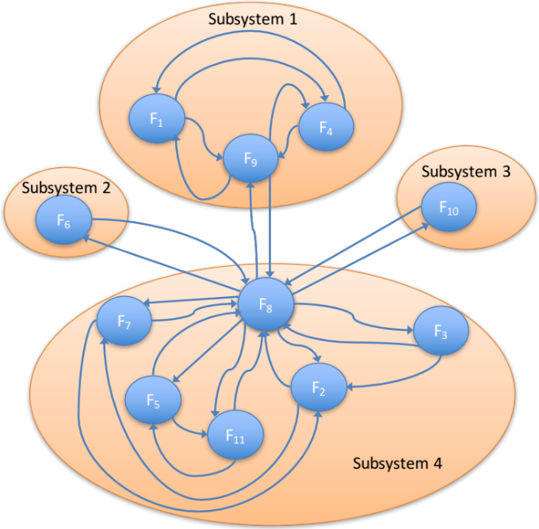
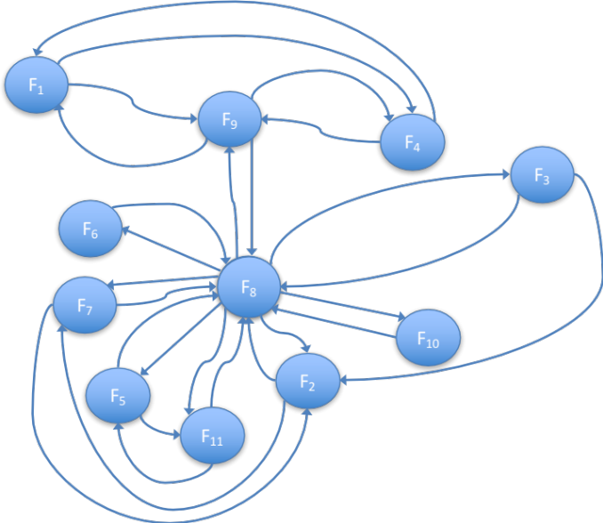
Finding the “best” Logical Architecture
If we understand the Functional interactions we can design the system architecture to minimize the interfaces

Slide 72
The Systems Approach to System Design
The bridge between requirements and the solution is the functionality (purpose)
FUNCTIONALITY
Requirements
-Land
Solution-Land
Functionality helps us uncover the unspoken requirements
Functionality is invariant and provides a consistent basis for dividing and ruling
Functionality can help find Unwanted Behaviour
Functionality helps us determine the system architecture
Functionality helps us identify and select the technological solutions

Slide 73
Functions can be Modelled Mathematically
Inputs (u)
System (x)
Outputs (Y)
In certain cases it is possible to model the system mathematically
  Outputs(Y) = function(Inputs(u), State(x))
If we can model the system before it is built we can predict its behaviour – there are NO SURPRISES!
We can find the ROBUST Optimum

Slide 74
Where is the best place to be?
What would be the best target or nominal values for X₁ and X₂ to give best possible performance?
System
Performance
Required
Customer
Performance
Design
Parameter X₂
Design
Parameter X₁
How System Performance Varies as X₁ and X₂ vary is the Design Space

Slide 75
The Best Place – the Global Optimum?
Having found the global optimum we can “work backwards” to specify the target values for the design parameters
System
Performance
Target Value of X₂
Required
Customer
Performance
Design
Parameter X₂
Target Value of X₁
Design
Parameter X₁

Slide 76
All Systems are Subject to Noise
In practice, the design target value will not be met for many reasons it will be subject to variation – we call this variation NOISE
Variation in Performance
NOISE variation has three sources:
Manufacture or Unit-to-unit
Environmental
Deterioration
Required
Customer
Performance
Variation in X₂ due to noise
Variation in X₁ due to noise
This design is sensitive to variation and its performance will frequently fall short of the customer’s expectation
What can be done to reduce the variation in performance?

Slide 77
The Classic Strategy: Tighten Tolerances
Variation in Performance
Required
Customer
Performance
Set Tight Tolerances for X₂
Set Tight Tolerances for X₁
The classic reaction to a sensitive design is to set tighter tolerances. This does work but often comes at a great cost.

Slide 78
Achieving Design Robustness
A Robust Optimum
Variation in Performance
New Nominal Value for X₂
New Nominal Value for X₁
This design is less sensitive to variation and will consistently meet the customers expectation

Slide 79
Systems Engineering uses a Systems Approach to System Design
Search and evaluate the solutions to determine and select the “best” solution
(Convergent Thinking)
Do
Do
Do
GENERATE SOLUTION OPTIONS AND SELECT
MAKE THE SYSTEM TO THE DESIGN
SYSTEM PROBLEM
UNDERSTAND
PROBLEM
solution
“best”
solution
solution
Built System
Understand the problem in terms of Purpose and Context
solution
Stakeholder needs and expectations
solution
Check (& Act)
Identify and document all possible solutions to the problem (Divergent Thinking)
Confirm the understanding of the problem reflects the stakeholder’s needs and expectations
Check (& Act)
Confirm that the selected solution solves the stakeholders’ problem

Slide 80
Systems Engineering operates in two dimensions
Complexity
Lifecycle

Slide 81

How do we Handle Complexity in System Design?
The complexity of the proposed system means it will have to be DESIGNED in “bite” sized chunks
We start by designing the SYSTEM as a number of subsystems – i.e. what is the architecture and technology of the system
System
In order to successfully design the system – Systems Thinking tells us we need to know its purpose and context
From the system design we have the necessary sub-purpose and context to specify the Subsystem Requirements
We then design the SUBSYSTEMS as a number of lower level elements, ultimately down to…
In order to design the subsystems, Systems Thinking tells us we need to know the purpose and context for each subsystem. This can only be known if we have designed the system
Subsystem 1
Subsystem 2
Subsystem 3
From the subsystem design we have the necessary context to specify the Component Requirements
The design of individual COMPONENTS
Component 2.1
Component 2.2

Slide 82
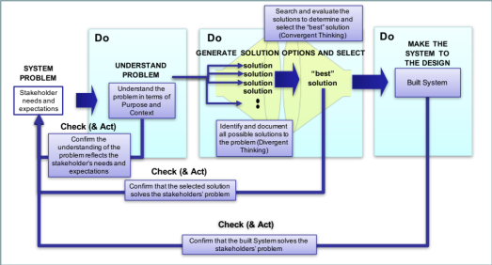
How do we Handle Complexity in System Design?
The complexity of the proposed system means it will have to be DESIGNED in “bite” sized chunks
We start by designing the SYSTEM as a number of subsystems – i.e. what is the architecture and technology of the system
System
In order to successfully design the system – Systems Thinking tells us we need to know its purpose and context
From the system design we have the necessary sub-purpose and context to specify the Subsystem Requirements
We then design the SUBSYSTEMS as a number of lower level elements, ultimately down to…
In order to design the subsystems, Systems Thinking tells us we need to know the purpose and context for each subsystem. This can only be known if we have designed the system
Subsystem 1
Subsystem 2
Subsystem 3
From the subsystem design we have the necessary context to specify the Component Requirements
The design of individual COMPONENTS
Component 2.1
Component 2.2

Slide 83
How do we Handle Complexity in System Build?
The complexity of the proposed system means it will have to be BUILT in “bite” sized chunks
We start by designing the SYSTEM as a number of subsystems – i.e. what is the architecture and technology of the system
System
The Built System
From the system design we have the necessary sub-purpose and context to specify the Subsystem Requirements
The Subsystems will be integrated to build the System
We then design the SUBSYSTEMS as a number of lower level elements, ultimately down to…
Subsystem 1
Subsystem 2
Subsystem 3
From the subsystem design we have the necessary context to specify the Component Requirements
These Components once realised will be integrated to build Subsystems
The design of individual COMPONENTS
Component 2.1
Component 2.2

Slide 84
The V Diagram
Working
System
Stakeholder
Requirements
System Level
Design
System
System Build And Check Requirements
Build and Check System
Subsystem
Requirements
Built and Checked Subsystems
Subsystem Level
Design
Subsystems
Subsystem Build and Check Requirements
Build and Check Subsystems
Component
Requirements
Built and Checked Components
Component Level
Component
Build and Check Requirements
Design
Components
Build and Check Components
We have to check at every level. The lower-level checks supporting the higher levels
To manage complexity we design in levels
Realise
Components

Slide 85
Systems Engineering is Fractal
At any one Level there is a
Fundamental Process – The Process Is Recursive
System
(Current Level)
Requirements
Working
(Current Level)
System
Design System
(Current Level)
System
Build and Check Requirements
Build and Check System
(Current level)
Subsystem
(Lower Level)
Requirements
Built and Checked (Lower Level)
Subsystems
Engineer
Subsystems
(Lower Levels)

Slide 86
Systems Engineering is Fractal
At any one Level there is a
Fundamental Process – The Process Is Recursive
System
(Current Level)
Requirements
Working
(Current Level)
System
Design System
(Current Level)
System
Build and Check Requirements
Build and Check System
(Current level)
Subsystem
(Lower Level)
Requirements
Built and Checked (Lower Level)
Subsystems
Engineer
Subsystems
(Lower Levels)

Slide 87
The Design System Process
Understand the problem – what does the customer want in measurable terms?
Stakeholder
Requirements
IDENTIFY
Design System
What are the design choices and what system concept will best meet the requirements?
DESIGN
Build and Check Requirements
Make the system concept as good as it can be – do we have the robust optimum?
System
Design
System
Design
OPTIMISE
A second key output of the Design System “block” is the Build and Check Requirements
VERIFY
Subsystem
Requirements
Verify and Validate the system design - is the system fit for purpose?

Slide 88
Systems Engineering is Fractal
At any one Level there is a
Fundamental Process – The Process Is Recursive
System
(Current Level)
Requirements
Working
(Current Level)
System
Design System
(Current Level)
System
Build and Check Requirements
Build and Check System
(Current level)
Subsystem
(Lower Level)
Requirements
Built and Checked (Lower Level)
Subsystems
Engineer
Subsystems
(Lower Levels)

Slide 89
VERIFY - the Build and Check System Process
Working
System
Demonstrate that the system meets the pre-determined and agreed acceptance criteria
VERIFY
Check that the system has been built correctly against pre-determined verification criteria and methods
Accept (Validate) System
Check (Verify) the built System
Build and Check
Requirements
Check and Accept Evidence
Build System
Built and Checked
Subsystems
Physically build the System from the Subsystems

Slide 90
Systems Engineering operates in two dimensions
Complexity
Lifecycle

Slide 91
Generic Lifecycle
build
design
deliver
Lifecycle Principles
  Through Life Capability Principles
  Project and Technical Engineering Activity in Distinct Phases in a Cycle
  Depicting the Cycle Linearly with Time describes a Lifecycle
  Systems Engineering Principles and Processes Can Be Applied
conceive
support
Next project
decommission
conceive
design
build
decom-
mission
THE LIFECYCLE
deliver
support
Time

Slide 92
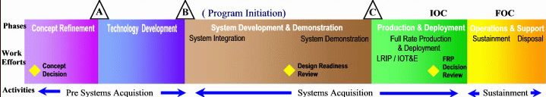
Some Systems Engineering Lifecycles
US DoD Acquisition Lifecycle
IG
MG
MOD CADMID Lifecycle
Concept
Assessment
Demonstration
Manufacture
In-Service
Disposal
IG
MG
MOD CADMIT Lifecycle
Concept
Assessment
Demonstration
Migration
In-Service
Termination
U
C
D
P
R
S
Concept
Development
Production
Utilisation & Support
Retirement
ISO 15288 Lifecycle Phases

Slide 93
Lifecycle Activity – Lifecycles within Lifecycles
System-Level
U
C
D
P
R
S
Infrastructure
U
C
D
P
R
S
IT System
U
C
D
P
R
S
If delivering an integrated capability, for example, including buildings and infrastructure and IT systems, these different elements of the system of systems need to be at a higher level of maturity earlier than the main system

Slide 94
Lifecycle Activity – Lifecycles within Lifecycles
System-Level
U
C
D
P
R
C
D
P
C
D
P
C
D
P
S
C
D
P
C
D
P
C
D
P
C
D
P
C
D
P
C
D
P
The Utilisation/Support Phase can be very long (can have a service life in excess of 30 - 50 years)
The Systems Engineering Lifecycle is repeated within the support phase many times over for the re-design and embodiment of sub-systems due to obsolescence or for operational enhancements.
These can range from simple modifications through to whole system update.

Slide 95
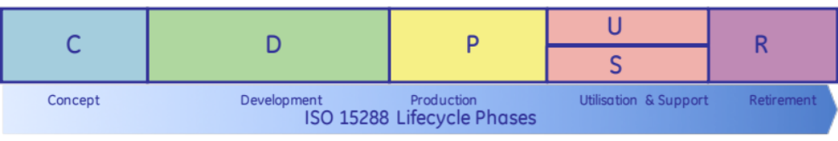
What is the Vestas Lifecycle?
Can we draw a life cycle model for Vestas?

Slide 96
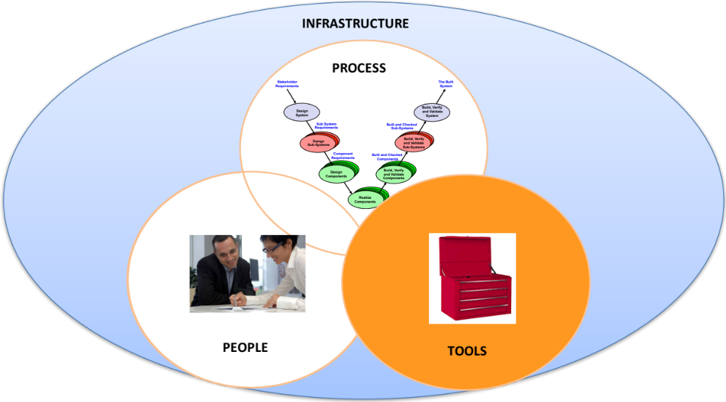
The Tools
Processes tell you what to do and when to do it (may also say who does it) – they should NOT specify how to do it – this is the job of tools
BUT we need a set of tools that all teams members can use, with confidence, that allow us to handle the complexity of the system but at the same time are simple enough for the whole team to use – we need generalist systems tools
Systems Engineering Tools are primarily communication devices that allow different disciplines to explore systems issues, often by building abstract models. They are scalable (any size of system), universal (any type of system)and above all simple (anybody can use them)

Slide 97
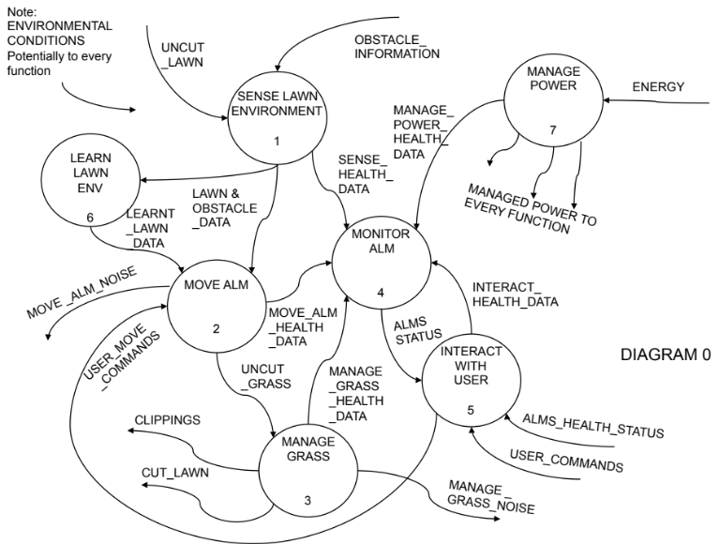
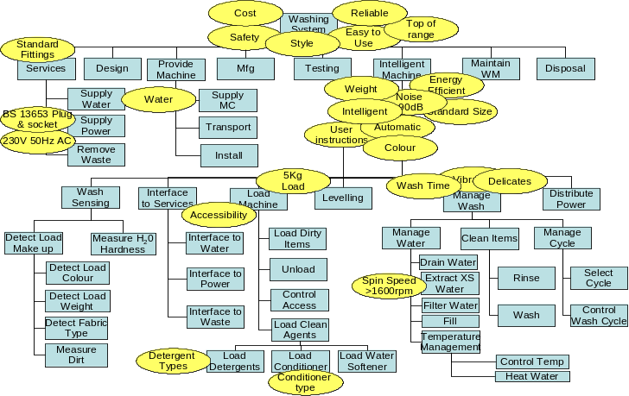
Systems Tools Build Models to Help the Team Reach a Common Understanding
Systems Engineering makes great use of MODELS to look for structures, relationships and dependencies at an abstract level to help predict behaviour at the real level

Slide 98


















Gather Requirements
Analyse and Validate Requirements
Specify
Requirements
The Business Requirements provide the rationale and overall business constraints for a system development project
Determine the Emergent Functionality
Stakeholder Map
Flow Sensitivity Analysis
The System Requirements defines the measurable design requirements for the system
Determine system stakeholders and select key ones for requirements elicitation
Identifies causal paths for potential system sensitivities
Functional Failure Mode and Effect Analysis
Quality Function Deployment 1
Captures the potential functional failure modes, effects and causes to identify remedies ab initio
Cross checks requirements for consistency and completeness
Verification Compliance Matrix
Affinity Diagram
Use Case
Determine Validation and Verification methods for each requirement and specify V& V Requirements
IDENTIFY
Elicit and capture key stakeholder requirements
Captures how a user expects to interact with a system
Determine the necessary generic System Functionality
Tree Diagram/Analytic Hierarchy Process
Systemic Textual Analysis
Viewpoint/Functional Analysis
Function Flow Diagram
Organize and prioritise key stakeholder requirements
Analyses expressed requirements into their atomic form to identify and clarify missing and ambiguous requirements
Generates and organizes system generic functionality necessary to achieve the Operational Requirement
Captures and shows how the component functionality of a system must cooperate to deliver the Operational Requirement
Requirements Database
The User Requirements defines the expressed requirements of a particular stakeholder or stakeholders
Need Mean Analysis
Identifies and explores system solutions at different levels to determine System Meta-Solution

Slide 99














DESIGN and OPTIMISATION
Requirements Database
Create System Definition and Sub-System Requirements and associated Sub-System Verification Requirements
Requirements Database
Update System Definition and Sub-System Requirements and associated Sub-System Verification Requirements
Create Candidate System Concepts
Qualitative Robustness and Critical Parameter Analysis
Quality Function Deployment 2
Verify System Concept Solution meets the System Requirements and allocation of Sub-System Requirements
Quality Function Deployment 2`
Parameter Diagram
Design 2 Noise Matrix
Design Failure Mode and
Effects Analysis
Update QFD 2 with the design parameter target values and as appropriate - tolerances
N² Analysis
Logical System Architecting
Identifies and captures the factors that influence the performance of a system output
Determine the factors that are most likely to influence the robustness of a nominal design
Identify and document the potential failure modes, Effects and Causes
Determines the natural structure of a system that can be exploited
Determines candidate system architectures with minimal interfaces
Preliminary Design and Feasibility
Use Engineering Modelling, Simulation and Analysis to undertake preliminary design and feasibility
Quantitative Robustness Analysis
Parameter & Tolerance Design
Function Means Analysis
Simulation and Modelling
Designed of Experiments
Use quantitative models to explore solution space to find robust optimum and thereby determine design parameter settings and tolerances
Identifies and captures all possible functional solutions to a system design problem and thereby determine suitable candidate system concepts
Pugh Matrix
Use models or physical Designed Experiments to characterise the transfer function and thereby robustness of the system design.
Compares candidate system concepts against a set of criteria

Slide 100








VERIFY & VALIDATE
Requirements Database
Realisation System Modelling and Analysis
Supportability Assessment
Assess supportability through predicted
reliability and operational analysis
Sequence Diagram
Identifies sequence of logical process steps (functions) of the realisation system
Fault Tree Analysis
Reliability Block Diagram
Operational Analysis
Quality Function Deployment 3
Model System Failures as a Fault Tree
Model the system design to predict the system reliability
Understand the System Operation
Check that System Concept Solution is realizable and determine critical realization parameters and target values
Parameter Diagram
Collect Verification Evidence
Identifies and captures the factors that influence the performance of a system output
Perform Verification Activities and collect verification evidence
Process Failure Mode and
Effects Analysis
Verification Compliance Matrix
Quality Function Deployment 4
Design and perform tests
Update Verification Compliance Matrix
For the critical realization parameters determine the Assurance Requirements and target values
Identify and document the potential failure modes, Effects and Causes

Slide 101

A Fool With a Tool
Is a More Dangerous Fool
Give somebody a hammer and they’ll find things to hit with it!

Slide 102


Power Generation from Wind – What is it?

Slide 103

Systems Map
What is it?
  A tool to create a simple high level diagram of the system under investigation to:
    Define system boundaries
    Indicate the major components (sub-systems) that lie within the boundaries
    Identify relationships between components
Where to use it?
  A Systems map is very useful when attempting to define the boundaries of system and uncover the major components
When to do it?
  Whenever there is a need to investigate and understand a complex situation – untangle thinking
  Need to communicate understanding
  Identify potential actions (problem solving)
How to do it
  A Systems Map can be drawn by an individual but it is best performed by a team
  The team should comprise people who have knowledge of the system throughout its life cycle

Slide 104
Basic Terminology
Component/Element of System
(Sub-System)
Component/Element
In the environment of the system
These are things that interact with the system
System Boundary
Component/Element of Sub-System

Slide 105
How to do it?
Brainstorm system components/elements – this is often best done using sticky notes, cards or alternatively writing on a white board
  Components/elements can be;
    things/objects (nouns) that are in the system or its environment
    functions/actions/activities (verbs) that the system has to perform to achieve its purpose
  Components can be a mixture of things and action
Look for natural groups of components/elements
  This should done for both internal and external elements
Look within each group for further sub-groupings
  Aim for at least three levels of hierarchy
  Groups should 5 elements or less

Slide 106

Example Systems Map
Notice: all the elements here are objects or things

Slide 107

Activity: Systems Map
In small teams
Draw a Systems Map for Plant Power Generation:
  Try to identify all the major elements
Be prepared to present your findings to the whole group
Time 20 minutes
Notes:
This is an affinity diagram.
10 minutes to brainstorm functions, 10 minutes to define affinity groups.

Slide 108
Systems Map - Summary
Pros
  Easy to use
  Captures teams members view of the Systems of Interest
  Promotes discussion
  Consensus view – a shared and common understanding
  Organized output
Cons
  Difficulties in finding agreed groupings – some elements can reside in several groups (for both internal and external elements)
  Deciding on the sub-group headers
  Output format not intuitive to novice reader
  Including lifecycle view
Tips
  Aim for three levels of hierarchy
  At each level aim for 7 or less items
  Take care in deciding headers.
  Try not to mix function and object views
  Allow time to investigate different groupings

Slide 109

Rich Picture
What is it?
  A diagrammatic representation of a “foggy” or “messy” situation to capture multiple views in order to gain and share understanding
When to use it
  Whenever you wish to understand a system
  Particularly useful for “foggy’ complex situations typified by a significant human element
Why use it?
  To capture and share various viewpoints and perceptions of a situation leading to a common understanding or representation
  To act as a source of inspiration to extract meaningful aspects for further investigation
A Rich Pictures is a key tool in the Soft Systems Methodology developed by Peter Checkland and Brian Wilson

Slide 110
Theory
Rich Pictures are an integral part of the Soft Systems Methodology that recognises that the real world is complex and messy because we, human beings, inhabit it:
    Each of us will have a different perception of the same situation
    Our individual perceptions will be based upon concepts and beliefs we hold in our head – mental model(s) that we use to make judgments about reality
To capture the various perceptions, Checkland et al developed the notion of a “Rich Picture”. They understood that complex situations couldn’t be adequately captured by words alone, diagrams and pictures are far more effective
The idea behind the construction of a Rich Picture of a particular situation is that it:
    Allows differences of interpretation to be identified
    Permits agreement to be made on the interpretation to be taken
    Is a source of inspiration as to what relevant systems could be modeled through the assimilation of relationships, issues etc. It helps identify themes to take into the systems world.
Because every situation is different and it is necessary to capture this potential variety, there are no formal Rich Picture modeling symbols. However, over the years of use, a number have become accepted as standard

Slide 111

Common Rich Picture Symbols
Although any symbol can be used, the ones here have become “standard” over the years:
Use symbols, scenes or images that represent the situation, such that somebody else can “read” the picture.
Capture whatever connections that are perceived between the symbols
Avoid too much writing – but remember somebody else should understand it
Try not to include system boundaries or references to systems in any way

Slide 112
Rich Picture Guidelines
A Rich Picture is an attempt to capture everything that could be relevant to a particular situation.
Try to minimize the use of words but do use them if pictures don’t come to mind
Try not to impose any style or structure on your picture like time goes from left to right – let people’s instincts guide them
Remember that different people will perceive different things about a situation - it is necessary to somehow represent these views
Rich pictures are a representation of the real world and therefore avoid using systems terms like marketing system and a production system and a quality control system.

Slide 114


Slide 115


Slide 116

Activity: Rich Picture
In small team Construct a Rich Picture of Vestas
Be prepared to present your findings to the whole group
Time 20 minutes
Notes:
This exercise is described in the exercise trainer notes.

Slide 117
What are the Vestas Meta-Solutions

Slide 118




Requirements and Solutions
Requirements
unknown to customer
DYNAMIC
High
Customer Knowledge
Risk
Migration
REVOLUTION
BROAD
NARROW
Requirements
known to customer
Low
STATIC
Conclusion: Customers and Providers often work in the static design domain because of knowledge and risk. Revolutionary improvement happens when a new dynamic concept is used. Making this decision is difficult and risky
Notes:
8

Slide 119
System Meta-solution
Operational Requirement
Company
Meta-solution
Toyota
To transport passengers and their baggage from one point to another efficiently and safely
Airbus
Bombardier
Yamaha
A Meta-solution is an organization’s current preferred solution to a system “problem”
It is often possible to identify and decide upon the Meta-solution very early in System Development. This will allow us to bound or scope the system functionality relative to that chosen Meta-solution - BUT

Slide 120


Failure to Explore New Meta-solutions - A Sorry Tale
Up to the late 1970s the carburettor was the dominant method of mixing air and petrol. Because of its cost and reliability, fuel injection was rare.
The carburettor manufacturers considered their business safe and focused on making better carburettors! They should have been investigating the engine manufacturer’s need for “providing the engine with an air-fuel mix”
Other people started working on cheap and effective fuel injection systems and before the carburettor manufacturers reacted their business had gone – there are no carburettor manufacturers left in the domestic automotive market!

Slide 121



Successful Dynamic Design Concept
Stena HSS – the largest fast ferry in the world, carrying up to 1500 passengers, it travels at speeds of up to 46 miles per hour, cutting journey times in half – it is a revolution in ferry design. It was designed and built as a reaction to the Channel Tunnel – Stena saw this a threat to the very survival of their business!

Slide 122
Unsuccessful Dynamic Design Concept
The Sinclair C5 – A potential revolution in personal transport – dynamic concept that failed dramatically.
Sir Clive Sinclair was so convinced that the C5 was the future of personal transport he spent $20M of his own money (1985) – equivalent to $150M today

Slide 123
System Meta-solution
Every “system of interest” is a subsystem of a bigger system. Examining the system of interest from the viewpoint of the super-system to which it belongs forces us to consider what it does and the NEED it satisfies.
Remember, customers do not buy systems, they buy capability. Airbus and Boeing do not buy gas turbines they buy propulsive power - and if somebody was to come along with a “better” alternative meta-solution to providing propulsive power they will buy it!
  From GE’s (or PW or Rolls-Royce’s) viewpoint their solution to providing power is the gas turbine – it is their Meta-solution. Their whole infrastructure is geared up to designing and building gas turbines
When considering the design of a new system, subsystem, or component, we should always review the current Meta-solution to see if it is viable within the project timescales. There will always be alternatives and some of these may be more acceptable to the customer/stakeholders
  Indeed, a sensible organization should always be researching alternative meta-solutions in preparation for a change - if necessary

Slide 124
Gather Requirements
Analyze and Validate Requirements
Specify
Requirements
The Business Requirements provide the rationale and overall business constraints for a system development project
Determine the Emergent Functionality
Stakeholder Map
Flow Sensitivity Analysis
The System Requirements defines the measurable design requirements for the system
Determine system stakeholders and select key ones for requirements elicitation
Identifies causal paths for potential system sensitivities
Functional Failure Mode and Effect Analysis
Quality Function Deployment 1
Captures the potential functional failure modes, effects and causes to identify remedies ab initio
Cross checks requirements for consistency and completeness
Verification Compliance Matrix
Affinity Diagram
Use Case
Determine Validation and Verification methods for each requirement and specify V& V Requirements
IDENTIFY
Elicit and capture key stakeholder requirements
Captures how a user expects to interact with a system
Determine the necessary generic System Functionality
Tree Diagram
Systemic Textual Analysis
Viewpoint/Functional Analysis
Function Flow Diagram
Organize and prioritise key stakeholder requirements
Analyses expressed requirements into their atomic form to identify and clarify missing and ambiguous requirements
Generates and organizes system generic functionality necessary to achieve the Operational Requirement
Captures and shows how the component functionality of a system must cooperate to deliver the Operational Requirement
Requirements Database
The User Requirements defines the expressed requirements of a particular stakeholder or stakeholders
Need Mean Analysis
Identifies and explores system solutions at different levels to determine System Meta-Solution

Slide 125
Analyse Requirements: An Iterative Process
Assess System Meta-Solution
Applying Systems Thinking to the task of analysing requirements tells us that we will need to take various perspectives to help uncover the unspoken requirements
Determine “working” Operational Requirement
Determine System Functionality
Determine Emergent Functionality
Determine Non-Functional Performance Requirements
The iteration may not be simple
Verify and Validate Requirements

Slide 126

Need Means Analysis
What is it?
  A lateral thinking approach aimed at getting people away from conventional solutions to explore and select the Meta-solution for the system of interest
  The approach is based around identifying the “need” that a system satisfies and then using this to investigate alternative solutions
How to do it
Step 1: Identify the Operational Requirement of the current Meta-solution to the system of interest
Step 2: Derive the NEED that this system satisfies
The Need Means Analysis output above is for a domestic washing machine that explores potential solutions at different levels to agree the system Meta-solution
Step 3: Use “the box of nine” to identify new solutions to the need at different levels
Step 4: Review “the box of nine” to decide on the Meta- solution for the system of interest

Slide 127
Step 1: Identify the Operational Requirement of the current Meta-solution to the system of interest
The starting point for a Need Means Analysis is to identify the current Meta-solution and determine its Operational Requirement
If Systems Engineering has been used in its development, the Operational Requirement should exist – otherwise one will have to be created
Remember
Example: Domestic Automatic Washing Machine
An Operational Requirement defines the major purpose of a system (i.e. what it fundamentally does - its capability) together with the key overarching constraints (that define the context)
To clean effectively domestic fabric items using minimum water and power and currently available detergents

Slide 128
Step 2: Derive the Need that this Systems Satisfies
An Operational Requirement defines what a system fundamentally does
The is always a higher level reason why that purpose is being carried out – this is the NEED
It is likely not to be the same as the Operational Requirement – but will be related
For example the operational Requirement for a pen is to “lay-down a trail of ink”
But why do we NEED to lay-down a trial of ink” – because we wish to communicate our thoughts
Example: Domestic Automatic Washing Machine
Why do we want
to clean effectively domestic fabric items?
Hygiene

Slide 129
Step 3: Use “the box of nine” to identify new solutions to the need at different levels
How can the Need be achieved without the User/Customer having to purchase/own a Washing Machine
Cleaning Service
Disposable Clothes/
Items
Holographic Clothing
New system
The User/Customer still purchases/owns a Washing Machine, but it’s a different Architecture
Top-Loading Machine
Front Loading Machine
OR: Clean domestic fabric Items
Need: Hygiene
Combined Dishwasher
New system
architecture
Ultrasonic Cleaning
Fuzzy Logic
Control
Auto Powder
Dispensing
The same Meta-solution but changes made at the subsystem level
New
subsystem
The “box of nine” encourages us to think of at least 3 options per level providing sufficient to explore the choices. Can include further options at any level

Slide 130





Need Means Applies at any level!
Can include further options
Machine from solid
Adhesive
Weld
Higher
Level
New system
Rivet Nut
Rivet
OR: Join 2 or more components together
Need: Structural integrity
Pop Rivet
Same
Level
New system
architecture
Dome Head
Countersunk
Flat Head
Lower
Level
New subsystem

Slide 131
Need Means Applies To Any System!
Can include further options
User
Repair
Postal Replacement
Redundant
System
Higher
Level
New system
Reliability Centred Maintenance
System
Man in a Van to repair system at user’s home
OR: Fix System
Need: Working System
Prognostic based system
Same
Level
New system
architecture
Computer – internet based technical publications
Electronic/ software based diagnostics
Internet based booking service
Lower
Level
New subsystem

Slide 132
Exercise – Need Means Analysis
Perform a Need Means Analysis for a Wind Turbine
Time 20 minutes
The Need Means Analysis output above is for a domestic washing machine that explores potential solutions at different levels to agree the system Meta-solution

Slide 133










Need Means analysis
Confined vortex
Vertical axis turbine
Air borne turbine
Diffuser concept
Standard solution
Direct drive
LIDAR
Concrete tower
Blade with winglet

Slide 134
Step 4: Review “the box of nine” to decide on the Meta- solution for the system of interest
The purpose of a Need Means Analysis is to reflect upon the alternative levels of solutions available - with the intention of agreeing the system Meta-solution
It is always possible to operate at higher and higher levels of abstraction in order to retain solution choices – BUT often the problem context allows the meta-solution to be decided at this point thereby focusing and scoping the design activity
By agreeing the Meta-solution we are bounding our system functionality
Example
In 1998-1999 a well known washing machine designer/manufacturer undertook a technology demonstration programme to develop an “intelligent washing system”.
One possible Meta-solution was a “dry-cleaning machine”. However, this particular company had no design or manufacturing experience with “dry-cleaning” which, combined with the health and safety issues, led them to retaining the same basic Meta-solution – a water-based electrically powered system

Slide 135
Meta-solutions, Level of Innovation and Risk
0.1%
Higher
Level
New system
Revolutionary
4.9%
Same
Level
New system architecture
Radical
95%
Lower
Level
New subsystem
Evolutionary

Slide 136
Need Means Analysis Summary
Pros
  Simple - anybody can contribute
  If performed in a team it promotes
    Discussion
    Thinking
  Identifies alternative solutions at different levels
  Can lead to an agreed meta- solution and therefore scope the problem space
Cons
  Deciding who does this? Is it an engineering or marketing tool
  Can give a false feeling of security
  Can give a solution that allows an organization to jump straight into detailed design without doing the full system design

