Slide 2


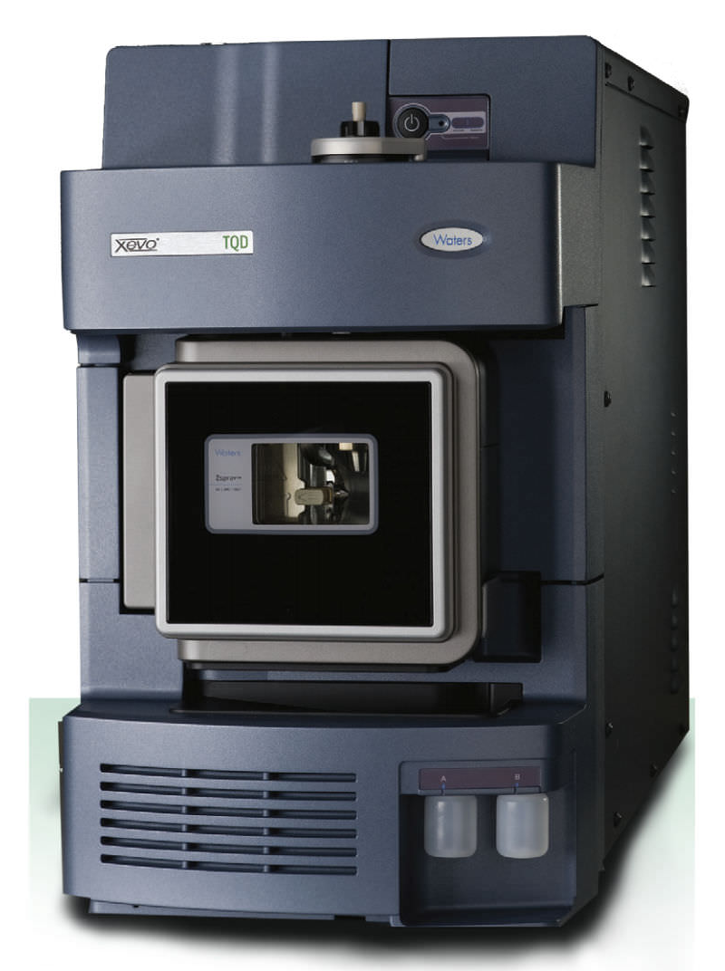
In Simple Terms – Systems Engineering is about:
I WANT
turning into
Customer/User Requirements
WOW!
It’s about design
The Solution

Slide 3
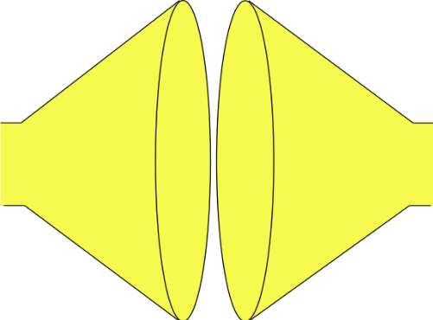
Systems Engineering uses a Systems Approach to System Design
Plan
Tailor the process, select the tools and determine the best checking strategy
Search and evaluate the solutions to determine and select the “best” solution
(Convergent Thinking)
Do
Do
Do
MAKE THE SYSTEM TO THE DESIGN
GENERATE SOLUTION OPTIONS AND SELECT
SYSTEM PROBLEM
UNDERSTAND
PROBLEM
solution
solution
“best”
solution
Built System
Understand the problem in terms of Purpose and Context
solution
Stakeholder needs and expectations
solution
Check (& Act)
Identify and document all possible solutions to the problem (Divergent Thinking)
Confirm the understanding of the problem reflects the stakeholder’s needs and expectations
Check (& Act)
Confirm that the selected solution solves the stakeholders’ problem
Check (& Act)
Confirm that the built System solves the stakeholders’ problem

Slide 4
The first step:
Understand the problem

Slide 5
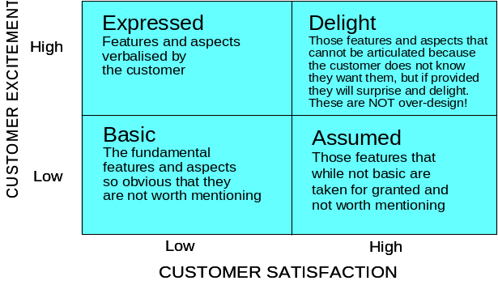
I WANT
are just the
The customer requirements are never complete, consistent, correct or clear
We have to find the unspoken requirements. But how?
The approach has to be one of divide and rule. But what is the best way to divide?
WOW!
The complexity of the problem and the likely complexity of the solution means it is too big to consider the whole solution

Slide 6
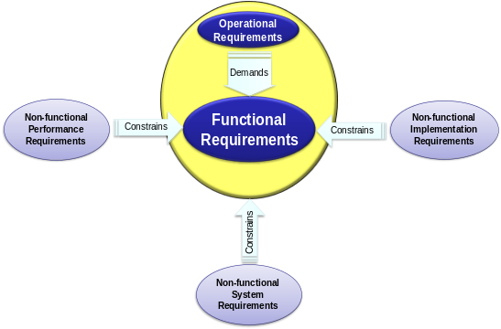
I WANT
are just the
Because
F₂
F₃
FUNCTIONALITY
F₁
F₄
WOW!
HOW WELL?

Slide 7
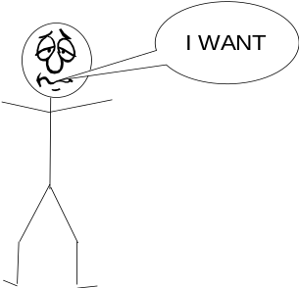


The Systems Approach to System Design
The bridge between requirements and the solution is the functionality (purpose)
FUNCTIONALITY
Requirements
-Land
Solution-Land
Functionality helps us uncover the unspoken requirements
Functionality is invariant and provides a consistent basis for dividing and ruling

Slide 8
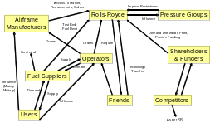
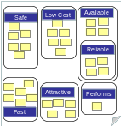

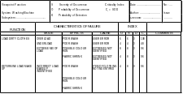
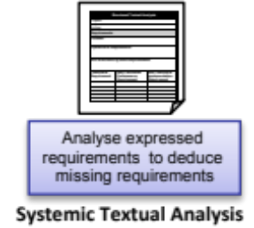
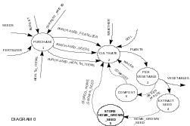
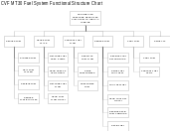

I WANT
are just the
Assess the functional sensitivity
and potential functional failure
modes to identify potential
emergent functionality and risk
Sensitivity & Failure Analysis
Stakeholder Map
Identify and group stakeholders
Affinity Diagram
Via interviews and focus groups use Affinity Diagram to Elicit, capture and structure expressed requirements
Needs Means Analysis
Assess potential meta-solutions to stakeholder needs
Determine system
functionality (Y = f)
and structure
Develop a model of the planned system to identify logical interfaces and functional dependencies
Determine Meta-Solution to scope system Functionality
Viewpoint Analysis
Functional Modelling
F₂
F₃
F₄
F₅
F₆
F₇
F₈
F₉
…
F_{N}
FUNCTIONALITY
F₁
WOW!

Slide 9
I WANT
are just the
Assess the functional sensitivity
and potential functional failure
modes to identify potential
emergent functionality and risk
Sensitivity & Failure Analysis
Stakeholder Map
Identify and group stakeholders
Affinity Diagram
Via interviews and focus groups use Affinity Diagram to Elicit, capture and structure expressed requirements
Needs Means Analysis
Assess potential meta-solutions to stakeholder needs
Determine system
functionality (Y = f)
and structure
Develop a model of the planned system to identify logical interfaces and functional dependencies
Determine Meta-Solution to scope system Functionality
Viewpoint Analysis
Functional Modelling
F₂
F₃
F₄
F₅
F₆
F₇
F₈
F₉
…
F_{N}
FUNCTIONALITY
F₁
WOW!
BUT is it complete?

Slide 10
QFD 1 To Verify and Validate
HOW
F₁
F₂
F₃
F₄
F₅
F₆
F₇
WHAT
USER RQMT₁ (NFS)
USER RQMT₂ (NFS)
USER RQMT₃ (NFS)
RELATIONSHIPS
USER RQMT₄ (NFS)
USER RQMT₅ (NFS)
USER RQMT₆ (NFS)
HOW MUCH

Slide 11
QFD 1 To verify and Validate
HOW
F₁
F₂
F₃
F₄
F₅
F₆
F₇
WHAT
Blank Row
Missing a Function or User Requirement Wrong!
USER RQMT₁ (NFS)
USER RQMT₂ (NFS)
USER RQMT₃ (NFS)
RELATIONSHIPS
USER RQMT₄ (NFS)
USER RQMT₅ (NFS)
USER RQMT₆ (NFS)
HOW MUCH

Slide 12
QFD 1 To verify and Validate
HOW
F₁
F₂
F₃
F₄
F₅
F₆
F₇
WHAT
Blank Row
Missing a Function or User Requirement Wrong!
USER RQMT₁ (NFS)
USER RQMT₂ (NFS)
USER RQMT₃ (NFS)
RELATIONSHIPS
USER RQMT₄ (NFS)
USER RQMT₅ (NFS)
USER RQMT₆ (NFS)
Blank Column
Unecesaary Function or User Requirement Wrong!
HOW MUCH

Slide 13
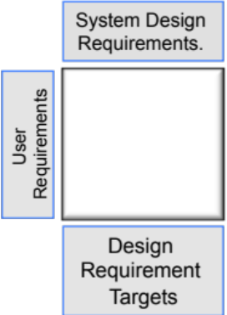
I WANT
are just the
Assess the functional sensitivity
and potential functional failure
modes to identify potential
emergent functionality and risk
Sensitivity & Failure Analysis
Stakeholder Map
Identify and group stakeholders
Affinity Diagram
Via interviews and focus groups use Affinity Diagram to Elicit, capture and structure expressed requirements
Needs Means Analysis
Assess potential meta-solutions to stakeholder needs
Determine system
functionality (Y = f)
and structure
Develop a model of the planned system to identify logical interfaces and functional dependencies
Determine Meta-Solution to scope system Functionality
Viewpoint Analysis
Functional Modelling
F₂
F₃
F₄
F₅
F₆
F₇
F₈
F₉
…
F_{N}
FUNCTIONALITY
F₁
WOW!

Slide 14
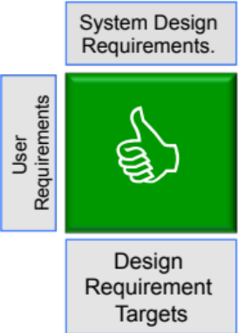
I WANT
are just the
Assess the functional sensitivity
and potential functional failure
modes to identify potential
emergent functionality and risk
Sensitivity & Failure Analysis
Stakeholder Map
Identify and group stakeholders
Affinity Diagram
Via interviews and focus groups use Affinity Diagram to Elicit, capture and structure expressed requirements
Needs Means Analysis
Assess potential meta-solutions to stakeholder needs
Determine system
functionality (Y = f)
and structure
Develop a model of the planned system to identify logical interfaces and functional dependencies
Determine Meta-Solution to scope system Functionality
Viewpoint Analysis
Functional Modelling
F₂
F₃
F₄
F₅
F₆
F₇
F₈
F₉
…
F_{N}
FUNCTIONALITY
F₁
WOW!

Slide 15
The Systems Approach to System Design
The bridge between requirements and the solution is the functionality (purpose)
FUNCTIONALITY
Requirements
-Land
Solution-Land
Functionality helps us uncover the unspoken requirements
Functionality is invariant and provides a consistent basis for dividing and ruling
Functionality helps us determine the system architecture
Functionality helps us identify and select the technological solutions

Slide 16
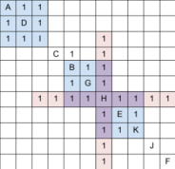
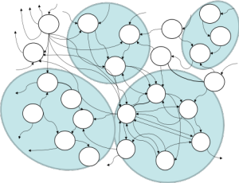

I WANT
are just the
Assess the functional sensitivity
and potential functional failure
modes to identify potential
emergent functionality and risk
Sensitivity & Failure Analysis
Stakeholder Map
Identify and group stakeholders
Affinity Diagram
Via interviews and focus groups use Affinity Diagram to Elicit, capture and structure expressed requirements
Needs Means Analysis
Assess potential meta-solutions to stakeholder needs
Determine system
functionality (Y = f)
and structure
Develop a model of the planned system to identify logical interfaces and functional dependencies
Determine Meta-Solution to scope system Functionality
Viewpoint Analysis
Functional Modelling
F₂
F₃
F₄
F₅
F₆
F₇
F₈
F₉
…
F_{N}
FUNCTIONALITY
F₁
Logical System Architecting
WOW!
Determine candidate logical
system architectures
N² Analysis
Assess degree of natural functional binding and coupling
Function
Means
Analysis
Identify means of achieving functionality and determination of whole system concept solutions

Slide 17
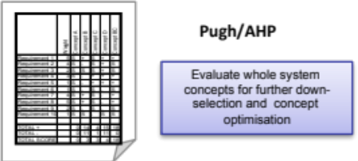
I WANT
are just the
Assess the functional sensitivity
and potential functional failure
modes to identify potential
emergent functionality and risk
Sensitivity & Failure Analysis
Stakeholder Map
Identify and group stakeholders
Affinity Diagram
Via interviews and focus groups use Affinity Diagram to Elicit, capture and structure expressed requirements
Needs Means Analysis
Assess potential meta-solutions to stakeholder needs
Determine system
functionality (Y = f)
and structure
Develop a model of the planned system to identify logical interfaces and functional dependencies
Determine Meta-Solution to scope system Functionality
Viewpoint Analysis
Functional Modelling
F₂
F₃
F₄
F₅
F₆
F₇
F₈
F₉
…
F_{N}
FUNCTIONALITY
F₁
Logical System Architecting
WOW!
Determine candidate logical
system architectures
N² Analysis
Assess degree of natural functional binding and coupling
Function
Means
Analysis
Identify means of achieving functionality and determination of whole system concept solutions

Slide 18
QFD 2 To Verify System Design
HOW
Solution₁
Solution₂
Solution₃
Solution₄
Solution₅
Solution₆
Solution₇
WHAT MUCH
WHAT
Functional RQMT₁
Functional RQMT₂
Functional RQMT₃
RELATIONSHIPS
Functional RQMT₄
Functional RQMT₅
Functional RQMT₆
HOW MUCH

Slide 19
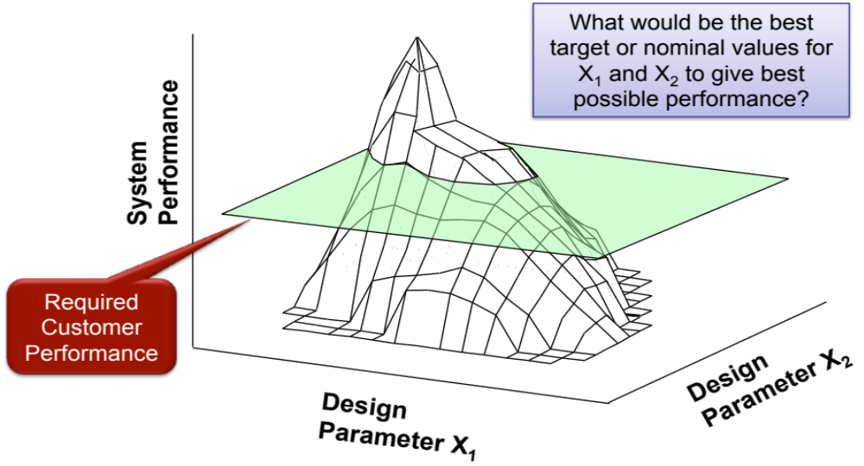
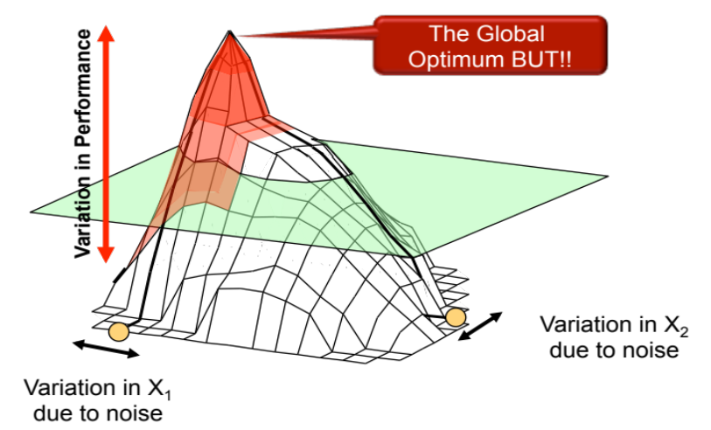
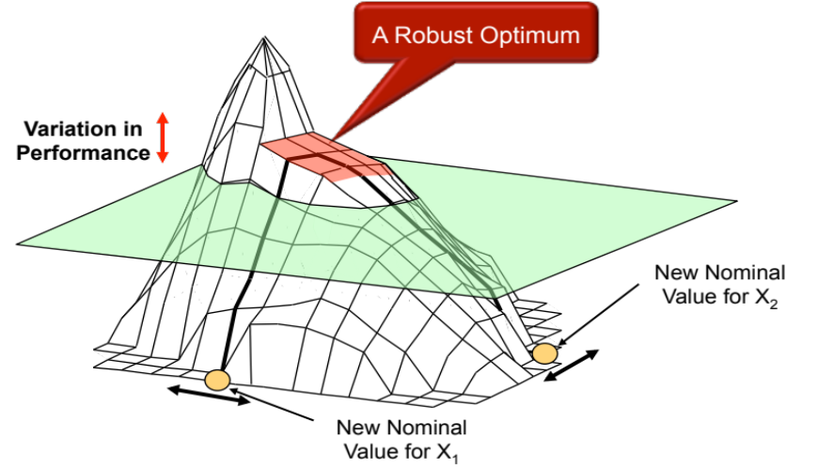
Exploring the Design Space (Robust Design)
A system can sensitive to small variation in its design parameters resulting in a performance short fall. The Optimise and Refine the System Design Concept phase requires us to find the PLATEAUS and avoid the peaks
We have a design solution that consistently delivers the customers’ requirements – We are delivering excellence

Slide 20
The Systems Engineering of a Kitchen

Slide 21


Slide 22
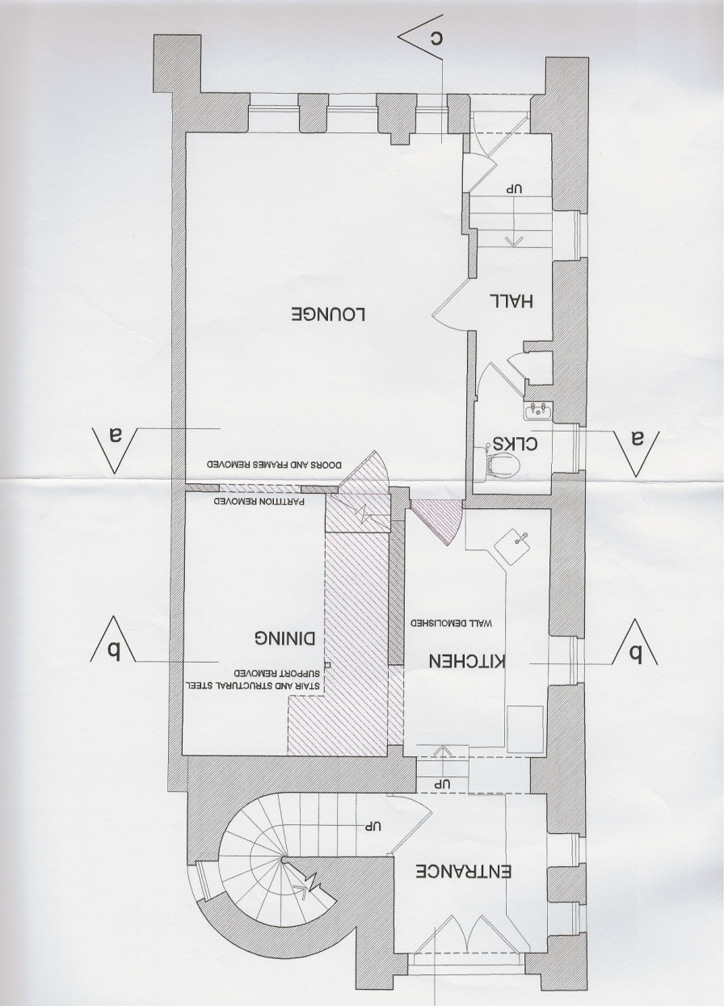
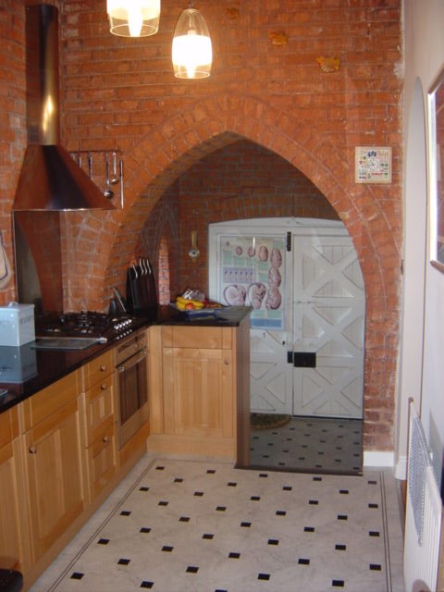
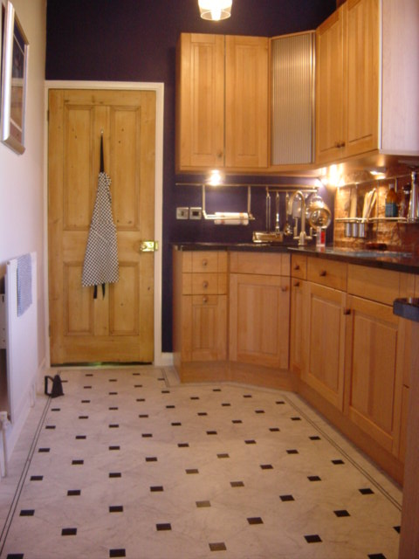
The Problem
The original kitchen was a narrow “galley” style. It was refurbished shortly after moving into the house. The design was based around fitting in a number of desirable items – i.e. hob, oven, dishwasher – into the available space.
The refurbishment was a great improvement on the previous kitchen – but was unworkable, only one person could effectively work in the kitchen at any moment in time - Moreover

Slide 23
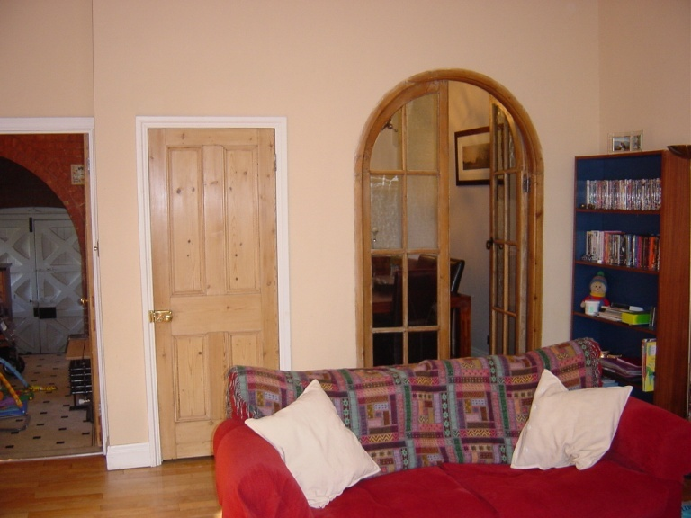
The Dining Room!
The primary staircase is in a tower to the rear of the property.
The presence of a second internal staircase stole a significant amount of dining room space.
Kitchen Door
p.s. the secondary staircase did not comply with local build regulations!
Dining Room
Door to secondary Staircase

Slide 24
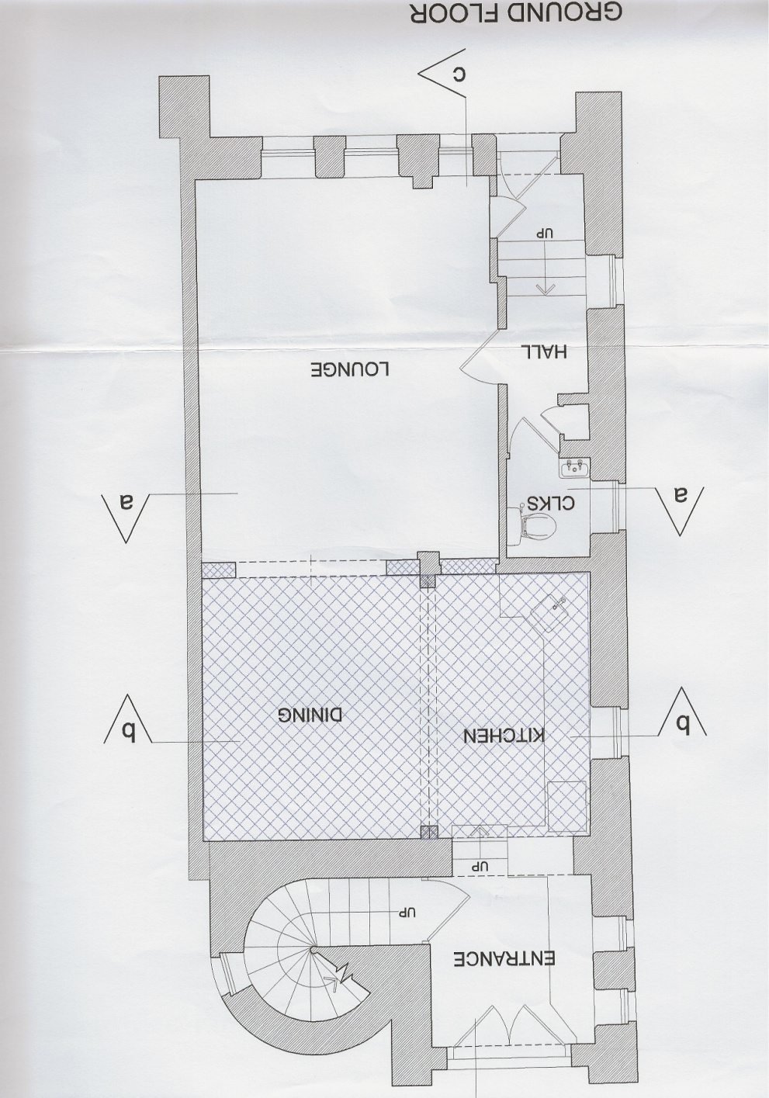
The Meta Solution
The meta-solution was to:
Remove the second staircase
Remove the wall between the dining room and kitchen to create one space
A desirable emergent property was that the removal of the staircase also allowed what was a small bedroom to be made into a good size bedroom

Slide 25
The New Problem – New Approach
To design a new kitchen/dining room solution
The previous approach – “solutioneering” failed!
The stakeholder environment was appropriate to adopt a “systems approach”
Elicit Stakeholder Requirements
Analyse Stakeholder Requirements/ Develop Systems Requirements
Generate System Concepts
Analyse System Concepts and select Concept
Detailed design/optimisation and build

Slide 26
Kitchen Stakeholder Map
Further Rqmts
Family
Design Solutions
uses
Kitchen Rqmts
Designers
Designs
Kitchen
Builders
Plans
Regulators
Permission
Builds

Slide 27
Elicit Requirements
Elicitation Questions
  What do you want?
  What would be your ideal kitchen?
  What do you like about the current kitchen?
  What don’t you like about the current kitchen?
  What do you want to do in the kitchen?
Approach
  Simple interview

Slide 28
Captured Requirements
What do you want?
  Plenty of storage
  Lots of work surface area
  Space around dining table
  Somewhere comfortable to have a chat
  Stand alone big fridge
  Easy to move around – open space
  When used as a dining area it does not feel like a kitchen
  Distinct areas for distinct tasks
  Dishwasher near crockery
  Downstairs area utility not kitchen
  More personal touches (from Sheran)
  Better organised
  Contempary style
  Plain walls
  Smaller dining table but extendable
  Work at kitchen counter discretely when people are eating
  Heart of the house
  Easy to use
  Easy to clean
  Looks spectacular – stunning want to be in it
  Fresh modern but retains and uses character of building
  Retains existing cupboards where possible
  Warm and appealing
  Easy for 2 people to use simultaneously (food vs drink prep)
  Functional and intuitive
  Long lasting durable and robust
  Energy efficient
What would be you ideal kitchen?
  Lots of space
  Room for 2/3 people to work without getting in each others way
  Cosy sometimes
  Homely but not old fashioned
  Light in daytime
  Comfortable
What do like about the current kitchen?
  Current cupboard design
  Granite work-surfaces
  General style
  Light floor
  3 pendants +secondary lighting
  Cooker hood
  Corner cupboard
What don’t you like about the current kitchen?
  Not enough cupboard space
  Plates piled on plates
  Not enough space
  Hard for 2 to work
  Kettle
  2 fridges
  Freezer too small
  Difficult to clean
  Not functional

Slide 29
Functionality?
What do you want to do in the kitchen?
  Cook food/meals
  Relax
  Chat
  Help Leila with her homework
  Do craftwork/painting with Leila
  Eat food
  Entertain guests
  Prepare food/meals
  Store food
  Store utensils/equipment/crockery
  Listen to music/radio
  Prepare drinks – tea coffee, cocktails, juice
  Store cookery books
Not a full set of functionality! Use Viewpoint Analysis to determine functionality

Slide 30
Kitchen
Wash eating-cooking
Utensils
Sharpen Knives
Install Kitchen
Clean Kitchen
Operate Kitchen
Fix Failures
Decorate Kitchen
Dry eating-cooking
Utensils
Maintain Cookware
Dispose Waste
Deliver Meal
Use Kitchen
Manage Environment
Store Items
Maintain Cookware
Store cook utensils
Store pans
Prepare Food
Prepare Drink
Manage Meal
Cook Food
Heat/Boil water
Store recipes
Store Bakeware
Heat Kitchen
Store foil/ cling film
Dispose compostable items
Liquidise Food
Prepare Cold drink
Set table
Bake/roast Food
Access Internet
Store cleaning products
Store Knives
Cool Kitchen
Store cutting boards
Mix/Blend ingredients
Prepare
Hot drink
Serve Food
Fry Food
Paint/draw
pictures
Store storage
Store utensils
Dispose Non compostable items
Vary light intensity
Store cooking items
Cool food
Make ice
Seat people
Boil/steam Food
Complete homework
Store perishable ingredients
Store Veg
Dispose Waste packaging
Eat food
Grill Food
Extract fumes
Store table linen
Store meat
Weigh ingredients
Chop/slice Food
Talk
Store cooked food
Store diary
Dispose recyclable packaging
Clear table
Warm/re-heat Food
Display
items
Store Food Items
Store non perishable ingredients
Store Fruit
Prepare Ingredients
Peel Food
Listen Music/
Radio
Light cooking
area
Store cutlery
Store Tins
Wash Food
Store Eating Items
Read books/
paper
Light Meal Preparation
area
Store eating crockery
Store Jars
Store Medicines
Store serving crockery
Store spices/herbs
Viewpoint Analysis of Kitchen Functionality
Socialise
Light Drink
preparation
area
Store Ironing items
Store Cereals
Maintain House Diary
Store drink crockery
Store oils
Display important items
Store Footwear
Store drinking items
Store glassware
Store Sauces

Slide 31
Non-Functional Performance Requirements
Store Pans
Width 92cm
Depth 45cm
Height 25cm
Store Items
Store cook utensils
Store pans
Store recipes
Store Bakeware
Store foil/ cling film
Store cleaning products
Store Knives
Store cutting boards
Store storage
Store utensils
Store cooking items
Store perishable ingredients
Store Veg
Store table linen
Store meat
Store cooked food
Store diary
Store Food Items
Store non perishable ingredients
Store Fruit
Store Eating Items
Store cutlery
Store Tins
Store eating crockery
Store Jars
Store Medicines
Store serving crockery
Store spices/herbs
Store Ironing items
Store Cereals
Store drink crockery
Store oils
Store drinking items
Store glassware
Store Sauces

Slide 32
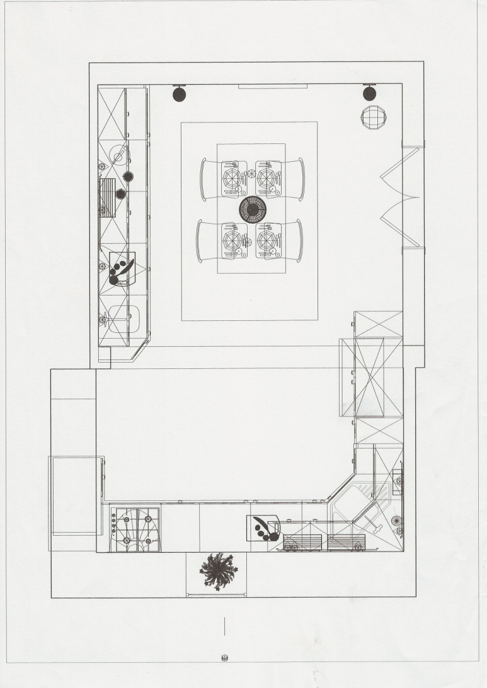
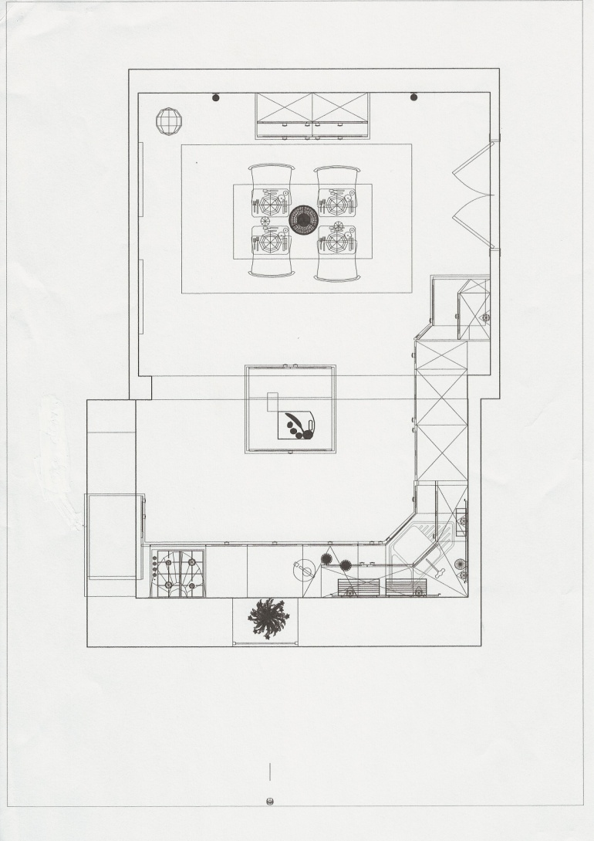
Concept Designs
Concept 1
Concept 2

Slide 33
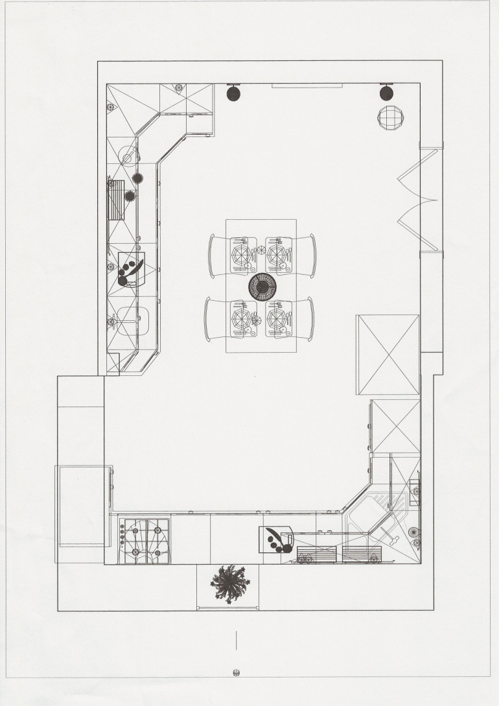
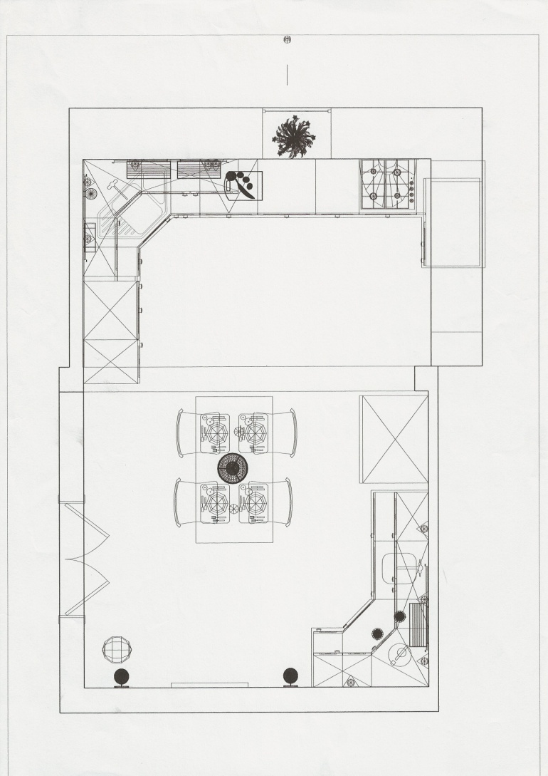
Concept Designs
Concept 3
Concept 4

Slide 34
Context Diagram
REFUSE COLLECTION
HOUSE
SERVICES
RECYCLABLE WASTE
HOT WATER
COLD WATER
GAS
NON-RECYCLABLE WASTE
Operate Kitchen
OR: To prepare and cook foodstuff
ELECTRICITY
WASTE WATER
HOT WATER CENTRAL HEATING SYSTEM
HEATING HOT WATER
PURCHASED
FOODSTUFFS
SHOPPING LIST
FOOD
SUPPLIERS
USER

Slide 35
Diagram 0
PURCAHSED
FOOD STUFF
SHOPPING LIST
RECYCLABLE
PACKAGIND
MANAGE FOOD ITEMS
2
WASTE FOOD
WASTE WATER
ELECTRICITY
HOT/COLD WATER
MANAGE WASTE
4
MANAGE UTENSILES
6
INGREDIENTS
UNRECYCABLE
WASTE
COOKING UTENSILES
PREPARE & COOK MEALS
3
WASTE PREP
STUFF
EATING
EQUIPMENT
MANAGE EATING EQUIPM’T
1
MEALS
PREPARE DRINKS
7
DRINK & FOOD WASTE
DIRTY ITEMS
DRINK
COMPONENTS
CONSUME ITEMS
5
DRINK
DRINKING
EQUIPM’T
CLEAN EATING EQUIP
MANAGE DRINK ITEMS
8
CLEAN COOKING UTENSILES
DIRTY
EATING ITEMS
MANAGE DRINK EQUIM’T
9
PROVIDE HEAT & LIGHT
11
CLEAN ITEMS
10
PURCAHSED
DRINK STUFF
CLEAN DRINKING
EQUIPM’T
ELECTRICITY

Slide 36
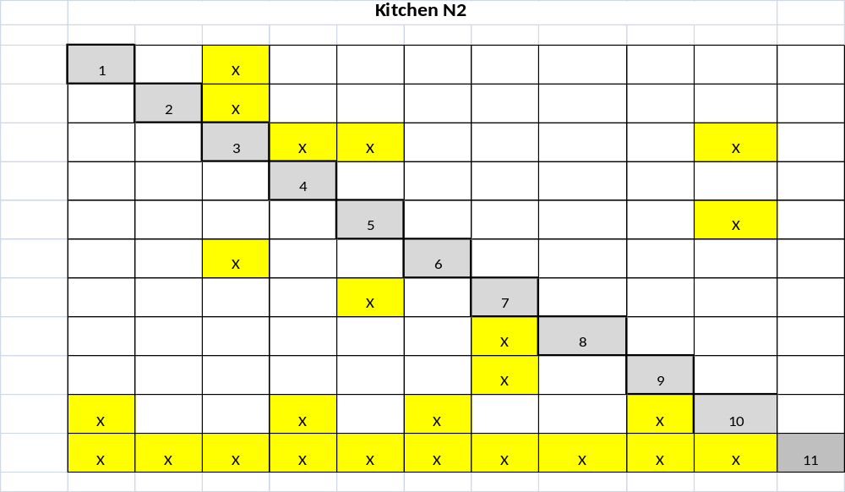
FFD N² Analysis

Slide 37
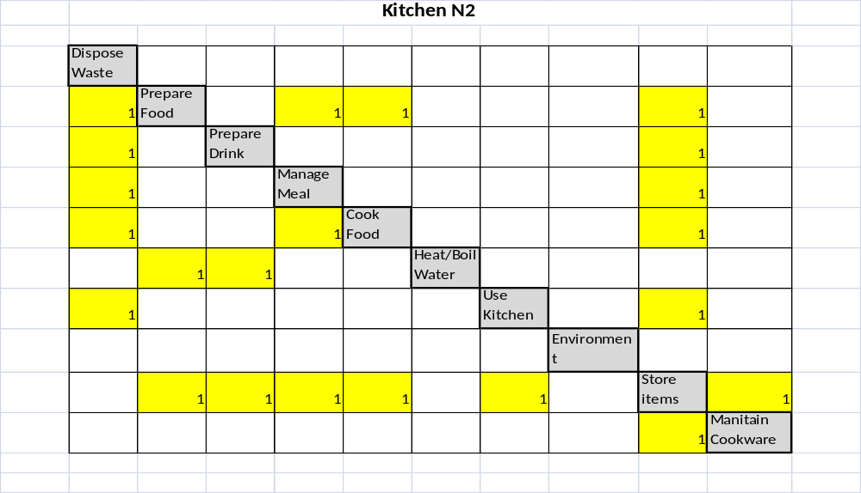
VPA N² Analysis

Slide 38
Non-Functional Performance Requirements
Store Pans
Width 92cm
Depth 45cm
Height 25cm
Store Items
Store cook utensils
Store pans
Store recipes
Store Bakeware
Store foil/ cling film
Store cleaning products
Store Knives
Store cutting boards
Store storage
Store utensils
Store cooking items
Store perishable ingredients
Store Veg
Store table linen
Store meat
Store cooked food
Store diary
Store Food Items
Store non perishable ingredients
Store Fruit
Store Eating Items
Store cutlery
Store Tins
The STORE ITEMS NFPs helped in selecting the best concept
Store eating crockery
Store Jars
Store Medicines
Store serving crockery
Store spices/herbs
Store Ironing items
Store Cereals
Store drink crockery
Store oils
Store drinking items
Store glassware
Store Sauces

Slide 39
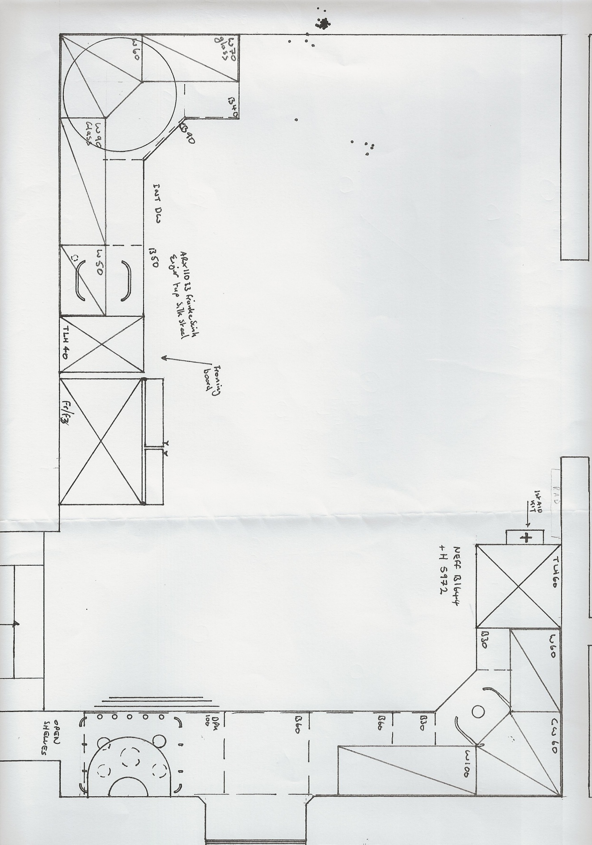
Final Concept

Slide 40
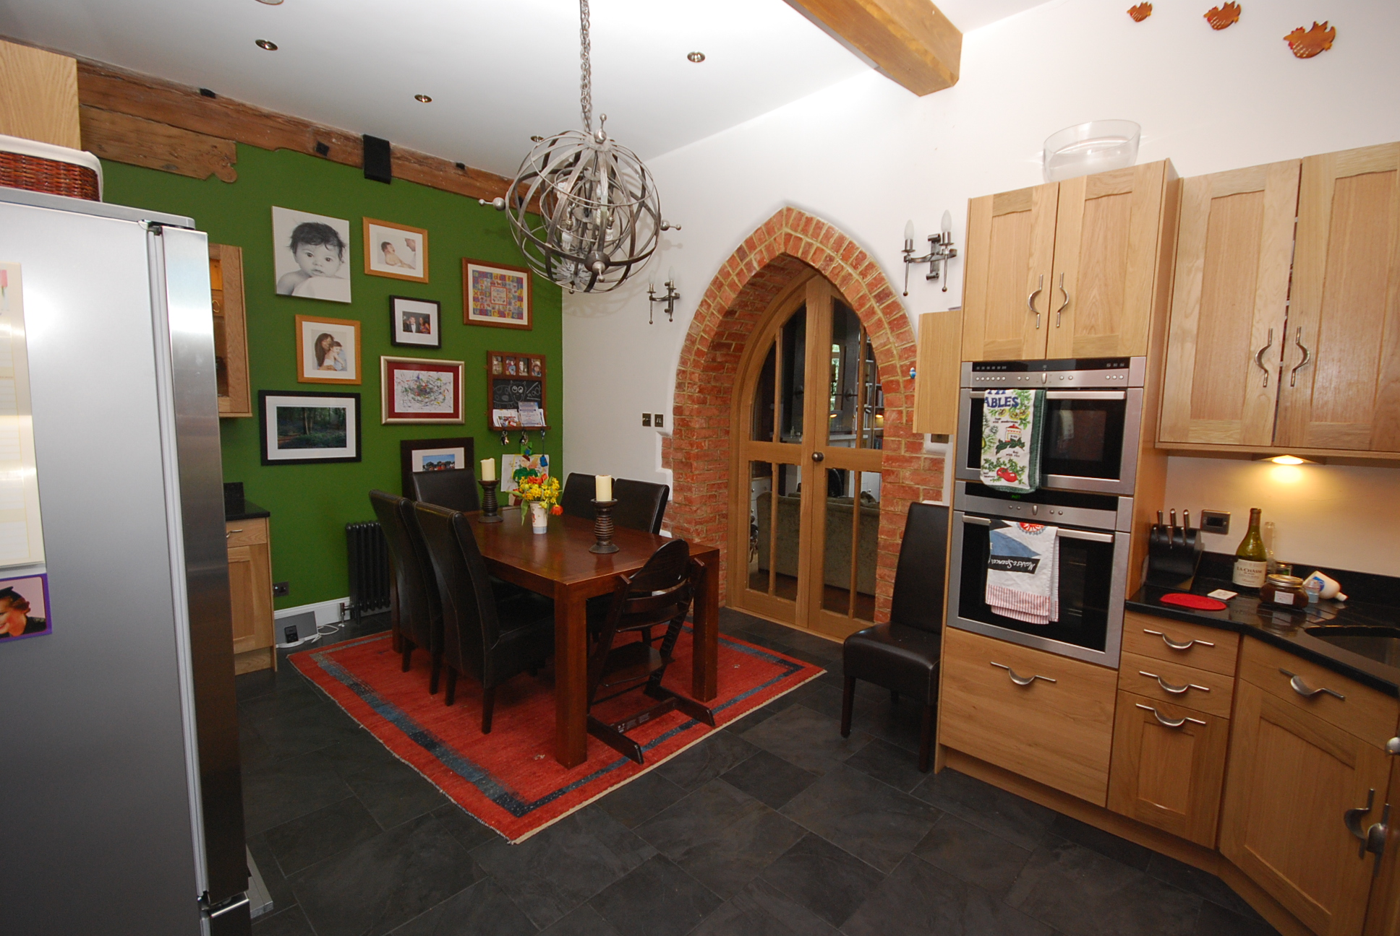

Slide 41
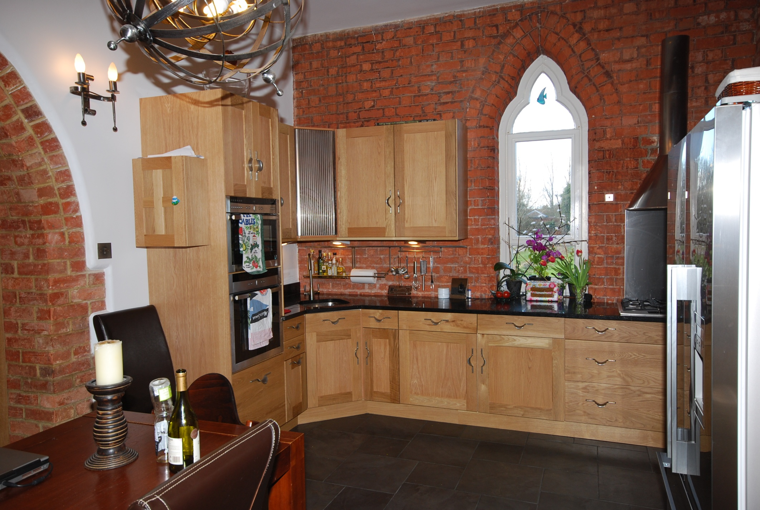

Slide 42


Validation

Slide 43
Feedback from review exercise
Is the “Systems” approach taught on this course useful / valuable?
If Yes
  Who else needs to know?
  What are blockers / opportunities to using?
  What follow-up / support do you need (back in work place)?
  What needs to be done next to exploit it –
    At a personal level?
    At an organisation level?
  If no – Why Not?
How can we improve the training?
Notes:
Can you please take a bit of time to make some notes concerning that above and feed them back to me before leaving.

Slide 44
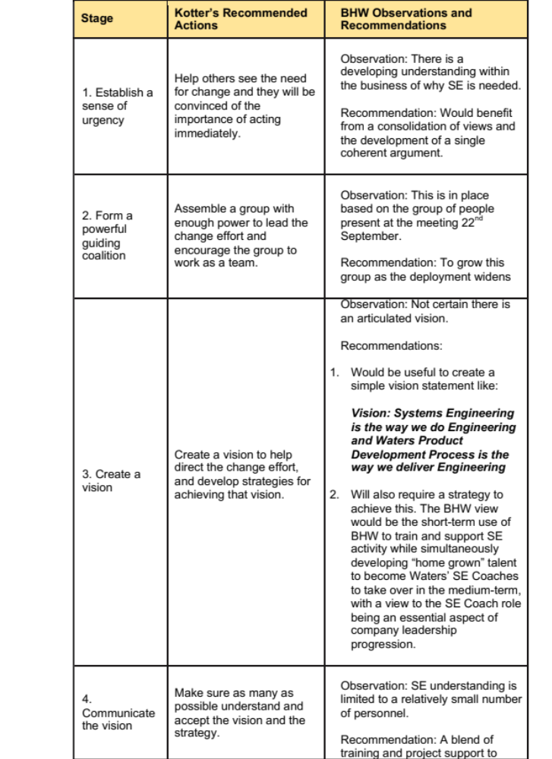

Slide 45
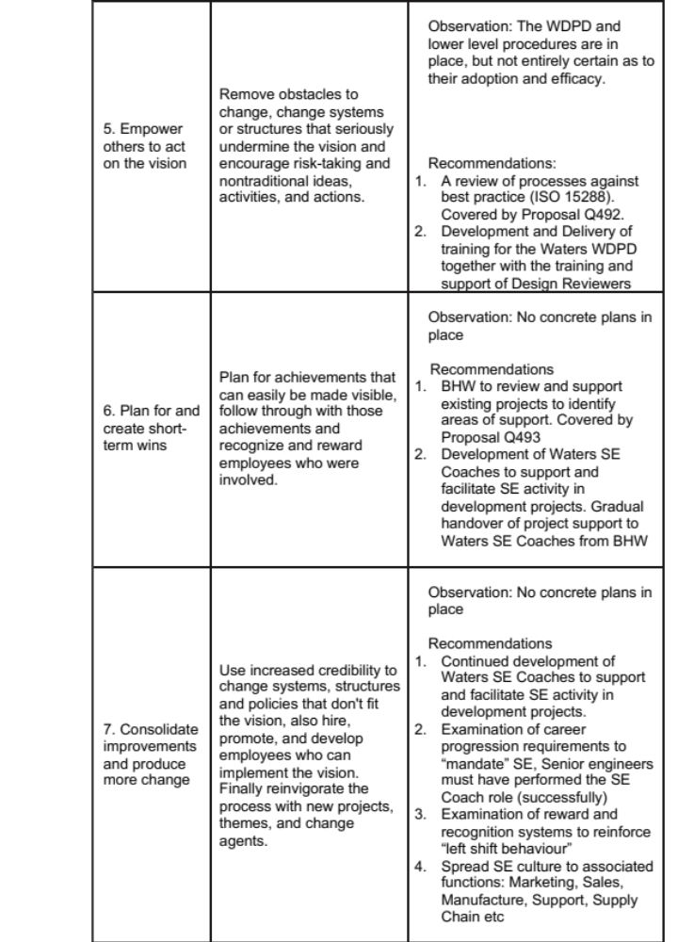

Slide 46
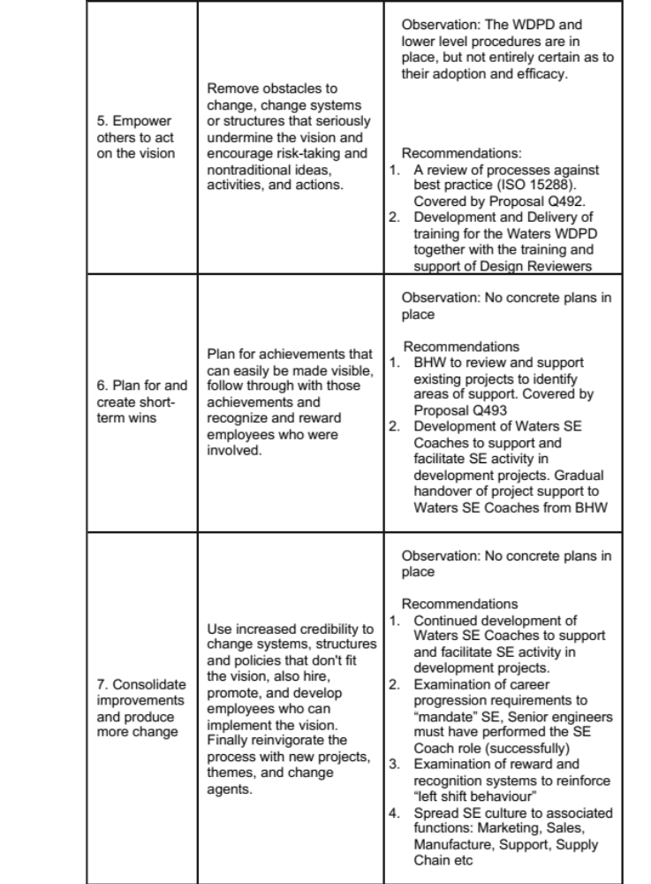

Slide 47
Flogging a Dead Horse
The tribal wisdom of the Dakota Indians, passed on from generation to generation, says that when you discover that you are riding a dead horse, the best strategy is to dismount.
In modern industry,however, a whole new range of far more advanced strategies are often employed, such as: -
Appoint a committee to study the horse
Determine whether the horse or the rider is to blame for the lack of performance
Doing a productivity study to see if lighter riders would improve the dead horse’s performance
Arrange a visit to other countries to see how they ride Dead Horse’s
Provide additional funding and/or training to increase the dead horse’s performance
Re-writing the expected performance requirements for all horse’s Lowering the standards so that dead horses can be included
Don’t flog a dead horse apply Systems Engineering

