Slide 1

The Fundamentals of Systems Engineering
Day 1

Slide 2
% Recall
100%
75%
50%
25%
0%
F L O R A
1 day 1 week 1 month 6 months 1 year

Slide 3
% Recall
100%
75%
50%
25%
0%
F L O R A
First & Last
1 day 1 week 1 month 6 months 1 year

Slide 4
% Recall
100%
75%
50%
25%
0%
F L O R A
Outstanding
1 day 1 week 1 month 6 months 1 year

Slide 5
% Recall
100%
75%
50%
25%
0%
F L O R A
Application
1 day 1 week 1 month 6 months 1 year

Slide 6
% Recall
100%
75%
50%
25%
0%
F L O R A
Review
1 day 1 week 1 month 6 months 1 year

Slide 7
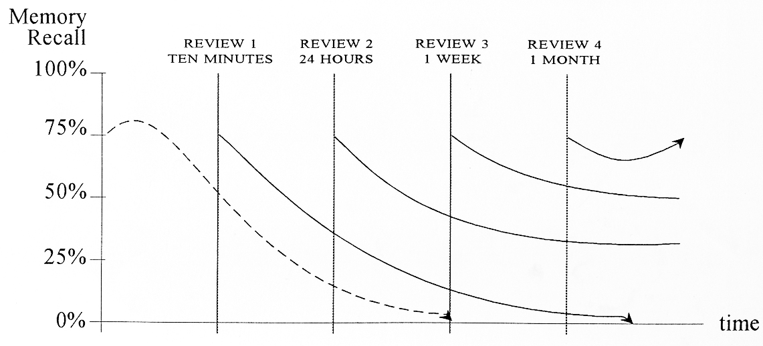
Good Bad News
Tony Buzan – Systems Thinker and creator of the “Mind Map” shows how REVIEW significantly impacts our ability to recall

Slide 8
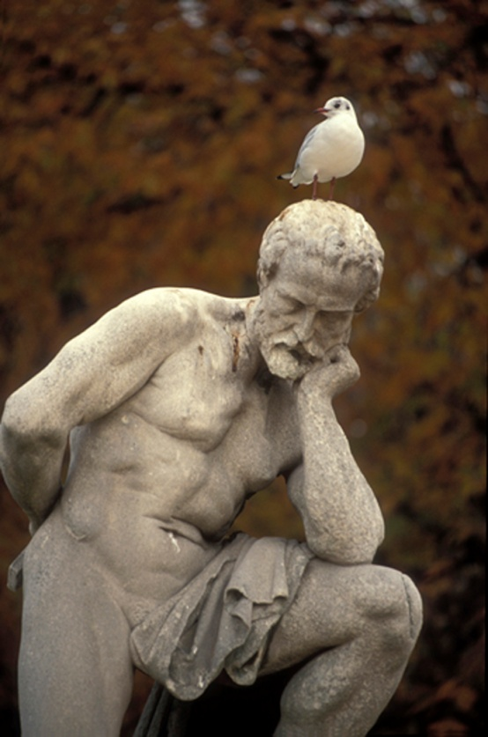
Review and Reflect
Kolb Learning Cycle
In your teams
  Identify what you consider to be the 4 key learning points-concepts from yesterday
    10 minutes
  Be prepared to present one of them to the class
    12 minutes
1
Experience
4
Test
2
Review & Reflection
3
Generalise

Slide 9
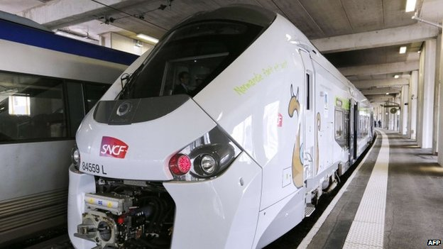
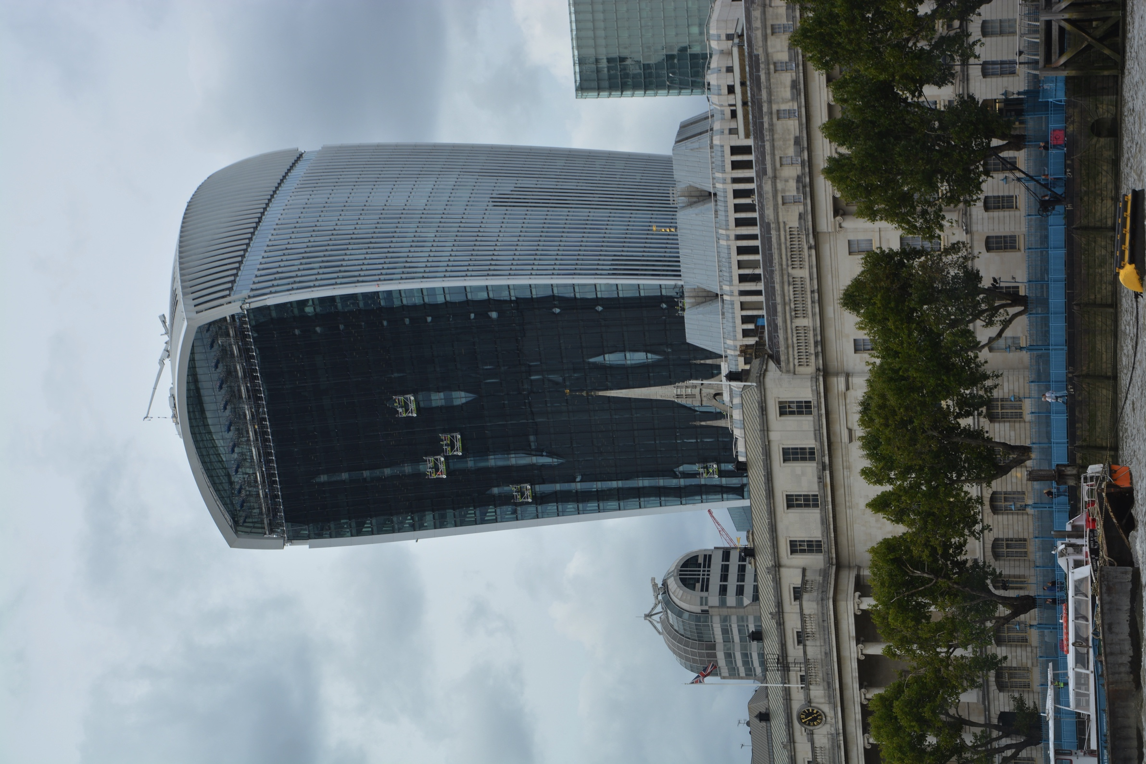
A Few Problems

Slide 10
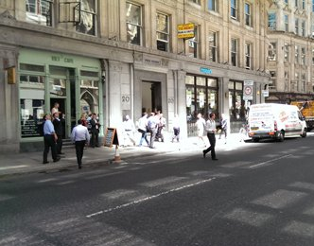
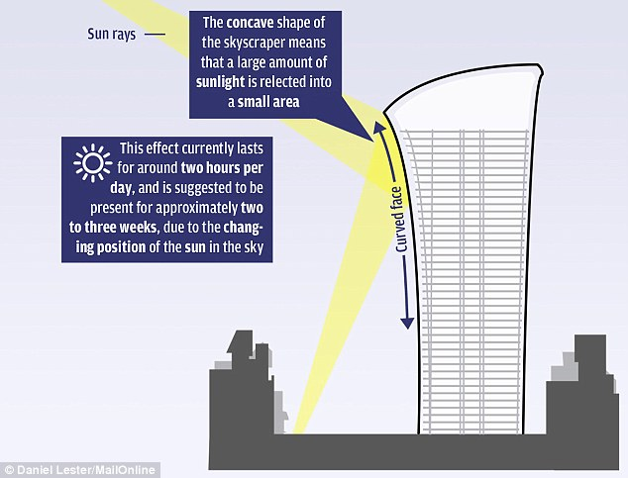

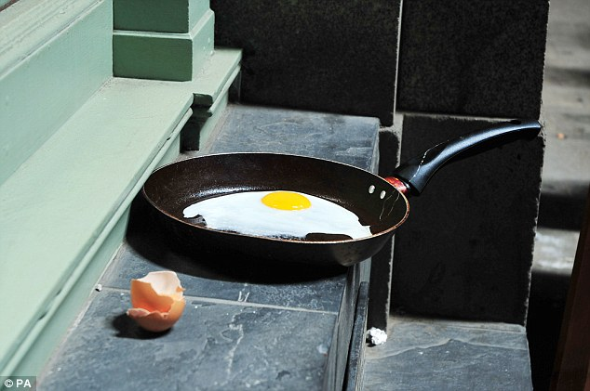

The fryscraper

Slide 11
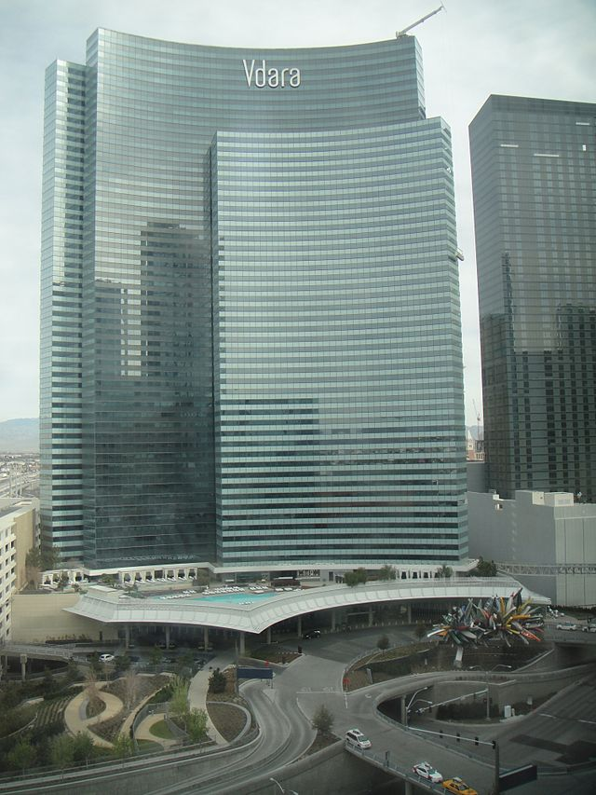
History
Vdara Hotel Las Vegas
Designed by Rafael Vinoly
The building's reflective surface and concave design can act as a parabolic
20 Fenchurch Street designed by Rafael Vinoly and cost over £200 million
In an interview with The Guardian, Viñoly said while he conceded that there had been "a lot of mistakes" with the building, he agreed with the building’s developers that the sun was too high in the sky on that particular day. "[I] didn't realise it was going to be so hot," he said, suggesting that global warming was at fault. "When I first came to London years ago, it wasn't like this ... Now you have all these sunny days
reflector to create a phenomenon in which the reflected rays of the sun can create dangerously hot conditions at particular points on the pool deck. Employees have called the phenomenon the "Vdara death ray"; the management has described it as a "solar convergence"

Slide 12
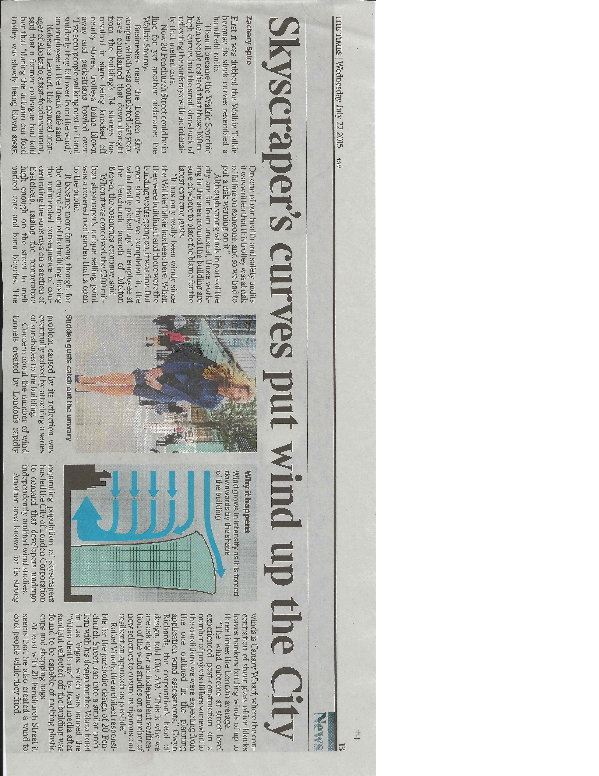
And there’s more

Slide 13
A Few Problems
In all these examples the issues were:
Discovered late on: - they emerged
Expensive: - because they were discovered late
Avoidable:

Slide 14
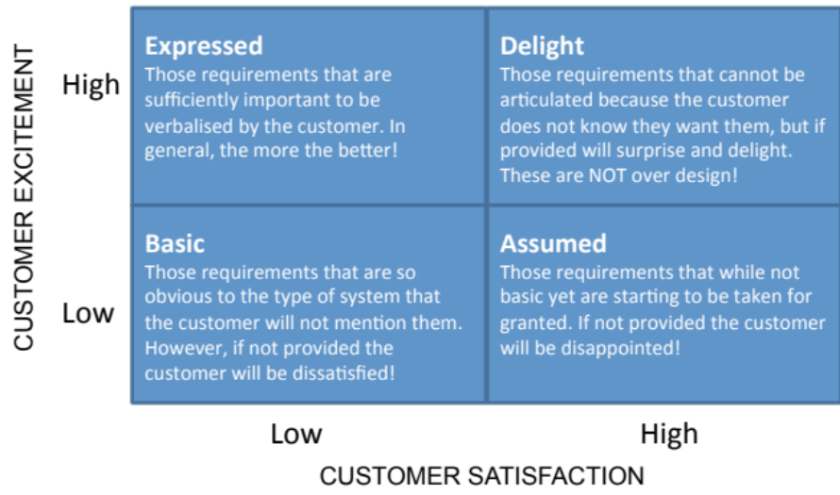
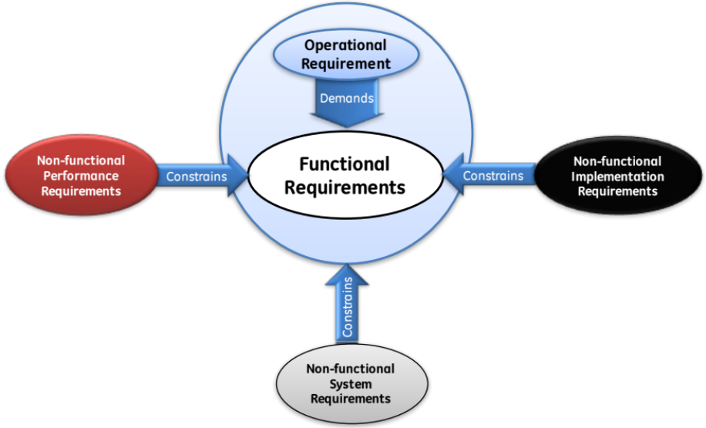
Two Models of Requirements
Kano Requirements Model
Customer facing
Holistic Requirements Model
System facing
Both represent a complete model of requirements

Slide 15


















Process and Tools
Gather Requirements
Analyse and Validate Requirements
Specify
Requirements
The Business Requirements provide the rationale and overall business constraints for a system development project
Determine the Emergent Functionality
Stakeholder Map
Flow Sensitivity Analysis
The System Requirements defines the measurable design requirements for the system
Determine system stakeholders and select key ones for requirements elicitation
Identifies causal paths for potential system sensitivities
Functional Failure Mode and Effect Analysis
Quality Function Deployment 1
Captures the potential functional failure modes, effects and causes to identify remedies ab initio
Cross checks requirements for consistency and completeness
Verification Compliance Matrix
Affinity Diagram
Use Case
Determine Validation and Verification methods for each requirement and specify V& V Requirements
Elicit and capture key stakeholder requirements
Captures how a user expects to interact with a system
Determine the necessary generic System Functionality
Tree Diagram/Analytic Hierarchy Process
Systemic Textual Analysis
Viewpoint/Functional Analysis
Function Flow Diagram
Organize and prioritise key stakeholder requirements
Analyses expressed requirements into their atomic form to identify and clarify missing and ambiguous requirements
Generates and organizes system generic functionality necessary to achieve the Operational Requirement
Captures and shows how the component functionality of a system must cooperate to deliver the Operational Requirement
Requirements Database
The User Requirements defines the expressed requirements of a particular stakeholder or stakeholders
Need Mean Analysis
Identifies and explores system solutions at different levels to determine System Meta-Solution

