Slide 2


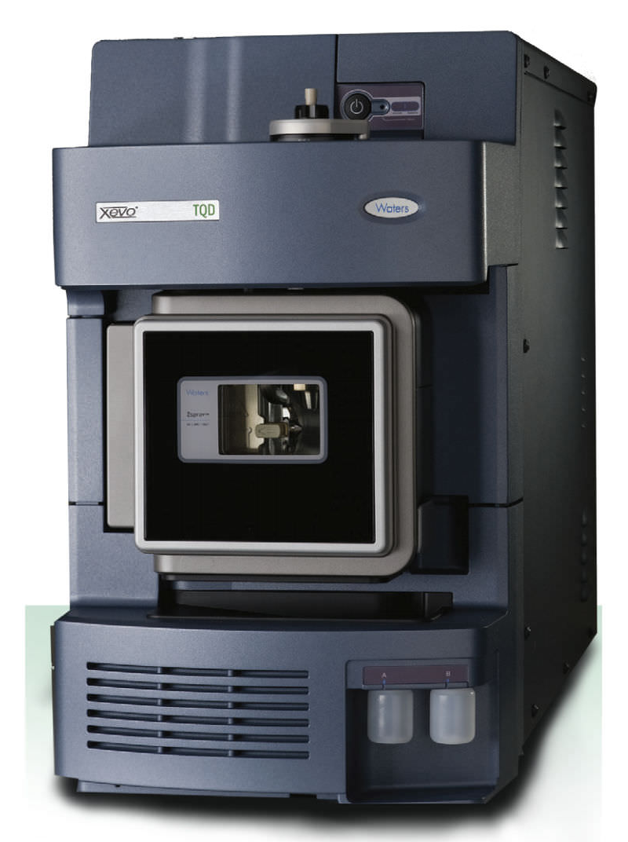
In Simple Terms – Systems Engineering is about:
I WANT
turning into
Customer/User Requirements
WOW!
It’s about design
The Solution

Slide 3
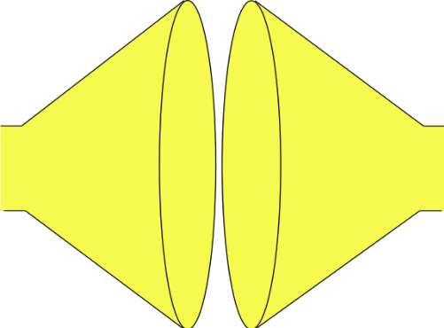
Systems Engineering uses a Systems Approach to System Design
Plan
Tailor the process, select the tools and determine the best checking strategy
Search and evaluate the solutions to determine and select the “best” solution
(Convergent Thinking)
Do
Do
Do
MAKE THE SYSTEM TO THE DESIGN
GENERATE SOLUTION OPTIONS AND SELECT
SYSTEM PROBLEM
UNDERSTAND
PROBLEM
solution
solution
“best”
solution
Built System
Understand the problem in terms of Purpose and Context
solution
Stakeholder needs and expectations
solution
Check (& Act)
Identify and document all possible solutions to the problem (Divergent Thinking)
Confirm the understanding of the problem reflects the stakeholder’s needs and expectations
Check (& Act)
Confirm that the selected solution solves the stakeholders’ problem
Check (& Act)
Confirm that the built System solves the stakeholders’ problem

Slide 4
The first step:
Understand the problem

Slide 5
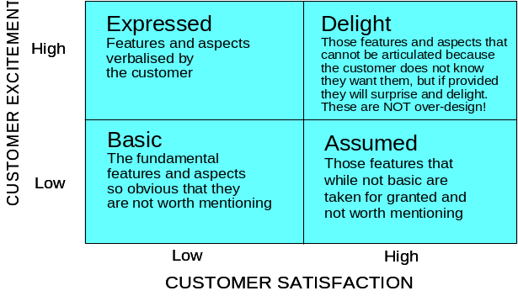
I WANT
are just the
The customer requirements are never complete, consistent, correct or clear
We have to find the unspoken requirements. But how?
The approach has to be one of divide and rule. But what is the best way to divide?
WOW!
The complexity of the problem and the likely complexity of the solution means it is too big to consider the whole solution

Slide 6
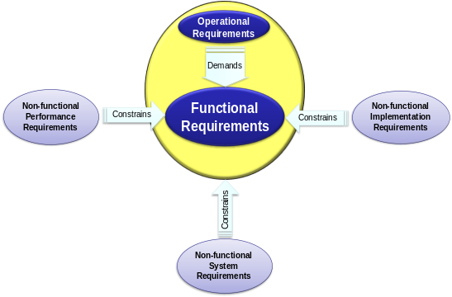
I WANT
are just the
Because
F₂
F₃
FUNCTIONALITY
F₁
F₄
WOW!
HOW WELL?

Slide 7
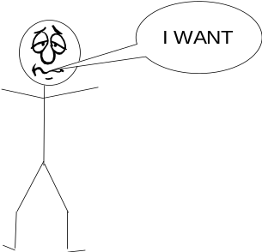


The Systems Approach to System Design
The bridge between requirements and the solution is the functionality (purpose)
FUNCTIONALITY
Requirements
-Land
Solution-Land
Functionality helps us uncover the unspoken requirements
Functionality is invariant and provides a consistent basis for dividing and ruling

Slide 8
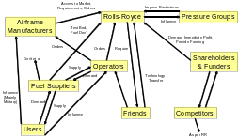
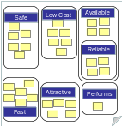

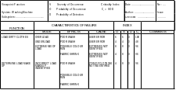
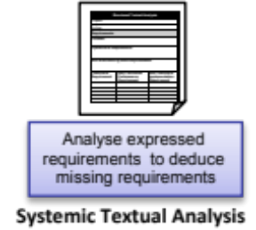
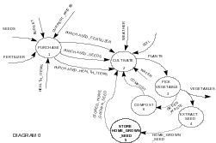
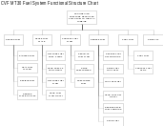

I WANT
are just the
Assess the functional sensitivity
and potential functional failure
modes to identify potential
emergent functionality and risk
Sensitivity & Failure Analysis
Stakeholder Map
Identify and group stakeholders
Affinity Diagram
Via interviews and focus groups use Affinity Diagram to Elicit, capture and structure expressed requirements
Needs Means Analysis
Assess potential meta-solutions to stakeholder needs
Determine system
functionality (Y = f)
and structure
Develop a model of the planned system to identify logical interfaces and functional dependencies
Determine Meta-Solution to scope system Functionality
Viewpoint Analysis
Functional Modelling
F₂
F₃
F₄
F₅
F₆
F₇
F₈
F₉
…
F_{N}
FUNCTIONALITY
F₁
WOW!

Slide 9
I WANT
are just the
Assess the functional sensitivity
and potential functional failure
modes to identify potential
emergent functionality and risk
Sensitivity & Failure Analysis
Stakeholder Map
Identify and group stakeholders
Affinity Diagram
Via interviews and focus groups use Affinity Diagram to Elicit, capture and structure expressed requirements
Needs Means Analysis
Assess potential meta-solutions to stakeholder needs
Determine system
functionality (Y = f)
and structure
Develop a model of the planned system to identify logical interfaces and functional dependencies
Determine Meta-Solution to scope system Functionality
Viewpoint Analysis
Functional Modelling
F₂
F₃
F₄
F₅
F₆
F₇
F₈
F₉
…
F_{N}
FUNCTIONALITY
F₁
WOW!
BUT is it complete?

Slide 10
QFD 1 To Verify and Validate
HOW
F₁
F₂
F₃
F₄
F₅
F₆
F₇
WHAT
USER RQMT₁ (NFS)
USER RQMT₂ (NFS)
USER RQMT₃ (NFS)
RELATIONSHIPS
USER RQMT₄ (NFS)
USER RQMT₅ (NFS)
USER RQMT₆ (NFS)
HOW MUCH

Slide 11
QFD 1 To verify and Validate
HOW
F₁
F₂
F₃
F₄
F₅
F₆
F₇
WHAT
Blank Row
Missing a Function or User Requirement Wrong!
USER RQMT₁ (NFS)
USER RQMT₂ (NFS)
USER RQMT₃ (NFS)
RELATIONSHIPS
USER RQMT₄ (NFS)
USER RQMT₅ (NFS)
USER RQMT₆ (NFS)
HOW MUCH

Slide 12
QFD 1 To verify and Validate
HOW
F₁
F₂
F₃
F₄
F₅
F₆
F₇
WHAT
Blank Row
Missing a Function or User Requirement Wrong!
USER RQMT₁ (NFS)
USER RQMT₂ (NFS)
USER RQMT₃ (NFS)
RELATIONSHIPS
USER RQMT₄ (NFS)
USER RQMT₅ (NFS)
USER RQMT₆ (NFS)
Blank Column
Unecesaary Function or User Requirement Wrong!
HOW MUCH

Slide 13
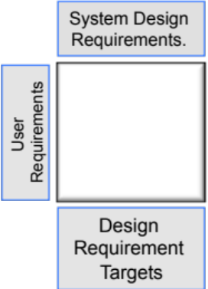
I WANT
are just the
Assess the functional sensitivity
and potential functional failure
modes to identify potential
emergent functionality and risk
Sensitivity & Failure Analysis
Stakeholder Map
Identify and group stakeholders
Affinity Diagram
Via interviews and focus groups use Affinity Diagram to Elicit, capture and structure expressed requirements
Needs Means Analysis
Assess potential meta-solutions to stakeholder needs
Determine system
functionality (Y = f)
and structure
Develop a model of the planned system to identify logical interfaces and functional dependencies
Determine Meta-Solution to scope system Functionality
Viewpoint Analysis
Functional Modelling
F₂
F₃
F₄
F₅
F₆
F₇
F₈
F₉
…
F_{N}
FUNCTIONALITY
F₁
WOW!

Slide 14
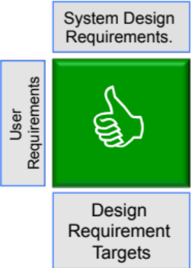
I WANT
are just the
Assess the functional sensitivity
and potential functional failure
modes to identify potential
emergent functionality and risk
Sensitivity & Failure Analysis
Stakeholder Map
Identify and group stakeholders
Affinity Diagram
Via interviews and focus groups use Affinity Diagram to Elicit, capture and structure expressed requirements
Needs Means Analysis
Assess potential meta-solutions to stakeholder needs
Determine system
functionality (Y = f)
and structure
Develop a model of the planned system to identify logical interfaces and functional dependencies
Determine Meta-Solution to scope system Functionality
Viewpoint Analysis
Functional Modelling
F₂
F₃
F₄
F₅
F₆
F₇
F₈
F₉
…
F_{N}
FUNCTIONALITY
F₁
WOW!

Slide 15
The Systems Approach to System Design
The bridge between requirements and the solution is the functionality (purpose)
FUNCTIONALITY
Requirements
-Land
Solution-Land
Functionality helps us uncover the unspoken requirements
Functionality is invariant and provides a consistent basis for dividing and ruling
Functionality helps us determine the system architecture
Functionality helps us identify and select the technological solutions

Slide 16
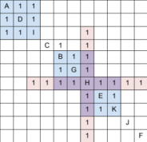
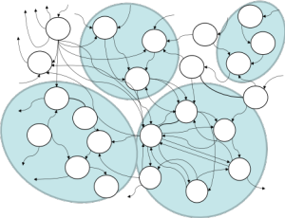

I WANT
are just the
Assess the functional sensitivity
and potential functional failure
modes to identify potential
emergent functionality and risk
Sensitivity & Failure Analysis
Stakeholder Map
Identify and group stakeholders
Affinity Diagram
Via interviews and focus groups use Affinity Diagram to Elicit, capture and structure expressed requirements
Needs Means Analysis
Assess potential meta-solutions to stakeholder needs
Determine system
functionality (Y = f)
and structure
Develop a model of the planned system to identify logical interfaces and functional dependencies
Determine Meta-Solution to scope system Functionality
Viewpoint Analysis
Functional Modelling
F₂
F₃
F₄
F₅
F₆
F₇
F₈
F₉
…
F_{N}
FUNCTIONALITY
F₁
Logical System Architecting
WOW!
Determine candidate logical
system architectures
N² Analysis
Assess degree of natural functional binding and coupling
Function
Means
Analysis
Identify means of achieving functionality and determination of whole system concept solutions

