Slide 1

This is Systems Engineering
Secondary Information Goes Here
This Session
Defines Systems Engineering and its benefits
Explains the relationship between Systems Thinking, Approach and Engineering
Introduces Systems Thinking as the foundation of Systems Engineering
Provides an overview of Systems Thinking
Introduces the basic Systems Engineering process, tools and role of people

Slide 2


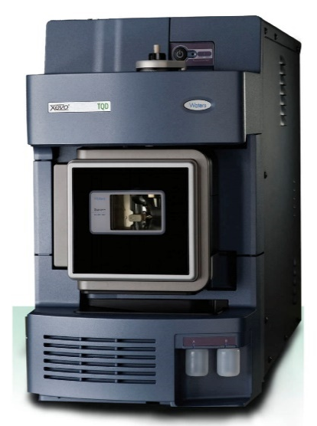
In Simple Terms – Systems Engineering is about:
I WANT
turning into
Customer/User Requirements
WOW!
It’s about design
The Solution

Slide 3
Traditional Design
When given a problem it is human nature to immediately think of solutions. We want an outline answer we can work on. This concept design solution is often based on prior experience, where previous solutions are adapted to fit the current problem or assumptions are made unconsciously about a solution.
problem
solution

Slide 4
Approaches – The Choices
Photocopying

Slide 5

Photocopying
Take an existing design (that works!) and enlarge or reduce to fit the requirements
Benefits
  Have a solution quickly
  Previous one worked so risks are considered low
Issues
  Scale laws are often to high powers (X³ or X⁴) – we assume linearity but it isn’t and undesirable behaviour occurs
  Requirements not fully understood and the “photocopied” design doesn't work – redesign and greater costs

Slide 6
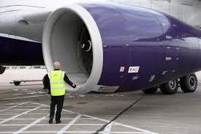

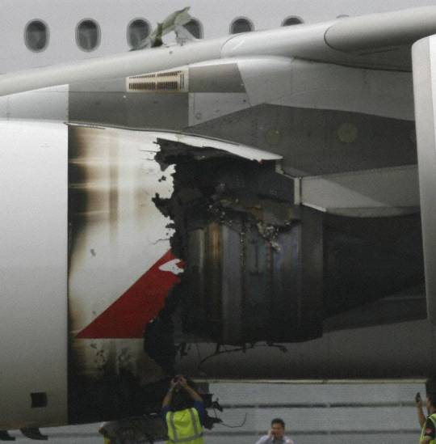

Trent 700
Fan Dia 97.4’’
Thrust 70,000lb
Trent 900
Fan Dia 116’’
Thrust 85,000lb
x1.19

Slide 7
Approaches – The Choices
Photocopying
Flower
Arranging

Slide 8

Flower Arranging
Take some nice looking components and arrange them to build a bigger thing
Benefits
  Uses known and trusted components
  Good fun
Issues
  Unexpected behaviour
  Relies on luck (can be mitigated by analysis i.e. design - analyse – redesign – analyse – re-redesign - analyse) – therefore costly

Slide 9

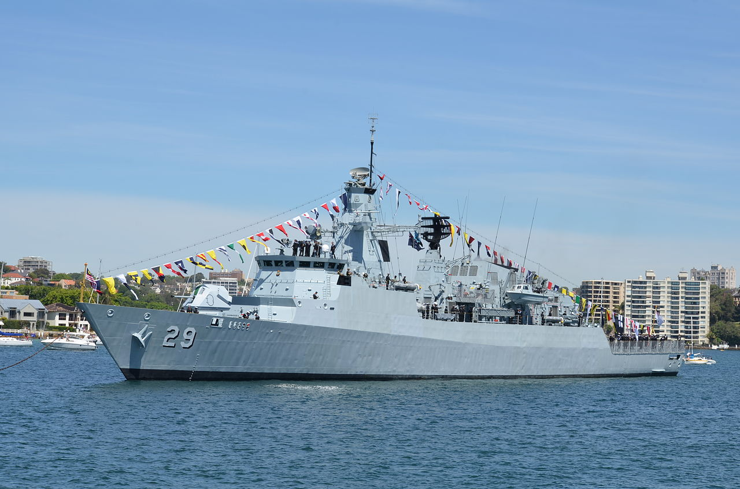

Slide 10
Approaches – The Choices
Photocopying
Flower
Arranging
Evolutionary

Slide 11

Evolution
Successive modifications to an existing design quite often involving replacing one or more sub-systems
Benefits
  Perceived as tried and tested – trustworthy
  Continuous improvement
Issues
  Improvements are incremental – limited opportunity for step change
  Shortfalls in performance due to unexpected interactions

Slide 12
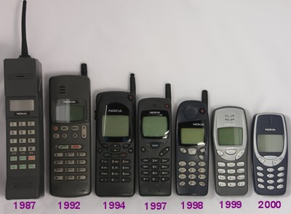
Evolutionary
2007
Sales
Size
In September 2013, Microsoft announced that it would acquire Nokia's mobile phone business

Slide 13
Approaches – The Choices
Photocopying
Pet Pony
Flower
Arranging
Evolutionary

Slide 14
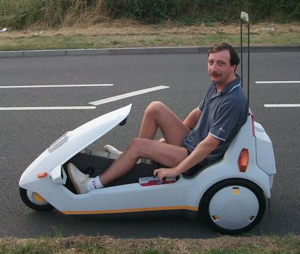
Pet Pony
A idea, usually a piece of technology, that an individual wants to use come what may
Benefits
  Might be the next “wheel”
Issues
  More logical, risk adverse approaches overridden
  Extensive late re-design or having to live with a sub-standard system
Sir Clive Sinclair was so convinced that the C5 was the future of personal transport he spent £12M of his own money (1985) – equivalent to £100m today

Slide 15

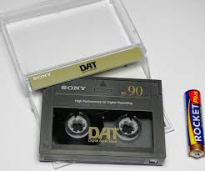
There’re many more
Notes:
Apple Newton – this first ipad! Ridiculed in the press for its expense and lack of flexibility compared to a note pad and pencil
Digital Audio Tape: never really took off like compact cassettes – even though technically it was rather good.

Slide 16
Analysis to the Rescue
When given a problem it is human nature to immediately think of solutions. We want an outline answer we can work on. This concept design solution is often based on prior experience where previous solutions are adapted to fit the current problem or assumptions are made unconsciously about a solution. It is also human nature to stop once we have found the first adequate solution and begin:
problem
solution
Engineering Analysis

Slide 17
Analysis and Engineering Design
Analysis is the core of traditional engineering design where we use engineering science to understand
Having jumped to a solution
Take apart the design
Understand the parts
Combine the understanding of the parts to understand the whole

Slide 18
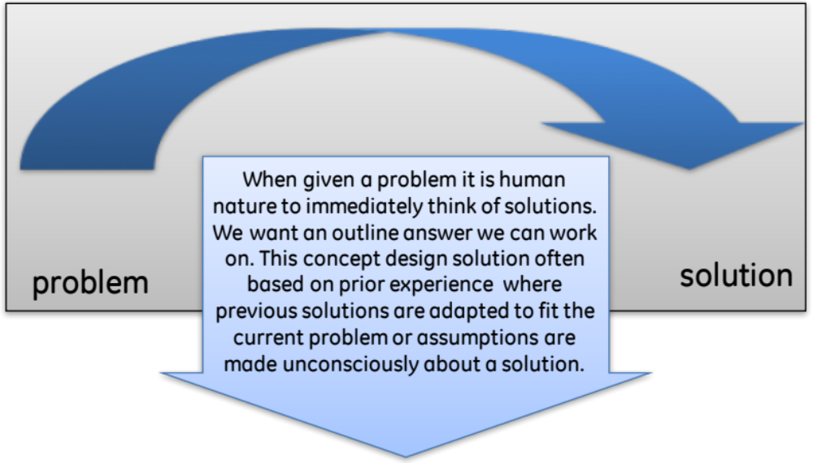
The Facts
We Believe
  Fast
  The only way
  Worked in the past
  Get there in the end
We Experience
  Redesign
  Late
  Cost overruns
  Testing
  Firefighting
  Heroes

Slide 19
Conclusion
We no longer have the time or the money to rely on traditional “solutioneering” approaches (1 in 10 chance of getting it right¹)
We need:
  to identify and fix issues early
  a through-life view – design for the life cycle
  a concurrent (Product, Manufacturing, Operation, Support, Disposal) view
  a customer focused view to deliver performance, quality and cost
We need a Systems Approach to Systems Design
¹Elm J.P and Goldenson D.R “The Business Case for Systems Engineering Study: Results of the Systems Engineering Effectiveness Survey” November 2012 SPECIAL REPORT, CMU/SEI-2012-SR-009, Carnegie Mellon University

Slide 20
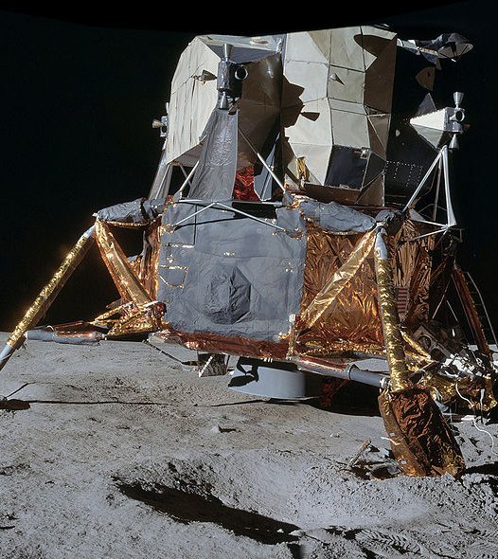
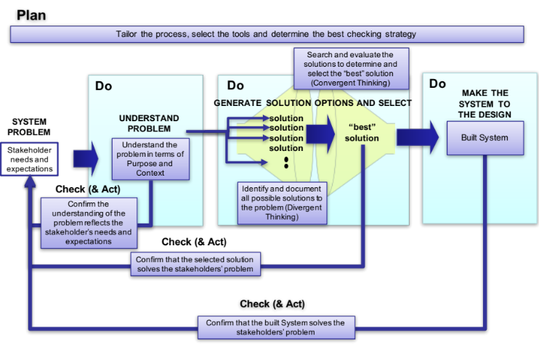
A Systems Approach to Systems Design
Rigorous process based on Systems Thinking
Benefits
  97% success rate (Carnegie Mellon University, 2012)
Issues
  Perceived to be slow – but actually faster because of low rate of avoidable re-design

Slide 21
Consequence of Solutioneering?
Form two lines standing opposite each other
Each team member should use one finger to support the paper tube from the underside
Keeping every finger in constant contact with underside of the tube, as a team, lower it to the ground
Time 10 minutes
Notes:
This exercise is described in the exercise trainer notes.

Slide 22
The “helium” tube exercise illustrates what is called
.. and is why
Systems Engineering
is absolutely essential
Emergent
Behaviour
Note: 1. Changing a person would have little effect on the behaviour of the team
2. Rhetoric will have little effect
3. Organization of the team has the biggest effect

Slide 23
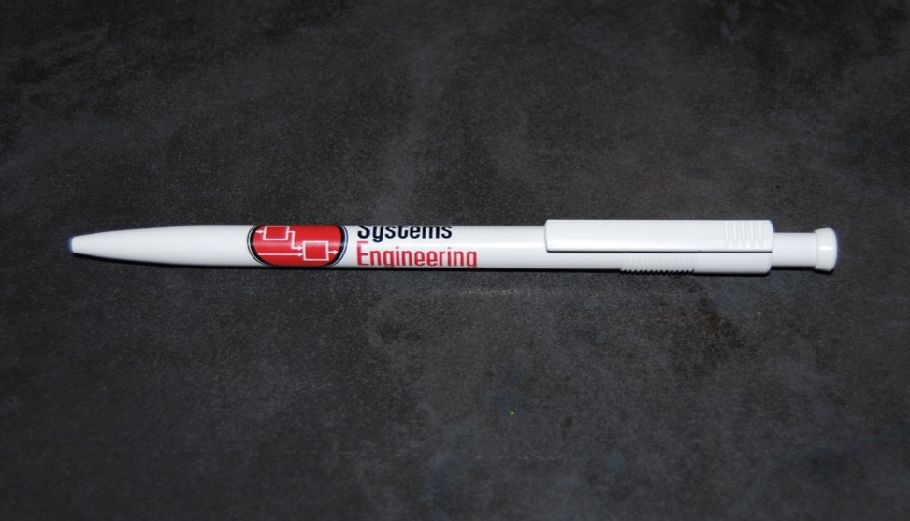
Emergence and Emergent Behaviour
The properties of the pen as a whole are not found in any of the individual components. Only when the components are assembled in the right sequence and the right place do we get the desirable emergent behaviour of being able to make marks on paper
All systems display emergent behaviour – this can be DESIRABLE and/or UNDESIRABLE!

Slide 24
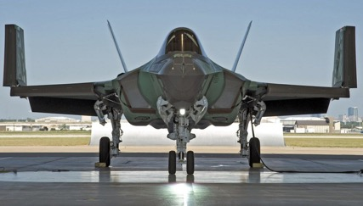

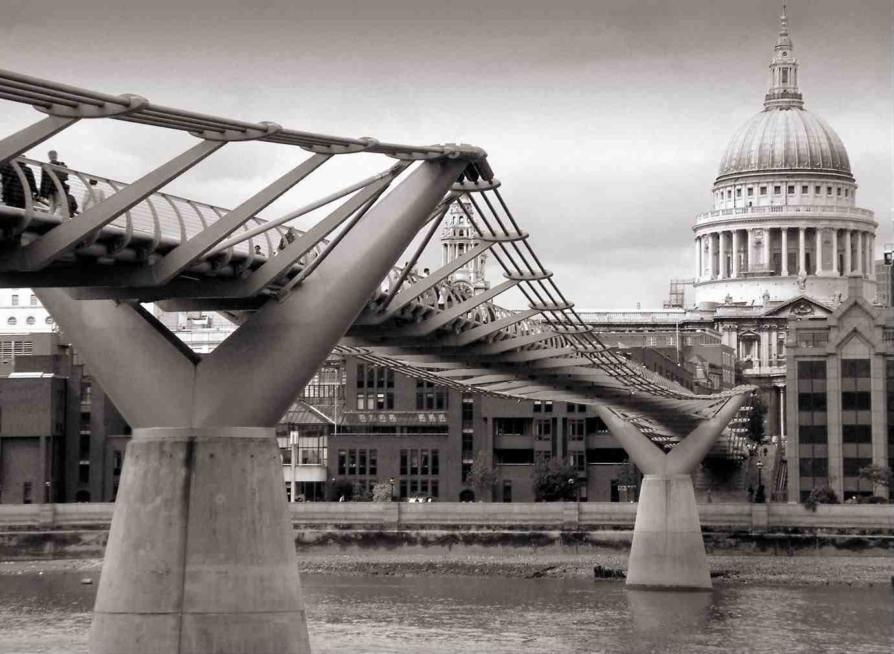
A Few Problems

Slide 25
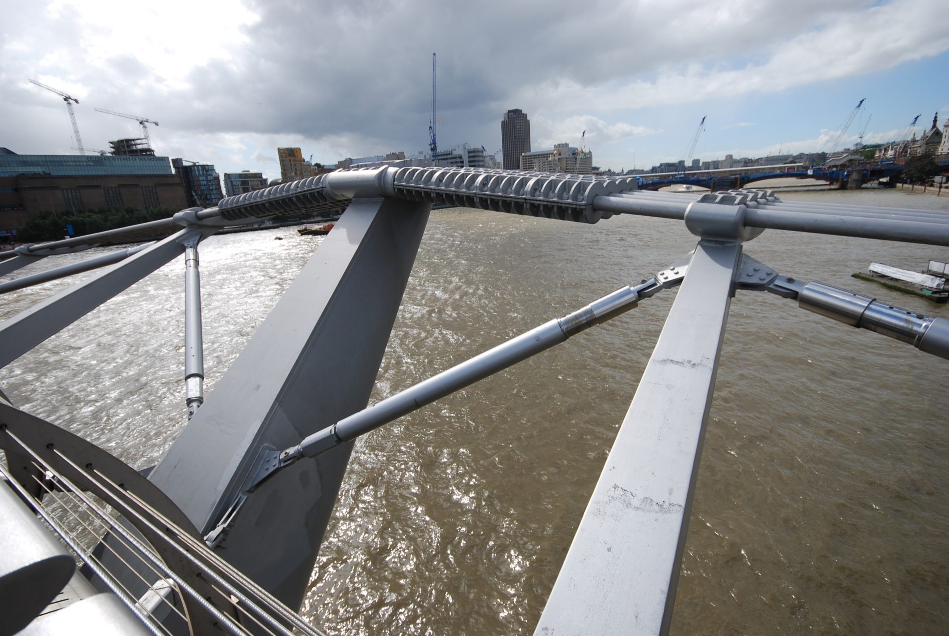

Slide 26
A Few Problems
In all these examples the issues were:
Discovered late on: - they emerged
Expensive: - because they were discovered late
Avoidable

Slide 27



Problems Happen Everywhere

Slide 28
Desirable and Undesirable Emergence
We DESIRE emergent behaviour in our products and services but we can also get UNDESIRABLE emergent behaviour
Undesirable emergent behaviour has three causes
  Variation: unexpected cliff edge performance where small variations cause a significant change in behaviour
  Sub-optimisation: unexpected low performance – the mistaken belief that the “best” system must have the “best components”
  Dynamic: unexpected time related behaviour - we assume things will carry on in the same way – they don’t
Emergent behaviour is a consequence of bringing together the components of a system. Therefore to understand and predict emergent behaviour we need to consider the WHOLE and how the components INTERACT with each other. This is obvious …….
BUT …..

Slide 29
We put our effort in the Wrong place
Cost to
Fix (£/$)
Much of the effort in Systems Engineering is expended early on.
Pre-work NOT
Re-work
Errors found late on
are caused very early on
This is where
we tend to look
This is where
we should
put our effort
Requirements
Engineering
Design
Development
Production
Customer
use
because
BUT
because
Difficult to see
and predict
Easy to see
Difficult and
costly to fix
BUT
Easy and
cheaper to fix
Source GE DFSS course

Slide 30
Why is it Difficult to See Issues Early?
When undesirable emergent behaviour appears, hindsight shows the actual cause to be “obvious”
So why did we not spot it earlier?
There are several interrelated reasons
  Complexity
  Functional Divides
  Mind set
  Project Management/Life Cycle Management
We are going to explore a couple of the reasons

Slide 31
Exercise: Complexity and Humans
You are about to be shown a series of 4 slides
Each slide presents a sentence
Your task is to count the number of occurrences of the letter “f” in each sentence
Each sentence will become longer – but you will be given pro-rata more time in which to count
Time 5 minutes
How many f’s
Slide
A
B
C
D
Count
Notes:
This exercise is described in the exercise trainer notes.

Slide 32
A
Systems Engineering is the foundation of future success.

Slide 33
B
Followers of Systems Engineering offer a lot of hope for the future prosperity of the country.

Slide 34
C
Those organizations that follow Systems Engineering rigorously reap significant benefits in terms of profitability, performance and on time delivery of
of products that both satisfy and delight their customers.

Slide 35
D
The application of Systems Engineering approaches in the design of systems, that permit sustained, reliable, full spectrum operation, in a wide range of future operating environments, has been demonstrated time after time to deliver substantial business advantage in highly competitive narrow markets by offering non-ephemeral holistic solutions of a unique countenance that totally satisfy multi-stakeholder customers.

Slide 36
A
Systems Engineering is the foundation of future success.

Slide 37
B
Followers of Systems Engineering offer a lot of hope for the future prosperity of the country.

Slide 38
C
Those organizations that follow Systems Engineering rigorously, reap significant benefits in terms
of profitability, performance and
on time delivery of
of products that both satisfy and delight their customers.

Slide 39
D
The application of Systems Engineering approaches in the design of systems, that permit sustained, reliable, full spectrum operation, in a wide range of future operating environments, has been demonstrated time after time to deliver substantial business advantage in highly competitive narrow markets by offering non-ephemeral holistic solutions of a unique countenance that totally satisfy multi-stakeholder customers.

Slide 40
The Other Mistake
C
Those organizations that follow Systems Engineering rigorously, reap significant benefits in terms of profitability, performance and on time delivery of
of products that both satisfy and delight their customers.

Slide 41
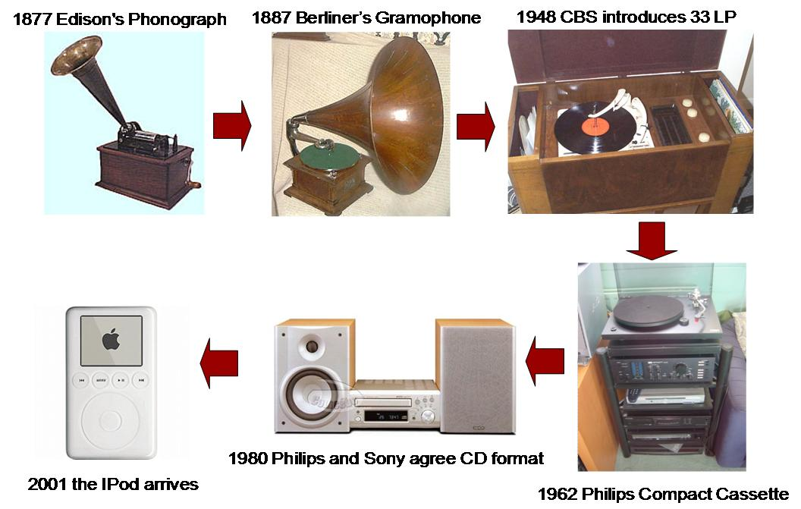
Complexity
Complexity lies at the heart of the problem because humans cannot handle complexity
In order to satisfy customer needs and expectations, organizations are designing increasingly more complex products and services
This increased complexity has resulted in problems and even failures that demonstrate symptoms of:
  Late delivery
  Cost overruns
  Performance shortfalls
Pick any product, including service based products, and as it evolved its complexity will have increased
The increased complexity increases the opportunity for an error and makes errors more difficult to find. These errors, if undetected, will result in undesirable emergent behaviour

Slide 42
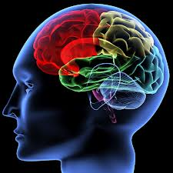
Our Brain
Pre-frontal Cortex
Miller showed that there is a processing limitation of 7 +/- 2
But we can “chunk” – grouping information together into chunks of 7+/- 2
Limbic System
Brain Stem
Notes:
George Miller who in his 1956 seminal paper "The Magical Number Seven, Plus or Minus Two: Some Limits on Our Capacity for Processing Information" did what said on the tin. In simple terms all humans have a processing limit and when faced with complexity beyond this limit we make mistakes, we start to miss things.
However, this processing limitation can be overcome by “chunking”. This is where we group thinks together to form “chunks” and as long as we stick to the 7 +/- 2 we can comprehend any level of complexity.

Slide 43
Emergence is the Future
Products and services WILL get more complex and therefore issues of undesirable emergent behaviour are going to INCREASE
Organizations no longer provide just a product or service but a cradle to grave solution comprising several interrelated and interdependent systems each of which is becoming increasingly more complex compounding the issues of emergent behaviour
Unless we do something

Slide 45


Slide 46
Mind Set
START
Source GEC
DON
’
T MESS
YES
DOES THE DAMN
NO
DOES THE DAMN
WITH IT
THING WORK?
THING WORK?
YES
NO
DID ANYBODY YOU
DID ANYBODY YOU
’
’
RE
YOU IDIOT
DID YOU MESS
RE
RESPONSIBLE FOR
WITH IT?
RESPONSIBLE FOR
WITH IT?
MESS WITH IT?
MESS WITH IT?
NO
DOES ANYBODY
YES
YOU REALLY
YES
NO
KNOW YOU MESSED
NAIL THEM
ARE AN IDIOT
NAIL THEM
WITH IT?
YES
WILL YOU CATCH
HELL ANYWAY?
YES
CAN IT BE FIXED
NO
NO
HIDE IT
BEFORE YOUR BOSS
YOU
’
RE IN IT UP
FINDS OUT?
TO YOUR NECK
DUMP IT
IN THE SKIP
IT
’
S YOUR
YES
NO
LUCKY DAY
QUIT
WILL YOU
YOU
’
RE
QUIT?
FIRED
THE END

Slide 47
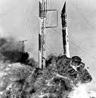
Mind Set
Mind Set plays an important role at two levels:
  Individual level - e.g. “FLY” locked-in thinking
  Organizational – e.g. “hide it”
As products, processes and services get more complex and functional divides persist, mind set is an increasingly important factor in not uncovering undesirable emergent behaviour
Quote from NASA
“The biggest advantage of not doing Systems Engineering is that failure takes us by surprise”
Unless we do something

Slide 48
Complexity, Mind Set and Emergence
Human kind has only developed two approaches to handling complexity:
    Reductionism
    Systems Thinking

Slide 49
Managing Complexity: Reductionism
Rene Descartes
  “I think Therefore I am”
Discourse on Method and the Meditations …..
  “to divide each of the difficulties under examination into as many parts as possible, and as might be necessary for its adequate solution.”
P
^{P}
^{P}
^{P}
P
P
P
P
P

Slide 50
Handling Emergence
The only known way to handle issues of emergence, caused by complexity (and the other reasons) is to view the situation (the product, process, or service) as a system and apply Systems Thinking in an organized and disciplined way … and do it early
The beauty of Systems thinking is that it provides a very powerful framework for understanding complex situations by:
  simplifying and clarifying situations to understand the key aspects
  allowing different aspects and perceptions to be portrayed and considered simultaneously to understand and predict emergent behaviour
  looking for dependencies and influences between elements to understand and predict emergent behaviour
  bringing experience to bear upon a situation to understand and predict emergent behaviour

Slide 51
What is Systems Thinking
Applying the concept of a system to a situation in order to gain insight and understanding

Slide 52
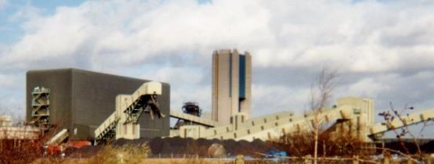
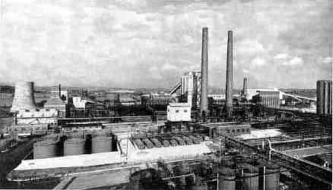
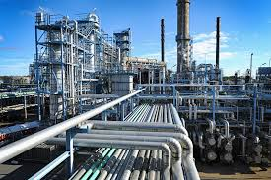
Me

Slide 53
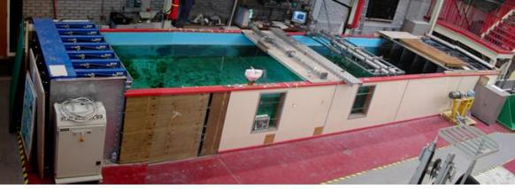

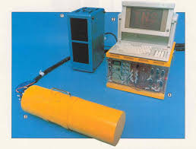
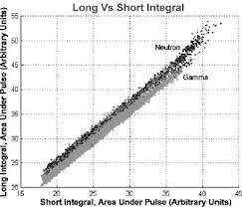
Me

Slide 54
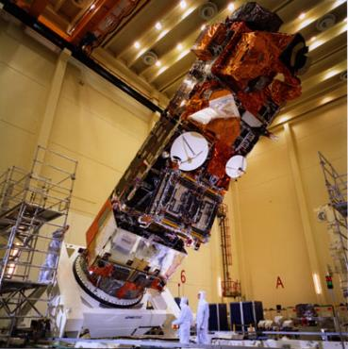
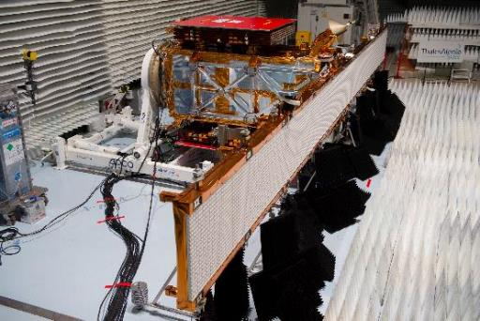
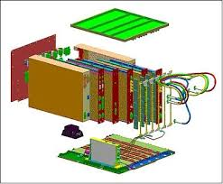

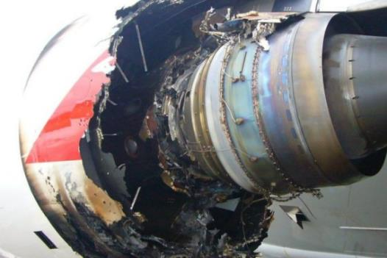
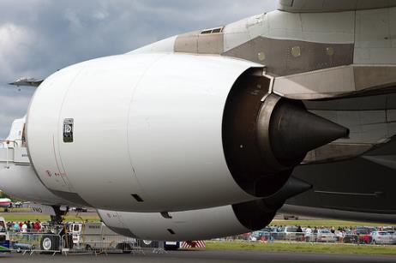
Me

Slide 55
Who does Systems Thinking
Anybody
Systems Thinking has and can be applied to every discipline
Some of mankind’s greatest achievements have come about from systems thinking:
  Isaac Newton
  John Maynard Keynes
  Albert Einstein
  Charles Darwin
  Barnes Wallis
  W Edwards Deming
Most humans are not natural Systems Thinkers, we have to work hard to do Systems Thinking

Slide 56
Systems Thinking, Systems Approach and Systems Engineering
Systems Thinking is:
Applying the concept of a system to a situation in order to gain insight and understanding
Systems Approach is:
Applying Systems Thinking in a systematic and repeatable manner
Systems Engineering is:
Applying a Systems Approach to the creation of a system

Slide 57
The Beauty and Power of Systems Thinking
In Systems Thinking we treat the situation as a system
Product, Process, Service
We can do this even if the situation is NOT a system! This makes it truly universal
We assume that the situation has all the properties and characteristics of a system and explore these to gain more understanding and make predictions about behaviour both desirable and undesirable
Let’s have a look at some of these properties and characteristics of a system

Slide 58
The Basis of Systems Thinking: The System
An assembly of components, connected together in an organized way to achieve something that is a consequence of the whole
Peter Checkland – Lancaster University
This definition of a system allows for the development of a number of characteristics and properties.
Note: this is not the only definition of a system there are many others but, generally, they all agree that a system comprises three key ingredients:
  Components
  Interconnections
  Purpose
Notes:
This is not the only definition of a system; there are many more. A few for example include:
“A System is a set of entities, real or abstract, comprising a whole where each component interacts with or is related to at least one other component and they all serve a common objective” Source: Wikipedia
“An interacting combination of elements to accomplish a defined objective. These include hardware, software, firmware, people, information, techniques, facilities, services, and other support elements.” Source INCOSE Systems Engineering Handbook
“An integrated composite of people, products, and processes that provide a capability to satisfy a stated need or objective” Source: Mil-Std 499B)
“A set of interrelated components which interact with one another in an organized fashion toward a common purpose” Source: NASA Systems Engineering Handbook)
The fact there is no universally agreed definition of a system is irritating but on a practical level it makes little difference since it is what these definition imply that is important . The definition used in this book is that defined by Peter Checkland.
References:
Checkland P. “Systems Thinking, Systems Practice, 1999, Wiley, ISBN 0-471-98606-2
The updated version of Peter Checkland’s ground breaking text on Soft System Methodologies. Rather academic so it’s hard to find the useful bits
Checkland P. Scholes J. Soft Systems Methodology in Action, 1990, John Wiley, ISBN0-471-98605-4
Much more readable than Checkland’s book

Slide 59
Systems Thinking: Some Key Concepts
Anything can be treated as a system
  A system is an assembly of components, connected together in an organized way to form a whole, this showing properties of the whole, rather than properties of the components
Systems are made up of Subsystems
  Whenever we look “inside” the chosen system of interest we see further smaller systems or subsystems
  Whenever we look outside the chosen system of interest we see that it is part of a larger system
All systems seek to achieve a PURPOSE
  Every system has a purpose that defines fundamentally what it has to do
  Humans tend not to think about purpose explicitly – but implicitly through the thing that achieves the purpose
All systems have CONTEXT
  Every system has context that defines the environment and constraints that impact upon that system
  System context often restricts the solution options that satisfy the purpose

Slide 60
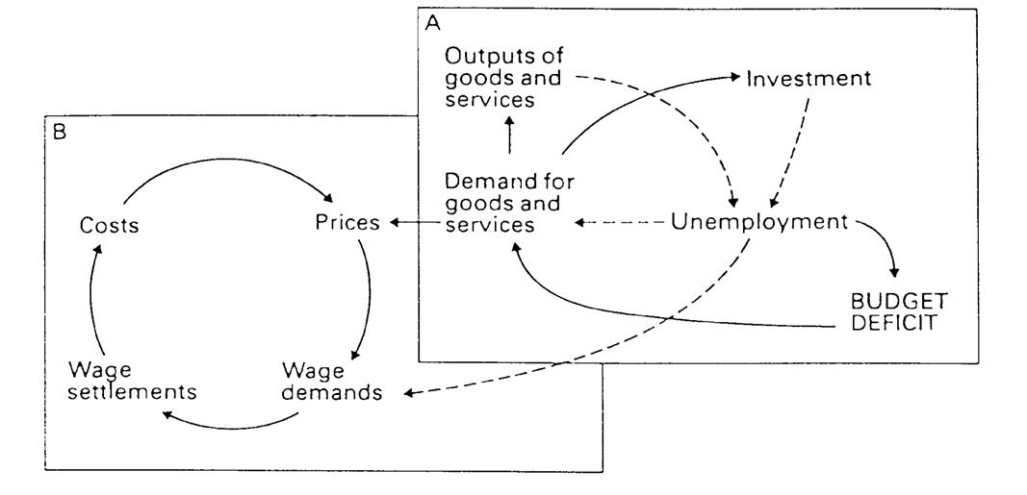
One More Key Systems Concept
Everything is connected to everything else
Reinforcing (positive) Feedback: successive changes add to previous changes in the same direction
Balancing (negative) Feedback: resist change in one direction by producing change in the opposite direction
The whole is greater (or less than) the sum of parts not because of the parts, but because of the connections between the parts. Systems Thinkers care more about what happens between the components of the system than the components themselves

Slide 61
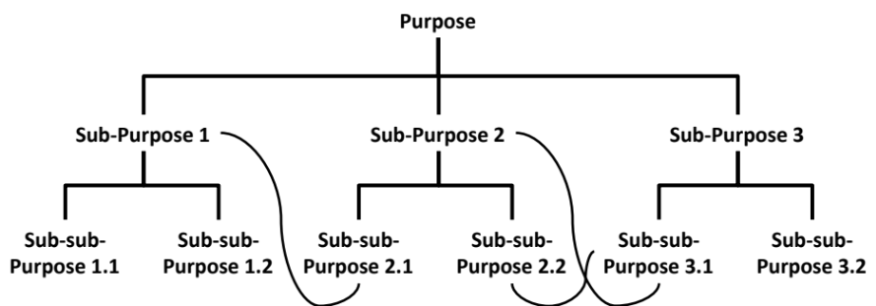
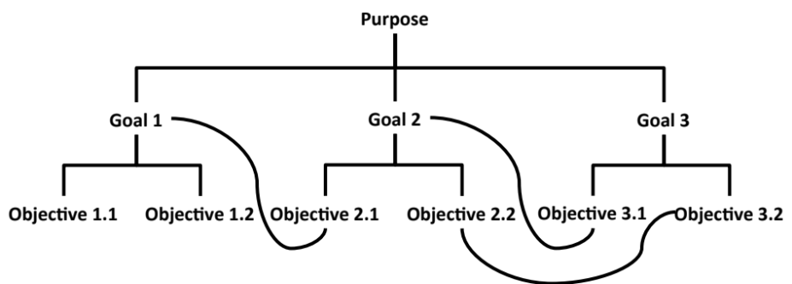
System Purpose
All systems seek to achieve a purpose
The purpose is a property of the whole and not found in any of the components
Some systems have more than one purpose
The purpose demands the achievement of lower level purposes as a consequence of the immutable laws of the universe (physics, chemistry etc.)
These lower level purposes in turn demand even lower level purposes which .... BUT it is rarely a simple hierarchy
People who use, or are part of, a system are often totally unaware of its purpose. Moreover, when asked, different users have different, and even sometimes conflicting, views as to the exact nature of the purpose
Rather than talk in sub-purposes we invent taxonomies

Slide 62
What is the purpose of a pen?

Slide 63


Exercise: Purpose
In small teams
  Work together to determine the purpose of the listed items
  Be prepared to share your answer with the whole class
Time 15 minutes

Slide 64
Purposeful Thinking
Defining the purpose of a system is not easy!
The purpose of a system is often a sentence or two – it’s easier to refer to the object!
WE ARE OBJECT ORIENTED we have been brought up from a early age to talk about things and NOT what they DO
IN SYSTEMS THINKING (and ENGINEERING) WE THINK ABOUT THE
PURPOSE

Slide 65
A key question when Systems Thinking is
What is the purpose?

Slide 66
System Context
All systems have context which depends on:
  The purpose
  The application (the bigger task or job which the system is part of)
  The environment of the system
  The observer
    an understanding of a system depends upon the perception of the observer. A tax payer will have a different perception of the “Tax System” to the tax collector or government official who is going to spend the tax revenue.

Slide 67
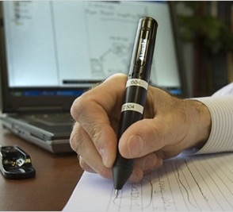
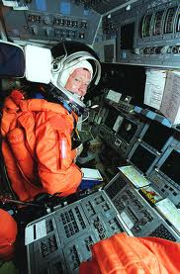

Does Context Matter
The PURPOSE is the same in each situation “turn thoughts into marks on paper”
BUT can the same pen solution be used in all three situations?
Context matters and we need to be able to understand it by defining the extent of the system of interest and its environment

Slide 68



Context is more than just the environment
Recording event in a journal
Flip Chart in a Training class
The purpose is the same, but the bigger need or application is different
Record of birth in a Registry Office

Slide 69
Properties and Characteristics of Systems
System Boundary and Environment
The environment of a system is that part of the outside world which significantly interacts with it and impacts upon it. Usually by being the source of system inputs and destination of system outputs. A system’s environment is also a major contributor to the context of that system.
Those parts of the outside world which do NOT significantly interact with the system are part of its universe. These can be physically very close
Universe
Environment
System
Inputs
Outputs
System
Boundary
A system has a boundary that defines the extent of the system.
Notes:
Difficulties are:- deciding on boundary and choosing elements of environment
Basis for system boundary is level of significance and relevance to purpose of system. Boundary encloses those components which make a clear contribution to achievement and have characteristics, properties, or attributes which are considered in assessing the behaviour of the system. Environment contains elements which influence how the system behaves but these elements are not directly considered in assessing the behaviour of the system

Slide 70
What’s the System Here?
A system boundary is an artificial (a mental creation) but useful concept in Systems Thinking.
It provides a way of “bounding” or “scoping” the situation of interest. It helps decide what is inside and what is outside the system
System boundaries can be temporal (time related), logical (purpose), or geographical (physical)
The choice of what is and what is not the chosen system of interest depends upon the observer and their reason for examining that system
Defining what is and what is not part of the system of interest is not easy

Slide 71
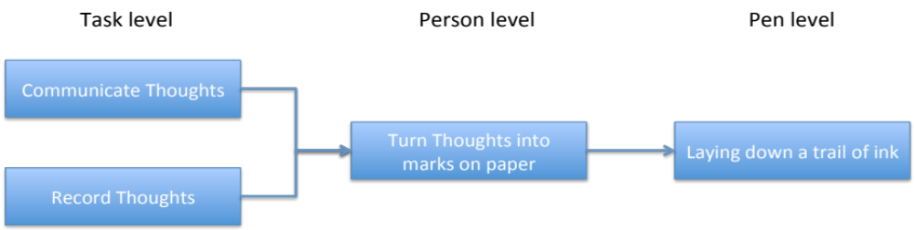
Using Boundaries
The “right” boundary for thinking about a situation rarely coincides with existing political or physical definitions
We invent boundaries in order to simplify and clarify a complex situation – to help decide “what’s in” and “what’s out”
Where we draw the boundary impacts both PURPOSE and CONTEXT
We should always reconsider the boundary for each situation whether new or old
We should also be prepared to change the boundary as our understanding grows. Sometimes we don’t fully know why we are investigating a situation! We “have a feeling” – and its only by exploring the situation as a system we begin to appreciate what needs to be done which in turn will define the boundary

Slide 72
The Observer
The context of a system also depends on who’s looking at it
We see different things
When exploring a system’s context we need to take multiple perspectives to increase our understanding
3
4

Slide 73
A key question when Systems Thinking is
What is the context?

Slide 74
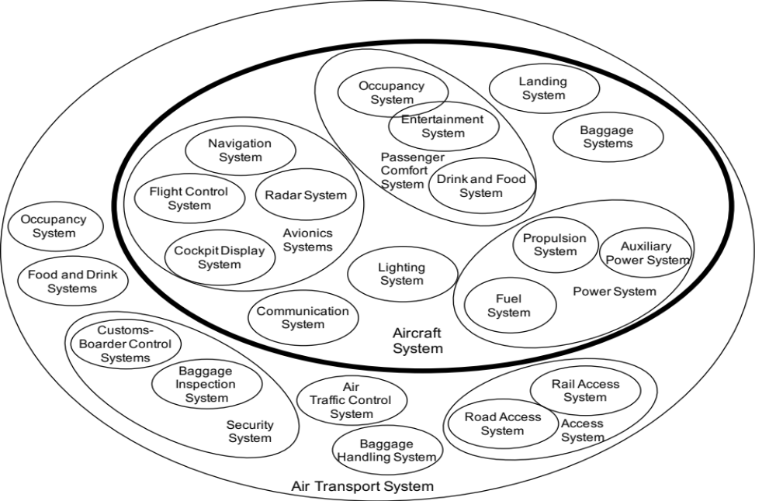
Systems are made up of subsystems and Systems are subsystems of bigger Systems
Whenever we look “inside” the chosen system of interest we see further smaller systems or subsystems
We can use this concept to manage complexity through the use of subsystems
Whenever we look outside the chosen system of interest we see that it is part of a larger system

Slide 75
The context of a subsystem comes from the system it sits within
At any level It is the other systems outside the boundary of our system of interest that provide its context. These other systems will provide constraints (requirements) on our system of interest

Slide 76
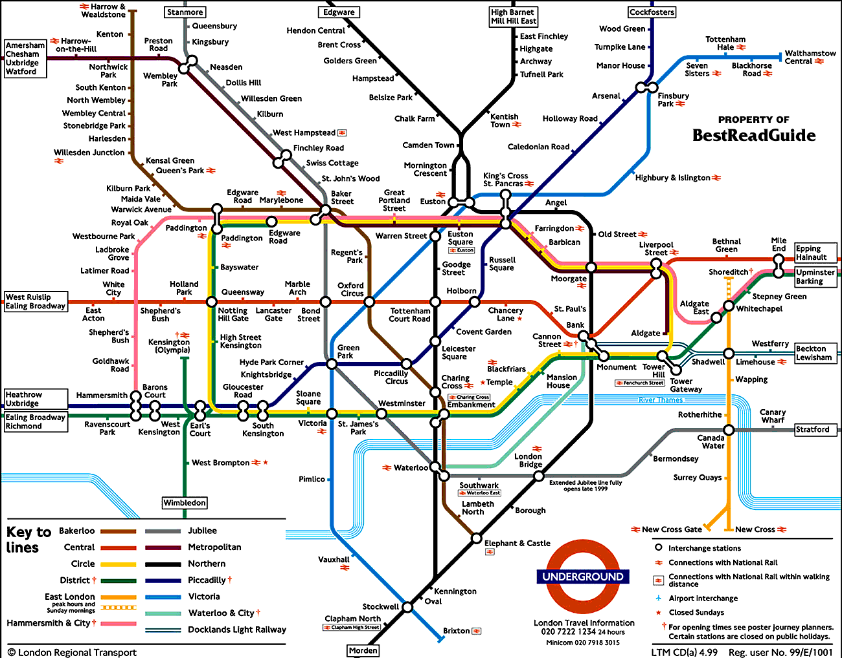
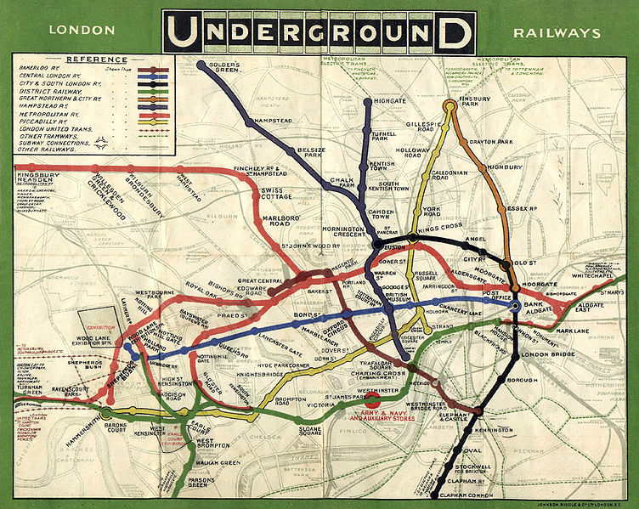
Subsystems and Information Hiding
The fact that any system is made up of subsystems is extremely useful in Systems Thinking.
By “hiding” the detail in sub-systems it provides a way of managing complexity
This “abstraction” of reality is very powerful – it allows complex situations to be explained in simple ways
The map of the London underground is a classic example of abstraction to make complexity understandable. The “real” map is just too complex to be of any use in navigating the system.

Slide 77
Abstraction in Design
Highest-Level
Purpose
Pleasure User
Theater Play/show
Higher-Level
Purpose
Entertain User
Cinema/Film
Level of abstraction
Sport
Mobile Phone
Converts a signal into light and sound
Lap/desk Top
Purpose
Tablet
Projector
Object
TV
TV

Slide 78
A key question when Systems Thinking is
What’s inside?
What’s Outside?

Slide 79
System Behaviour and Connections
Many Systems (particularly Business and Engineering Systems) are often concerned with a transformation – converting inputs to outputs. How the output varies over time is called the system behaviour
The behaviour of a system manifests itself in two related ways:
  Events are things that happen at a certain point in time. Events are the output of a system moment by moment. For example a commercial aircraft retracting its undercarriage can be treated as an event, so can a road traffic accident or the purchase of a new business unit.
  Patterns are an accumulation of events that display a recurring trend over time. For example a commercial aircraft pushes off from the stand, taxis, accelerates down the runway, rotates, becomes airborne, retracts its undercarriage, etc. in a series of events that defines a pattern of behaviour repeated by most commercial aircraft.
System
Inputs
Outputs
All systems will display patterns of behaviour if we observe them for long enough.

Slide 80
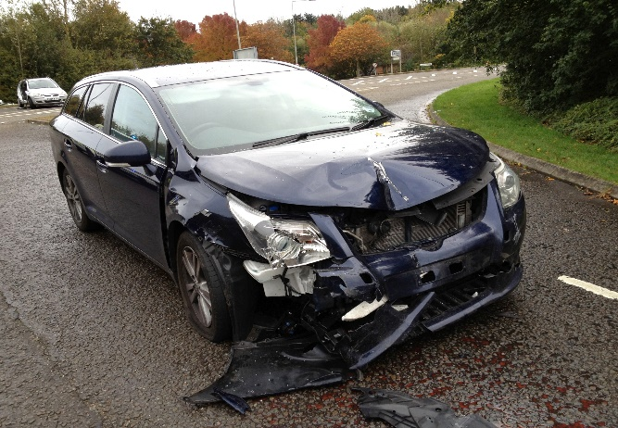
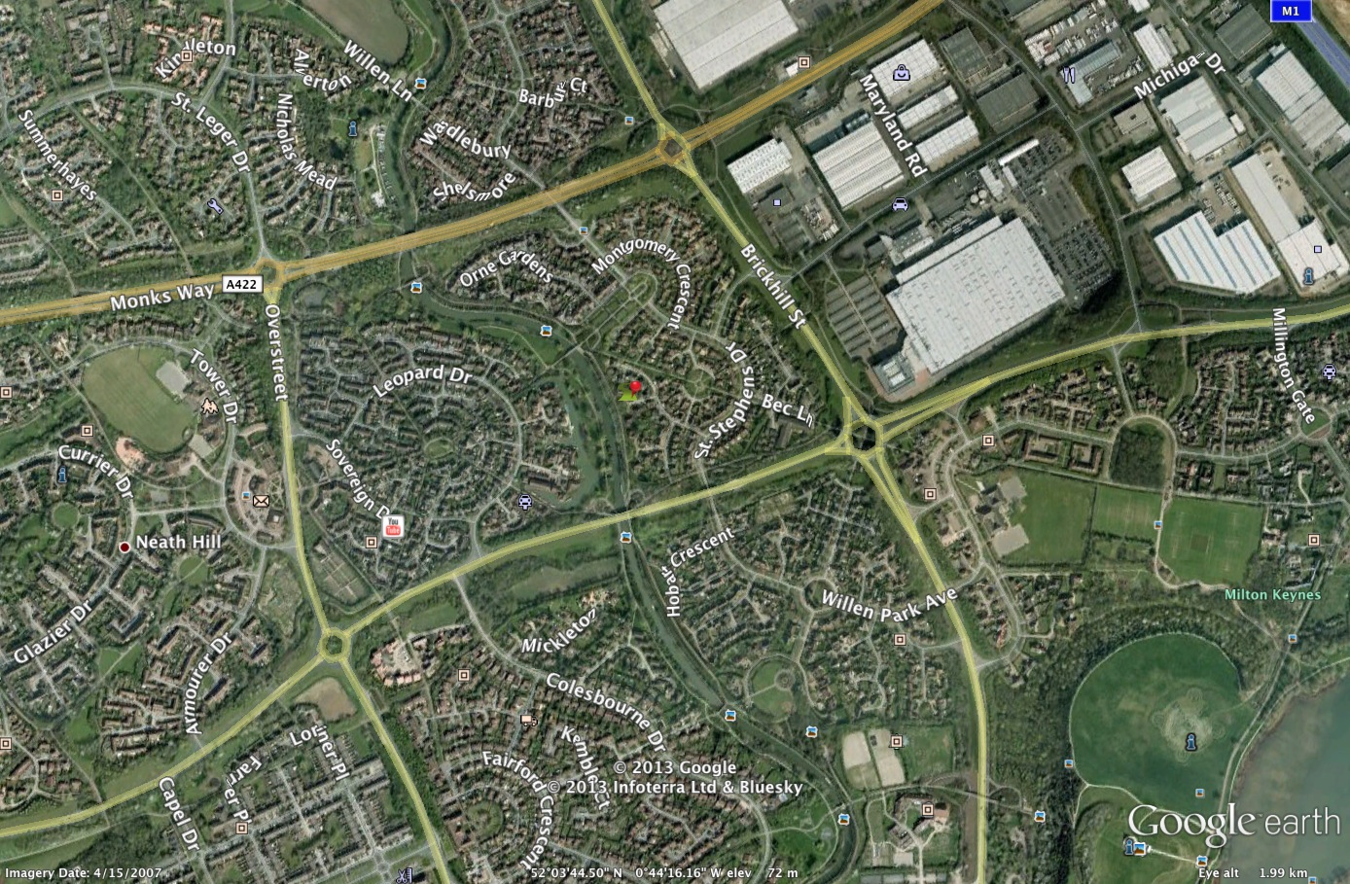
Events, Patterns and Behaviour
Humans find events more memorable and often view reality just in terms of events. If you were involved in a road traffic accident – you might call the local police and exchange driver details. Indeed, it’s our ability to react to events that has ensured our survival!
Patterns or “trends” over time offer a deeper understanding of reality. It’s our ability to spot patterns that has lifted us from “just surviving” – but whereas reacting to events is instinctive, finding patterns is not! Reducing road traffic accidents at the pattern level could involve finding accident “hot spots” in terms of location and time and staffing the emergency services accordingly
BUT something is behind, or causing, the patterns – the System Structure
An accident hot spot

Slide 81
Interrelationships, Structure and Behaviour
To fully understand a system we need to examine its behaviour over time. This behaviour can be simple, complex, desirable or undesirable but it is due to how the system components are interrelated – the system structure, organization or architecture
Because “Structure” is defined by the interrelationships of a system’s components, and not the components themselves, the structure is invisible
It is by changing the structure or organization of a system that we can significantly affect its behaviour
Events
Patterns
Structure, Architecture, Organization
We experience and remember events
Behind every event is a pattern
It is the interrelationships in a system that cause the patterns and events

Slide 82
Change the Structure – the Systems Intervention
What could we do to reduce or remove this accident hot spot?
Ideas?
Main road speed limit 60
Side road speed limit 30
Accident hot spot
Reacting to events and patterns can make a difference but the real differences come with changes in the structure of the system

Slide 83

Exercise
Same people who did the “Helium” tube exercise
Organize yourselves into two equal groups
Each group should form a “star” with their fingers touching
Keeping the finger in constant contact with underside of the tube lower it to the ground
Time 2 minutes

Slide 84
Behaviour, Interrelationship and Feedback
The behaviour we observe in every system – designed or evolved is a consequence of the interrelationships between the components
Remarkably the dynamic nature of these interrelationships comprise just two forms (for the whole universe!!):
  Reinforcing feedback
  Balancing feedback
The behaviour of every system is due to these two forms of feedback and synchronisation of the feedback

Slide 85
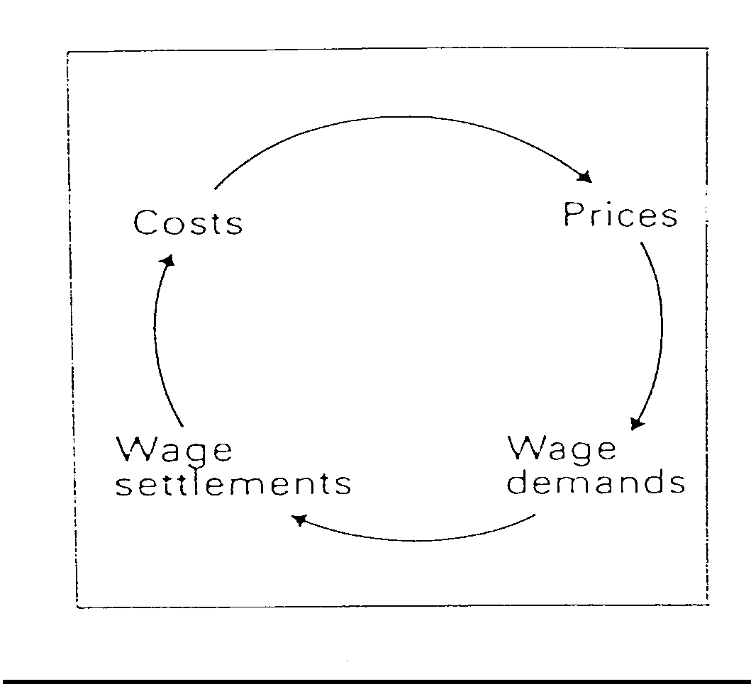
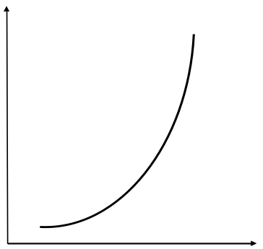
Properties and Characteristics of Systems
Dynamic Behaviour and Feedback
Reinforcing (positive) Feedback: successive changes add to previous changes in the same direction
Date | Whole Price Index
July 1914 | 1.0
January 1919 | 2.6
July 1919 | 3.4
January 1920 | 12.6
January 1921 | 14.4
July 1921 | 14.3
January 1922 | 36.7
July 1922 | 100.6
January 1923 | 2,785
July 1923 | 194,000
November 1923 | 726,000,000,000
German wholesale price index |  | The exponential growth of positive feedback
This model of “inflation” is a pure positive feedback loop which if left unchecked will lead to exponential growth – what economists call hyper-inflation. In this case undesirable – but such feedback can be beneficial

Slide 86
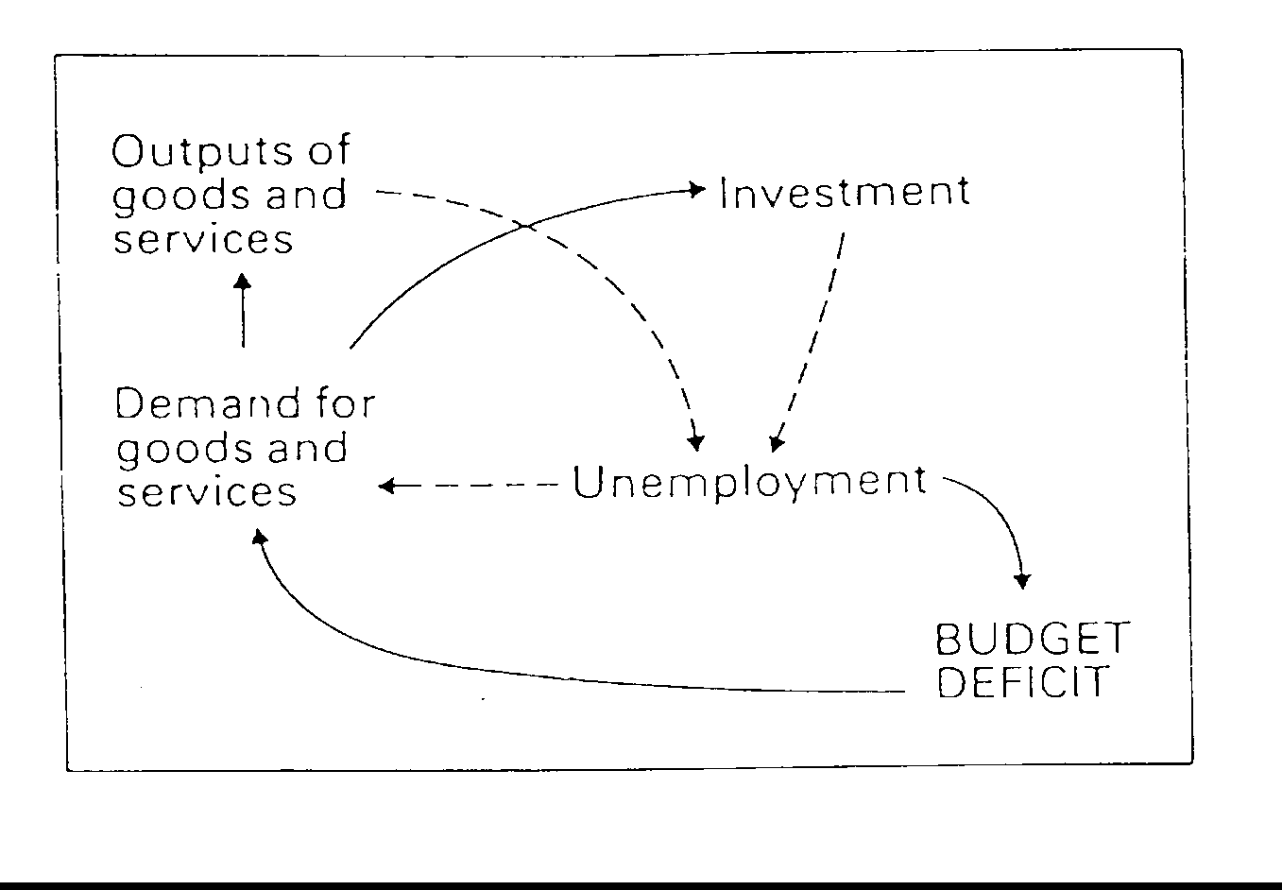
Negative and Positive Feedback
Balancing (negative) Feedback: resists change in one direction by producing change in the opposite direction
Balancing feedbacks stabilise behaviour - they calm things down
In this economic example the full lines represent positive or reinforcing feedback, while the dotted lines represent balancing or negative feedback

Slide 87
Behaviour is Affected by all the Elements in a System
This is the model developed by Keynes. He was able to “see” further connections and feedback loops in the bigger system. We often find that a lower level system is subject to feedback at a higher level.
The model given here is of course a qualitative model. But is does help in understanding the behaviour of a complex situation like a national economy.

Slide 88
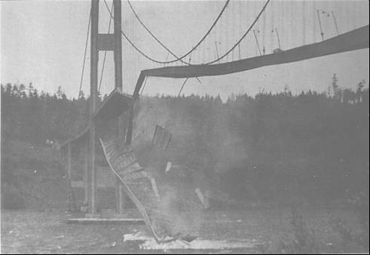
Properties and Characteristics of Systems
System Stability
Stable
A system that is initially in equilibrium is disturbed, it is said to be stable if it returns to that equilibrium condition.
Imagine a ball, that was originally resting in the bottom of a bowl, moved up one side and released – it will eventually return to the bottom of the bowl
Marginally Stable
A system that is initially in equilibrium is disturbed, it is said to be marginally stable if it finds a new equilibrium condition.
Unstable systems can offer significant performance improvements but they can also destroy themselves
If the ball is on a flat surface then if it is moved it will stay in its new position
Date | Whole Price Index
July 1914 | 1.0
January 1919 | 2.6
July 1919 | 3.4
January 1920 | 12.6
January 1921 | 14.4
July 1921 | 14.3
January 1922 | 36.7
July 1922 | 100.6
January 1923 | 2,785
July 1923 | 194,000
November 1923 | 726,000,000,000
German wholesale price index
If a ball placed on an upside down bowl is disturbed it will move away from its original position
Unstable
A system that is initially in equilibrium is disturbed, it is said to be unstable if it continues to move away from equilibrium condition.

Slide 89

System Stability
System Stability is determined by the interconnectedness and synchronization of the system elements
System Stability can be changed by increasing or decreasing (removing or adding) “connections”
  A stable system can be made less stable by reducing/removing balancing feedback or by increasing/adding positive feedback
  An unstable system can be made more stable by reducing/removing positive feedback or increasing/adding balancing feedback
System Stability can be changed by increasing or shortening the delays in a system – this is often counter intuitive.
Motorway Queues experience shock waves: fast-slow and stop-start behaviour because of an increase in the volume of vehicles causing a positive feedback. If we reduce the number of vehicles (reduce the positive feedback) the problem goes away!
The stop-start behaviour can also be influenced by introducing negative feedback into the system – variable speed limits. It should also be possible to change the behaviour by changing some of the delays in the system.

Slide 90
Systems Thinking in Engineering
Utilises Systems Thinking to
  Understand context and purpose
    To elicit and analyse requirements
    To generate and explore solutions through abstraction
  Manage complexity
    Through determination of sub-systems
    Through multiple perspectives
  Manage emergent behaviour
    By paying attention to the “connections” between sub-systems
    By consideration of a lifecycle view
Putting it in to practice requires a systematic and repeatable approach – we need a process.
  The Systems Engineering Process is based on two fundamental basic processes:
    Divergent and Convergent Thinking
    Plan-Do-Check-Act
Notes:
Text to go with this
Systems Engineering is a key enabler of effective pre-work – if you have the wrong requirements then you will get the wrong solution – regardless of how good your design (rest of engineering) is. At also you will discover this very very late in programme (in service, sales etc.)
Systems engineering Utilises a systems approach to understand context and purpose (which we will explain further later)
Systems engineering Is used to control emergence (simplistically to minimise unwanted / undesirable emergence, and to maximise / optimise the desired emergent properties – but to do this you need to understand the principle of emergence
Employs Systems Thinking to
Enable elicitation and understanding of requirements – expressed in solution neutral form
Use of requirements to create solutions – avoiding the natural jump to solution
Flow down of requirements from one solution level to the next level of detail – utilising the understanding of functionality, decomposition of solution into architecture etc.
Provides key link to planning and risk identification based on understanding of requirements – gives you an idea of the iteration and areas needing special attention. Also – as you get requirements tells you what “evidence” you need to prove the requirements have been met – so drives the definition of the verification plan

Slide 91
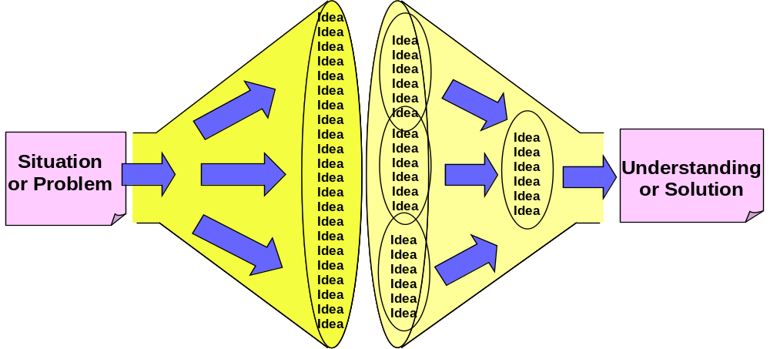
Divergent-Convergent Thinking a Systems Meta Process
When attempting to understand a situation or solve a problem the task is to find amongst all the possibilities the critical aspects. This task logically comprises two activities:
    Generating information
    Organizing information
We often try to do this in one step by “jumping” to the “answer” – the problem is we stop thinking once we find a first adequate “answer”
It is better to divide the task up into its component activities
Divergent Thinking
Convergent Thinking
Concerned with generating ideas or information about a situation or problem
Concerned with organizing and making sense of ideas or information

Slide 92
Plan Do Check Act a Systems Meta Process
Often attributed to the American quality guru Edwards Deming, he said he got the idea from Walter Shewhart the inventor of Statistical Process Control. But even Shewhart’s work can be traced to the Englishman Francis Bacon who first expounded the scientific method of Hypothesis, Experiment and Evaluation.
Do
Carry out the activity
Check
Check the activity
D
C
PDCA is logical common sense that is often not followed..
Plan
What has to be done
P
A
Act
Act on the check
Notes:
References:
Deming, W. Edwards (1986). Out of the Crisis. MIT Press. ISBN 0-911379-01-0.
Shewhart, Walter A[ndrew]. (1931). Economic control of quality of manufactured product. New York: D. Van Nostrand Company, ISBN 0-87389-076-0

Slide 93
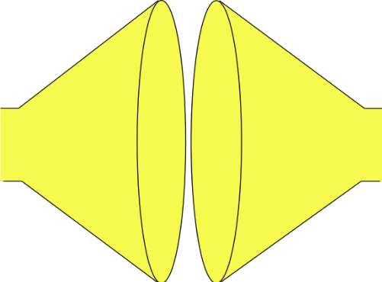
Systems Engineering uses a Systems Approach to System Design
Plan
Tailor the process, select the tools and determine the best checking strategy
Search and evaluate the solutions to determine and select the “best” solution
(Convergent Thinking)
Do
Do
Do
MAKE THE SYSTEM TO THE DESIGN
GENERATE SOLUTION OPTIONS AND SELECT
SYSTEM PROBLEM
UNDERSTAND
PROBLEM
solution
solution
“best”
solution
Built System
Understand the problem in terms of Purpose and Context
solution
Stakeholder needs and expectations
solution
Check (& Act)
Identify and document all possible solutions to the problem (Divergent Thinking)
Confirm the understanding of the problem reflects the stakeholder’s needs and expectations
Check (& Act)
Confirm that the selected solution solves the stakeholders’ problem
Check (& Act)
Confirm that the built System solves the stakeholders’ problem

Slide 94
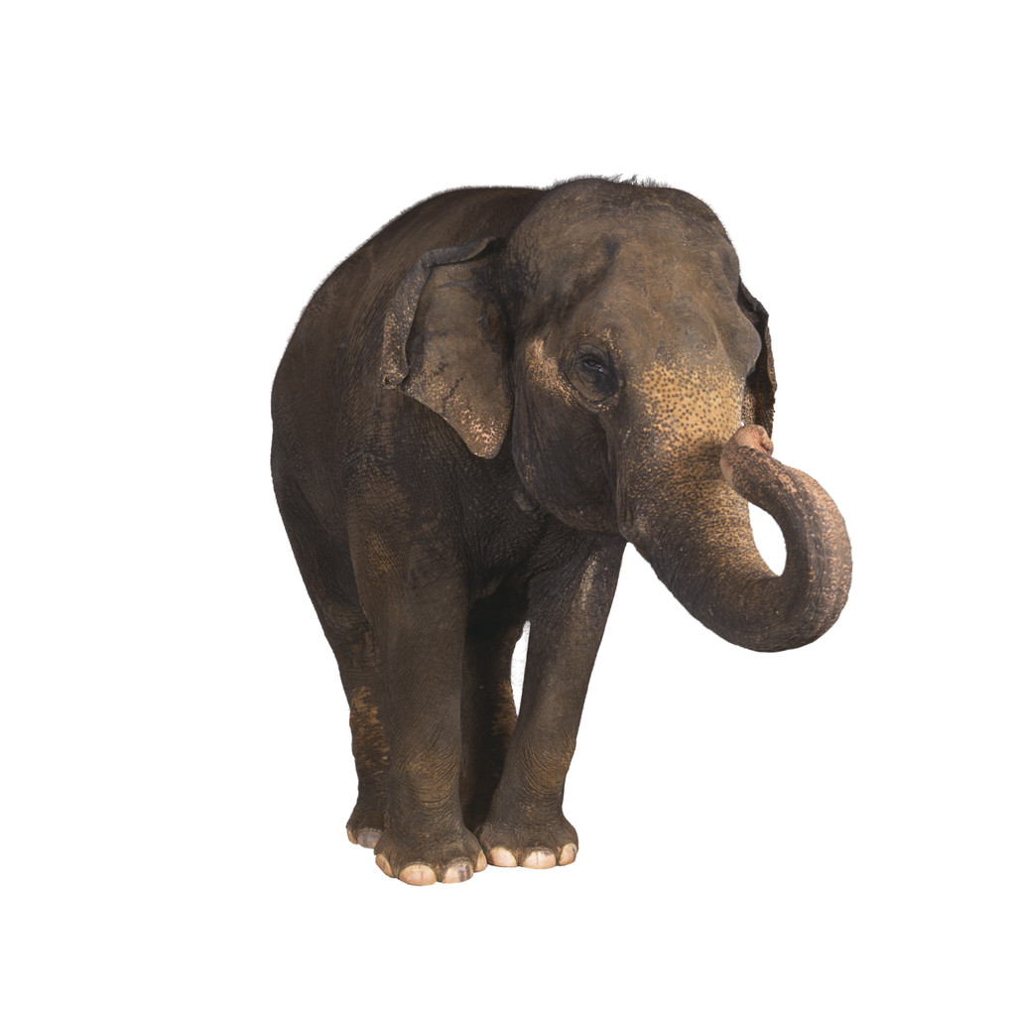
How do we Handle Complexity in System Design?
The complexity of the proposed system means it will have to be DESIGNED in “bite” sized chunks
We start by designing the SYSTEM as a number of subsystems – i.e. what is the architecture and technology of the system
System
In order to successfully design the system – Systems Thinking tells us we need to know its purpose and context
From the system design we have the necessary sub-purpose and context to specify the Subsystem Requirements
We then design the SUBSYSTEMS as a number of lower level elements, ultimately down to…
In order to design the subsystems, Systems Thinking tells us we need to know the purpose and context for each subsystem. This can only be known if we have designed the system
Subsystem 1
Subsystem 2
Subsystem 3
From the subsystem design we have the necessary context to specify the Component Requirements
The design of individual COMPONENTS
Component 2.1
Component 2.2

Slide 95
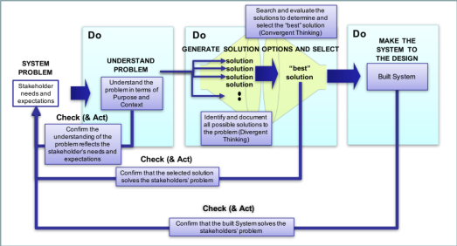
How do we Handle Complexity in System Design?
The complexity of the proposed system means it will have to be DESIGNED in “bite” sized chunks
We start by designing the SYSTEM as a number of subsystems – i.e. what is the architecture and technology of the system
System
In order to successfully design the system – Systems Thinking tells us we need to know its purpose and context
From the system design we have the necessary sub-purpose and context to specify the Subsystem Requirements
We then design the SUBSYSTEMS as a number of lower level elements, ultimately down to…
In order to design the subsystems, Systems Thinking tells us we need to know the purpose and context for each subsystem. This can only be known if we have designed the system
Subsystem 1
Subsystem 2
Subsystem 3
From the subsystem design we have the necessary context to specify the Component Requirements
The design of individual COMPONENTS
Component 2.1
Component 2.2

Slide 96
How do we Handle Complexity in System Build?
The complexity of the proposed system means it will have to be BUILT in “bite” sized chunks
We start by designing the SYSTEM as a number of subsystems – i.e. what is the architecture and technology of the system
System
The Built System
From the system design we have the necessary sub-purpose and context to specify the Subsystem Requirements
The Subsystems will be integrated to build the System
We then design the SUBSYSTEMS as a number of lower level elements, ultimately down to…
Subsystem 1
Subsystem 2
Subsystem 3
From the subsystem design we have the necessary context to specify the Component Requirements
These Components once realised will be integrated to build Subsystems
The design of individual COMPONENTS
Component 2.1
Component 2.2

Slide 97
The V Diagram
Stakeholder
Requirements
Working
System
System Level
Design
System
System Build And Check Requirements
Build and Check System
Subsystem
Requirements
Built and Checked Subsystems
Subsystem Level
Design
Subsystems
Subsystem Build and Check Requirements
Build and Check Subsystems
Component
Requirements
Built and Checked Components
Component Level
Component
Build and Check Requirements
Build and Check Components
Design
Components
We have to check at every level. The lower-level checks supporting the higher levels
To manage complexity we design in levels
Realise
Components

Slide 98
Systems Engineering is Fractal
At any one Level there is a
Fundamental Process – The Process Is Recursive
System
(Current Level)
Requirements
Working
(Current Level)
System
Design System
(Current Level)
System
Build and Check Requirements
Build and Check System
(Current level)
Subsystem
(Lower Level)
Requirements
Built and Checked (Lower Levels)
Subsystems
Engineer
Subsystems
(Lower Levels)

Slide 99
Systems Engineering is Fractal
At any one Level there is a
Fundamental Process – The Process Is Recursive
System
(Current Level)
Requirements
Working
(Current Level)
System
Design System
(Current Level)
System
Build and Check Requirements
Build and Check System
(Current level)
Subsystem
(Lower Level)
Requirements
Built and Checked (Lower Levels)
Subsystems
Engineer
Subsystems
(Lower Levels)

Slide 100
The Design System Process
Stakeholder
Requirements
Understand the problem – what does the customer want in measurable terms?
A second key output” are the Build and Check Requirements
Determine System Requirements
Design System
What are the design choices and what system concept will best meet the requirements?
Create System Design Concept
Build and Check Requirements
Make the system concept as good as it can be – do we have the robust optimum?
System
Design
System
Design
Design System
Verify & Validate System Design
A key output is the Subsystem Requirements
Subsystem
Requirements
Verify and Validate the system design

Slide 101
Systems Engineering is Fractal
At any one Level there is a
Fundamental Process – The Process Is Recursive
System
(Current Level)
Requirements
Working
(Current Level)
System
Design System
(Current Level)
System
Build and Check Requirements
Build and Check System
(Current level)
Subsystem
(Lower Level)
Requirements
Built and Checked (Lower Levels)
Subsystems
Engineer
Subsystems
(Lower Levels)

Slide 102
The Build and Check System Process
Working
System
Demonstrate that the system meets the pre-determined and agreed acceptance criteria
Build and Check System
Check that the system has been built correctly against pre-determined verification criteria and methods
Accept (Validate) System
Build and Check
Requirements
Check (Verify) the built System
Check and Accept Evidence
Build System
A key output is the evidence that the right system has been designed and built correctly
Physically build the System from the Subsystems
Built and Checked
Subsystems

Slide 103
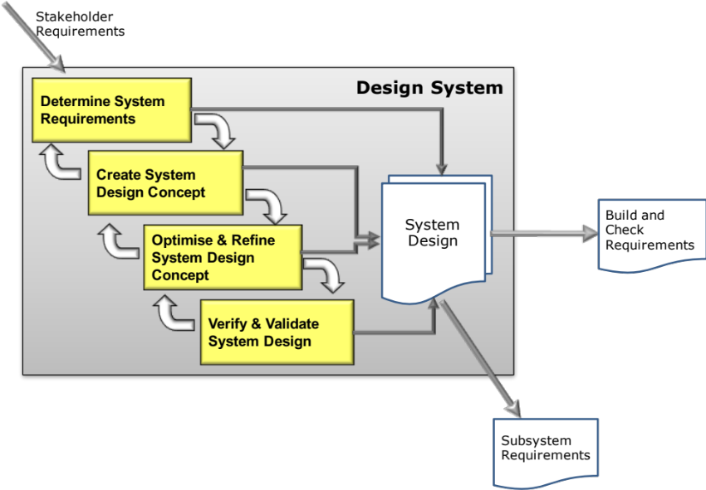
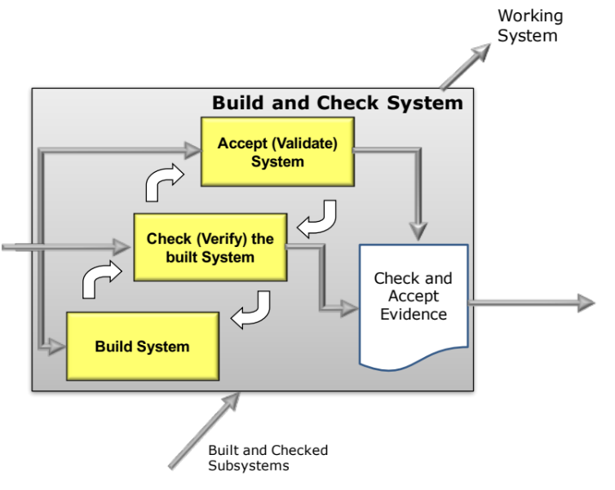
The Output of Systems Engineering
It is important to note that the output of Systems Engineering is
Indeed you can argue that the purpose of Systems Engineering is to generate information about the system being created such that it can be successfully built
INFORMATION

Slide 104
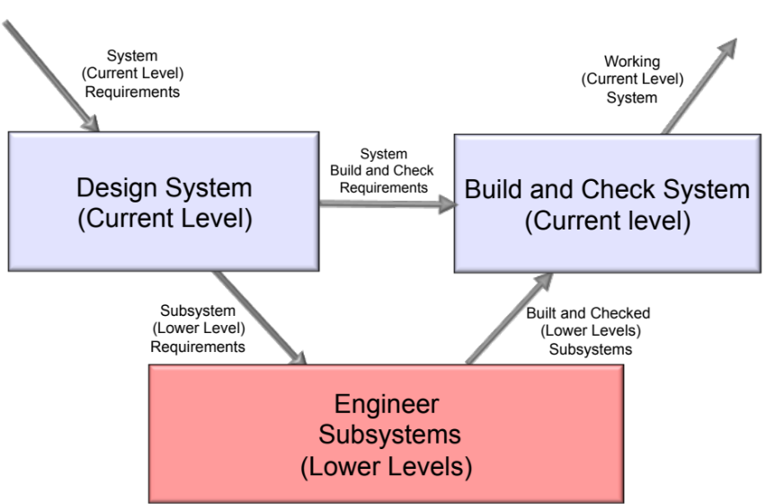
Checking
Checking as we Build
As the components are put together to make subsystems, and subsystems put together to make the system, common sense dictates that we check what has been built at each stage, that is:
  Components and subsystems meet their requirements
  The system behaves as expected by the customer
Both are necessary to have complete confidence in the final system
Checking here is obviously the correct thing to do – BUT it could be too late!

Slide 105




Verify and Validate Across the V
Years
Subsystem Level

Slide 106
By Checking we Mean Verification and Validation (V&V)
Verification: Confirmation by examination and provision of objective evidence that the specified requirements to which an end system is built, coded or assembled have been fulfilled
Validation: Confirmation by examination and provision of objective evidence that the specified intended use of an end system or aggregation of end systems is accomplished in an intended usage environment
Did we do the thing right?
Did we do the right thing?
These are the generally accepted systems engineering definitions of V&V. The implications of these are quite profound since Validation becomes “something that can only be done when the thing is built! However, it is important to realise validation can apply throughout the system design activity.
Notes:
The terms “Verification” and “Validation” are often confused, mis-used and misunderstood. These definitions reflect the generally accepted meanings for these terms.
Verification is a free-standing black box process which establishes that an item meets the requirements established for it, i.e., “Did we build the thing right?”.
Validation is a higher order process which establishes that an item meets the end purpose of that item, i.e. “Did we build the right thing?”
Arguably, a subsystem at a particular tier has an end use in the tier above. When tested within its own tier, this is, in the context of the above definitions, “Verification”. When it is integrated into the tier above, and shown to operate correctly (as distinct from simply satisfying its “shalls”), this could be viewed as “Validation”; although the term is seldom used in this context, the activity is implicit in the integration testing that occurs at that tier.
But the discussion is somewhat specious – in practice, the term “Validation”, when used in accordance with these definitions, is generally only commonly used to refer to the Operational Test and Evaluation process which the DoD typically undertakes at Tier 0, following delivery of the system – and in that context it is precisely correct. But most commonly, the term is lumped with its partner into the generic “V&V” which is even more widely mis-used than the term “system”.

Slide 107
Checking
Checking as we Design
As system elements are designed common sense dictates that we check as we progress that the
  requirements are correct - are we designing the right system? (Validation)
  design meets the requirements - has the system been designed right? (Verification)
Both are necessary to have complete confidence in the final system
We need to check as we progress

Slide 108


Verify and Validate Inside the V

Slide 109
Checking by Review
Why
  It is business critical that any project remains on track and at each stage fulfils the specified requirements.
  Reviews at specified stages of the lifecycle ensure that all the business and functional requirements fully comply with their agreed specifications.
  Reviews are essential to reduce risk - experts are used to independently assess the status of the project.
Generic Review Principles
  Reviews held in accordance with current engineering plan even if project is late
  Review uses existing project documents where possible
  Reviews are objective
  Reviews are evidence-based
  Reviews are conducted by acknowledged “expert” assessors
  Review Chair is independent of the project
  Results reported to the project director
  Reviews referred to by numbers, e.g. 2
  Reviews are key learning points - a basis for corporate learning
But WHEN do we Review?

Slide 110
Systems Engineering operates in two dimensions
Complexity
Lifecycle

Slide 111
Generic Lifecycle
build
design
deliver
Lifecycle Principles
  Through Life Capability Principles
  Project and Technical Engineering Activity in Distinct Phases in a Cycle
  Depicting the Cycle Linearly with Time describes a Lifecycle
  Systems Engineering Principles and Processes Can Be Applied
conceive
support
Next project
decommission
conceive
design
build
decom-
mission
THE LIFECYCLE
deliver
support
Time

Slide 112

Some Systems Engineering Lifecycles
US DoD Acquisition Lifecycle
IG
MG
MOD CADMID Lifecycle
Concept
Assessment
Demonstration
Manufacture
In-Service
Disposal
They all align to ISO 15288
U
C
D
P
R
S
Concept
Development
Production
Utilisation & Support
Retirement
ISO 15288 Lifecycle Phases

Slide 113

In Waters
Notes:
Animated – Mention additional supporting notes in pack
The lifecycle of a product. From cradle to grave (or lust to dust!).
Firstly, for a product, there is a lifecycle that is divided-up into stages. This covers the period of activity from the twinkle in the designer’s eye, through to the removal of the product from service, and the associated activities to remove any legacy of hardware, tooling, contractual obligations, etc. The timescale of the lifecycle can vary from 10 to 50 years, dependent on the product and market.
Secondly, during this period of time, there are some significant milestones to be achieved
Thirdly, there are some review points that are aligned to these milestones, in order to check that the required activities are being completed
[The next slides in the handouts identify the STAGE descriptions]

Slide 114

They all fit 15288
U
C
D
P
R
S
Concept
Development
Production
Utilisation & Support
Retirement
ISO 15288 Lifecycle Phases

Slide 115
Lifecycle Activity – Lifecycles within Lifecycles
System-Level
U
C
D
P
R
S
Application Level
U
C
D
P
R
S
If delivering an integrated capability, for example, MS , Chemistry and Application Systems, these different elements of the system of systems may need to be at a higher level of maturity earlier than the main system

Slide 116

Lifecycle and the V-Diagram
Notes:
Animated – Mention additional supporting notes in pack
The lifecycle of a product. From cradle to grave (or lust to dust!).
Firstly, for a product, there is a lifecycle that is divided-up into stages. This covers the period of activity from the twinkle in the designer’s eye, through to the removal of the product from service, and the associated activities to remove any legacy of hardware, tooling, contractual obligations, etc. The timescale of the lifecycle can vary from 10 to 50 years, dependent on the product and market.
Secondly, during this period of time, there are some significant milestones to be achieved
Thirdly, there are some review points that are aligned to these milestones, in order to check that the required activities are being completed
[The next slides in the handouts identify the STAGE descriptions]

Slide 117



More Than a Process
PROCESS
PEOPLE
TOOLS

Slide 118





Exercise: People
Capital Cities
  Part 1: individually, list as many Capital Cities of the world as you can in two minutes
  Part 2: in small teams, use your individual lists to create a team list – time five minutes
Notes:
THE RECKONING
•
Review the answer sheet.
•
Give yourself one point for each correct individual answer.
•
Score the group answer.
•
Complete the following chart
Bush (snr & jnr), Clinton, Reagan, Nixon, Lincoln, Roosevelt, Johnson, Ford, Carter
Washington, Eisenhower, Adams, Kennedy...

Slide 119
Sharing Knowledge
Extent of
my knowledge
Gaps in my knowledge
Team knowledge is greater and fills the gaps

Slide 120

Creating Knowledge
Working as a team will cause us to share knowledge but
  System Design often requires us to be creative
We can be individually creative, BUT we are better when we work as a team
  Voicing my ideas can help other team members to be more creative and vice versa

Slide 121
People and Tools in Systems Engineering
PEOPLE
Systems Engineering is a team sport!
People are essential - they generate the information required
Teams are better than individuals because of
  the sharing of knowledge and expertise
  the information and knowledge generated by working together
System design and development can involve many disciplines. Hence for complex multidisciplinary systems we have to have highly skilled multidisciplinary teams
For a multidisciplinary team to deliver they must be able to communicate with each other to share information and have a common understanding to avoid having different perceptions
TOOLS
Processes tell you what to do and when to do it (may also say who does it) – they should NOT specify how to do it – this is the job of tools
BUT we need a set of tools that all teams members can use, with confidence, that allow us to handle the complexity of the system but at the same time are simple enough for the whole team to use – we need generalist systems tools
Systems Engineering Tools are primarily communication devices that allow different disciplines to explore systems issues, often by building abstract models. They are scalable (any size of system), universal (any type of system)and above all simple (anybody can use them)

Slide 122


Systems Tools Build Models to Help the Team Reach a Common Understanding
Systems Engineering makes great use of MODELS to look for structures, relationships and dependencies at an abstract level to help predict behaviour at the real level

Slide 123


















Determine System Requirements
Gather Requirements
Analyse and Validate Requirements
Specify
Requirements
The Business Requirements provide the rationale and overall business constraints for a system development project
Determine the Emergent Functionality
Stakeholder Map
Flow Sensitivity Analysis
The System Requirements defines the measurable design requirements for the system
Determine system stakeholders and select key ones for requirements elicitation
Identifies causal paths for potential system sensitivities
Functional Failure Mode and Effect Analysis
Quality Function Deployment 1
Captures the potential functional failure modes, effects and causes to identify remedies ab initio
Cross checks requirements for consistency and completeness
Verification Compliance Matrix
Affinity Diagram
Use Case
Determine Validation and Verification methods for each requirement and specify V& V Requirements
Elicit and capture key stakeholder requirements
Captures how a user expects to interact with a system
Determine the necessary generic System Functionality
Tree Diagram/Analytic Hierarchy Process
Systemic Textual Analysis
Viewpoint/Functional Analysis
Function Flow Diagram
Organize and prioritise key stakeholder requirements
Analyses expressed requirements into their atomic form to identify and clarify missing and ambiguous requirements
Generates and organizes system generic functionality necessary to achieve the Operational Requirement
Captures and shows how the component functionality of a system must cooperate to deliver the Operational Requirement
Requirements Database
The User Requirements defines the expressed requirements of a particular stakeholder or stakeholders
Need Mean Analysis
Identifies and explores system solutions at different levels to determine System Meta-Solution

Slide 124














Create System Design Concept & Design System
Requirements Database
Create System Definition and Sub-System Requirements and associated Sub-System Verification Requirements
Requirements Database
Update System Definition and Sub-System Requirements and associated Sub-System Verification Requirements
Create Candidate System Concepts
Qualitative Robustness and Critical Parameter Analysis
Quality Function Deployment 2
Verify System Concept Solution meets the System Requirements and allocation of Sub-System Requirements
Quality Function Deployment 2`
Parameter Diagram
Design 2 Noise Matrix
Design Failure Mode and
Effects Analysis
Update QFD 2 with the design parameter target values and as appropriate - tolerances
N² Analysis
Logical System Architecting
Identifies and captures the factors that influence the performance of a system output
Determine the factors that are most likely to influence the robustness of a nominal design
Identify and document the potential failure modes, Effects and Causes
Determines the natural structure of a system that can be exploited
Determines candidate system architectures with minimal interfaces
Preliminary Design and Feasibility
Use Engineering Modelling, Simulation and Analysis to undertake preliminary design and feasibility
Quantitative Robustness Analysis
Parameter & Tolerance Design
Function Means Analysis
Simulation and Modelling
Designed of Experiments
Use quantitative models to explore solution space to find robust optimum and thereby determine design parameter settings and tolerances
Identifies and captures all possible functional solutions to a system design problem and thereby determine suitable candidate system concepts
Pugh Matrix
Use models or physical Designed Experiments to characterise the transfer function and thereby robustness of the system design.
Compares candidate system concepts against a set of criteria

Slide 125








Verify and Validate System
Requirements Database
Realisation System Modelling and Analysis
Supportability Assessment
Assess supportability through predicted
reliability and operational analysis
Sequence Diagram
Identifies sequence of logical process steps (functions) of the realisation system
Fault Tree Analysis
Reliability Block Diagram
Operational Analysis
Quality Function Deployment 3
Model System Failures as a Fault Tree
Model the system design to predict the system reliability
Understand the System Operation
Check that System Concept Solution is realizable and determine critical realization parameters and target values
Parameter Diagram
Collect Verification Evidence
Identifies and captures the factors that influence the performance of a system output
Perform Verification Activities and collect verification evidence
Process Failure Mode and
Effects Analysis
Verification Compliance Matrix
Quality Function Deployment 4
Design and perform tests
Update Verification Compliance Matrix
For the critical realization parameters determine the Assurance Requirements and target values
Identify and document the potential failure modes, Effects and Causes

Slide 126

A Fool With a Tool
Is a More Dangerous Fool
Give somebody a hammer and they’ll find things to hit with it!

Slide 127
This Section:
Explained why Systems Engineering is necessary
  Undesirable emergent behaviour as a consequence of complexity
Explained the relationship between Systems Thinking, Systems Approaches and Systems Engineering
Introduced Systems Thinking as the foundation of Systems Engineering
Provided an overview of Systems Thinking
  The only way to manage complexity
Showed how Systems Engineering utilises Systems Thinking to
  Understand context and purpose
  Manage complexity
  Manage emergent behaviour
Introduced the three ingredients of Systems Engineering
  Process (Lifecycle and Complexity)
  People (multidisciplinary teams)
  Tools (easy to use, scalable and universal)

Slide 128
This Course Will Focus on
Stakeholder
Requirements
Determine System Requirements
Design System
Create System Design Concept
Build and Check Requirements
System
Design
System
Design
Design System
Verify & Validate System Design
Subsystem
Requirements

