Slide 1
The Design System Process
Stakeholder
Requirements
Determine System Requirements
Design System
Create System Design Concept
Build and Check Requirements
System
Design
System
Design
Design System
Verify & Validate System Design
Subsystem
Requirements

Slide 2
The Design System Process
Stakeholder
Requirements
Determine System Requirements
Design System
Create System Design Concept
Build and Check Requirements
System
Design
System
Design
Design System
Verify & Validate System Design
Subsystem
Requirements

Slide 3
The Design System Process
Stakeholder
Requirements
Determine System Requirements
Design System
Create System Design Concept
Build and Check Requirements
System
Design
System
Design
Design System
Verify & Validate System Design
Subsystem
Requirements

Slide 4
The Design System Process
Stakeholder
Requirements
Determine System Requirements
Design System
Create System Design Concept
Build and Check Requirements
System
Design
System
Design
Design System
Verify & Validate System Design
Subsystem
Requirements

Slide 5
The Design System Process
Stakeholder
Requirements
Determine System Requirements
Design System
Create System Design Concept
System
Design
System
Design
Build and Check Requirements
Design System
Verify & Validate System Design
Subsystem
Requirements

Slide 6
The Build and Check System Process
Working
System
Build and Check System
Accept (Validate) System
Check (Verify) the built System
Check and Accept Evidence
Build System
Built and Checked
Subsystems

Slide 7
The Build and Check System Process
Working
System
Build and Check System
Accept (Validate) System
Check (Verify) the built System
Check and Accept Evidence
Build System
Built and Checked
Subsystems

Slide 8
The Build and Check System Process
Working
System
Build and Check System
Accept (Validate) System
Build and Check
Requirements
Check (Verify) the built System
Check and Accept Evidence
Build System
Built and Checked
Subsystems

Slide 9
The Build and Check System Process
Working
System
Build and Check System
Accept (Validate) System
Build and Check
Requirements
Check (Verify) the built System
Check and Accept Evidence
Build System
Built and Checked
Subsystems

Slide 10
The Design System Process
Stakeholder
Requirements
Determine System Requirements
Design System
Create System Design Concept
System
Design
System
Design
Build and Check Requirements
Design System
Verify & Validate System Design
Subsystem
Requirements

Slide 11
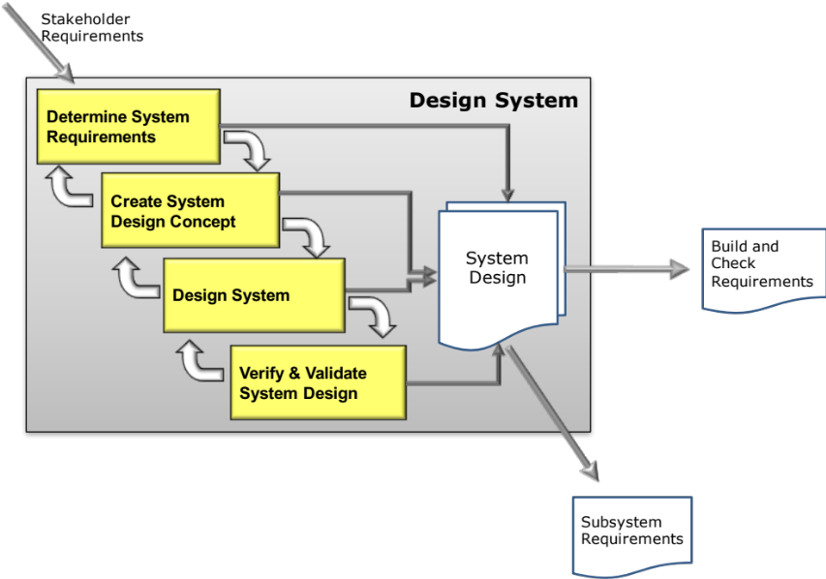
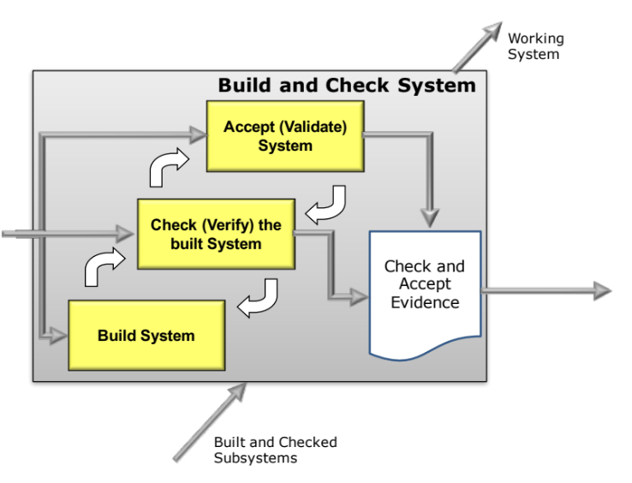

Slide 12
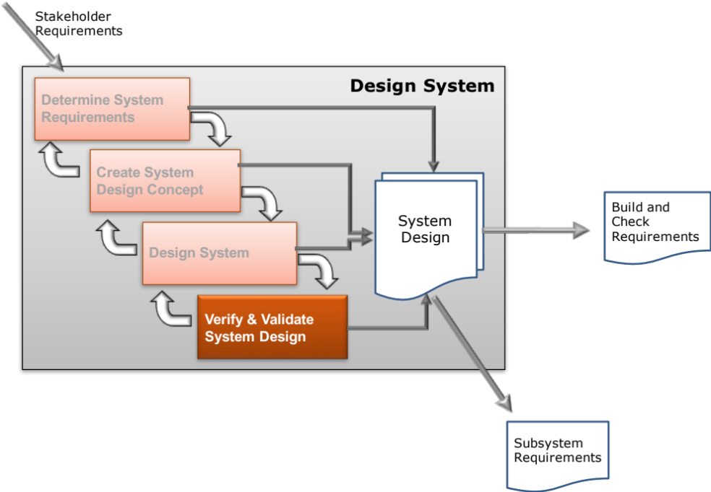
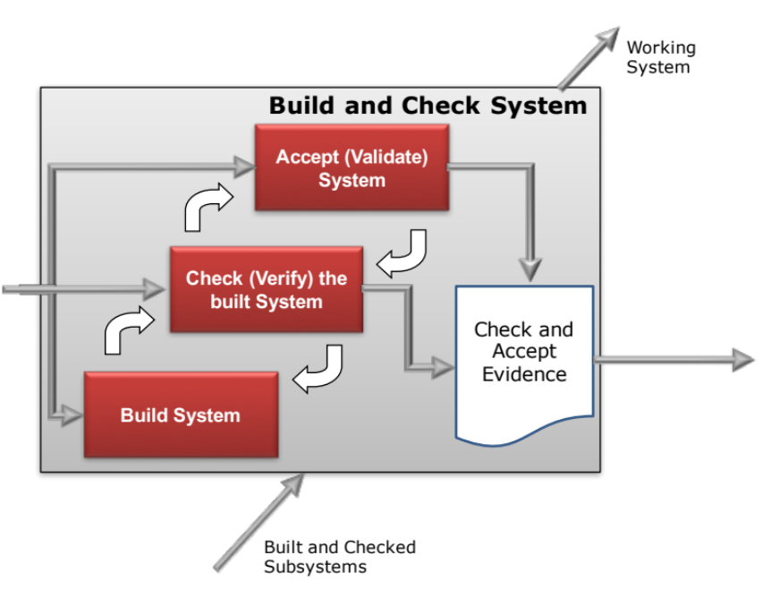

Slide 13
Operational
Requirement
Demands
Non-functional Performance Requirements
Functional Requirements
Non-functional Implementation Requirements
Constrains
Constrains
Constrains
Non-functional System Requirements
13

Slide 14
Operational
Requirement
Demands
Non-functional Performance Requirements
Functional Requirements
Non-functional Implementation Requirements
Constrains
Constrains
Constrains
Non-functional System Requirements
14

Slide 15
Implementation
System
Performance
Operational
Functional

Slide 16
Implementation
System
Performance
Operational
Functional

Slide 17
High
Low
Expressed
Those requirements that are sufficiently important to be verbalised by the customer. In general, the more the better!
Delight
Those requirements that cannot be articulated because the customer does not know they want them, but if provided will surprise and delight. These are NOT over design!
CUSTOMER EXCITEMENT
Basic
Those requirements that are so obvious to the type of system that the customer will not mention them. However, if not provided the customer will be dissatisfied!
Assumed
Those requirements that while not basic yet are starting to be taken for granted. If not provided the customer will be disappointed!
Low High
CUSTOMER SATISFACTION

Slide 18
Gather Requirements
Typical Systems Tools
Requirements Elicitation Plan
Stakeholder Map
Affinity Diagrams
Use Case
Tree Diagram
Analytic Hierarchy Process
Identify Stakeholders
Capture Requirements
Validate Source Requirements
Analyse Requirements
Typical Systems Tools
Need Means Analysis
Systemic Textual Analysis
Viewpoint Analysis
Functional Analysis
Functional Modelling
Flow Sensitivity Analysis
Functional FMEA
Quality Function Deployment
Assess Meta-solution
Determine Functionality
Verify System Requirements
Specify Requirements
Typical Systems Tools
Requirements Templates
Requirements Database
Document Requirements
Validate Requirements
Typical Systems Tools
Quality Function Deployment
Verification Compliance Matrix
Determine Verification and Acceptance Criteria
Notes:
9
9

Slide 19
Gather Requirements
Typical Systems Tools
Requirements Elicitation Plan
Stakeholder Map
Affinity Diagrams
Use Case
Tree Diagram
Analytic Hierarchy Process
Identify Stakeholders
Capture Requirements
Validate Source Requirements
Analyse Requirements
Typical Systems Tools
Need Means Analysis
Systemic Textual Analysis
Viewpoint Analysis
Functional Analysis
Functional Modelling
Flow Sensitivity Analysis
Functional FMEA
Quality Function Deployment
Assess Meta-solution
Determine Functionality
Verify System Requirements
Specify Requirements
Typical Systems Tools
Requirements Templates
Requirements Database
Document Requirements
Validate Requirements
Typical Systems Tools
Quality Function Deployment
Verification Compliance Matrix
Determine Verification and Acceptance Criteria
Notes:
9
9

Slide 20
Gather Requirements
Typical Systems Tools
Requirements Elicitation Plan
Stakeholder Map
Affinity Diagrams
Use Case
Tree Diagram
Analytic Hierarchy Process
Identify Stakeholders
Capture Requirements
Validate Source Requirements
Analyse Requirements
Typical Systems Tools
Need Means Analysis
Systemic Textual Analysis
Viewpoint Analysis
Functional Analysis
Functional Modelling
Flow Sensitivity Analysis
Functional FMEA
Quality Function Deployment
Assess Meta-solution
Determine Functionality
Verify System Requirements
Specify Requirements
Typical Systems Tools
Requirements Templates
Requirements Database
Document Requirements
Validate Requirements
Typical Systems Tools
Quality Function Deployment
Verification Compliance Matrix
Determine Verification and Acceptance Criteria
Notes:
9
9

Slide 21
Gather Requirements
Typical Systems Tools
Requirements Elicitation Plan
Stakeholder Map
Affinity Diagrams
Use Case
Tree Diagram
Analytic Hierarchy Process
Identify Stakeholders
Capture Requirements
Validate Source Requirements
Analyse Requirements
Typical Systems Tools
Need Means Analysis
Systemic Textual Analysis
Viewpoint Analysis
Functional Analysis
Functional Modelling
Flow Sensitivity Analysis
Functional FMEA
Quality Function Deployment
Assess Meta-solution
Determine Functionality
Verify System Requirements
Specify Requirements
Typical Systems Tools
Requirements Templates
Requirements Database
Document Requirements
Validate Requirements
Typical Systems Tools
Quality Function Deployment
Verification Compliance Matrix
Determine Verification and Acceptance Criteria
Notes:
9
9

Slide 22
Gather Requirements
Identify Stakeholders
Typical Systems Tools
Requirements Elicitation Plan
Stakeholder Map
Affinity Diagrams
Use Case
Tree Diagram
Analytic Hierarchy Process
Capture Requirements
Validate Source Requirements
Analyse Requirements
Typical Systems Tools
Need Means Analysis
Systemic Textual Analysis
Viewpoint Analysis
Functional Analysis
Functional Modelling
Flow Sensitivity Analysis
Functional FMEA
Quality Function Deployment
Assess Meta-solution
Determine Functionality
Verify System Requirements
Specify Requirements
Typical Systems Tools
Requirements Templates
Requirements Database
Document Requirements
Validate Requirements
Typical Systems Tools
Quality Function Deployment
Verification Compliance Matrix
Determine Verification and Acceptance Criteria
Notes:
9
9

Slide 23
Typical Systems Tools
Creative Thinking Tools
Function Means Analysis
Evaluation Tools
  Pugh Matrix
  Analytic Hierarchy Process
Logical System Architecting
N² Analysis (Design Structure Matrix)
Determine System Technology
Determine System Architecture
Design
System Concept
Embodiment Design
Typical Systems Tools
Engineering Analysis Tools
Engineering Design
Verify System Design
Typical Systems Tools
Quality Function Deployment 2
Requirements Database
Define Subsystem Design Requirements
Initial Flow Down of Requirements
Notes:
9
9

Slide 24
Typical Systems Tools
Creative Thinking Tools
Function Means Analysis
Evaluation Tools
  Pugh Matrix
  Analytic Hierarchy Process
Logical System Architecting
N² Analysis (Design Structure Matrix)
Determine System Technology
Determine System Architecture
Design
System Concept
Embodiment Design
Typical Systems Tools
Engineering Analysis Tools
Engineering Design
Verify System Design
Typical Systems Tools
Quality Function Deployment 2
Requirements Database
Define Subsystem Design Requirements
Initial Flow Down of Requirements
Notes:
9
9

Slide 25
Key Tasks and Systems Tools
Typical Systems Tools
P-Diagram
What-Why Table
DFMEA
Simulation studies
Prototype tests
Design of Experiments
  Full Factorial
  Screening Design
  Response Surface Methods
Characterise Design
Determine Critical Design Parameters and Noise Variables
Characterise Concept Design Transfer Functions
Perform Parameter and Tolerance Design
Typical Systems Tools
Simulation Studies
Prototype Tests
Design of Experiments
  Full Factorial
  Response Surface Methods
  Noise Experiments
Quality Function Deployment 2
Define Subsystem Requirements
Robust Design & Flow-
down of Requirements
Notes:
9
9

