Slide 1
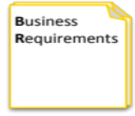
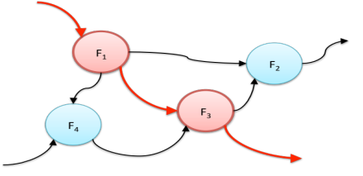
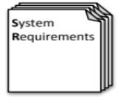
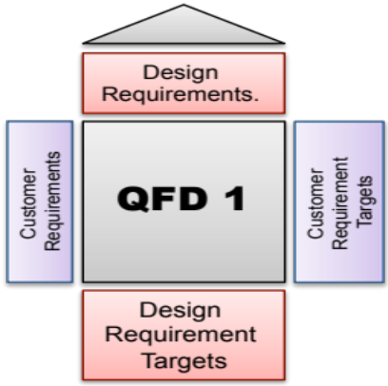
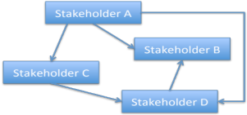
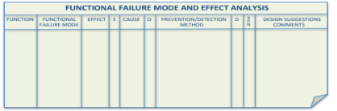
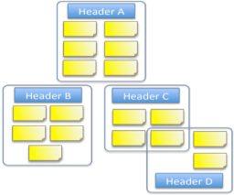

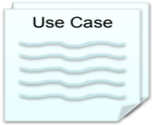
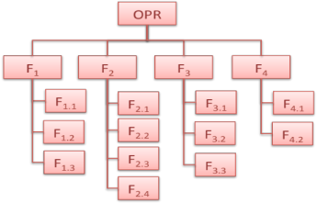

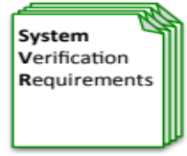

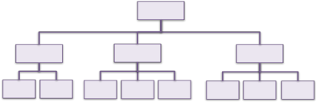
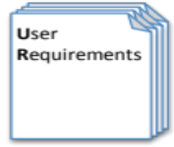
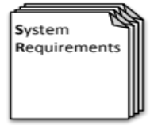

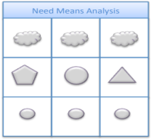
Determine System Requirements
Gather Requirements
Analyse and Validate Requirements
Specify
Requirements
The Business Requirements provide the rationale and overall business constraints for a system development project
Determine the Emergent Functionality
Stakeholder Map
Flow Sensitivity Analysis
The System Requirements defines the measurable design requirements for the system
Determine system stakeholders and select key ones for requirements elicitation
Identifies causal paths for potential system sensitivities
Functional Failure Mode and Effect Analysis
Quality Function Deployment 1
Captures the potential functional failure modes, effects and causes to identify remedies ab initio
Cross checks requirements for consistency and completeness
Verification Compliance Matrix
Affinity Diagram
Use Case
Determine Validation and Verification methods for each requirement and specify V& V Requirements
Elicit and capture key stakeholder requirements
Captures how a user expects to interact with a system
Determine the necessary generic System Functionality
Tree Diagram/Analytic Hierarchy Process
Systemic Textual Analysis
Viewpoint/Functional Analysis
Function Flow Diagram
Organize and prioritise key stakeholder requirements
Analyses expressed requirements into their atomic form to identify and clarify missing and ambiguous requirements
Generates and organizes system generic functionality necessary to achieve the Operational Requirement
Captures and shows how the component functionality of a system must cooperate to deliver the Operational Requirement
Requirements Database
The User Requirements defines the expressed requirements of a particular stakeholder or stakeholders
Need Mean Analysis
Identifies and explores system solutions at different levels to determine System Meta-Solution

Slide 2
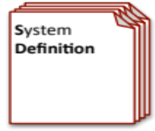
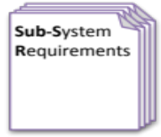
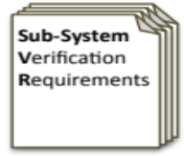


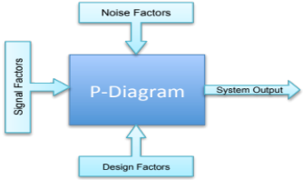
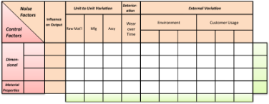
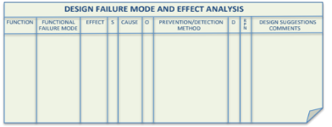
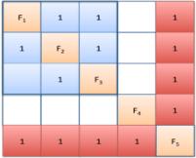
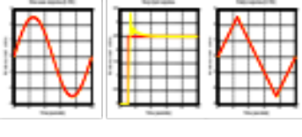
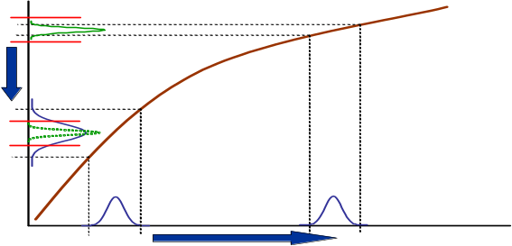

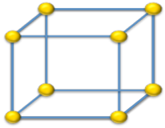
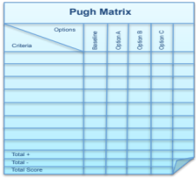
Create System Design Concept & Design System
Requirements Database
Create System Definition and Sub-System Requirements and associated Sub-System Verification Requirements
Requirements Database
Update System Definition and Sub-System Requirements and associated Sub-System Verification Requirements
Create Candidate System Concepts
Qualitative Robustness and Critical Parameter Analysis
Quality Function Deployment 2
Verify System Concept Solution meets the System Requirements and allocation of Sub-System Requirements
Quality Function Deployment 2`
Parameter Diagram
Design 2 Noise Matrix
Design Failure Mode and
Effects Analysis
Update QFD 2 with the design parameter target values and as appropriate - tolerances
N² Analysis
Logical System Architecting
Identifies and captures the factors that influence the performance of a system output
Determine the factors that are most likely to influence the robustness of a nominal design
Identify and document the potential failure modes, Effects and Causes
Determines the natural structure of a system that can be exploited
Determines candidate system architectures with minimal interfaces
Preliminary Design and Feasibility
Use Engineering Modelling, Simulation and Analysis to undertake preliminary design and feasibility
Quantitative Robustness Analysis
Parameter & Tolerance Design
Function Means Analysis
Simulation and Modelling
Designed of Experiments
Use quantitative models to explore solution space to find robust optimum and thereby determine design parameter settings and tolerances
Identifies and captures all possible functional solutions to a system design problem and thereby determine suitable candidate system concepts
Pugh Matrix
Use models or physical Designed Experiments to characterise the transfer function and thereby robustness of the system design.
Compares candidate system concepts against a set of criteria

Slide 3
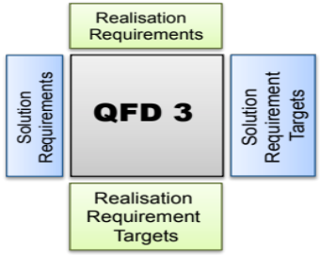
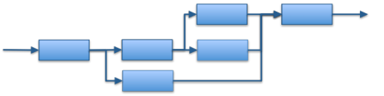
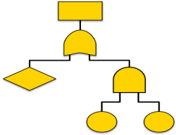
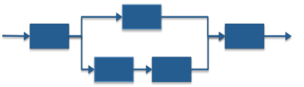
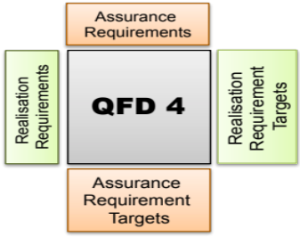
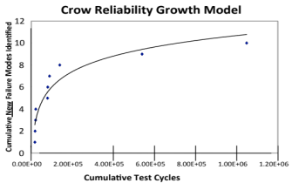

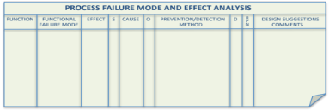
Verify and Validate System
Requirements Database
Realisation System Modelling and Analysis
Supportability Assessment
Assess supportability through predicted
reliability and operational analysis
Sequence Diagram
Identifies sequence of logical process steps (functions) of the realisation system
Fault Tree Analysis
Reliability Block Diagram
Operational Analysis
Quality Function Deployment 3
Model System Failures as a Fault Tree
Model the system design to predict the system reliability
Understand the System Operation
Check that System Concept Solution is realizable and determine critical realization parameters and target values
Parameter Diagram
Collect Verification Evidence
Identifies and captures the factors that influence the performance of a system output
Perform Verification Activities and collect verification evidence
Process Failure Mode and
Effects Analysis
Verification Compliance Matrix
Quality Function Deployment 4
Design and perform tests
Update Verification Compliance Matrix
For the critical realization parameters determine the Assurance Requirements and target values
Identify and document the potential failure modes, Effects and Causes

