Slide 1


Systems Engineering Principles
Requirements
Engineering
Secondary Information Goes Here
This Session:
Describes and explains the purpose and activities of Requirements Engineering

Slide 2
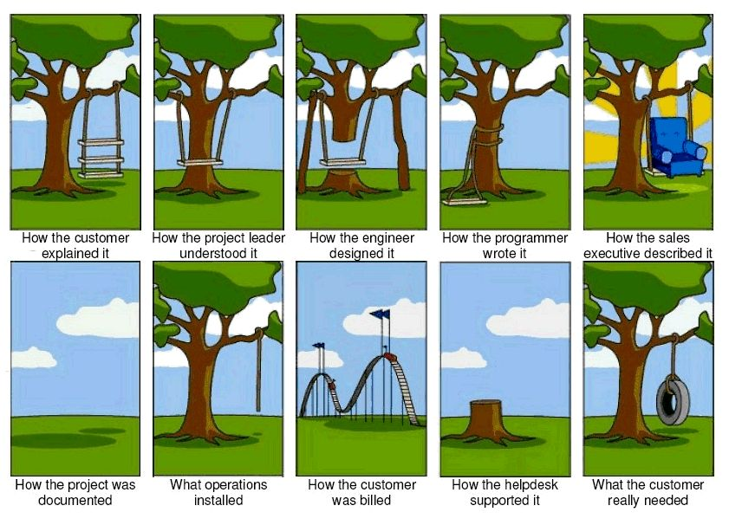
Requirements: A Common Problem
Notes:
Having explained what we intend to do on the previous slide this introduces a diversion. In order to explain how to determine and manage requirements it is useful to spend some time talking about customers and in general how they express their needs and requirements.

Slide 3
What is a Requirement?
In simple terms a requirement is a need or want expressed by a “customer”

Slide 4
Why we Need Requirements
Requirements:
  Express a need or want
  Are the basis for design
  Are the basis for confirming something has been done correctly
Define what we are commercially obligated to deliver against
If we do not have a “good” set of requirements we do NOT understand our commercial obligation and are therefore at RISK

Slide 5
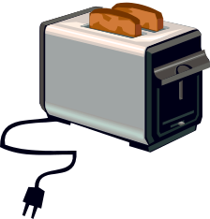

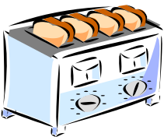
In small groups
Develop a set of customer/user requirements for a Toaster!
  Flip chart the requirements
  Time 15 minutes
Notes:
This exercise is described in the exercise trainer notes.

Slide 6
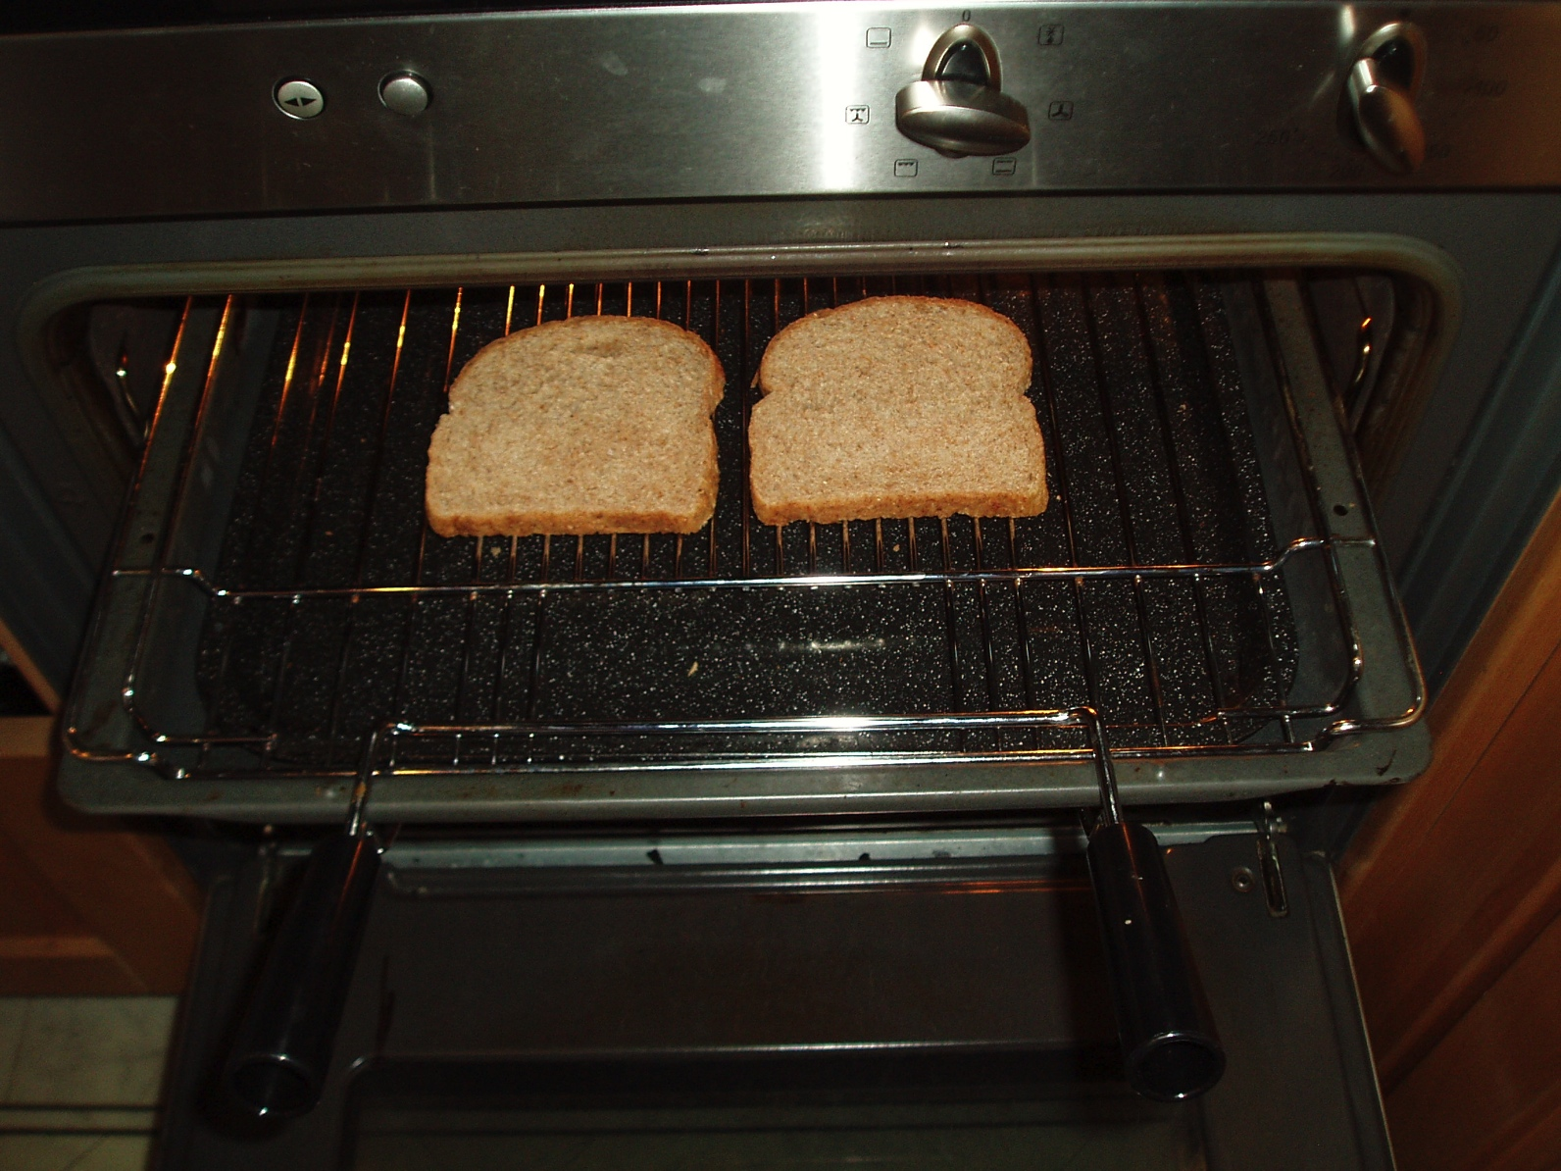

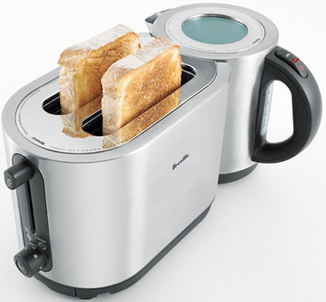

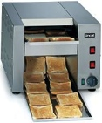
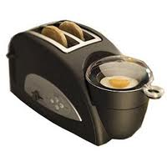
Satisfied?
If these requirements were delivered would you be happy?
  When developing the requirements did you think of your toaster at home?
  If you were the retailer would your requirements be different?
  Are all the requirements for the Toaster?
  Are your requirements complete?
  Are your requirements realistic?
  Are your requirements unambiguous?
  Will your requirements change?
Notes:
See Trainer notes:

Slide 7
Requirements:
Market Aspects
The need for a system will arise, in general, from one of two principal sources:
  Broad market: where the requirement is generated by the producer
  Narrow market: where the requirement is generated by the customer
Broad
Narrow
In practice most organizations sit somewhere
between the two extremes
Notes:
3

Slide 8
Broad Market Characteristics
A Broad Market is where the intention is to sell the same system to as many customers as possible e.g. a TV or motor car
It is impossible to “ask” every customer and so requirements are elicited from a representative sample of customers
The organization has to go to the customer to elicit their requirements
Usually Broad Market organizations establish a marketing function which should:
  determine the need: is there a market for a particular system, are there any gaps in the market, etc.
  define market sector: what group of people will buy this system, how big is this group, what price are they willing to pay, etc.
  determine customer requirements: What does the customer want
  communicate customer requirements clearly and accurately: to the design organization
Notes:
4

Slide 9
Narrow Market Characteristics
A Narrow Market contains one or very few customers who have a specific need - e.g. Defence, Infrastructure, Health Care, Power/Energy Provision are Narrow Markets
The systems are typically very complex and expensive
The customer comes to the organization with a set of requirements they have generated
Narrow market requirements are a formal statement of customer needs and expectations in terms of:
  purpose of the system
  performance characteristics
    including environmental and usage conditions, reliability, safety, maintenance requirements, cost
  applicable standards and statutory regulations
  quality levels
  supportability
  packaging etc.
Notes:
6

Slide 10

Summary
Market
Push
Broad Market
Marketing
In both cases
the true
requirements
are “filtered”
Source
“Customer”
Requirements
Source
Customer
Requirements
Customer
Narrow Market
Conclusion:
We need to know which market we are in and should be guided by the source customer requirements but they are not sacrosanct
Market
Pull

Slide 11
Requirements:
Static and Dynamic System Concepts
Another dimension to customer requirements comes from the idea of static and dynamic design concepts
Most systems are conceptually static as an overall design concept
  For example: motor cars, washing machines, civil airliner conceptually have not changed for several decades
Few systems are conceptually dynamic
Static concept designs are often dynamic at the subsystem level
  For example: Compare today’s motor car with those of thirty years ago – they now have Engine Management Systems, ABS, Climate Control Systems, Traction Control Systems etc.
Notes:
7

Slide 12
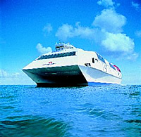



Knowledge & Risk
Requirements
unknown to customer
DYNAMIC
High
Customer Knowledge
Risk
Migration
REVOLUTION
BROAD
NARROW
Requirements
known to customer
Low
STATIC
Conclusion: Customers and Providers often work in the static design domain
because of knowledge and risk. Revolutionary improvement happens when a new dynamic concept is used. Making this decision is difficult and risky
Notes:
8

Slide 13
Requirements:
Customers’ Customers and Stakeholders
We must always be aware of the customer chain
Indirect
customer
Indirect
customer
Us
Indirect
customer
Direct
customer
Indirect
customer
We must also be aware of the categories of customer (stakeholder)
Purchaser
Evaluator
User
Maintainer
These have different expectations:
Different requirements - possibly in conflict
Conclusion:
We need to identify all possible customers/ stakeholders and elicit their requirements
Notes:
This slide amplifies the issue of multiple customers or stakeholders. It shows that we are often supplying to a “customer chain” (cf. supply chain). Not only do we have understand what our direct customer requires but also our customer’s customer.
The situation is further complicated by the fact that for any single customer (another company or organisation) there may be three different types involved:
the purchaser e.g. DMO
the evaluator e.g. DSTO
the user e.g. the armed forces
the maintainer e.g. the armed forces
Each of these different types of customer are likely to have different goals and therefore expectations

Slide 14
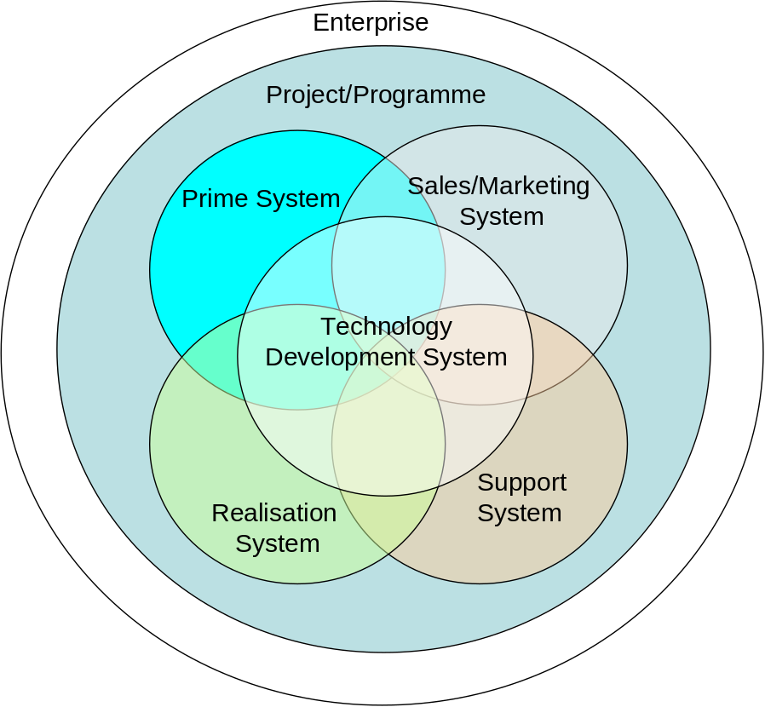
Requirements:
The PRIME System’s Friends
Every PRIME system is associated with several other systems. When we ask “stakeholders” what are their requirements for the PRIME system they will also tell us requirements for the other systems!
.
The enterprise itself is also a system
The project or programme is also a system
The System responsible for developing new technologies for ALL the other systems
The System responsible for marketing and selling the prime system
The Systems (design, development, supply chain) that realise the Prime System
The System responsible for the support of the prime system in operation and ultimately disposal
Conclusion: We cannot stop customers and stakeholders giving requirements for the associated systems. This is not a bad thing (in fact it is good that they do this) but it does mean we have to sort the raw requirements and align them to their respective systems

Slide 15
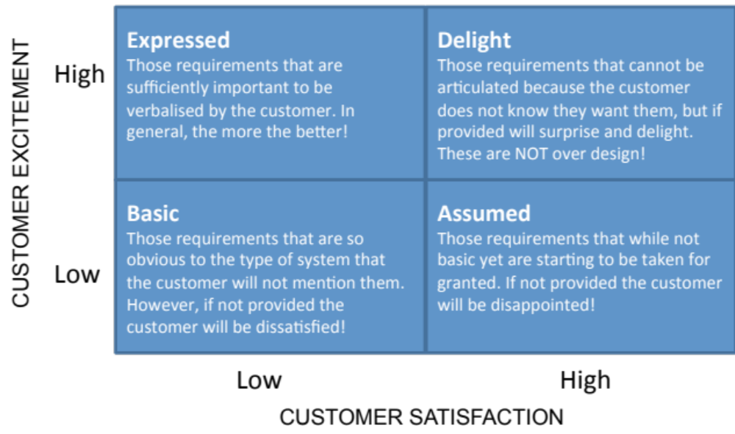
Requirements:
Customers can’t get no Satisfaction
Conclusion:
Customers/Stakeholders require more than satisfaction - we need to think about excitement
Customers/Stakeholders only tell us their expressed requirements; typically only 20% - 30% of the full set of requirements (spoken vs. unspoken requirements). We are going to have to determine the missing ones!
Notes:
This slide continues the argument. The previous slide indicates that errors committed during the early activities are expensive and difficult to find - but why. This slide starts to answer this question
The diagram above shows that customer satisfaction and customer excitement form two dimensions - they are not the same thing. The four quadrants then lead to a number of situations:
Basic: those requirements that form the basic set of expectations of a customer. These may not be expressed by the customer, but are well know. Examples include windscreen wipers on a motor vehicle
Expressed: those requirements verbalised by the customer
Assumed: Requirements or expectations not expressed by the customer. Similar to basic requirements and indeed over time will become basic requirements. Examples include electric windows, power steering, and ABS on a motor vehicle
Delight: features beyond the current expectations of customers
The point here is that for customer delight we have to capture and provide the stated Expressed requirements and the unstated Basic and Assumed requirements. Customers will never tell exactly every thing they expect

Slide 16

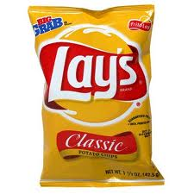


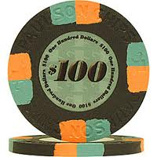


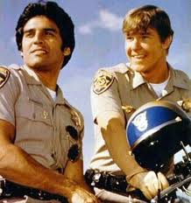

Requirements:
Ambiguity
I would like a bag of chips please.
Conclusion:
We need to identify where there is ambiguity – and resolve it

Slide 17
Requirements:
Just a Little bit More than Last Time
Requirements that while expressed may not actually be needed
What all of the stakeholders need
What a stakeholder needs
What the stakeholder thinks they need
What the stakeholder tells us they need
Conclusion:
We should never assume, because a customer/stakeholder has expressed a requirement , that it is correct or actually needed - they often express goals or “wish lists”

Slide 18
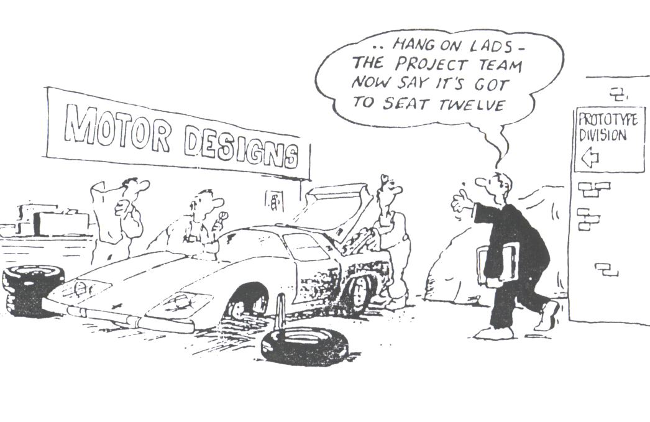
Requirements:
Customers Change their Minds!
Conclusion:
We have to manage and cope with requirements that will change
Notes:
A slide to illustrate customers change their minds! They do today and they will do tomorrow. Key questions to ask the class
are:
Can we stop customers changing their minds? – ans: NO
What do we do then? – ans: develop ways of working that handle customer change

Slide 19
Summary: A Bit of a Mess
The Facts
The Questions
Customers are biased by what they know
Customers are not the only stakeholder and they all have different requirements
Customer requirements are never complete
Customers will ask for things they don’t actually need
Customers give ambiguous and vague requirements
Customers will change their mind
How do we remove bias from requirements?
Who are the stakeholders and what are their requirements?
How do we find out what requirements are missing?
How do we find out what requirements are not needed?
How do we interpret vague and ambiguous requirements?
How do we cope with changing requirements?
Notes:
The previous slides have explored in more detail several of the points raised by the toaster exercise – which in turn leads to the questions above. These are the systems engineering issues when dealing with customer requirements. The answers to these questions in what the next few days is about.

Slide 20
What do we need From Requirements?
Having just identified some of the issues with requirements – the reverse suggests that the key characteristics of a “good” requirement are:
  Clear
  Concise
  Consistent
  Complete
  Correct
  Confirmable
There are other aspects to good requirements that relate to using them to design the system – Systems Thinking says we need to know
  The fundamental purpose of the system
  The major constraints that affect the system
  What the system has to do in order to meet the fundamental purpose
  How well the system has to perform

Slide 21
Getting to Grips with Requirements
Achieving
  Completeness: requires several viewpoints to be taken
  Consistency, Conciseness and Clarity: requires the identification and removal of ambiguity this in turn requires communication to share information and arrive at a common understanding - to avoid having different perceptions
  Correctness and Confirmation: requires the verification and validation of requirements
This demands discipline and organization
A consistent approach to engineering the requirements –
We need a process
A consistent way of organizing and interpreting requirements –
a framework

Slide 22
Remember
Requirements
Define what we are commercially obligated to deliver against
If we do not have a “good” set of requirements we do NOT understand our commercial obligation and therefore at RISK
The Answer: Requirements Engineering

Slide 23
What is Requirements Engineering
Requirements Engineering is a relatively new discipline that has emerged from Systems Engineering and Software Engineering in recognition of the need to address the issues raised
Requirements Engineering is concerned with:
  Gathering and analysing (understanding) requirements
  Organizing, specifying and validating requirements
  Specifying evidence-based means of confirming requirements have been met
  Managing and tracking requirements throughout the life of a particular system
It is an often overlooked activity BUT it is the key to both design success, and RISK reduction!

Slide 24
Activities of Requirements Engineering
Requirements Engineering comprises a number of logical interrelated activities
Requirements Engineering
Determine Requirements
Manage Requirements
Gather
Requirements
Concerned with the activities to gather source requirements from relevant stakeholders
Analyse
Requirements
  To interpret the gathered source requirements and to translate these into clear, concise, complete, consistent and confirmable system design requirements
Specify
Requirements
Recording the system design requirements in forms that will communicate what is required throughout the development team
Validate
Requirements
Ensures that the specified requirements are correct, will satisfy the stakeholder needs and have the characteristics of high quality requirements
Manage
Change
Ensures that as change occurs it is controlled and documented
Track
Requirements
Concerned with controlling the status of each requirement over time to monitor project status

Slide 25
Requirements Engineering Summary
This section has
  Explained the issues surrounding customer requirements
  Presented the purpose of Requirements Engineering and its key activities

