Slide 1


Determine System Requirements
Gather Requirements
Secondary Information Goes Here
This Session:
Explains the need for a Systems Approach to Gathering Requirements
Presents a process for Gathering Requirements
Describes and provides an opportunity to practise tools for Gathering Requirements
  Requirements Elicitation Plan
  Stakeholder Influence Map
  Affinity Diagram
  Use Case
  Requirements Tree
  Analytic Hierarchy Process

Slide 2
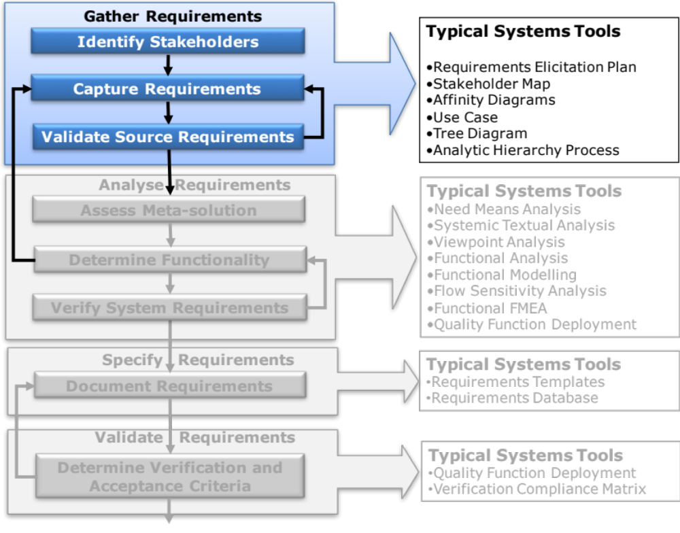
Determine Requirements: Tasks and Tools
Notes:
9
9

Slide 3














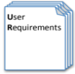



Process and Tools
Gather Requirements
Determine the Emergent Functionality
Analyse and Validate Requirements
Specify
Requirements
The Business Requirements provide the rationale and overall business constraints for a system development project
Stakeholder Map
Flow Sensitivity Analysis
The System Requirements defines the measurable design requirements for the system
Determine system stakeholders and select key ones for requirements elicitation
Identifies causal paths for potential system sensitivities
Functional Failure Mode and Effect Analysis
Quality Function Deployment 1
Captures the potential functional failure modes, effects and causes to identify remedies ab initio
Cross checks requirements for consistency and completeness
Verification Compliance Matrix
Affinity Diagram
Use Case
Determine Validation and Verification methods for each requirement and specify V& V Requirements
Elicit and capture key stakeholder requirements
Captures how a user expects to interact with a system
Determine the necessary generic System Functionality
Tree Diagram/Analytic Hierarchy Process
Systemic Textual Analysis
Viewpoint/Functional Analysis
Function Flow Diagram
Organize and prioritise key stakeholder requirements
Analyses expressed requirements into their atomic form to identify and clarify missing and ambiguous requirements
Generates and organizes system generic functionality necessary to achieve the Operational Requirement
Captures and shows how the component functionality of a system must cooperate to deliver the Operational Requirement
Requirements Database
The User Requirements defines the expressed requirements of a particular stakeholder or stakeholders
Need Mean Analysis
Identifies and explores system solutions at different levels to determine System Meta-Solution

Slide 4
Customer or Stakeholder?
Confusion Reigns:
We often use “customer” to mean the person(s) who buys or uses a system (whether it is a product or service based system). Hence the phrase “Customer Requirements” refers to those expressed needs and wants of the system user or purchaser
In some situations, where they are different people, we also differentiate the User from the Purchaser
Within a complex supply chain it is also typical to call the person who expresses requirements for a subsystem or component the “customer”
If we take a life-cycle view of a system, subsystem etc., we find that there are many more interested parties. These people also have requirements for the system of interest and include:
  Sales, Design, Manufacture, Test, Support and Maintainers etc.
There can be other people who have an interest in a system that are external to it such as legislators, pressures groups etc. These may also have requirements for a particular system, subsystem etc.
Collectively all these people are called stakeholders
It is also usual to include the system as a stakeholder
It is important to be clear who is who! – every requirement has a source and that needs to be captured

Slide 5
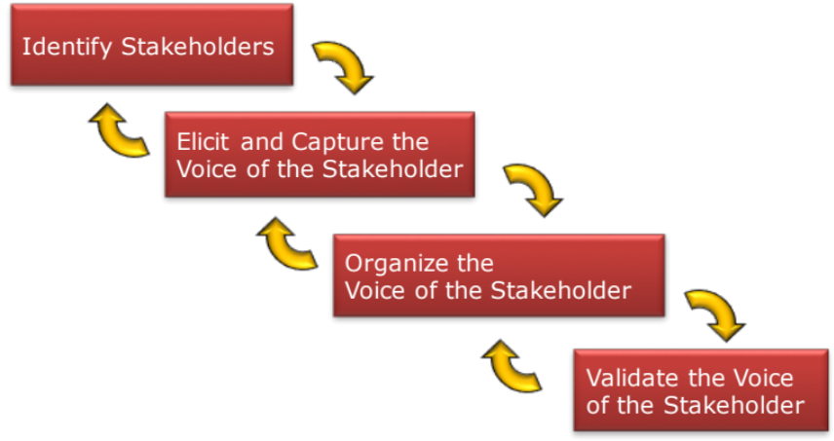
What’s the problem?
All systems have a range of stakeholders
All the stakeholders will have their own expectations and needs
Understanding stakeholders’ expectations and needs is therefore about:
  Identifying all the stakeholders
  Eliciting and capturing their
  expectations
  Organizing their expectations
  Validating their expectations
There is a
Process
Note that sometimes our direct customers will provide a detailed set of requirements. We should never assume that this is complete – we still need to undertake the above

Slide 6
Gather Requirements: An Iterative Process
Identify Stakeholders
Elicit and Capture the
Voice of the Stakeholder
Organize the
Voice of the Stakeholder
Validate the Voice
of the Stakeholder

Slide 7
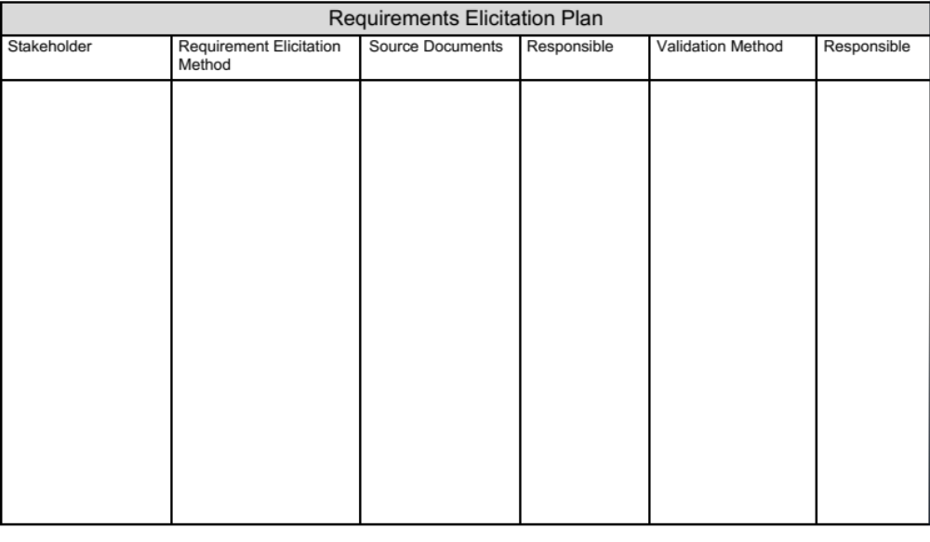
Planning to Gather Requirements
Requirements elicitation is not a random or haphazard process it needs to be carefully thought through and planned in detail. The above template captures the outcomes of that planning activity – it defines the requirements gathering strategy

Slide 8
Identify Stakeholders
Identify Stakeholders
Elicit and Capture the
Voice of the Stakeholder
Organize the
Voice of the Stakeholder
If we want to design an optimal
system we have to gather requirements
from all potential stakeholders. In order to do this
we need to identify the potential stakeholders
A useful tool is a Stakeholder Influence Map
Validate the Voice
of the Stakeholder

Slide 9
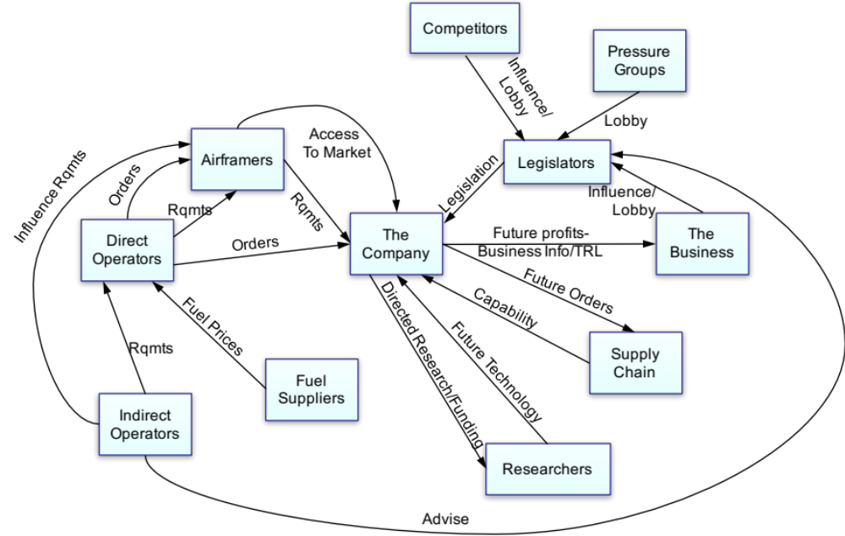
Stakeholder Influence Map
What is it?
  A derivative of the Influence Map (a Systems Thinking tool)
  It is a simple tool for identifying and capturing the potential stakeholders of a system and the interactions/influences that exist between them
When to use it
  Prior to undertaking any preliminary design work and before talking to the stakeholders
Why use it?
  To determine all the potential stakeholders to ensure their views are elicited if necessary
  To understand the scope of the bigger system
In the example Stakeholder Influence Map above, the boxes are groups of Stakeholders that we believe have similar requirements. The arrows indicate potential or known interactions/influences between the groups of stakeholders

Slide 10
Stakeholder Influence Map Process
Step 1: Identify all potential system stakeholders
Constructing a Stakeholder Influence Map is basically a linear process
Step 2: Identify groups of stakeholders with common requirements
Step 3: Construct Stakeholder Influence Map
Step 4: Review Stakeholder Influence Map to determine requirements gathering strategy

Slide 11
STEP 1: Identify all potential System potential stakeholders
  Usually performed as a simple Brainstorm to capture potential stakeholders on sticky notes (one stakeholder per sticky note)
  A stakeholder is anybody who comes into contact with, or has an interest in, the system throughout its entire life
Future Civil A/C Power Plant: brainstorm of potential Stakeholders
Company Test
Air Traffic Controllers
Universities
General Public
Blue Chip Airlines
Is it complete?
Certification Bodies
3rd Party Maintainers
Civil Airframe Manufacturers
Funding Sources
Company SCU
Suppliers
Service Representatives
Airline Maintainers
Company Design
Government Policy Makers
Competitors
Company Energy Business
Aircrew
Technology Providers
Company Maintainers
Company Development
Passengers
Airport Operators
Company CFBU
Company
Employees
Partners
Blue-Chip Air Forces
Military Airframe Manufacturers
Company Future Projects
Company
Shareholders
Company Board
2nd Tier Airlines
NGOs
2nd Hand Air Forces
Fuel Suppliers
Tanker
Operators
Environmental Groups
Company Future Sales
Freight Operators
Low-Cost Airlines

Slide 12
Step 2: Identify Groups of Stakeholders (based on similar/common requirements)
Step 2 is concerned with forming groups of stakeholder who the team believe have similar requirements. Such if one group member is asked for their requirements their answer is taken as representative of the whole group

Slide 13
Step 3: Construct Stakeholder Influence Map
The Stakeholder Influence Map is not essential to identify the stakeholders – but is often worthwhile constructing to:
understand the system's market environment
prioritize Stakeholders for eliciting requirements
If one stakeholder group is felt to influence another capture with a “named” arrow showing the direction of the influence and a describing name

Slide 14
The client is a manufacturer of domestic house heating systems and would like to establish a stronger presence in new build housing market. Current fashion is for a water-based gas system in which a gas boiler provides both hot water and space heating. Although gas fired systems are very popular they have several disadvantages that include:
Poor overall system efficiency (very good is 90% poor is below 70%)
Poor individual room temperature control. There is usually a central thermostat and achieving different temperatures in different rooms is not possible
Poor room temperature regulation: maintaining the set room temperature during a 24-hour period due to solar heating (the effect of the sun on a well-insulated house), wind speed and direction.
To address these deficiencies and provide a clear value proposition, the proposal is for an electrically-based intelligent system that will make use of the weather forecast and house characteristics to optimise energy use.
There is also a clear move towards the “smart home” where through the use of application software a number of “devices”, including the central heating can be monitored, controlled and integrated through a simple user interface. As part of the Intelligent Heating System project, the client would like to explore the architectural options for such a “smart” system. Including options for what smart devices could be integrated.

Slide 15
Exercise – Stakeholder Influence Map
In small teams
    Construct a Stakeholder Influence Map for the system described to you by the Trainer
    Be prepared to share your outcome with the rest of the class
Time 35 minutes
  15 minutes brainstorm
  10 minutes grouping
  10 minutes constructing influence map
15
mins
20
mins

Slide 16
So What? Step 4: Review Stakeholder Influence Map
For any system there is potentially a large number of stakeholders. In the ideal world we should wish to elicit and capture requirements from all these stakeholders. Pragmatically, we are likely to have neither the time nor the money to do so and therefore need to be selective – but which ones?
We use the Stakeholder Influence Map to decide:
  Which groups of stakeholders MUST we get requirements from?
  Which groups of stakeholders can be ignored (this time and why?)
  Which group of stakeholders SHOULD we get requirements from
Key
Stakeholders

Slide 17
Stakeholder Influence Map Summary
Pros
  Simple - anybody can contribute
  If performed in a team can promote
    Discussion
    Thinking
  Identifies stakeholders
  Helps to understand relationships and influences between stakeholders
  Helps determine which stakeholders to elicit requirements from
Cons
  Deciding who does this – who should be involved
  Assumes we know what the system is that we are intending to design and develop:
    The scope of the system could change after collecting some requirements thereby introducing new stakeholders from which we will have to collect requirements – expect iteration

Slide 18
Update Requirements Elicitation Plan
Add the Stakeholders, these can be groups of stakeholders from the Stakeholder Influence Map, individual stakeholders or any suitable combination

Slide 19
Elicit an Capture the Voice of the Stakeholder
Identify Stakeholders
Elicit and Capture the
Voice of the Stakeholder
Organize the
Voice of the Stakeholder
Validate the Voice
of the Stakeholder
If we want to elicit and capture stakeholder needs and expectations – it is not just a question of asking “what do you want?” We have to understand their issues and concerns - we have to listen

Slide 20
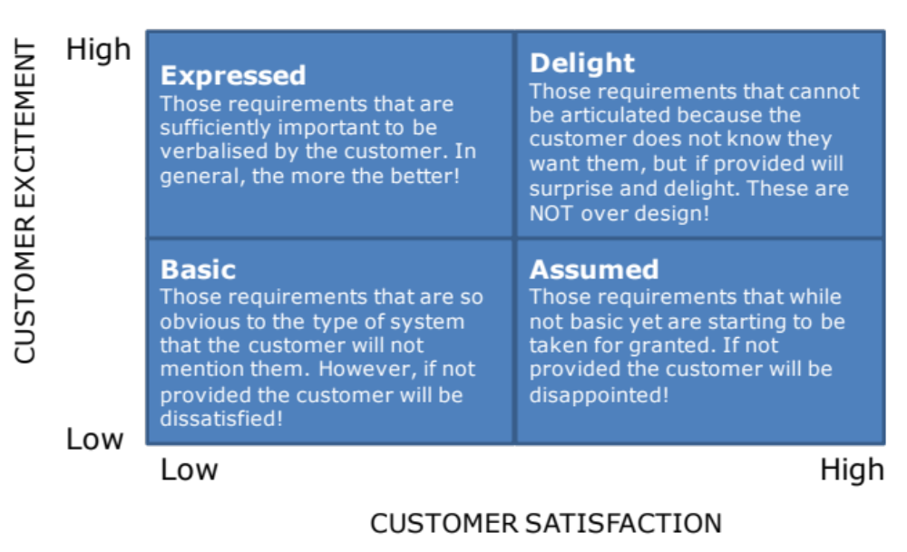
Remember Spoken vs. Unspoken
If we ask a stakeholder “what do you want?” we will get only those requirements that are important to them at that point in time: the expressed requirements
There are other requirements that are left unspoken
Conclusion: Stakeholders only tell us their expressed requirements; typically only 20% - 30% of the full set of requirements. They do not tell us the basic, assumed or delighter requirements (spoken vs. unspoken requirements). We need to determine the missing ones

Slide 21
Different Approaches for Different Types
We need to remember that:
  Different stakeholders have different needs and expectations
  Different stakeholders have different priorities
Stakeholders often express their needs, expectations/issues etc. in vague general terms and tell us what they think is important today
Spoken Expressed
  User/Customer supplied requirements
  Face-to-face interviews/Focus Groups
  Pretend to be the stakeholder - Put yourself in their shoes
Unspoken Basic and Assumed
  Customer complaints
  Manufacturing issues/failures
  Determine functional requirements
Unspoken Excitement (Delighters!)
  Gemba visits (watch the user using the system)
  Customer modifications
  Systems Thinking (purpose based thinking)
SPOKEN
UNSPOKEN
UNSPOKEN
UNSPOKEN

Slide 22
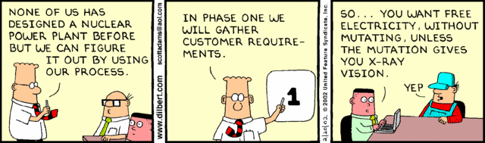
Approach 1: Asking the Stakeholder
The answers you elicit will depend on:
  The questions you ask
  What they think you want to know
For all stakeholders, you should ask questions and listen to the answer
Typical questions are:
  What are your requirements for the system (product, process or service)?
    What do you want?
    What don’t you want?
  Are there any features/aspects in the previous design you wish to keep?
  Are there any features/aspects in the previous design that must be avoided?
  What are your programme requirements? (time, cost, resource etc.)
A good tool for eliciting and capturing requirements is the Affinity Diagram

Slide 23
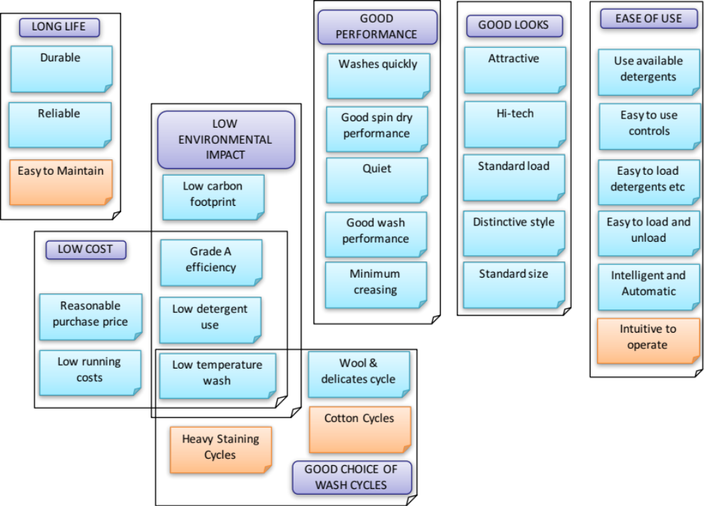
Affinity Diagrams
What is it?
  Affinity Diagramming is a simple tool that integrates both divergent and convergent thinking. It allows a team or individual to
    Generate ideas about a situation or problem
    Organize a large number of ideas, opinions, issues into meaningful groups
Why do it?
  An alternative to brainstorming when
    The situation under investigation is too large or complex
    There is a need to get agreement
    There is a need to communicate ideas to others
    There are issues with group personalities
In the example Affinity Diagram above, the individual requirements are captured on sticky notes or cards. These have been put in to form groups of requirements that have an affinity. Each group is given a header to create a higher-level requirement

Slide 24
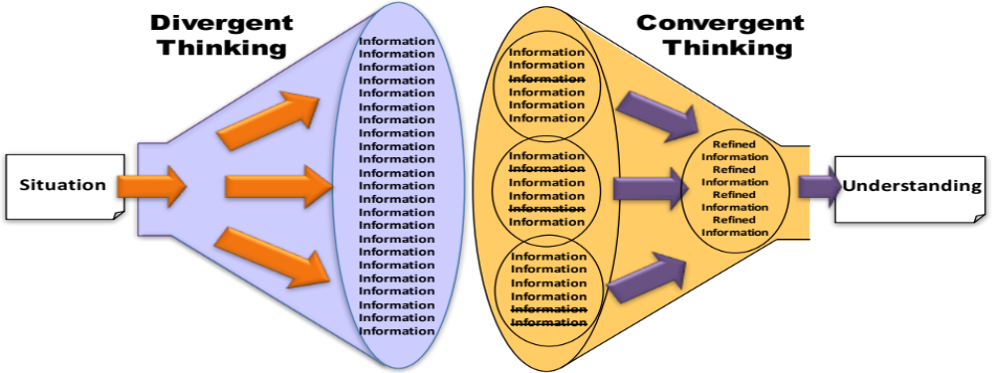
Affinity Diagram Process
Step 1: Identify and capture ideas
Step 2: Organize ideas in to affinity groups
Affinity Diagrams are created using Divergent and Convergent thinking
Step 3: Decide Group Headers
Step 4: Review affinity groups

Slide 25
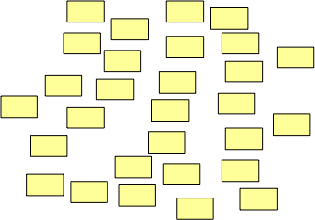
Step1: Identify and Capture Ideas
The team:
    Up to 7 members. If group larger than 7 consider splitting into two smaller teams
    Team has knowledge and background to issue or situation
    Preferably some inexperienced members – to ask the obvious
The process:
  Divergent Thinking
    Uses sticky notes or cards to record the individual views/ideas about issue or situation
    Each team member writes their ideas on a sticky note or card with one per note or card
    Ideas posted on a wall or pin board
    Quantity not quality is emphasised

Slide 26
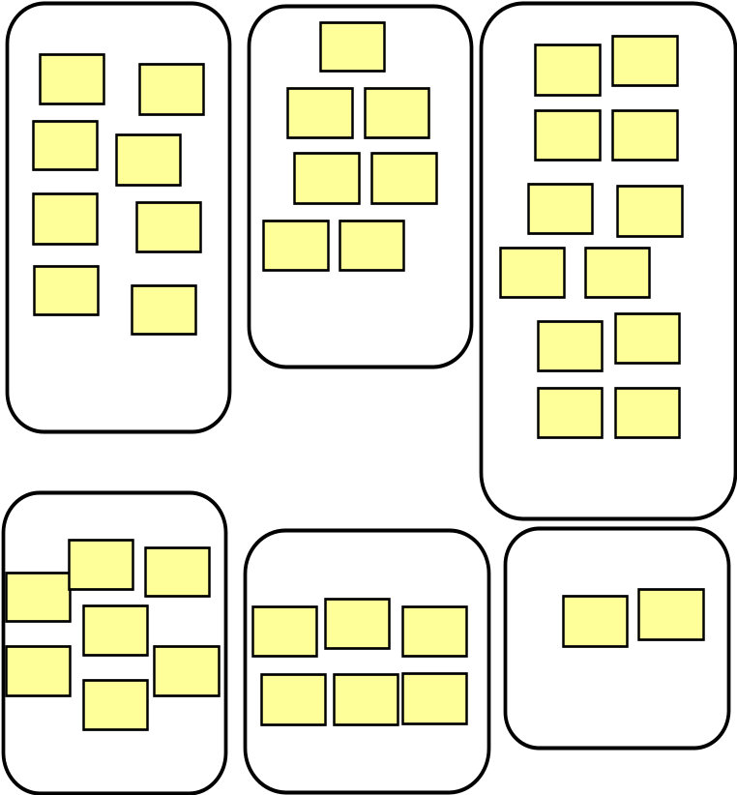
Step 2: Organize Ideas into Affinity Groups
Should be done in SILENCE!
The team organize the sticky notes or cards into related groups (themes) – that have an affinity
Everyone moves sticky notes or cards to place them with others with which they consider they have affinities
Allow new groups to emerge if a sticky note “moves around” a lot
Consider sub-dividing large groups (>10 items)

Slide 27
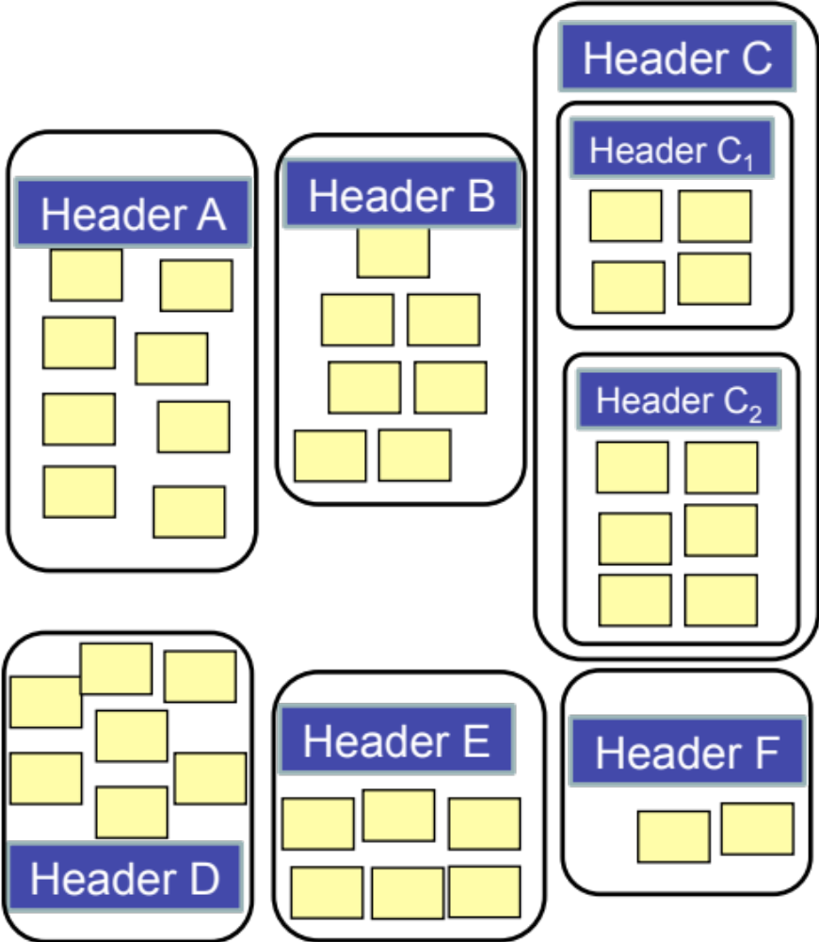
Step 3: Decide Group Headers
Each group should be given a header that describes the contents of the group
This may be an existing sticky note or card
If you have difficulty finding a suitable header – question the grouping
Make sure the “headers” reflect the context of the Affinity Diagram

Slide 28
Step 4: Review Affinity Groups
Review groups to:
  Remove duplications
    Sticky notes or cards that are the same
    Sticky notes or cards that are similar
  Consider each group for new items
  Consider alternative groupings

Slide 29
Affinity Diagrams in Gathering Requirements
The Affinity Diagram is tool for generating and organizing ideas and information
It is a very powerful alternative to Brainstorming
It can be used for:
  Root cause analysis
  Solution generation
  Goal and objective definition
  Task and activity definition
  Requirements capture
It is particularly useful when gathering requirements to elicit and capture requirements from stakeholders because:
  Encourages the stakeholder to write their own requirements so we capture their words
  Overcome any individual dominating the requirements capture session
  Allows everybody to contribute
  Organizes the requirements in a simple structure

Slide 30
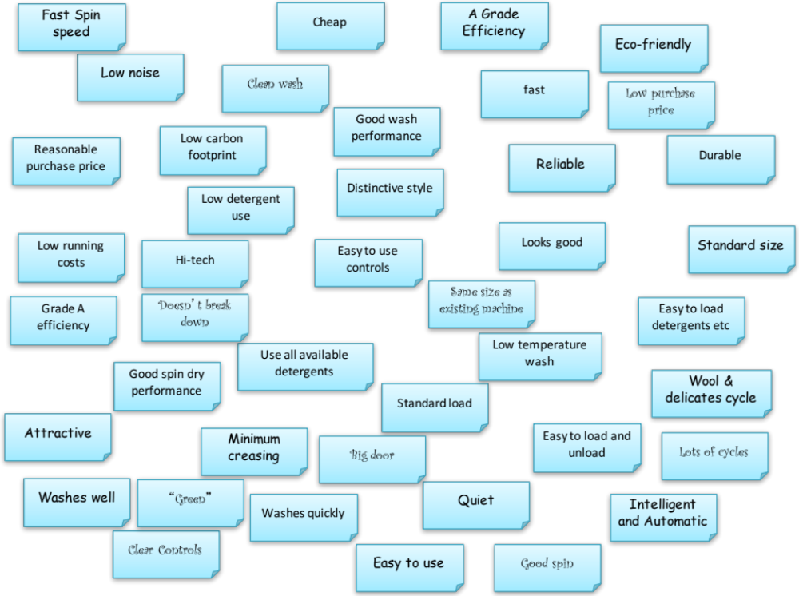
Example: Step1: Identify and Capture Requirements
A Focus Group (a small team of Users) was used to brainstorm and organize requirements for a washing machine
Step 1:
Team members individually capture their thoughts on sticky notes and put on a wall

Slide 31
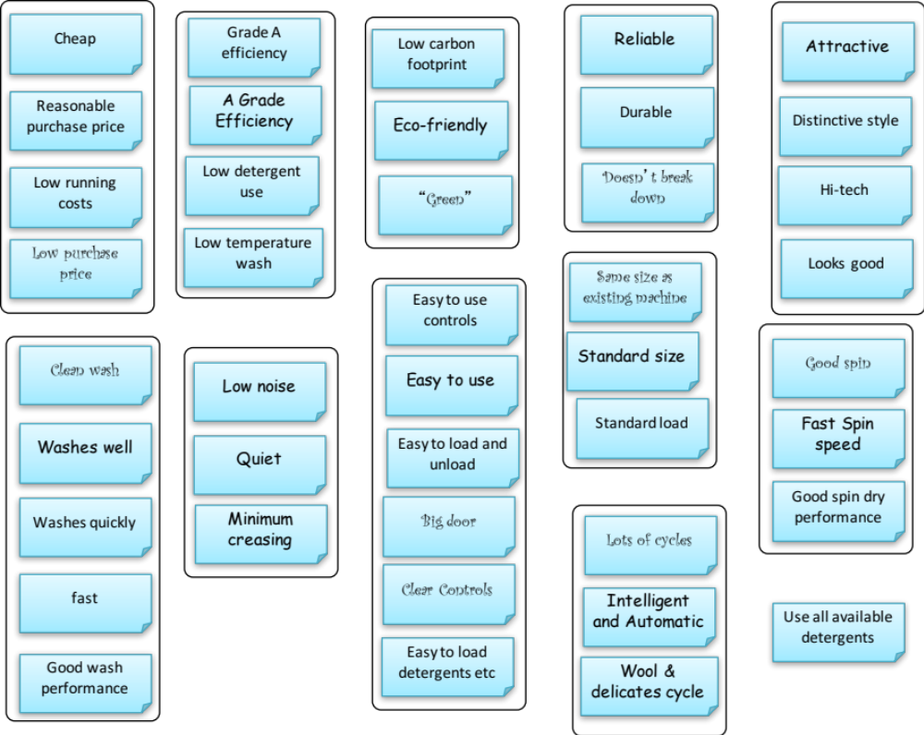
Step 2: Organize Requirements in to Affinity Groups
Step 2:
The team, in silence, organize the requirements into groups that have affinities

Slide 32
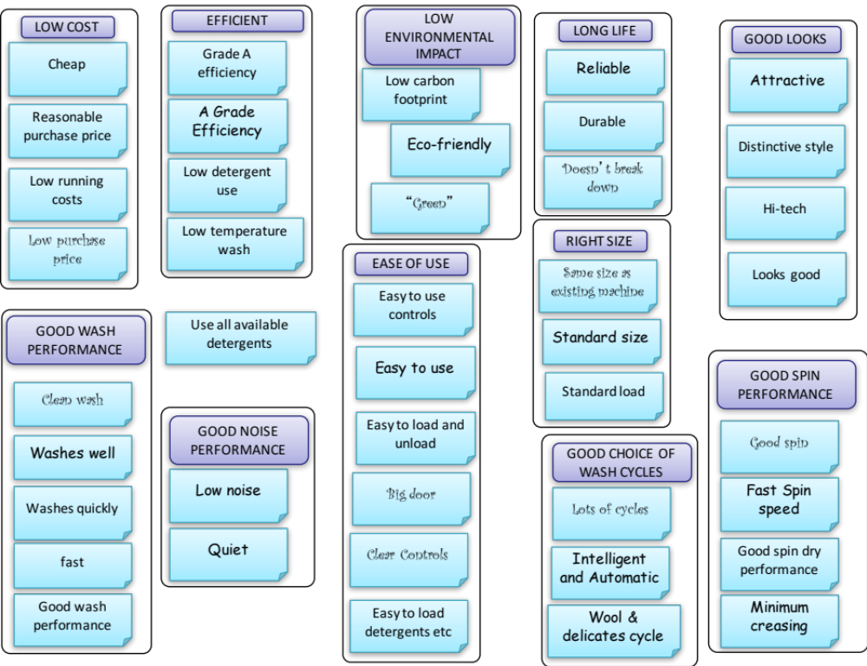
Step 3: Decide Group Headers
Step 3:
The team, decide headers for each group, the header may be an existing sticky note. The chosen headers can lead to a re-organization of the sticky notes
In this requirements example the headers themselves should be requirements!

Slide 33
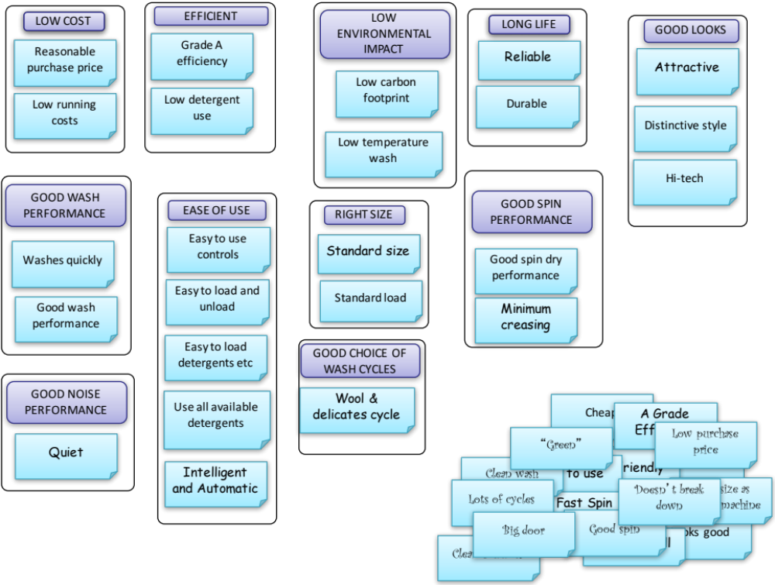
Step 4: Review Affinity Groups a) Remove/Reconcile Duplications
Step 4a)
The sticky notes are reviewed and duplications discussed and where appropriate removed and revised
Removed Duplications

Slide 34
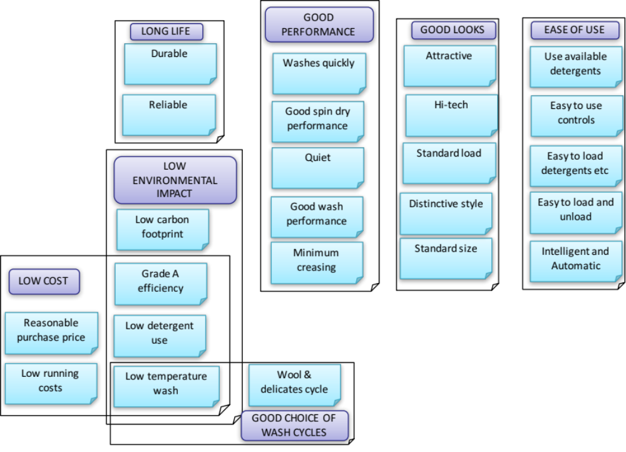
Complex Groupings
We often find that some sticky notes could reside in several groups. In such situations Affinity Diagrams can be used to capture complex groupings

Slide 35
Step 4: Review Affinity Groups b) Review Groups for Further Elements
Step 4b)
The groups are reviewed for further items
Have we got all the requirements that relate to “ease of use?”

Slide 36
Exercise: Affinity Diagram
In small Teams
  Create an Affinity Diagram for the User Requirements of the system described by the Trainer
Time 25 minutes
10
mins
15
mins
Aim for 7±2 Groups
10 Max

Slide 37
Affinity Diagram Summary
Pros
  Easy to use
  Generates lots of ideas (two heads are better than one)
  Promotes discussion
  Consensus view – a shared and common understanding
  Organized output
  Useful in hierarchical groups – everybody contributes “evenly”
Cons
  Difficulties in finding agreed affinities
  Deciding on the headers
  Don’t spend the time checking out duplications
  Don’t spend the time investigating complex groupings
  Don’t spend the time seeking additional elements
  Output format not intuitive to novice reader

Slide 38
Probing for Requirements
Stakeholders are often biased by their prior experience and couch the requirements in terms of what they know – i.e. a solution-based requirement (NFI): e.g. I want a touch screen display or Grade A energy efficiency
We need to identify such situations and ask “probing” questions - “why do you want a touch screen display?” to get at the true requirement – which might be “easy to use”

Slide 39
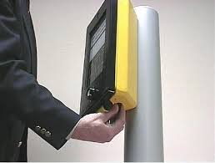
Approach 2: The Use Case
What is it?
  An alternative to “what do you want?” is to ask the stakeholder (particularly the user) to describe in a story how they expect to USE the system (hence the name Use Case)
Why use it?
  It is a natural intuitive communication
  The stories situate requirements in context
  Define logical chunks of functionality
  Can help define both wanted and unwanted behaviour
How to do it
  Ask the user to describe in a time-line how they expect to interact with the system and how they expect the system to respond. For moded or multipurpose systems it may be necessary to have a number of Use Cases for different “scenarios”
USE Case for a Pedestrian Crossing
Pedestrian approaches crossing that informs pedestrian not to cross
Pedestrian makes cross request
System waits, shows red light to cars, waits, informs pedestrian it is safe to cross
Pedestrian crosses
System continues to inform pedestrian it is safe to cross
System informs pedestrian it is not safe to cross, waits, shows green light to cars
In the example above, the Use Case describes, generically, how a user (pedestrian) has to interact with the crossing to safely cross

Slide 40
Solution to Generic
  One of the potential drawbacks with Use Cases is that it elicits a description of an existing system design. In such situations it may be necessary to “abstract” the Use Case to get the generic functions
Use Case for Pedestrian Crossing
Pedestrian approaches crossing that shows red light to pedestrian
Pedestrian presses cross button, button lights to indicate press successful
System waits, shows red light to cars, waits, shows green light to pedestrians
Pedestrian crosses
System gives visual and audible warning
System shows red light to pedestrians, waits, shows green light to cars
Generic Version
Use Case for a generic Pedestrian Crossing
Pedestrian approaches crossing that informs pedestrian not to cross
Pedestrian makes cross request
System waits, shows red light to cars, waits, informs pedestrian it is safe to cross
Pedestrian crosses
System continues to inform pedestrian it is safe to cross
System informs pedestrian it is not safe to cross, waits, shows green light to cars
Why still Red and Green lights for the cars?

Slide 41
Exercise: Use Cases
Generic Version
Use Case for a generic Pedestrian Crossing
Pedestrian approaches crossing that informs pedestrian not to cross
Pedestrian makes cross request
System waits, shows red light to cars, waits, informs pedestrian it is safe to cross
Pedestrian crosses
System continues to inform pedestrian it is safe to cross
System informs pedestrian it is not safe to cross, waits, shows green light to cars
In Small Teams
  Write a simple Use Case as to how the User would expect to interact with the system under development
Time 20 Minutes

Slide 42
Use Case Summary
Pros
  Can extract system functionality from the stakeholder
  Intuitive to stakeholder
  Can be useful for unprecedented systems to capture the perceived concept of operation
Cons
  Stakeholder often relates to and describes an existing design solution – we may need to “abstract” the Use Case to determine the generic system functions
  Getting the “right” level for the functionality – not too high or too low.
  Not very useful for embedded, automatic or some unprecedented systems. The for example asking a pilot to write a Use Case for an aircraft power plant will not provide much information
  Does not elicit Non-Functional constraint type requirements

Slide 43
Approach 3: Put Yourself in Their Shoes
In many situations, gathering requirements is a lengthy activity - but it is possible to generate requirements (and therefore proceed with the system design) by “putting yourself in their shoes”
This will certainly generate some realistic requirements but there is the risk that these are what we “want” and not what stakeholders actually want!
Again an Affinity Diagram can be used to generate, capture and organize the requirements
The lesson is: - Validate your view of stakeholder requirements
Beware
SAAB engineers were convinced that customers needed a glove box that could fit an A4 file. This could only be achieved through a design that compromised access. Customers hated it at production evaluation and it had to be re-designed at x1000 times the original development costs.

Slide 44
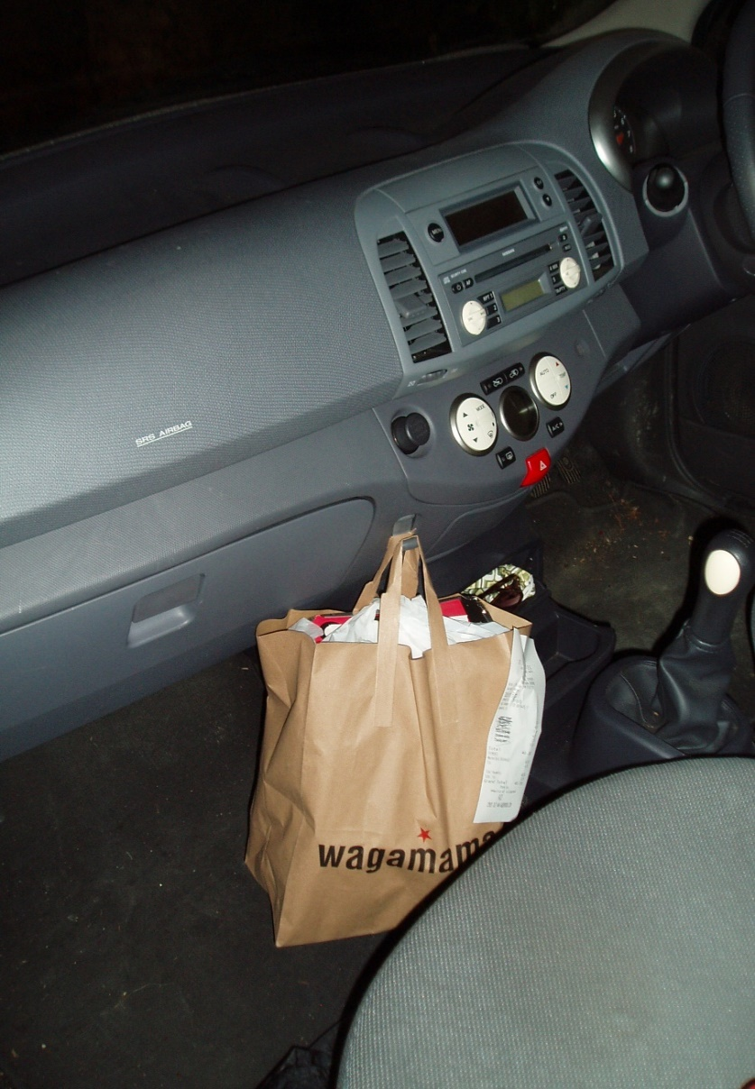
Approach 4: Gemba Visits
People can find it hard to verbally articulate their thoughts – other methods are necessary
People very often accept a sub-standard level of performance and don’t believe there are problems when using a product because ‘I thought this was it’.
People are flexible and learn to adapt to using a system of inferior quality.
Observing end users (Gemba Visit) is one way to unearth some unarticulated needs.
Observing end users with other stakeholders also aids our understanding of their needs and requirements.

Slide 45
Other Sources of Requirements
Gathering requirements does not have to be proactive, some requirements will arrive come what may. If we do a “bad job” stakeholders will complain and these are a good source of basic and assumed requirements
Proactive systems
You need to put effort into gathering the information
  Interviews and focus groups
    Affinity and Tree Diagrams
    Use Cases and Scenarios
  Pretend to be the stakeholder (Put yourself in their shoes)
    Affinity and Tree Diagrams
    Use Cases and Scenarios
  Direct observation (Gemba visits)
  Market Research and Benchmarking
This information tells us about past, current and future needs
Reactive systems
Information comes to you whether you take action or not
  Complaints
  Problem or service messages
  Technical support messages
  Sales team reporting
  System return information
  Warranty claims
This information tells us about current and past problems
Very useful in determining unspoken requirements and in identifying delighters

Slide 46
Requirements Elicitation
We have to think carefully about the “best” elicitation method or methods for a particular stakeholder – it’s easy to try and “do all of them”
It is important to consider the drivers:
  The business case
  The stage of design
  The point in the life cycle
  The project/programme requirements – particularly timescales

Slide 47
Update Requirements Elicitation Plan
Any documents that contain potential requirement sources – e.g. Customer Specifications, Customer complaints, Manufacturing defect reports should be noted here
Update Requirements Elicitation Plan with the elicitation methods chosen for each stakeholder or stakeholder group

Slide 48
Capturing Requirements
Sometimes stakeholders will provide a set of written requirements
Sometimes stakeholders will only speak their requirements
Expect a mixture of both types of stakeholder
Stakeholder wants
  May be ideal, unattainable, expressed really as goals rather than true attainable requirements – but we should still capture them
Many stakeholders, with different requirements
  Will include conflicts and therefore will need to trade
If possible ask the stakeholder why?
When stakeholders speak their requirements we will have to capture them
This can be done as:
  A list of requirements
    We should always try to capture the exact words spoken by the stakeholder
    When interviewing stakeholders work in pairs: one asking the questions one writing down the reply
  Affinity Diagrams
    Captures the actual words of the stakeholder but they may need some help
  A Use Case
    A text based description (story) of how a stakeholder expects a system to respond to a request from a stakeholder – particularly useful for software/process intensive systems
  A Requirements Model
    Builds up a pictorial view of the stakeholders’ requirements – see functional modelling later

Slide 49
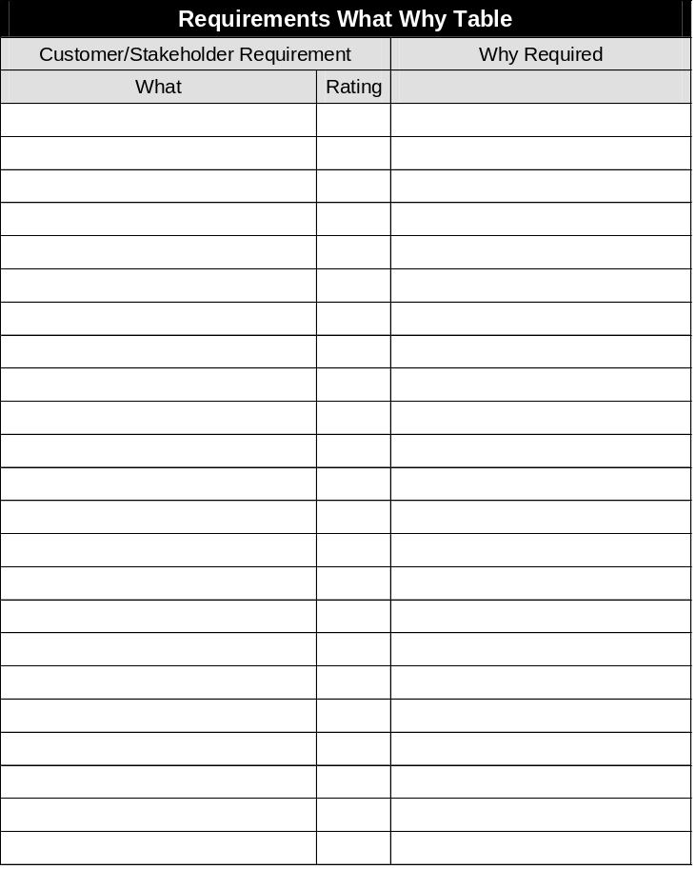
Completing the list – digging deeper
Understanding WHY the requirement is being requested is important because
  It helps us to understand the need that the requirement satisfies
  It can help clarify the requirement through understanding the rationale It can help refine solution based expressed requirements (NFI):
    determines whether the expressed solution based requirements is justifiable (and therefore retained) or lazy (and therefore subject to further analysis for re-definition)
  Can help understand the importance of requirements
  Can help identify delighters
Capturing requirement rationale is important since it provides the context
If we are eliciting requirements from a Stakeholder we can also ask how important the requirements are. Typically on a 1 – 5 scale (5 more important)

Slide 50
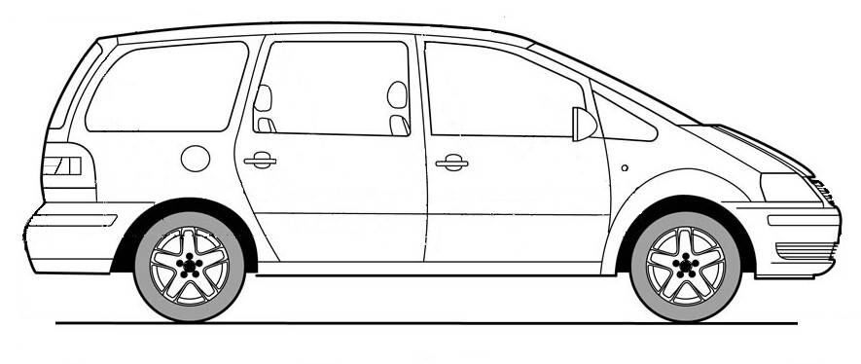
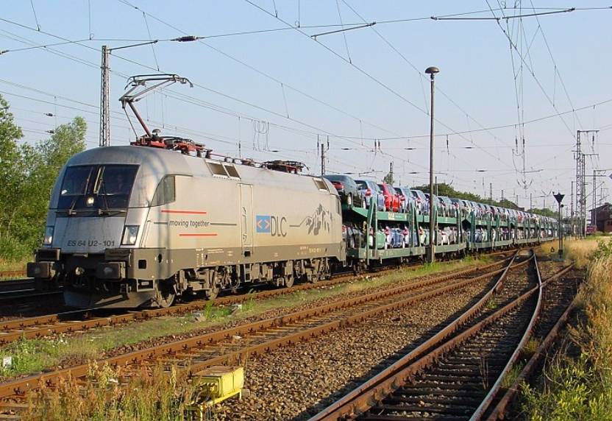
Why ask Why?
The designer assumed this was an error and rewrote the requirement to a more “realistic“ value:
  let a maximum backwards speed of the car be 32km/h.
It turned out that the first batch of cars delivered had the rear window lying inside the car – Because:
Requirement:
The rear window must be capable of surviving a wind speed of 160 km/h
Cost and weight targets exist as well

Slide 51
An Iterative Process
Identify Stakeholders
Elicit and Capture the
Voice of the Stakeholder
Organize the
Voice of the Stakeholder
Having gathered requirements
it is important to structure them to:
  help understand relationships between requirements
  simplify the requirements
  help manage the requirements
A useful tool is a Tree Diagram
Validate the Voice
of the Stakeholder

Slide 52
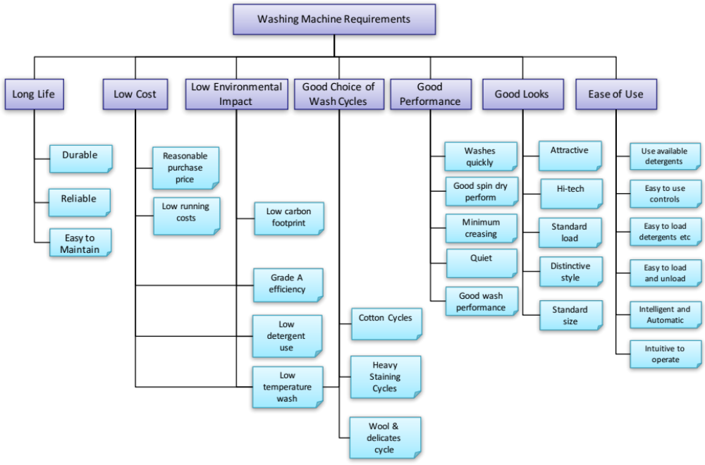
Tree Diagram (alias Systematic Diagram)
What is it?
  A simple tool that helps with the logical hierarchical breakdown of ideas, situations, events, activities, or things
Why do it?
  To manage complexity through sub-division
Presents information in an intuitive format
Can be used to organize:
  Goal or objective
  Task or activity
  Thing or product
  Need or requirement
  Problem or Issue
In the example Tree Diagram above, the requirements for a washing machine are shown in a simple hierarchy.

Slide 53
How to do it: Tree Diagrams from Affinity Diagrams
Affinity Diagrams
  In some situations it is easier and more convenient to start with a brainstorming session to generate ideas that can be logically grouped (and sub-grouped)
  This grouping can be used to form the basic Tree Diagram
C₂
A₁
B
C
C₁
B
A₂
C₁
A₂
A
A
A₁
C₂
C

Slide 54
Requirements Tree Diagram

Slide 55
Tree Diagram Summary
Pros
  Easy to build and read
  Promotes discussion
  Organized output
  Output intuitive to novice reader
Cons
  Encourages reductionist thinking rather than system thinking (there will be relationships beyond the simple hierarchy)

Slide 56
Prioritizing Requirements
The Tree Diagram provides one approach to organizing requirements
It can be useful to also consider the relative importance of the requirements
  This can provide additional information that will be useful later
Tools for prioritizing requirements include
  Stakeholder (Customer) Importance Numbers
  Analytic Hierarchy Process

Slide 57
Stakeholder Importance Numbers
Each Stakeholder Requirement is assigned an importance rating typically expressed using a scale of 1 to 5 with higher numbers indicating a greater importance to the “customer” (stakeholder)
It is important that these reflect the values of the stakeholder and NOT internal company beliefs; however, many organizations start from an internal assessment
There are several ways to determine the Customer Importance numbers.
Absolute scales use definitions like:
    1 Lowest importance to the customer
    2 Moderate importance to the customer
    3 Medium importance to the customer
    4 Very important to the customer
    5 Of highest importance to the customer
Absolute scales are perhaps the easiest to apply but do lead to only the upper numbers being used (3 to 5). This is because if the stakeholder has articulated a requirement then it is hardly going to be rated as a 1
An alternative is a “Sales Driven” scale

Slide 58
Sales Driven Scale
An alternative to the absolute scale is the sales driven scale based on the concept of Order Winners and Order Qualifiers
  Order Winners: those aspects of a system that WIN it orders in the market place. If we are better than our competition we will win on these aspects.
  Order Qualifiers: those aspects of a product that KEEP it in the market place. We only need to be as good as the competition in these aspects. Bettering the competition does not win any further orders. These are sometimes called ‘givens’. However, these can be order-losing sensitive. That is we must be as good as the competition, if we are worse we will not win ANY orders.
The advantage of this scale is that it avoids emotional scoring!

Slide 59
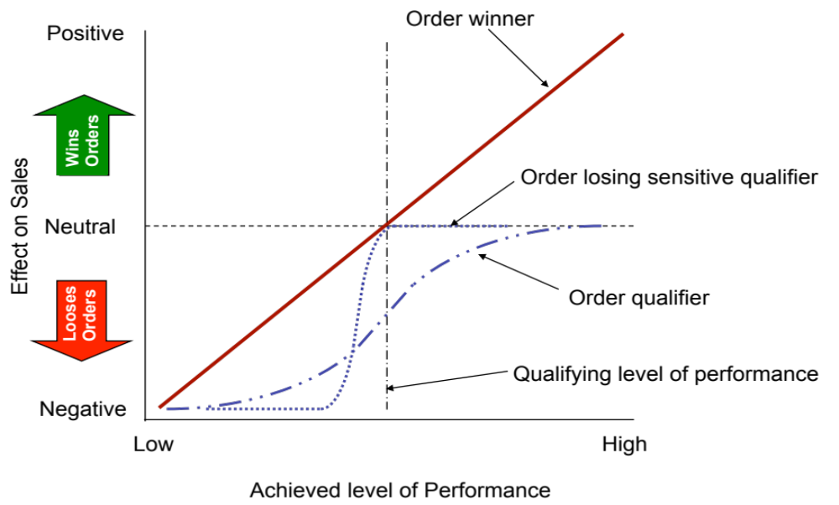
Order Winners and Qualifiers
Order qualifying criteria are ‘givens’ that the customer expects to be there at a certain level. Exceeding this level is unlikely to bring in more sales and failure to deliver to this level leads to customer dissatisfaction. On the 1 to 5 scale, such customer requirements are rated as a 1 or 2. Some qualifying criteria can be sensitive in that failure to reach the perceived minimum standard will result in a loss of orders. These
criteria are typically aspects like safety where a minimum safety level is expected (due to legislation for example) and failing to meet that level will halt customer purchases. These are called order losing sensitive qualifiers. Such criteria are rated between 3 or 4. Order winners are those aspects in which improvements will result in an increase in sales. These are rated 4 or 5.

Slide 60
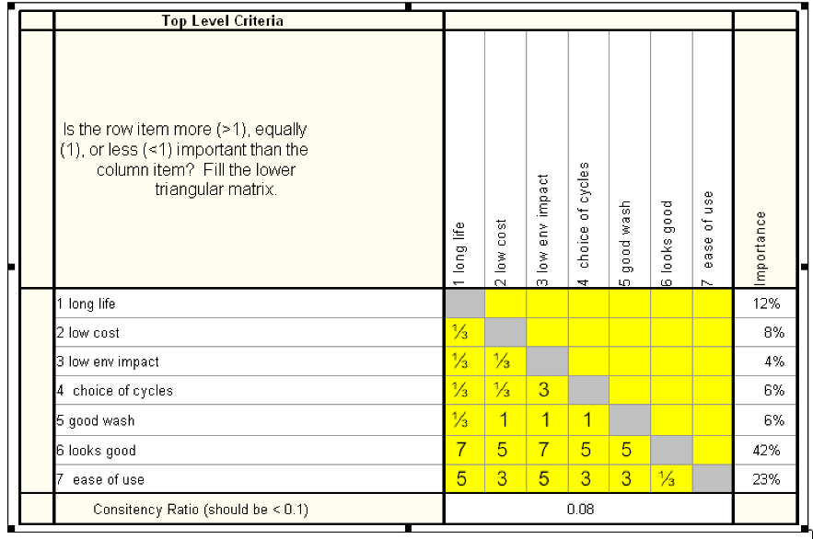
Analytic Hierarchy Process
What is it?
  The Analytic Hierarchy Process (AHP) provides an effective structure for group decision-making. It can be used to:
    Select between a number of options
    Prioritise requirements/decision criteria
  It helps the group assign numerical values to subjective judgments about a number of criteria and consequently combining the judgments into a single scale for decision-making.
Why do it?
  Prioritising or deciding often concerns a number of criteria whose selection is at the bidding of the decision-makers. These various criteria are likely to be measured on different scales, such as weight and height, or are intangible, as no scales currently exist. Ideally, we require a way of combining these criteria in a meaningful way.
  The Analytic Hierarchy Process provides a structured and disciplined approach to taking these multiple criteria into account when reaching a decision providing a result on a single scale
In the example Analytic Hierarchy Process matrix above, the requirements for a washing machine are prioritised for importance

Slide 61
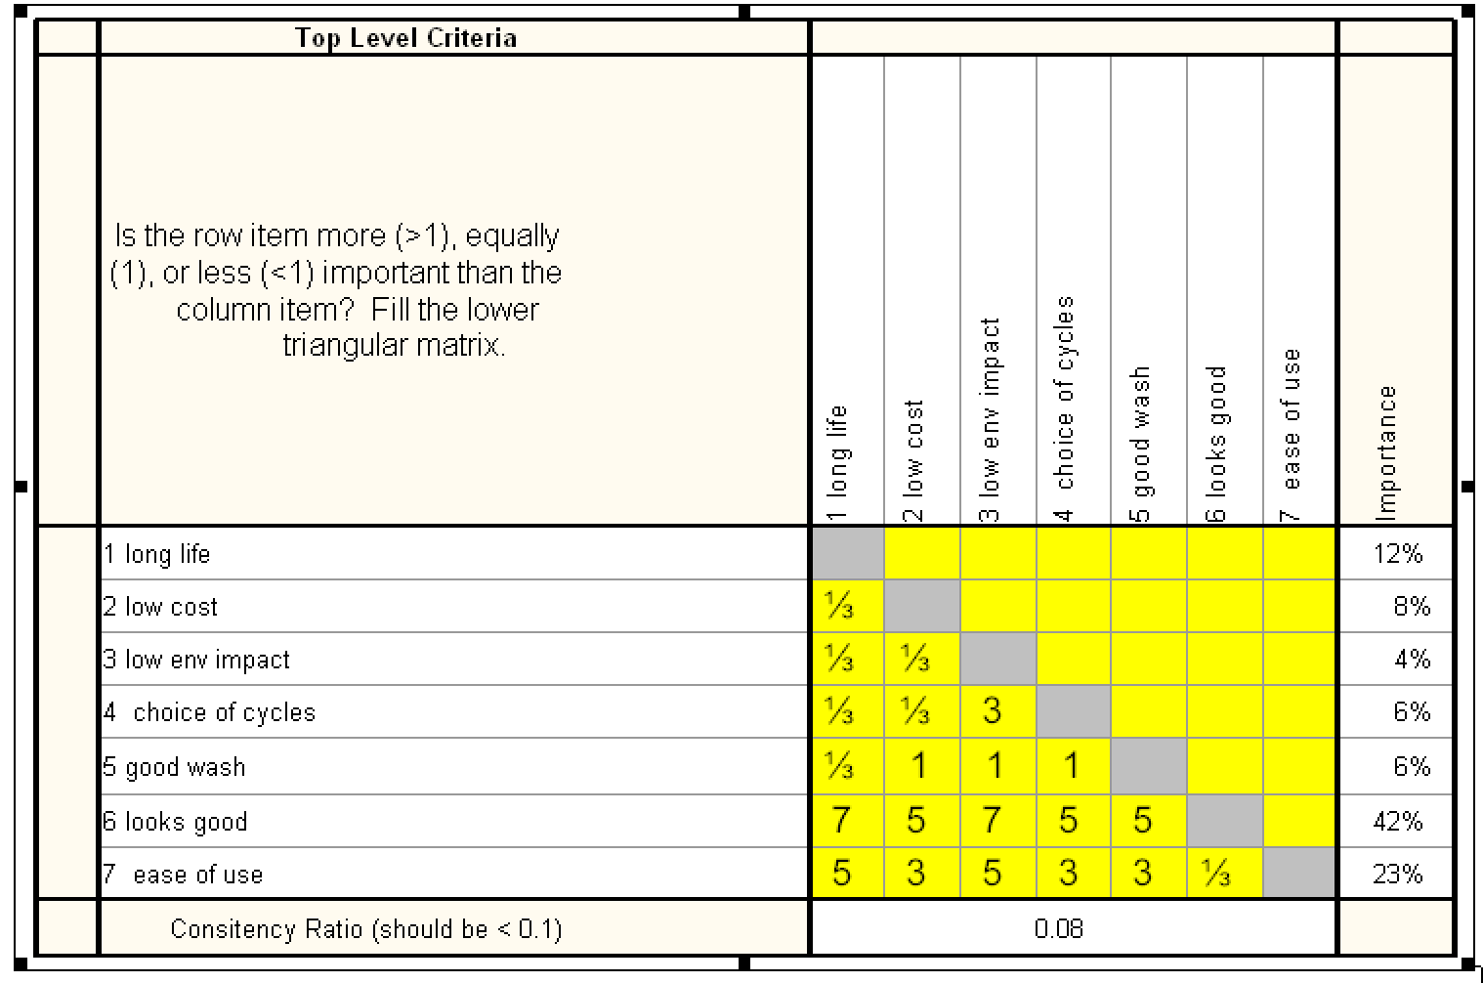
AHP Output for Requirement Prioritisation
The main output of interest is the priority of each of the requirements on a true ratio scale
An Importance of 40% for Safer to use versus 19% for Easier to use means that Safer to use is twice as important as Easier to use.
Rankings do not give you this discrimination
Another key output is a consistency ratio. Have we been consistent in our assessment?
Notes:
61

Slide 62
AHP Process
STEP 1
Construct the Decision Hierarchy
STEP 2
Perform paired comparisons
STEP 3
Analyse the Paired Comparisons and check consistency
STEP 4
Make the final decision

Slide 63
Step 1: Construct Decision Hierarchy
The Analytic Hierarchy Process requires us to decompose the decision problem into a hierarchy of more easily comprehended sub-problems, each of which can be analyzed independently
The elements of the hierarchy can relate to any aspect of the decision problem: tangible or intangible, carefully measured or roughly estimated, well, or poorly-understood, indeed anything that applies to the decision at hand
LEVEL 1
LEVEL 2
LEVEL 3
The key is to apply a series of AHPs at each level.
  Level 2 – to prioritize the primary criteria
  Level 3 – a series of AHPs that prioritize each cluster of secondary criteria beneath their respective primary criterion

Slide 64
The AHP Decision Hierarchy
AHP hierarchies are best explained by example. In this case the aims is to prioritise a set of gathered User Requirements by Affinity Diagram and Tree Diagram such that we have the tree
These are all on a similar level of scale when comparing concepts
We can use this Requirements Tree Diagram as an AHP Decision Hierarchy

Slide 65
Setting Up the Paired Comparison Matrix
To perform the AHP a group of criteria at the same level are subject to a pairwise comparisons systematically using an NxN matrix – where N represents the number of criterion being prioritized.
For example returning to the washing machine User Requirements the following matrix is constructed from the primary requirements
The leading diagonal is filled with 1s, indicating that first row requirement “Long Life” is equally as important as the first column requirement “Long Life”

Slide 66
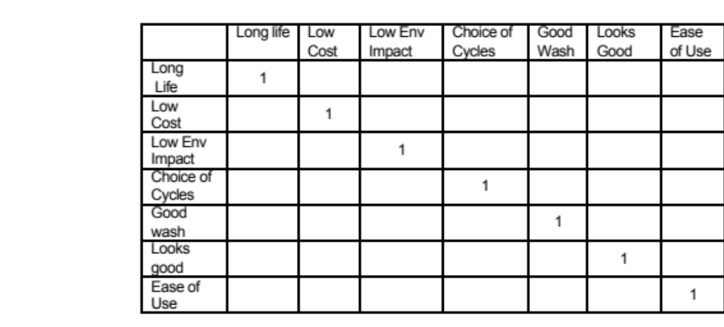
Setting up - Continued
The lower left half of the Paired Comparison Matrix is filled with formulae to compute the inverses of their conjugate cells
This cell will contain a number
This cell is its inverse

Slide 67
Step 2: Perform Paired Comparisons
Paired comparisons are then performed on the criteria – order is important - it’s always the rows versus the columns
When performing the paired comparisons the phrasing of the question is VERY important
If we were comparing the criteria of Long Life and Low Cost we could ask:
  “How much more important to the User is improved Long Life than improved Low Cost”
Or we could be more specific if there are improvement targets x and y:
  “How much more benefit to the User would it be to improve Long Life by x% than to improve Low Cost by y%”
Getting the question right is very important. It is always worthwhile pre-preparing the Comparison Matrix and questions before the comparison session
Notes:
67

Slide 68
AHP Paired Comparison Scale
We use a standard scale for making these judgments which accounts for cases when a criterion is less important than another and when it is more important
Intensity of Importance | Definition | Interpretation
1 | Equal importance | Two factors contribute equally to the objective
3 | Moderately more important | Experience and judgment slightly favour one factor over another
5 | Strongly more important | Experience and judgment strongly favour one factor over another
7 | Very strongly more important | A factor is favoured very strongly over another; its dominance is demonstrated in practice.
9 | Extremely more important | The evidence favouring one factor over another is of the highest possible order of affirmation.
2,4,6,8 | For compromise between the above values | Sometimes one needs to interpolate a compromise judgment numerically because there is no good word to describe it.
Reciprocals of above | If factor j has one of the above numbers assigned to it when compared with activity k, then k has the reciprocal value when compared with j. | The inverse meaning to the above; If comparing A with B then a reciprocal value would mean that A was dominated by B; e.g. 1/5 means that A is strongly dominated by B.

Slide 69
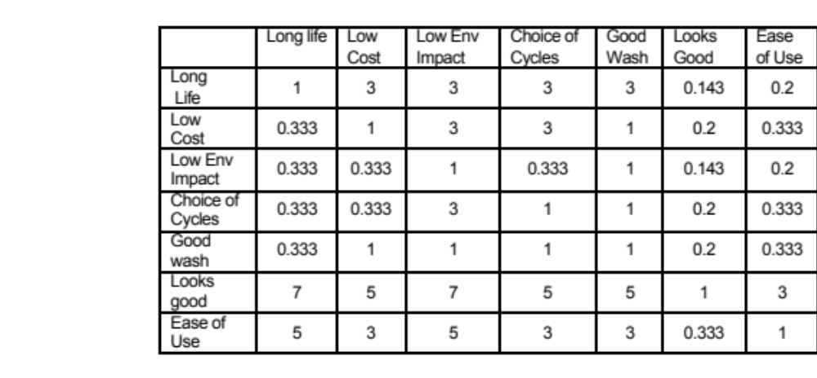
Washing Machine Example
The question here was “How much more important to the customer is improved Long Life than improved Low Cost”?
The judgment was “it is somewhat more important”
With the table populated, we can do the analysis to calculate the importance weightings.

Slide 70
Step 3: Analyse the Paired Comparisons and check consistency
The analysis behind the computation of the relative priorities of each of the criteria is fairly involved, but software packages ease the burden.
The analysis comprises two basic steps:
  Calculation of the importance weighting
  Calculation of the consistency ratio
The Consistency Ratio is an important metric for assessing the quality of the analysis – i.e. how good our decision is!

Slide 71
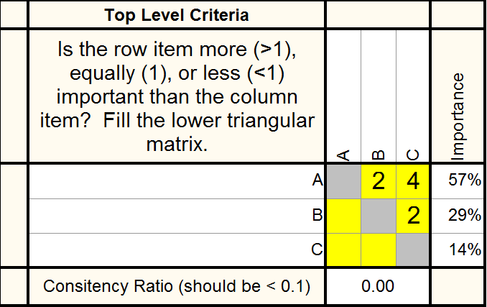
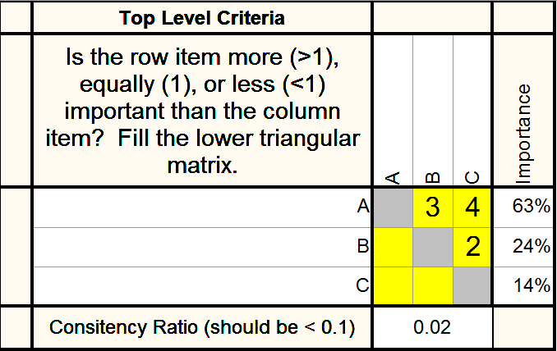

Consistency Ratio
A > B
B > C
C ? A
A = 2B
B = 2C
C = ?A
A = 3B
B = 2C
C = 1/4A

Slide 72
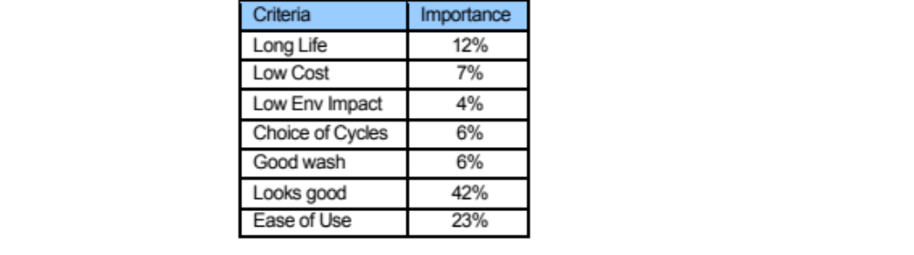
The Results
The following results where obtained using the software package called Qualica
This result is saying “Looks Good” is approximately three as important as “Long Life”
This result is saying “Looks Good” is approximately three as important as “Long Life”
This result is saying “Looks Good” is approximately twice as good as “Ease of use”
This result is saying “Looks Good” is approximately twice as important as “Ease of use”
Consistency Ratio = 0.08
The Consistency Ratio = 0.08 is below 10% and therefore shows the judgments on the Pairwise table are consistent

Slide 73
Guidance on Applying AHP
The example given to illustrate the process had a small number of criteria (Requirements)
In practice we could be dealing with a large number of criteria especially if we are using AHP to prioritize requirements we would construct a requirement hierarchy
AHP works best when the number of requirements at any one level is 7 or less. If you have too many then look to aggregate requirements to reduce the number
  It is critical that the requirement hierarchy is carefully constructed and that all the requirements at a level in the hierarchy are truly at the same level – don’t mix high and low in a single AHP table
  The Affinity/Tree Diagrams are useful tools to accomplish this

Slide 74
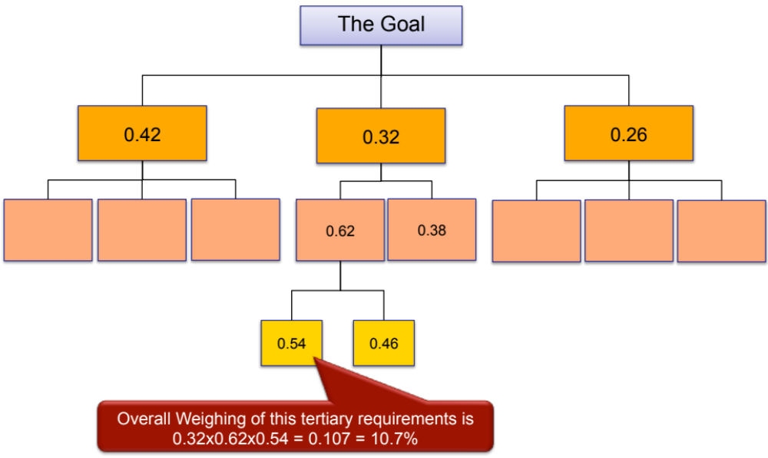
Step 4: Make the Final Decision
We can multiply the “importances” down through the hierarchy to get lowest level weightings

Slide 75
Some words of advice
The Analytic Hierarchy Process gives discipline and structure to our decision making and prioritisation – BUT because we have done some mathematics and have numbers we can be lulled into believing in the precision of the outcome.
  Use the weightings to help guide subsequent activities
  Recognise there is still a large degree of subjectivity in the assessments
  Perform a sensitivity analysis to test the robustness of the final prioritisation

Slide 76
Exercise – AHP Pairwise Table
In teams
  Use the primary requirements from the User Requirements Affinity (Tree) Diagram and complete the pairwise table
  At a break the Trainers will perform the analysis
Time: 20 minutes

Slide 77
Analytic Hierarchy Process Summary
Pros
  If performed in a team can promote
    Discussion
    Thinking
  Structured and disciplined process
  Prioritises requirements on a true ratio scale
  Checks consistency
Cons
  Deciding who does this – who should be involved
  Mathematical basis adds unfounded credibility
  Tedious in many requirements (limit of 7 – 10 per level)

Slide 78
An Iterative Process
Identify Stakeholders
Elicit and Capture the
Voice of the Stakeholder
Organize the
Voice of the Stakeholder
Validate the Voice
of the Stakeholder
Wherever possible we should attempt to validate any requirements – (validate = is a particular requirement correct)

Slide 79
Validate Requirements
This can take many forms including:
  Presenting and walking through the requirements to different groups of representative stakeholders for comment and agreement
  Providing the stakeholders with copies of our written and structured requirements for comment and agreement
  Cross checking with other requirements – in particular the system design requirements – this is usually part of analyse requirements
Note: The ultimate validation of requirements happens when the system is delivered – but by then it is too late!

Slide 80
Gather Requirements Summary
This section has
  Explained the need for a systematic approach to gathering requirements
  Presented a process for gathering requirements
  Introduced some tools and techniques for gathering requirements
    Requirements Elicitation Plan
    Stakeholder Influence Map
    Affinity Diagram
    Use Case
    (Requirements) Tree Diagram
    Analytic Hierarchy Process

