Slide 1


Determine System Requirements
Analyse Requirements
Secondary Information Goes Here
This Session:
Explains the need to analyse gathered stakeholder requirements
Presents a process for analysing requirements
Provides an introduction to some of the tools for analysing requirements

Slide 2
Why Analyse Requirements
Despite every effort in gathering requirements, stakeholder requirements will be:
  Ambiguous
  Rambling
  Incomplete
  Inconsistent
  Incorrect
The purpose of Analysing Requirements is to translate the Expressed (spoken) stakeholder requirements into a set of System Design Requirements that are:
  Clear (Unambiguous)
  Concise
  Complete
  Consistent
  Correct
  and ultimately Confirmable (Measurable)

Slide 3
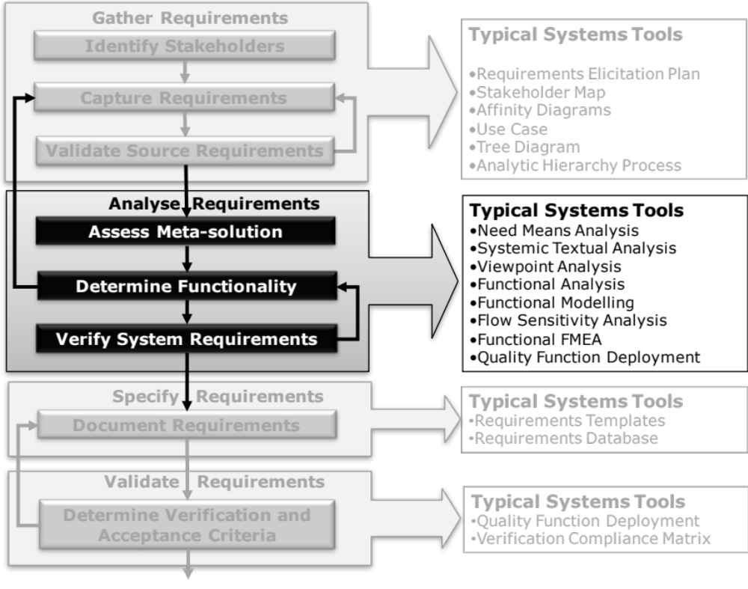
Key Tasks and Systems Tools
Notes:
9
9

Slide 4
What have we done?
Gathering Requirements is concerned with asking the User/Customer
The use of tools like Affinity Diagrams and Tree Diagrams will help elicit, capture and structure those expressed requirements
The response to the question is often a “Black Box” view comprising:
This is because they are important to the stakeholders
But from the Holistic Requirements Model we know what Requirements are missing
What are your requirements?
Non-functional System Requirements – those constraint-based requirements that can be attributed to the System
Non-functional Implementation Requirements – those solution-based requirements that can be justifiable or lazy
System of Interest

Slide 5
What Are We Going to do?
To “get at” the missing requirements we will have to analyse what has been expressed. The question we ask is
This is a “White Box” view of the system concerned with determining what is needed to deliver the “Black Box” performance
The White Box view will focus on uncovering the functionality (Functional Requirements) necessary to deliver the Operational Requirement of the System of Interest
What are the necessary requirements?
Operational Requirement
Functional Requirements
Non-functional System Requirements
Non-functional Implementation Requirements
Non-functional Performance Requirements
System of Interest

Slide 6
The Rationale
Given a problem statement in terms of an Operational Requirement we are going to use the laws of physics and logic to deduce the necessary Functionality needed to deliver it
From that collection of Functions we can ask two important questions:
  How well does a particular Function have to perform?
  What can go wrong?
To “put a Man of the moon ….” the laws of physic and logic tells me that I WILL have to:
  Escape Earth’s Gravity
  Accommodate Crew
  Navigate to Moon
  Land on Moon
  Explore Moon
  Escape Moon’s Gravity
  Navigate to Earth
  Land on Earth
  and many more …..

Slide 7
Analyse Requirements: An Iterative Process
Assess System Meta-Solution
Applying Systems Thinking to the task of analysing requirements tells us that we will need to take various perspectives to help uncover the unspoken requirements
Determine “working” Operational Requirement
Determine System Functionality
Determine Emergent Functionality
Determine Non-Functional Performance Requirements
The iteration may not be simple
Verify and Validate Requirements

Slide 8
And ……..
We will also need to reconcile inconsistency
To address ambiguity we first need to spot it and then resolve it
There is no single tool that will accomplish these tasks. Instead we use a System of Tools each contributing to the overall objective
The Holistic Requirements Model provides the reference structure

Slide 9














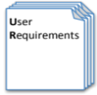



Process and Tools
Gather Requirements
Analyse and Validate Requirements
Specify
Requirements
The Business Requirements provide the rationale and overall business constraints for a system development project
Determine the Emergent Functionality
Stakeholder Map
Flow Sensitivity Analysis
The System Requirements defines the measurable design requirements for the system
Determine system stakeholders and select key ones for requirements elicitation
Identifies causal paths for potential system sensitivities
Functional Failure Mode and Effect Analysis
Quality Function Deployment 1
Captures the potential functional failure modes, effects and causes to identify remedies ab initio
Cross checks requirements for consistency and completeness
Verification Compliance Matrix
Affinity Diagram
Use Case
Determine Validation and Verification methods for each requirement and specify V& V Requirements
Elicit and capture key stakeholder requirements
Captures how a user expects to interact with a system
Determine the necessary generic System Functionality
Tree Diagram/Analytic Hierarchy Process
Systemic Textual Analysis
Viewpoint/Functional Analysis
Function Flow Diagram
Organize and prioritise key stakeholder requirements
Analyses expressed requirements into their atomic form to identify and clarify missing and ambiguous requirements
Generates and organizes system generic functionality necessary to achieve the Operational Requirement
Captures and shows how the component functionality of a system must cooperate to deliver the Operational Requirement
Requirements Database
The User Requirements defines the expressed requirements of a particular stakeholder or stakeholders
Need Mean Analysis
Identifies and explores system solutions at different levels to determine System Meta-Solution

Slide 10
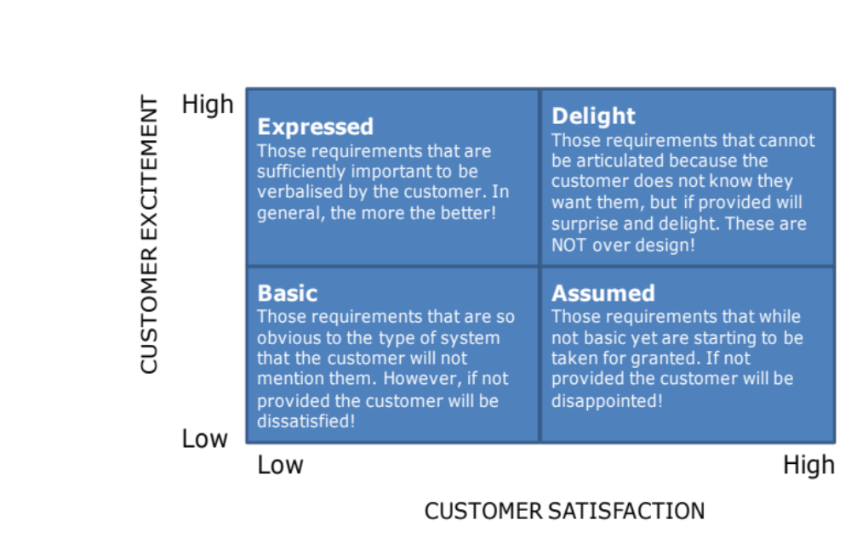
What do the Tools do?
Each of the tools helps us uncover more of the requirements space
Systemic Textual
Analysis
Flow Sensitivity
Analysis And
Functional
FMEA
Quality Function
Deployment 1
Viewpoint
Analysis/
Functional Analysis
Functional
Modelling

Slide 11
Gathering vs. Analysis
We have both to gather and analyse requirements
The more effort we put into gathering requirements the easier (faster and cheaper) the analysis becomes
There is a trade-off however
Tools like Quality Function Deployment can help in measuring the maturity of the requirements set
It is worth recording the effort expended in each activity to provide a reference for future projects
Effort to Analyse Requirements
Effort to Gather Requirements

Slide 12
How Much Effort?
Empirical data shows there is a relationship between the amount of effort (cost) spent on requirements engineering and the cost overrun in a project. However, spending more effort is not always productive
200
150
100
50
0
Percentage of Cost Overrun
0 5 10 15 20
Percentage of Development Cost spent on Requirements
Adapted from: Hooks, Managing Requirements, 1994 - Figure 1
and Young, Effective Requirements Practices, Addison-Wesley, 2001 - Figure 4-1

Slide 13
This section
Explained the need to analyse gathered stakeholder requirements
Presented a process for analysing requirements
Provided an introduction to some tools for analysing requirements
  Systemic Textual Analysis
  Viewpoint Analysis
  Functional Analysis
  Functional Modelling
  Sensitivity and Failure Analysis
  Quality Function Deployment

