Slide 1


Analyse Requirements
Assess the System Meta-solution using Need Means Analysis
Secondary Information Goes Here
This Session:
Highlights the need to explore potential system Meta-solutions early to scope system functionality
Describes Need Means Analysis as a simple practical tool for quickly assessing the potential system Meta-solutions

Slide 2


















Process and Tools
Gather Requirements
Analyse and Validate Requirements
Specify
Requirements
The Business Requirements provide the rationale and overall business constraints for a system development project
Determine the Emergent Functionality
Stakeholder Map
Flow Sensitivity Analysis
The System Requirements defines the measurable design requirements for the system
Determine system stakeholders and select key ones for requirements elicitation
Identifies causal paths for potential system sensitivities
Functional Failure Mode and Effect Analysis
Quality Function Deployment 1
Captures the potential functional failure modes, effects and causes to identify remedies ab initio
Cross checks requirements for consistency and completeness
Verification Compliance Matrix
Affinity Diagram
Use Case
Determine Validation and Verification methods for each requirement and specify V& V Requirements
Elicit and capture key stakeholder requirements
Captures how a user expects to interact with a system
Determine the necessary generic System Functionality
Tree Diagram/Analytic Hierarchy Process
Systemic Textual Analysis
Viewpoint/Functional Analysis
Function Flow Diagram
Organize and prioritise key stakeholder requirements
Analyses expressed requirements into their atomic form to identify and clarify missing and ambiguous requirements
Generates and organizes system generic functionality necessary to achieve the Operational Requirement
Captures and shows how the component functionality of a system must cooperate to deliver the Operational Requirement
Requirements Database
The User Requirements defines the expressed requirements of a particular stakeholder or stakeholders
Need Mean Analysis
Identifies and explores system solutions at different levels to determine System Meta-Solution

Slide 3
Where are we?: Analyse Requirements
Assess System Meta-Solution
Applying Systems Thinking to the task of analysing requirements tells us that we will need to take various perspectives to help uncover the unspoken requirements
Determine “working” Operational Requirement
Determine System Functionality
Determine Emergent Functionality
Determine Non-Functional Performance Requirements
The iteration may not be simple
Verify and Validate Requirements

Slide 4
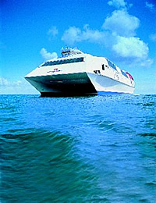



Remember: Knowledge & Risk
Requirements
unknown to customer
DYNAMIC
High
Customer Knowledge
Risk
Migration
REVOLUTION
BROAD
NARROW
Requirements
known to customer
Low
STATIC
Conclusion: Customers and Providers often work in the static design domain
because of knowledge and risk. Revolutionary improvement happens when a new dynamic concept is used. Making this decision is difficult and risky
Notes:
8

Slide 5
System Meta-solution
Operational Requirement
Company
Meta-solution
Toyota
To transport passengers and their baggage from one point to another efficiently and safely
Airbus
Bombardier
Yamaha
A Meta-solution is an organization’s current preferred solution to a system “problem”
It is often possible to identify and decide upon the Meta-solution very early in System Development. This will allow us to bound or scope the system functionality relative to that chosen Meta-solution - BUT

Slide 6
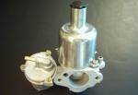

Failure to Explore New Meta-solutions - A Sorry Tale
Up to the late 1970s the carburettor was the dominant method of mixing air and petrol. Because of its cost and reliability, fuel injection was rare.
The carburettor manufacturers considered their business safe and focused on making better carburettors! They should have been investigating the engine manufacturer’s need for “providing the engine with an air-fuel mix”
Other people started working on cheap and effective fuel injection systems and before the carburettor manufacturers reacted their business had gone – there are no carburettor manufacturers left in the domestic automotive market!

Slide 7

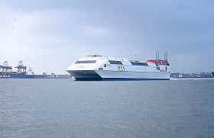
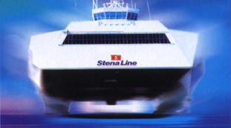
Successful Dynamic Design Concept
Stena HSS – the largest fast ferry in the world carrying up to 1500 passengers, the Stena HSS travels at speeds of up to 46 miles per hour, cutting journey times in half – it is a revolution in ferry design

Slide 8

Unsuccessful Dynamic Design Concept
The Sinclair C5 – A potential revolution in personal transport – A dynamic concept that failed dramatically.

Slide 9
System Meta-solution
Every “system of interest” is a subsystem of a bigger system. Examining the system of interest from the viewpoint of the super-system to which it belongs forces us to consider what it does and the NEED it satisfies.
Remember, customers do not buy systems, they buy capability, they have a need and if somebody was to come along with a “better” alternative meta-solution that delivers their need they will buy it!
When considering the design of a new system, subsystem, or component, we should always review the current Meta-solution to see if it is viable within the project timescales. There will always be alternatives and some of these may be more acceptable to the customer/stakeholders
  Indeed, a sensible organization should always be researching alternative meta-solutions in preparation for a change - if necessary

Slide 10
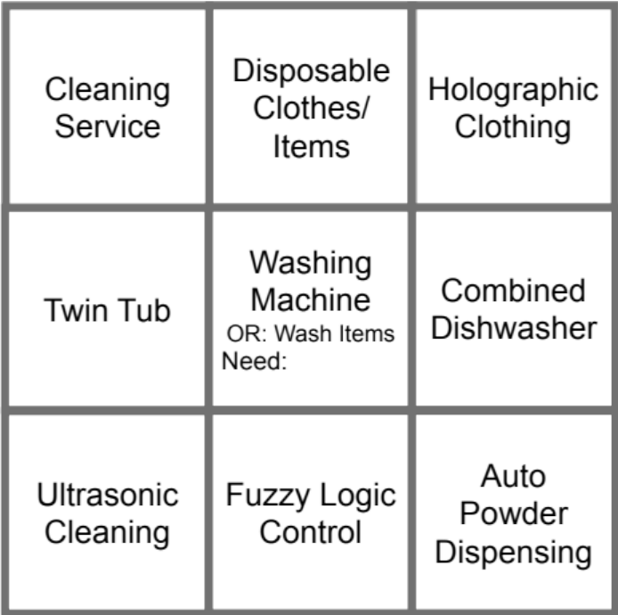
Need Means Analysis
What is it?
  A lateral thinking approach aimed at getting people away from conventional solutions to explore and select the Meta-solution for the system of interest
  The approach is based around identifying the “need” that a system satisfies and then using this to investigate alternative solutions
How to do it?
Step 1: Identify the Operational Requirement of the current Meta-solution to the system of interest
Step 2: Derive the NEED that this system satisfies
The Need Means Analysis output above is for a domestic washing machine that explores potential solutions at different levels to agree the system Meta-solution
Step 3: Use “the box of nine” to identify new solutions to the need at different levels
Step 4: Review “the box of nine” to decide on the Meta- solution for the system of interest

Slide 11
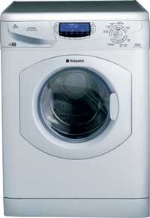
Step 1: Identify the Operational Requirement of the current Meta-solution to the system of interest
The starting point for a Need Means Analysis is to identify the current Meta-solution and determine its Operational Requirement
If Systems Engineering has been used in its development, the Operational Requirement should exist – otherwise one will have to be created
Remember
Example: Domestic Automatic Washing Machine
An Operational Requirement defines the major purpose of a system (i.e. what it fundamentally does - its capability) together with the key overarching constraints (that define the context)
To clean effectively domestic fabric items using minimum water and power and currently available detergents

Slide 12
Step 2: Derive the Need that this Systems Satisfies
An Operational Requirement defines what a system fundamentally does
The is always a higher level reason why that purpose is being carried out – this is the NEED
It is likely not to be the same as the Operational Requirement – but will be related
For example the operational Requirement for a pen is to “lay-down a trail of ink”
But why do we NEED to lay-down a trial of ink” – because we wish to communicate our thoughts
Example: Domestic Automatic Washing Machine
Why do we want
to clean effectively domestic fabric items?
Hygiene

Slide 13
Step 3: Use “the box of nine” to identify new solutions to the need at different levels
How can the Need be achieved without the User/Customer having to purchase/own a Washing Machine
Cleaning Service
Disposable Clothes/
Items
Holographic Clothing
New system
The User/Customer still purchases/owns a Washing Machine, but it’s a different Architecture
Twin Tub
Washing Machine
OR: Clean domestic fabric Items
Need: Hygiene
Combined Dishwasher
New system
architecture
Ultrasonic Cleaning
Fuzzy Logic
Control
Auto Powder
Dispensing
The same Meta-solution but changes made at the subsystem level
New
subsystem
The “box of nine” encourages us to think of at least 3 options per level providing sufficient to explore the choices. Can include further options at any level

Slide 14
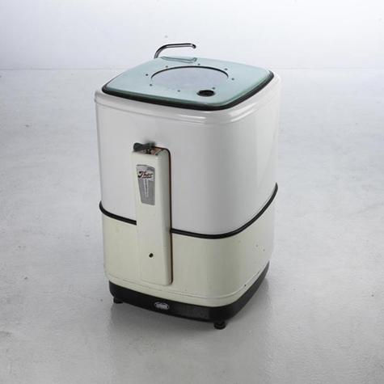

Slide 15
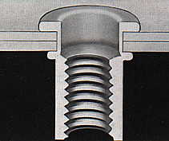
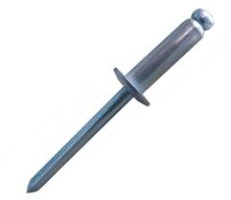
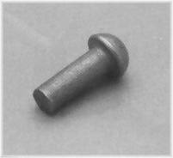
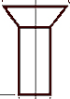

Need Means Applies at any level!
Can include further options
Machine from solid
Adhesive
Weld
Higher
Level
New system
Rivet Nut
Rivet
OR: Join 2 or more components together
Need: Structural integrity
Pop Rivet
Same
Level
New system
architecture
Dome Head
Countersunk
Flat Head
Lower
Level
New subsystem

Slide 16
Need Means Applies To Any System!
Can include further options
User
Repair
Postal Replacement
Redundant
System
Higher
Level
New system
Reliability Centred Maintenance
System
Man in a Van to repair system at user’s home
OR: Fix System
Need: Working System
Prognostic based system
Same
Level
New system
architecture
Computer – internet based technical publications
Electronic/ software based diagnostics
Internet based booking service
Lower
Level
New subsystem

Slide 17
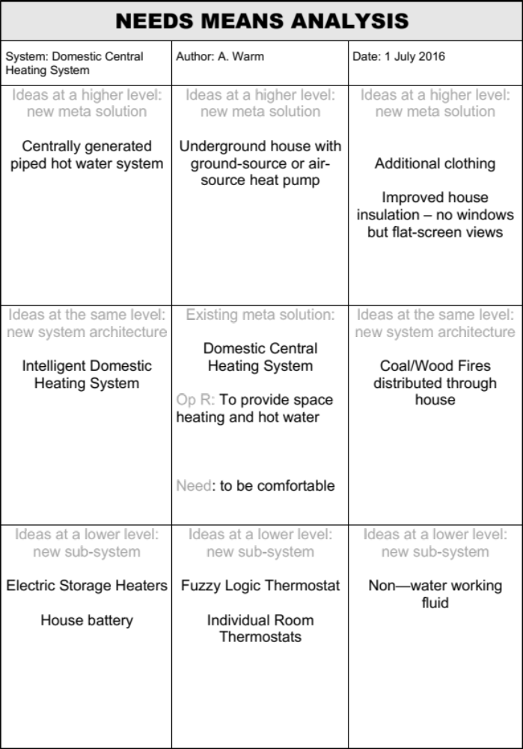
Exercise – Need Means Analysis
In small Teams
  Perform a Need Means Analysis for the System Described by the Trainer
  Be prepared to share your outcome with the rest of the class
Time 15 minutes

Slide 18
Step 4: Review “the box of nine” to decide on the Meta- solution for the system of interest
The purpose of a Need Means Analysis is to reflect upon the alternative levels of solutions available - with the intention of agreeing the system Meta-solution
It is always possible to operate at higher and higher levels of abstraction in order to retain solution choices – BUT often the problem context allows the meta-solution to be decided at this point thereby focusing and scoping the design activity
By agreeing the Meta-solution we are bounding our system functionality
Example
In 1998-1999 a well known washing machine designer/manufacturer undertook a technology demonstration programme to develop an “intelligent washing system”.
One possible Meta-solution was a “dry-cleaning machine”. However, this particular company had no design or manufacturing experience with “dry-cleaning” which, combined with the health and safety issues, led them to retaining the same basic Meta-solution – a water-based electrically powered system

Slide 19
Meta-solutions, Level of Innovation and Risk
0.1%
Higher
Level
New system
Revolutionary
4.9%
Same
Level
New system architecture
Radical
95%
Lower
Level
New subsystem
Evolutionary

Slide 20
Radical Innovation
What are the issues with adopting any or your “same” level solutions? i.e. a change or architecture.
  e.g. what would a move from a hi-bypass turbofan to an open-rotor architecture mean for the airframer?
Radical change (change of architecture) at the subsystem level often requires a change in architecture at the system level
Evidence suggests this won’t happen unless there is a performance improvement >40%!

Slide 21
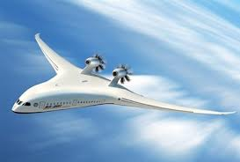

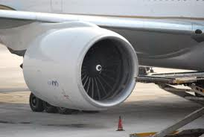
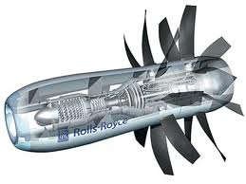

Example
Commercial aircraft typically use hi-bypass turbo fans to generate thrust
BUT
Such a power plant will require the airframer to change their architecture
A far more fuel efficient solution is the “open rotor” offering fuel savings of up to 30%

Slide 22
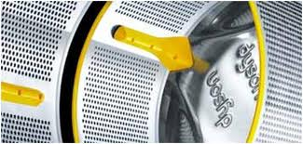
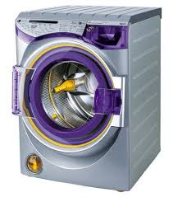

Slide 23
Need Means Analysis Summary
Pros
  Simple - anybody can contribute
  If performed in a team it promotes
    Discussion
    Thinking
  Identifies alternative solutions at different levels
  Can lead to an agreed meta- solution and therefore scope the problem space
Cons
  Deciding who does this? Is it an engineering or marketing tool
  Can give a false feeling of security
  Can give a solution that allows an organization to jump straight into detailed design without doing the full system design

