Slide 1


Analyse Requirements
Analysing Expressed Requirements using
Systemic Textual Analysis
Secondary Information Goes Here
This Session:
Highlights the issues of “traditional” Textual Analysis
Introduces and describes Systemic Textual Analysis as a powerful alternative to Traditional Textual Analysis
Provides an opportunity to practise using Systemic Textual Analysis

Slide 2


















Process and Tools
Gather Requirements
Analyse and Validate Requirements
Specify
Requirements
The Business Requirements provide the rationale and overall business constraints for a system development project
Determine the Emergent Functionality
Stakeholder Map
Flow Sensitivity Analysis
The System Requirements defines the measurable design requirements for the system
Determine system stakeholders and select key ones for requirements elicitation
Identifies causal paths for potential system sensitivities
Functional Failure Mode and Effect Analysis
Quality Function Deployment 1
Captures the potential functional failure modes, effects and causes to identify remedies ab initio
Cross checks requirements for consistency and completeness
Verification Compliance Matrix
Affinity Diagram
Use Case
Determine Validation and Verification methods for each requirement and specify V& V Requirements
Elicit and capture key stakeholder requirements
Captures how a user expects to interact with a system
Determine the necessary generic System Functionality
Tree Diagram/Analytic Hierarchy Process
Systemic Textual Analysis
Viewpoint/Functional Analysis
Function Flow Diagram
Organize and prioritise key stakeholder requirements
Analyses expressed requirements into their atomic form to identify and clarify missing and ambiguous requirements
Generates and organizes system generic functionality necessary to achieve the Operational Requirement
Captures and shows how the component functionality of a system must cooperate to deliver the Operational Requirement
Requirements Database
The User Requirements defines the expressed requirements of a particular stakeholder or stakeholders
Need Mean Analysis
Identifies and explores system solutions at different levels to determine System Meta-Solution

Slide 3
Where are we?: Analyse Requirements
Assess System Meta-Solution
Applying Systems Thinking to the task of analysing requirements tells us that we will need to take various perspectives to help uncover the unspoken requirements
Determine “working” Operational Requirement
Determine System Functionality
Determine Emergent Functionality
Determine Non-Functional Performance Requirements
The iteration may not be simple
Verify and Validate Requirements

Slide 4
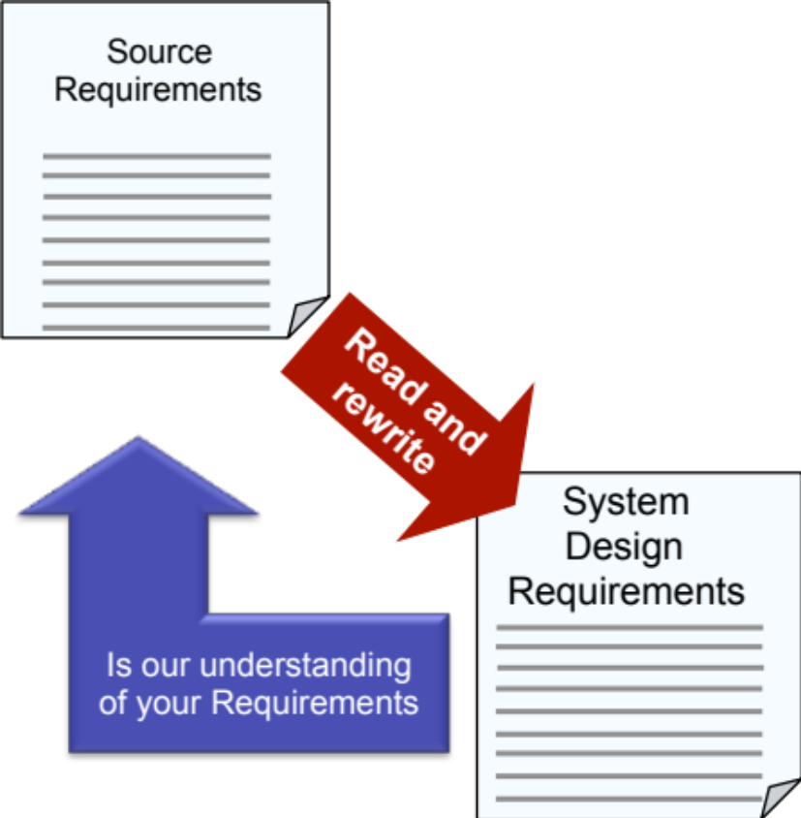
Traditional Requirements Analysis
Source (customer/stakeholder) Requirements are typically written documents and are passed to engineers to analyse and interpret in terms of a set of System Design Requirements
The traditional method of analysis and interpretation is through conducting Textual Analysis
Textual Analysis is a line by line analysis of the written requirements to decompose, clarify and expand as appropriate. Ultimately, leading to a set of written System Design Requirements
While this approach has undoubtedly been successful, there is growing evidence that it is failing!

Slide 5

Recent Failures of Requirements Management
The UK Government’s requirements for a Scottish Parliament building were stated in the White Paper on devolution.
“The building the Scottish Parliament occupies must be of such a quality, durability and civic importance as to reflect the Parliament’s status and operational needs; it must be secure but also accessible to all including people with special needs; it must promote modern and efficient ways of working and good environmental practice.
It will be an important symbol for Scotland. It should pay tribute to the country’s past achievements and signal its future aspirations. It must be flexible enough to accommodate changes over time in operational requirements. Quality and value for money are also key considerations.
The accommodation must allow Scottish Parliamentarians and their staff to work efficiently harnessing the best of modern technology. People must be able to see and meet their elected representatives and to watch the Scottish Parliament in operation. Provision needs to be made to permit easy reporting and broadcasting of Parliamentary proceedings so that people throughout Scotland can be aware of its work and decisions.”
That’s all folks
The building was not treated as a systems and therefore no analysis of these requirements was done whatsoever!
Notes:
This is an example of poor requirements engineering.
It is the Scottish Parliament Building in Edinburgh. The only statement of requirements is that given next to the picture. The budget was set at 9 to 40 million pounds!
The final cost was £413 Million ten times over budget – which the UK tax payer paid for!!
What went wrong! Firstly it was treated as a building whereas it is in fact a system. No Requirements engineering was undertaken just a cursory glance at the above – the focus was on the Architecture!
The building underwent several redesigns as the “architects” discovered what they had missed – eg security system, It system, ventilation system etc

Slide 6
Failings of Traditional Textual Analysis
One of the prime reasons Traditional Textual Analysis is failing is the increasing complexity implicit and explicit in the requirements
Indeed, it is no longer possible for a single person to understand the “whole” of the requirements – we all too quickly reach a “brain full”
It’s the old maxim “How do you eat an Elephant? - one bite at a time!”
  The Source Requirements have to be broken down into manageable “chunks” in some way so that individuals can address their “chunk”
    It is, of course, assumed that the individuals will interpret their “chunk” in a way consistent with all the other individuals – i.e. if we gave the same “chunk” to two individuals their interpretation would be the same?
In recent times
  The requirements document to define the replacement for the Spitfire and Hurricane contained some 46 requirements in 3 ½ pages and led to the Gloster Meteor the RAF’s first operational jet aircraft
  The requirements document for the Astute class submarine contained 16,000 requirements in some 2000 pages
Notes:
Systems are becoming more complex – so are requirements. The two examples given are only some 40 years apart – both are “state of the art” for their time:
46 Requirements in 3.5 pages VS 16,000 requirements in 2000 pages
Ask the question “if you were the Chief Engineering for Astute and a 200 page requirements document landed on your desk – what would you do?”
The universal answer is of course – delegate
An important point here is that the “divide and rule” is often based on the architecture of the last late and over budget system.

Slide 7
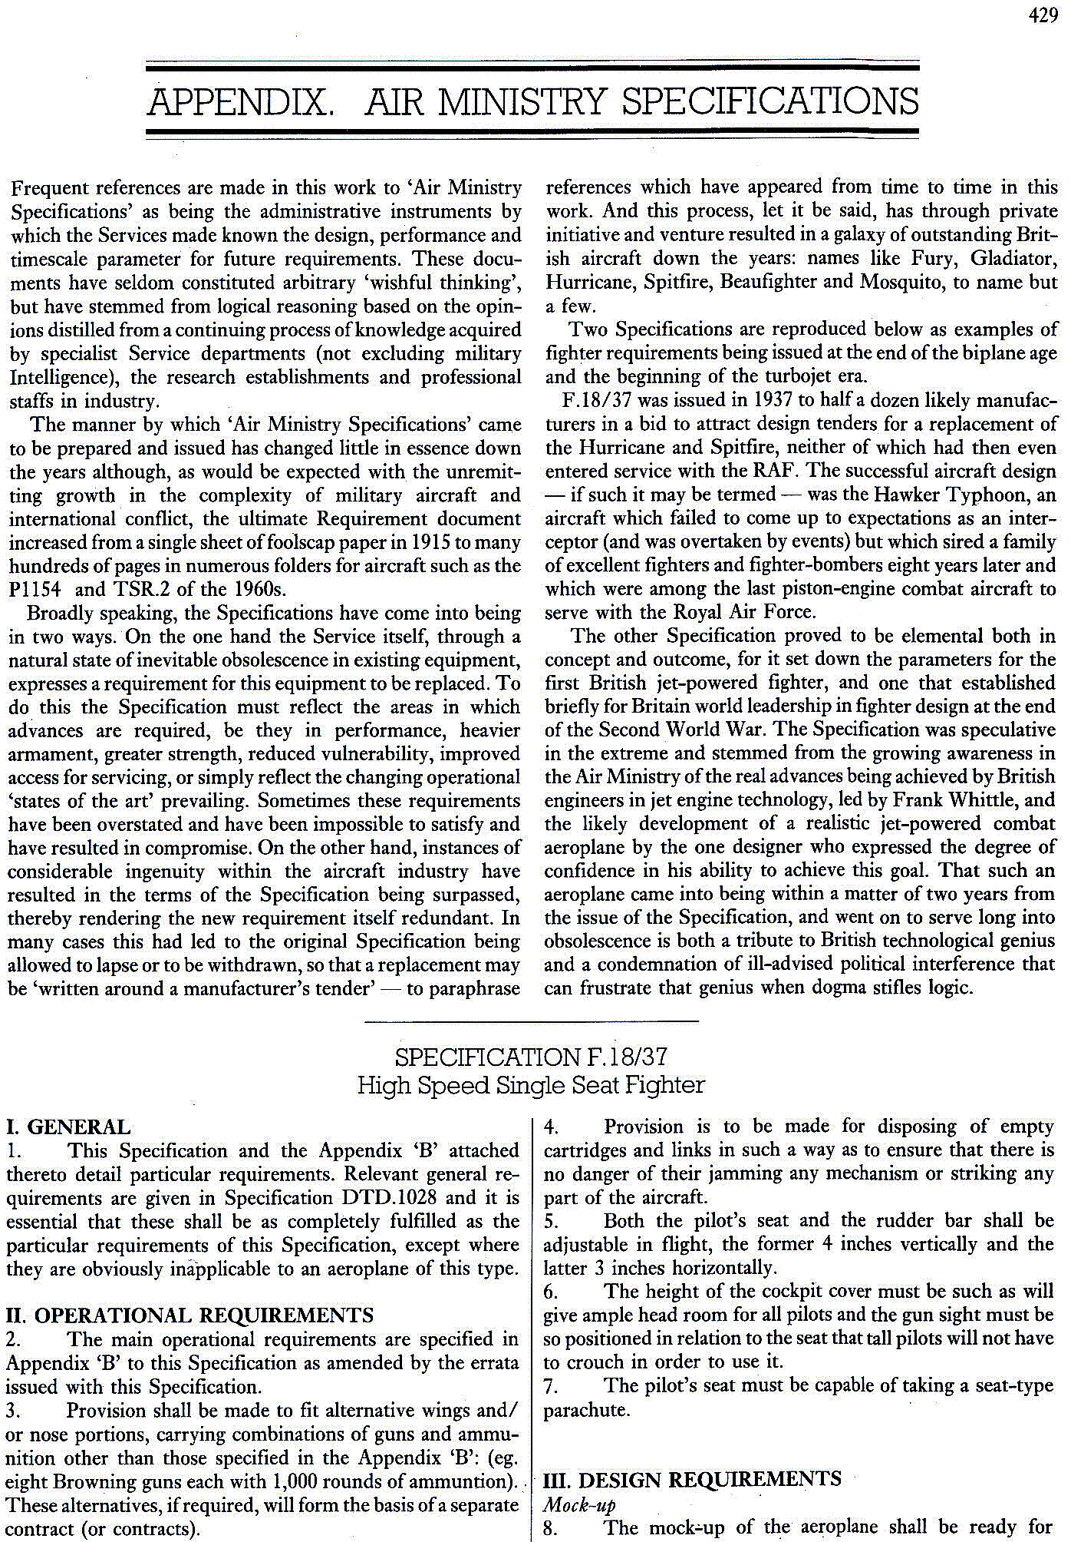
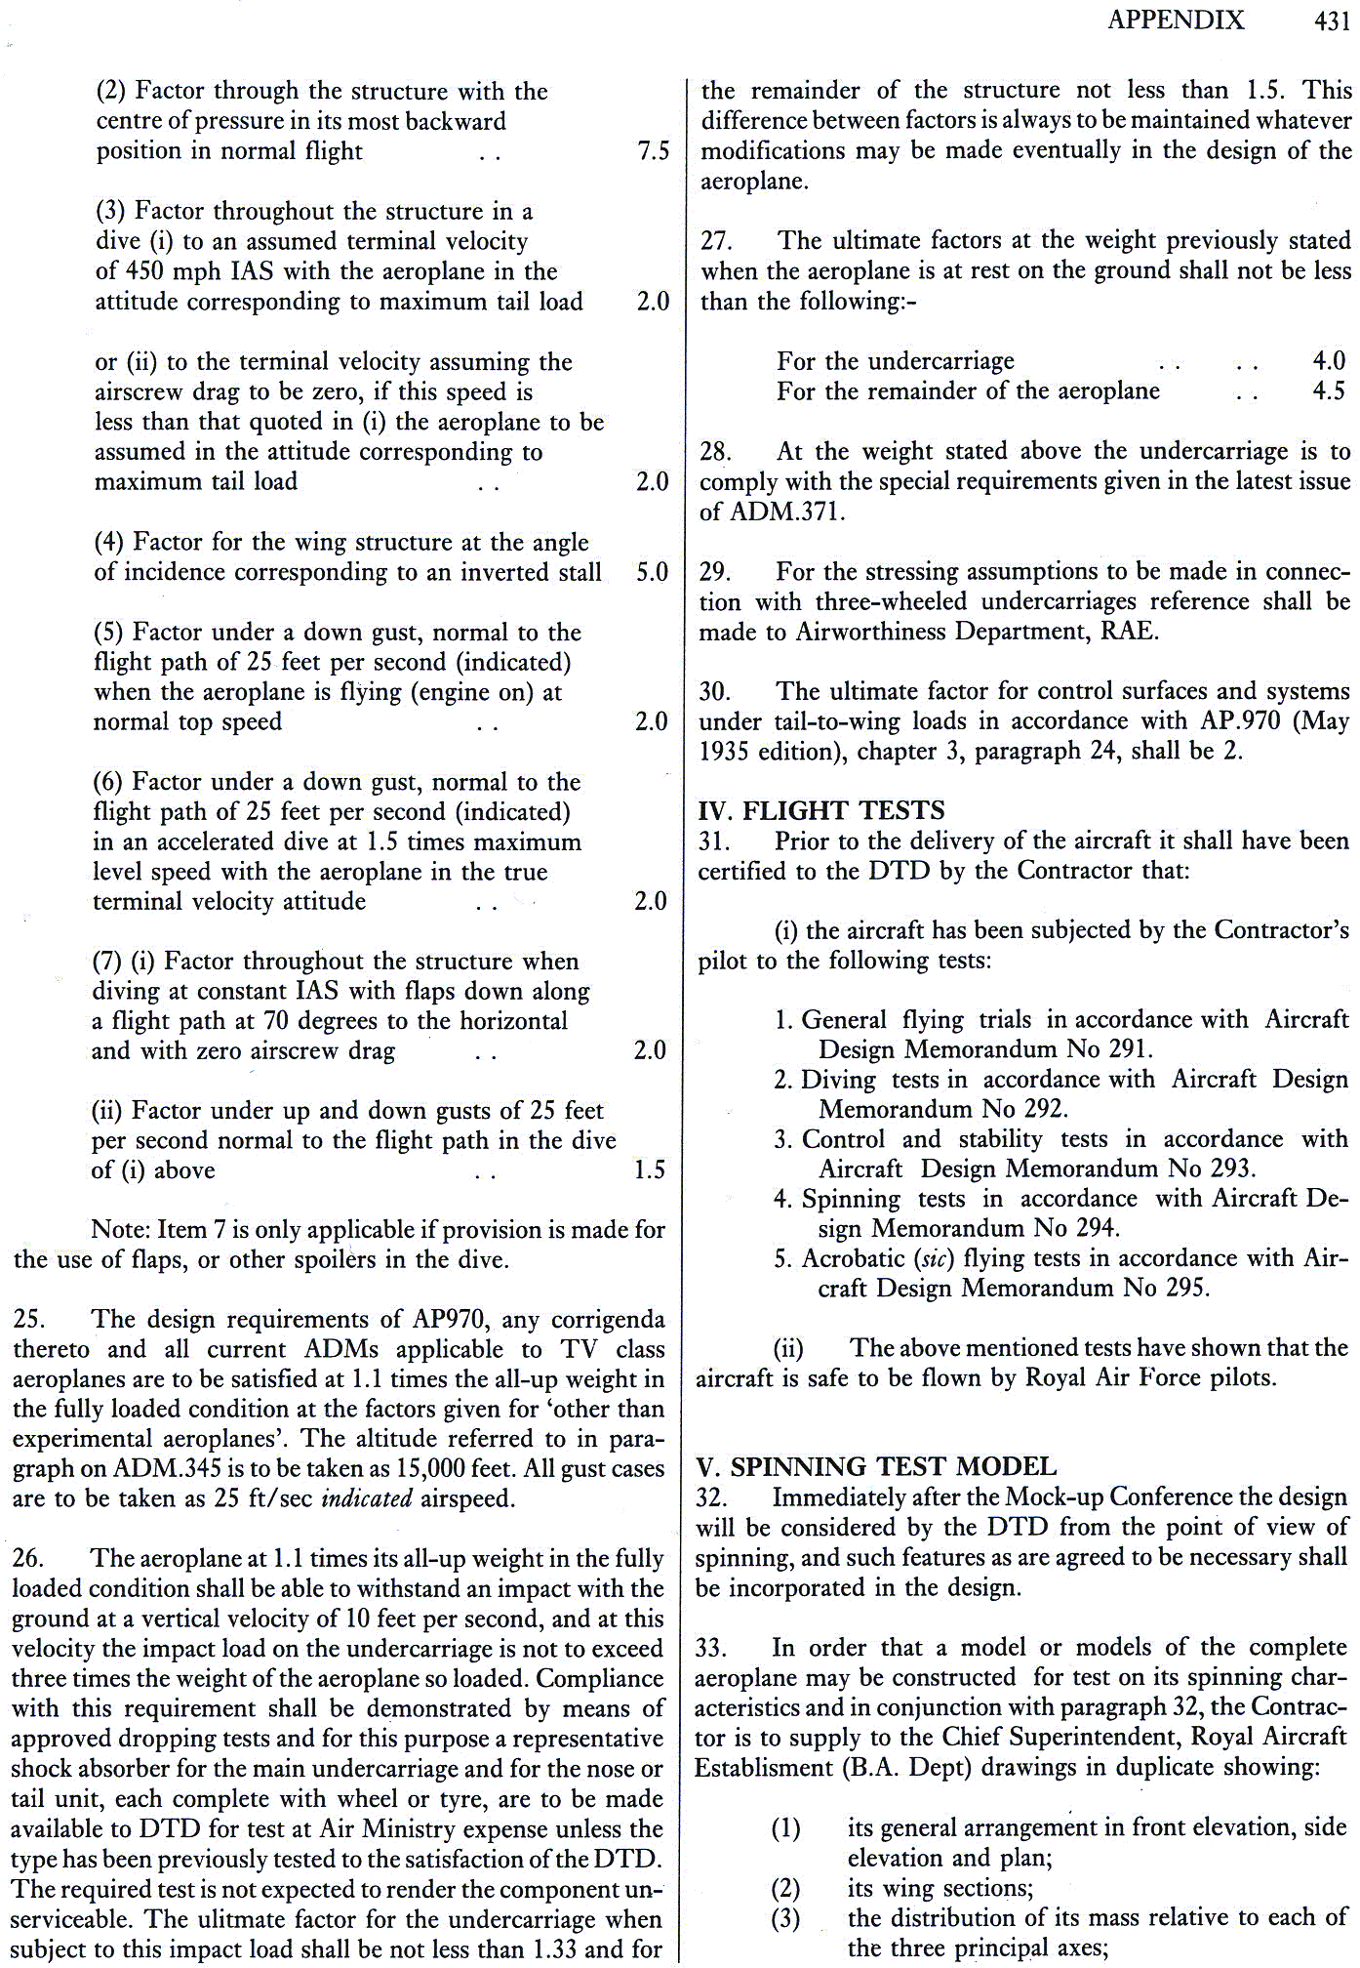
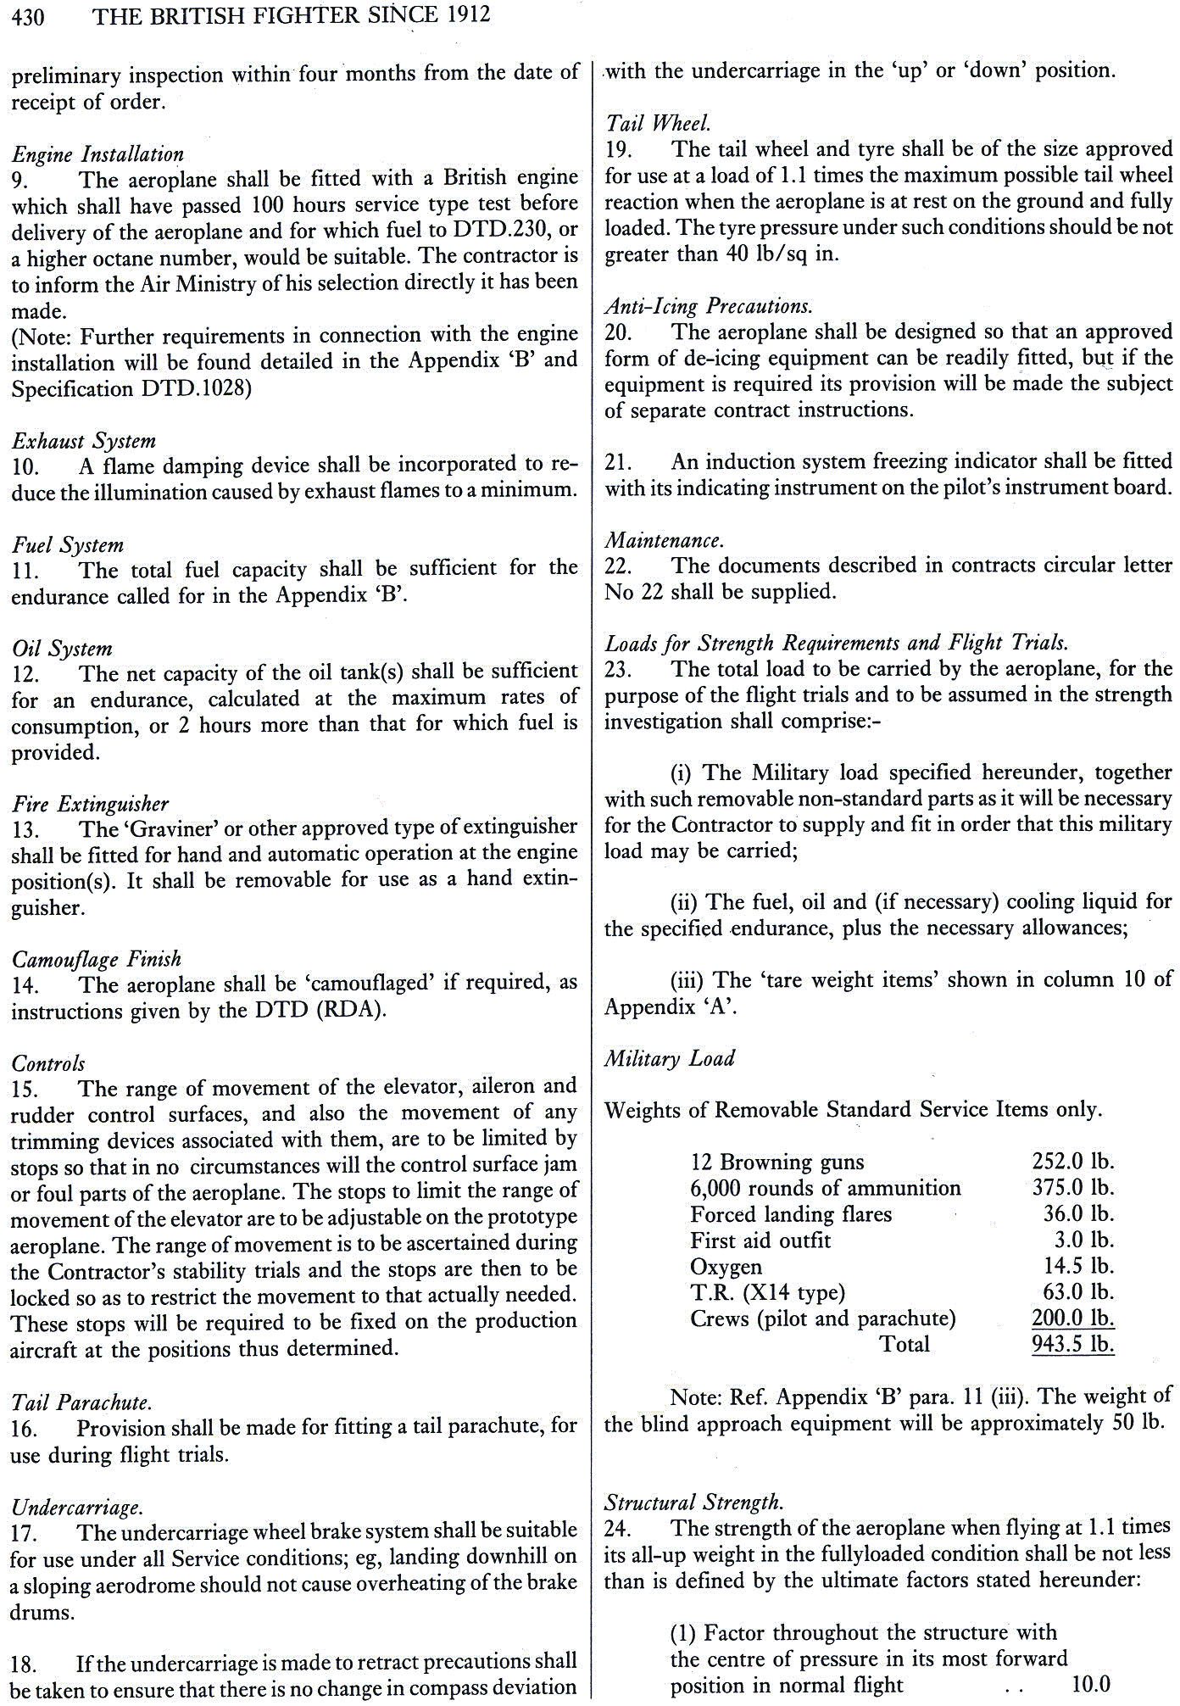
In recent times!
These are the requirements for the replacement to the Spitfire and Hurricane fighter aircraft. These requirements ultimately led to the Gloster Meteor The RAF’s first operational jet fighter

Slide 8
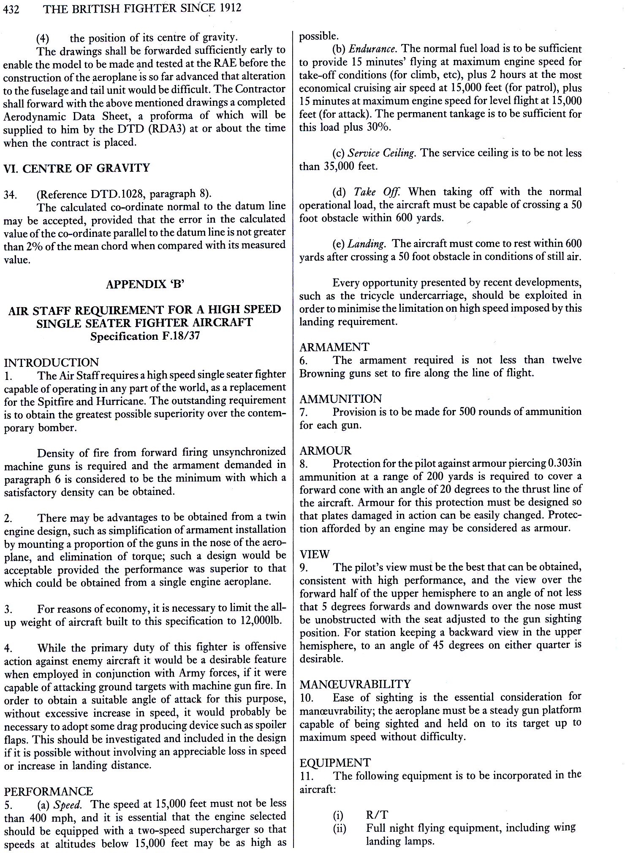
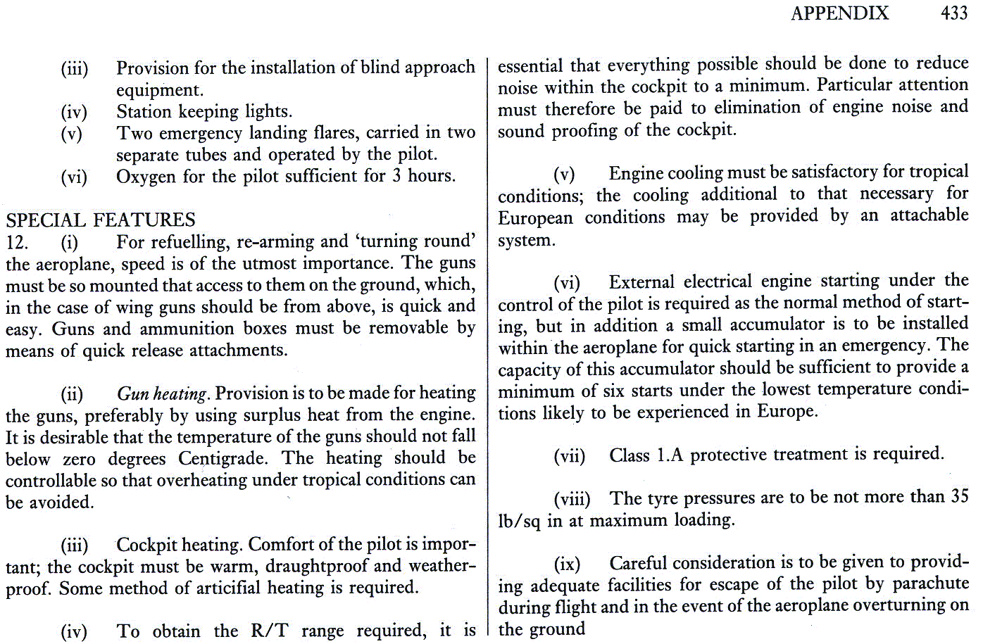
Compare these 3 ½ pages with the Astute class submarine whose customer requirements document contained some 16,000 requirements

Slide 9

Exercise – Perceptions
Read the short story
Individually determine whether the statements are:
  True
  False
  Don’t know
Feedback how many you found to be True, False and Unknown

Slide 10
Perceptions Introduce Bias
We all have different perceptions of the same thing! When faced with ambiguity our experience, our “baggage”, causes us to make assumptions that may differ significantly from others – we make a different interpretation.
When we analyse a set of Source Requirements, how do we resolve the fact that we will have to deal with the ambiguity that will introduce bias into the analysis?
Conclusion:
  We need a way of parsing¹ the individual source requirements, such that different individuals will interpret the requirements in a consistent way
¹ Parsing is a common term used in describing language comprehension. In the current context, parsing refers to the way that human beings analyse a sentence or phrase "in terms of grammatical constituents, identifying the parts of speech, syntactic relations, etc. that lead to a complete understanding”.
Notes:
There is a “got ya” here. If we have a large requirements document we have no choice but to divide and rule – but if we are going to divide and rule we have to have confidence that people will interpret requirements in a consistent fashion. Systemic Textual Analysis provides this through the Holistic Requirements Model.

Slide 11
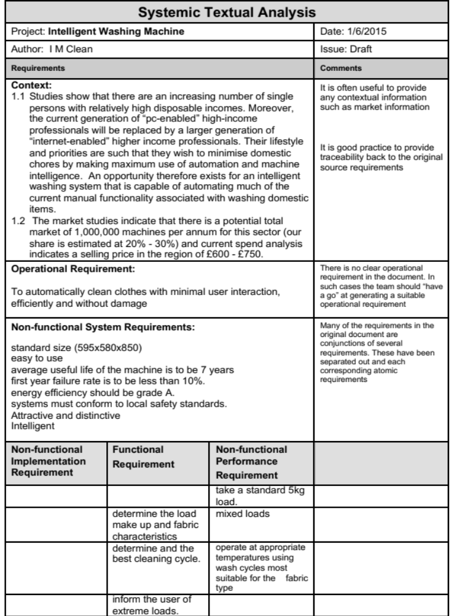
Systemic Textual Analysis
What is it?
A line-by-line analysis (parsing) of the source requirements using the Holistic Requirements Model as a framework for organizing the analysis
Why Do it?
To interpret, expand and clarify the individual expressed requirements
To identify missing requirements
To deduce requirements
When to do it?
Whenever a set of expressed Source Requirements are available
The example above shows a partially complete Systemic Analysis for an Intelligent Washing Machine
Notes:
30
Note that traditional Textual Analysis is basically Step 3!

Slide 12
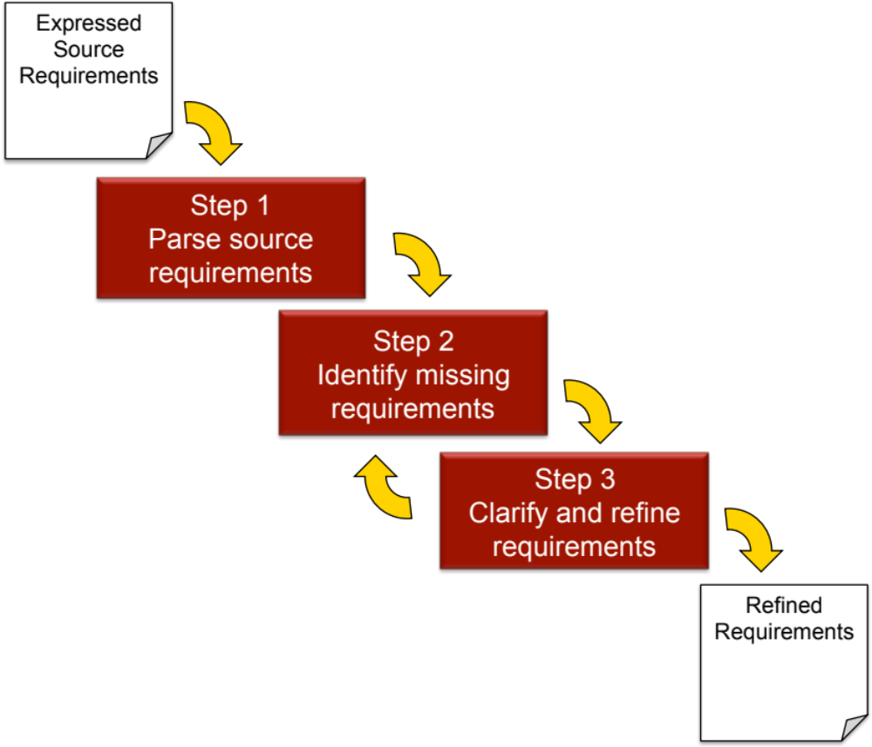
How to do it?
Systemic Textual Analysis uses the Holistic Requirements Model to separate the requirements into the categories
  Operational
  Functional
  Non-functional
    System
    Performance
    Implementation
This can allow missing and ambiguous requirements to be more easily identified

Slide 13
Step : Separate and Sort Source Requirements
Operational
Requirements
Source
Expressed
Requirements
Functional
Requirements
We need to think about the easiest way to do this separation. Given a paper-based set of Source Requirements, a simple approach is scissors, glue and labelled Flip Charts. If the Source Requirements are electronic, cutting and pasting works well
Non-functional
Requirements
Note the term ‘source’
is used generically to
cover expressed requirements from any stakeholder at any point
System
Performance
Implementation

Slide 14
The Need to Analyse Requirements
Requirements cause problems for two key reasons:
  In general, people find it difficult to write requirements – usually because they have received no guidance
  Equally, people find it difficult to analyse and understand requirements – usually because they have received no guidance
We do get better with practice, but a few simple tips can help in both areas
Notes:
Considering our reliance on written requirements most people in an organization are not taught how to
Write Requirements
OR
Analyse Requirements

Slide 15
Parsing (Untangling) Requirements
TIP #1
Look for any VERBS - they may specify or imply Functional Requirements
TIP #3
Look for the “be” segments - they often specify Non-functional System requirements
The mower must be safe and needs to navigate around a lawn avoiding permanent and moving obstacles. An electronic memory facility to record the shape and position of fixed obstacles might be useful.
This is a typical “customer” requirement. At first glance okay – but it actually comprises several requirements of different categories
TIP #2
Look for conditions after the verbs - they may specify or imply Non-functional Requirements
TIP #4
Look for “things” or objects - they may specify or imply Non-functional Implementation Requirements
Notes:
Compound or co-joined requirements abound! We cannot stop ourselves when writing requirements but we do need to separate them out into their atomic form
Eg the above contains
NFR Safe
FR Navigate Mower
FR Avoid Obstacles
moving NFP
fixed NFP
FR record obstacle characteristics
shape NFP
position NFP
NFI electronic memory

Slide 16
Step 2: Identify Missing Requirements
Stated Operational Requirements demand certain system constraints
Operational
Requirements
Stated Operational Requirements will demand certain functionality
Key stated Non -functional System Requirements are the constraints in the Operational Requirements
Functional
Requirements
Stated Functional Requirements provide the “purpose” element of the Operational Requirements
Stated Non-functional Performance and Implementation Requirements are associated to a particular function and therefore imply functionality
Non-functional
Requirements
Stated Functional Requirements will require Non-functional Performance Requirements
Performance
Implementation
System
The Systemic Textual Analysis template helps us do this
Notes:
A busy but critical slide: we are exploiting the structure and relationships between the requirement types of the Holistic Requirements Model to discover missing requirements.
A NF Performance requirement defines how well a Function as to perform. Therefore that function should form part of the Functional Requirements – if its not there “write it down”
A NF Implementation requirement is the solution to a Function and will therefore will infer a Functional requirement

Slide 17
Systemic Textual Analysis makes use of the fundamental relationships between Requirements
Given an NFI requirement – the solution - its function must be deduced along with how well it is done or needs to be done
Given a Functional requirement –how well it is done or needs to be done must be determined
Given an NFP requirement – how well a function has to perform its function must be deduced
Non-functional
Implementation Requirements
HOW it is DONE
implies
Functional Requirements
WHAT is to be DONE
requires
Non-functional
Performance Requirements
HOW well it is DONE
implies
VERB NOUN
requires
Notes:
This slide emphases the relationships between NFP – F – NFI
Customers/Stakeholders tend to provide just one – either the NFP or NFI
However if:
I am given an NFP – I can deduce the F
I am given an NFI – I can deduce the F

Slide 18
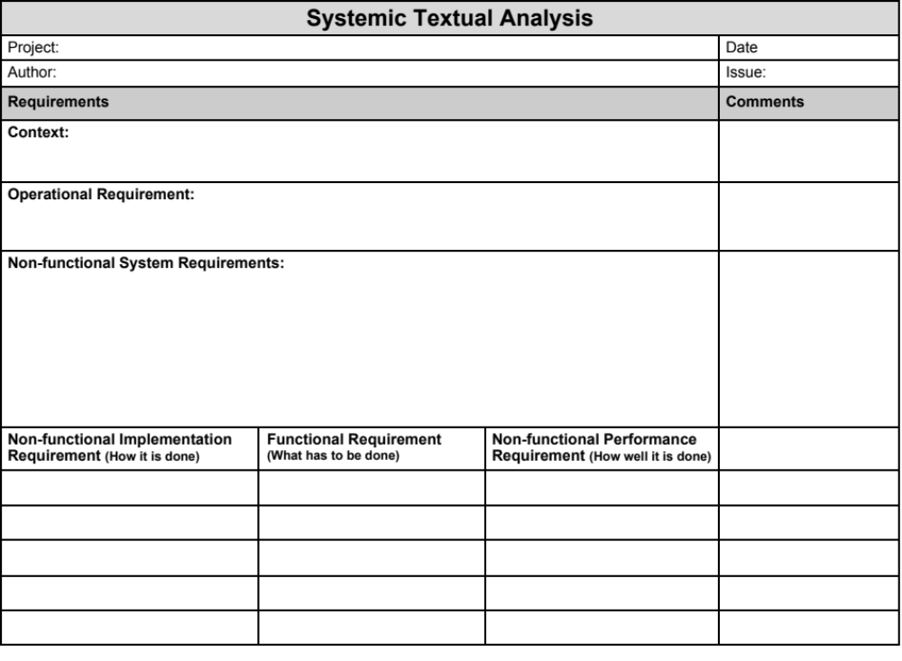
Systemic Textual Analysis Template
Source Requirements Documents often contain contextual information - this is captured here
Operational Requirement goes here – if there is one!
Non-functional System Requirements go here. Note that these constrain what is below
Non-functional Implementation, Functional and Non-functional Performance Requirements go here. The order helps to identify missing requirements
Notes:
The STA pro-forma is organized to bring out the relationship between NFI – F - NFP
It is worth telling the class - If you can’t find a OR, look at the KEY NFS rqmnts combined with the overall system purpose and write your own – but you will need to confirm this with your customer/stakeholder

Slide 19
Operational Requirement
We often find that the set of source requirements does not contain a clear Operational Requirement – in such cases we need to develop one – it’s likely not to be the finished definition, that will emerge as the analysis proceeds, and is called the “working” Operational Requirement
A good approach here is to get all teams members to draft there own – remember the 20 word target (but do not get hung-up on it – 25 words is okay, as might be 13!)
For example:
To toast bread products and other toastable items safely effectively and efficiently with the minimum of human intervention
To toast bread products and other toastable items safely effectively, efficiently and ‘interruptably’ with the minimum of human intervention
It may be necessary to define what is meant by:
Intelligently
Effectively
Efficiently
This is the “Working OR” – a starting point! It actually is not a particularly “good” requirement because in its present form is not measurable! – BUT trying to be “perfect” at this point can be nugatory work

Slide 20
Template Layout helps identify Missing Requirements
The Systemic Textual Analysis Template makes use of the relationships between the Functional Requirements (what is to be done), Non-functional Performance Requirements (How well it is done) and the Non-functional Implementation Requirements (How it is done)
Non-functional Implementation Requirement | Functional Requirement | Non-functional Performance Requirement
 |  | Capacity 2 to 4 slices
 |  | Different sizes of bread
 | Apply Heat to sides of bread
 | Monitor the browning
 | Control browning
Standard Single phase 230V 50 Hz ac
Crumb Tray
 |  | Cool to the touch
“Gap”
Missing Requirements
“Gap”
Missing Requirement
“Gap”
Missing Requirement
“Gap”
Missing Requirement
“Gap”
Missing Requirements
Notes:
The STA pro-forma uses the relationships between the requirements to highlight missing requirements. The gaps in column 2 and 3 need to be filled. – we do NOT fill in the NFI column!

Slide 21
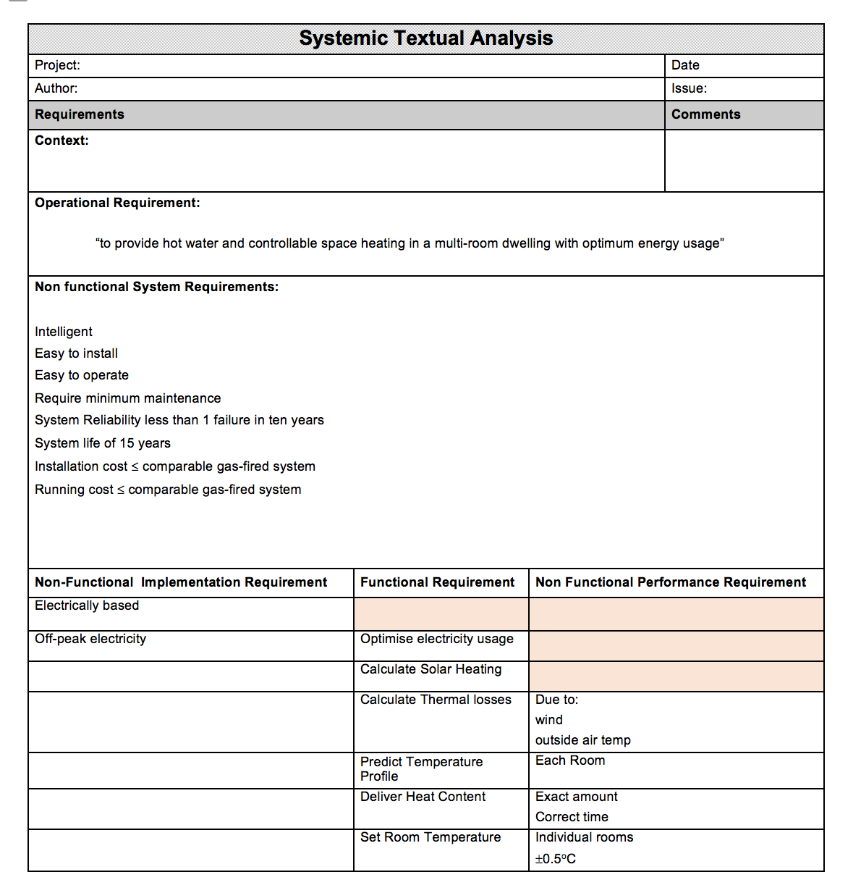
Exercise – Systemic Textual Analysis
In small teams:
  Consider the Source Requirements Document given to you by the Tutor
  Perform Steps 1 and 2 of a Systemic Textual Analysis
    Step 1: Parse the individual written requirements to identify the atomic requirements and categorise as
      the operational requirements
      the functional requirements
      the non functional requirements
        System
        Performance
        Implementation
      Tip: use sticky notes and annotate with the original requirements number to maintain traceability
    Step 2: identify any missing requirements
  Record the outcomes on the Systemic Textual Analysis form provided and be prepared to share with the rest of the group
Time 45 minutes

Slide 22
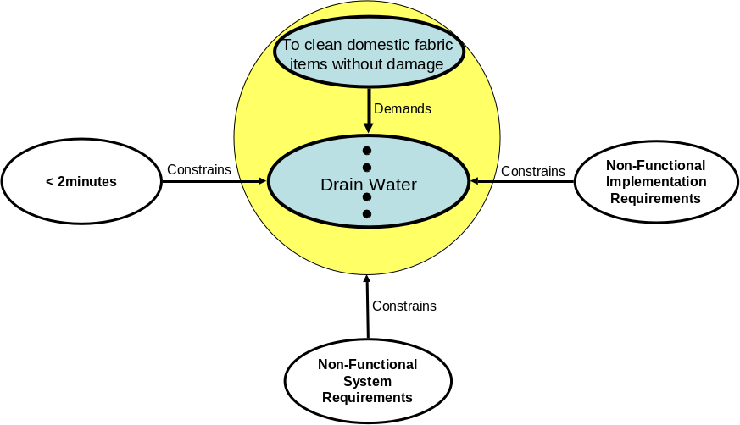
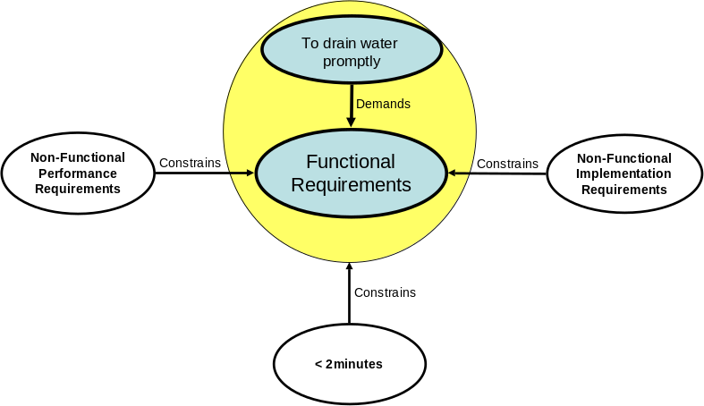
Issues: What’s My System?
Washing M/C level
When performing a Systemic Textual Analysis it is essential we are clear on what is the system because the allocation of requirements to the NFS or NFP categories is dependent on this
Remember one person’s system is another person’s subsystem!
That is, NFP requirements at the system level are NFS requirements at the sub-system level and so on
NFP requirements at the “system” level become NFS and the “subsystem” level
Drain Water level
If you are uncertain as to whether a requirement is NFS or NFP – start by assuming it is NFP this will force you to ask the question: if it is an NFP what is the associated “function”
Notes:
An important but quite difficult slide to talk to – it basically explains the statement “one person’s sub-system is another person’s system” In this example of a domestic washing machine which can be considered as a system and which can be defined by a HRM. One of the functions of a domestic washing machine is to “drain water”. The “drain water” function can be treated as a sub-system of the washing machine system. If the drain water function is considered in isolation it is a system in its own right and can be defined its own HRM. Clearly the two HRMs are different but must be related. The relationship is two-fold:
1. The Non-Functional Performance Requirements of the function of the system become Non-Functional System Requirements of the sub-system, some of which (the critical ones) complete the Operational Requirement of the sub-system.
For 2 see over

Slide 23
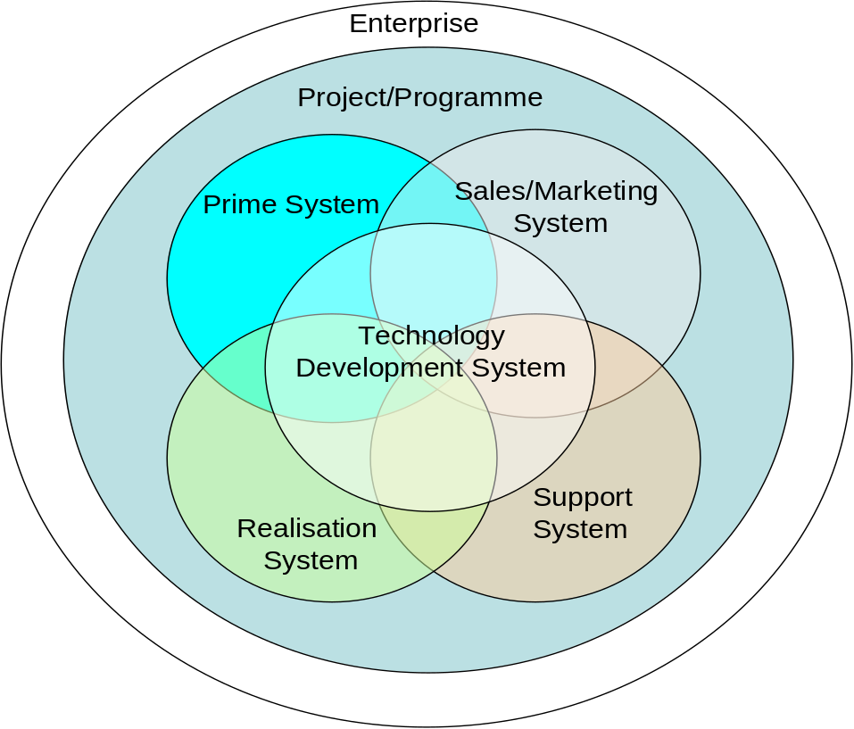
Issues: The Wrong Requirements
Source Requirements documents contain requirements for the systems associated with the Prime System
One of the most common situations is to include requirements for the project/ programme
This is to be expected - but it does mean we have to sort the raw requirements and align them to their respective systems
This may require us to start a number of Systemic Textual Analyses - one for each system!
Notes:
Many source requirements documents often contain requirements for the prime system that is to be developed and requirements for other systems. Indeed, this is to be expected and encouraged but unless approached with a clear mind can cause confusion and ultimately the miss-allocation and miss-interpretation of requirements. A classic example is the “customer” requiring a “good warrantee” for a product. A perfectly reasonable requirement, ambiguous but reasonable. However, this is not a requirement on the product, the product does not provide a warrantee, the product cannot do “warrantee” or be “warranteable”. The warrantee is provided by the manufacturer and is a requirement on their business. It can, however, be interpreted and lead to a derived reliability requirement. If there are many requirements for other associated systems (typically, support, sales, realization, technology development, project and enterprise) consideration should be given to undertaking a STA for the other systems?

Slide 24
Missing Requirements ➔Deduce Requirements
The purpose of the Systemic Textual Analysis is not just to parse requirements and find where requirements are missing but to deduce those requirements
All the “gaps” in the STA template should be discussed to deduce suitable requirement(s)
At this stage this may lead to re-categorising the source requirements. For example, a requirement initially considered to be Non-functional Performance, for which no single function can be deduced or where several emerge should be re-categorised as Non-functional System
It is important to record, in some way, which requirements are deduced – hence the comments column on the template
There are three possible situations where the expressed requirement is a:
  Non-functional Implementation
  Non-functional Performance
  Functional

Slide 25
Deducing Requirements from Non-functional Implementation Requirements
Non-functional Implementation Requirements specify how part of the system is to be built – they are solution-based requirements
Non-functional Implementation requirements should be tested as to whether they are justifiable or lazy
Non-functional Implementation Requirement | Functional Requirement | Non-functional Performance Requirement
Standard Single phase 230V 50 Hz ac
Crumb Tray
Having determined the function we need to identify the associated Non-functional Requirements – see later
Where there are gaps for lazy NFI requirements we need to determine the function that the “solution” performs
Where there are gaps for justifiable NFI requirements we should also determine the function and later (when undertaking system design) explore alternative solutions to see if any of these could “delight” the customer

Slide 26
Deducing Requirements from Non-functional Performance Requirements
Non-functional Performance Requirements specify how well a particular function has to perform
Complete Non-functional Performance Requirements comprise a metric, an attribute and associated numerical target values. Expressed requirements are often not complete but will form the basis for determining numerical targets
Non-functional Implementation Requirement | Functional Requirement | Non-functional Performance Requirement
 |  | Capacity 2 to 4 slices
 |  | Different sizes of bread
Remember stakeholders like users or customers rarely specify functionality but imply it through the NFP requirements.
We need to determine the function that is implied by the partial NFP requirement. Note in doing so we often have choice over the verb and need to choose verbs that in themselves don’t infer a solution.
Note: We are not designing the system and therefore the Non-functional Implementation column should not be completed. In the ideal world this column should be empty

Slide 27
Deducing Non-functional Performance Requirements from Functional Requirements
Functional Requirements specify what the system has to do in order to meet the Operational Requirement of the system
Non-functional Implementation Requirement | Functional Requirement | Non-functional Performance Requirement
 | Generate Heat
 | Control Browning
Functional Requirements are typically captured at this point as a simple verb noun description
The function defines the “job” to be done we now have to determine “how well’ that job has to be done in order to specify the Non-functional Performance Requirements
Note: We are not designing the system and therefore the Non-functional Implementation column should not be completed. In the ideal world this column should be empty

Slide 28
The Nature of Non-functional Performance Requirements
Non-functional Performance Requirements comprise: a metric, measure or property and a numerical value as a target, lower or upper limit, that defines how well a particular function has to perform
For any given function there WILL be several NFP requirements that are specific to that function
Radiant heat output > 0.5kW/m² radiant heat per side
Heat area per side = 140x140mm
Time to 350ºC < 15 seconds
Generate Heat
Cost (DTUPC) < £1.90
First Year Failure Rate < 0.005
etc.

Slide 29
Deducing Non-functional Performance Requirements
If we are designing a system with a known meta-solution we should have most the of the NFP requirements. It will be a matter of collecting and collating them against the Functions
If not, a common approach here is to consider two solutions, say A and B, to each function and ask what could be measured to decided between them? The key here is to identify measurable characteristics
We should also consider the flow-down of the Non-functional System requirements

Slide 30
Systemic Textual Analysis: Step 3
Clarify and Refine the Requirements
The individual requirement fragments identified from step 2 should now be examined one at a time asking the following questions:
  Is it correct? (is it asking for something possible?)
  Is it complete? (how do I turn it in to a sentence?)
  Is it clear and concise? (is it unambiguous in simple direct language?)
  Is it consistent? (with the other requirements)
  Is it confirmable? (is there a way in which we can demonstrate that we have met this requirement?)
In answering these questions we may need to seek clarification from the source stakeholder. We should avoid making assumptions, but if there is no choice document the assumption
The requirement should be, if necessary, rewritten to have positive outcomes to the above questions
The set of requirements must be examined to ensure they form a complete consistent set with no contradictions
We should always maintain traceability between our clarified and derived set of requirements and the original customer requirements
Much more later when Specifying Requirements
Notes:
.

Slide 31
Systemic Textual Analysis
Pros
  Simple - anybody can contribute
  Start with a list and end with a bigger list
  If performed in a team can promote
    Discussion
    Thinking
  Helps structure the requirements
  Helps identify missing and ambiguous requirements
  Helps in deducing requirements
Cons
  Requirements categories require some practice to be comfortable
  Not very useful if the requirements set is very small
  Difficult to convey structure and relationships between requirements
  Difficult to verify completeness and consistency
  Will NOT uncover all of the unspoken requirements

Slide 32
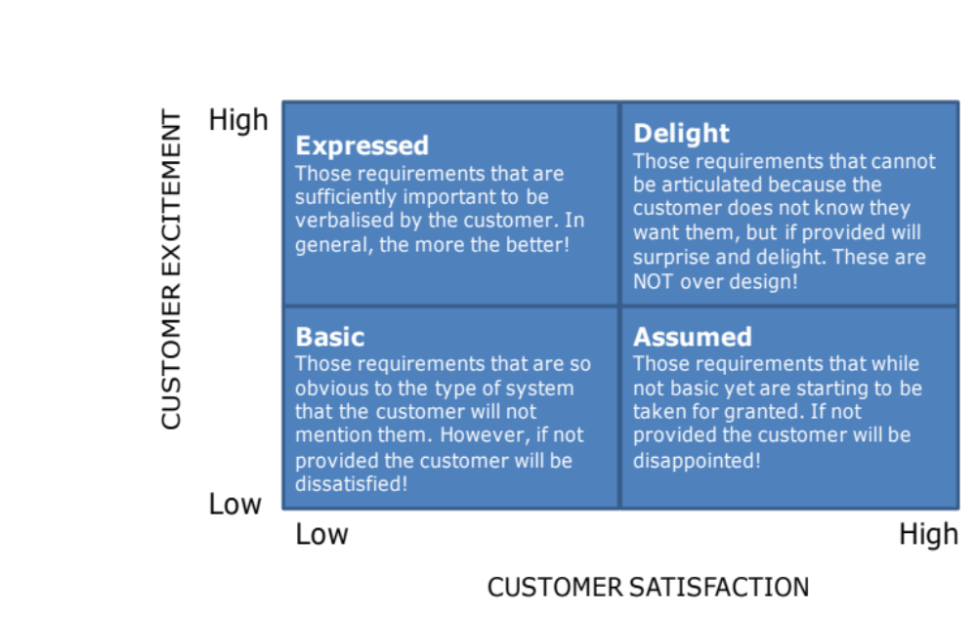
Summary
Systemic Textual Analysis often helps us “get into” the problem by sorting the requirements into logically related categories that enable missing requirements to be identified. It will not guarantee to uncover all of the requirements because it is very much dependent upon the quality of the source requirements
Systemic Textual
Analysis
To get at the other unspoken requirements we will have to tackle the problem from another direction

