Slide 1
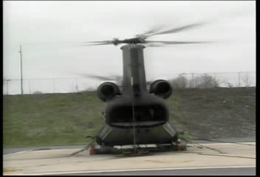

Slide 2


Analyse Requirements
Determine the Generic System Functionality Using
Viewpoint or Functional Analysis
This Session
Will introduce and provide an opportunity to practise two tools for determining the generic functionality of a system:
  Functional Analysis
  Viewpoint Analysis

Slide 3
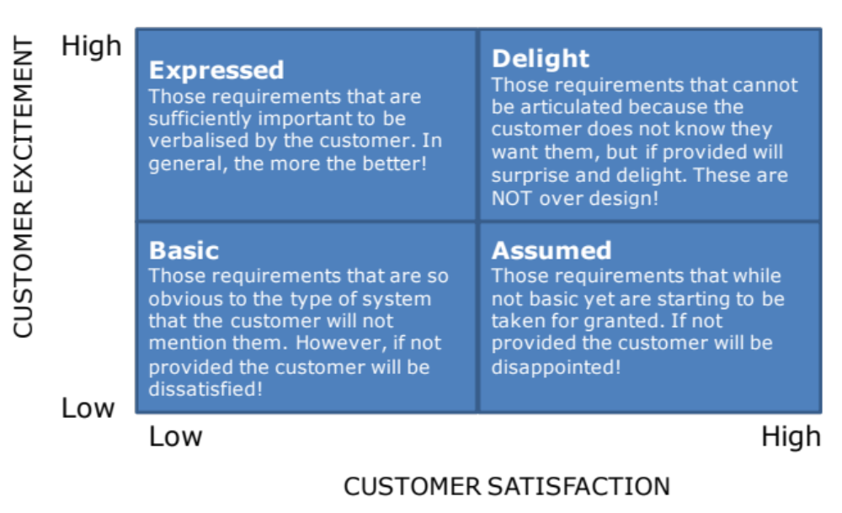
Getting at the Basic Requirements
Systemic Textual Analysis can help us analyse the expressed requirements and begin the discovery of the “unspoken” requirements. There is no guarantee, however, that it will find them all – we have to adopt another approach – experience and common sense
Systemic
Textual
Analysis
We can “get at” the unspoken requirements by identifying the system functionality

Slide 4


















Process and Tools
Gather Requirements
Analyse and Validate Requirements
Specify
Requirements
The Business Requirements provide the rationale and overall business constraints for a system development project
Determine the Emergent Functionality
Stakeholder Map
Flow Sensitivity Analysis
The System Requirements defines the measurable design requirements for the system
Determine system stakeholders and select key ones for requirements elicitation
Identifies causal paths for potential system sensitivities
Functional Failure Mode and Effect Analysis
Quality Function Deployment 1
Captures the potential functional failure modes, effects and causes to identify remedies ab initio
Cross checks requirements for consistency and completeness
Verification Compliance Matrix
Affinity Diagram
Use Case
Determine Validation and Verification methods for each requirement and specify V& V Requirements
Elicit and capture key stakeholder requirements
Captures how a user expects to interact with a system
Determine the necessary generic System Functionality
Tree Diagram/Analytic Hierarchy Process
Systemic Textual Analysis
Viewpoint/Functional Analysis
Function Flow Diagram
Organize and prioritise key stakeholder requirements
Analyses expressed requirements into their atomic form to identify and clarify missing and ambiguous requirements
Generates and organizes system generic functionality necessary to achieve the Operational Requirement
Captures and shows how the component functionality of a system must cooperate to deliver the Operational Requirement
Requirements Database
The User Requirements defines the expressed requirements of a particular stakeholder or stakeholders
Need Mean Analysis
Identifies and explores system solutions at different levels to determine System Meta-Solution

Slide 5
Where are we?: Analyse Requirements
Assess System Meta-Solution
Applying Systems Thinking to the task of analysing requirements tells us that we will need to take various perspectives to help uncover the unspoken requirements
Determine “working” Operational Requirement
Determine System Functionality
Determine Emergent Functionality
Determine Non-Functional Performance Requirements
The iteration may not be simple
Verify and Validate Requirements

Slide 6
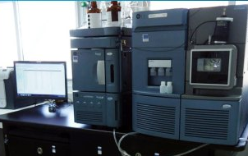
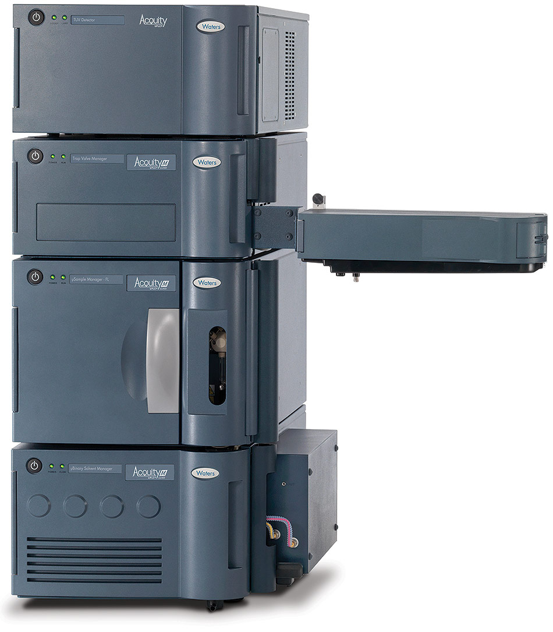
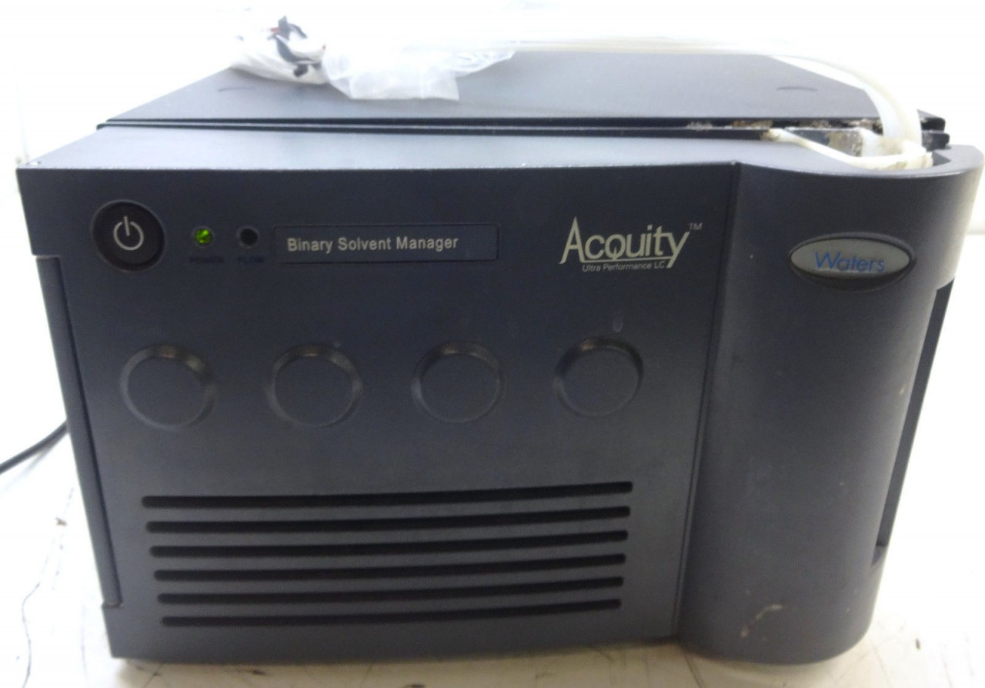
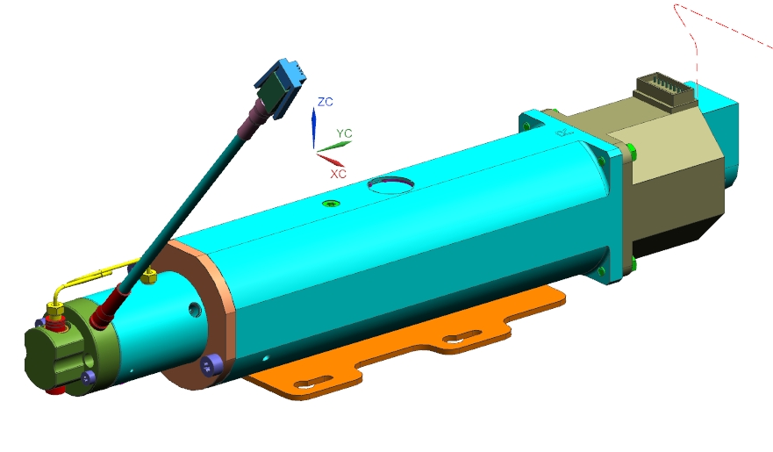
Top-down & Bottom-up
TOP-DOWN
Super-System
Viewpoint Analysis
System
Functional Analysis
Subsystem
Component
BOTTOM-UP

Slide 7
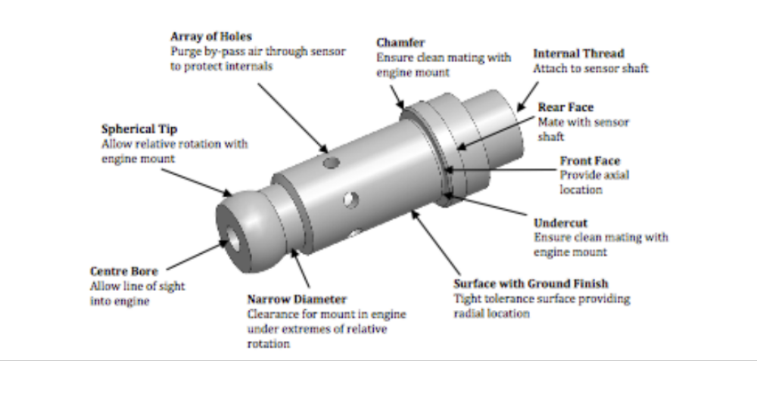
Functional Analysis
What is it?
Functional Analysis is a tool that can help a multi-disciplinary team identify and structure the Generic System Functionality of a System based on a previous solution
When to use it?
When attempting to determine the functionality of a component or simple subsystem
How does it work?
The approach adopted is one of using existing design solutions and determining the function of each component or component feature
Functional Analysis is based on the assumption that every component and feature has a purpose
The example above shows an EJ200 temperature sensor that required re-design. Functional Analysis was used to identify the functionality of the existing design to determine the generic functionality

Slide 8
How to do it?
The approach adopted is one of using existing design solutions and determining the function of each component AND component feature
In performing a Functional Analysis the process is basically linear
Step 1: Identify the constituent components AND features
    Step 2: For each component/feature discuss and agree its function – what it does
Step 3: Repeat Step for a alternative design solution to uncover generic functionality
Step 4: If complex create a Function Tree Diagram

Slide 9
Step 1: Identify Constituent Components AND Features
Cup
Lip Varnish
Disk
Composition
Void
Washer
Features on Face
Liner
Transfer Mix
Priming
Composition/Lighting
Example: AA Tracer

Slide 10
Step 2: Discuss and Agree Functionality
Cup
Retain Tracer Unit
Disk
Prevents Moisture Ingress From Propellant
Control Tracer Lighting Pressure
Lip Varnish
Seals Disk and Lip
Composition
Generate Coloured Light
N.B Pellets to aid Mfg.
Provides Oxygen & Fuel
Glues Components
Void
Provide Space for Disk Collapse
Washer
Control (cokes) Pressure on Face of Tracer
Liner
Protect Against Set-Back
Maintain Cigarette Burn
Features on Face
Increase Surface Area
Transfer Mix
Transfer Ignition
Priming Composition/Lighting
Lights Coloured Light Generator (CLG)
Protects CLG from Barrel Pressure

Slide 11
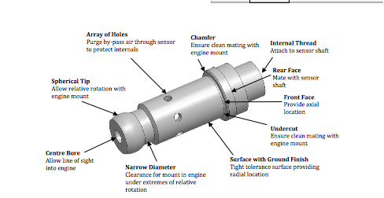
EJ200 Temperature Sensor

Slide 12
Step 3: Repeat for an Alternative Design
Our aim is to identify the Generic System Functionality – existing system designs, potentially will have every type of functionality:
  Generic
  Solution dependent
  Legislation dependent
  Architectural
  Emergent
By repeating the exercise with a similar item – i.e. a design solution that achieves the same Operational Requirements the generic functionality can be identified through repetition
Alternatively common sense can be used

Slide 13
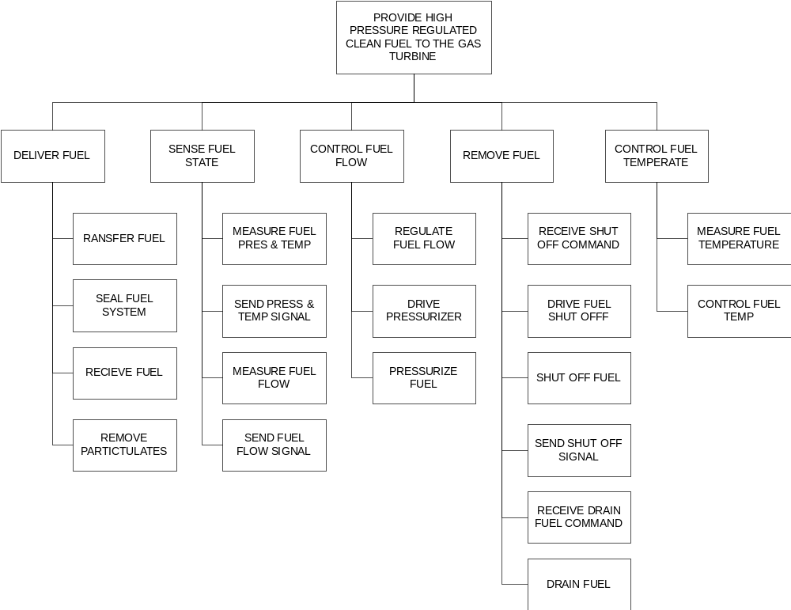
Step 4: If Complex, Convert to a Tree Diagram
Once the functionality has been determined it is useful to convert the list into a Tree Diagram

Slide 14
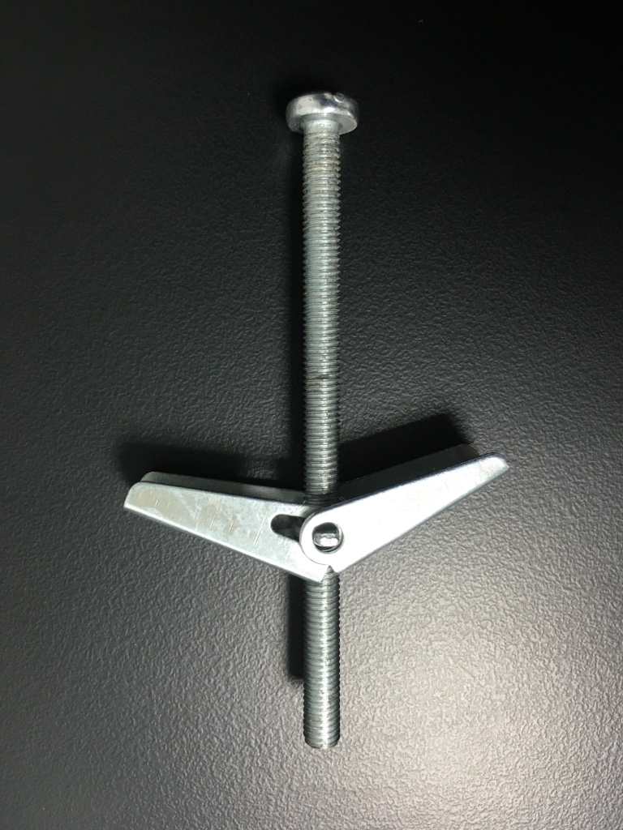
Exercise – Functional Analysis
In small groups
  Examine the simple object provided by the tutor to identify each component and feature
  For each component or feature determine its functionality
  Be prepared to share your outcome with the rest of the class
Time 20 minutes

Slide 15
Functional Analysis
Pros
  Simple tool for identifying component/subsystem functionality
  It can help to gain more understanding about the component/subsystem
  Provides a documented reusable analysis
  When used within a team context it allows the whole team to share information and agree a common understanding
Cons
  Particular items may lead to unnecessary functionality – non-generic functionality – leading to repetition of previous designs (and their drawbacks)
  Only works successfully at the component/subsystem level. Higher level systems are amenable to Functional Analysis but often generate functions at all levels resulting, potentially, in over-emphasis of unimportant functions and under-emphasis of important functions
Notes:
23

Slide 16
Top-down & Bottom-up
TOP-DOWN
Super-System
Viewpoint Analysis
System
Functional Analysis
Subsystem
Component
BOTTOM-UP

Slide 17
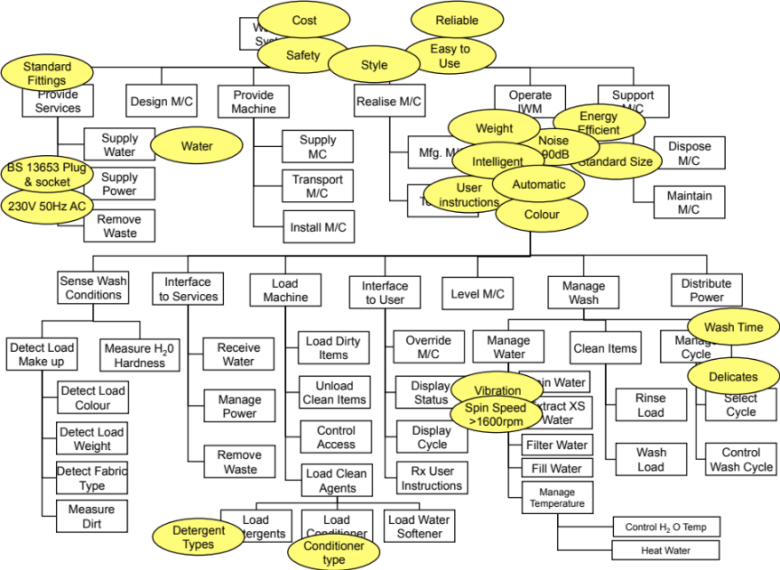
Viewpoint Analysis
What is it?
  Viewpoint Analysis is a tool that can help a multidisciplinary team identify and structure the requirements of a system
Why do it?
  To identify the required functionality necessary for a system to achieve its Operational Requirement
When to use it?
  Whenever attempting to determine and analyse a set of requirements.
  Particularly useful when there is a small number of customer requirements
How does it work?
  The approach adopted is one of divergent and convergent thinking to generate and structure the requirements.
  The system is examined from two viewpoints
    Functional Viewpoint
    Non-functional Viewpoint
  The approach identifies the natural structure between the functional requirements and how the non-functional requirements impact on them
The example above is the output of a Viewpoint Analysis. It is a Tree Diagram of the system functionality necessary to achieve the Operational Requirement . The “bubbles” contain constraints on that functional structure at the point they impact

Slide 18
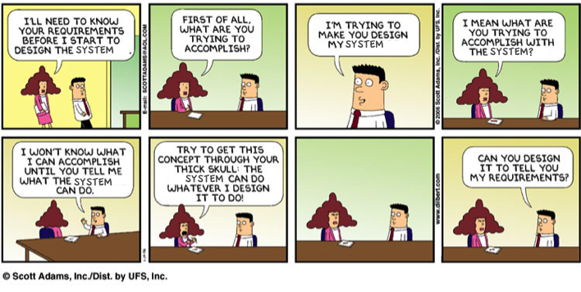

Slide 19
The Viewpoints
The Non-functional Viewpoint
  Requirements that are constraints
The Functional Viewpoint:
  Requirements that are functions deemed necessary for the system to achieve its Operational Requirement
  There are two types of functional viewpoint
    EXTERNAL or BOUNDING: An external or bounding viewpoint is a view of the system from the outside – this highlights external functionality of the system of interest particularly life-cycle functions
    INTERNAL or DEFINING: An internal or defining viewpoint is a view of the system from the inside and is used to describe the internal function of the system of interest
Notes:
7

Slide 20
How to do it: Viewpoint Analysis Process
Step 1
Requirements Generation
Step 2
Viewpoint Separation
Step 3
Functional Viewpoint Structuring
Step 4
Functional Viewpoint Grouping
Step 5
Functional Viewpoint Structure Chart
Step 6
System Viewpoint Structure Chart
Notes:
9

Slide 21
Step 1: Requirements Generation
The first stage is to generate the requirements for the system that will make up the functional and non-functional viewpoints
It is important to remember that any customer requirements will not be complete and the team WILL have to “add” obvious (basic) requirements
The approach is for the team to “brainstorm” and write down all possible requirements using sticky notes. There is NO sorting at this point
A key point to note here is that the requirements will come from the
  customer requirements document,
  legislative documents
  experience of the team
The intention is to “brainstorm” requirements not solutions (any solutions should be turned into requirements)
Notes:
10

Slide 22
We are after Functions
The focus when performing a Viewpoint Analysis is to encourage the team to brainstorm the FUNCTIONS necessary to deliver the Operational Requirement
Like all brainstorming sessions, criticism must be avoided and therefore the activity will also generate Non-functional requirements (including solutions) – this is not a bad thing. Such Non-functional requirements can infer functions
We do need, however, an Operational Requirement for the System of Interest.
  If none exists the starting point for a Viewpoint Analysis is to develop a “Working Operational Requirement”
  If one does exist we need to check that it truly reflects the purpose of the system at the right level

Slide 23
Example: Intelligent Washing Machine
Product Brief
This machine will replace our existing top of the range model. It will be of standard size and take a standard load.
The machine must be easy to use and will be capable of determining the load make up and fabric type and of determining the ‘best’ cleaning cycle. It will detect mixed loads and where necessary inform the user of extreme loads.
The cost must be within 15% of the existing machine price. The machine must conform to EU safety standards.
The style must be distinctive and attractive. The machine will use domestic water and currently available detergents. Standard electricity supplies will provide the power source.
It will operate at appropriate temperatures and wash cycles most suitable for the fabric type, which are determined by the machine.
The user will have the facility to check the wash cycle and override the machine decision. The machine will rinse and spin-dry the clothing as appropriate to load and type.
Note: There is an assumed Meta-solution of a water-based electrically powered system

Slide 24
Step 1: A “Working Operational Requirement”
In the example “customer” requirements document there is no clear obvious Operational Requirement – we need to develop one
A good approach here is to get all teams members to draft their own – remember the 18 word target (but do not get hung-up on it – 25 words is okay, as might be 13!)
In this case:
To intelligently wash domestic fabric items effectively and efficiently with the minimum of human intervention
It may be necessary to define what is meant by:
Intelligently
Effectively
Efficiently
This is the “Working OR” – a starting point! It actually is not a particularly “good” requirements because in its present form not measurable! – BUT trying to be “perfect” at this point can be nugatory work

Slide 25
The Big Question!
What will the system have to do in order to intelligently wash domestic fabric items effectively and efficiently with the minimum of human intervention?

Slide 26
“to deliver hot water and controllable space heating in a multi-room dwelling with optimum energy usage”

Slide 27
Step 1 Output: The Viewpoint Requirements Diagram
Drum
Easy to
Use
Interlocks
Detergent
Types
Accessibility
Standard
Fittings
Maintain
W/M
Top of
range
Install
Heat
Water
Safety
Door
Load
Detergent
Testing
Controls
User input
Wash
Load
Water Softener
Fill with
water
Load
Conditioner
User
instructions
Detect
Load Colour
Rinse
Detect Fabric
Type
Spin
Power
connection
Detect
Load Weight
5Kg
Load
Measure dirt
Water
Energy
Efficient
Distribute
Power
Control
Temp
Cost
Standard Size
Transport
Detect Load
Make-up
Design IWM
Conditioner
type
Measure H2O
hardness
Drain
Water
Cycle
Display
Reliable
Vibration
Disposal
Unload
Weight
Style
Automatic
Noise
.90dB
Wash Time
Filter
water
Power
Supply
Adjustable
Feet
Cycle
Selection
Status
Display
Delicates
Supply
M/C
Spin Speed
>1600rpm
Mfg.
Colour
Intelligent
Override

Slide 28
The team use their experience and common sense to introduce basic, assumed and delighter requirements
Not expressed
Drum
Easy to
Use
Interlocks
Detergent
Types
Standard
Fittings
Accessibility
Standard
Fittings
Accessibility
Maintain
W/M
Maintain
W/M
Top of
range
Install
Heat
Water
Safety
Install
Door
Load
Detergent
Load
Detergent
Testing
Testing
Controls
Controls
User input
Wash
Load
Water Softener
Load
Water Softener
Fill with
water
Fill with
water
Load
Conditioner
Load
Conditioner
User
instructions
Rinse
Detect
Load Colour
Spin
Detect
Load Colour
Detect Fabric
Type
Power
connection
Power
connection
Detect
Load Weight
5Kg
Load
Detect
Load Weight
Water
Energy
Efficient
Distribute
Power
Measure dirt
Distribute
Power
Control
Temp
Control
Temp
Cost
Standard Size
Transport
Transport
Detect Load
Make-up
Design
Design IWM
Conditioner
type
Measure H2O
hardness
Measure H2O
hardness
Drain
Water
Drain
Water
Cycle
Display
Reliable
Vibration
Disposal
Disposal
Unload
Unload
Weight
Weight
Style
Automatic
Noise
.90dB
Wash Time
Wash Time
Filter
water
Adjustable
Feet
Cycle
Selection
Filter
water
Power
Supply
Cycle
Selection
Status
Display
Delicates
Delicates
Mfg.
Supply
M/C
Mfg.
Supply
M/C
Spin Speed
>1600rpm
Colour
Intelligent
Override

Slide 29
Functions not Solutions
Step 1 of VPA demands that the team “brainstorm requirements and not solutions”
In practice this is impossible and actually not desirable, people will naturally tend to think in terms of solutions – which is the “how” rather than the “what”. Hence there is the need to convert the solutions into requirements – into logical functions.
Examples
      Object Function
      Front door Load clothes
      Spinning drum Extract water
This conversion can be done as the brainstorm progresses or after the brainstorm has finished

Slide 30
Functions not Solutions
Drum
Easy to
Use
Interlocks
Detergent
Types
Accessibility
Standard
Fittings
Maintain
W/M
Top of
range
Install
Heat
Water
Measure dirt
Door
Load
Detergent
Testing
Controls
User input
Wash
Load
Water Softener
Fill with
water
Load
Conditioner
User
instructions
Rinse
Detect
Load Colour
Detect Fabric
Type
Spin
Power
connection
Detect
Load Weight
5Kg
Load
Water
Energy
Efficient
Distribute
Power
Safety
Control
Temp
Cost
Standard Size
Transport
Detect Load
Make-up
Design IWM
Conditioner
type
Measure H2O
hardness
Drain
Water
Cycle
Display
Reliable
Vibration
Disposal
Unload
Weight
Style
Automatic
Noise
.90dB
Wash Time
Filter
water
Power
Supply
Adjustable
Feet
Cycle
Selection
Status
Display
Delicates
Supply
M/C
Spin Speed
>1600rpm
Mfg.
Colour
Intelligent
Override

Slide 31
Comments
Drum
Interlocks
“Interlocks” is a solution to “prevent early access”. This is actually OK, but negative. It is better to try and write the function as a positive action
Prevent
Early Access
The “Drum” is a solution but one that has multiple functionality – e.g. wash, spin, rinse etc. Need to check that all the functionality has been identified
Control Access
Spin
Extract Excess
Water
Door
Load
Dirty Items
“Spinning” could be viewed as a function (it passes the “ing” test) but it is, in this context, a solution.
“Door” is a solution and has been transferred into its logical function. What the door does.
“Adjustable feet” is a solution and has been transferred into its logical function.
Adjustable
Feet
Level M/C

Slide 32
Functions as Verb Noun Phrases
When brainstorming requirements we are often economical with our language and describe functions by just the verb
This is not a bad thing to do, the requirements generation step is about quantity not quality
It is, however, good practice to review the brainstormed requirements and convert verb only functions into full verb noun descriptions
For example
Testing
Test M/C
Rinse
Rinse Load

Slide 33
Defining “good” Functions
A System Function defines something the System has to do – it’s a job, a task, an activity
Functions are defined as a
The NOUN defines the object the verb acts on. It should be a concrete noun
  something that can be touched, seen, tasted, smelt or heard.
Beware of abstract nouns
  these are things you cannot touch, see, hear, smell or taste (but can sometimes measure) like reliability, safety, style, etc.
The VERB is also important to define correctly
Look for VERBS that don’t imply a solution – BUT later when designing the system will allow you to explore all the solution options
  Deliver Toast (good)
  Eject Toast (bad because it suggests a “pop-up” mechanism)
Do explore different verbs – we always have choice.
Try to use imperative verbs – command verbs - wherever possible
VERB NOUN

Slide 34
Functions as Verb Noun Phrases
Easy to
Use
Control Access
Detergent
Types
Accessibility
Standard
Fittings
Maintain
W/M
Top of
range
Install
Heat
Water
Measure dirt
Load
Detergent
Testing
Load
Dirty Items
Controls
User input
Wash
Load
Water Softener
Fill with
water
Load
Conditioner
User
instructions
Rinse
Detect
Load Colour
Detect Fabric
Type
Extract Excess
Water
Power
connection
Detect
Load Weight
5Kg
Load
Water
Energy
Efficient
Distribute
Power
Safety
Control
Temp
Cost
Standard Size
Transport
Detect Load
Make-up
Design
Conditioner
type
Measure H2O
hardness
Drain
Water
Cycle
Display
Reliable
Vibration
Disposal
Unload
Weight
Style
Automatic
Noise
.90dB
Wash Time
Cycle
Selection
Filter
water
Power
Supply
Delicates
Status
Display
Level M/C
Supply
M/C
Spin Speed
>1600rpm
Mfg.
Colour
Intelligent
Override

Slide 35
Functions as Verb Noun Phrases
Easy to
Use
Control Access
Detergent
Types
Accessibility
Standard
Fittings
Maintain
W/M
Top of
range
Install M/C
Heat
Water
Measure dirt
Load
Detergent
Test M/C
Load
Dirty Items
Controls
User input
Wash
Load
Load
Water Softener
Fill with
water
Load
Conditioner
User
instructions
Rinse Load
Detect
Load Colour
Detect Fabric
Type
Extract Excess
Water
Power
connection
Detect
Load Weight
5Kg
Load
Water
Energy
Efficient
Distribute
Power
Safety
Control
Temp
Cost
Standard Size
Transport
M/C
Detect Load
Make-up
Design M/C
Conditioner
type
Measure H2O
hardness
Drain
Water
Cycle
Display
Reliable
Vibration
Dispose M/C
Unload
Clean Items
Weight
Style
Automatic
Noise
.90dB
Wash Time
Cycle
Selection
Filter
water
Power
Supply
Delicates
Status
Display
Level M/C
Supply
M/C
Spin Speed
>1600rpm
Mfg. M/C
Colour
Intelligent
Override M/C

Slide 36
Do Take a Lifecycle View
When brainstorming system functions we should also consider the life cycle functions like:
  Design IWM
  Manufacture IWM
  Test IWM
  Sell IWM
  Operate IWM
  Support IWM
  Etc.
These functions are likely to be part of the External Functional Viewpoint but are important to include because:
  They are “systems” in their own right that may have to be developed
  They are sources of further constraints that will affect the design
  We haven’t yet defined the system boundary (Step 3)

Slide 37
Step 2: Viewpoint Separation
The second step in Viewpoint Analysis is to separate the functional and non-functional requirements to provide the two basic viewpoints
Care should be exercised when identifying the functions that form the functional viewpoint
  Function descriptions are a verb or a verb noun phrase where the verb is typically an imperative verb and the noun is a common noun
  Functions transform inputs to outputs
  Beware of pseudo functions
Remember customers tend to specify solutions (NFI) and performance (NFP and NFS), we should consider every requirement to see if it implies a function - which we should deduce and record on a new sticky note
Our aim here is identify all possible functionality of the proposed system – we can always choose not to implement functionality, but if it is not identified in the first place we will never have the opportunity to make that decision.
Notes:
12

Slide 38
Typical Step 2 Output
Detergent
Types
Safety
Maintain
W/M
Load
Detergent
Accessibility
Standard
Fittings
Load
Dirty Items
Load
Water Softener
Rinse Load
Power
Supply
Easy to
Use
Water
Load
Conditioner
Detect Fabric
Type
Design M/C
Controls
Top of
range
Reliable
Detect
Load Colour
Detect Load
Make-up
Transport M/C
Power
connection
Conditioner
type
Energy
Efficient
Detect
Load Weight
Filter
water
Fill with
water
Cycle
Display
Noise
.90dB
Weight
Drain
Water
Control
Temp
Wash Load
Status
Display
Delicates
Colour
Level M/C
Test M/C
Extract Excess
Water
Cycle
Selection
Intelligent
Automatic
Supply
M/C
Control Access
Unload Clean Items
User input
Spin Speed
>1600rpm
Style
Measure dirt
Heat
Water
Override M/C
Standard Size
Wash Time
Not Clear
Measure H2O
hardness
Distribute
Power
Mfg. M/C
User
instructions
Vibration
Install M/C
Dispose M/C
5Kg
Load
Cost
Functional
Non-functional

Slide 39
It’s best to be pedantic
Supply
Power
Power
Supply
230V 50Hz AC
Control
Wash Cycle
Controls
Interface to
Power
Power
connection
BS 13653 Plug
& socket
Capture Non
Functional
Requirements
Capture Non
-functional
Requirements
Convert solutions
into functions
Convert solutions
into functions
Display
Cycle
Cycle
Display
Display
Status
Status
Display
Select
Cycle
Cycle
Selection
Receive user
instructions
User input
Not Clear

Slide 40
Typical Step 2 Output
Maintain
M/C
Load
Detergent
Supply
Power
Display
Cycle
Detergent
Types
Accessibility
Standard
Fittings
Load
Dirty Items
Load
Water Softener
Rinse Load
Display
Status
Safety
Easy to
Use
Water
Load
Conditioner
Detect Fabric
Type
Design M/C
Select
Cycle
230V 50Hz AC
Top of
range
Reliable
Detect
Load Colour
Detect Load
Make-up
Transport M/C
Receive user
instructions
BS 13653 Plug
& socket
Conditioner
type
Energy
Efficient
Detect
Load Weight
Filter
water
Fill with
water
Mfg. M/C
Noise
<90dB
Weight
Drain
Water
Control
Temp
Wash Load
Delicates
Colour
Level M/C
Test M/C
Extract Excess
Water
Intelligent
Automatic
Supply
M/C
Control Access
Unload
Clean Items
Spin Speed
>1600rpm
Style
Measure dirt
Heat
Water
Override M/C
Standard Size
Wash Time
Measure H2O
hardness
Distribute
Power
Control
Wash Cycle
User
instructions
Vibration
Install M/C
Dispose M/C
Interface to
Power
5Kg
Load
Cost
Functional
Non-functional

Slide 41
Step 3: Functional Viewpoint Structuring
The Non-functional Viewpoint requirements are temporarily discarded and consideration is given to logically structuring the Functional Viewpoint requirements
The first step in structuring the Functional Viewpoint requirements is to identify the External and Internal Functional Viewpoint requirements
This effectively defines the “prime system” and those systems elements in its environment that it will have to interact with (which we may have to consider in more detail in order to design a “better” prime system)
Notes:
14

Slide 42
Typical Step 3 Output
Display
Cycle
Load
Dirty Items
Supply
Power
Maintain
M/C
Select
Cycle
Rinse Load
Load
Detergent
Design M/C
Supply
M/C
Load
Water Softener
Mfg. M/C
Detect Fabric
Type
Display
Status
Transport M/C
Install M/C
Detect
Load Colour
Detect Load
Make-up
Load
Conditioner
Test M/C
Detect
Load Weight
Filter
water
Fill with
water
Unload
Clean Items
Drain
Water
Control
Temp
Wash Load
Receive user
instructions
Dispose M/C
Level M/C
Extract Excess
Water
External Viewpoint
Interface to
Power
Control Access
Some functions could be inside or outside the prime system. Where we decide to put them defines the system boundary. We need to think carefully about these. Will they lead to design solutions that will be part of the prime system
Measure dirt
Heat
Water
Override M/C
Measure H2O
hardness
Distribute
Power
Control
Wash Cycle
Internal Viewpoint

Slide 43
Final Step 3 Output
Display
Cycle
Load
Dirty Items
Maintain
M/C
Supply
Power
Select
Cycle
Rinse Load
Load
Detergent
Design M/C
Supply
M/C
Load
Water Softener
Mfg. M/C
Detect Fabric
Type
Display
Status
Transport M/C
Detect
Load Colour
Detect Load
Make-up
Load
Conditioner
Install M/C
Supply
Water
Test M/C
Detect
Load Weight
Filter
water
Fill with
water
Unload
Clean Items
Receive
Waste
Drain
Water
Control
Temp
Wash Load
Receive user
instructions
Dispose M/C
External Viewpoint
Level M/C
Extract Excess
Water
Manage
Power
By separating and categorising requirements we start to simplify our understanding which often leads to identifying additional necessary functionality (requirements)
Control Access
Receive
Water Supply
Measure dirt
Heat
Water
Override M/C
Remove
Waste
Measure H2O
hardness
Distribute
Power
Control
Wash Cycle
Internal Viewpoint

Slide 44
Step 4: Functional Viewpoint Grouping
The next step is to logically group the functions together so that at any one level of grouping there is a maximum of 5 functions ( 7 – 2 allowing “headroom” for undiscovered functions)
The groups should be logical and named
  If you have difficulty deciding a name the grouping is not logical – look for another grouping
  Choose a name that is a Verb Noun combination to maintain the emphasis on functions (we tend to drift back to object-oriented thinking)
Notes:
16

Slide 45
Internal Viewpoint
Operate IWM
External Viewpoint
Sense Wash Conditions
Detect Load
Make-up
Provide
machine
Design M/C
Detect
Load Colour
Supply
M/C
Load Cleaning
Agents
Load Machine
Detect
Load Weight
Load
Dirty Items
Transport M/C
Support M/C
Load
Water Softener
Disposal M/C
Detect Fabric
Type
Install M/C
Maintain
M/C
Load
Detergent
Unload
Clean Items
Measure dirt
Load
Conditioner
Control Access
Provide Services
Realise M/C
Supply
Water
Measure H2O
hardness
Test M/C
Receive
Waste
Manage Wash
Clean Items
Supply
Power
Mfg. M/C
Rinse Load
Manage Water
Drain
Water
Level M/C
Distribute
Power
Interface
to services
Wash Load
Manage
Temperature
Extract Excess
Water
Manage
Power
Interface to User
Control
Temp
Filter
water
Manage Cycle
Override M/C
Display
Status
Select
Cycle
Receive
Water Supply
Heat
Water
Fill with
water
Control
Wash Cycle
Display
Cycle
Receive user
instructions
Remove
Waste

Slide 46
Step 5: Functional Viewpoint Structure Chart
The penultimate stage is to convert the structured viewpoint affinity diagram into a Functional Viewpoint Structure Chart
We put the external viewpoint functions at the same level as the prime system – it is usual to capture the prime system as the function “Operate XYZ System”
  The purpose here is to elevate these critical lifecycle and interface functions such that their importance is recognised early because:
    We need to design for
      Manufacture
      Sales
      Disposal
      Maintenance
      Etc.
    “design for” means “design in”
As we construct the Functional Viewpoint Structure Chart, we should review it to identify any further functionality
Notes:
18

Slide 47
Typical Step 5 Output
Washing
System
Provide Services
Design M/C
Provide
Machine
Realise M/C
Operate
IWM
Support
M/C
Supply
Water
Supply
MC
Mfg. M/C
Dispose
M/C
Supply
Power
Functions that appear “not to fit” should be investigated!
Transport
M/C
Test M/C
Maintain
M/C
Remove
Waste
Install M/C
Sense Wash
Conditions
Interface
to Services
Load
Machine
Interface to User
Level M/C
Manage
Wash
Distribute
Power
Detect Load
Make up
Measure H₂0
Hardness
Receive
Water
Load Dirty
Items
Override
M/C
Manage
Water
Clean Items
Manage
Cycle
Detect Load
Colour
Unload
Clean Items
Display
Status
Drain Water
Manage
Power
Extract XS
Water
Rinse
Load
Select
Cycle
Detect Load
Weight
Control
Access
Display
Cycle
Remove
Waste
Filter Water
Wash
Load
Control
Wash Cycle
Detect Fabric
Type
Load Clean
Agents
Rx User
Instructions
Fill Water
Manage
Temperature
Measure
Dirt
Load
Detergents
Load
Conditioner
Load Water
Softener
Control H₂ O Temp
Heat Water

Slide 48
Typical Step 5 Output
Washing
System
Provide Services
Design M/C
Provide
Machine
Realise M/C
Operate
IWM
Support
M/C
Supply
Water
Supply
MC
Mfg. M/C
Dispose
M/C
Supply
Power
Transport
M/C
Test M/C
Maintain
M/C
Remove
Waste
Install M/C
Sense Wash
Conditions
Interface
to Services
Load
Machine
Interface to User
Manage
Wash
Distribute
Power
Detect Load
Make up
Measure H₂0
Hardness
Receive
Water
Load Dirty
Items
Override
M/C
Manage
Water
Clean Items
Manage
Cycle
Detect Load
Colour
Unload
Clean Items
Display
Status
Drain Water
Manage
Power
Extract XS
Water
Rinse
Load
Select
Cycle
Detect Load
Weight
Control
Access
Display
Cycle
Remove
Waste
Filter Water
Wash
Load
Control
Wash Cycle
Detect Fabric
Type
Load Clean
Agents
Rx User
Instructions
Fill Water
Have we got everything? Are we missing logical generic functionality?
Manage
Temperature
Measure
Dirt
Load
Detergents
Load
Conditioner
Load Water
Softener
Control H₂ O Temp
Heat Water

Slide 49
Step 6: Non-functional Viewpoint Structure
The final stage in Viewpoint Analysis is to re-introduce the Non-functional Requirements but at their most appropriate point in the Functional Viewpoint Structure Chart
This can be achieved by considering each of the Non-functional Viewpoint Requirements and finding the “best” place for it to sit in the functional viewpoint structure
This step can be very useful in identifying further missing requirements – particularly Non-functional Performance Requirements. All system functions identified must have associated Non-Functional Performance Requirements
Notes:
20

Slide 50
Cost
Easy to
Use
Washing
System
Safety
Reliable
Standard
Fittings
Style
Provide Services
Design M/C
Provide
Machine
Realise M/C
Operate
IWM
Support
M/C
Weight
Energy
Efficient
Supply
Water
Water
Supply
MC
Mfg. M/C
Noise
.90dB
Dispose
M/C
Intelligent
Standard Size
BS 13653 Plug
& socket
Automatic
Supply
Power
Transport
M/C
User
instructions
230V 50Hz AC
Test M/C
Colour
Maintain
M/C
Remove
Waste
Install M/C
Sense Wash
Conditions
Interface
to Services
Load
Machine
Interface to User
Level M/C
Manage
Wash
Distribute
Power
Wash Time
Detect Load
Make up
Measure H₂0
Hardness
Receive
Water
Load Dirty
Items
Override
M/C
Manage
Water
Clean Items
Manage
Cycle
Delicates
Detect Load
Colour
Unload
Clean Items
Display
Status
Vibration
Drain Water
Manage
Power
Spin Speed
>1600rpm
Extract XS
Water
Rinse
Load
Select
Cycle
Detect Load
Weight
Control
Access
Display
Cycle
Remove
Waste
Filter Water
Wash
Load
Control
Wash Cycle
Detect Fabric
Type
Load Clean
Agents
Rx User
Instructions
Fill Water
Manage
Temperature
Measure
Dirt
Load
Detergents
Load
Conditioner
Load Water
Softener
Detergent
Types
Control H₂ O Temp
Conditioner
type
Heat Water
Sense Water Temp

Slide 51
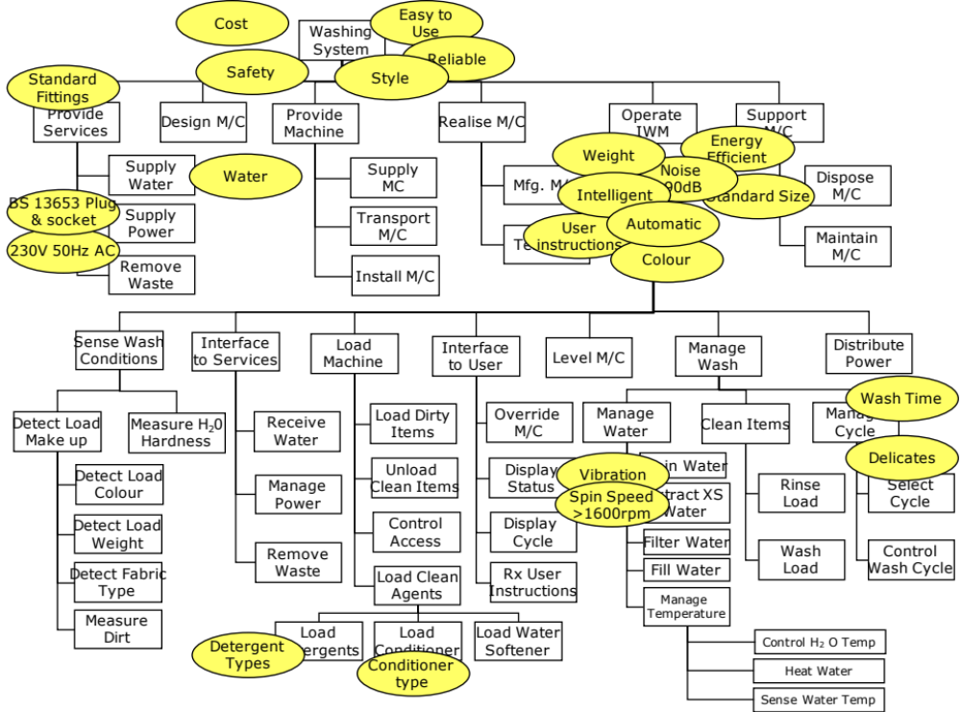
Holistic Requirements Model and VPA
Non-
functional
System
Non-
functional
Performance
Functions with no attached sticky notes tell us there are missing NFP requirements

Slide 52
Other Systems
The Viewpoint Analysis will identify other “systems” that need consideration. These are often the “Life Cycle” functions like Supply, Maintenance, Disposal etc. These could be subject to their own Viewpoint Analysis and will have their own Requirements

Slide 53
Functional Structure Chart for the Support System
INTELLIGENT WASHING SYSTEM
SELL IWM SS
BUILD
IWM SS
MANAGE SS
FACILITIES
OPERATE SUPPORT
SYSTEM
SUPPORT
SUPPORT SYS
OPERATE IWM
DISPOSE
SUPPORT SYS
MANAGE
STAFF
PERFORM FIX
MANAGE
FAULT
MANAGE
CUSTOMER
MANAGE
PROGNOSIS
MANAGE FAILURE DATA
MANAGE ISSUE
MANAGE FINANCE
COLLECT IWM HEALTH DATA
COLLECT FAILURE DATA
TRAIN STAFF
TRANSPORT TECHNIAN
PROVISON SPARES
RECEIVE CUSTOMER ISSUE
INVOICE CUSTOMER
UPDATE
IWM
ANALYSE FAILURE DATA
RECRUIT STAFF
FIX IWM
SELECT VISIT TIME
INTERROGATE
IWM
MONITOR STAFF
PROVIDE TECH ASSIST
LOG ISSUE
MANAGE
COMPLAINTS
REPORT FAILURE INFO
SCHEDULE TECHNICIAN
TRACK ISSUES
PROGNOSE FAULT
PROVIDE TECH DATA
MANAGE WARRANTY
INFORM CUSTOMER
(INCIPIENT FAILURE)
REPORT ACTION
DIAGNOSE FAULT
INFORM PROGRESS
UPDATE IWM HISTORY

Slide 54
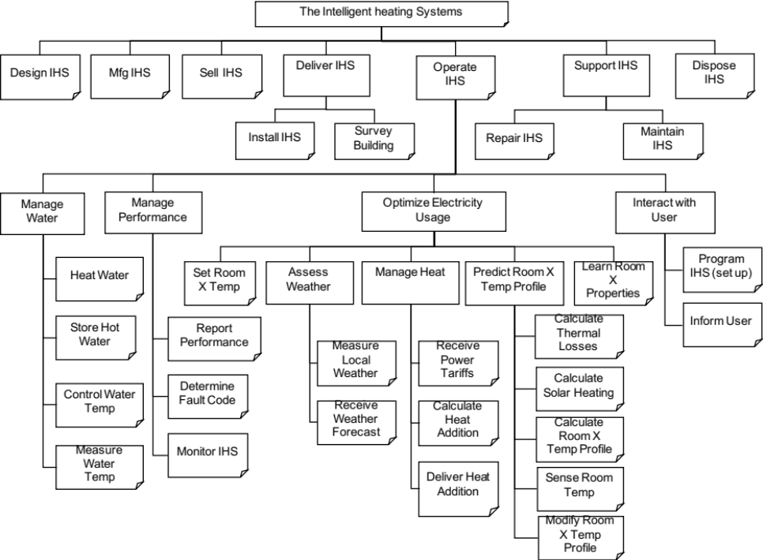
Exercise: Viewpoint Analysis
In teams:
  Undertake a Viewpoint Analysis for the case study example
  Be prepared to share your viewpoint structure chart with the rest of the group
Time: 60 Minutes

Slide 55
The Intelligent heating Systems
Design IHS
Mfg IHS
Sell IHS
Deliver IHS
Operate IHS
Support IHS
Dispose IHS
Install IHS
Survey Building
Repair IHS
Maintain IHS
Manage Water
Manage Performance
Manage Space Heating
Interact with User
Heat Water
Program IHS (set up)
Set Room X Temp
Assess Weather
Manage Heat
Predict Room X Temp Profile
Learn Room X
Properties
Calculate Thermal Losses
Inform User
Store Hot Water
Report Performance
Measure Local Weather
Receive Power Tariffs
Determine Fault Code
Calculate Solar Heating
Control Water
Temp
Receive Weather Forecast
Calculate Heat Addition
Calculate Room X Temp Profile
Measure
Water
Temp
Monitor IHS
Deliver Heat Addition
Sense Room Temp
Modify Room X Temp Profile

Slide 56
Concerns
Teams are often concerned with “is the diagram right?”
The purpose of viewpoint analysis is to generate more knowledge about a proposed system. As long as the viewpoint structure represents the whole of the problem, it does not matter if it is different to another potential viewpoint structure
Manage
Wash
Manage
Wash
Manage
Water
Clean Items
Manage
Cycle
Perform
Wash
Control
Wash
Drain Water
Fill
Water
Extract XS
Water
Rinse
Items
Select
Cycle
Control
Temp
Filter Water
Filter Water
Control
Wash Cycle
Agitate
Items
Control
Wash Cycle
Heat Water
Fill With
Water
Select
Cycle
Common Purpose
(Group on the noun)
Agitate
Items
Manage
Temp
Rinse Items
Common Themes
(Group on the verb)
Control Temp
Drain Water
Heat Water
Extract XS
Water

Slide 57
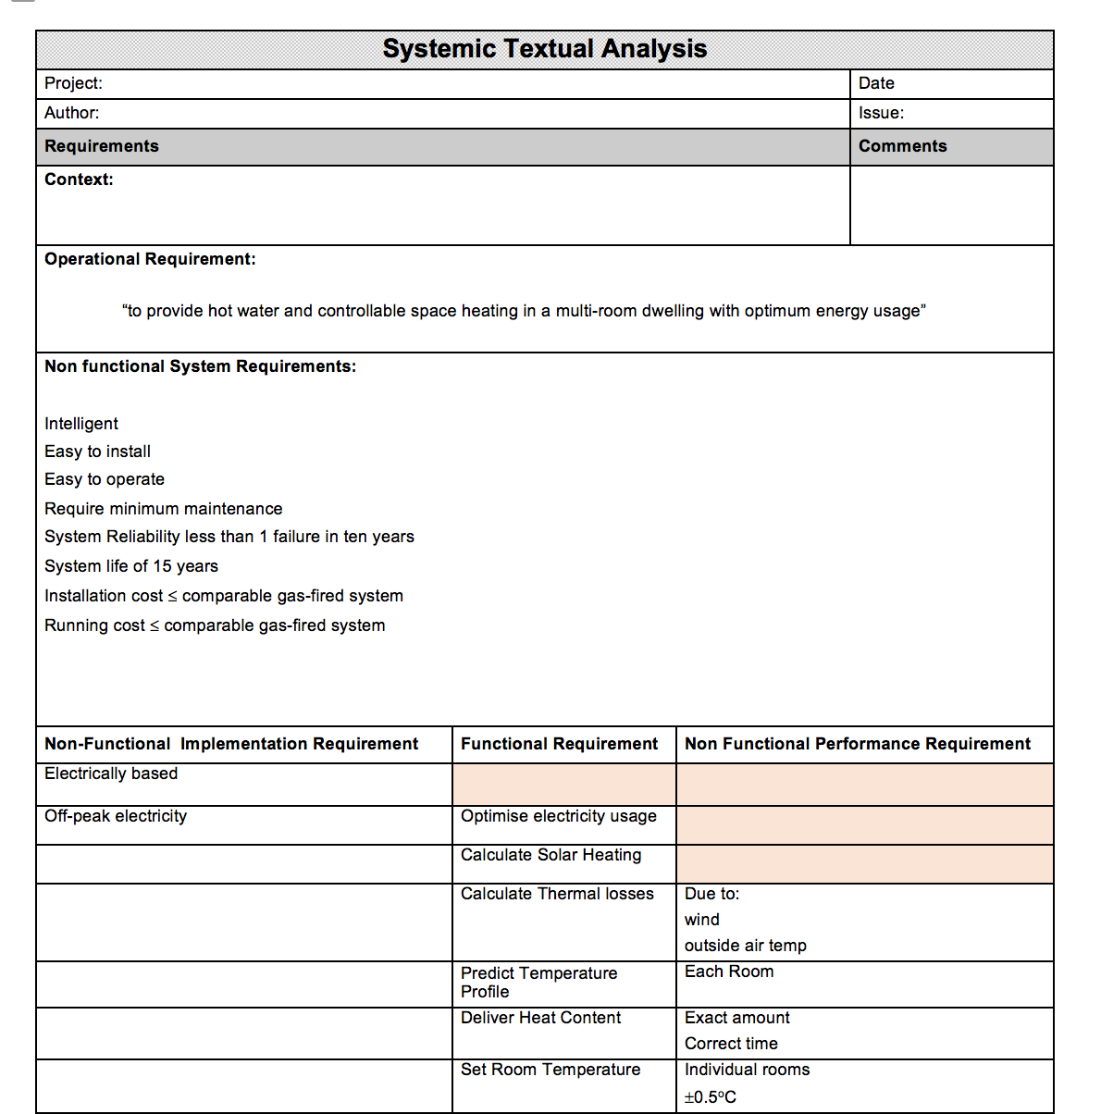
Tying up loose ends
Viewpoint Analysis is very good at identifying 80% - 90% of the system functionality – we need to do something else to find the other 10% - 20%
If a Systemic Textual Analysis has been undertaken it should be updated with the new derived requirements from the Viewpoint Analysis
If a Systemic Textual Analysis has not been undertaken – start one now.

Slide 58
Summary : Viewpoint Analysis
Pros
  Simple tool for diagrammatically showing the hierarchy/structure of functional and non-functional requirements
  It can highlight requirements missing from the original source (customer/stakeholder) requirements - and identify and emphasise life cycle aspects: it helps us be holistic
  It can help to structure the concept design and project management
  It can help to gain more understanding about the system and what all the stakeholders expect
  It can help in showing the various stakeholders that you understand what they are after
  When used within a team context it allows the whole team to share information and agree a common understanding
Cons
  Grouping can be difficult since many functions could reside in several groups
  Does not show cross links between functions
Notes:
23

Slide 59

Summary
Viewpoint and/or Functional Analysis helps identify and record in a structured diagrammatic fashion the generic functionality of a system uncovering unspoken requirements and implying further ones
Systemic Textual
Analysis
Viewpoint/
Functional Analysis

