Slide 1


Analyse Requirements
Verifying Customer – Technical Requirements using
Quality Function Deployment
This Session:
To describe and practise Quality Function Deployment as a tool that can be used to help in the Determine System Requirements process to:
  Check for completeness and consistency
  Summarise the requirements set
  Help define requirements
  Provide a framework for ancillary analyses
  Provide a reference for future systems

Slide 2


















Process and Tools
Gather Requirements
Analyse and Validate Requirements
Specify
Requirements
The Business Requirements provide the rationale and overall business constraints for a system development project
Determine the Emergent Functionality
Stakeholder Map
Flow Sensitivity Analysis
The System Requirements defines the measurable design requirements for the system
Determine system stakeholders and select key ones for requirements elicitation
Identifies causal paths for potential system sensitivities
Functional Failure Mode and Effect Analysis
Quality Function Deployment 1
Captures the potential functional failure modes, effects and causes to identify remedies ab initio
Cross checks requirements for consistency and completeness
Verification Compliance Matrix
Affinity Diagram
Use Case
Determine Validation and Verification methods for each requirement and specify V& V Requirements
Elicit and capture key stakeholder requirements
Captures how a user expects to interact with a system
Determine the necessary generic System Functionality
Tree Diagram/Analytic Hierarchy Process
Systemic Textual Analysis
Viewpoint/Functional Analysis
Function Flow Diagram
Organize and prioritise key stakeholder requirements
Analyses expressed requirements into their atomic form to identify and clarify missing and ambiguous requirements
Generates and organizes system generic functionality necessary to achieve the Operational Requirement
Captures and shows how the component functionality of a system must cooperate to deliver the Operational Requirement
Requirements Database
The User Requirements defines the expressed requirements of a particular stakeholder or stakeholders
Need Mean Analysis
Identifies and explores system solutions at different levels to determine System Meta-Solution

Slide 3
Where are we?: Analyse Requirements
Assess System Meta-Solution
Applying Systems Thinking to the task of analysing requirements tells us that we will need to take various perspectives to help uncover the unspoken requirements
Determine “working” Operational Requirement
Determine System Functionality
Determine Emergent Functionality
Determine Non-Functional Performance Requirements
The iteration may not be simple
Verify and Validate Requirements

Slide 4

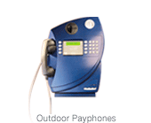
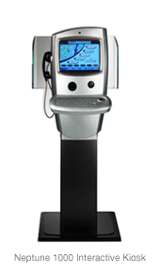
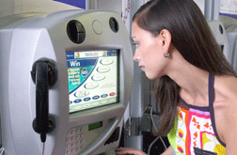
A QFD Success: The Neptune Payphone
MARCONI'S WEB PHONE AND INTERACTIVE KIOSK WIN TOP INDUSTRY AWARDS
KioskCom 2003 Interactive Kiosk Excellence Awards recognise excellence of Marconi's Neptune 800 and 1000
London and Las Vegas — 10 April 2003 — At a ceremony held in Las Vegas on 8 April 2003, Marconi's (MONI) Neptune web phones and interactive kiosks won two categories in the annual KioskCom Interactive Kiosk Excellence Awards. The Awards, widely seen as the most prestigious in the kiosk industry, recognise achievements in the design and application of interactive kiosks. Marconi won the "Best Public Communications Kiosk Application" award for the nationwide deployment of its Neptune 800 web phone and Neptune 1000 interactive kiosk in the UK, the world's largest roll-out of its kind. In addition, the Neptune 800 won the "Most Innovative/Creative Kiosk Enclosure Design" award, with the Neptune 1000 finishing a close second.

Slide 5
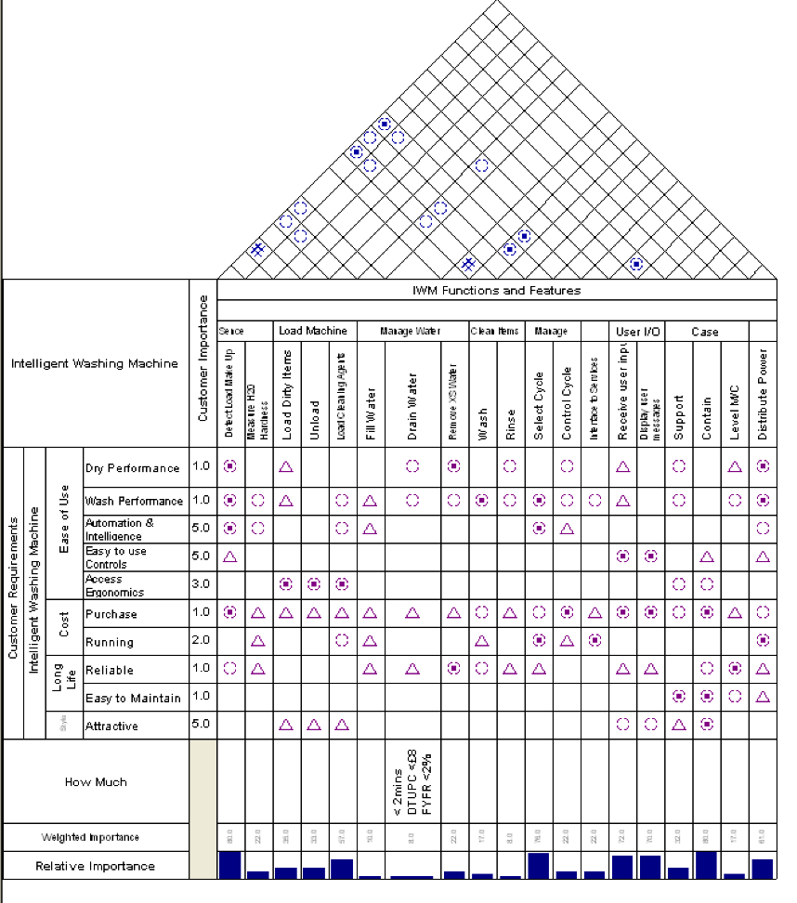
Quality Function Deployment
What is it?
  QFD is more than a tool – potentially it’s a complete methodology that can help an organization capture, translate, summarise and manage requirements throughout the system introduction process
  It is a structured and systematic approach to flowing customer requirements into measurable organization requirements at each stage from market research through design to realisation.
  The QFD chart is basically a type of matrix diagram that allows a team to assess the relationships between two sets of requirements thereby helping assure:
    completeness
    consistency
When to use it
  Whenever attempting to determine and analyse a set of requirements in order to deliver a customer centric solution.
The example above is simplified Quality Function Deployment phase 1 matrix for the Intelligent Washing Machine. It shows the relationship between the User Requirements and the System Design Requirements to demonstrate completeness and consistency

Slide 6
Lost in Translation
Created in Japan in the late 1960s’ and first used in a ship yard (low volume production), Quality Function Deployment (QFD) is a structured approach for translating customer requirements into company requirements at each stage from market research through to manufacture.
品質 機能 展開
HIN
SHITSU
KI
NO
TEN
KAI
QUALITY
FEATURES
ATTRIBUTES
QUALITIES
FUNCTION
MECHANISATION
DEPLOYMENT
DIFFUSION
DEVELOPMENT
EVOLUTION
Direct Translation
CUSTOMER DRIVEN ENGINEERING
Contextual Translation

Slide 7
Translation of Customer Requirements
Customer Requirements
Marketing
QFD 1
Translation
Design Requirements
Systems Engineering
QFD 2
Translation
Part Requirements
Design
QFD 3
Translation
Manufacturing Requirements
Manufacturing Systems
Engineering
QFD 4
Translation
Production Requirements
Production and QA

Slide 8
Originally Product Focused But Universally Applicable
Product
System
Customer Requirements
Customer Requirements
QFD 1
Design Requirements
Design Requirements
QFD 2
Part Requirements
Solution Requirements
QFD 3
Manufacturing Requirements
Realisation Requirements
QFD 4
Production Requirements
Assurance Requirements

Slide 9
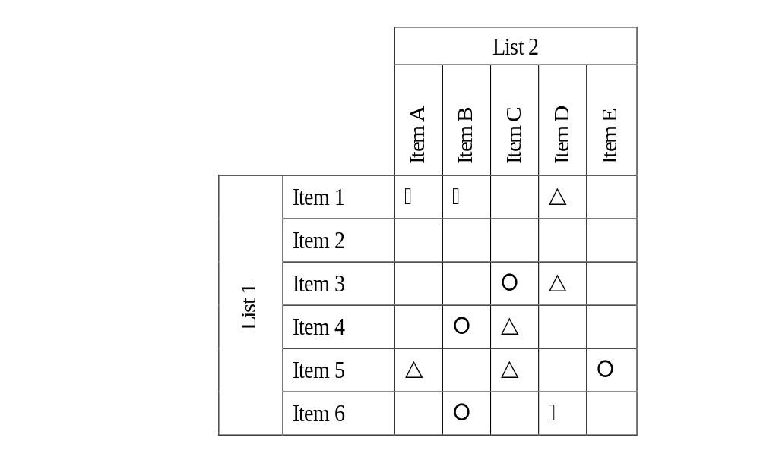
Translation via a Matrix Diagram
A Matrix Diagram is a Systems Thinking tool to identify, quantify and capture the many-to-many relationships that exist between two list of items
Secondary List of Items
(must have something in common)
Many-to-many Relationship Matrix
STRONG
MEDIUM
Primary List of Items
(must have something in common)
WEAK

Slide 10
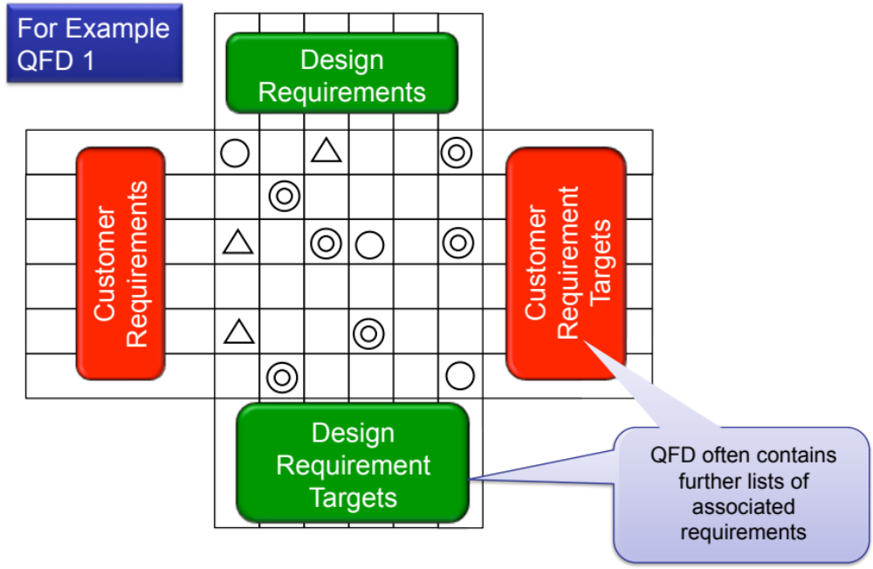
In QFD the Lists are Requirements

Slide 11
Four Phases of QFD: The Methodology
Translation confirmed using the Relationship Matrix
Requirements Flow-Down
QFD 1
QFD 2
Design Requirements.
QFD 3
Solution Requirements
QFD 4
Start Here

Realisation Requirements

Assurance Requirements
Customer Requirements

Design Requirements.

Solution Requirements
Realisation Requirements
Design Requirement Targets
Solution Requirement Targets
Realisation Requirement Targets
Assurance Requirement Targets
Requirements Traceability

Slide 12
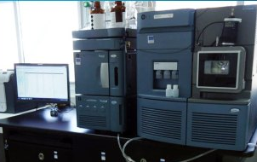
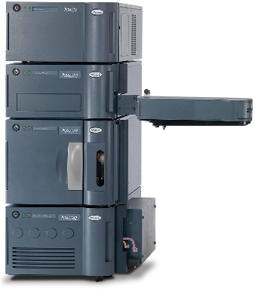
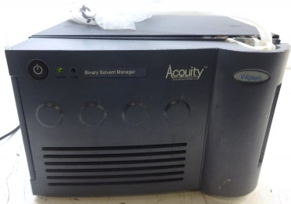
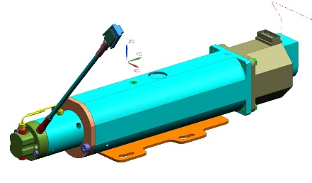
Top-down & Bottom-up
TOP-DOWN
Super-System
Viewpoint Analysis
System
Functional Analysis
Subsystem
Component
BOTTOM-UP

Slide 13
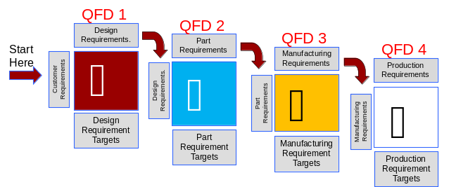

We Use QFD at Every Level
System Level
Subsystem Level
Customer Requirements flow down
Verification data flow up
Component Level

Slide 14
Start From Where We Are
The fact that QFD was not used at the higher levels should not stop us applying it at the lower levels
Customer Requirements flow down

Slide 15
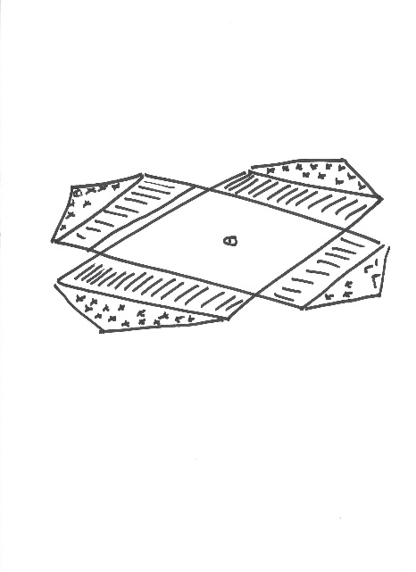


A Perfect Tool!
At face value, QFD sounds an ideal tool for the Research/ Medical industry
  Traceability
  Low volume etc
However, applying QFD in the aerospace/power industry can be difficult and frustrating because of the nature and origin of the customer requirements

Slide 16
Design Requirements.
Quality Function Deployment Phase 1
QFD 1
Translating “Customer” Requirements into Technical Design Requirements
QFD Chart
#1
Customer Requirements
QFD 1
Design Requirement Targets

Slide 17
QFD 1 is about Translating Customer Requirements into Technical Design Requirements
Technical Design
Requirements
Customer
Wants/
Requirements
It’s easy!
or
is it?

Slide 18
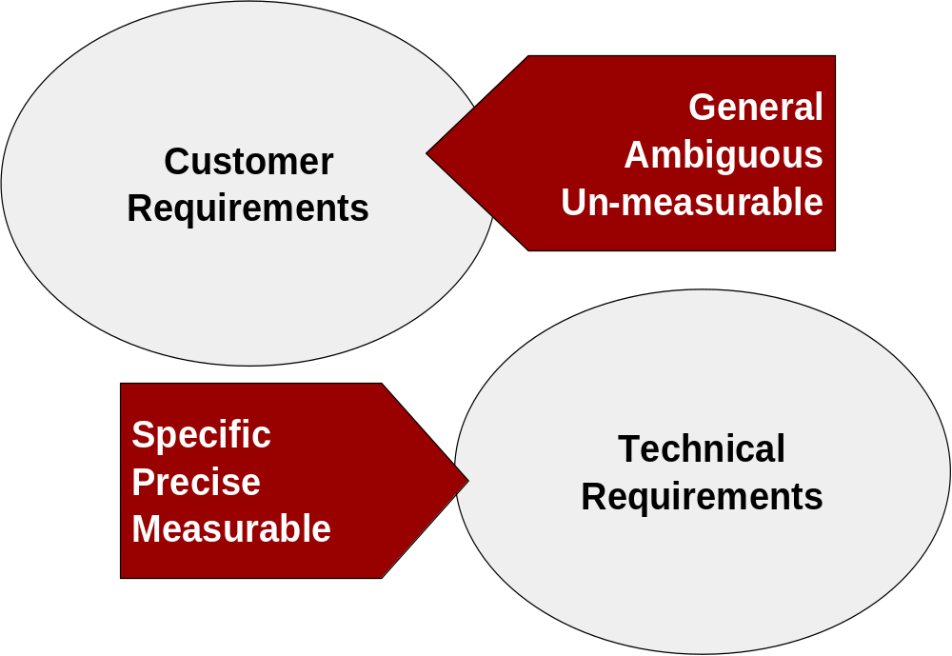
The QFD Assumption
Text book QFD makes the implicit assumption that customer requirements are general, ambiguous and un-measurable.

Slide 19
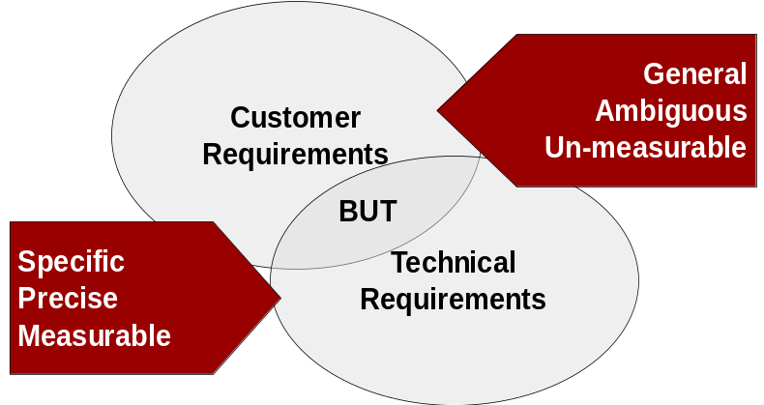
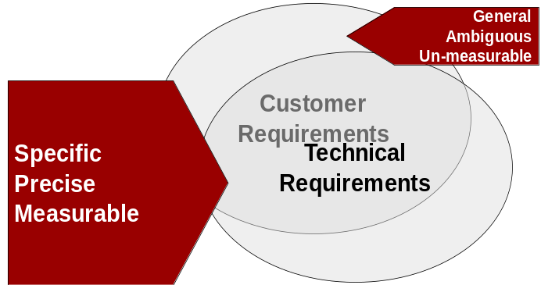
Reality: Markets and Requirements
Broad
Narrow
Broad Market Requirements
Typically the requirements are ambiguous and general in nature because the customer cannot express in technical terms their precise needs and expectations
Narrow Market Requirements
The customer often has a very good knowledge of the system and is able to describe their requirements in considerable technical detail
It is often easier to apply QFD in a Broad Market, because the spoken or expressed customer requirements rarely contain any technical requirements (but there may be some)
It is often more difficult to apply QFD in a Narrow Market, because the spoken customer requirements contain a large number of technical requirements

Slide 20
QFD in a Narrow Market
QFD is often (if not always) explained or taught from a Broad Market perspective
Certain Industries – Defence, Infrastructure, Research, Medical etc are Narrow Markets
If a broad market perspective is used with a set of Narrow Market requirements the outcome is confusion, frustration and ultimately failure!
This is due to the customer providing a considerable amount of technical detail in their requirements – which is logical since they are spending a great deal of money and therefore they want to be careful
Applying QFD in this Narrow Market situation requires a slightly different approach

Slide 21
Back to QFD
How
Correlations
QFD charts look complex. They are complicated but not complex.
The chart comprises a roof and a series of rooms that form a matrix diagram between the WHAT Requirements and the HOW Requirements
The QFD method follows a set of steps to build up the rooms and roof
The core process focuses on the WHAT, HOW, RELATIONSHIPS and HOW MUCH rooms
HOW
WHAT
Customer competitive
assessment
CUSTOMER IMPORTANCE
RELATIONSHIPS
WHAT HOW MUCH
Target Values
HOW MUCH
Target values
Technical competitive
assessment
Importance Weighting

Slide 22
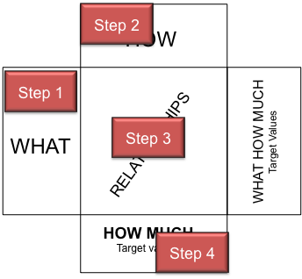
QFD Core Process
The process steps relate to completing one of the “rooms”
The process steps relate to completing one of the “rooms”
Completing a room often requires the use of other tools
The QFD 1 Chart provides a method of monitoring progress
The completed chart can be used as a summary of progress and as such is a powerful deliverable for phase and design reviews
Step 1: Identify the chart WHAT list requirements
QFD 1: Identify customer requirements
Step 2: Translate WHAT requirements into measurable HOW requirements
QFD1: Translate customer requirements into measurable technical requirements
Step 3: Determine relationships between WHAT and HOW requirements
QFD 1: Determine relationships between customer and technical requirements
Step 4: Determine HOW MUCH for HOW requirements
QFD 1: Determine targets for technical requirements

Slide 23
Step 1 in a Broad Market
With Broad Markets it is necessary to “talk” to many customers and stakeholders and listen to their expressed customer requirements
WHAT the customer wants is called “the voice of the customer”
In a Broad Market situation the requirements that make up the WHATs are typically general, vague and un-measureable
Capturing and recording these is highly desirable because it is “the voice of the customer” – but it is not directly actionable
For example “easy to use” is an obvious user
requirement for a payphone, but could have a variety of
meanings for different people.
If questioned as to “how easy to use?” the response is usually “very” i.e. equally vague
Note, however, while the customer cannot describe specifically what they mean they can and will assess how “easy to use” it is once the system is delivered
WHAT
Easy to use
Pay anyway
Working
Clean

Slide 24
Step 1: in a Narrow Markets
Narrow Market customers provide a detailed set of requirements that contain both vague, general requirements and specific technical requirements. Indeed, the customer will have put considerable effort into not giving any vague requirements
Although these source requirements represent “what” the customer wants they should NOT all go in the WHATs!
In such cases customers are providing some of the HOW and HOW MUCH requirements
In consequence we have to work out where best to put each requirement in the QFD chart
This can be time consuming but worthwhile because QFD will help us identify missing requirements
HOW
Some go here
WHAT
CUSTOMER IMPORTANCE
RELATIONSHIPS
Some go here
Some go here
HOW MUCH
Target values

Slide 25
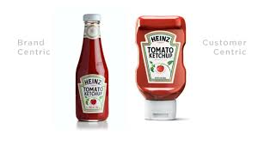
Discussion – Voice of the customer
Consider the case study system
  What are the primary requirements of customers/user?
  What type of requirements are these?
Time: 10 minutes

Slide 26
Customer WHATs and Narrow Market Requirements
The requirements (WHATs) in a narrow market are the:
  Operational Requirements (that element relating to the overall system purpose)
  Non-functional System Requirements
This is also true of a Broad Market, but in these markets customers naturally talk in these terms. We should be wary, however, of any “technical requirements” from the customer particularly if they are not at a system level but appear to refer to a specific aspect. Such requirements may sit better elsewhere in the QFD chart!

Slide 27
Non-functional System Requirement Target Values
Narrow Market Non-functional System Requirements are often measurable (unlike Broad Markets). This is because it is important to the customer.
Narrow Market Non-functional System Requirements will therefore have target values. This often leads to confusion since requirements with targets are often just categorised as “performance requirements”
  it is important to distinguish between those “performance requirements that relate to a particular FUNCTION (NFP) and those that relate to the SYSTEM (NFS)
To capture the target values for Non-functional System Requirements we modify the basic QFD chart to include an extra room
HOW
WHAT
HOW MUCH
Target values for the Non-Functional System Requirements
CUSTOMER IMPORTANCE
RELATIONSHIPS
HOW MUCH
Target values

Slide 28
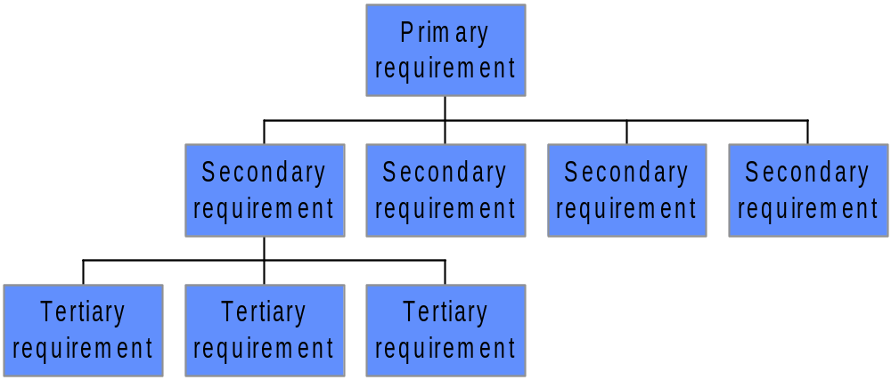
Structure the Voice
With both Broad and Narrow markets there may well be a significant number of WHATs requirements. In such cases it is important to structure the customer requirements into the general primary requirements and the more detailed secondary and tertiary requirements
Level 1
Level 2
Level 3
In practice this can be accomplished by means of Affinity Diagramming and Tree Diagramming – see the section on Gathering Requirements

Slide 29
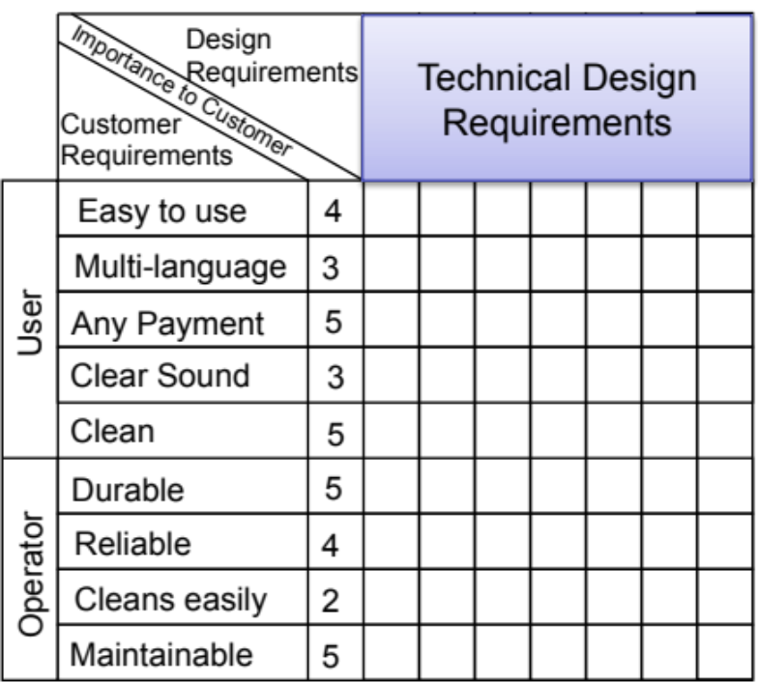
QFD and Multiple Customers/Stakeholders
One key advantage of QFD is its ability to consider simultaneously multiple customers/stakeholders and thereby develop a set of System Technical Design Requirements that provide universal satisfaction - failing that identify where trades may be necessary
One of the advantages of QFD is that it can help determine a set of System Design Requirements that satisfy all stakeholders
User
Requirements
Operator
Requirements

Slide 30
Step 2: Translate into Technical Requirements
HOW
The System
Functions
The idea behind QFD is that the vague customer requirements should be translated into specific, precise and measureable technical design requirements
This is HOW not in terms of solutions but HOW in terms of technical design requirements
The HOWs must be measurable which allow the system to be evaluated once built
This is can achieved through consideration of the necessary functionality
Enter Number
Select Language
Handle Coins
Read Cards
WHAT
Display Info
Easy to use
Experience shows that 20 to 30 functions is a good balance between detail and making the QFD unwieldy. If there is more than 30 functions they will need to be grouped to form “super” functions

Slide 31
HOWs and Narrow market Requirements
The HOWs are the
Functional Requirements
Warning:
Customer specified Non-functional Implementation (NFI) requirement present a particular challenge with QFD – where do we put them? The temptation is to put them in the HOWs.
Firstly, any NFI requirement should be tested to see if they are justifiable or lazy requirements, i.e. does the customer really want “door mirrors” or “to see behind”? Remember, customers think in objects not functions.
If lazy, and not already done, determine the function inferred by the solution-based requirement and write the function in the HOWs. The link to a solution can be captured in the Requirements Database or as a note on the QFD matrix
If justifiable, determine the function inferred by the solution-based requirement and write the function in the HOWs AND write the solution in the corresponding HOWMUCHs together with any specifications (see later)

Slide 32
Step3: Form WHAT-HOW Relationship Matrix
HOW
Functions
This method allows complex
relationships to be depicted and
easily interpreted
It also permits cross checking or
requirements compliance -
blank or sparse rows or columns
indicate inadequate translation
of WHATs into HOWS
For example, a blank or sparse row
indicates that there is a customer
requirement for which no function
or feature has been identified
The matrix can also be used to “test” potential “delighters”
Function 2
WHAT
Function 1
Customer RQMT 1
Customer RQMT 2
Blank or
sparse column
Blank or sparse row
STRONG relationship
MEDIUM relationship
WEAK relationship

Slide 33
Payphone Example
Measurable technical interpretation through functionality
Design
Requirements
Vague ambiguous
customer requirements
TX/RX Aural Messages
Importance to Customer
Handle Coins
Select Lang
Display Info
Read Cards
Customer
Requirements
Enter No.
Relationships
between customer
requirements
and technical
interpretation
Easy to use
4
Multi-language
3
User
Any Payment
5
Clear Sound
3
Clean
Sparse Rows!
something is missing!
5
Sparse Rows!
something is missing!
Durable
5
Reliable
4
Operator
Cleans easily
2
Maintainable
5

Slide 34
Payphone Example
Design
Requirements
TX/RX Aural Messages
Importance to Customer
Handle Coins
Select Lang
Display Info
Read Cards
Contain &
Protect
Customer
Requirements
Enter No.
Easy to use
4
Multi-language
3
What’s missing is the box! It has functionality: it protects, supports, contains etc. Can either include as a set of functions or as a new feature to address the customer requirements
User
Any Payment
5
Clear Sound
3
Clean
5
Durable
5
Reliable
4
Operator
Cleans easily
2
Maintainable
5

Slide 35
Relationship Guidance!
Complete the relationship matrix row-wise – we are interested in delivering the “customer’s/stakeholder’s” requirements
Relationships are NOT digital – it is easy to argue that the absence of a function will stop the system working and therefore it must be a strong relationship – We are concerned with how changing the “performance” of a particular function impacts on the customer/stakeholder requirement. One simple approach is to consider a “volume” knob that turns-up a particular function!
Do not over argue relationships – consider first order effects
In any row the function that has the biggest impact on the customer requirement should not be automatically categorised as “strong” – think carefully about its relationship!
Typically the relationship matrix is 50% - 60% empty

Slide 36
Overly full Rows or Columns
ROWS
  It is common to find overly full rows in the QFD relationship matrix because the WHATs are “system” level requirements (NFS for the item we are considering)
  What can be important here is the distribution of Strong, Medium and Weak symbols.
    A good guideline is the Pareto Principle or 80/20 rule
Columns
  Overly full columns on the other hand are an indication of:
    Over-aggregation of lower level functionality
      Overly full columns should be decomposed into two or three lower level functions and the relationships re-evaluated
      Equally empty or sparse columns should be tested for over-decomposition
    Critical Functions that have a significant impact on many of the customer facing requirements

Slide 37
Exercise – QFD1 steps 1 to 3
* The full spectrum of functionality for your system should be captured
In teams for the case study exercise
Complete steps 1, 2 and 3 of a QFD1 chart
Flip chart the outcomes and be prepared to share with the rest of the group
Time 30 Minutes
List 10-15 functions for your system *
List 10 -15 NFS requirements and the purpose element of the OR for your system
Complete the mapping

Slide 38
So What
QFD 1 will tell us where there are missing requirements or requirements not needed!
Typically the missing requirements relate to missing functionality, particularly that to do with the structure and architecture of the system functionality that is necessary to implement the operational functionality
We should also examine the relationship matrix for “structures”
  Full columns could indicate the presence of critical functions (or over aggregated lower level functionality)
  Full rows indicate requirements that will need careful management across the system

Slide 39
What’s Important?
Densely populated columns can indicate critical functions – but we can be intelligent by taking into account the customer requirements and their importance
Assign Customer
Importance to
WHATs on
1 to 5 scale
HOW
= 1
Function 1
Function 3
Function 2
WHAT
= 3
Customer Rqmt 1
5
Customer Rqmt 2
3
= 9
Customer Rqmt 3
1
2
1
The second column is fuller – but has a weight score of 42
5
Importance Rating
53
42
9
45
9
6
5x9+1x3+2x1+1x3
HOW MUCH

Slide 40
Customer Importance Numbers
QFD charts often make use of Customer Importance numbers to assist in prioritizing requirements
The WHAT IMPORTANCE RATING is determined from an assessment of the WHATS
Each WHAT is assigned an importance rating typically expressed using a relative scale of 1 to 5 with higher numbers indicating a greater importance to the “customer” (stakeholder)
It is important that these reflect the values of the stakeholder and NOT internal company beliefs; however, many organizations start from an internal assessment
There are several ways to determine the Customer Importance numbers.
Absolute scales
Sales Driven Scales (order winners/qualifiers)
Analytic Hierarchy Process

Slide 41
Step 4: Determine Targets and Ceilings
HOW MUCH is Enough?
The fourth element of the QFD chart is the HOW MUCHs
These are measures or metrics for the HOWs and the associated target values that define how good the HOWs have to be in order to satisfy the customer
The HOW MUCHs are the Non-functional Performance Requirements and “flowed-down” Non-functional System Requirements
Empty cells indicate where we need to identify appropriate performance targets
For any particular HOW function there will be many associated HOW MUCH metrics and target values
HOW
WHAT
RELATIONSHIPS
HOW MUCH

Slide 42
Example
The “HOW MUCHs” complete the technical interpretation and comprise: A metric, measure or property and a value as a target, lower or upper limit.
It is where most of the non-functional requirements align to the QFD structure.
These can be very detailed and refer to other documents
Associated performance metrics and target values that define “how well” the function has to perform
Function
(HOW)
Shock Proof > 1kN impact
Size < 300x259x690mm
Cost (DTUPC) < £9.90
Contain
& Protect
Payphone
Thickness > 6mm at all points
Durability > 5,000 rub cycles to BT 1795
Corner radii > 55mm
etc

Slide 43
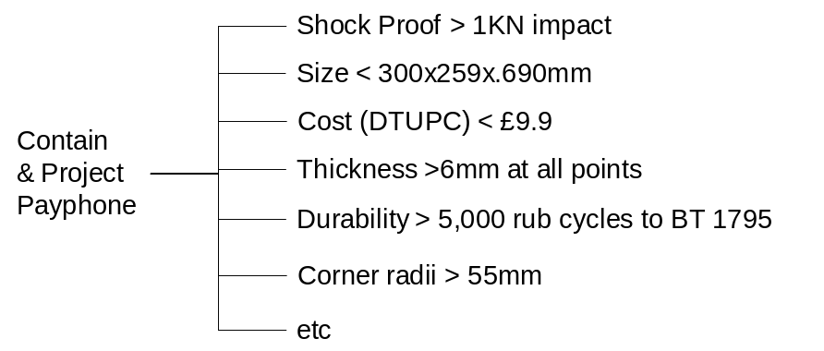
Deriving HOW MUCHs is Top-Down and Bottom-Up
HOW
Bottom-Up
  Common sense, experience, judgement says that the way you measure Function 4 is by …
Top-Down
Function 7
Function 6
Function 1
Function 5
Function 2
Function 4
Function 3
WHAT
RQMT A
RQMT B
RQMT C
RQMT D
RQMT E
RQMT F
The HOW MUCH for Function 4 must contain metrics/measures that relate to Customer Requirements A, B and E – or an error has been made!
A common approach here is to consider two solutions to a particular function. Say A and B, and ask what metrics could be used to decide between them?
HOW MUCH

Slide 44
High Level NFS Flow Down
HOW
Non-functional
System Requirements (System level performance requirements)
WHAT
HOW
MUCH
High Level performance requirements
WHAT
Cost
£X
Reliability
MTBF Y
Can flowed down through the relationship symbols
Can be “flowed down” through the relationship symbols
The QFD matrix can also be helpful in “flowing-down” system level performance requirements to individual functional requirements – it can help set and manage budgets for critical system level requirements such as cost, weight, reliability etc.
Sub-cost £D
Sub-cost £B
Sub-cost £A
Sub-cost £C
…
HOW MUCH
X = A+B+C+D+ . . .

Slide 45
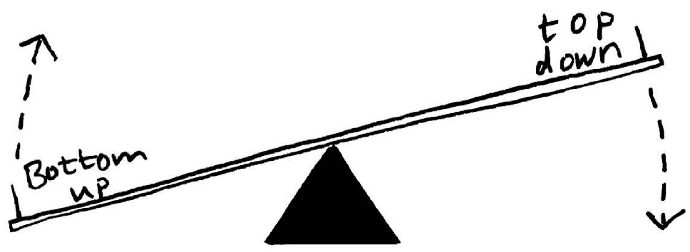
Exercise – QFD 1
In teams
Choose a Function and identify suitable HOW MUCH metrics or measures (cannot determine targets values)
Use both approaches described:
  Bottom up: given two possible solutions A and B, what metrics would you use to decide between them?
  Top down: Using the relationship symbols, is a related customer requirement addressed by the “bottom metrics”? Is the relationship symbol selected appropriate?
Time 15 Minutes

Slide 46
Terminology
QFD, and the Holistic Requirements Model, helps us define what a Technical Requirement is:
Technical Requirement is QFD terminology. The equivalent system engineering terminology is a System Design Requirement
Measure/property + value
Measure/property + value
Function
+
Measure/property + value
etc.
System Design Requirement ≡ Technical Requirement

Slide 47
V&V through HOW MUCHs
HOW
WHAT
Either or both WHAT and/or HOW “HOW MUCHs” provide the basis for verification and validation. They provide the way in which we can measure the vague customer WHATs
RELATIONSHIPS
HOW MUCH

Slide 48
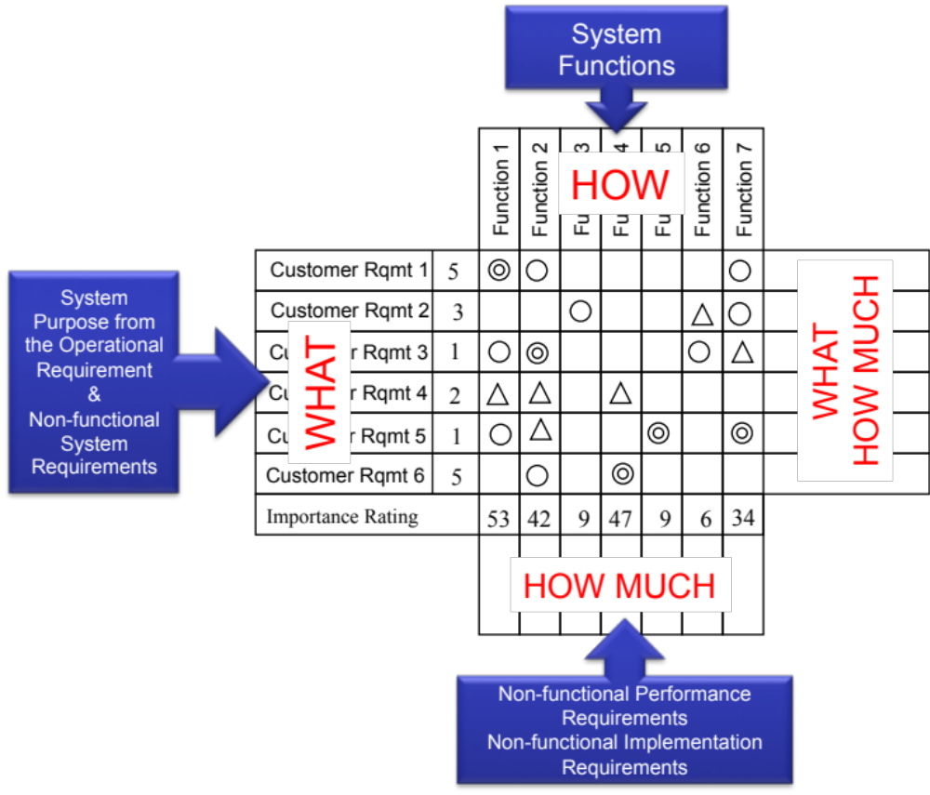
Holistic Requirements Model and QFD 1
Note that the structure of the Holistic Requirements Model is reflected in the structure of the QFD. We are exploiting this structure to consolidate and verify the requirements set. Blank or sparse cells, columns or rows indicate where the requirements set is incomplete
Note that we DO NOT have to have a complete QFD 1 chart to proceed. There may well be elements of the HOW MUCHs to be decided (TBD) that can only be determined through design activities

Slide 49
The “Bells and Whistles”
How
Correlations
Steps 1 to 4 are the basis of QFD – But it also supports a number of ancillary analyses that can provide further information about the System of Interest
HOW
What
Correlations
WHAT
Customer competitive
assessment
CUSTOMER IMPORTANCE
RELATIONSHIPS
WHAT HOW MUCH
Target Values
HOW MUCH
Target values
Technical competitive
assessment
Importance Weighting

Slide 50
(Step 5): Determine Requirement Correlation and Trade-offs
The CORRELATION MATRIX is the roof of the chart
Its purpose is to identify areas where trade-off decisions and further research may be needed
CORRELATION
MATRIX
x
x
x
HOW
WHAT
STRONG POSITIVE
RELATIONSHIPS
POSITIVE
NEGATIVE
STRONG NEGATIVE
HOW MUCH

Slide 51
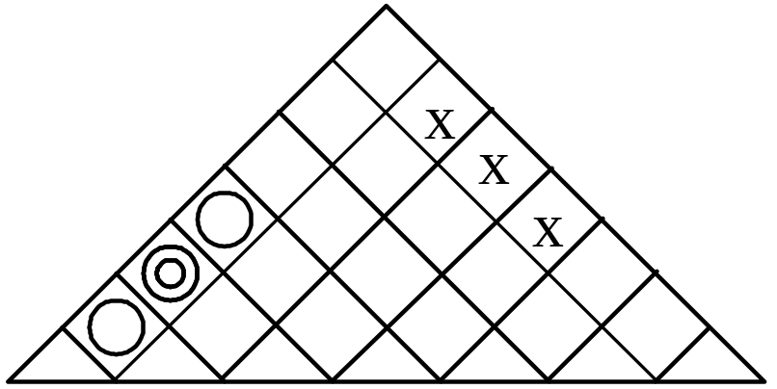
Correlation : Trade-offs
+ve the HOWs
support each other
–ve the HOWs
are in conflict
TX/RX Aural Messages
Improvement in Function 2
Select Lang
Display Info
Read Cards
Contain &
Protect
Enter No.
Handle Coins
Improvement in Function 2
Improvement in Function 1
Improvement in Function 1
luminosity
European
Arabic letter Set
All standard
500k inserts
European
Arabic
16 max
1M ops
95%
validation
<80dB
1kN shock
3 min
min ingress
The HOW MUCHs often define the correlations

Slide 52
What do Correlations tell you?
Positive correlations indicate possible win-win situations
Negative correlations indicate where trade-off decisions are likely BUT:
  The initial response to a negative correlation should be to make the trade-off go away. This may require innovation or research. A negative correlation indicates where functions are in conflict.
  Some negative correlations will require high level decisions, either by the company’s senior management or by the customer. In both cases early resolution is essential
Many negative correlations imply trade offs which are resolved by adjusting the HOW MUCHs
Tips
If there are no negative correlations there has probably been an error
The correlation matrix should be about 10% full
It is possible to argue some situations both ways (i.e. positive or negative correlations). In such cases capture the negative on the chart but record the discussion. This often occurs with aggregated functions – consider decomposing the aggregated functions into their atomic form
To fully understand the correlation between two functions it is often useful to consider the functional metrics (non-functional performance requirements = how that function is measured)

Slide 53
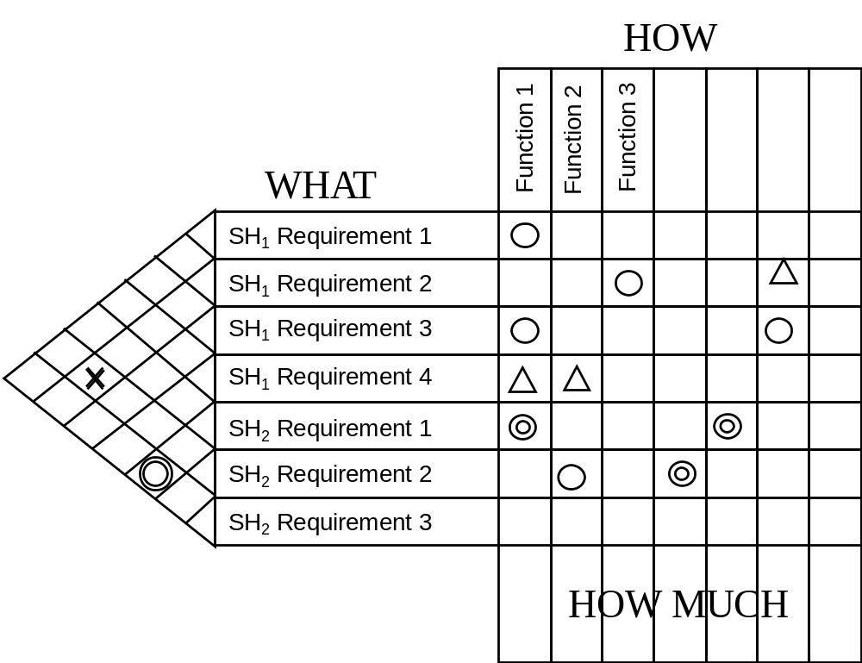
Conservatory Correlations
The idea of a correlation matrix can be extended to look for relationships between the stakeholder (customer) requirements
A strong negative correlation indicates a conflict between the requirements of Stakeholder 1 and Stakeholder 2!
A strong positive correlation between two requirements of Stakeholder 2

Slide 54

Rome and a Day
Key Success Factors
  Decide the need! Why is the QFD being constructed? – what questions will it help answer?
  Plan the completion of a QFD over several sessions
  Determine an appropriate set of WHAT requirements that are structured and validated and clearly defined (appropriate to the system and at the right level)
  A full set of functionality at a sensible level of generality that are clearly defined – if aggregated define the components
  Relationships strengths that are not “over-egged”
  Develop realistic metrics and measures for the HOW MUCHs
Rome wasn’t built in a day!
Likewise you CANNOT complete a QFD in a day
Indeed, the best way to construct a QFD is step-by-step over a number of weeks since each step may require some effort

Slide 55
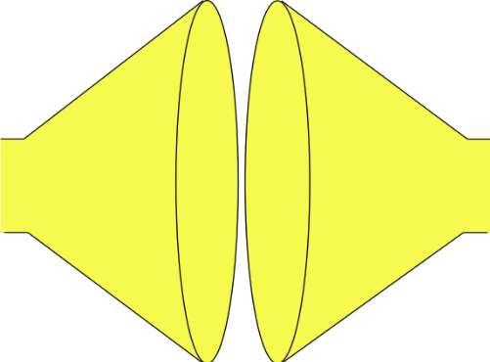
What have we done?
We have used QFD 1 to check our understanding of the System Problem
Search and evaluate the solutions to determine and select the “best” solution
(Convergent Thinking)
Do
Do
Do
MAKE THE SYSTEM TO THE DESIGN
GENERATE SOLUTION OPTIONS AND SELECT
SYSTEM PROBLEM
UNDERSTAND
PROBLEM
solution
solution
“best”
solution
Built System
Understand the problem in terms of Purpose and Context
solution
Stakeholder needs and expectations
solution
Check (& Act)
Identify and document all possible solutions to the problem (Divergent Thinking)
Confirm the understanding of the problem reflects the stakeholder’s needs and expectations
Check (& Act)
Confirm that the selected solution solves the stakeholders’ problem
Check (& Act)
Confirm that the built System solves the stakeholders’ problem

Slide 56
Summary
Pros
  Checks completeness and consistency of requirements set (expressed and deduced) leading to:
    Improved company performance - satisfied customers
    Lower costs in design and manufacture
  Helps in determining measurable requirements
  Traceability of requirements
  Improved communication throughout company (standard tool)
  Maintains traceable customer focus
Cons
  Can become unwieldy if the detail is not controlled
  Can over-argue relationships
  Need to be clear which requirements go where (mixing technical requirements with customer requirements)
  Management understanding, support and commitment
  Seen as an imposition rather than a useful tool

Slide 57
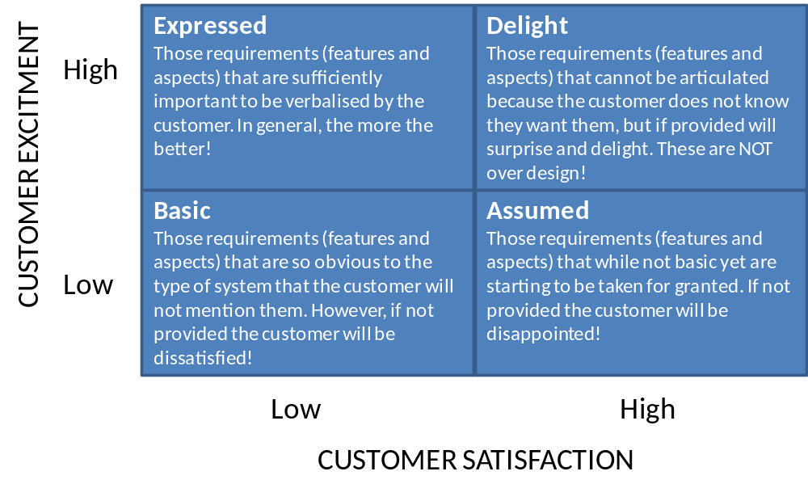
Summary
Quality Function Deployment 1 brings together the work completed so far providing a check on completeness and consistency as well as providing a summary of the full requirements set
Systemic Textual
Analysis
Failure
Analysis
QFD 1
Viewpoint/
Functional Analysis
Functional
Modelling

