Slide 1

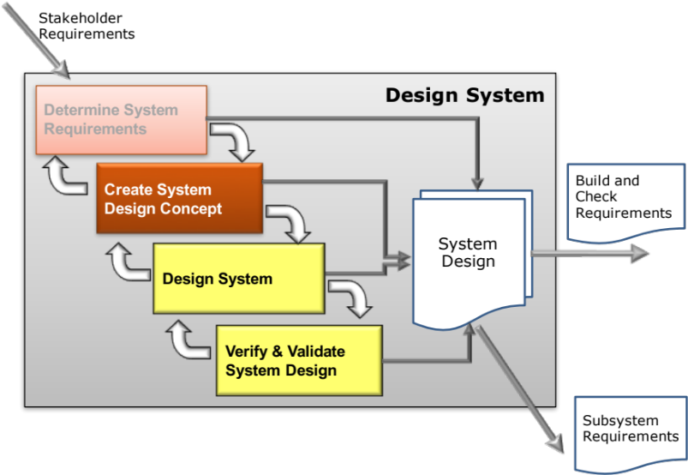
Create System Design Concept
Technology Concept Generation
Secondary Information Goes Here
This Session:
Explains the concepts and principles of Technological Concept Generation
Describes and provides opportunities to practise a number of powerful but simple Creative Thinking Tools to generate potential functional solutions
Describes and provides an opportunity to create candidate whole system concepts via Function Means Analysis

Slide 2


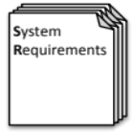

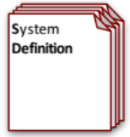
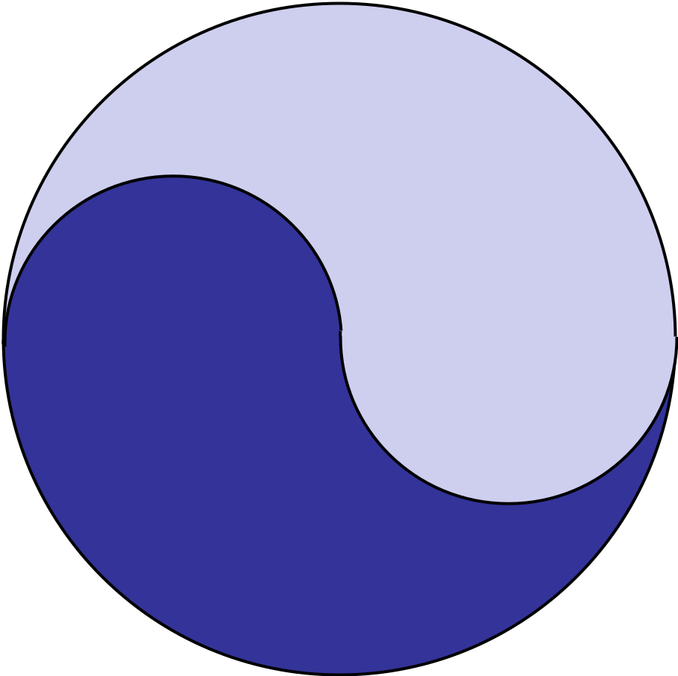
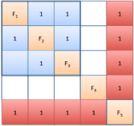



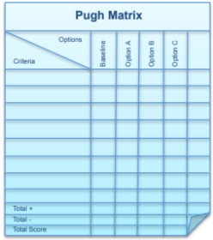
Process and Tools
Requirements Database
Create System Definition and Sub-System Requirements and associated Sub-System Verification Requirements
Quality Function Deployment 2
N² Analysis
Verify System Concept Solution meets the System Requirements and allocation of Sub-System Requirements
Determines the natural structure of a system that can be exploited
Preliminary Design and Feasibility
Use Engineering Modelling, Simulation and Analysis to undertake preliminary design and feasibility
Logical System Architecting
Determines candidate system architectures with minimal interfaces
Function Means Analysis
Identifies and captures all possible functional solutions to a system design problem and thereby determine suitable candidate system concepts
Compares candidate system concepts against a set of criteria
Pugh Matrix

Slide 3
A Holistic Approach to Arriving at the “best” Solution
Idea
Idea
Idea
Idea
Idea
Idea
Idea
Idea
Idea
Idea
Idea
Idea
Idea
Idea
Idea
Idea
Idea
Idea
Idea
Idea
Idea
Idea
Idea
Idea
Idea
Idea
Idea
Idea
Idea
Idea
Idea
Idea
Idea
Idea
Idea
Idea
Idea
Idea
Idea
Idea
Idea
Idea
Idea
Idea
Divergent Thinking
Convergent Thinking
System
Requirements
Functionality
and Performance
Measures
Concept
Concept
Concept
Concept
Concept
Solution
Concept(s)
CONCEPT
SELECTION
Evaluate the whole system concepts to identify the “best”
CONCEPT GENERATION
Use functionality as a means of handling complexity yet simultaneously ensuring whole system coverage to generate all possible functional solutions
CONCEPT INTEGRATION
From the set of all possible solutions determine those combinations that form a whole system concept

Slide 4
Start with Concept Generation
Idea
Idea
Idea
Idea
Idea
Idea
Idea
Idea
Idea
Idea
Idea
Idea
Idea
Idea
Idea
Idea
Idea
Idea
Idea
Idea
Idea
Idea
Idea
Idea
Idea
Idea
Idea
Idea
Idea
Idea
Idea
Idea
Idea
Idea
Idea
Idea
Idea
Idea
Idea
Idea
Idea
Idea
Idea
Idea
Divergent Thinking
Convergent Thinking
System
Requirements
Functionality
and Performance
Measures
Concept
Concept
Concept
Concept
Concept
Solution
Concept(s)
CONCEPT
SELECTION
Evaluate the whole system concepts to identify the “best”
CONCEPT GENERATION
Use functionality as a means of handling complexity yet simultaneously ensuring whole system coverage to generate all possible functional solutions
CONCEPT INTEGRATION
From the set of all possible solutions determine those combinations that form a whole system concept

Slide 5
Tools for Technology Concept Generation
Concept generation is a divergent thinking activity – it is about being creative, radical and innovative, but in a disciplined and structured manner
Achieving “structured innovation” requires two phases:
  Unconstrained ideas generation where teams members have an open mind and are willing to explore options
  Logical ideas structuring where the team needs to assemble the ideas in a logical framework
There are many tools to assist in the unconstrained ideas generation – these include:
  Brainstorming and derivatives
  Similarities and Differences
There are very few tools to help structure ideas – the main tool here is:
  Morphological Analysis or Function Means Analysis

Slide 6
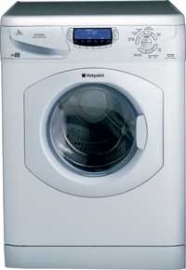
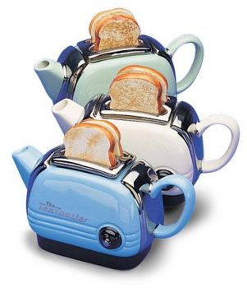

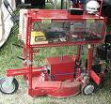


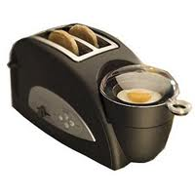


Unconstrained Ideas Generation

Slide 7
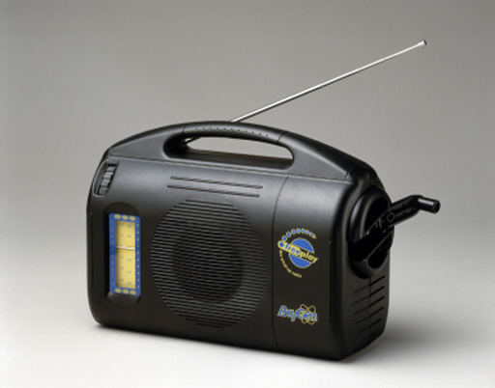

Creativity?
What is creativity?
Are you creative?
  Many people believe that only a handful of geniuses are capable of making creative contributions – it just isn’t true.
Creative thinking is a norm in human beings
  – we’re just good at turning it off
What are your barriers to being creative?

Slide 8

Barriers to Creativity
We are surrounded by barriers to creative thinking
  Human limitations
  Personal “baggage” and experience
  Organizational and sector culture
  Internal structures and politics

Slide 9

The United States of
of
America

Slide 10
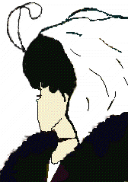

Slide 11


Slide 12
Lunar Spaceship Landing Light
Do we always need a glass bulb?

Slide 13
Human Limitations:
We are Blinded to New Ideas
Because of -
  Familiarity (The United States of America)
  Assumptions (The Short Story)
  Perceptions (The Old Lady/Young Lady)
  Psychological Inertia (Space ship bulbs)

Slide 14
Analytical Thinking
How many different ways can the first five letters in the alphabet be arranged?
Do the sequence of four words, "triangle, glove, clock, bicycle," corresponds to this sequence of numbers “3, 5, 12, 2.”
What is the next number in the following sequence of numbers: 2, 6, 14, 30...
We use Logic to find an answer

Slide 15

Your Brain
The human brain comprises two hemispheres, for right handed people
  The LEFT hand side has been shown to be concerned with logical thinking
  The RIGHT hand side of the brain has been shown to be concerned with artistic creative thinking
Excessive training can cause one side to dominate
  Engineers and Scientists – the logical Left
  Humanities and Arts – the creative Right
Size representation
of brain usage for
a typical engineer
Size representation
of brain usage for
a typical artist

Slide 16
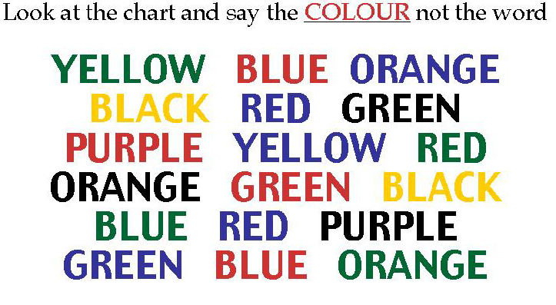
Left and Right Brain Conflict
- overcoming the logical left

Slide 17
Organizational Barriers
“I am right” thinking
Tramline thinking - “things have always been done this way”
Looking foolish
Premature evaluation - “That’s not possible!”
There is only one right answer to a problem - the Search for Logic

Slide 18
Breaking Down the Barriers
We all have the potential to be creative – BUT
  We must break down the barriers
Breaking the barriers demands several approaches
  Using lateral thinking (solving problems by illogical means) as well as logical thinking
  Using tools to promote creative thinking and remove organizational barriers
  Being disciplined and systematic

Slide 19

Lateral Thinking
By moving one coin only leave two lines of five coins

Slide 20

Lateral and Logical Thinking
How do you cross an empty moat 10m wide with two planks each 9.5m long?

Slide 21
Creative Thinking in Practice
Characteristics
  Idea fluency – LOTS of ideas and associations
  Variety and Flexibility
  Originality
  Elaboration
Creative thinking tools
  Brainstorming
  Negative Brainstorming
  Affinity Diagrams
  Similarities & Differences

Slide 22

Brainstorming
What Is it?
  Brainstorming is a team based creative thinking method
When to use it?
  Brainstorming can be used to tackle all types of problem
How to do it?
  The team is given a problem for which they initially generate their own solutions or ideas
  The group members read out their solutions or ideas, in a round robin fashion, which are collectively recorded. During this initial phase it is important that no criticism is levelled at any of the solutions or ideas – no matter how ridiculous they may appear. These “ridiculous ideas” may blossom into sound solutions or trigger other members of the team to generate a sound solution
  Once the first stage is complete the list of solutions or ideas can then be evaluated to identify the ‘best’

Slide 23
Brainstorming Guidelines
The group should be as diverse as possible
The group should be non-hierarchical (although one person should take the lead)
No criticism should be allowed during the early non-evaluative session
Freewheeling is encouraged
Concentrate on getting the maximum number of ideas
Record every idea, even repetitions
Incubate all the ideas, do not reject anything out of hand
Ideas/solutions should be kept short and concise
An independent trained facilitator is often useful

Slide 24
Brainstorming Derivatives
Brainstorming will work if the rules are followed. It often fails to deliver because:
  of dominant or submissive personalities within the team
  “low energy” in the team
There are alternative tools that can be used in such situations
  Negative Brainstorming
  Affinity Diagrams
Already used

Slide 25
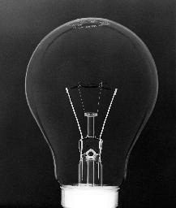
Negative Brainstorming
What is it?
  A simple alternative to brainstorming in which the problem is “reversed” to consider negative solutions which can be reviewed and reversed to generate new ideas
How to do it?
  Identify the problem for which a solution is sought and generate a “negative” statement
    How can we ensure meetings are a disaster?
    How can we ensure the system produces defects?
  Brainstorm the solutions as per brainstorming
  Review the ideas and reverse those that have potential

Slide 26

Similarities and Differences
What is it?
  A divergent thinking approach aimed at getting people away from the ‘baggage’ that inhibits creativity.
  The approach is based around comparing the ‘problem’ with an entirely unrelated item or situation and by comparing similarities and differences develop new solutions
How to do it?
  Identify an item for comparison. For product based systems try a nature based object (bird, tree etc.), for process based systems try a natural process (river, digestion etc). Do not think too hard about this!
  List all the similarities
  List all the differences
  Identify similarities and differences that may lead to new ideas

Slide 27
Example: A Nail (Atherton Nail Co)
The Atherton Nail Co realised that they needed new products
A team was assembled to generate some new ideas using Similarities & Differences
They compared a Nail with Grass (first suggestion from team)
  Similarities
    Pointed
    Slender
    Many types
    Found in large numbers
    Different lengths
    Head

Slide 28
Differences
Nail Grass
Various colours Green
Metal Non-metal
Hard Soft
Stiff Flexible
Strong Weak
Straight Curved
Sharp-ended Sharp-edged
Inorganic Organic
Non-biodegradable Biodegradable
Factory produced Seasonal production
Corrodes Rots
Manufactured Grown
No Roots Roots
No flowers Flower heads
Comes in bags Comes in lawns

Slide 29
Outcome
From these lists conclusions were drawn about nails that are:
  Non-Metallic
  Soft, flexible, weak
  Curved
  Sharp-edged ✓
  Grown self-replenishing
  Biodegradable
  Rooted ✓
  Lawn of nails ✓
It is the differences that the new ideas come from. Listing the similarities is important. It helps the team think laterally
If the method does not generate any new ideas try a different unrelated item

Slide 30
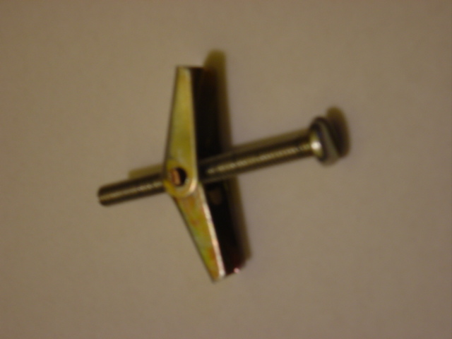
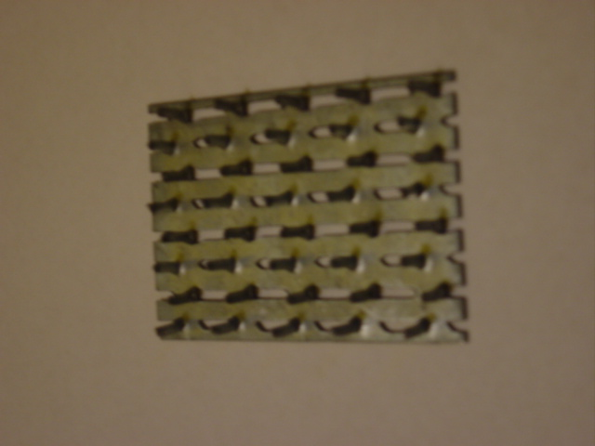

Outcomes
“Rooted Nail”
“Lawn of Nails”

Slide 31
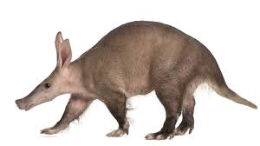

Exercise – Similarities and Differences
In teams
  Perform a Similarities and Differences on the case study project
Time: 20 minutes

Slide 32
Summary
The tools presented are all concerned with overcoming
    Baggage
    Assumptions
    Perceptions
    Psychological Inertia
    Personalities and organizational culture
In looking for creative solutions be prepared to try several of the tools
Do not worry if a tool does not yield results for a particular problem – try another

Slide 33

Logical Ideas Structuring

Slide 34

Ideas Generation for a Holistic Solution
Even for the simplest of systems it is not possible to move from requirements to complete system solution – we are unable to “juggle” all the options and permutations in our head
The problem has to be broken up into parts and solutions found for each part (using divergent thinking) and the whole assembled to give a complete system solution (using convergent thinking)
It is obviously important that no part-solution is overlooked. Hence the division of the of the whole system solution must guarantee completeness – it must be holistic
This can only be achieved through consideration of the system functionality that has been deduced during Determining Requirements
A simple but powerful tool to accomplish this is a derivative of Morphological Analysis known as Function Means Analysis

Slide 35
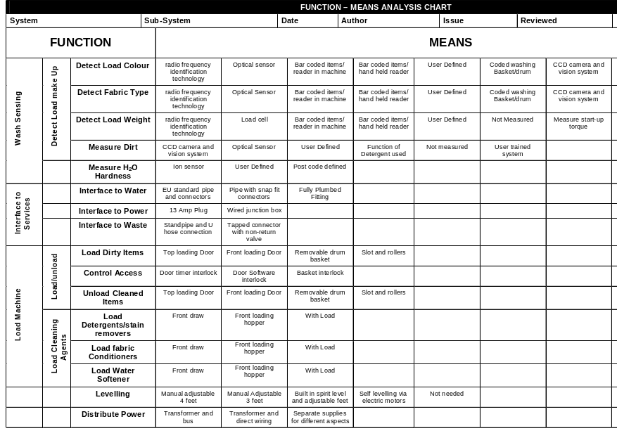
Function Means Analysis (Stage 1)
What is it?
  Function Means Analysis (FMA) is a simple structured tool for generating, capturing, selecting and documenting system design concepts.
How to do it
  Function Means Analysis has a number of steps that fall into two stages:
  Stage 1
    Concept Generation: a divergent thinking activity where the functions of the system are considered in turn and the means of achieving those functions identified
  Stage 2
    Concept Integration and Selection: a convergent thinking activity that identifies whole system concepts and down-selects these to a small number of high potential solutions
The example above shows a partial Function Means Analysis for the Intelligent Washing Machine

Slide 36
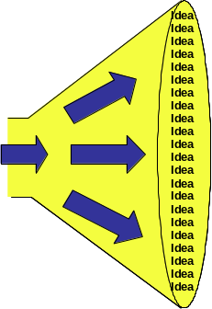
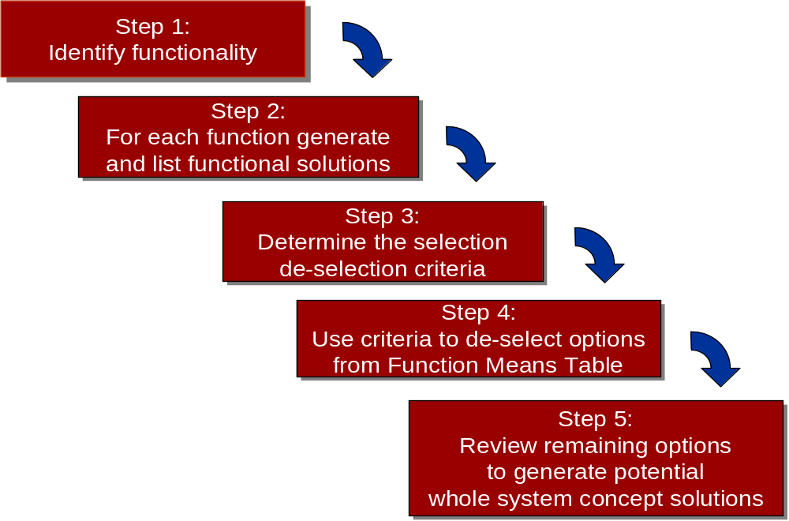
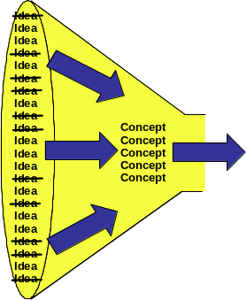
Function Means Analysis Process
Stage 1
Stage 2

Slide 37
Step 1: Identify Functionality
To undertake a Function Means Analysis requires knowledge of the functionality of the system. The functionality should be:
  Complete i.e. encompass the whole of the system
  At the same level of generality
These rules are not rigid. Indeed, Function Means Analysis can help to check whether the system functionality is complete. Very few systems are unprecedented and therefore a check can be made to ensure that the current system solution sits within the means identified – if not then perhaps we are missing some functionality
Once identified the functions should be entered in the Function column of the Function Means Table

Slide 38
Step 2: For each Function Generate Solutions
Taking each function in turn, the team should identify and record in the table ALL the POSSIBLE means of achieving that function
Quantity rather than quality is the aim at this point and a good rule of thumb is to aim for 9 ideas per function. This assumes 3 conventional, 3 extreme and 3 with high potential. Ridiculous, silly, impractical ideas should not be shot-down, ridiculed, or ignored – write them down
If it is difficult to generate solutions to functions:
  The function my be a pseudo-function like “generate style” these either need rewriting as “proper” functions or removing
  The function description may be at too high a level and needs to be decomposed into a number of lower level functions for which design options can be explored

Slide 39
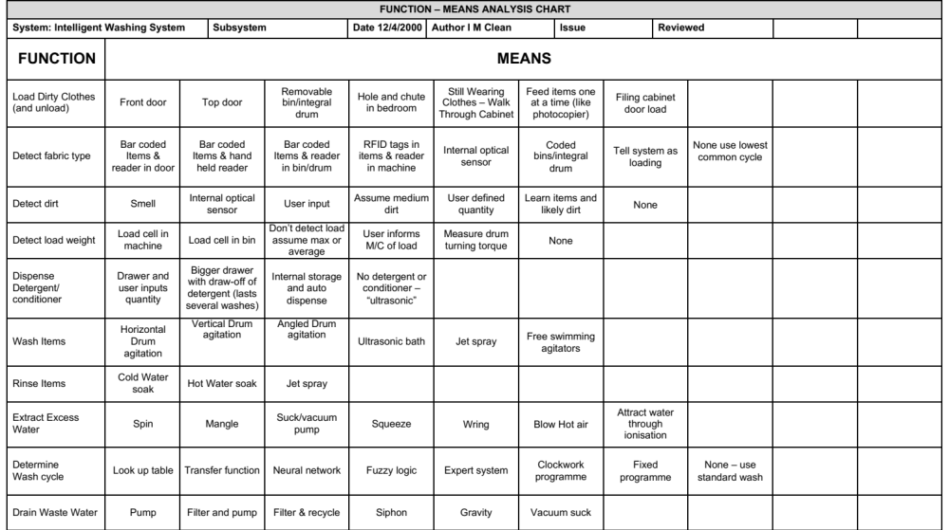
Example: Intelligent Washing Machine
For each function identify and record potential design solutions

Slide 40
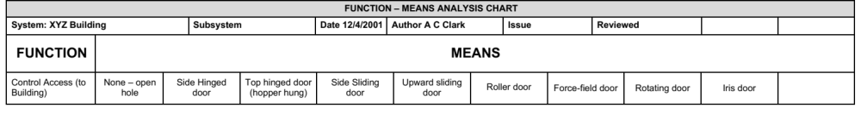
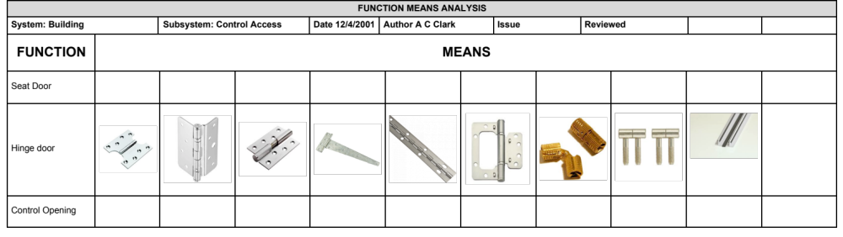
Top Down
Function Means Analysis can be applied in top down fashion – once a design decision has been made at the higher level, it can be applied again at the next level down.
At higher levels choices can be captured as words.
At lower levels pictures/diagrams are more useful
For example one of the functions of a building is “control access” for which there are many choices – once the choice has been made it can be subject to its own Function Means Analysis
At higher levels choices can be captured as words.
At lower levels pictures/diagrams are more useful

Slide 41
Exercise – FMA (Part 1)
Idea
Idea
Idea
Idea
Idea
Idea
Idea
Idea
Idea
Idea
Idea
Idea
Idea
Idea
Idea
Idea
Idea
Idea
Idea
Idea
Idea
Idea
In teams
  Perform a Function Means Analysis for the case study project to generate solutions
  Consider using several of the creative thinking tools
Time: 30 minutes
System
Requirements
Functionality
and Performance
Measures

Slide 42
Summary FMA (Part 1)
Pros
  Simple to use
  Allows the design problem to be logically broken down into manageable elements for which solution options can be easily found
  When used with an open mind is extremely powerful for identifying and recording “all” possible design options
  The Function Means Table allows all the design options to be displayed simultaneously allowing for easier review
  Applicable at any level of design (system, subsystem to component)
Cons
  Getting the functions at the correct level of abstraction in order to explore solution choices
  The outcome can be a significant number of options which must be combined together
  Sometimes viewed as too simplistic and therefore not a serious tool

Slide 43
Create System Design Concept
Concept Integration
Secondary Information Goes Here
This Session:
Explains the concepts and principles of Concept Integration
Describes and provides an opportunity to practise the use of Function Means Analysis to identify candidate whole system solutions

Slide 44
Process and Tools
Requirements Database
Create System Definition and Sub-System Requirements and associated Sub-System Verification Requirements
Quality Function Deployment 2
N² Analysis
Verify System Concept Solution meets the System Requirements and allocation of Sub-System Requirements
Determines the natural structure of a system that can be exploited
Preliminary Design and Feasibility
Use Engineering Modelling, Simulation and Analysis to undertake preliminary design and feasibility
Logical System Architecting
Determines candidate system architectures with minimal interfaces
Function Means Analysis
Identifies and captures all possible functional solutions to a system design problem and thereby determine suitable candidate system concepts
Compares candidate system concepts against a set of criteria
Pugh Matrix

Slide 45
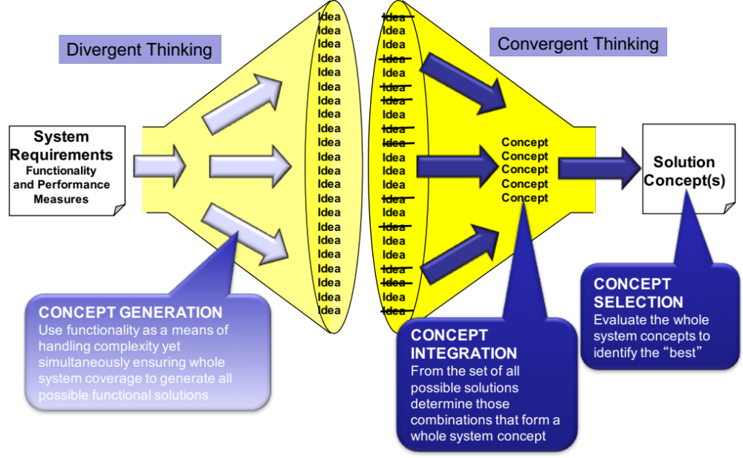
Introduction to Concept Integration
The first stage of Function Means Analysis provides a large number of potential functional solutions. The task now is to:
  Generate a number of potential complete system solutions frequently referred to as design concepts or concept system solutions – this is called Concept Integration

Slide 46
Concept Integration
The purpose of Concept Integration is to arrive at a number of potential whole system solution concepts
  Remember, we often use the word integration to mean just the final “physical” integration of a system – but the decisions we are about make are fundamentally integration decisions, and poor choices at this point in time will have detrimental effects on the physical integration of the system
Assuming that the concept generation has been done by Function Means Analysis, there are a number of strategies for Concept Integration
  Identify the “best” means for each function
    Cannot guarantee an optimal system solution
  Consider every permutation from the Function Means Analysis
    Will take too long
  Reduce the number of options and develop a limited number of potential whole concept solutions
This last strategy can be accomplished using the Function Means Chart

Slide 47
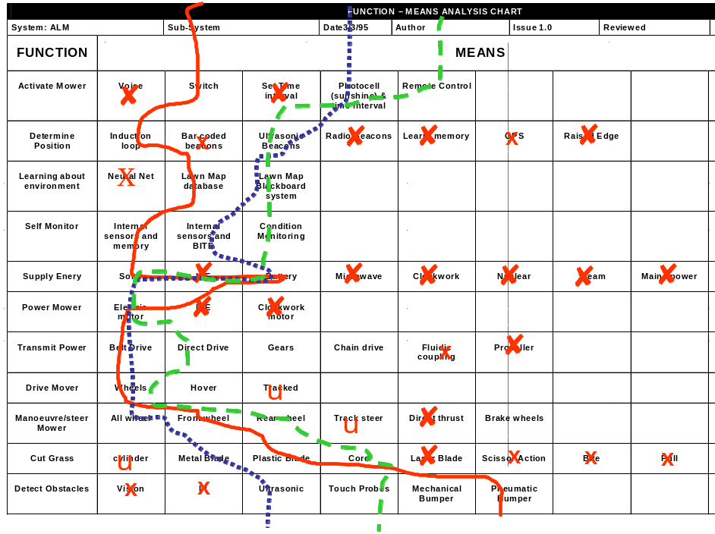
Function Means Analysis (Stage 2)
What is it?
  Function Means Analysis is a highly structured approach to generating, selecting and documenting system design concepts.
How to do it
  FMA has a number of steps that fall into two stages:
    Concept Generation: a divergent thinking activity where the functions of the system are considered in turn and the means of achieving those functions identified
    Concept Integration and Selection: a convergent thinking activity that identifies whole system concepts and down-selects these to a small number of high potential solutions

Slide 48
Function Means Analysis Process
Stage 1
Stage 2

Slide 49
Step 3: Determine Selection/De-selection Criteria
What is required at this step are some key criteria that can be used to quickly eliminate or promote the solutions documented in the Function Means Table
The aim is to remove the obvious “sore thumbs”.
A good starting point for the criteria is the primary WHATs from the QFD 1. These are customer facing and therefore deselecting functional solutions that do not meet these will ensure that only “compliant” ideas are carried forward
The general recommendation here is between 3 and 6 criteria. Too many criteria can make the process time consuming. The drawback with few criteria is that those that are selected have a significant impact on the selected system solution – the wrong criteria lead to the wrong solution

Slide 50
Example: Intelligent Washing Machine
Step 3: The de-selection criteria and order of importance
  Easy to use (order winner)
  Reliability (order qualifier – losing sensitive)
  Attractive & distinctive (order winner)
  Wash Performance (order qualifier – losing sensitive)
Note - having too many de-selection criteria can be counter productive. The aim initially is to remove the obvious non-runners quickly
Note – The criteria are not just the order winners – also need to consider those losing sensitive criteria – those that unless we meet the expected level will lose orders

Slide 51
Step 4: Use the Criteria to De-select from the Table
The de-selection criteria, determined in the previous step, are now systematically applied to remove candidate functional solutions
The aim here is to remove approximately 50% quickly, i.e. the obvious “sore thumbs”
As functional solutions are removed a note should be made of the criteria and reasoning that led to their removal
Over arguing at this point is counter productive – functional solutions that generate “excessive” debate should be retained

Slide 52
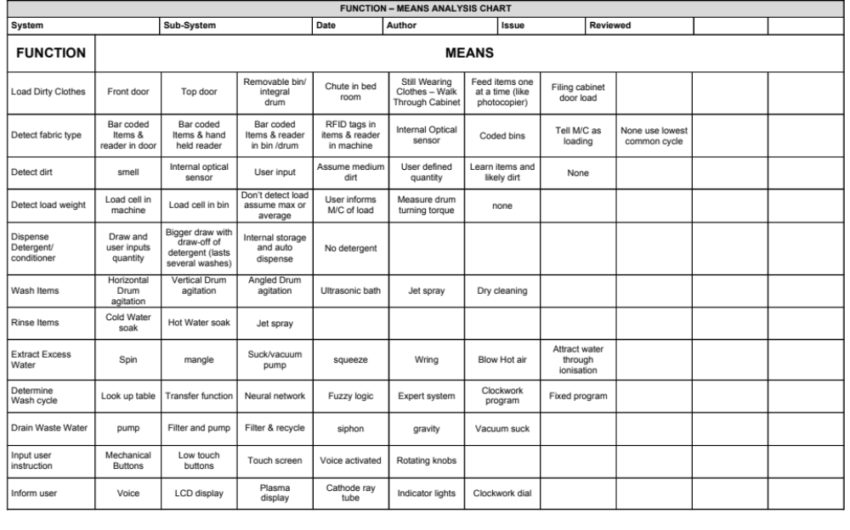
Example: Intelligent Washing Machine
Step 4: Apply criteria to de-select solutions
The de-selection should be looking for the obvious “sore thumbs”
✗
x
x
✗
✗
✗
✗
✗
✗
u
u
✗
✗
✗
Easy to use
u
x
Reliability
x
Attractive
✗
x
u
x
x
u
x
x
Wash Perf.
x
u
u
u
x
✗
x
✗
x
x
x
x

Slide 53
Step 5: Review Remaining Options to Generate Potential Whole System Concept Solutions
With the “sore thumbs” removed the task now is to determine potential whole system concepts
A simple approach here is to plot routes through the table that represent complete candidate system concept solutions
For any given function as many means as necessary can be selected for a particular whole system concept – note though if several solutions are necessary it could be a consequence of the function being too abstract! In such situations it is worth considering decomposing the high-level function into lower-level functions
Selecting the “routes” can be based on technologies that
  Are compatible or avoid incompatibilities
  Support the “best” logical architectures
The aim should be to generate as many whole system concepts as realistically possible – common sense should also prevail

Slide 54
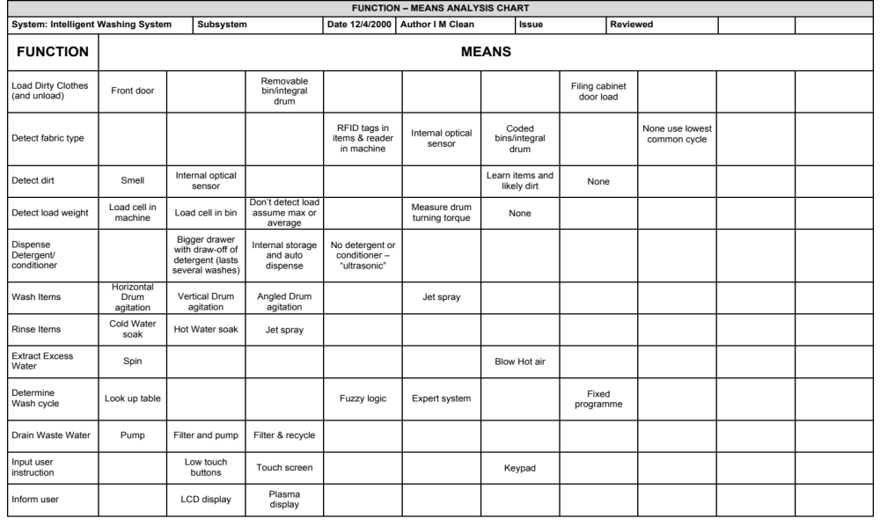
Example: Intelligent Washing Machine
Step 5: Review Chart for candidate whole system concept solutions
The number of candidate whole system concept solutions should be allowed to emerge. It could be 20 - it could be 2.
Any unused functional solutions should be investigated. Why were they not selected?
Were the de-selection criteria correct?

Slide 55
Exercise – Concept Selection
Idea
Idea
Idea
Idea
Idea
Idea
Idea
Idea
Idea
Idea
Idea
Idea
Idea
Idea
Idea
Idea
Idea
Idea
Idea
Idea
Idea
Idea
In teams
For the case study project
Identify three potential whole concept system solutions
Time: 45 Minutes
Concept
Concept
Concept
Concept
Concept
CONCEPT INTEGRATION
From the set of all possible solutions determine those combinations that form a whole system concept

Slide 56
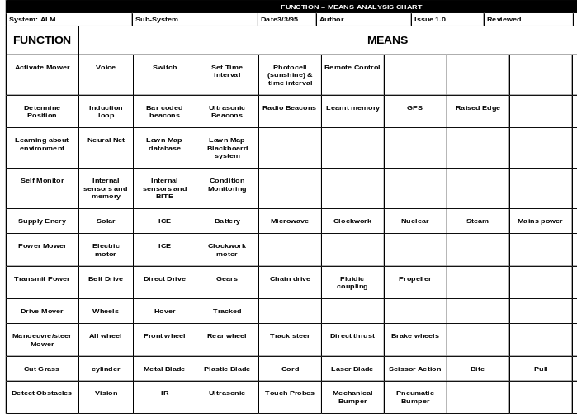
Concept Selection Preparation
Preferred
Solution
In teams
  Extract from the Function Means
  Table your system concepts
  Describe these on flip charts
Functions
Brand 1
Brand 2
Brand 3
From Function Column of FMA Chart
Solutions from Route 1
Solutions from Route 2
Solutions from Route 3

Slide 57
Summary: FMA Part 2
FMA part 2
  Pros
    Easy to undertake
    Visual and structured tool for the systematic identification of candidate whole system concept solutions
    Clear descriptions of whole concepts
    Captures in a simple way the justified design rationale
    Encourages team discussion and consensus decision making
FMA part 2
  Cons
    Ensuring the “best” de-selection criteria
    High level concepts can incorporate many “means”

Slide 58
Next Step
The next step, having identified a number of candidate whole system concept solutions, is to “work up” the concepts to allow them to be evaluated
This may involve:
  Sketching out the physical layout/architecture
  Producing concept drawings – show what a concept looks like
  Defining the concept of operation – the Use Case or Use Cases for the concept
  Performing “back of the envelope” calculations on performance for each concept

