Slide 1

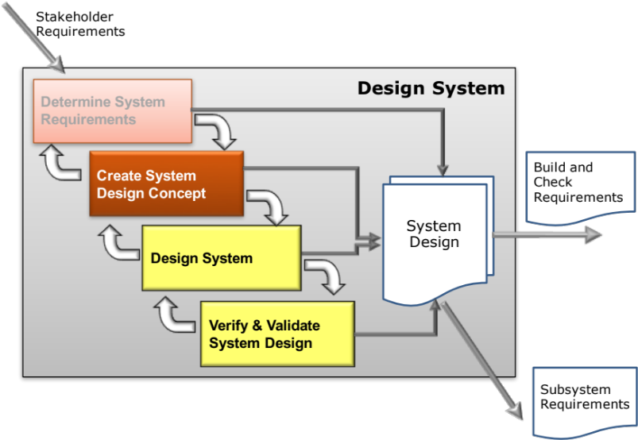
Create System Design Concept
Concept Integration
Secondary Information Goes Here
This Session:
Explains the concepts and principles of Concept Integration
Describes and provides an opportunity to practise the use of Function Means Analysis to identify candidate whole system solutions

Slide 2


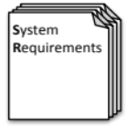

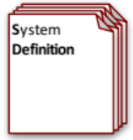
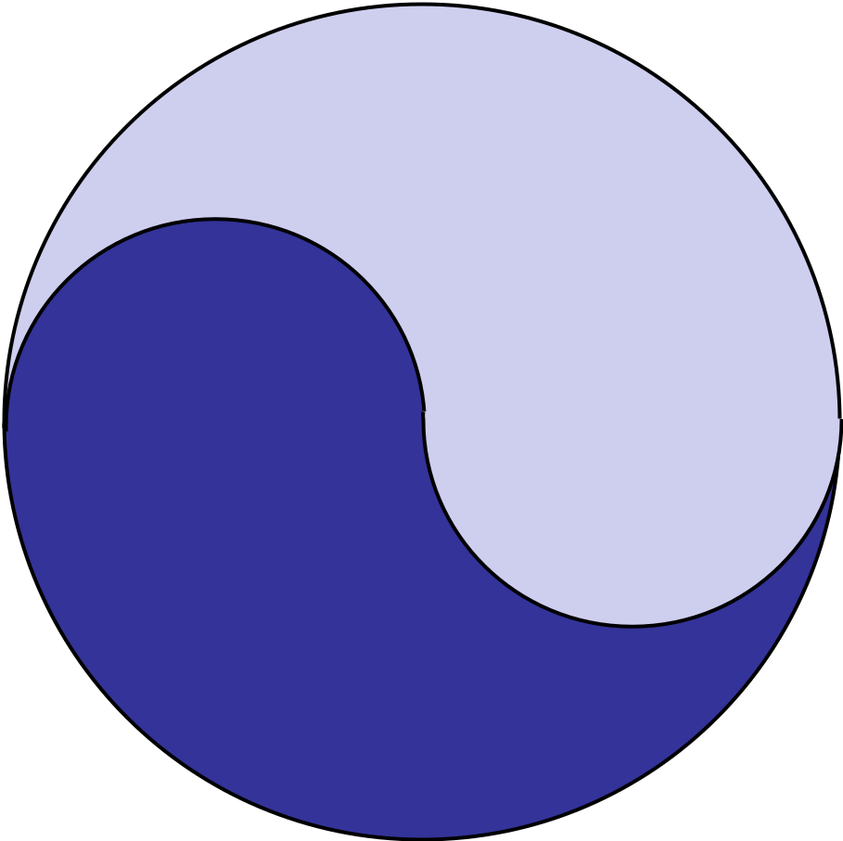
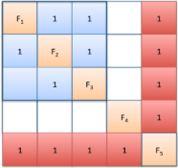



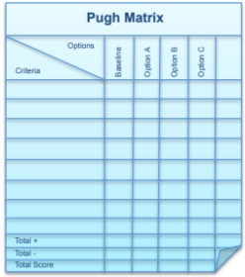
Process and Tools
Requirements Database
Create System Definition and Sub-System Requirements and associated Sub-System Verification Requirements
Quality Function Deployment 2
N² Analysis
Verify System Concept Solution meets the System Requirements and allocation of Sub-System Requirements
Determines the natural structure of a system that can be exploited
Preliminary Design and Feasibility
Use Engineering Modelling, Simulation and Analysis to undertake preliminary design and feasibility
Logical System Architecting
Determines candidate system architectures with minimal interfaces
Function Means Analysis
Identifies and captures all possible functional solutions to a system design problem and thereby determine suitable candidate system concepts
Compares candidate system concepts against a set of criteria
Pugh Matrix

Slide 3
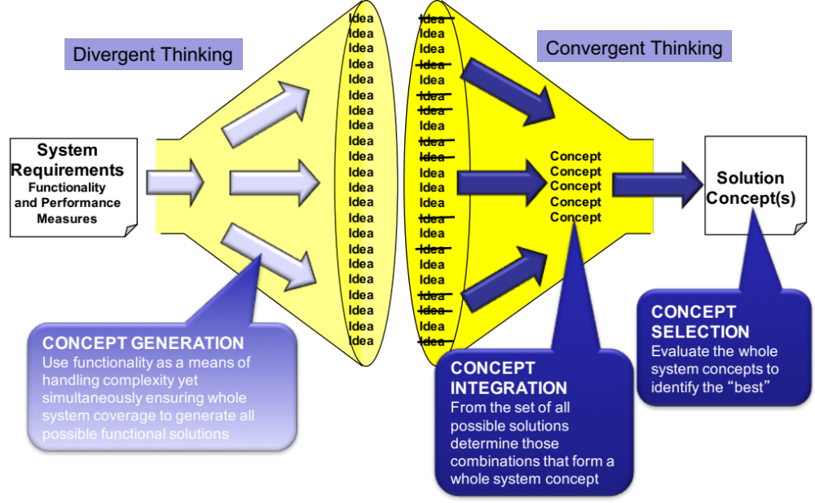
Introduction to Concept Integration
The first stage of Function Means Analysis provides a large number of potential functional solutions. The task now is to:
  Generate a number of potential complete system solutions frequently referred to as design concepts or concept system solutions – this is called Concept Integration

Slide 4
Concept Integration
The purpose of Concept Integration is to arrive at a number of potential whole system solution concepts
  Remember, we often use the word integration to mean just the final “physical” integration of a system – but the decisions we are about make are fundamentally integration decisions, and poor choices at this point in time will have detrimental effects on the physical integration of the system
Assuming that the concept generation has been done by Function Means Analysis, there are a number of strategies for Concept Integration
  Identify the “best” means for each function
    Cannot guarantee an optimal system solution
  Consider every permutation from the Function Means Analysis
    Will take too long
  Reduce the number of options and develop a limited number of potential whole concept solutions
This last strategy can be accomplished using the Function Means Chart

Slide 5
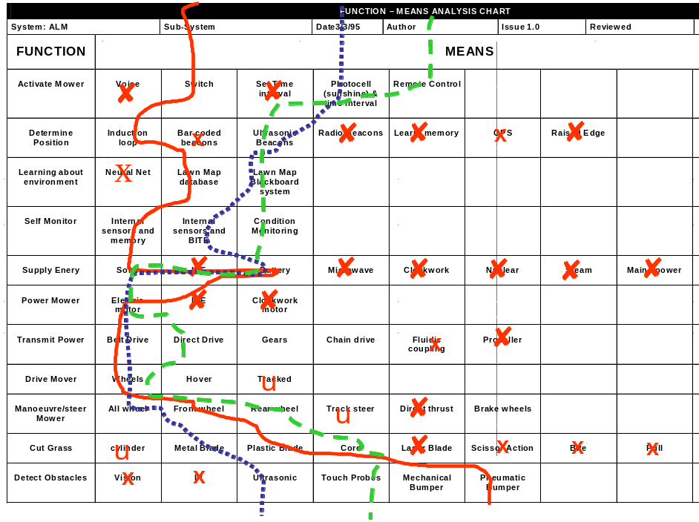
Function Means Analysis (Stage 2)
What is it?
  Function Means Analysis is a highly structured approach to generating, selecting and documenting system design concepts.
How to do it
  FMA has a number of steps that fall into two stages:
    Concept Generation: a divergent thinking activity where the functions of the system are considered in turn and the means of achieving those functions identified
    Concept Integration and Selection: a convergent thinking activity that identifies whole system concepts and down-selects these to a small number of high potential solutions

Slide 6
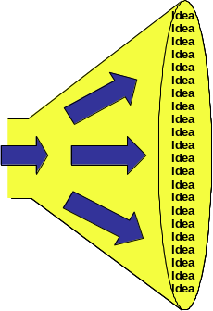
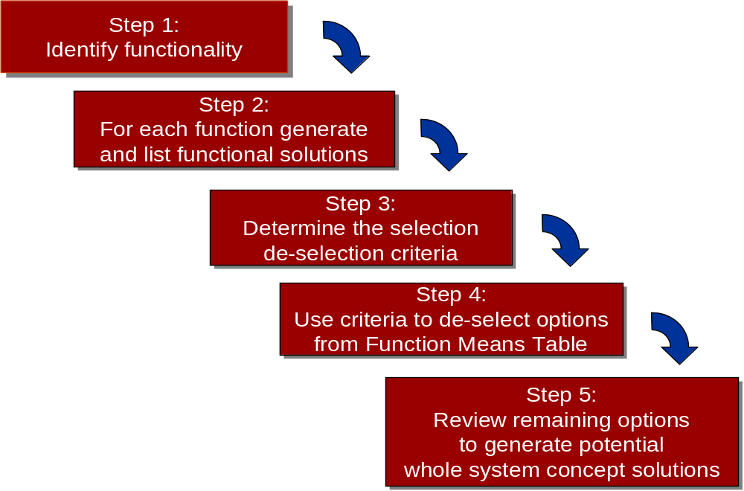
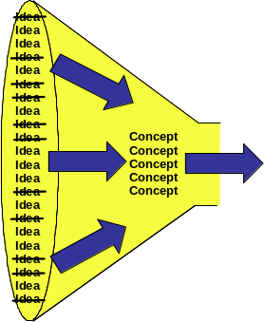
Function Means Analysis Process
Stage 1
Stage 2

Slide 7
Step 3: Determine Selection/De-selection Criteria
What is required at this step are some key criteria that can be used to quickly eliminate or promote the solutions documented in the Function Means Table
The aim is to remove the obvious “sore thumbs”.
A good starting point for the criteria is the primary WHATs from the QFD 1. These are customer facing and therefore deselecting functional solutions that do not meet these will ensure that only “compliant” ideas are carried forward
The general recommendation here is between 3 and 6 criteria. Too many criteria can make the process time consuming. The drawback with few criteria is that those that are selected have a significant impact on the selected system solution – the wrong criteria lead to the wrong solution

Slide 8
Example: Intelligent Washing Machine
Step 3: The de-selection criteria and order of importance
  Easy to use (order winner)
  Reliability (order qualifier – losing sensitive)
  Attractive & distinctive (order winner)
  Wash Performance (order qualifier – losing sensitive)
Note - having too many de-selection criteria can be counter productive. The aim initially is to remove the obvious non-runners quickly
Note – The criteria are not just the order winners – also need to consider those losing sensitive criteria – those that unless we meet the expected level will lose orders

Slide 9
Step 4: Use the Criteria to De-select from the Table
The de-selection criteria, determined in the previous step, are now systematically applied to remove candidate functional solutions
The aim here is to remove approximately 50% quickly, i.e. the obvious “sore thumbs”
As functional solutions are removed a note should be made of the criteria and reasoning that led to their removal
Over arguing at this point is counter productive – functional solutions that generate “excessive” debate should be retained

Slide 10
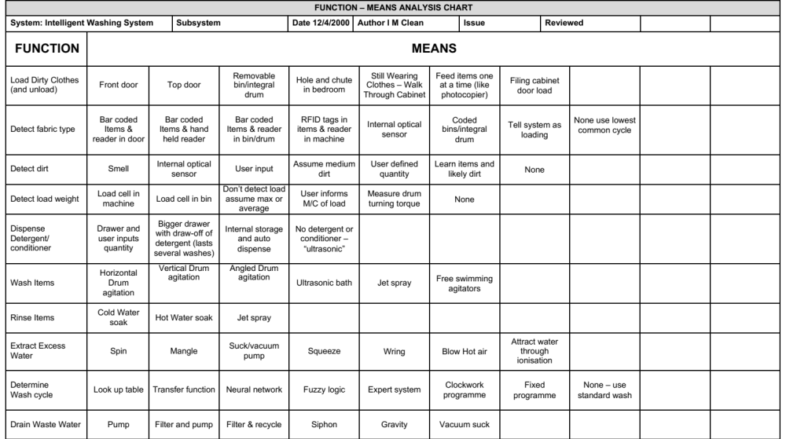
Example: Intelligent Washing Machine
Step 4: Apply criteria to de-select solutions
The de-selection should be looking for the obvious “sore thumbs”
✗
x
x
✗
✗
✗
✗
✗
✗
u
u
✗
✗
✗
Easy to use
u
x
Reliability
x
Attractive
✗
x
u
x
x
u
x
x
Wash Perf.
x
u
u
u
x
✗
x
✗
x
x
x
x

Slide 11
Step 5: Review Remaining Options to Generate Potential Whole System Concept Solutions
With the “sore thumbs” removed the task now is to determine potential whole system concepts
A simple approach here is to plot routes through the table that represent complete candidate system concept solutions
For any given function as many means as necessary can be selected for a particular whole system concept – note though if several solutions are necessary it could be a consequence of the function being too abstract! In such situations it is worth considering decomposing the high-level function into lower-level functions
Selecting the “routes” can be based on technologies that
  Are compatible or avoid incompatibilities
  Support the “best” logical architectures
The aim should be to generate as many whole system concepts as realistically possible – common sense should also prevail

Slide 12
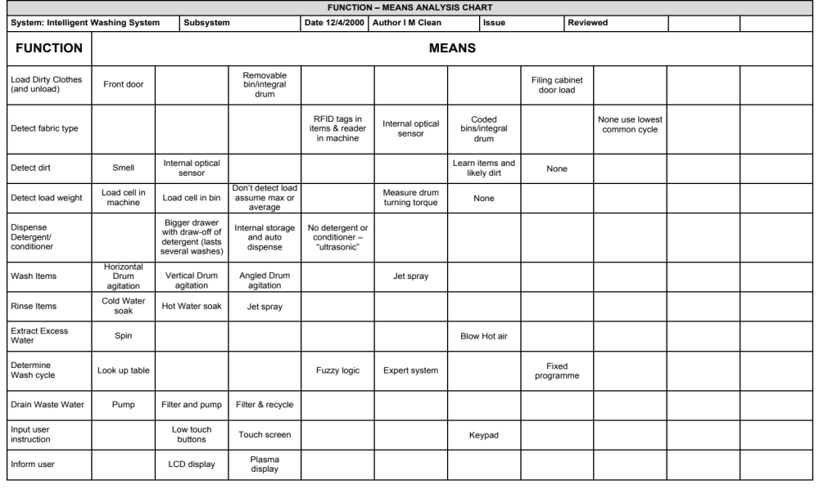
Example: Intelligent Washing Machine
Step 5: Review Chart for candidate whole system concept solutions
The number of candidate whole system concept solutions should be allowed to emerge. It could be 20 - it could be 2.
Any unused functional solutions should be investigated. Why were they not selected?
Were the de-selection criteria correct?

Slide 13
Exercise – Concept Selection
Idea
Idea
Idea
Idea
Idea
Idea
Idea
Idea
Idea
Idea
Idea
Idea
Idea
Idea
Idea
Idea
Idea
Idea
Idea
Idea
Idea
Idea
In teams
For the case study project
Identify three potential whole concept system solutions
Time: 45 Minutes
Concept
Concept
Concept
Concept
Concept
CONCEPT INTEGRATION
From the set of all possible solutions determine those combinations that form a whole system concept

Slide 14
Summary: FMA Part 2
FMA part 2
  Pros
    Easy to undertake
    Visual and structured tool for the systematic identification of candidate whole system concept solutions
    Clear descriptions of whole concepts
    Captures in a simple way the justified design rationale
    Encourages team discussion and consensus decision making
FMA part 2
  Cons
    Ensuring the “best” de-selection criteria
    High level concepts can incorporate many “means”

Slide 15
Next Step
The next step, having identified a number of candidate whole system concept solutions, is to “work up” the concepts to allow them to be evaluated
This may involve:
  Sketching out the physical layout/architecture
  Producing concept drawings – show what a concept looks like
  Defining the concept of operation – the Use Case or Use Cases for the concept
  Performing “back of the envelope” calculations on performance for each concept

