Slide 1

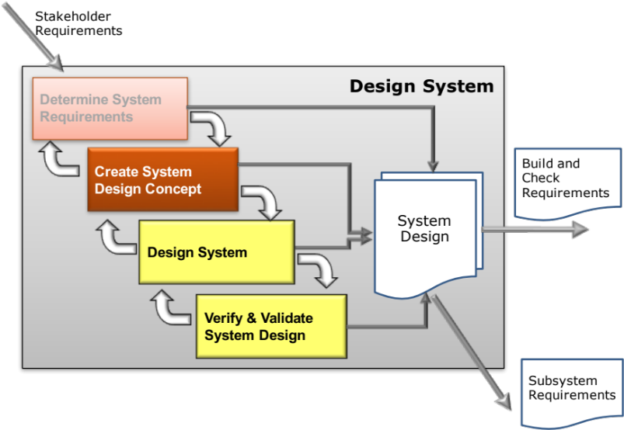
Create System Design Concept
Concept Evaluation and Selection
Secondary Information Goes Here
This Session:
Explains the concepts and principles of Concept Selection
Describes and provides an opportunity to practise the use of simple tools to evaluate and select whole system solution concepts
  Pugh Matrix
  Analytic Hierarchy Process

Slide 2


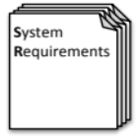

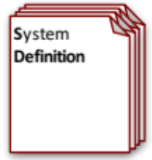
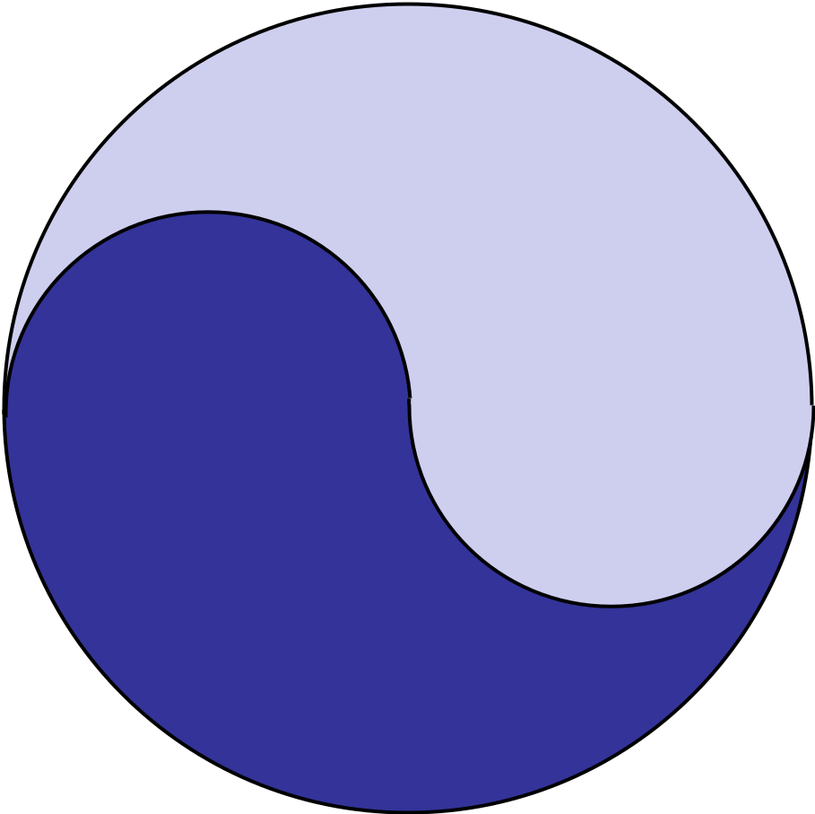
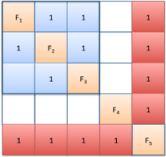



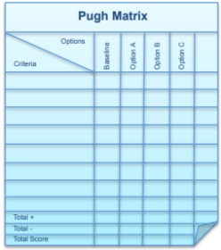
Process and Tools
Requirements Database
Create System Definition and Sub-System Requirements and associated Sub-System Verification Requirements
Quality Function Deployment 2
N² Analysis
Verify System Concept Solution meets the System Requirements and allocation of Sub-System Requirements
Determines the natural structure of a system that can be exploited
Preliminary Design and Feasibility
Use Engineering Modelling, Simulation and Analysis to undertake preliminary design and feasibility
Logical System Architecting
Determines candidate system architectures with minimal interfaces
Function Means Analysis
Identifies and captures all possible functional solutions to a system design problem and thereby determine suitable candidate system concepts
Compares candidate system concepts against a set of criteria
Pugh Matrix

Slide 3
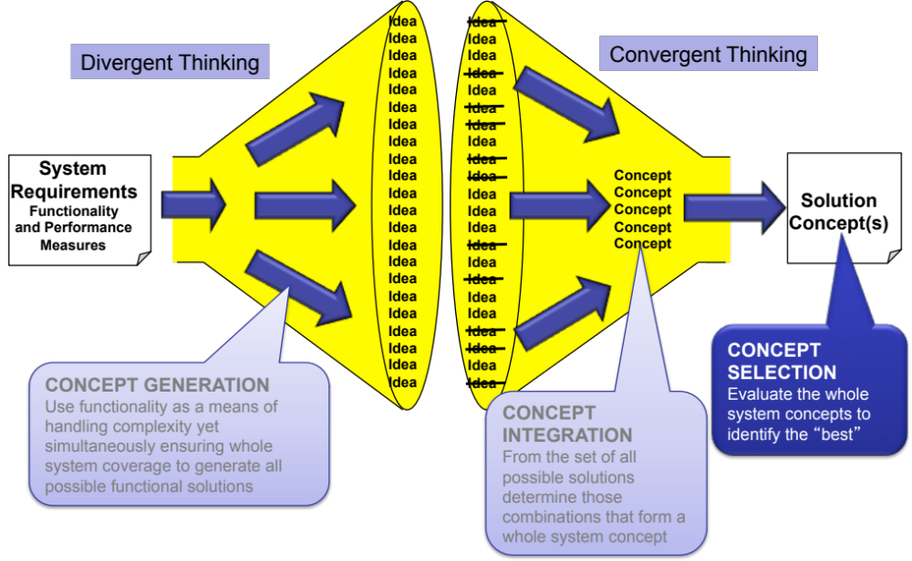
Introduction to Concept Integration and Selection
The second stage of Function Means Analysis provided a number of candidate whole system solutions. The task now is to:
  Evaluate the concept system solutions to arrive at the final concept solution(s) – this is called Concept Selection/Evaluation

Slide 4
Concept Selection/Evaluation
The purpose of Concept Integration is to identify many alternate candidate whole concept system solutions
The purpose of Concept Selection/Evaluation is to arrive at the best possible and feasible whole system solution from the candidate list, or at least eliminate the weaker options
Useful tools include:
  Pugh Matrix
  Analytic Hierarchy Process

Slide 5
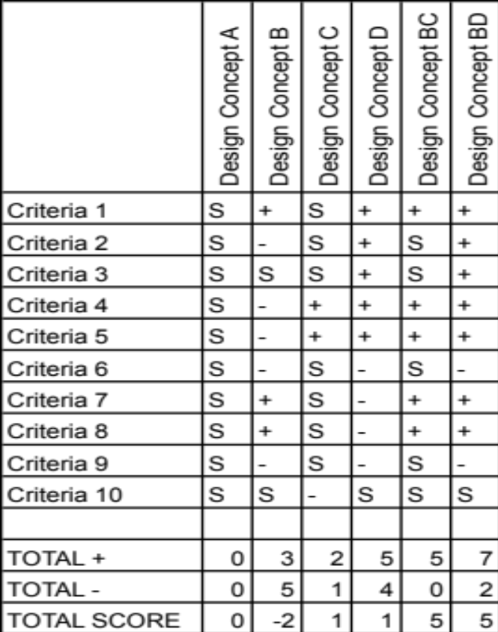
The Pugh Matrix
What is it?
The Pugh Matrix is a form of Matrix Diagram that is useful when comparing a number of alternatives and for finding which best meets a set of requirements/criteria
Why do it?
To quickly identify the best concept or eliminate the weaker ones
When to use it?
Whenever attempting to decide between a number of alternate system concept designs
Particularly useful when there is relatively large number of key customer requirements/criteria
Who Does it?
Best performed by a team that includes all interested disciplines and functions

Slide 6
Pugh Matrix Process- How to do it
STEP 1: Determine evaluation – selection criteria
STEP 2: Select “standard” design concept for comparison
STEP 3: Compare options against “standard” and determine total score
STEP 4: Undertake qualitative optimization through consideration of hybrid concepts
STEP 5: Evaluate criteria weighting and sensitivity analysis
STEP 6: Evaluate results for a decision

Slide 7
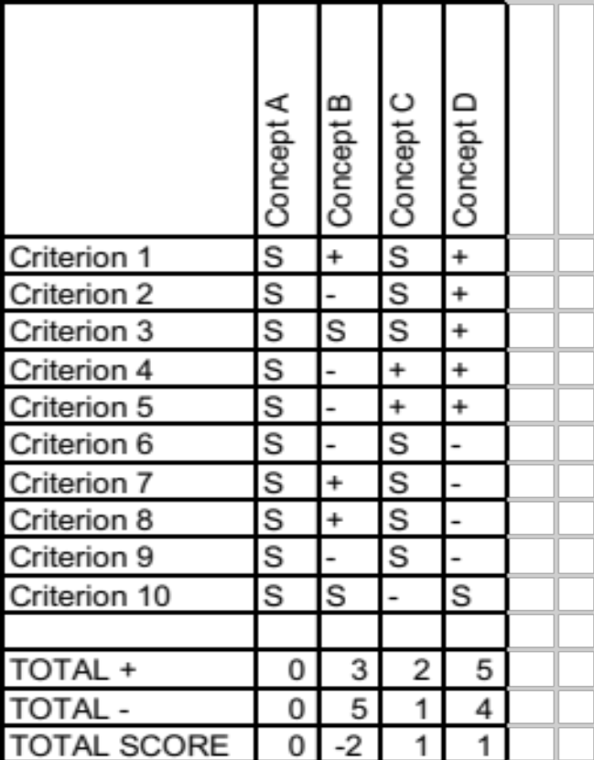
How to Do it: Steps 1 to 3
Step 1:
Determine suitable evaluation criteria. The customer facing requirements particularly the key Non-Functional System Requirements are sensible. It is important that these are supplemented by other stakeholder requirements - criteria that reflect other stakeholder views – particularly those of the business
It is vey important to have a clear definition of each criterion
Step 2:
One design concept is selected to be the “standard”. All criteria are scored ‘S’ for “Standard”. If appropriate, a good choice is to use the previous design for the standard because it exists and therefore its performance should be well known
Step 3:
Compare each design concept against the “standard” “requirement by requirement” and decide a “pair-wise score with
  S = same
  + = better
  - = worse
Can use ++ for much better and - - for much worse. Record decisions and rationale
Sum the +’s and –’s to determine the Total Score
Always record rationale behind decisions

Slide 8
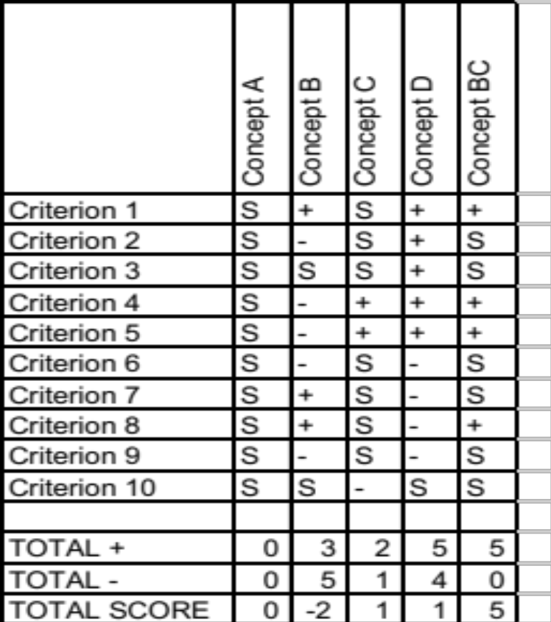
How to Do it: Step 4
Step 4:
Having scored each candidate design option, consider hybrids by combining where possible the best from each alternative. This is a form of qualitative optimisation.
Concept BC – a hybrid between Concepts B and C

Slide 9
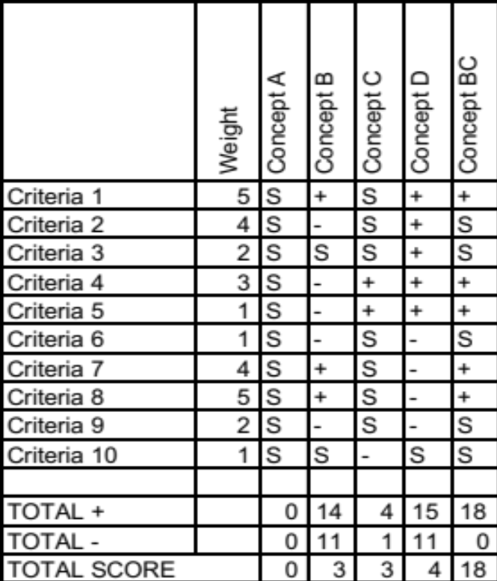
How to do it: Steps 5 & 6
If you do have weightings – don’t use them for the first pass to rank system solutions. Use them on the second pass – if the system solution ranking order is unchanged you have evidence of a robust decision.
Step 5
The ability of the Pugh Matrix to discriminate between concepts can be improved by weighting the criteria
The weighting is usually a simple 1 to 5 scale with 1 of the lowest importance and 5 of the highest
It is also possible to perform a simple sensitivity analysis to assess the impact of small variations in the weightings – i.e. conclusions should be insensitive to small variations in the weightings
Step 6:
Make the decision and record reasons behind decisions. Quite often there is no clear “winner” but there is often a clear “loser” in such cases perform a sanity check (does the decision make sense) and remove the losing option.

Slide 10
Double Check
The strength and weakness of the Pugh Matrix is the pairwise comparison against a standard. We need to be consistent in our judgments
If we judge option A to be + (better) than the standard and option B to be – (worse). To be consistent Option A must be what compared to B?
A good consistency check is having found a winner that is not the standard, it is good practice to make it the standard, redo the pairwise comparison to test consistency, the ranking should be the same!

Slide 11
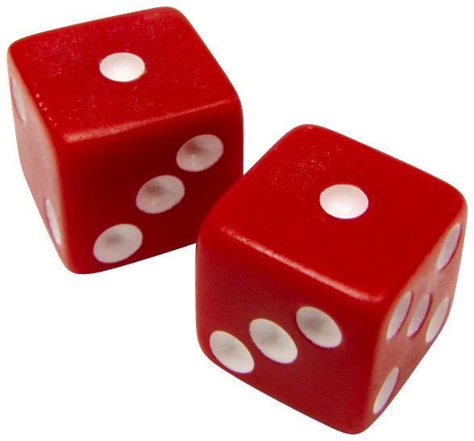
Exercise – Concept Selection
In teams
  Construct a Pugh Matrix to make a final selection. Use the customer facing requirements (from QFD 1) and include some internal requirements like:
    Ease of Realisation/implementation
    Technology Readiness Level
    Risk
Time: 30 Minutes

Slide 12
Summary: Pugh Matrix
Pros
  Provides a rapid assessment of alternative whole concepts
  Can use stakeholder requirements to give greater confidence of compliance
  Can help develop hybrid system concepts (qualitative optimisation)
Cons
  Temptation to use too many requirements slowing down the process
  Objective subjectivity! can select criteria, weightings and scores to obtain any result!
  Often no clear winner (but eliminates the weaker options)
  Can be treated as a “handle turning” process without thinking

Slide 13
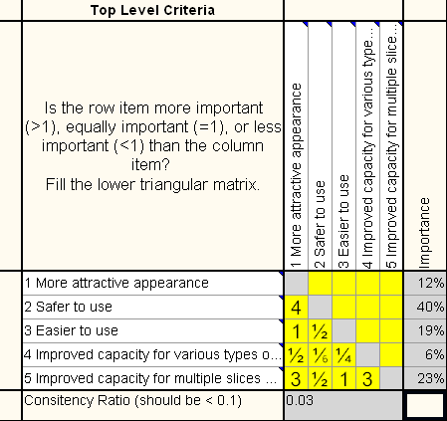
Analytical Hierarchy Process
What is it?
  The Analytical Hierarchy Process (AHP) is a tool that provides structure and discipline to group decision-making in order to:
    Select between a number of options
    Prioritise requirements/criteria
  It helps the group assign numerical values to subjective judgments and synthesise those judgments into true ratio scale numbers to determine which items have the highest priority, and by how much
Why do it?
  Prioritising or deciding often concerns a number of interrelated factors that are sufficiently complex to result in inconsistent and irrational decisions. AHP provides a framework to minimise the inconsistencies

Slide 14
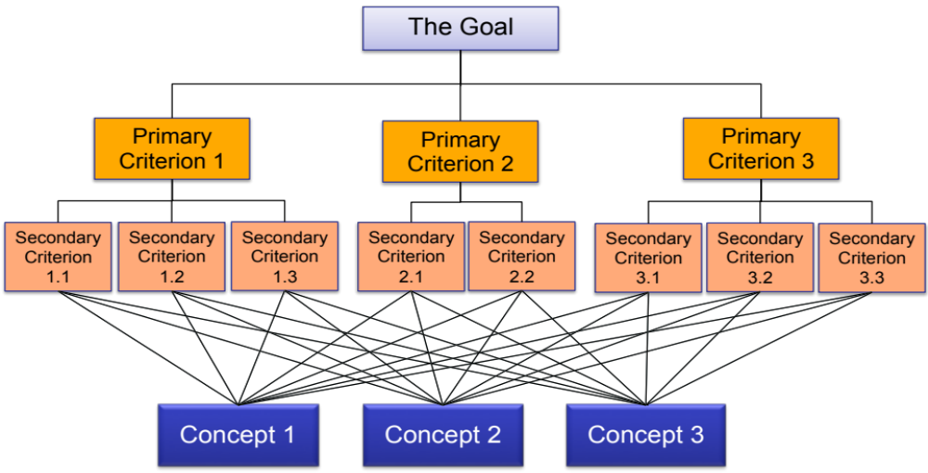
The Hierarchy for Concept Selection
Level 1
Level 2
Level 3
Level 4

Slide 15
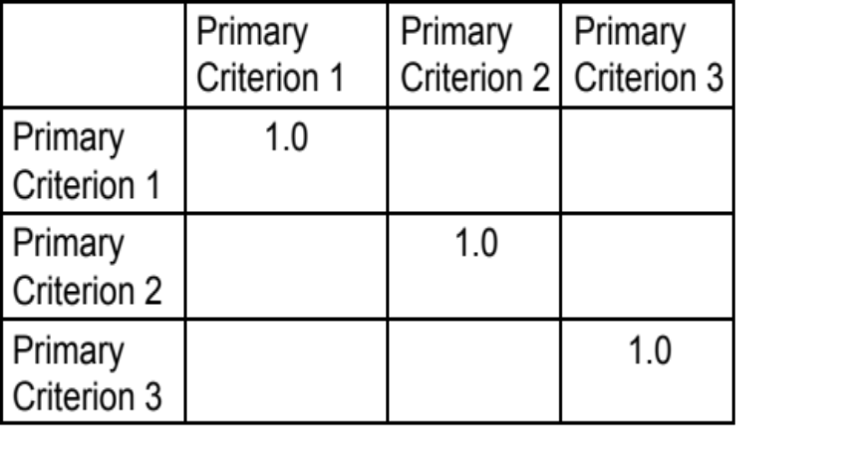
Top Down: Start by Determining which Weighting for the Primary Criterion
The first step is to establish the weightings of the primary criteria by asking the questions:
  How much more important is improved Primary Criterion 1 than improved Primary Criterion 2 in selecting a concept?
  How much more important is improved Primary Criterion 1 than improved Primary Criterion 3 in selecting a concept?
  How much more important is improved Primary Criterion 2 than improved Primary Criterion 3 in selecting a concept?
Importance
W_{PC1} = 0.2
W_{PC2} = 0.5
W_{PC3} = 0.3
Consistency < 0.1
By completing the matrix and performing the analysis we can find out the weightings of the primary criteria

Slide 16

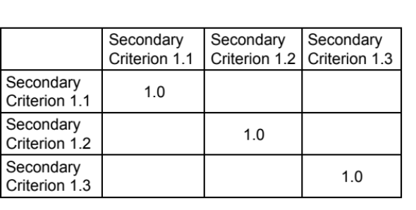
Next level down
For the first Primary Criterion we form the 3x3 matrix
And ask the questions:
How much better is it to improve Secondary Criterion 1.1 than improve Secondary Criterion 1.2 in achieving Primary Criterion 1?
How much better is it to improve Secondary Criterion 1.1 than improve Secondary Criterion 1.3 in achieving Primary Criterion 1?
How much better is it to improve Secondary Criterion 1.2 than improve Secondary Criterion 1.3 in achieving Primary Criterion 1?
Importance
W_{SC1.1} = 0.18
W_{SC1.2} = 0.4
W_{SC1.3} = 0.42
Consistency < 0.1
This is repeated for all secondary decision criterion relating to a primary criterion

Slide 17
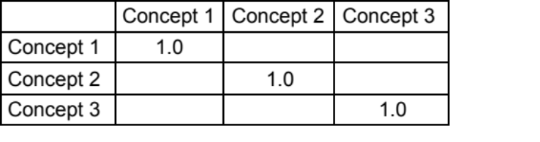
And Finally
For each decision criterion at this level we form the 3x3 or (2x) matrix
And ask the questions:
How much better is Concept 1 than Concept 2 in relation to the criterion under consideration?
How much better is Concept 1 than Concept 3 in relation to the criterion under consideration?
How much better is Concept 2 than Concept 3 in relation to the criterion under consideration?
Importance
C_{1-1.1} = 0.1
C_{2-1.1} = 0.5
C_{3-1.1} = 0.4
Consistency < 0.1
This is repeated for all decision criterion at the lowest level
Note: we have to construct 12 AHP decision matrices!

Slide 18
An Example
In looking for a new job a graduate receives offers from 3 companies
The overall goal is Job Satisfaction which the graduate decides comprises six criteria
The decision hierarchy is:
Job Satisfaction
Good Role
Growth opportunities
Benefits
Colleagues
Location
Reputation
Job A
Job B
Job C

Slide 19
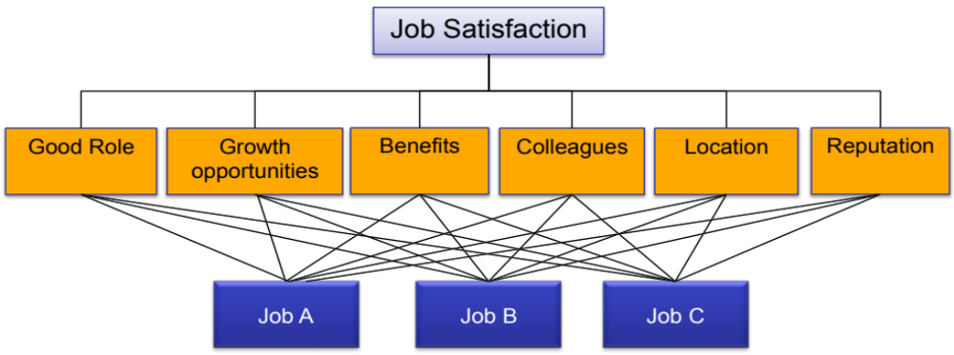
The Decision Hierarchy
Level 1: Goal
Level 2: Criteria
Level 3: Choices
Key
Role = R
Growth = G
Benefits = B
Colleagues = C
Location = L
Reputation = Rp
How many AHP matrices are needed and how many paired comparisons?

Slide 20
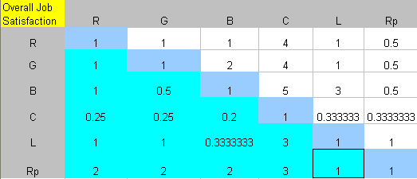
Level 2 of the Hierarchy
Importance
0.16
0.18
0.20
0.05
Interpretation
Benefits are 4 times more important than Colleagues (only 4??)
Interpretation
Benefits are 4 times more important than Colleagues (only 4??)
0.16
0.25
The matrix is not consistent. Why?
  Acceptable level of inconsistency is covered later, but it is worth noting now inconsistency is a real human trait and is arguably necessary in order for us to grow intellectually.
Notes:
An illustration of inconsistency is given by the assessment of R versus G (equally important), R versus B (equally important) leading to equal importance for G and B. But G versus B = 2 (G is twice as important as B). This is inconsistent.
If we were always perfectly consistent we couldn‘t like apples one day, and oranges the next – but we do.

Slide 21
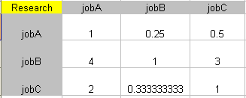
Level 3 of the Hierarchy
Role
Importance
Similar 3x3 matrices are constructed for:
Growth = G
Benefits = B
Colleagues = C
Location = L
Reputation = Rp
0.14
0.62
0.24
The pairwise question:
“How much better is job A than job B in relation to the role on offer?”
The answer was “It’s not, it’s moderately worse”

Slide 22
The Results
 | R | G | B | C | L | Rp
Level 2 Importance | 0.16 | 0.18 | 0.20 | 0.05 | 0.16 | 0.25
Job A Importance | 0.14 | 0.10 | 0.32 | 0.28 | 0.47 | 0.77
Job B Importance | 0.62 | 0.33 | 0.22 | 0.65 | 0.47 | 0.17
Job C Importance | 0.24 | 0.57 | 0.46 | 0.07 | 0.07 | 0.05
Consistency Ratio | 2% | 2% | 54% | 6% | 0.1% | 20%
Comparisons of jobs versus benefits (salary etc.), and versus reputation were very inconsistent. In practice these judgments should be re-visited – were the right questions asked?
Comparisons of jobs versus benefits (salary etc), and versus reputation were very inconsistent. In practice these judgments should be re-visited – where the right questions asked?
Notes:
You can also work out the consistency index and consistency ratio for a complete hierarchy, to see whether the whole thing is sensible, on balance. Individual inconsistencies, although high, may not be very damaging to the overall conclusion.
Consistency at high levels in the hierarchy is important, since it is these levels which drive the final decision most.
As a matter of interest, in this case the overall CR is just under 10%, which is ok.
It is quite straightforward to calculate the overall CI and CR for a hierarchy, but we shall leave that for another day!

Slide 23
Selecting the Job!
 | R | G | B | C | L | Rp
Level 2 Importance | 0.16 | 0.18 | 0.20 | 0.05 | 0.16 | 0.25
Job A Importance | 0.14 | 0.10 | 0.32 | 0.28 | 0.47 | 0.77
Job B Importance | 0.62 | 0.33 | 0.22 | 0.65 | 0.47 | 0.17
Job C Importance | 0.24 | 0.57 | 0.46 | 0.07 | 0.07 | 0.05
Consistency Ratio | 2% | 2% | 54% | 6% | 0.1% | 20%
Overall priority for Job A is
(0.16x0.14) + (0.18x0.10) + (0.20x0.32) + (0.05x0.28) + … = 0.39
Similarly, Job B = 0.35 and Job C =0.26
Notes:
You can also work out the consistency index and consistency ratio for a complete hierarchy, to see whether the whole thing is sensible, on balance. Individual inconsistencies, although high, may not be very damaging to the overall conclusion.
Consistency at high levels in the hierarchy is important, since it is these levels which drive the final decision most.
As a matter of interest, in this case the overall CR is just under 10%, which is ok.
It is quite straightforward to calculate the overall CI and CR for a hierarchy, but we shall leave that for another day!

Slide 24
Decision
Job A = 0.39 Job B = 0.35 Job C = 0.26
Job A is the one that comes closest to meeting the goal of job satisfaction, based on the criteria used
Jobs A and B are pretty close though!
There are a number of things we can do to help make a decision:
  Identify further criteria to compare Job A and Job B
  Undertake a sensitivity analysis

Slide 25
Analytic Hierarchy Process Summary
Pros
  If performed in a team can promote
    Discussion
    Thinking
  Structured and disciplined process
  Can be used to aid decision-making using a True Ratio scale
  Checks consistency of judgements adding confidence to the decision making
Cons
  Deciding who does this – who should be involved
  Ensuring judgements are made correctly
  Mathematical basis adds unfounded credibility
  Tedious if many requirements (limit of 7 per level)

Slide 26
AHP in Decision Making
There is no doubt the Analytic Hierarchy Process works and is highly effective
It is, however, potentially unwieldy and time consuming! - But in combination with simpler tools like the Pugh Matrix it can provide a very powerful approach to decision making where:
  STEP 1: Use the Pugh Matrix to eliminate the weaker concept options
  STEP 2: Use AHP to reach a final decision
It is of course possible that even with AHP that the outcome is no decision. All this is telling you is: -
“you do not have enough information to make the decision!”

