Slide 1

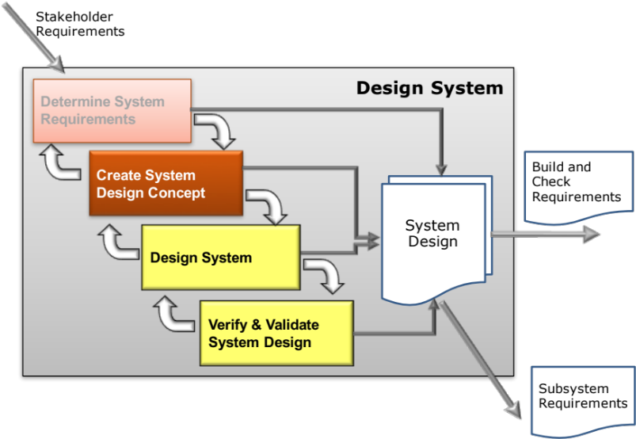
Create System Design Concept
Concept – Requirements Verification using Quality Function Deployment Phase 2
Secondary Information Goes Here
This Session:
To describe and practise Quality Function Deployment 2 as a tool that can be used to help in the System Concept Design process to:
  Check that design solutions meet specified requirements
  Flow-down requirements to subsystem level
  Provide a reference for future systems

Slide 2
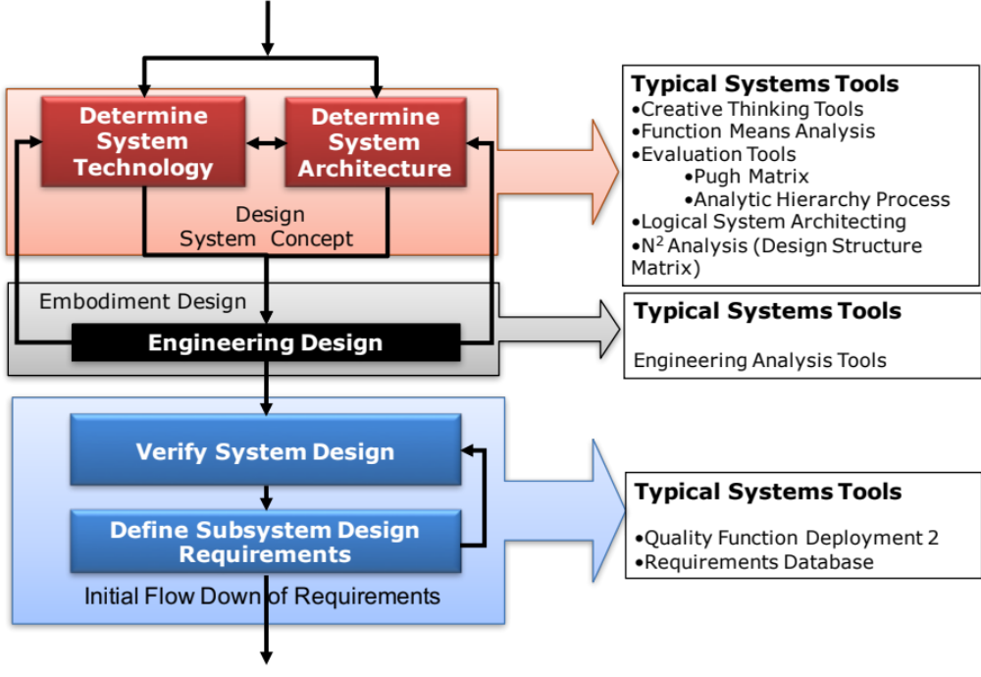
Key Tasks and Systems Tools
Notes:
9
9

Slide 3
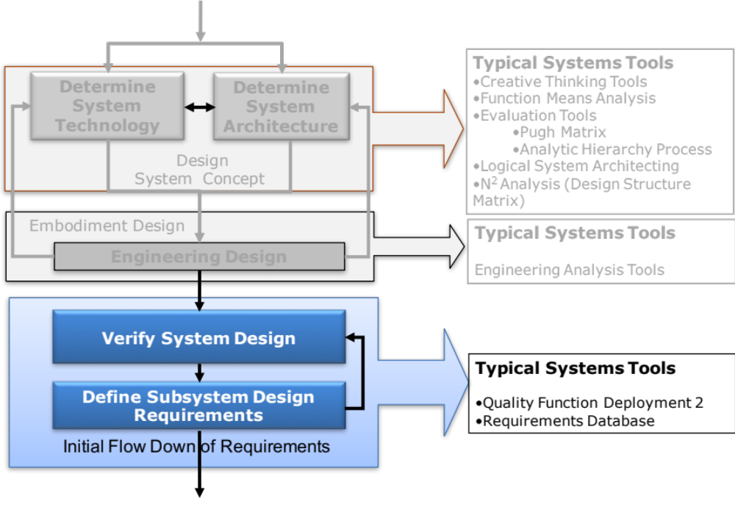
Key Tasks and Systems Tools
Notes:
9
9

Slide 4

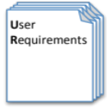
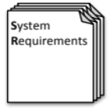

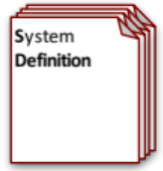
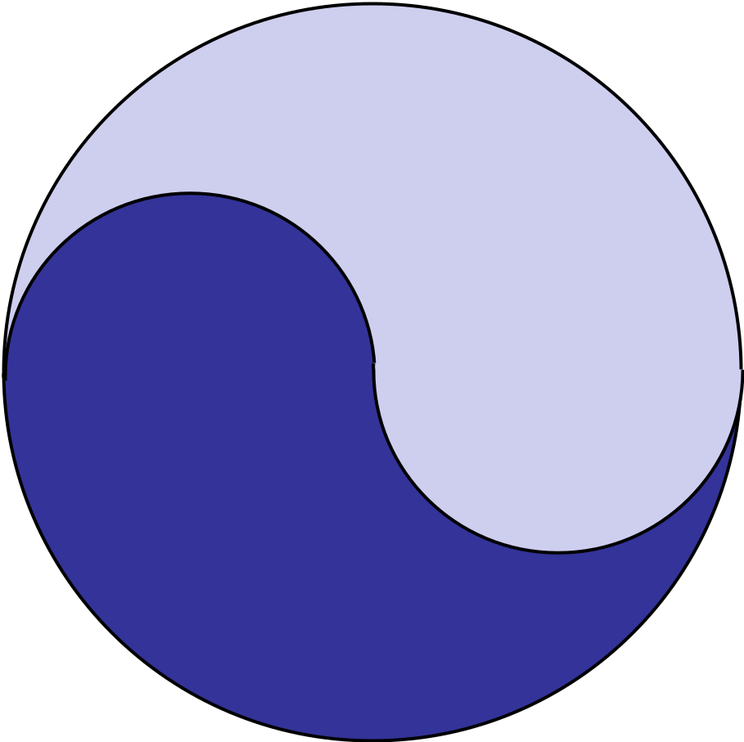
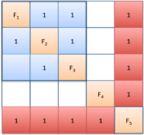



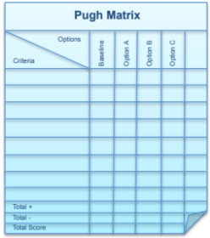
Process and Tools
Requirements Database
Create System Definition and Sub-System Requirements and associated Sub-System Verification Requirements
Quality Function Deployment 2
N² Analysis
Verify System Concept Solution meets the System Requirements and allocation of Sub-System Requirements
Determines the natural structure of a system that can be exploited
Preliminary Design and Feasibility
Use Engineering Modelling, Simulation and Analysis to undertake preliminary design and feasibility
Logical System Architecting
Determines candidate system architectures with minimal interfaces
Function Means Analysis
Identifies and captures all possible functional solutions to a system design problem and thereby determine suitable candidate system concepts
Compares candidate system concepts against a set of criteria
Pugh Matrix

Slide 5
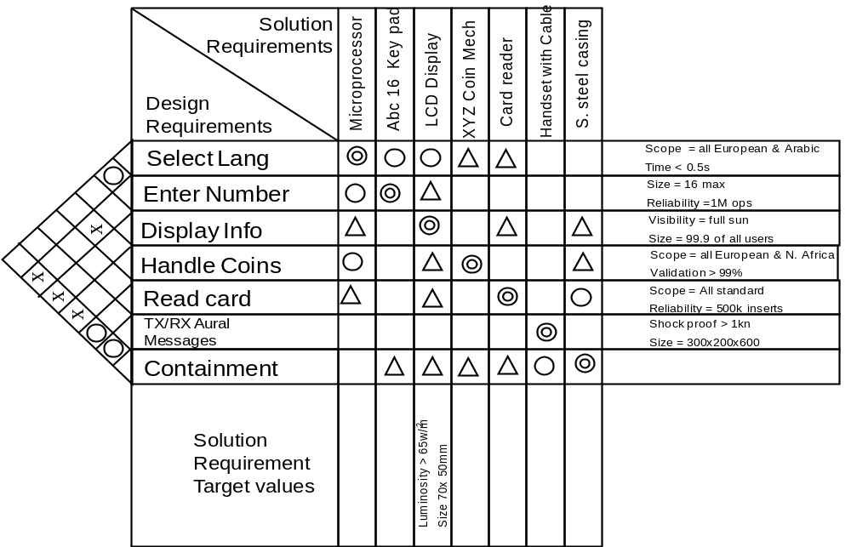
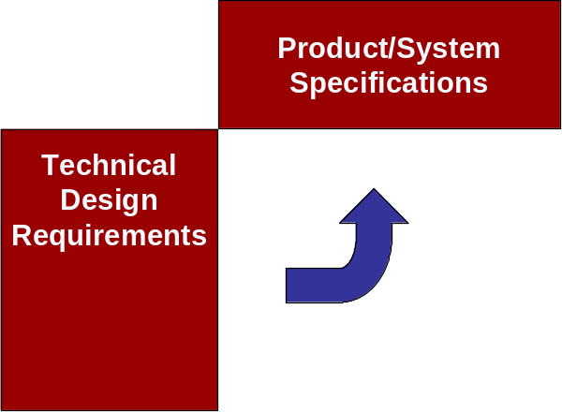
Quality Function Deployment
Phase 2
What is it?
  QFD 2 is concerned with translating Design Requirements into Solution Requirements. In the context of system development, it can be used to
    Verify if the selected whole concept solution is compliant with the technical requirements
    Correctly flow-down lower-level subsystem requirements
The example QFD 2 is for the Payphone and shows the relationship between the design requirements and the system concept to verify the concept.

Slide 6
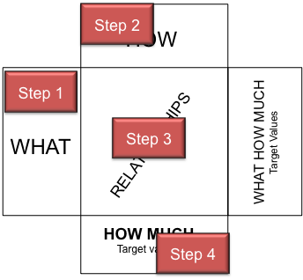
QFD Core Process
Step 1: Identify the chart WHAT list requirements
QFD 2 uses the same basic process as for QFD 1
The process steps relate to completing one of the “rooms”
It can take several weeks to complete a room!
QFD 1: Transfer System Design Requirements
Step 2: Translate WHAT requirements into measurable HOW requirements
QFD1: Translate Design Requirements into Design Solutions
Step 3: Determine relationships between WHAT and HOW requirements
QFD 1: Determine relationships between Design and Solution Requirements
Step 4: Determine HOW MUCH for HOW requirements
QFD 1: Determine Subsystem Requirements

Slide 7
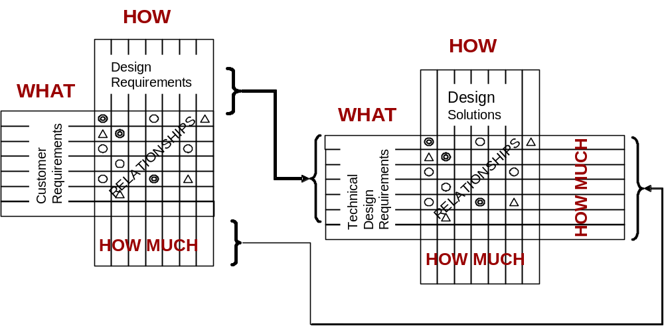
Step 1: Transfer Technical Requirements
The HOWs and HOW MUCHs of QFD 1 form the WHATs for QFD 2. This ensures complete requirements flow-down
QFD 1
QFD 2

Slide 8
Step 2: Translate into Solution Requirements
The WHATs of QFD 2 are the HOWS of QFD 1 which now require further definition in terms of the system solution
This is achieved by reference to the concept system solution, adding further decisions as necessary
If we have performed a Function Means Analysis, then the translation can be taken directly from the FMA table
The selected concept system solution is written in the HOWs room.
If there are several candidate system solutions then either
  Several QFD 2 can be generated – one for each whole system concept
  A single QFD 2 created with multiple whole system concepts
HOW
Solutions
WHAT
Technical
Design
Requirements
Solution
Solution
Solution
Solution
Solution
Function
Design Solution
QFD 1 HOWs
Notes:
This slide shows the second stage of QFD 1 translating the customer requirements into technical requirements that are measurable. In other words HOW we intend to satisfy WHAT the customer requires.
The process is to consider each customer “what” in turn and translate this into technical requirements. These technical requirements should not specify solutions but remain general. Typically this is done by consideration of the functionality or features.
A key point to note here that some of the technical translations may well come from the customer requirement. This is very typical in defence products because the customer has set ideas about what they require.

Slide 9
Step 3: Determine HOW-WHAT Relationship Matrix
This method allows complex
relationships between the system functionality and system solutions to be depicted and easily interpreted
It also permits cross-checking.
Blank rows or columns indicate
places where the translation of WHATs into HOWS is inadequate
If the QFD 2 is derived from the Function Means Analysis, then the leading diagonal should/will contain strong relationships. What is of interest is the off diagonal terms! They indicate potential emergent properties,
interactions or interfacing issues.
HOW
Design Solutions
WHAT
Technical
Design
Requirements
Solution
Function
Blank or Sparse column
Blank or Sparse row
STRONG relationship
MEDIUM relationship
WEAK relationship

Slide 10
Example
Note strong relationships on leading diagonal due to the earlier use of a Function Means Analysis
Functional Solutions from the body of the Function Means Analysis
Functions from the LHS of the Function Means Analysis
Off-diagonal relationships indicate potential emergent behaviour or interaction issues

Slide 11
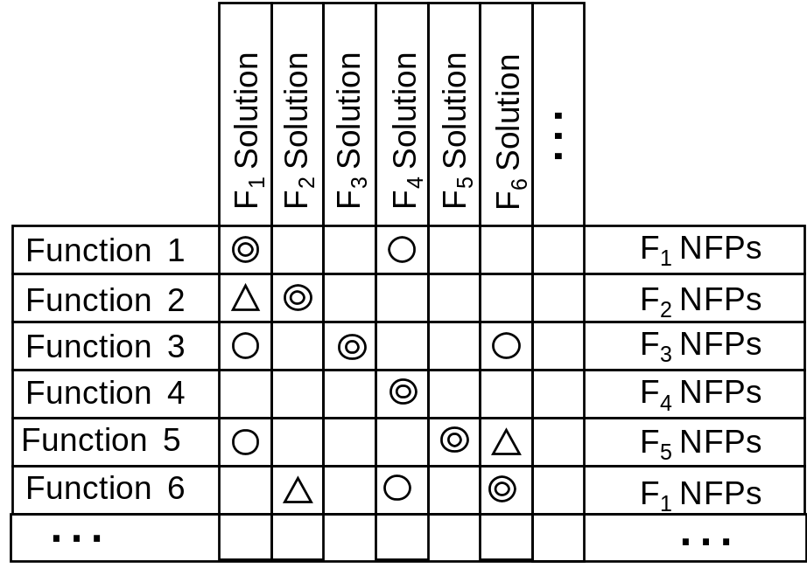
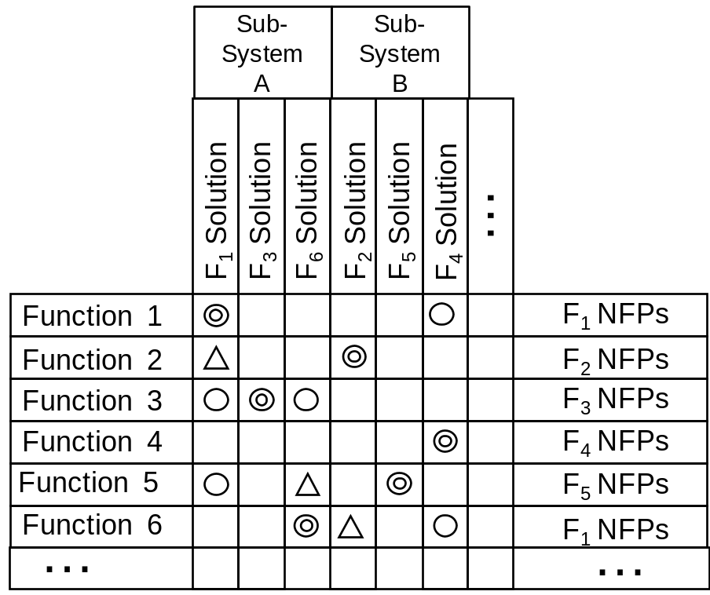
Capturing Architecture on QFD 2
QFD 2 Chart with columns reordered to reflect architectural choice
QFD 2 Chart maintaining Function-Solution order
A ”good” architecture should result in block diagonal structure

Slide 12
Exercise – QFD 2 Relationship Matrix
In teams
For the case study exercise transfer functions and a system solution from the Function Means Analysis
Complete the relationship matrix and identify any interesting features
Flip chart the outcomes and be prepared to share with the rest of the group
Time 20 Minutes

Slide 13
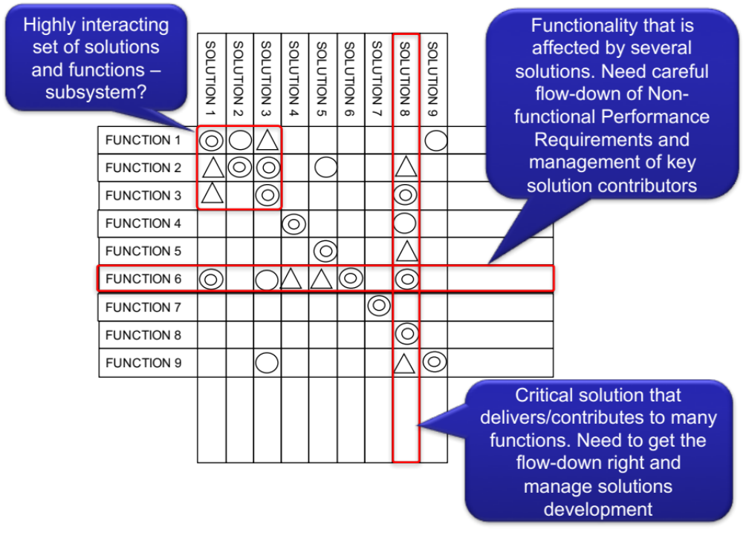
Look for “Structure”
We should examine the resultant relationship matrix for “structure” as this will show how the system functionality is provided by the solutions and vice versa. It can help in the management of key design aspects

Slide 14
Step 4: Flow-down Targets and Ceilings
HOW MUCH is Enough?
The fourth element of the QFD 2 chart is flowing down the WHAT-HOW MUCHs to give a set of target values for the chosen design solution
These are design characteristics and targets for the design solution HOWs and specify how good the HOWs have to be in order to satisfy the customer
If we are dealing with a system then the HOW MUCHs are the basis for the subsystem requirements
If we are dealing with components or parts then the HOW MUCHs are the part specifications
At higher system levels the HOW MUCHs may be a simple flow-down, but at the lower levels it will be necessary to undertake detailed design work (including Robust Design) to obtain the desired information to complete the HOW MUCHs
HOW
WHAT
WHAT
HOW MUCH
HOW MUCH

Slide 15
Flowing Requirements Down
Solution
Requirements
The relationships indicate that a particular design requirement target value needs to be appropriately flowed down to define the solution characteristic target values
Design Solution
Design Solution
Design Solution
Design Solution
Design Solution
Design
Requirements
Function
Measure A + Target Value
Measure B + Target Value
Measure C + Target Value
What goes in the HOW MUCH boxes depends on the “level” of the system under consideration. If we are dealing with a big system at a high level then each box will contain a subsystem specification
Solution
Requirement
Target values
The completion of the QFD 2 HOW MUCH boxes may also identify where trades are necessary between subsystems

Slide 16
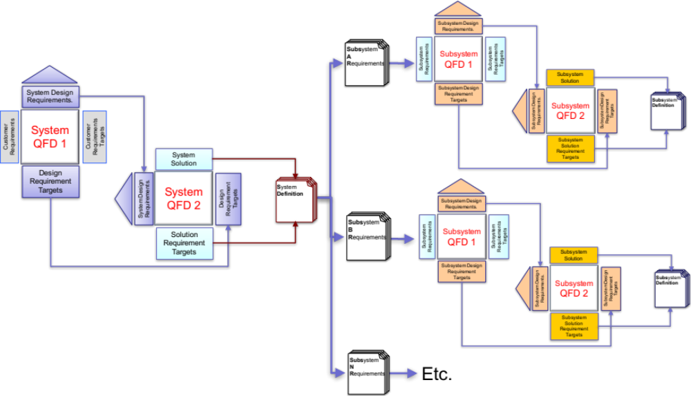
Subsystem Requirements
QFD 2 can help us develop Subsystem requirements - in fact the Subsystem requirements SHOULD be ready and waiting

Slide 17
QFD 2 Summary
Pros
  Verifies that system concept solution(s) are compliant with the System Design Requirements
  Identifies potential system interactions that could result in undesirable emergent behaviour
  Helps in the correct and complete flow-down of requirements from higher levels to lower levels
  Helps manage requirements and trade-offs
Cons
  If several concepts system exist then is will require the development of several QFD 2s
  Can take time to complete, particularly the flow-down of HOW MUCH requirements

Slide 18
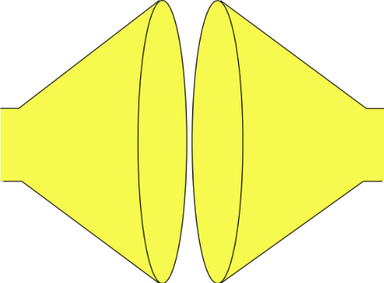
What have we done?
We have used QFD 2 to check our selected solution delivers the System Requirements
Search and evaluate the solutions to determine and select the “best” solution
(Convergent Thinking)
Do
Do
Do
MAKE THE SYSTEM TO THE DESIGN
GENERATE SOLUTION OPTIONS AND SELECT
SYSTEM PROBLEM
UNDERSTAND
PROBLEM
solution
“best”
solution
solution
Built System
Understand the problem in terms of Purpose and Context
solution
Stakeholder needs and expectations
solution
Check (& Act)
Identify and document all possible solutions to the problem (Divergent Thinking)
Confirm the understanding of the problem reflects the stakeholder’s needs and expectations
Check (& Act)
Confirm that the selected solution solves the stakeholders’ problem
Check (& Act)
Confirm that the built System solves the stakeholders’ problem

