Slide 1

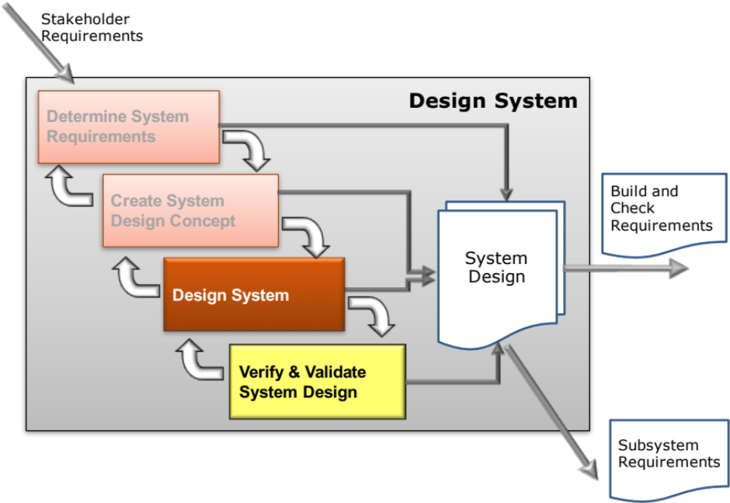
Design System
A Systems Approach to Robust Design
Secondary Information Goes Here
This Session:
Explains the Systems Approach to Optimising and Refining [the] Solution Concept
Emphasise the importance of finding the“Robust Optimum”

Slide 2
Where are we: Optimise Solution Concept
Design Space?
Robust Optimum?
Purpose :
  To explore and characterise the design space of the selected system concept design(s) in order to identify the robust optimum
Outcomes :
  The robust optimum concept design
  Requirements flowed down to subsystem level

Slide 3
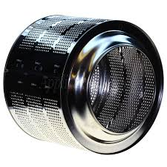
System Design Optimization
The performance of a system will be influenced by a number of system design parameters – those variables that the designer selects target values for to achieve the desired level of system performance
The challenge for the system designer is to find the best target or nominal values for the system design parameters in order to meet or, better still, exceed the performance requirements
For example if a drum is selected as the means to the “wash items” function of a washing machine
The quality of the wash will depend on:
  Speed of rotation
  Drum diameter
  Drum depth
  Drum material
  etc.
diameter
depth
Steel 708430
Notes:
4
4

Slide 4
Where is the best place to be?
What would be the best target or nominal values for X₁ and X₂ to give best possible performance?
System
Performance
Required
Customer
Performance
Design
Parameter X₂
Design
Parameter X₁
How System Performance Varies as X₁ and X₂ vary is the Design Space

Slide 5
The Best Place – the Global Optimum?
Having found the global optimum we can “work backwards” to specify the target values for the design parameters
System
Performance
Target Value of X₂
Required
Customer
Performance
Design
Parameter X₂
Target Value of X₁
Design
Parameter X₁

Slide 6
All Systems are Subject to Noise
In practice, the design target value will not be met for many reasons it will be subject to variation – we call this variation NOISE
Variation in Performance
Required
Customer
Performance
Variation in X₂ due to noise
Variation in X₁ due to noise
This design is sensitive to variation and its performance will frequently fall short of the customer’s expectation
What can be done to reduce the variation in performance?

Slide 7
Many Sources of Noise Variation
There are three groups:
  External: The environment and the load under which a system must function are the two main external sources of variation
      Temperature, humidity, vibration
      Operator usage
  Unit-to-Unit Variation: The variation in a manufacturing process leads to variation in the system from unit-to-unit
      Differences in diameter from machining
      Raw material variation
      Calibration
      Gauge Repeatability & Reproducibility
  Deterioration: As time passes the system characteristics can change leading to a deterioration in performance

Slide 8
The Classic Strategy: Tighten Tolerances
Variation in Performance
Required
Customer
Performance
Set Tight Tolerances for X₂
Set Tight Tolerances for X₁
The classic reaction to a sensitive design is to set tighter tolerances. This does work but often comes at a great cost.

Slide 9
Achieving Design Robustness
A Robust Optimum
Variation in Performance
New Nominal Value for X₂
New Nominal Value for X₁
This design is less sensitive to variation and will consistently meet the customers expectation

Slide 10
Robust System Optimisation
Finding the target or nominal values for the system design parameters that deliver best performance may sound like the “optimum design” but can result in sensitive designs that suffer excessive variation in performance, causing customer dissatisfaction.
The optimum design in systems engineering is the robust optimum.
  The best target values for the system design parameters that meet the customer requirements CONSISTENTLY, robust against the effects of variation.
THE ROBUST OPTIMUM
Variation in Performance
But how can it be achieved in practice?
New Nominal Value for X₂
New Nominal Value for X₁
Notes:
4
4

Slide 11
Key Tasks and Systems Tools
Typical Systems Tools
P-Diagram
What-Why Table
DFMEA
Simulation studies
Prototype tests
Design of Experiments
  Full Factorial
  Screening Design
  Response Surface Methods
Characterise Design
Determine Critical Design Parameters and Noise Variables
Characterise Concept Design Transfer Functions
Perform Parameter and Tolerance Design
Typical Systems Tools
Simulation Studies
Prototype Tests
Design of Experiments
  Full Factorial
  Response Surface Methods
  Noise Experiments
Quality Function Deployment 2
Define Subsystem Requirements
Robust Design & Flow-
down of Requirements
Notes:
9
9

Slide 12
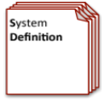
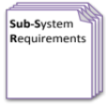
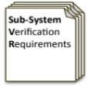

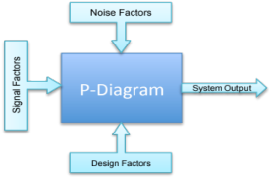
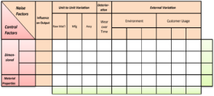
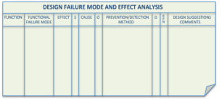
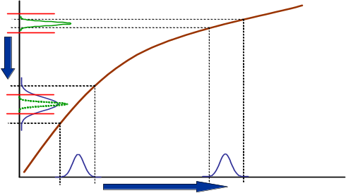

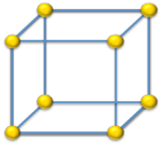
Create System Design Concept & Design System
Requirements Database
Update System Definition and Sub-System Requirements and associated Sub-System Verification Requirements
Qualitative Robustness and Critical Parameter Analysis
Quality Function Deployment 2`
Parameter Diagram
Design 2 Noise Matrix
Design Failure Mode and
Effects Analysis
Update QFD 2 with the design parameter target values and as appropriate - tolerances
Identifies and captures the factors that influence the performance of a system output
Determine the factors that are most likely to influence the robustness of a nominal design
Identify and document the potential failure modes, Effects and Causes
Quantitative Robustness Analysis
Simulation and Modelling
Designed of Experiments
Parameter & Tolerance Design
Use models or physical Designed Experiments to characterise the transfer function and thereby robustness of the system design.
Use quantitative models to explore solution space to find robust optimum and thereby determine design parameter settings and tolerances

Slide 13
We are Talking about Variation and Loss Functions
Taguchi’s loss function applies to other system outputs and not just cost!
LSL
USL
Loss of Y
Variation of X
Loss = k(y-m)²
Target
m
y
Deviation
from target

Slide 14
Achieving Design Robustness is Therefore
Design robustness is concerned with:
  Exploring the design space to find regions where the desired system performance (Y) is achieved even in the face of variation in the noise factors
  i.e. finding the plateaus and avoiding the peaks and troughs.
Fundamental approach is to:
  Identify the transfer function that quantifies the relationship between the performance requirement and the signal, control and noise factors
  Find the “best” settings for the control factors (design parameters) that optimise the performance requirement while simultaneously reducing the sensitivity to noise
Where is the best place to be?
Variation in Performance
New Nominal Value for X₂
New Nominal Value for X₁

Slide 15
Iterate Design: A Systems Approach
System Design
Establish the fundamental design and engineering concepts
Parameter Design
Determination of target values AND
sensitivity to variation – i.e. the loss functions are determined. If a sensitive design, iterate the design by changing the target values
Tolerance Design
Tolerances established based on
sensitivity analysis. Robust components
do not need a tight tolerance -
sensitive ones do

Slide 16
Conventional Design
The requirements for the system output express a range of suitable values
System Output Y
Transmission of the variation in X₁ to Y through the transfer function Y=f(X₁)
Y = f(X₁)
Use the mid point of the customer spec to define the target value for X₁
Spec Y
Having determined a target we ask manufacturing for the likely variation around this nominal: Note this may not be the only noise
Oh dear!. The manufacturing noise variation is “transmitted” through the transfer function to give this variation at the output
Target for X₁
Design Parameter X₁

Slide 17
Traditional Solution
System Output Y
Transmission of the variation in X₁ to Y through the transfer function Y=f(X₁)
Y = f(X₁)
Spec Y
Design Parameter X₁
Solution: Tighten the Tolerance! Live with the cost!

Slide 18
Taguchi’s Parameter Design
At the new nominal for X₁ - Y is insensitive but off target.
Y
Change mean of another design ‘Control’ parameter X₂ which has a relationship with Y such that it can bring Y back on target without affecting variance of Y.
ChangeX₂
Spec Y
Tol X₁
X₁
Exploit non-linearity to re-specify
mean of X₁ with same tolerance

Slide 19
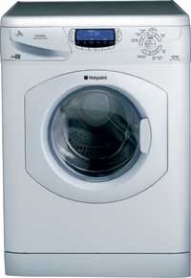
Example: The Intelligent Washing Machine
Start by finding out what the customer wants
Customer satisfaction is affected by:
  Attractive and distinctive
  Cost of purchase
  Running costs
  Washing performance
  Dry performance
  Reliability/Durability
  Ease of use
  Access Ergonomics
  Easy to maintain
  Safety

Slide 20
Need to Interpret Customer Requirements Technically
Use QFD 1 to translate into Technical Design Requirements
QFD 1
IWM Functions and Features
Washing performance is affected by several system functions including the Drain Water Function. Customer research determines that the target for the Drain Water function is less than 2 minutes. The Drain Water Function also has other high level requirements of reliability and cost
Intelligent Washing
Machine
Wash Sensing
Load Machine
Manage Water
Clean Items
Manage
User I/O
Customer Importance
Control Cycle
Unload
Drain Water
Select Cycle
Casing
Measure H20
Fill Water
Wash
Rinse
Hardness
Load Cleaning Agents
Remove XS Water
Interface to Services
Display user
Load Dirty Items
messages
Detect Load Make Up
Receive user input
Wash Performance
1.0
○
Good Wash
Dry Performance
1.0
Automation &
5.0
Ease of Use
Intelligence
Easy to use
5.0
Controls
Customer Requirements
Access
3.0
Intelligent Dishwasher
Ergonomics
Δ
Cost
Purchase
1.0
Running
2.0
Δ
Long
Reliable
1.0
Easy to Maintain
1.0
Style
Attractive
5.0
How Much might be:
Drain <2min
FYFR <1%
DTUPC <£8.0
How Much
Weighted Importance
81.0
23.0
35.0
33.0
57.0
10.0
15.0
25.0
17.0
9.0
76.0
22.0
22.0
72.0
70.0
71.0
Relative Importance

Slide 21
System Design & Requirements Flow Down
The concept design stage (FMA, Pugh, QFD 2) identifies a pump as the solution for the drain water function.
The NFP requirement of:
drain time < 2min
Can be translated in to a subsystem requirements as a target flow rate and allowable variation of 10 +/-1 (litres/min). Below 9 litres/min cannot meet the < 2 min limit. Above 11 litres/min will cause flooding!
Element
Requirements
pump
Direction of improvement
Weight sensors
Hardness Sensor
Design
Requirements
Switch
RFI Tags
Etc .
BITE
Activate
Manually activated
Determine Load
Distribution
7Kg Max .1 res
< 2 mins
FYFR <1%
DTUPC <£8.0
Drain Water
Self Monitor
95%
validation
Detect Load make up
5.6 kg max
Detect H₂O hardness
EU Limits
Inform user
Cycle, status in cycle
Target values
10 l/min +/- 1
FYFR <1%
DTUPC<£8.0
16A 240V Double pole
15 type xyz type
Etc.
15 x xyz type
3 x XYZ type

Slide 22
Determining Design Parameter Requirements
A reciprocating pump is selected as the design solution to the “Drain Water” functional requirement.
The pump subsystem requirements flowed down from the system requirements are:
  Flow Rate = 10 litres/min +/-1 litre
  Reliability FYFR < 1%
  DTUPC <£8.00
From first principles the transfer function for the flow rate F is
One way valve
Tubing
F = (10⁻⁶πR²L - B)N
Where
R = Piston radius (M)
L = Stroke length (M)
B = Back flow (l)
N = Motor speed (rpm)
Piston

Slide 23
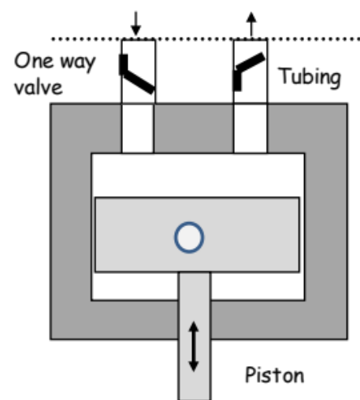
Target (Nominal) Design
Using:
F = (10⁻⁶πR²L - B)N
A Nominal Design exists for
Piston Radius R = 40mm
Stroke Length L = 40mm
Valve Backflow B = 0.002L
Motor Speed N = 50 rpm
F = (10⁻⁶π40²x40 – 0.002)50 = 9.95L/min
It is decided that the valves and motor are to be bought out items with the following specifications (obtained from the OEM catalogues).The piston (and cylinder) and connecting rod will be made in house and using standard tolerances (same as last time)
 | Make |  | Buy
 | Piston Radius R (mm) | Con-rod centre length L (mm) | Valve leakage B (L) | Motor Speed N (rpm)
Target | 40 | 40 | 0.002 | 50
Lower Limit | 39.7 | 39.4 | 0.00185 | 44
Upper Limit | 40.3 | 40.6 | 0.00215 | 56

Slide 24
Assess Sensitivity of Nominal Design due to Manufacturing Variation
 | R (mm) | L(mm) | B(L/min) | N(rpm) | F (L/min)
Target | 40 | 40 | 0.002 | 50 | 9.95
High Flow | 40.3 | 40.6 | 0.00185 | 56 | 11.5
Low Flow | 39.7 | 39.4 | 0.00215 | 44 | 8.5
At the extremes of the expected manufacturing variation, the flow rate could vary from 8.5 up to 11.5 l/min – outside the design requirements The current target (nominal) design is not robust against this source of variation.
What are we going to do?

Slide 25
Traditional Strategy: Tighten Tolerances
The design requirement of 10 ± 1L/min can be achieved by tightening the tolerances
It is possible to meet the design requirements by only tightening tolerances of the bought-out elements!
Tolerance Design: tighten the tolerances
 | R (mm) | L(mm) | B(L/min) | N(rpm) | F (L/min)
High Flow | 40.3 | 40.6 | 0.00194 | 53 | 10.9
Low Flow | 39.7 | 39.4 | 0.00206 | 47 | 9.1
The design requirements can be achieved by tightening the tolerances on the bought-out elements. Looks good BUT costs will increase – usually faster than the losses

Slide 26
Robust Design Strategy: Parameter Design
A robust design strategy asks for a design iteration to find another point in the solution space that exploits the non-linearity in the system to find a “plateau” where the design is insensitive
Parameter Design
Iterate the design to find new target values such as R: 20, L: 60, N: 136 manufacturing variation remains the same
 | R (mm) | L(mm) | B(L/min) | N(rpm) | F (L/min)
Target | 20 | 60 | 0.002 | 136 | 9.98
High Flow | 20.3 | 60.6 | 0.00185 | 142 | 10.9
Low Flow | 19.7 | 59.4 | 0.00215 | 130 | 9.1

Slide 27
Searching the “Design Space” for the Robust Optimum
Robust design requires us to search the design space, not necessarily for the global-optimum, but for the robust-optimum.
Here is the global-optimum! But small variations in X₁ and X₂ will result in a dramatic fall off in performance. This is a sensitive design
Performance
X₂
Here is a region of low sensitivity. The performance is “lower” but will be maintained for likely variations in X₁ an X_{2.} This is the robust-optimum and would be a robust design
X₁
BUT how do we “quickly” find the Robust Optimum?

Slide 28
Exploring the Design Space
The task is to characterise the design space to “find” the peaks, troughs and plateaus
Approaches include:
  Trial and Error: Searching the design space using judgement, hunches and other magical techniques
Designed Experimentation
  Systematically but scientifically search the design space using Design of Experiments

Slide 29
Summary
Customers do not like sensitive systems – they appear to be unpredictable
Parameter design provides an approach for finding the robust optimum without resorting to tightening of design tolerances
It does require us however to find an efficient way of searching the design space
At Waters the intention is to have a 5-day Robust Design training programme starting 2017

